Slide 1

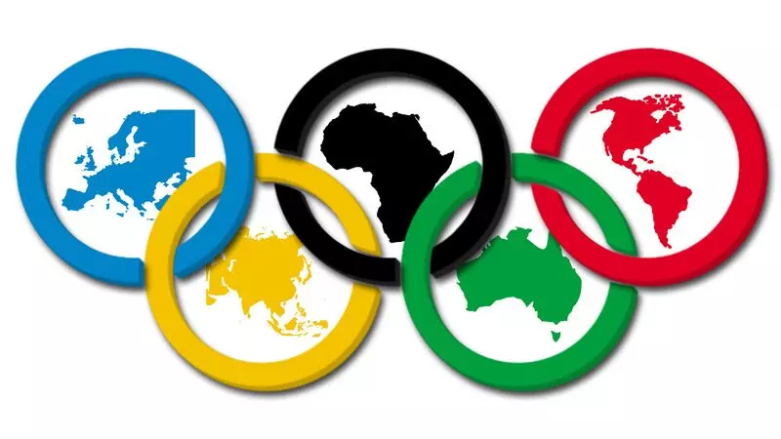
Global Data Standards for Geochemistry
Not the ‘One Ring to Rule Them All’,
Kerstin Lehnert
& Lesley Wyborn
but a set of ‘Olympic Rings’ that Link and Integrate across Continents.
lehnert@ldeo.columbia.edu

Slide 2
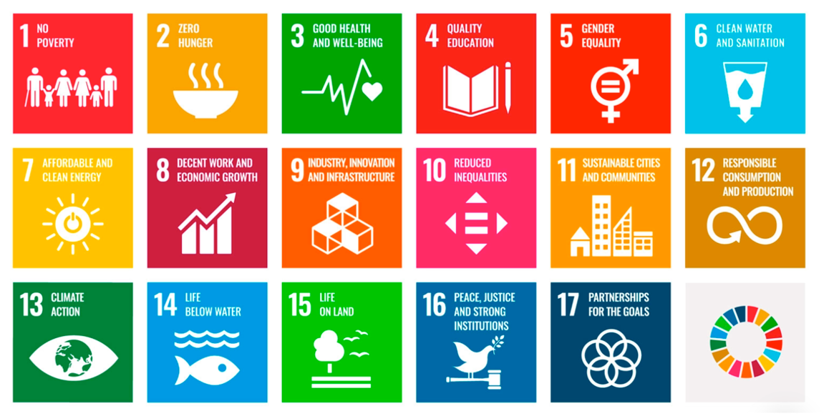


Global Access to Geochemical Data Needed
Geochemical data are highly relevant to the UN Sustainable Development Goals
  set in 2015 by the UN General Assembly
  a universal call to action to end poverty, protect the planet, and ensure that by 2030 all people enjoy peace and prosperity.
Geochemistry has a potential role in all 17 SDGs.

Slide 3
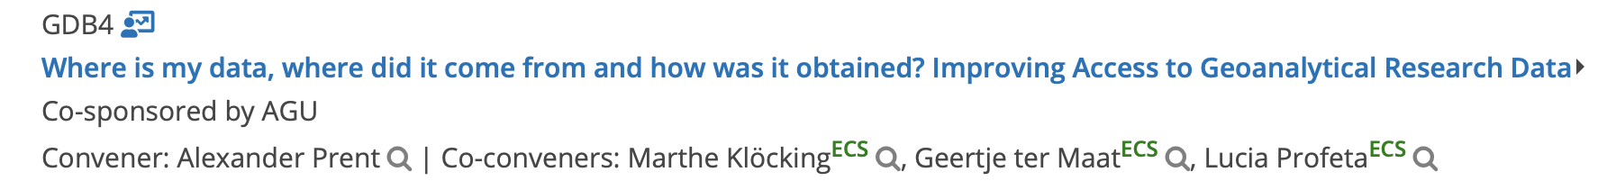
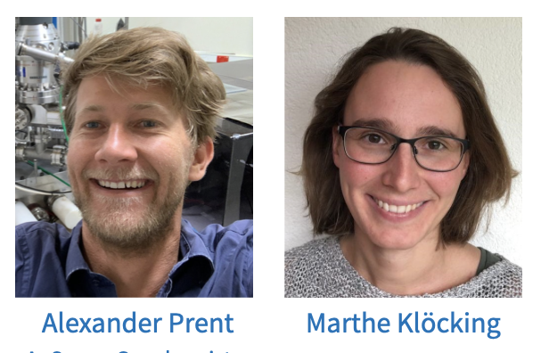
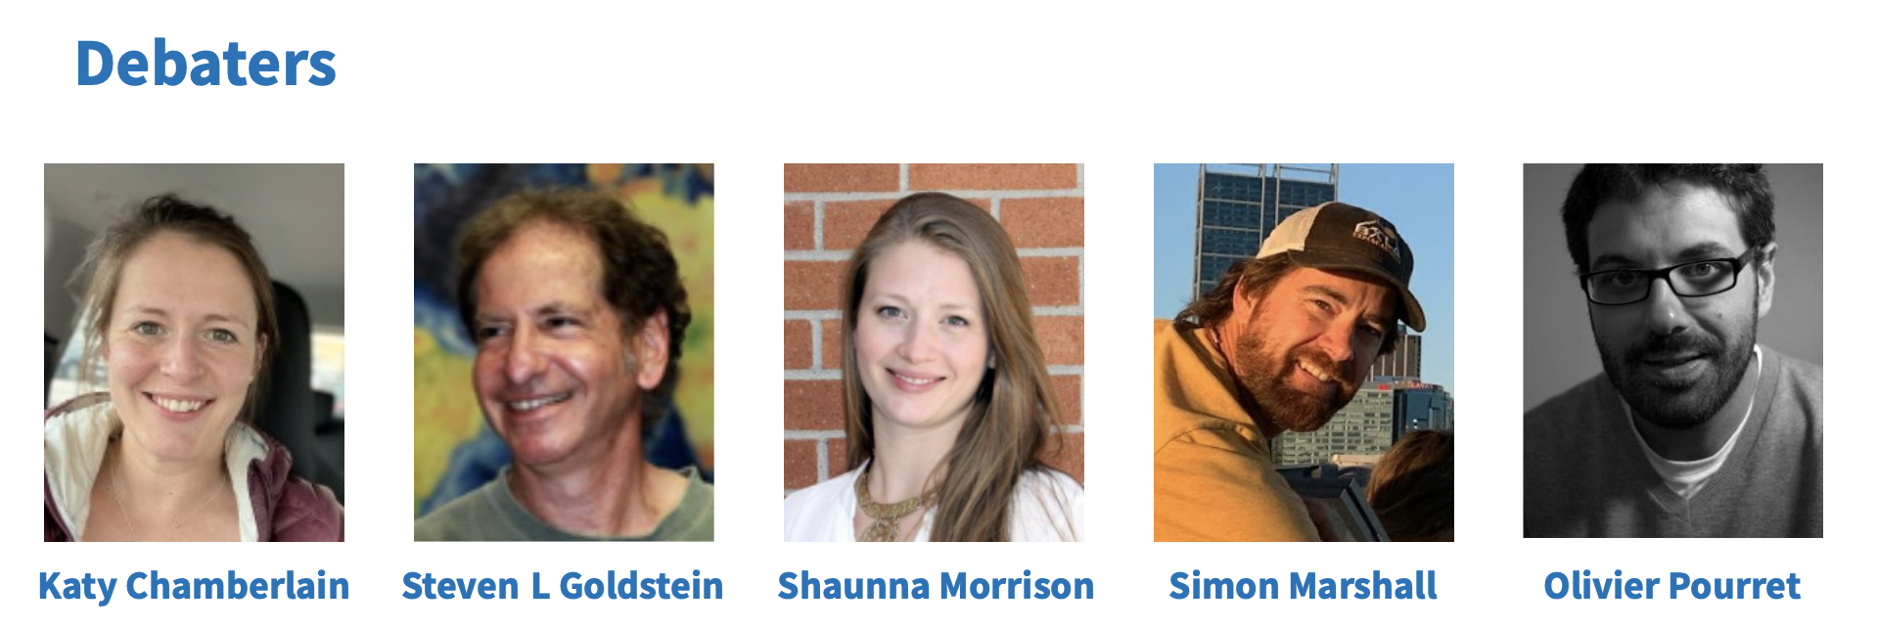
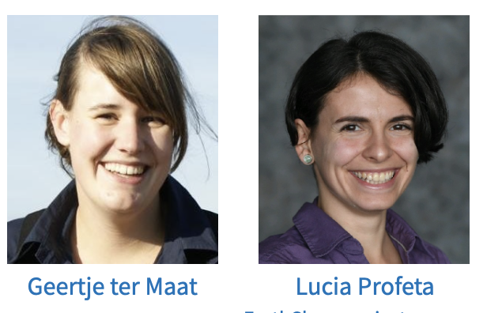
Earlier This Week: A GREAT Debate

Slide 4
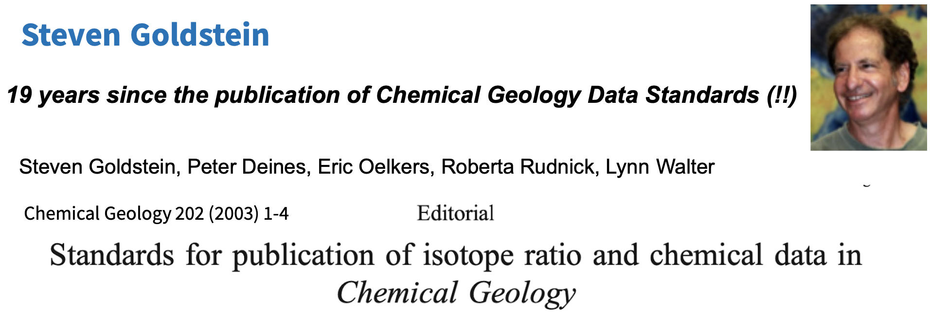
Earlier This Week: A GREAT Debate

Slide 5


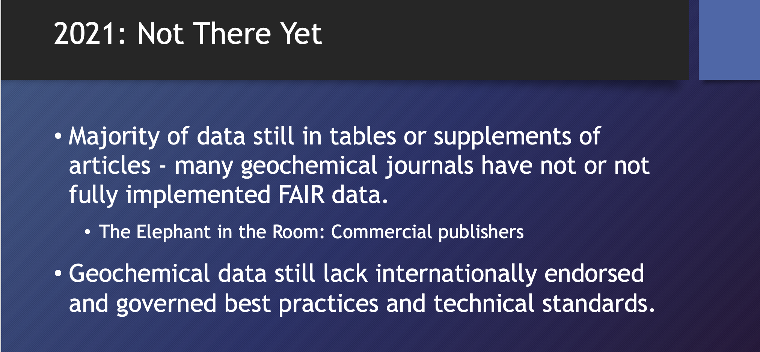
Data Standards in Geochemistry
“Managing Open and FAIR Data in Geochemistry: Where are we a decade after the Editors Roundtable?” S L Goldstein, K Lehnert, A W Hofmann; EGU 2021

Slide 6
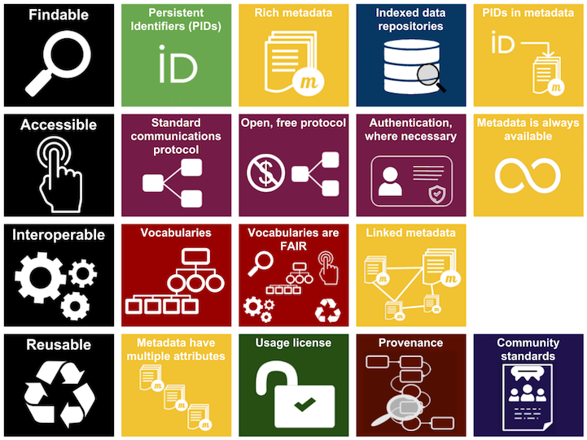
What Global Standards?
Metadata schemas
  Schemas
  Unambiguous links
Vocabularies
Persistent Identifiers (PID)
  PID types: data, samples, people, instruments, etc.
  PID metadata
  Granularity of use
Communication protocols
  Machine-readable
Repositories

Slide 7
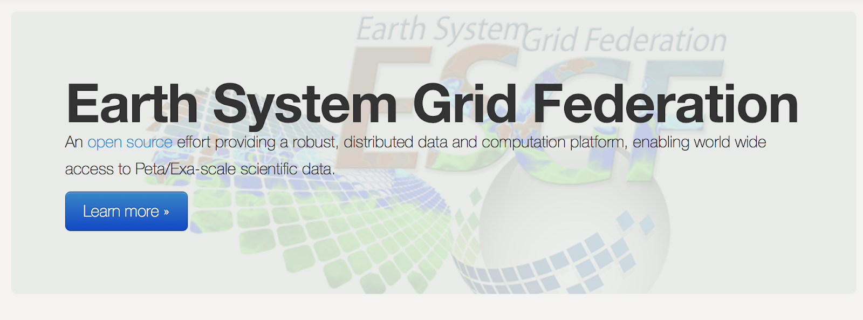
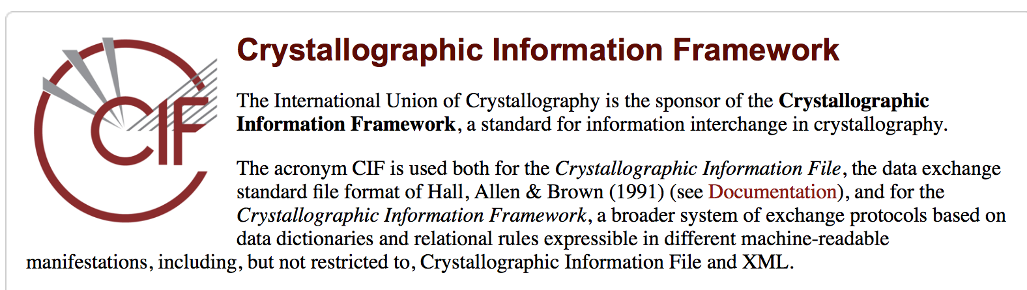
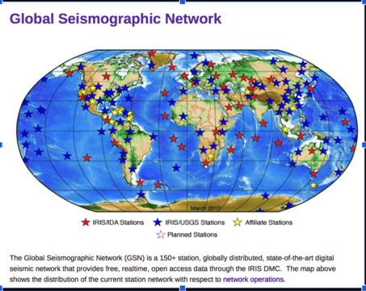
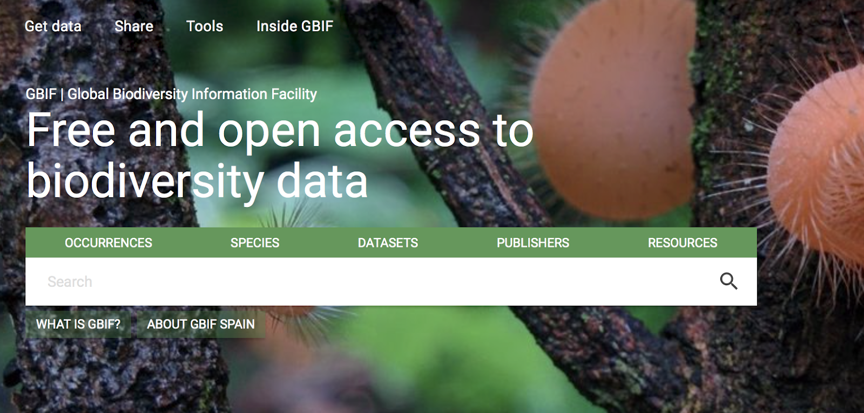

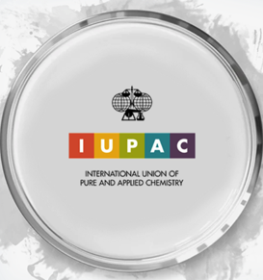
Other Domains Have Done It.
Why has geochemistry failed so miserably?
IUPAC Color Books
An authoritative resource for chemical nomenclature, terminology, and symbols. Terminology definitions are drafted by international committees of experts in the appropriate chemistry sub-disciplines

Slide 8
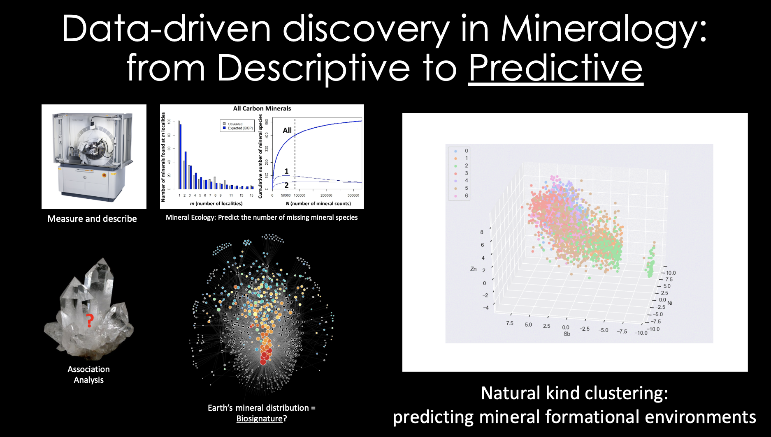
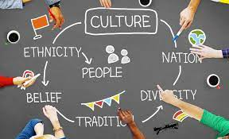
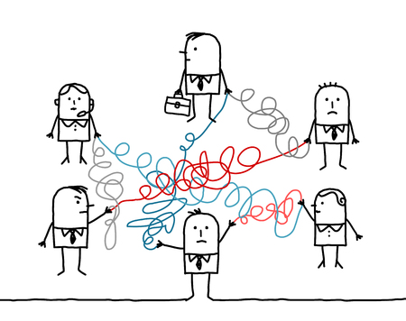

Insights from the EGU 2022 Great Debate
Community is very diverse (methods, samples, research applications).
Barriers for adoption are cultural.
  Fear of being scooped.
  Lack of credit for data management & sharing.
  Data management at the “finish line” (publication), not when it is created.
Sticks (data policies) are not enforced.

Slide 9
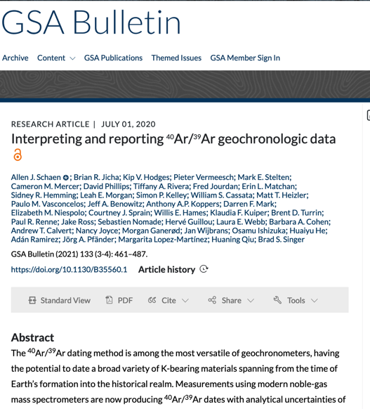
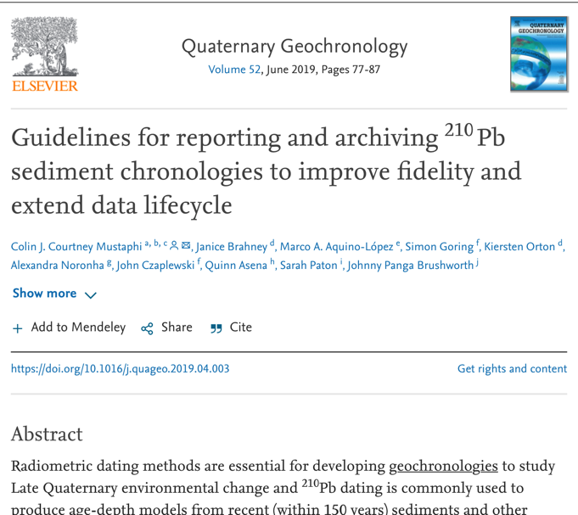
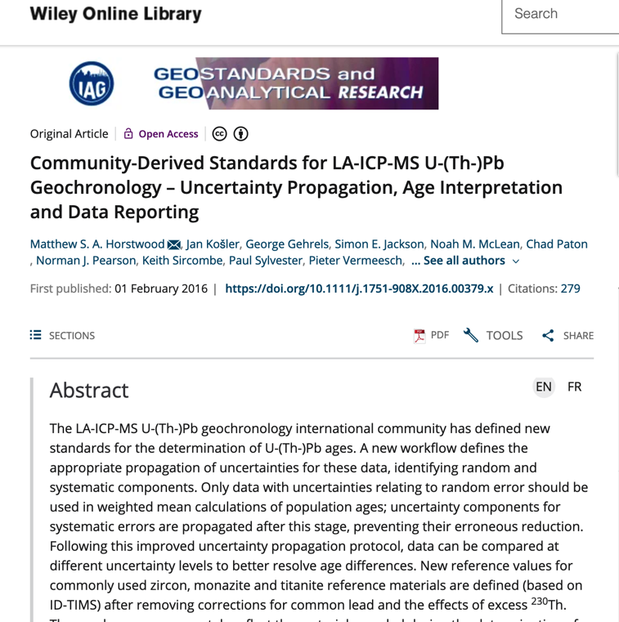
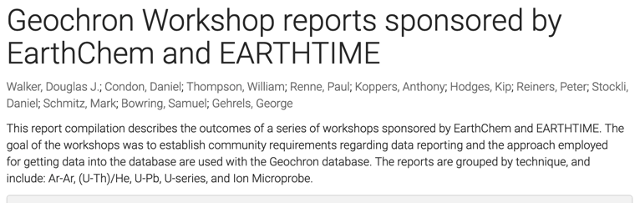
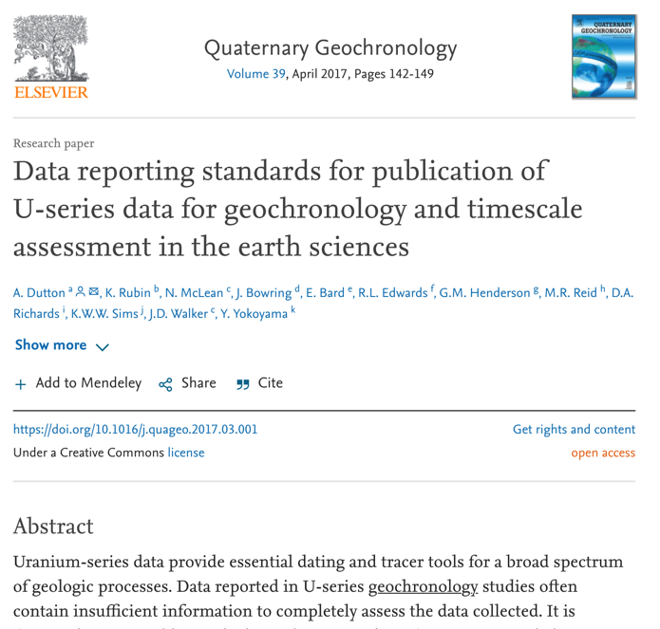
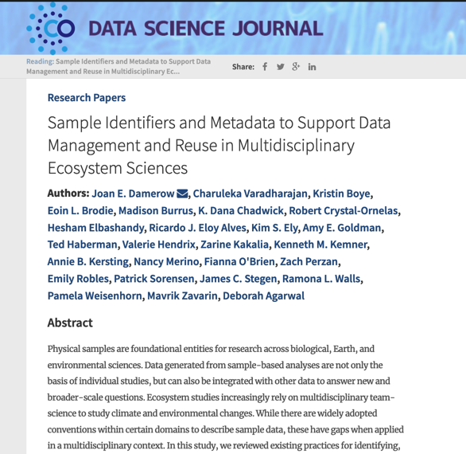
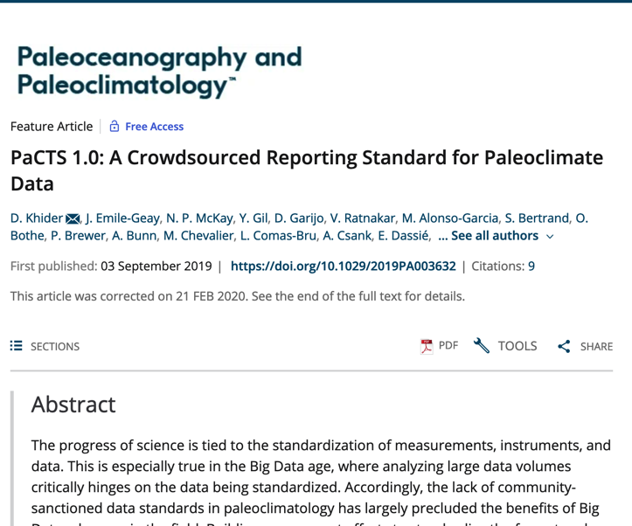
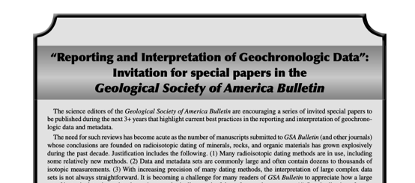
Standards are starting to be developed internationally!
Notes:
In the meantime many communities that use and generate geoanalytical data have started to

Slide 10
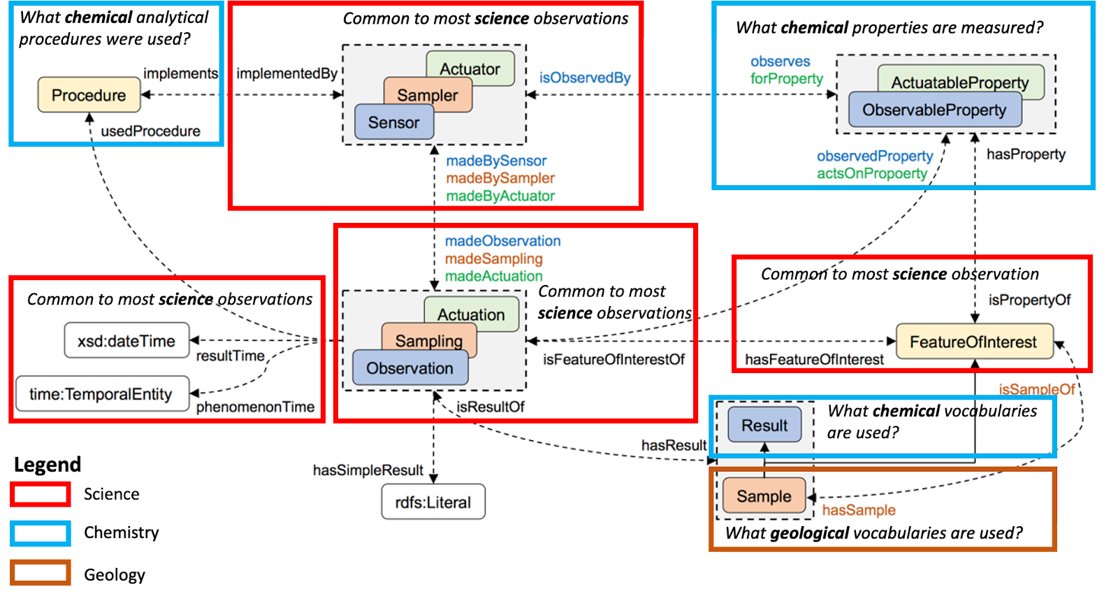

Geochemistry Standards Should Be Modular
Slide from “International Science Council (ISC)/CODATA Decadal Programme Vocabularies and Standards Working Groups: a means of engaging both domain and technical efforts.” (Lesley Wyborn, Simon Hodson, Nov 2021)
For Geochemistry to link machine-to-machine with other disciplines we need to harmonize with global community standards such as:
  Units of Measure, Time (CODATA, International Science Union)
  Periodic Table (International Union of Pure and Applied Chemistry)
  Rock names (International Union of Geosciences).
Method
Instrument
Periodic Table
Units of Measure
Location
Time
Wyborn, L.A.I., Cox, S.J.D., Lehnert, K.A., Klump, J. A modular approach to developing interdisciplinary, interoperable standards for geochemical data based on the Semantic Sensor Network (SSN) Ontology. In: SciDataCon 2018, The Digital Frontiers of Global Science. Available at: https://www.scidatacon.org/IDW2018/sessions/223/paper/659/.
Rock Name

Slide 11
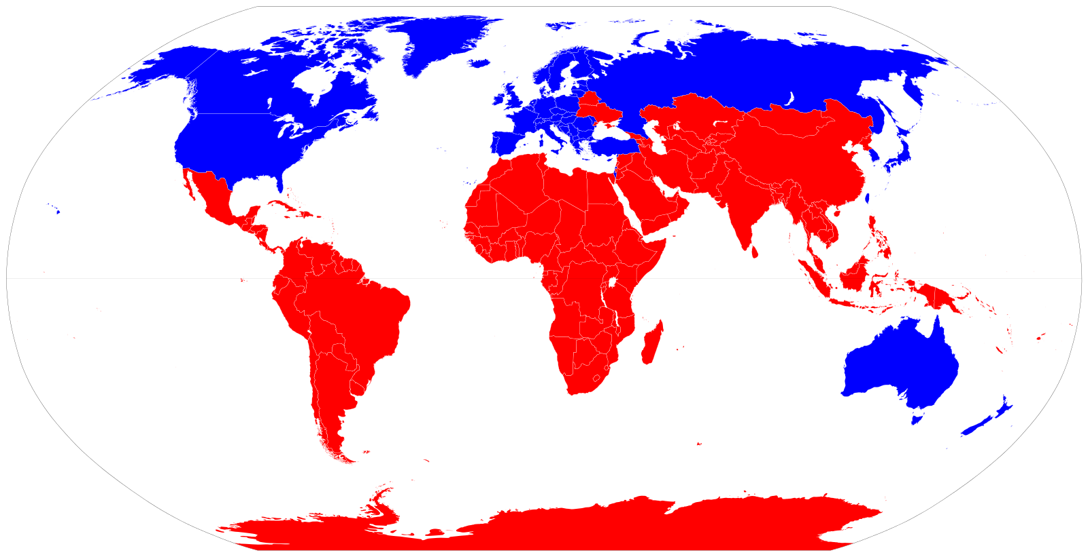

Moving Forward: OneGeochemistry
Global: Engage across both Global North & South.
Interdisciplinary: Align with existing standards in relevant domains.
Inclusive & equitable: No Parachute, Helicopter, or Parasitic Science.
Future oriented: Led by the next generation of geochemists

Slide 12





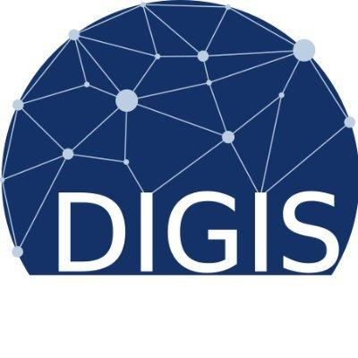






One Geochemistry Status
Started in 2018
Global participation amongst groups in the US, Europe, and Australia, not yet in the Global South.
Interim governance released on May 20, 2022; https://doi.org/10.5281/zenodo.6566074
Funding in place for 2 years via the WorldFAIR project.
  First deliverable: Governance

Slide 13
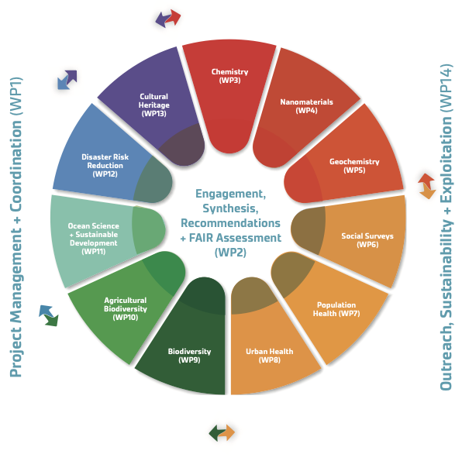
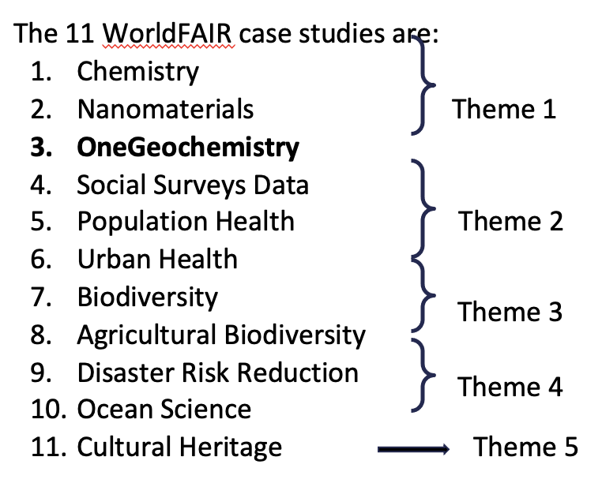
WorldFAIR Project: Global Cooperation on FAIR Data Policy and Practice
EU funded project: €1.98M over 2 years:
  Led by CODATA and the Research Data Alliance
  Project scheduled to start 1 June 2022.
  Exploring features of a Core Interoperability Framework with 11 case studies from a range of research areas (OneGeochemistry is one of these)
  Working at extracting the common definitions (units, vocabularies, data description, data structure, provenance…) across all 11 case studies
  More information: https://www.scidatacon.org/IDW-2022/sessions/439/

Slide 14
Synopsis
Data standards in geochemistry are needed urgently to link and integrate global data resources.
OneGeochemistry seeks to define the building blocks for a global framework including minimum core variables, vocabularies, machine readability of data.
The goal is a modular, flexible framework that will enable interoperability among data systems throughout the entire geochemical data pipeline.
Illustration by Beck Strauss

Slide 15
An invitation to participate!
Contacts:
Lesley Wyborn (Australian National University) lesley.wyborn@anu.edu.au
Alexander Prent (Auscope Geochemistry Network) alexander.prent@curtin.edu.au
Jens Klump (AuScope) jens.klump@csiro.au
Kerstin Lehnert (EarthChem, Astromat, OSIRIS-REx) lehnert@ldeo.columbia.edu
Geertje ter Maat (EPOS) g.w.termaat@uu.nl
Kirsten Elger (GFZ Potsdam) kelger@gfz-potsdam.de
Marthe Klöcking (DIGIS/GEOROC) marthe.kloecking@uni-goettingen.de
Dominik Hezel (NFDI4Earth) dominik.hezel@em.uni-frankfurt.de

