Slide 1

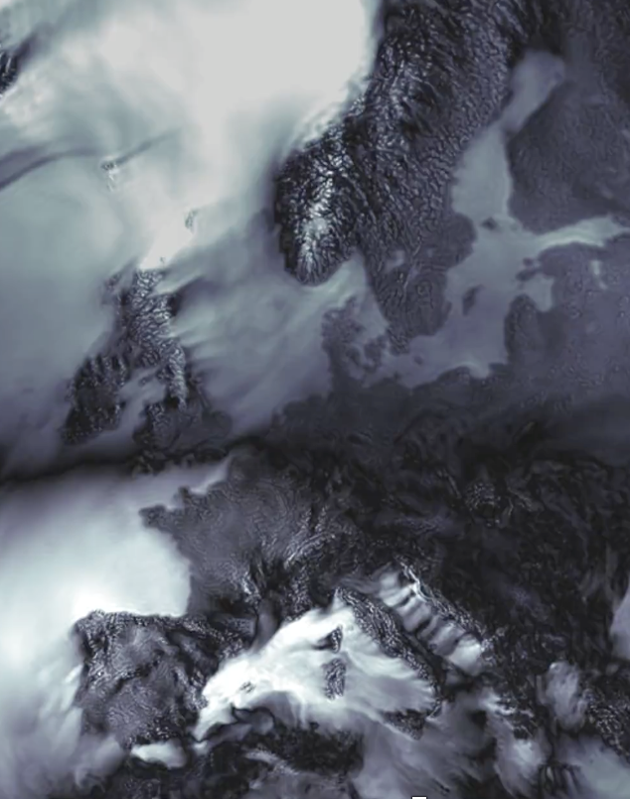

Storm-resolving simulations with IFS-NEMO/FESOM in the nextGEMS project
Thomas Rackow, Tobias Becker, Xabier Pedruzo Bagazgoitia, Irina Sandu, Lorenzo Zampieri, Florian Ziemen, and the ECMWF-AWI Team:
Gabriele Arduini, Gianpaolo Balsamo, Peter Bechtold, Michail Diamantakis, Peter Dueben, Richard Forbes, Helge F. Goessling, Ioan Hadade, Jan Hegewald, Thomas Jung, Nikolay Koldunov, Kristian Mogensen, Inna Polichtchouk, Christopher Roberts, Patrick Scholz, Tido Semmler, Dmitry Sidorenko, Nils Wedi
27 May 2022

Slide 2
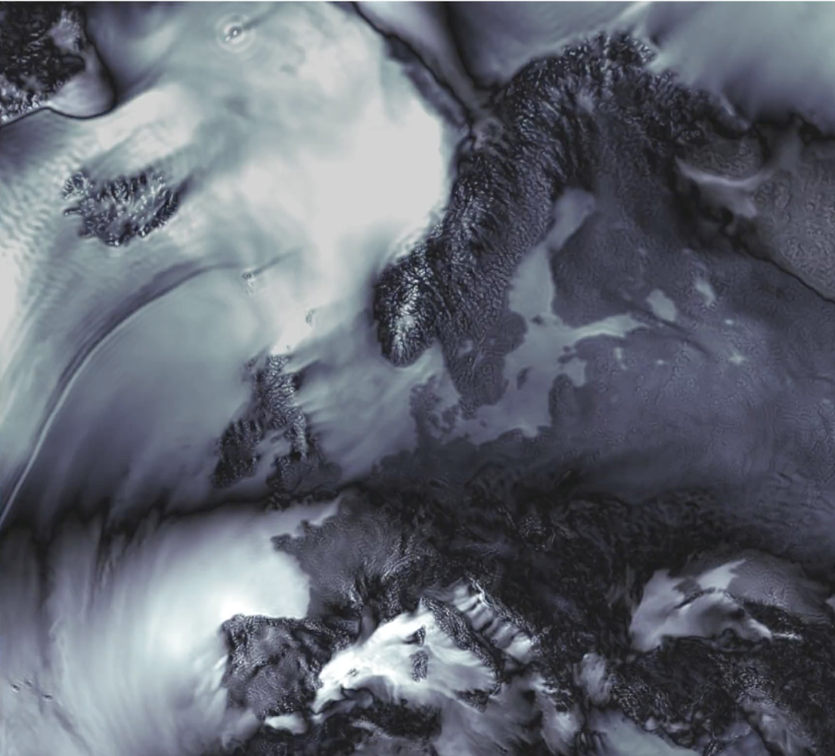
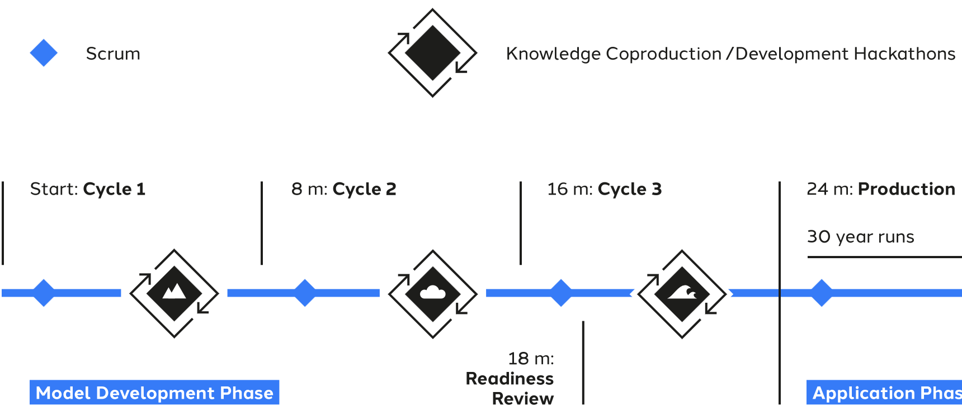
What is nextGEMS, why ‘storm-resolving’?
Integrated Forecasting System (IFS) at about 4km (Tco2559) and 2.5km (Tco3999)
Coupled to WAM (waves) and NEMO/FESOM (ocean), down to 5km
Different Development Cycles:
Cycle 2: 1-yr long simulation (and 2 seasons), 9km baseline over 2 years
upcoming hackathon
European Centre for Medium-Range Weather Forecasts
Wind gusts over Europe (Koldunov, AWI)
Notes:
2 MODELS, ICON and IFS
DEEP OFF for those, DEEP on for 9km
ML snow scheme added as well

Slide 3
Findings at first Hackathon
IFS Cycle 1 simulations showed a water imbalance as well as an energy imbalance
the semi-Lagrangian dynamics is non-conserving: gets worse at higher resolution and when deep convection parameterisation is switched off
1 % water imbalance can cause up to 1 W m⁻² enthalpy imbalance
Total energy leakage of -2 W m⁻² (9km, Deep On) and -6.4 W m⁻² (4km, Deep Off)
To fix the water imbalance for Cycle 2, we …
… changed from cubic to linear interpolation for water species
… activated a tracer mass fixer
… added source code change: conservative clipping of values below 10^-8 for moist species
European Centre for Medium-Range Weather Forecasts
Notes:
Cycle 1 IFS-FESOM simulations were still based on IFS cycle 46r1 Very similar grid to ORCA025 from IFS-NEMO Cycle 1 simulations
Only 25km in large parts of the ocean, going down to about 12 in polar regions
Tropical Instability Waves already resolved at 25km
0.9 million surface nodes
Large atmosphere-to-ocean resolution ratio -> increase res in the ocean model for Cycle 2

Slide 4
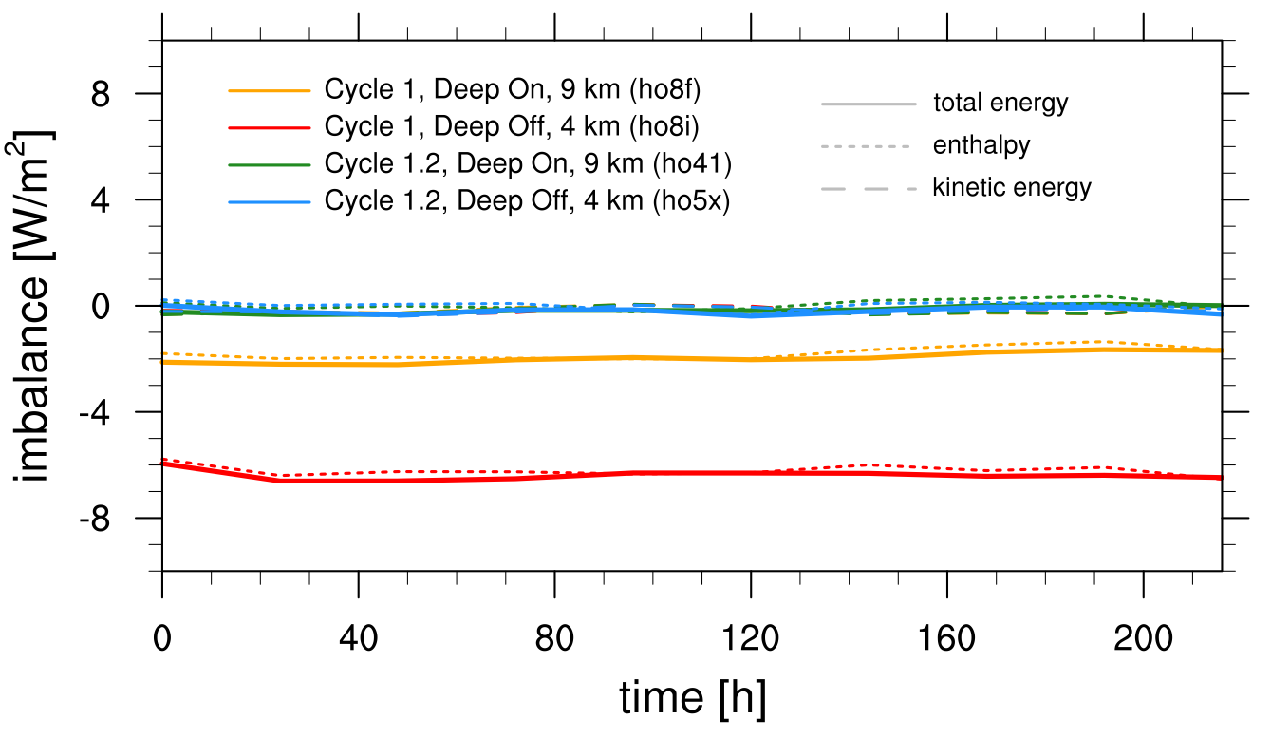
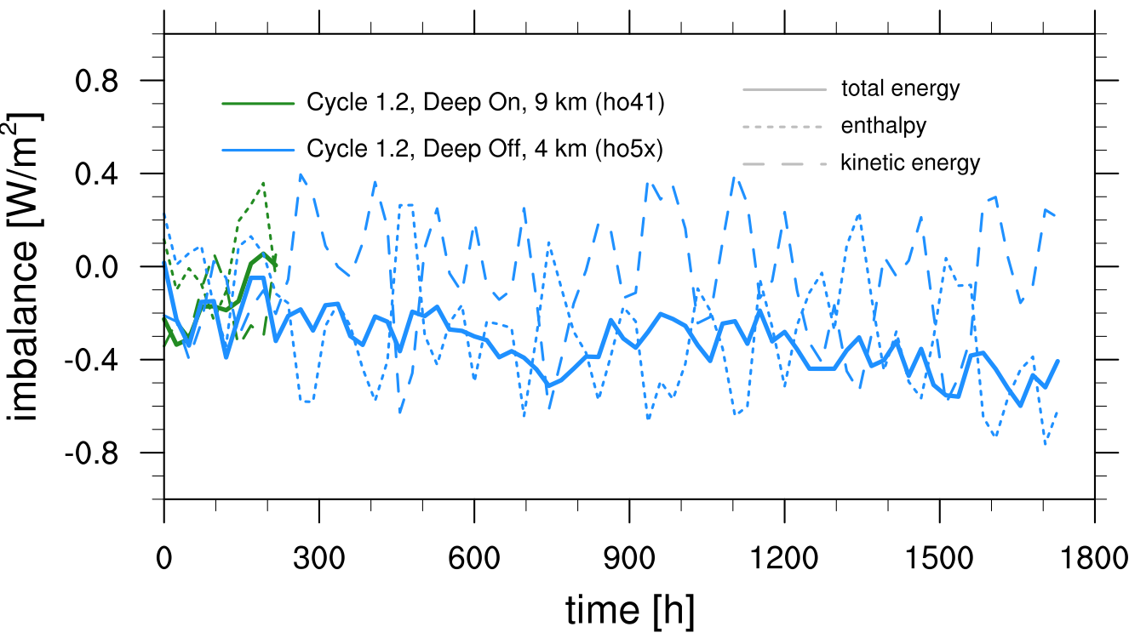
IFS: Fixing the water imbalance also (almost) fixes the total energy budget
Total energy leakage reduces to -0.15 W m⁻² (9km, 'Deep On') and -0.32 W m⁻² (4km, 'Deep Off')
European Centre for Medium-Range Weather Forecasts
Notes:
say during presentation that TCo399 has similar water and enthalpy leakage as the 9 km deep on simulation

Slide 5
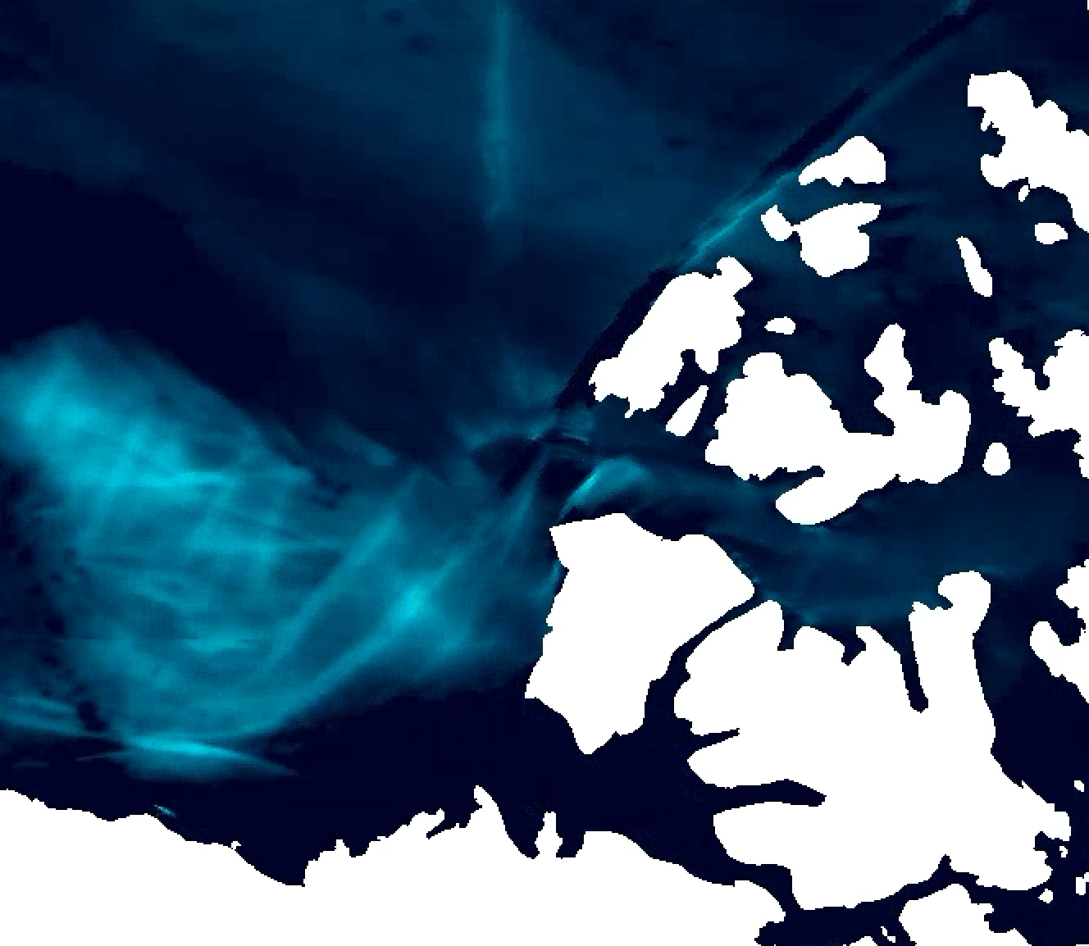
The nextGEMS ocean grid for Cycle 2: NG5
Cycle 1 ran with 0.25 degree oceans only (NEMO as well as FESOM), coupled to IFS 46r1
Cycle 2 uses higher ocean resolution and new cycle 47r3.2; refactored FESOM code is applied that allows hybrid MPI/OpenMP support
New NG5 grid: Same number of surface nodes as the ICON-5km grid (7.5 million)
Eddy-resolving in large areas; Tropical Instability Waves resolved
Allows for linear kinematic features (sea ice cracks) in both hemispheres
As of this week, Cycle 2 simulations are done and we are looking forward to the analysis and to sharing the data with the community
Evaporation over opening Arctic sea ice leads
European Centre for Medium-Range Weather Forecasts
Notes:
The nextGEMS ocean grid for Cycle 2: NG5

