Slide 1



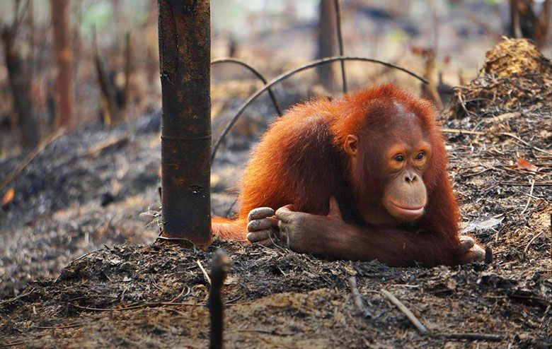
Predicting climate change impacts to peatland soil moisture in Southeast Asia
Nathan C. Dadap¹, Alexander Cobb², Alison M. Hoyt¹, Charles F. Harvey³,
Andrew Feldman⁴, Eun-Soon Im⁵, Alexandra G. Konings¹
¹Stanford University, ²Singapore-MIT Alliance for Research and Technology (SMART), ³Massachusetts Institute of Technology,
⁴NASA Goddard Space Flight Center, ⁵Hong Kong University of Science and Technology
Notes:
http://www.takepart.com/sites/default/files/styles/large/public/orangutan-on-ground-INLINE.jpg

Slide 2
See preprint for article
“Climate change-induced peatland drying in Southeast Asia”
DOI: 10.1002/essoar.10511429.1

Slide 3

Naturally wet conditions suppress peatland decomposition rates and wildfire
SE Asia peatlands store ~65 Gt carbon
(Page et al 2011, Warren et al 2017)

Slide 4
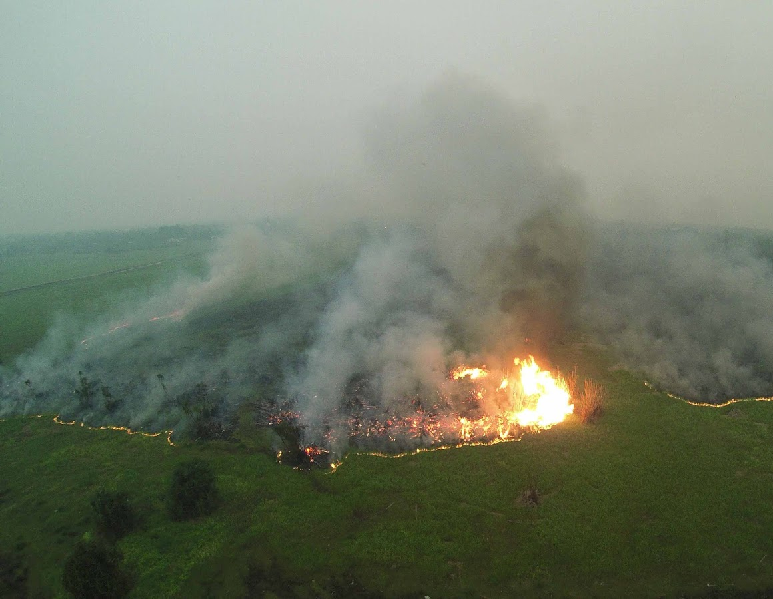
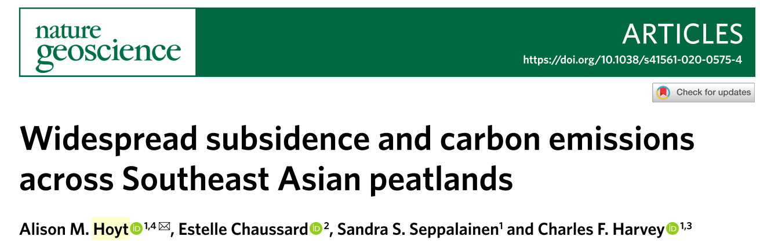
Widespread drying occurring in Southeast Asian peatlands
Subsidence
More prevalent severe fires
Notes:
http://outrop.blogspot.com/2015/11/are-peat-fires-in-indonesia-new-thing.html

Slide 5
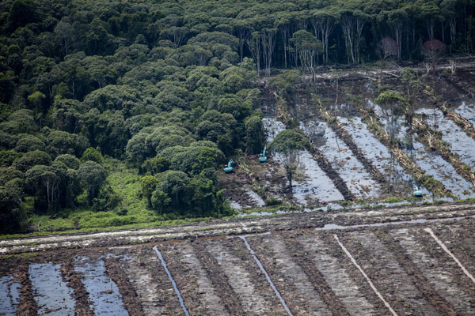
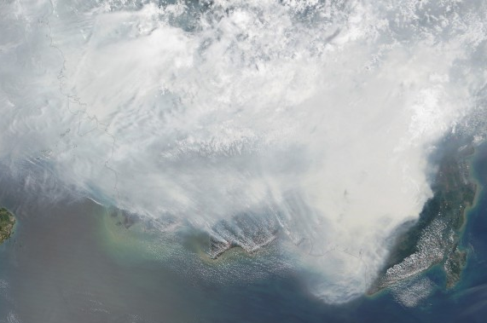
Climatic drought and peatland degradation
create dry soil conditions
~95% of SE Asia peatlands are disturbed
Peat fires worse during droughts (little rain)
(Miettinen et al 2016, Yin et al 2016)
Notes:
https://news.mongabay.com/2013/11/greenpeace-photos-expose-palm-oil-giants-deforestation-in-indonesia/
https://iri.columbia.edu/news/indonesias-parched-peatlands-burn-under-el-nino/ (smoke image from modis)

Slide 6
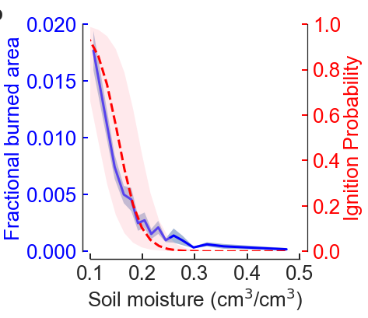
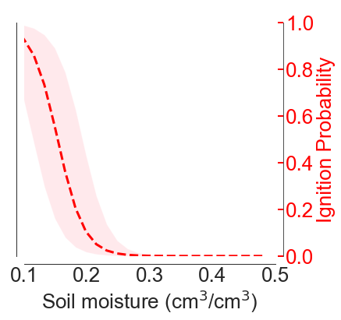
Soil moisture predicts burned area
Flammability determined by soil moisture
Soil moisture integrates over climate and degradation factors
Lab Ignition Probability
Frandsen 1997, Dadap et al 2019

Slide 7
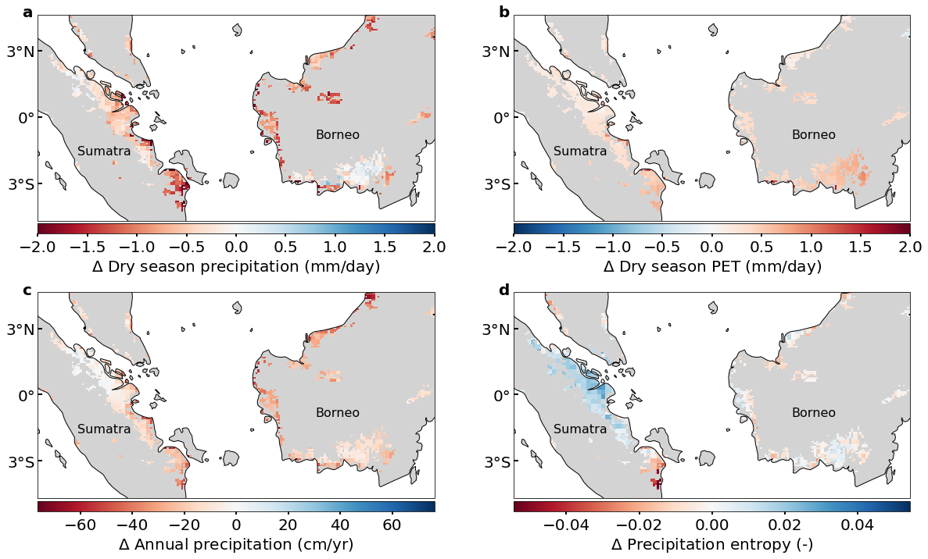
Climate change predicted to cause drier atmospheric conditions
1990-2005 vs 2030-2070
Regional climate model under RCP 8.5:
Reduced precipitation
Increased potential evapotranspiration
Dadap et al, in review;
data from Giorgi et al 2021

Slide 8
Climate change predicted to cause drier atmospheric conditions
1985-2005 vs 2040-2060
Regional climate model under RCP 8.5:
Reduced precipitation
Increased potential evapotranspiration
Dadap et al, in review;
data from Giorgi et al 2021
Notes:
Thankfully, over the past few years, higher resolution climate predictions have become available in this region
What we found that these data show decreased precipitation and also increased evaporative demand

Slide 9
Research question:
How will climate change impact future soil moisture regimes in Southeast Asian peatlands?

Slide 10

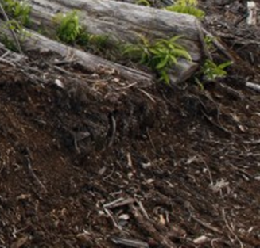
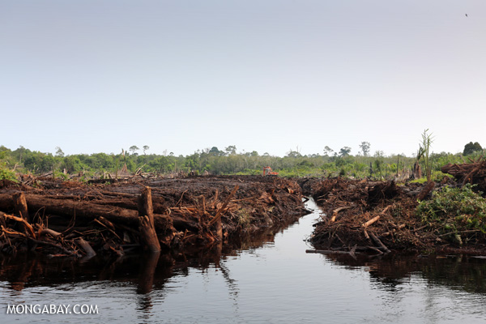
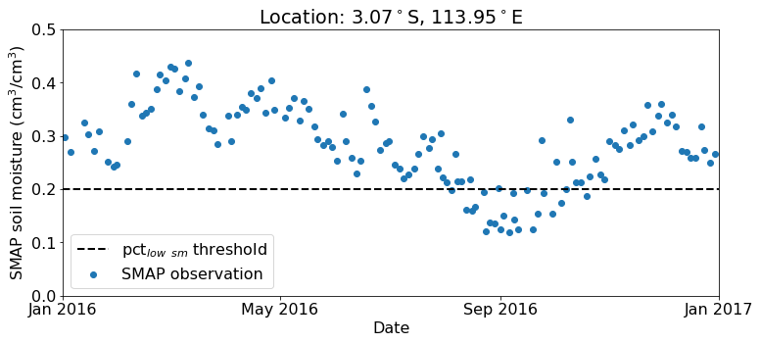
Experiment: Understand effects of changing
climate on soil moisture
Climate
?
Soil moisture
Degradation
& Location
Notes:
https://forestsnews.cifor.org/26254/indonesia-peatland-forest-carbon-emissions-model?fnl=

Slide 11
Experiment: Understand effects of changing
climate on soil moisture
Climate
……
Soil moisture
……
……
Degradation
& Location
Neural network
Notes:
https://forestsnews.cifor.org/26254/indonesia-peatland-forest-carbon-emissions-model?fnl=

Slide 12
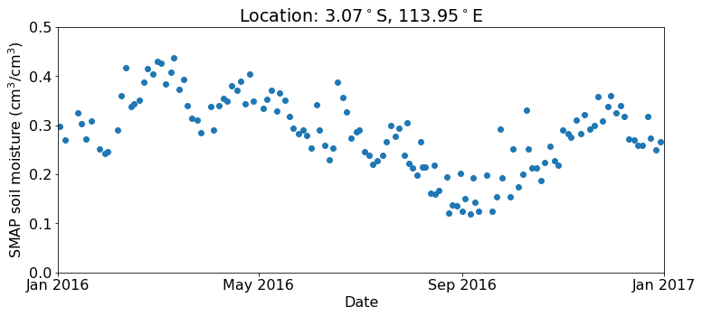
Target variables: Two aggregate statistics of soil moisture
Dry season soil moisture = 0.23 cm³/cm³
Wet season
Wet season
Notes:
https://forestsnews.cifor.org/26254/indonesia-peatland-forest-carbon-emissions-model?fnl=

Slide 13
Target variables: Two aggregate statistics of soil moisture
Percent low soil moisture (< 0.2 cm³/cm³) =
22 low observations / 135 total observations = 16%

Slide 14
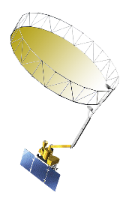
Experiment: Understand effects of changing
climate on soil moisture
Training (2015-2020)
SMAP satellite soil moisture observations
ERA5 Climate
Dry season
soil moisture
……
(sm_{dry season})
……
……
Percent of time
< 0.2 cm³/cm³
(pct_{low sm})
Degradation
& Location
Neural network
Notes:
https://forestsnews.cifor.org/26254/indonesia-peatland-forest-carbon-emissions-model?fnl=

Slide 15
Experiment: Understand effects of changing
climate on soil moisture
Prediction
(1985-2005 and 2040-2060)
RCM 1
Regional Climate Model
3 GCMs
RCP 8.5
RCM 2
sm_{dry season}
RCM 3
Climate
……
……
……
pct_{low sm}
Degradation
& Location
Predicted soil moisture
(reference and future)
Notes:
https://forestsnews.cifor.org/26254/indonesia-peatland-forest-carbon-emissions-model?fnl=

Slide 16



Predictor features include climate, degradation, and location
Variable | Category
Annual precipitation | Climate
Dry season precipitation | Climate
Dry season PET | Climate
Precipitation entropy (seasonality) | Climate
Tree cover fraction | Degradation
Drainage canal density | Degradation
Fire area | Degradation
Fire count | Degradation
Land Use Type | Degradation
Distance from peat edge | Location
Latitude | Location
Longitude | Location
Region | Location
Annual datasets
Static datasets

Slide 17
Predictor features include climate, degradation, and location
Variable | Category
Annual precipitation | Climate
Dry season precipitation | Climate
Dry season PET | Climate
Precipitation entropy (seasonality) | Climate
Tree cover fraction | Degradation
Drainage canal density | Degradation
Fire area | Degradation
Fire count | Degradation
Land Use Type | Degradation
Distance from peat edge | Location
Latitude | Location
Longitude | Location
Region | Location
Annual datasets
Static datasets

Slide 18
Predictor features include climate, degradation, and location
Variable | Category
Annual precipitation | Climate
Dry season precipitation | Climate
Dry season PET | Climate
Precipitation entropy (seasonality) | Climate
Tree cover fraction | Degradation
Drainage canal density | Degradation
Fire area | Degradation
Fire count | Degradation
Land Use Type | Degradation
Distance from peat edge | Location
Latitude | Location
Longitude | Location
Region | Location
Annual datasets
Static datasets

Slide 19
Predictor features include climate, degradation, and location
Variable | Category
Annual precipitation | Climate
Dry season precipitation | Climate
Dry season PET | Climate
Precipitation entropy (seasonality) | Climate
Tree cover fraction | Degradation
Drainage canal density | Degradation
Fire area | Degradation
Fire count | Degradation
Land Use Type | Degradation
Distance from peat edge | Location
Latitude | Location
Longitude | Location
Region | Location
Annual datasets
Static datasets

Slide 20
Predictor features include climate, degradation, and location
Variable | Category
Annual precipitation | Climate
Dry season precipitation | Climate
Dry season PET | Climate
Precipitation entropy (seasonality) | Climate
Tree cover fraction | Degradation
Drainage canal density | Degradation
Fire area | Degradation
Fire count | Degradation
Land Use Type | Degradation
Distance from peat edge | Location
Latitude | Location
Longitude | Location
Region | Location
Annual datasets
Static datasets

Slide 21
Models can effectively predict soil moisture
Cross validation results:
Variable | Train R² | Test R²
Dry season SM (sm_{dry season}) | 0.90 ± 0.08 | 0.73 ± 0.12
Percent of time < 0.2 cm³/cm³ (pct_{low sm}) | 0.91 ± 0.03 | 0.64 ± 0.13
Dadap et al, in review

Slide 22
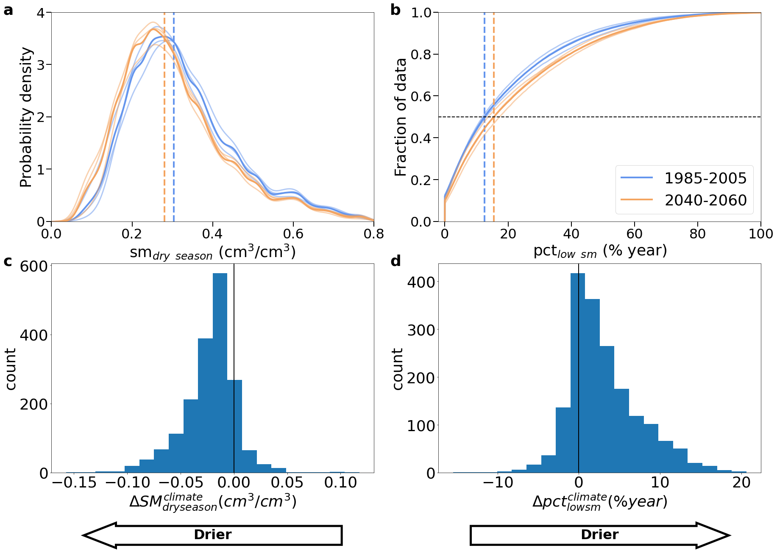

Neural networks predict drier soils in the future
Mean decrease of 0.02 cm³/cm³
Nearly half decrease during 2015/2019 El Niño
Dadap et al, in review

Slide 23
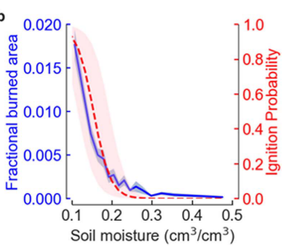

Dangerously dry conditions associated
with high fire risk also increase
Non-linear response of fire:
3% increase in median pct_{low sm}
≈10% increase in burned area
Dadap et al, in review

Slide 24
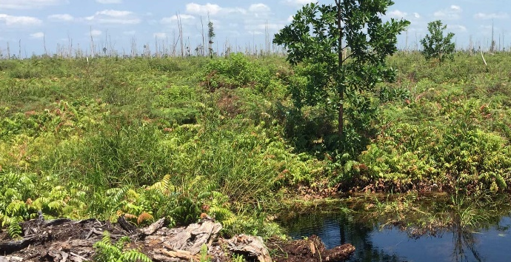
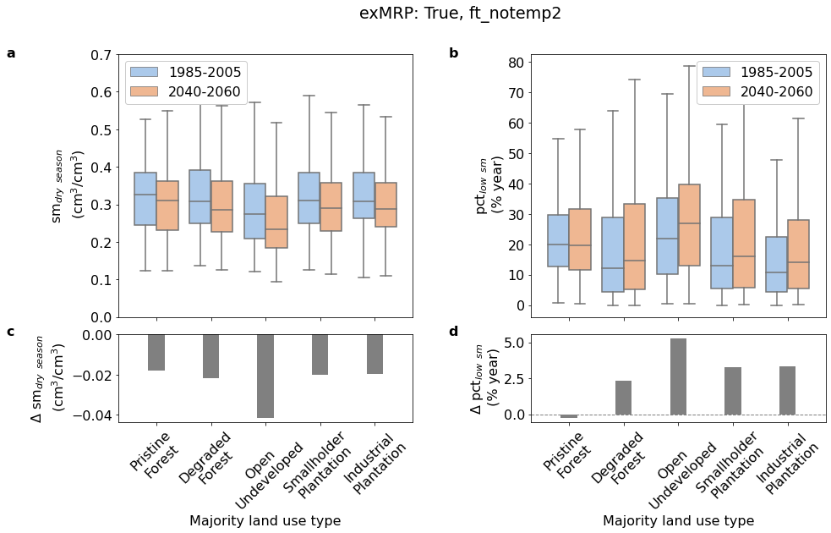
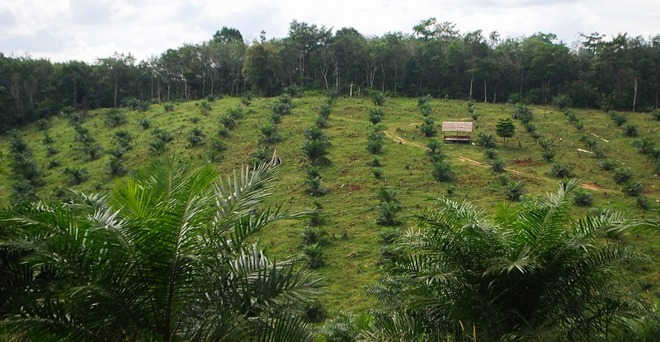
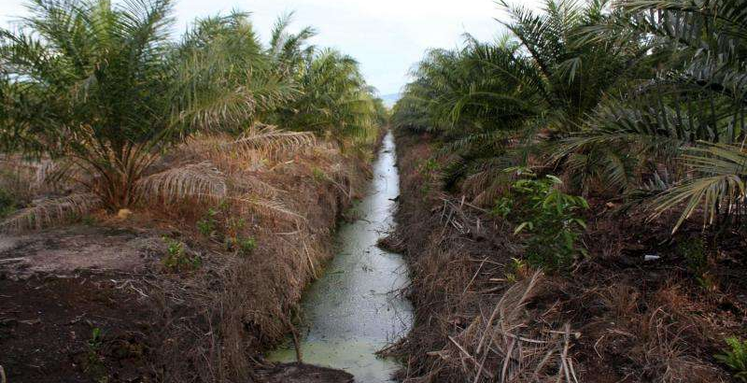
Deforested areas more sensitive to climate change
Notes:
https://www.mcc.gov/resources/doc/evalbrief-112019-ind-peatland
https://forestsnews.cifor.org/70714/indonesias-oil-palm-smallholders-need-more-support-for-rspo-certification-study-finds?fnl=en
https://phys.org/news/2015-07-tropical-peatland-carbon-losses-oil.html

