Slide 1

Choose your own weather adventure
Deep weather generation for
“what-if” climate scenarios
Campbell Watson <cwatson@us.ibm.com>
Dario Oliveira*, Daniela Szwarcman, Jorge Luis Guevara Diaz,
Leonardo Tizzei, Maysa Macedo, Bianca Zadrozny
IBM Research – USA & Brazil
*TU Munich
RESEARCH

Slide 2
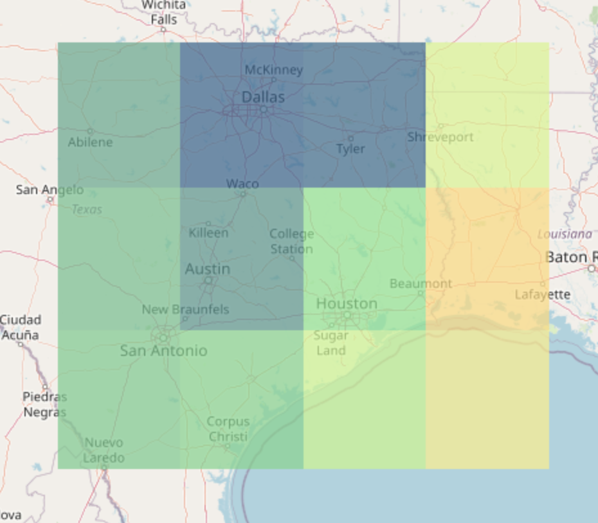
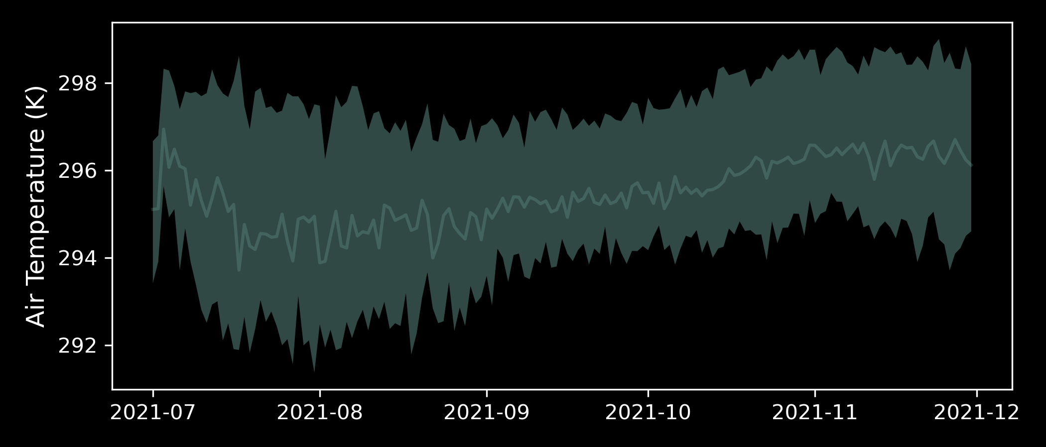
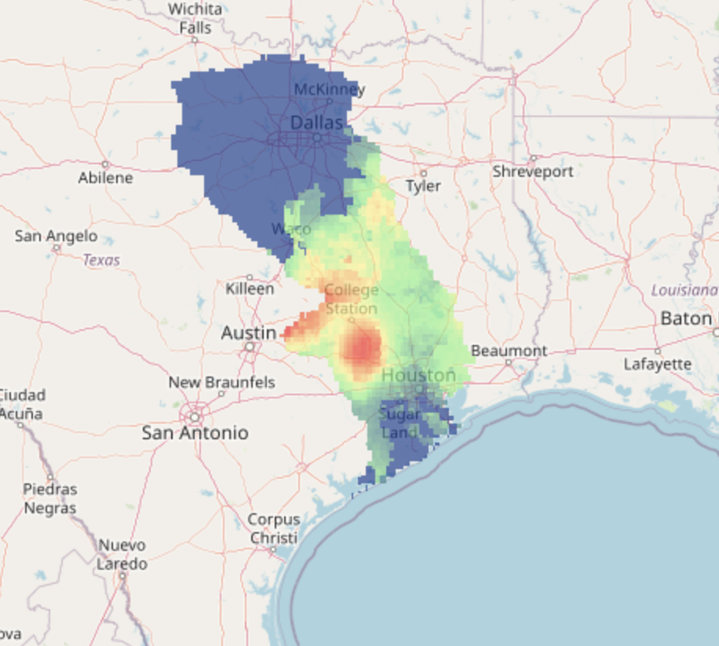
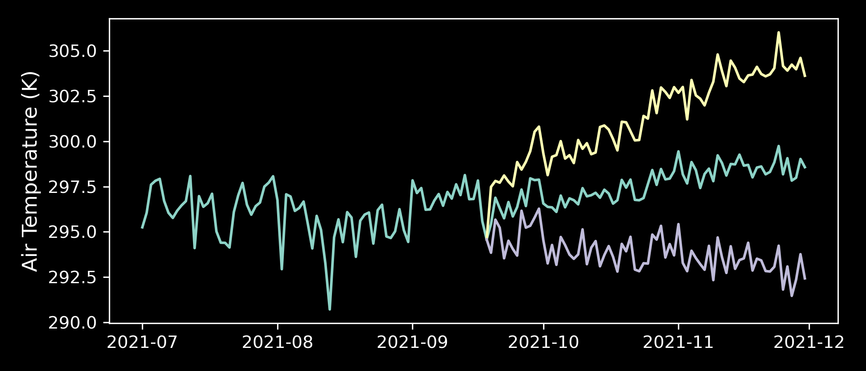
Opportunities arise from challenges of climate projection data
Uncertainty Quantification
Realistic spatiotemporal downscaling
“What if” scenarios & counterfactual analysis
IBM Research / May 21, 2022/ © 2022 IBM Corporation
1

Slide 3




Introducing the IBM WeatherGen
Control variables
Historical
high-resolution climate data
IBM WeatherGen
IBM PAIRS
Climate projections
Sequences of high-resolution synthetic weather fields
Statistically equivalent to observed data
Synthesis control
Computationally fast
Spatio-temporal dynamics
Correlation structures
Climate change
and variability
Simulation of extremes
Autoregressive wavelet decomposition
Markov Chains
K-nearest-neighbor simulator
IBM Research / May 21, 2022/ © 2022 IBM Corporation
2

Slide 4
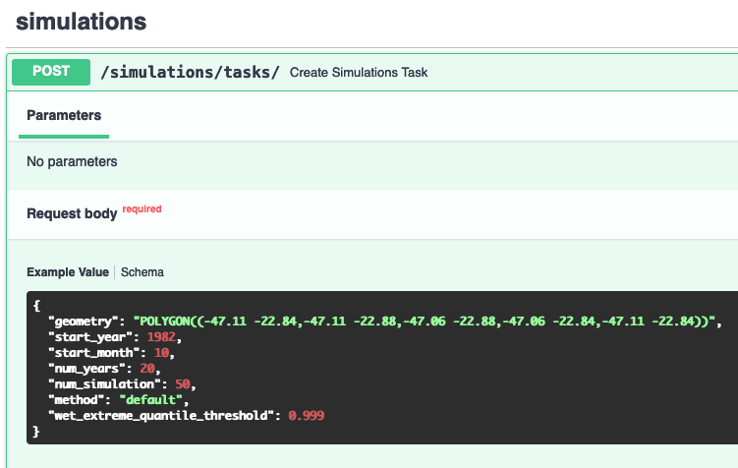
Introducing the IBM WeatherGen
Control variables
Historical
high-resolution climate data
IBM WeatherGen
Climate projections
Sequences of high-resolution synthetic weather fields
Statistically equivalent to observed data
Synthesis control
Computationally fast
Spatio-temporal dynamics
Correlation structures
Climate change
and variability
Simulation of extremes
Autoregressive wavelet decomposition
Markov Chains
K-nearest-neighbor simulator
IBM Research / May 21, 2022/ © 2022 IBM Corporation
3

Slide 5
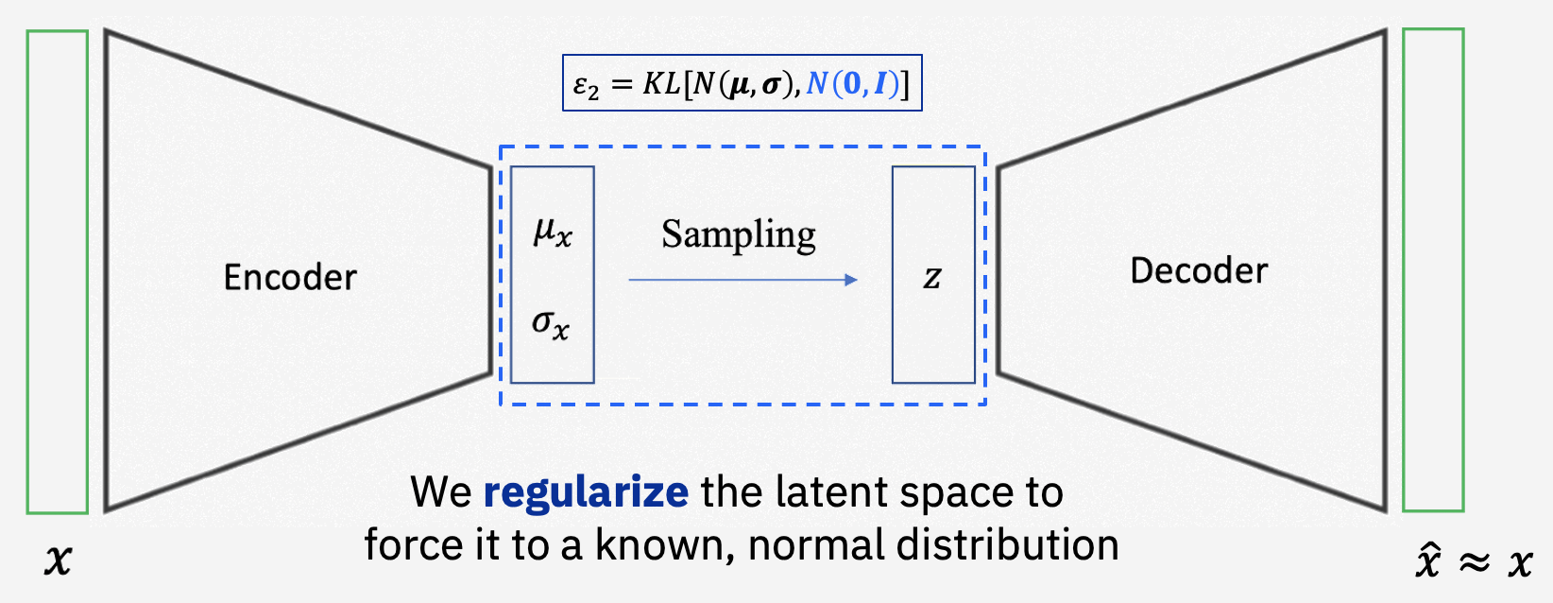
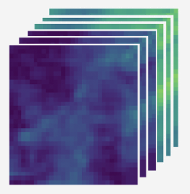
Deep Weather Generation
Deep WeatherGen
Quantized Reconstruction Losses
Deep generative models for extreme event synthesis
Components
Variational autoencoders
Latent space clustering
Variational Autoencoder
z
Information bottleneck
A compact, efficient and discriminant representation of the input…
IBM Research / May 21, 2022/ © 2022 IBM Corporation
4

Slide 6
Deep Weather Generation
Deep WeatherGen
Quantized Reconstruction Losses
Deep generative models for extreme event synthesis
Components
Variational autoencoders
Latent space clustering
Variational Autoencoder
z
Information bottleneck
A compact, efficient and discriminant representation of the input…
BUT it’s unconstrained
IBM Research / May 21, 2022/ © 2022 IBM Corporation
5

Slide 7
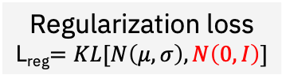
Deep Weather Generation
Deep WeatherGen
Quantized Reconstruction Losses
Deep generative models for extreme event synthesis
Components
Variational autoencoders
Latent space clustering
Regularization loss
L_{reg}$=KL[N\left(μ,σ\right),N\left(0,I\right)]$
Information bottleneck
We regularize the latent space to
force it to a known, normal distribution
Now, we can sample from N(0,I) for realistic synthesis
IBM Research / May 21, 2022/ © 2022 IBM Corporation
6

Slide 8
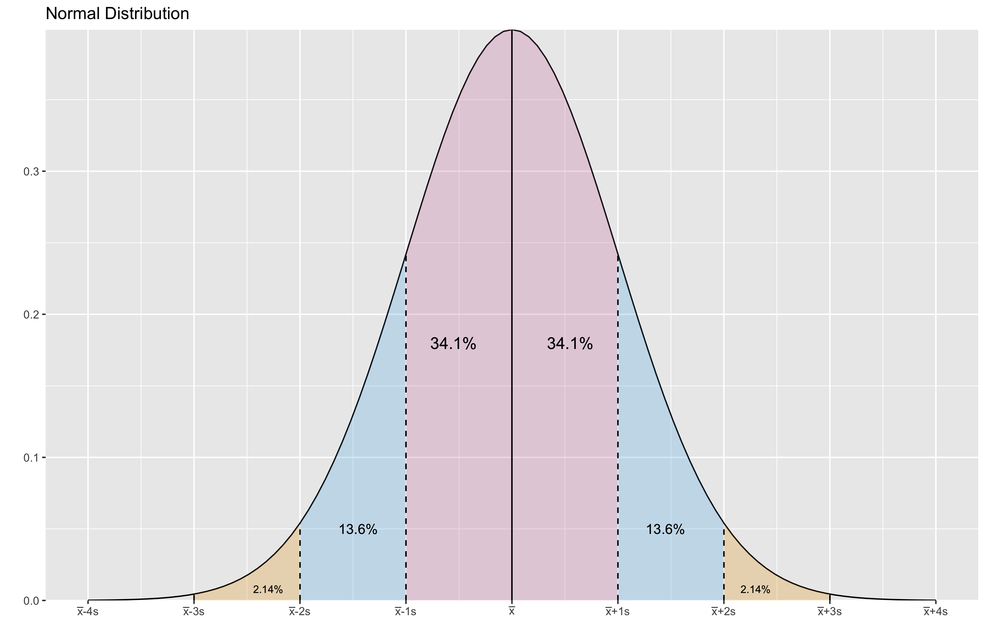
Deep Weather Generation
How are weather events distributed in the latent space ~ N(0,I)?
Very Common
Very common
Latent Space
~N(0,1)
Not rare
Not rare
Rare
Rare
IBM Research / May 21, 2022/ © 2022 IBM Corporation
7

Slide 9
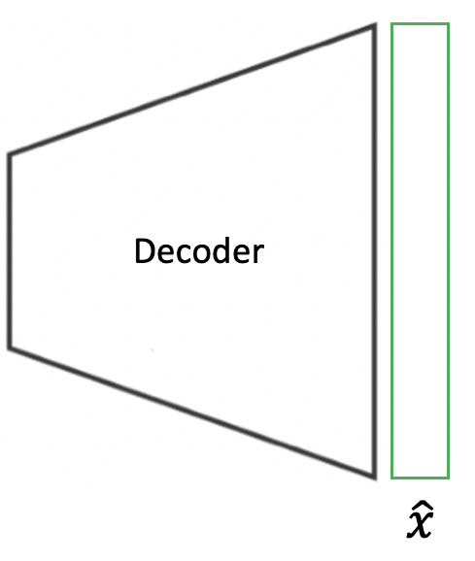
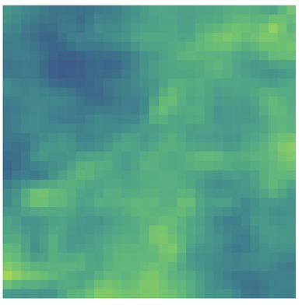
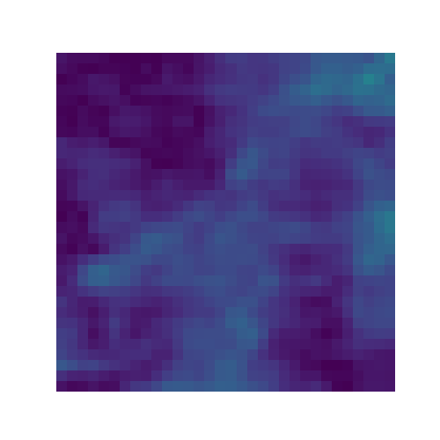
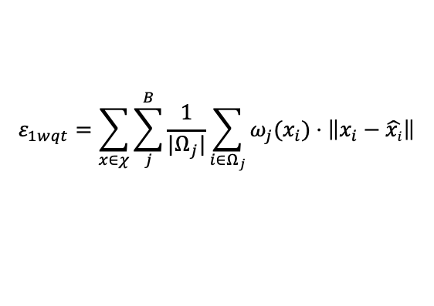
Deep Weather Generation
Latent Space
Sampler
Z
Z
Z
N(0,1)
Controlling Weather
Field Synthesis
To focus the training on under-represented values, we apply a weighted quantized MSE for reconstruction
$$ε_{1wqt}=\sum_{x∈χ}{\sum_{j}^{B}{\frac{1}{{|Ω}_{j}|}\sum_{i∈Ω_{j}}{ω_{j}(x_{i})⋅\left\|x_{i}−\hat{xi}\right\|}}}$$
IBM Research / May 21, 2022/ © 2022 IBM Corporation
8

Slide 10
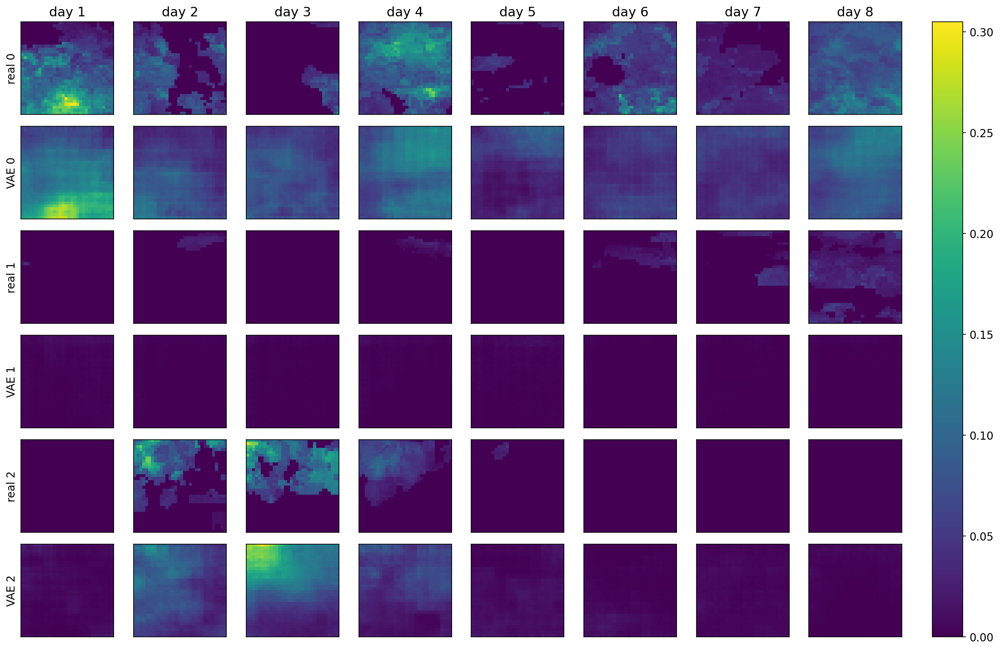
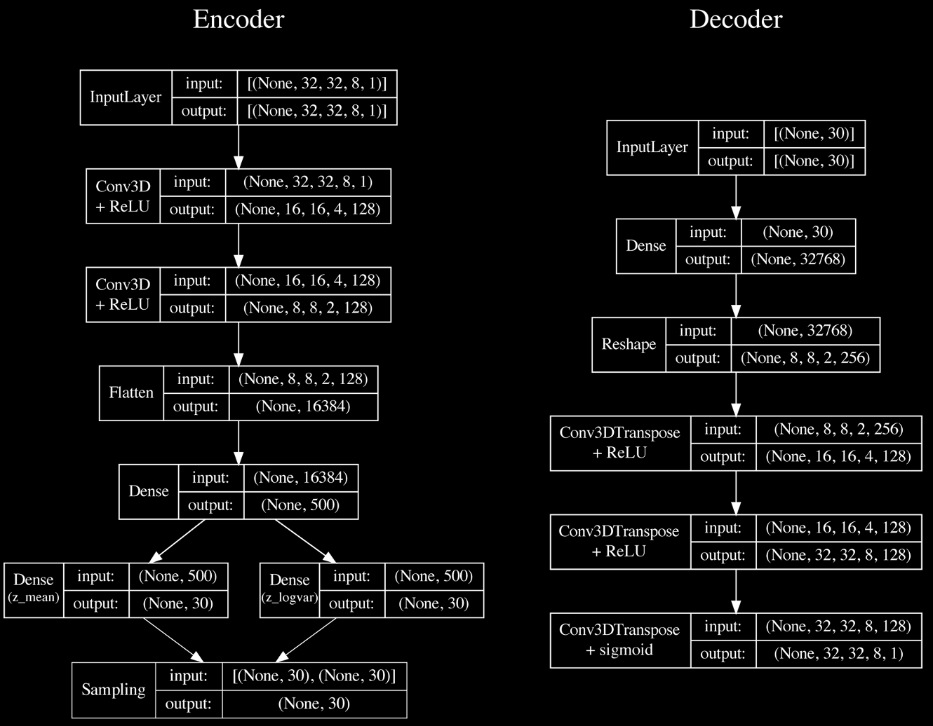
Reconstructing monsoon rains in Palghar, India
Vanilla VAE
IBM Research / May 21, 2022/ © 2022 IBM Corporation
9

Slide 11
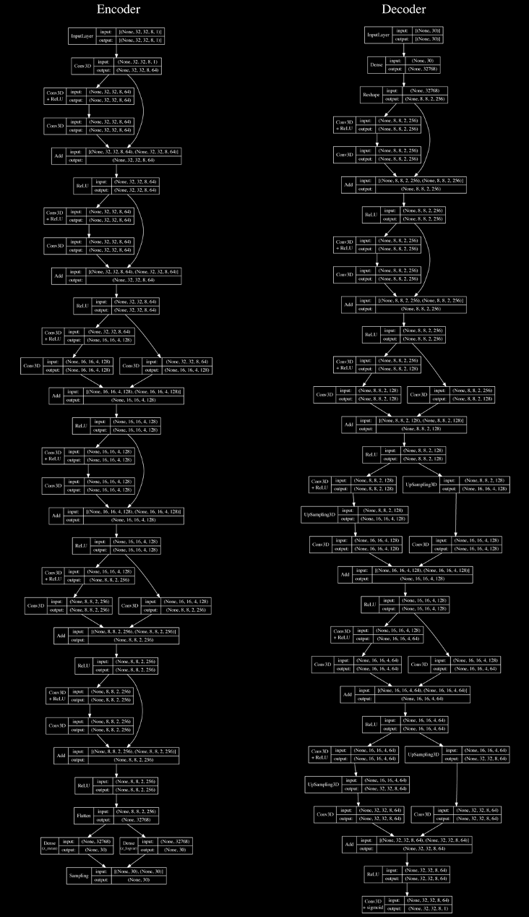
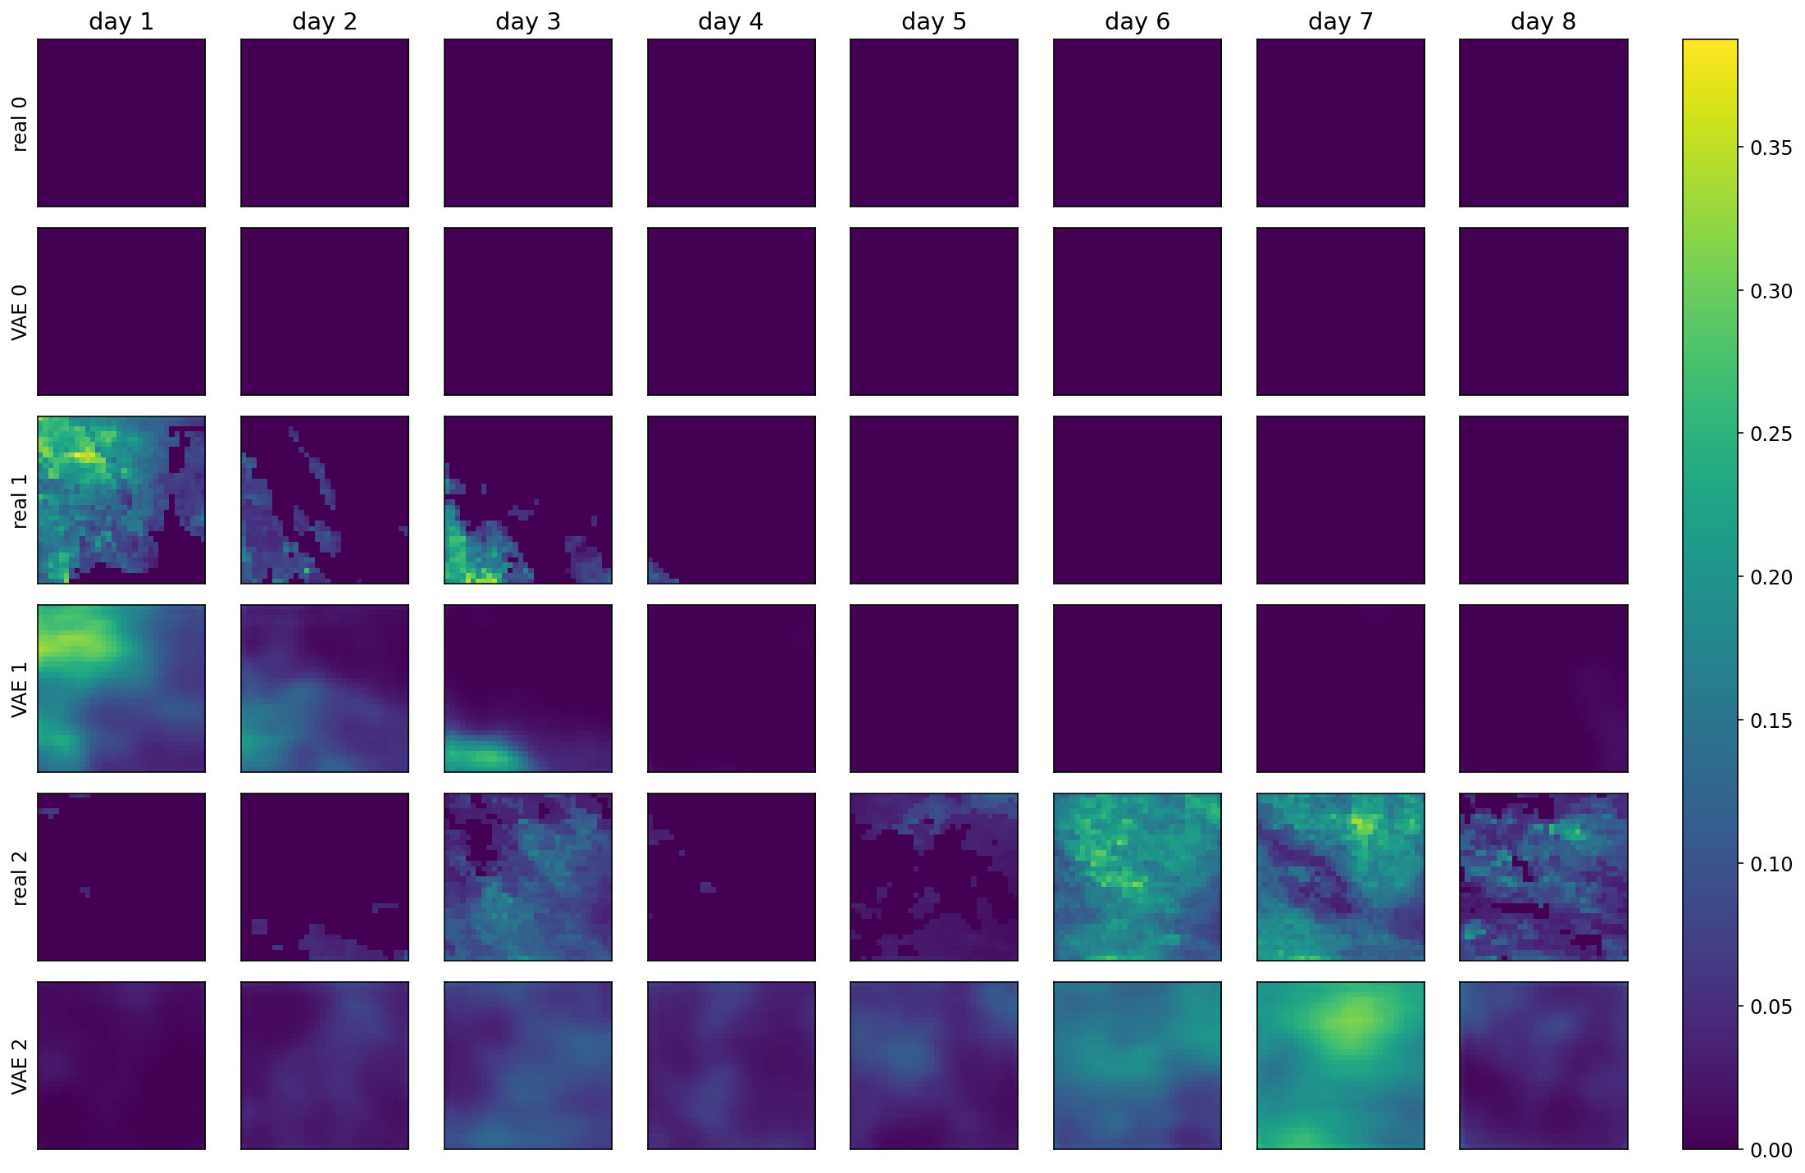
Reconstructing monsoon rains in Palghar, India
Residual
VAE
IBM Research / May 21, 2022/ © 2022 IBM Corporation
10

Slide 12
Final Notes
Controlling Weather Field Synthesis Using Variational Autoencoders
Long paper upcoming at IEEE IGARSS 2022
Short paper at https://arxiv.org/pdf/2108.00048.pdf
A comparative study of stochastic and deep generative models for multisite precipitation synthesis
Long paper in prep
Short paper at https://arxiv.org/pdf/2107.08074.pdf
The Brazil Lab is hiring a Geospatial ML Research Scientist
https://careers.ibm.com/job/15756460/
IBM talks at EGU ’22
Mon, 9:20–09:25: Matryoshka Neural Operators: Learning Fast PDE Solvers for Multiscale Physics [Björn Lütjens]
Mon, 14:00–14:07: S2S Extreme Weather Featurization: A Global Skill Assessment Study [Zubeida Patel]
Mon, 14:30–14:35: Choose your own weather adventure: deep weather generation for “what-if” climate scenarios [Campbell Watson]
Wed, 15:42–15:48: IBM Operations Risk Insights with Watson: a multi-hazard risk, AI for Natural Disaster Management use case [Thomas Ward]
Fri, 11:30–11:35: ML-based Probabilistic Prediction of 2m Temperature and Total Precipitation [Akram Zaytar]
IBM Research / May 21, 2022/ © 2022 IBM Corporation
11

