Slide 1
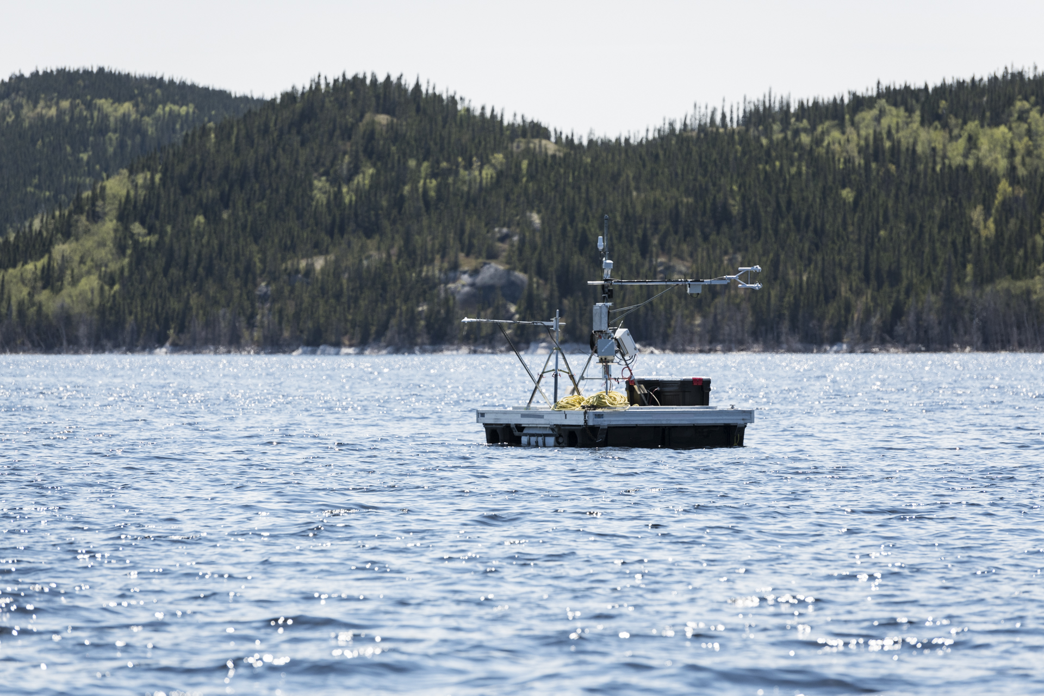




Validation of a 1-D lake model for modeling evaporation from an elongated and deep boreal reservoir
Habiba Kallel ^{(1,2)}, François Anctil^{(1,2)} , Daniel F.Nadeau ^{(1,2)}, Antoine Thiboult ^{(1,2)}, and Murray D.Mackay ⁽³⁾
⁽¹⁾ Department of Civil and Water Engineering, Université Laval, Quebec, Canada.
⁽²⁾ CentrEau, Water research center, Quebec QC, Canada
⁽³⁾ Meteorological Research Division, Environment and Climate Change Canada, Toronto, Ontario,Canada
Habiba.kallel.1@ulaval.ca

Slide 2
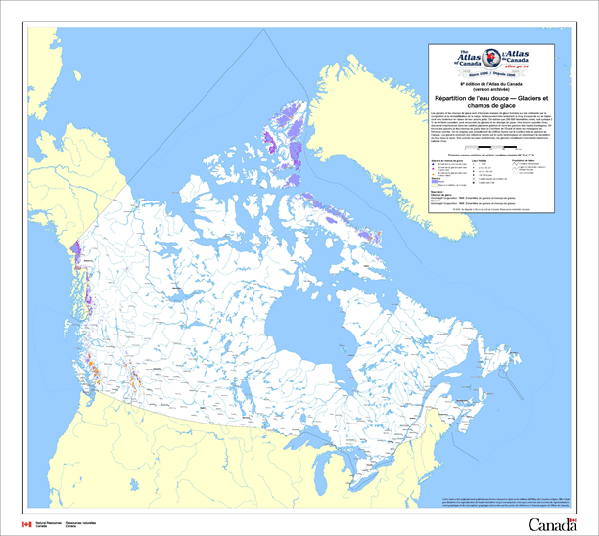
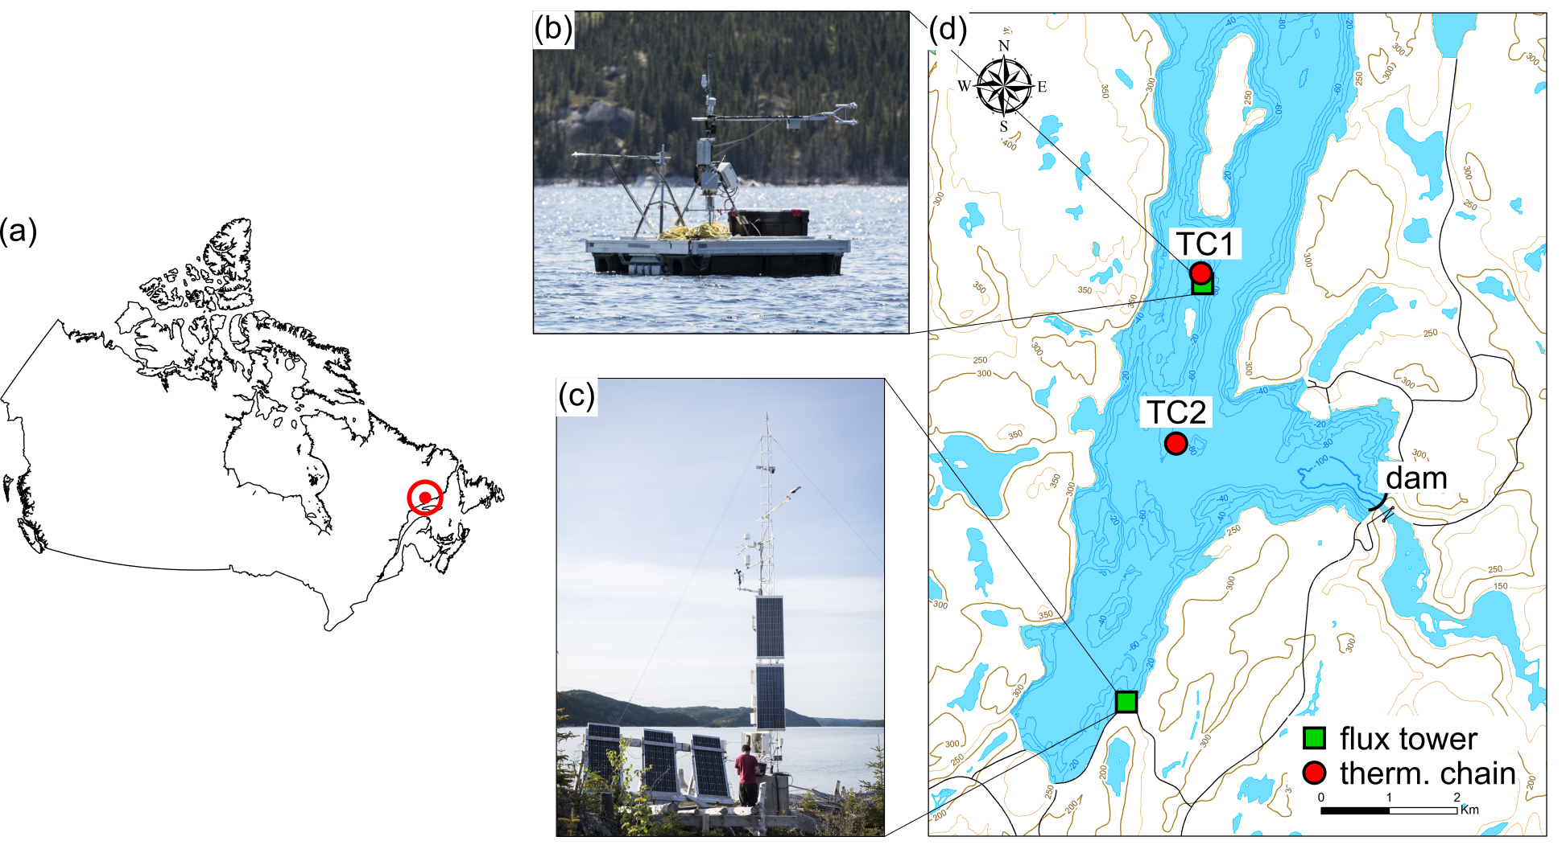
Introduction And Study Site
Canada
Lake-atmosphere interactions are crucial for climate and weather assessment.
Lake size | Number | Total area of Canada
0.001- 1 km² | 19.5 x10⁶ | 161000 (24 %)
1-10 km² | 27800 | 73000 (11%)
10-100 km² | 3300 | 86000 (13%)
100- 100000 km² | 400 | 356000 (52%)
Inland and water bodies are diverse in size and shape
La Romaine 2 hydroelectric reservoir (50.7°N, 63.2°W)
Observations
Twos fluxes towers using an eddy-covariance system with a sampling rate of 10 Hz.
A1. Year –round on shore
A2. Ice-free on a raft
B. Water temperature measurements available from the surface to 70 m deep.

Slide 3
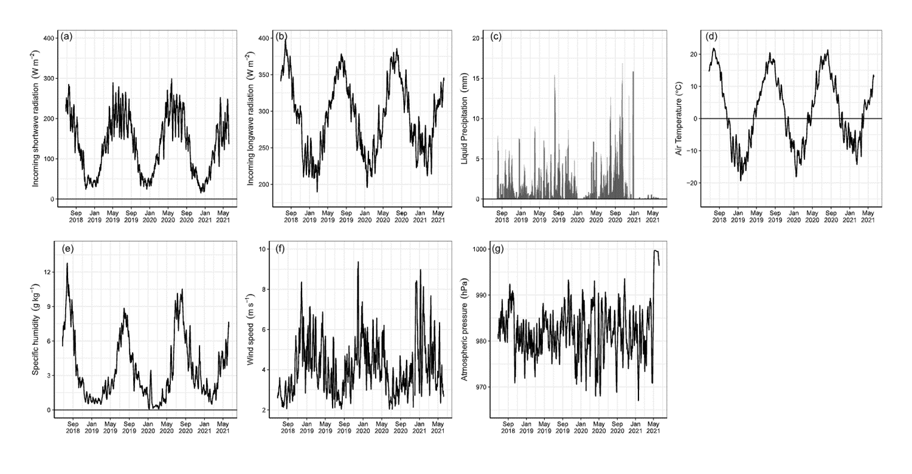
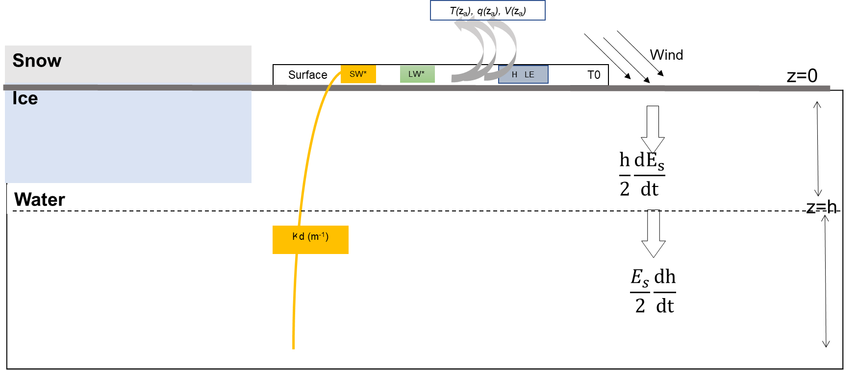
Model Assessment
Model setup
Meteorological forcing
Parameter | Value
Mean Depth (m) | 60
Vertical resolution | 0.5
Time step | 30 min
Fetch | 9200 m
Simulation period | 2018-06-25 to 2021-06-08 (3 years)
Initial temperature profile | Observations on 2018-06-25
Climate observations
Canadian Small Lake Model

Slide 4
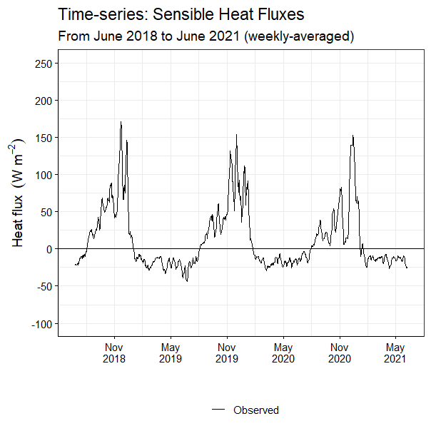
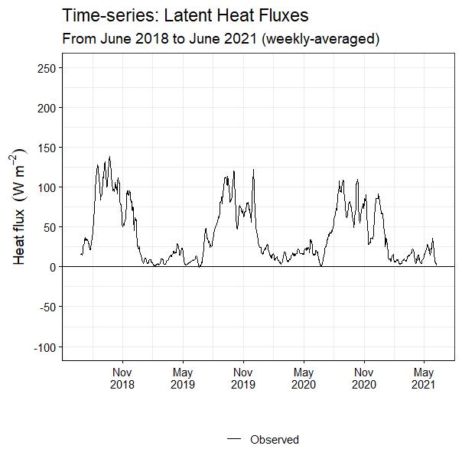
Model Performance: Turbulent Heat Fluxes

Slide 5
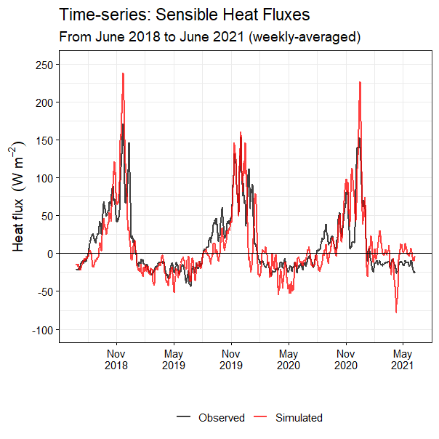
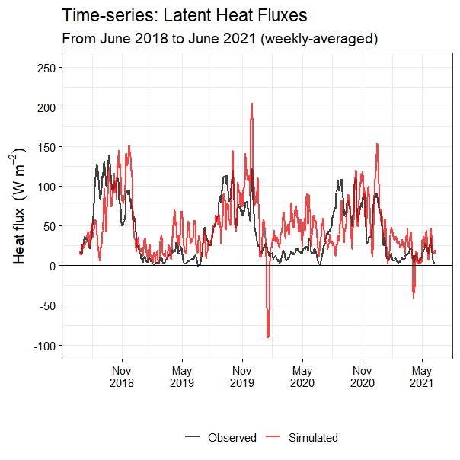
Model Performance: Turbulent Heat Fluxes
Comparison shows a good agreement for H.
Deviations mostly occur before freeze-up (October-December) and around ice-off (April-May).
Tendency of overestimating LE when its observed magnitude is small (ice cover period).

Slide 6
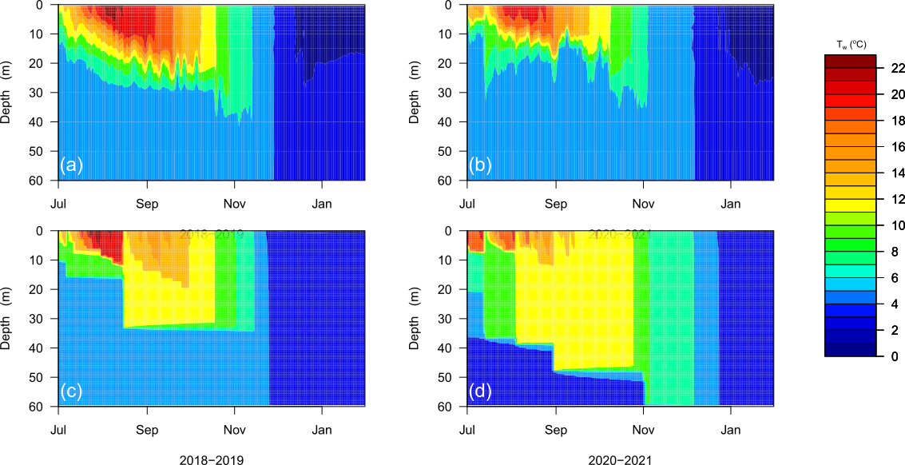
Thermal Regime
Observed
Observed
Simulated
Simulated
Near-surface water temperature confirming the ability of the CSLM to simulate the near-surface seasonal cycle.
During fall: overestimation of the water temperature induces an overestimation of the heat fluxes.
Early depletion of the energy storage leading to an early modeled freeze-up.

Slide 7
Thermal Regime
Observed
Observed
Simulated
Simulated
 | Observed (day) | Simulated (day) | Error (day)
Year 1 | 148 | 170 | 22
Year 2 | 133 | 148 | 15
Year 3 | 86 | 110 | 24
CSLM overestimates number of freezing days

Slide 8
Take home message
Objective
Accurate modeling water-atmosphere interactions to better understand the role of lakes on weather and climate
Strengths
Turbulent fluxes were successfully predicted during the open-water period.
Thermal mixing and mixed layer deepening well estimated.
Difference between number of simulated and observed freezing days always below 25 days.
Challenge
Surface heat fluxes are particularly challenging to model because of the scarcity of direct observations
Limitations
Overreaction to high wind speed episode.
Underestimation of water temperature in the late fall causing an early lake freeze-up.
Lower performance following the seasonal overturns.

Slide 9
Thank you for attention
Habiba.kallel.1@ulaval.ca

