Slide 1

Design Considerations for the 3rd Spatial Dimension of STARE
Mike L Rilee and Kwo-Sen Kuo
Bayesics, LLC, Bowie, Maryland, USA

Slide 2
Outline
What is STARE?
Which reference frame?
Where is Earth’s surface?
How to accommodate pressure coordinates?
Conclusion

Slide 3
STARE
STARE stands for SpatioTemporal Adaptive Resolution Encoding
  Uniqueness: encodes [coordinate location + neighborhood] in 1 64-bit integer “index”
  Focus on the geospatial encoding in the following
STARE geospatial index
  Geolocation (i.e., geospatial coordinate location) encoding is a variant of the Hierarchical Triangular Mesh, HTM
  An iterative quadfurcation (branching into 4) of an octohedron
  A binary encoding of 8 quad trees
  A one-dimensional index of solid angles instead of 2D like longitude+latitude
  Floating-point longitude (32-bit) and latitude (32-bit) use 64 bits but encode only geolocation

Slide 4
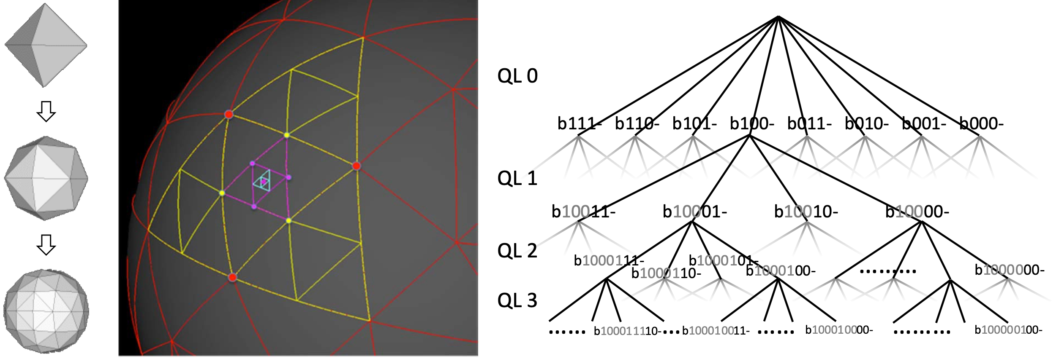
Iterative Quadfurcation of an Octahedron
- Increasingly finer trixels (spherical triangles)
Binary numbering of the spherical triangles

Slide 5
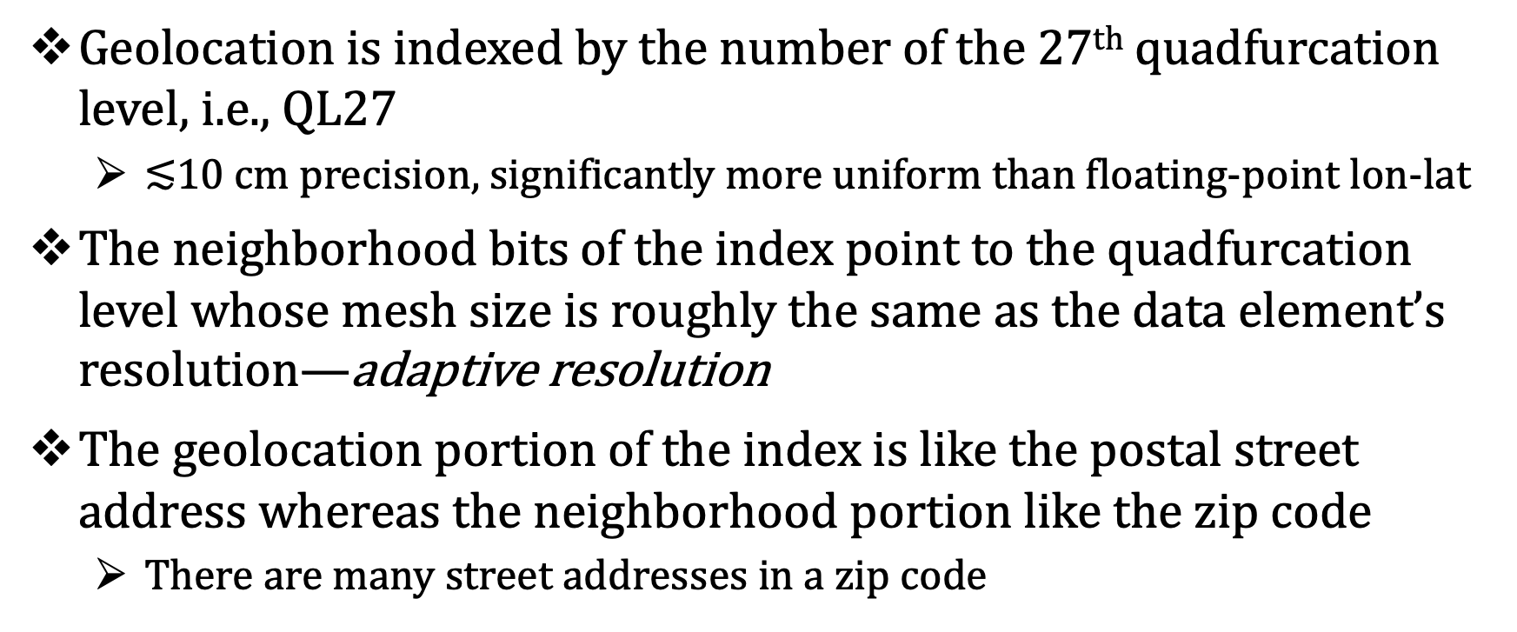
Encoding Geolocation and Neighborhood
Geolocation is indexed by the number of the 27th quadfurcation level, i.e., QL27
  $≲$10 cm precision, significantly more uniform than floating-point lon-lat
The neighborhood bits of the index point to the quadfurcation level whose mesh size is roughly the same as the data element’s resolution—adaptive resolution
The geolocation portion of the index is like the postal street address whereas the neighborhood portion like the zip code
  There are many street addresses in a zip code

Slide 6
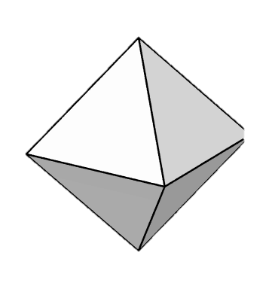
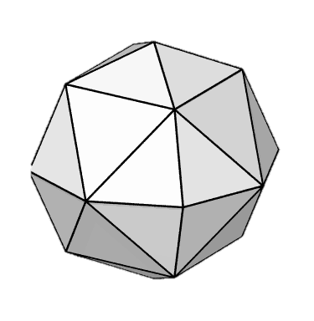
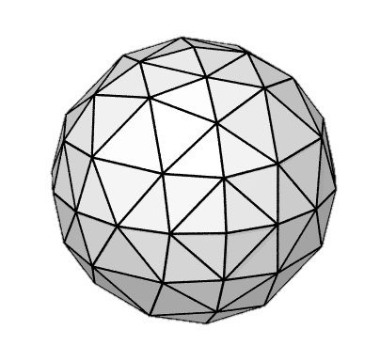
Encoding Geolocation and Neighborhood
- Akin to postal address and zip code
Root Octahedron
QL0
b111…
b110…
b101…
b100…
b011…
b010…
b001…
b000…
b11111…
b11110…
b11101…
b11100…
b11011…
b11010…
b11001…
b11000…
b10111…
b10110…
b10101…
b10100…
b10011…
b10010…
b10001…
b10000…
b01111…
b01110…
b01101…
b01100…
b01011…
b01010…
b01001…
b01000…
b00111…
b00110…
b00101…
b00100…
b00011…
b00010…
b00001…
QL1
b00000…
…
…
QL2
b0111111…
b0111110…
b0111101…
b0111100…
b0000011…
b0000010…
b0000001…
b0000000…
…
…
…
Q-Level
0
1
1
2
3
4
11
12
13
14
27
neighborhood
QL27
0
0
0
0
0
0
0
0
1
1
1
1
0
…
…
1
1
1
1
1
1
1
1
…
…
…
1
1
0
1
0
1
1
Bit #
63
62
61
60
59
58
57
56
55
54
53
52
…
…
38
37
36
35
34
33
32
31
…
…
…
6
5
4
3
2
1
0
37=59 - 11×2

Slide 7
Which Reference Frame?
STARE geolocation (i.e., lon-lat) encoding is obviously based on the spherical coordinate system
Earth’s center is thus the natural reference point for the radial dimension
  Radial distance from the center of the earth
We will keep the radial distance encoding hierarchical also
  (Details yet to be determined)

Slide 8
Where is Earth’s Surface?
In practice, we are accustomed to using height (elevation) and depth for references
  (A consequence of our being a surface creature.)
Height and depth are relative to the mean sea level (MSL)
We need to know the radial distance of the sea level from Earth’s center, in order to convert between height/depth and radial distance.
Issues
  The radial distance of MSL is not constant; it changes when the distribution of Earth’s mass changes
  Resolution of accepted standard(s), e.g., World Geodetic System, evolves too.

Slide 9
How to Accommodate Pressure Coordinates?
Geophysical simulation models like to use pressure (or isentropic) coordinate systems
  There are various pressure coordinates
We plan to use metric radial distance as the primary index and
  Either have the corresponding pressure levels as a secondary index
  Or implement the conversion as a STARE API option
  (The conversion formula must be provided by the model)

Slide 10
Conclusion
Designing the radial distance index turns out to be much more complicated than we expected.
Life is messy!

