Slide 1


Assessing the long-term evolution of abandoned salinized farmland via temporal remote sensing data
Liya Zhao, May 27th
Wuhan University, China

Slide 2
OUTLINES
OUTLINES
1.Background
2.Method
3.Results
4.Discussion
4.Conclusion
5.Conclusion

Slide 3
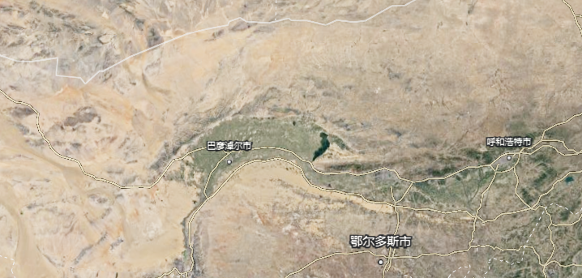

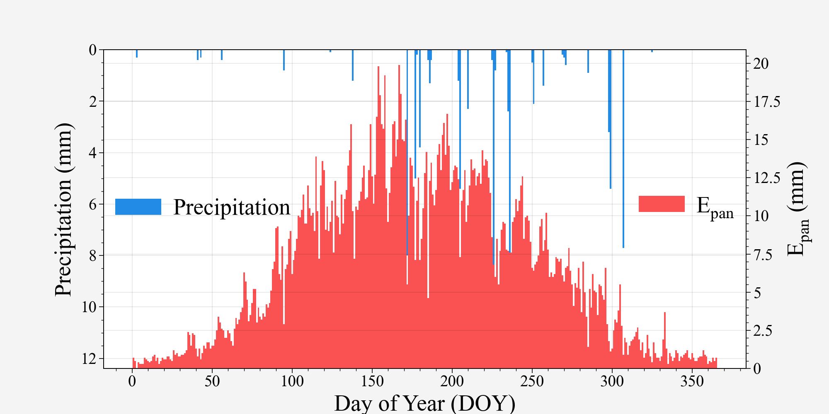
1.BACKGROUND
Hetao irrigation district
(On September 4, 2019, Hetao irrigation distric was
included in the World Heritage List of Irrigation Works)
Area: 1.12 M ha
Climate: arid and semi-arid area
Annual precipitation: 60-280 mm
Annual Evaporation: 2000-2400 mm
Average groundwater table depth: 1.76 m
High Potential ET but low precipitation
Shallow groundwater table
Secondary salinization !

Slide 4
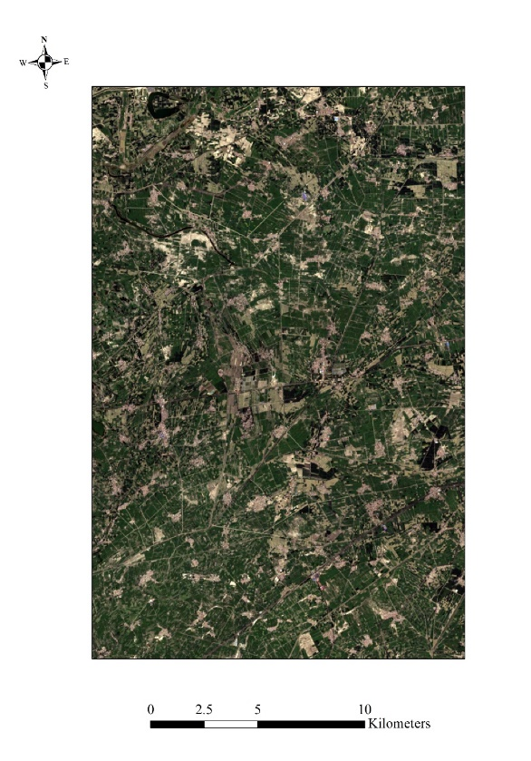
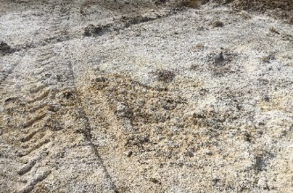
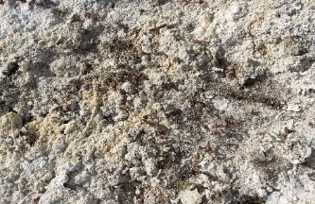
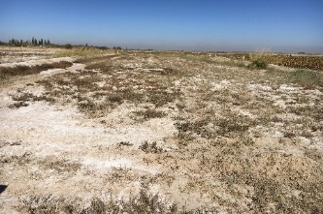
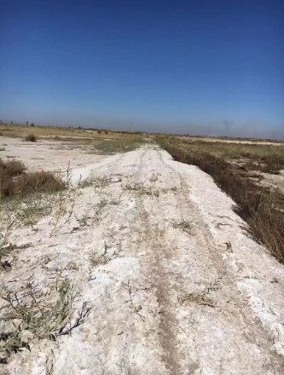
1.BACKGROUND
The abandoned salinized farmland
Soil salinization in Hetao

Slide 5
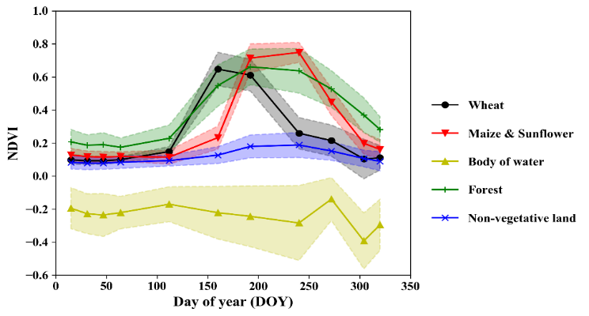
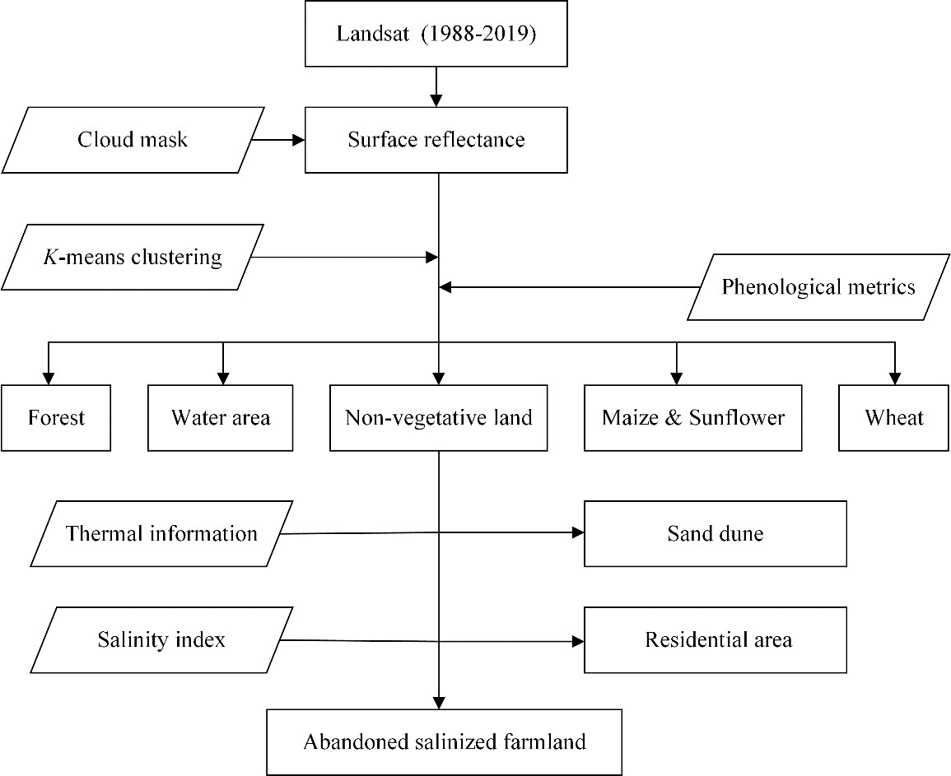
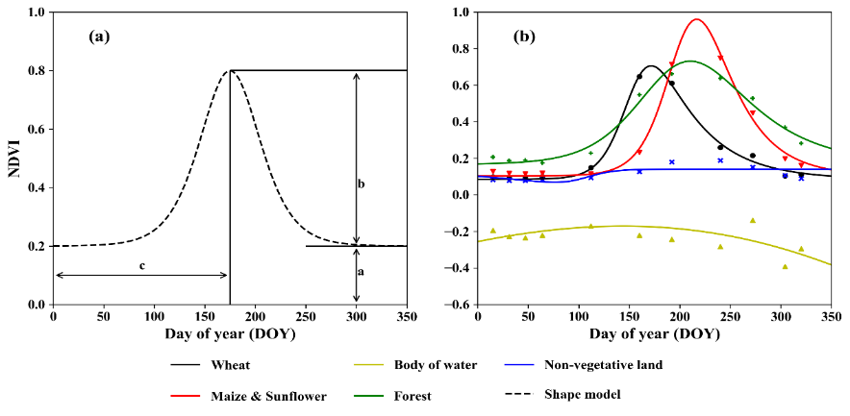
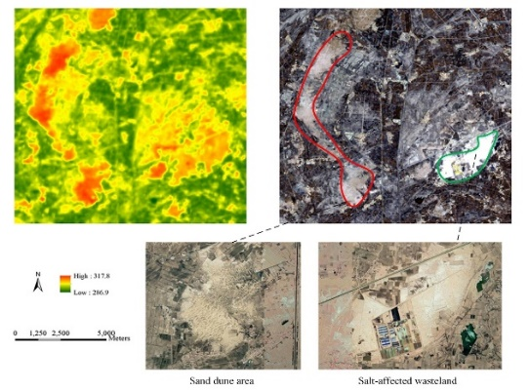
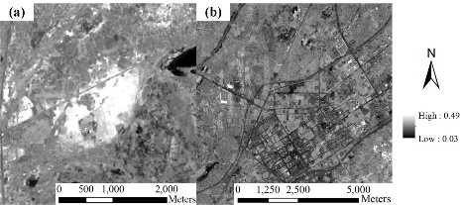
2.METHOD
Time-series optical reflectance and surface temperature was used to monitor the annual dynamic of abandoned salinized farmland in Hetao

Slide 6
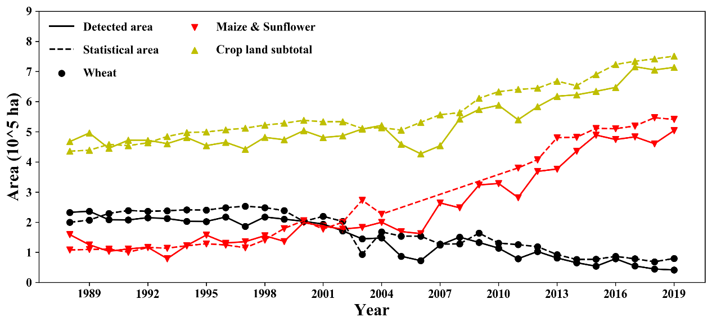
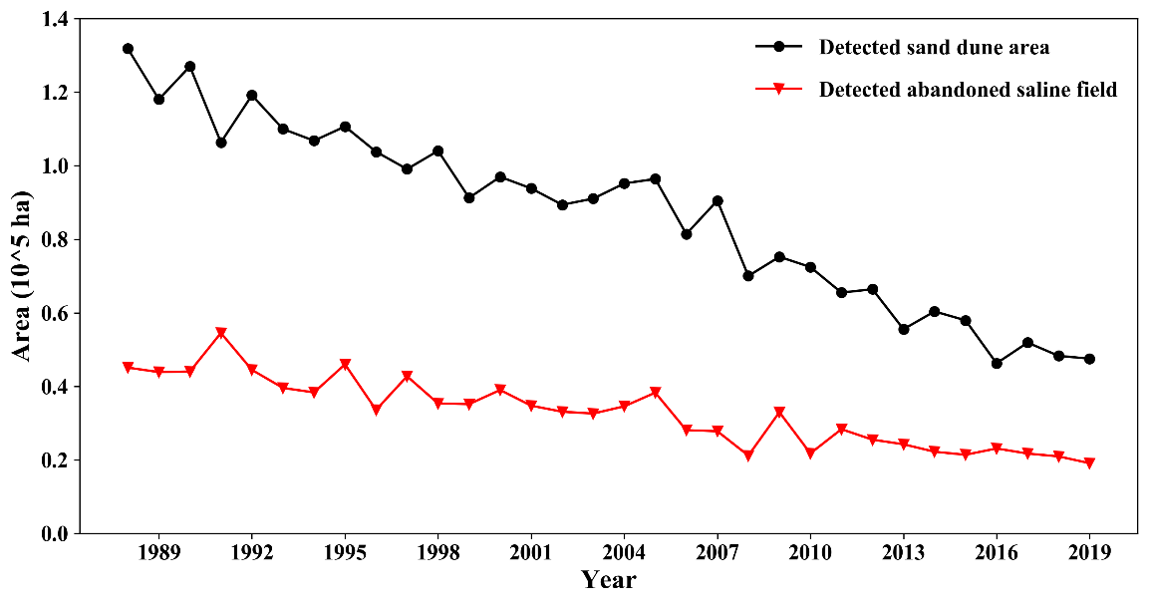
3.RESULTS
Cropland area (expanded 51%)
Wheat (decreased 60%)
Maize and sunflower (expanded 403%)
Abandoned salinized farmland (decreased 58%)
Sand dunes (decreased 64%)
A shift of planting structure was observed in Hetao during the last 30 years
A significant desalinization happened in Hetao

Slide 7
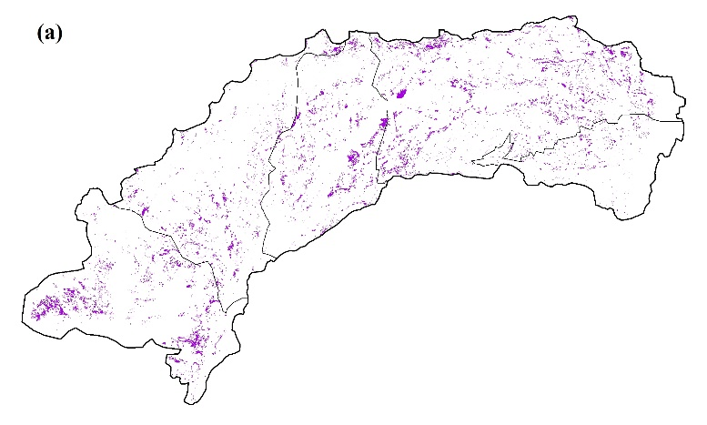
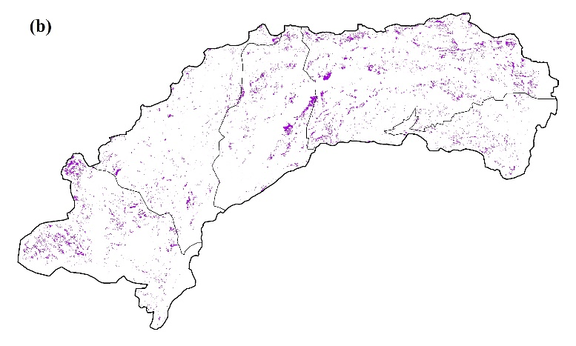
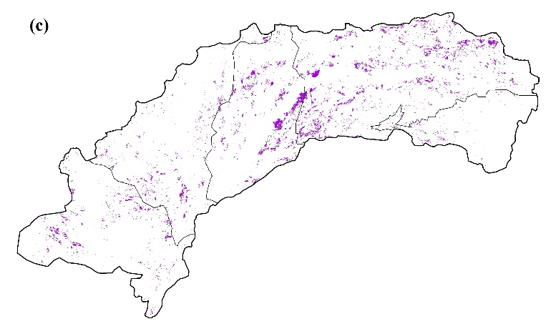
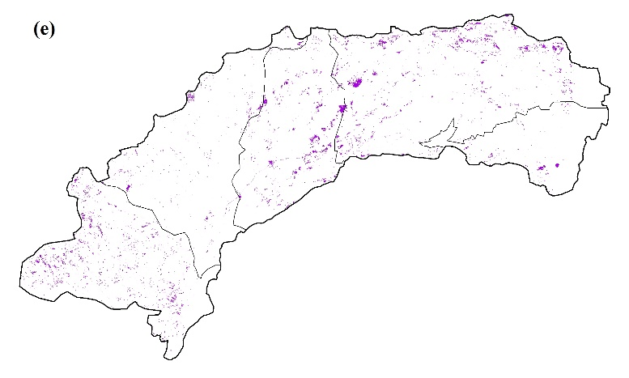
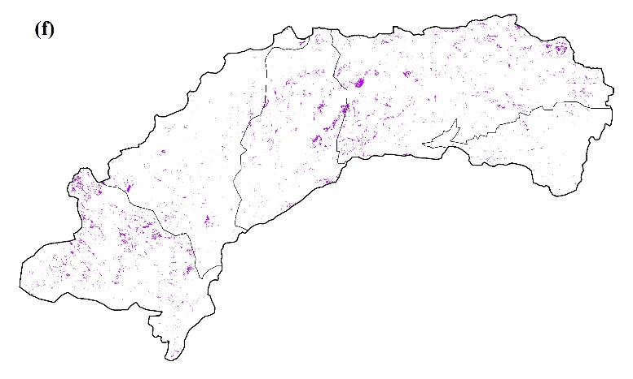
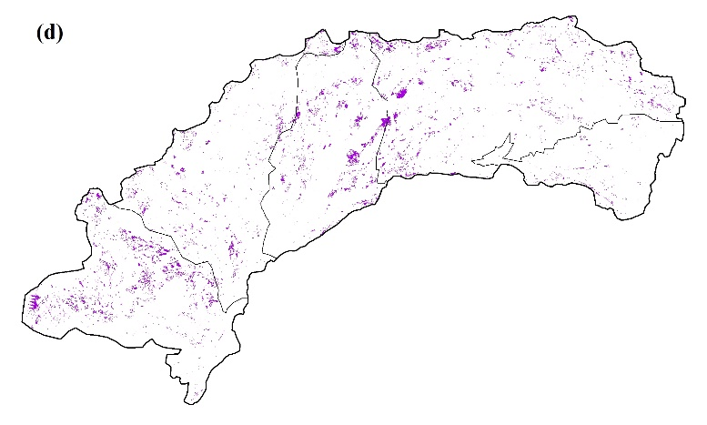
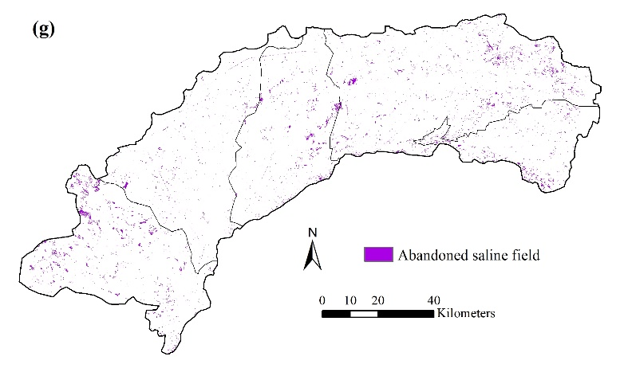
3.RESULTS
The spatial distribution of the detected abandoned salinized farmland from 1988 to 2018
1988
1993
1998
2008
2013
2003
2018
The abandoned salinized farmland vanished in both eastern and western Hetao
A group of abandoned salinized farmland that has been in existence for 30 years in central Hetao.

Slide 8
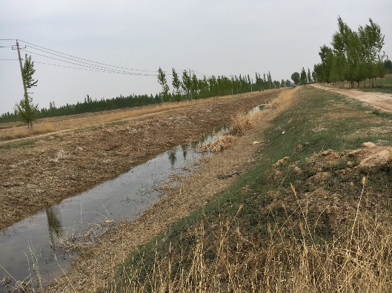
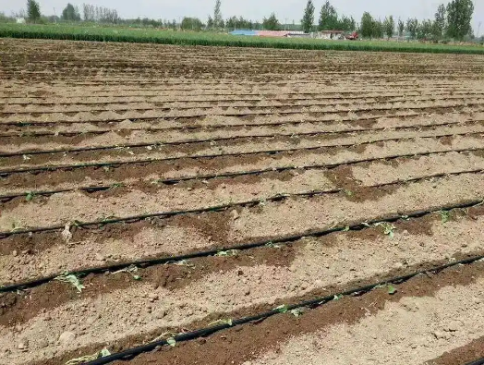
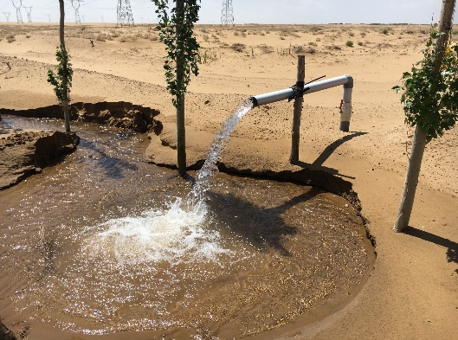
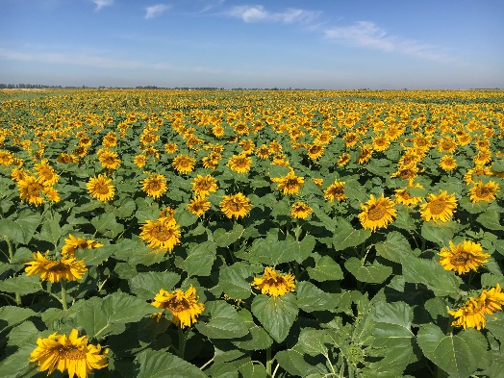
4.DISCUSSION
The reasons of desalinization in Hetao:
Drainage facilities and water-saving irrigation techniques reduced the groundwater table
A shift of irrigation source (water from Yellow river to groundwater)
Changed cropping structure reduced required irrigation amount and the inlet salt

Slide 9
5.CONCLUSION
Combining thermal information VI, and SI successfully distinguish the abandoned salinized farmland from other non-vegetative lands
The cropland in Hetao has continuously expanded during the last thirty years
The saline situation has been mitigated during recent decades
The promising possibility of reutilizing abandoned salinized farmland via a leaching campaign where the groundwater table is sufficiently deep

Slide 10
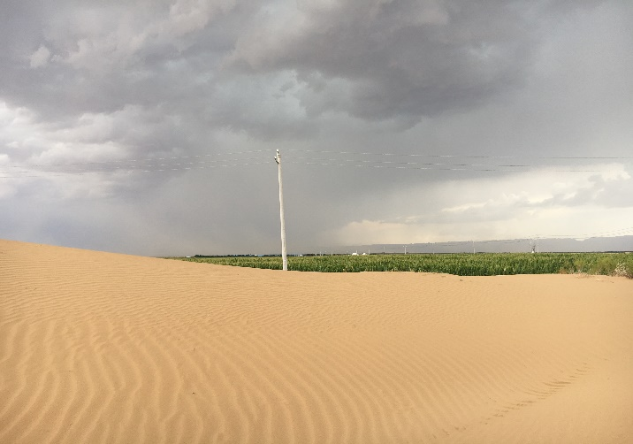
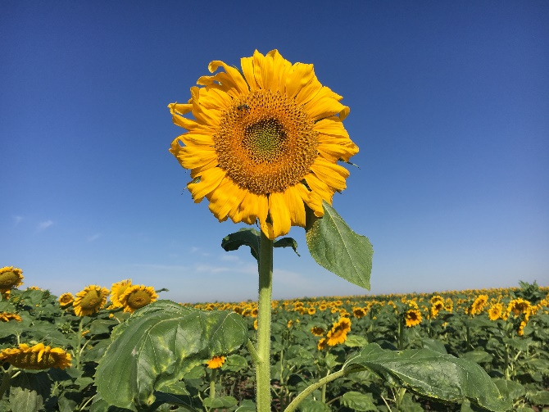

Thinks for your attention!
Email: zhaoliya921@whu.edu.cn

