Slide 1

Comparative analyses on geophysical survey responses for various numerical models constructed based on field data
Huieun Yu¹, Bitnarae Kim², Ahyun Cho¹, In Seok Joung¹, Juyeon Jeong¹, Hanna Jang¹,
Soojin Jang¹, and Myung Jin Nam^{1,3*}
¹Department of Energy and Mineral resources Engineering, Sejong University, Korea
²Bureau de Recherches Géologiques et Minières, France
³Earth and Resources sysem Engineering, Sejong University, Korea

Slide 2

Enbodying Contamination
Test-bed
Construct contaminant test-bed ➔ expensive, uncontrolled condition
Transition of geophysical properties ➔ takes too long time
Hard to control identical survey condition
Numerical Model
Control contaminants condition
Possible various physical properties
Diverse geophysical survey
Construct a contaminant diffusion model ➔ predict for future
Exploration design in contaminated area

Slide 3
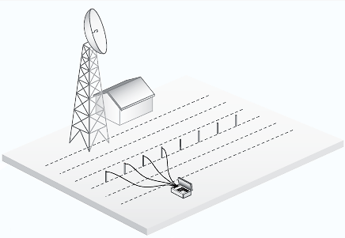
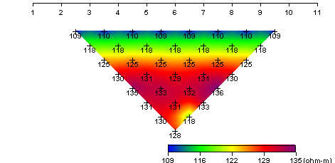
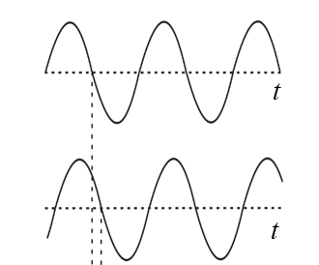
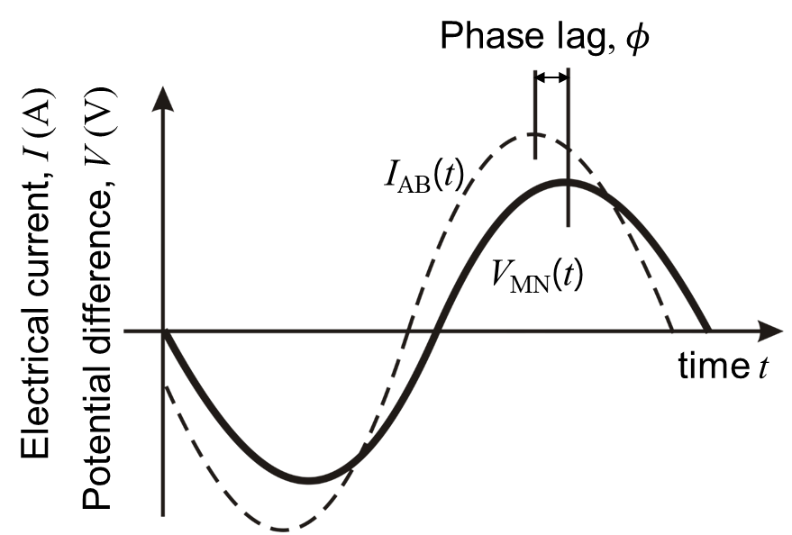
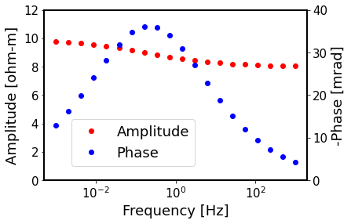
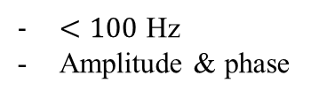
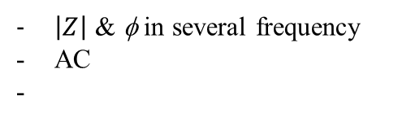
Geophysical Survey : Electromagnetic
Resistivity
Apparent resistivity
Time-domain
Complex resistivity
Spectral IP
$\left|Z\right|$ & φ in several frequency
AC
typical SIP
φ
Current On-Off time
Chargeability (m)
$<100$ Hz
Amplitude & phase
(Pelton, 1983)

Slide 4
Procedure
Assume
Various
Scenario
TDIP
Complex resistivity
SIP
Numerical model
Real Field
Geological structure
Physical properties
: using real field
& laboratory results
Assumption | feature
Leakage | Surface or adjacent from source
Extension | Extent size
Biodegradation | Characteristic of NAPL
absence water table | Maximum coverage Before degradation After degradation
Notes:
By analyzing the geophysical results from contaminated area
Construct numerical model
And assume several cases like to happen diffusion of contaminant
And then conduct numerical simulation of TDIP in linear and time channal/Complex resistivity/ SIP

Slide 5
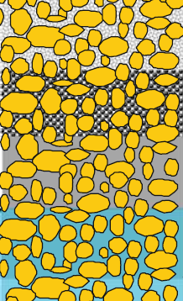
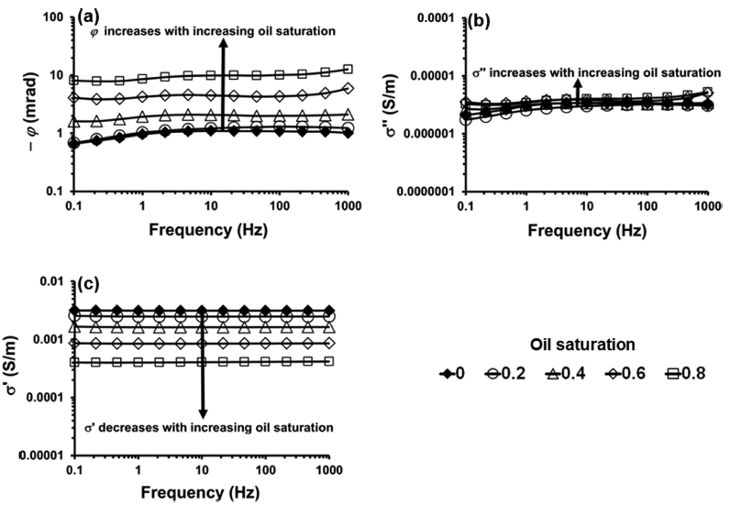
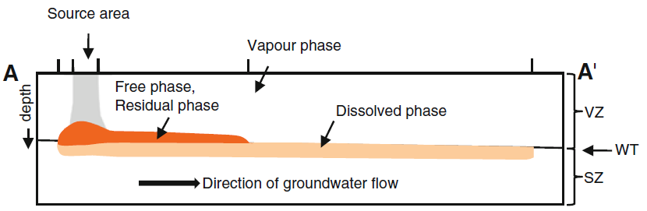
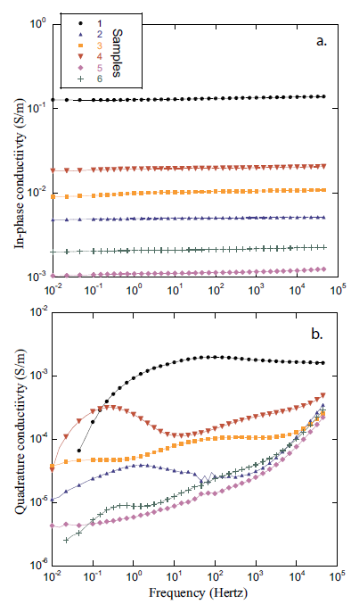
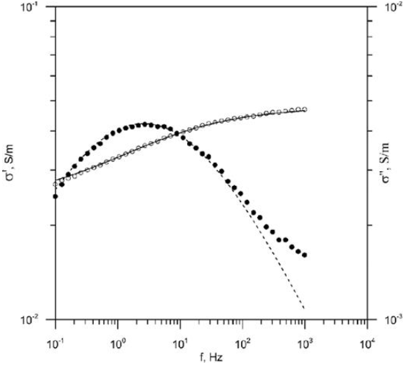
Physical Properties
NAPL
Distance
Biograded
Resistivity↓
IP effect↑
Resistivity↑
Vadose
Zone
Transition
zone
Capillary fringe
Water table
(Abdel Aal et al., 2014)
Saturated
zone
Clay
Sand
(Ahmed et al., 2020)
Phase
Mixture
with clay
Amplitude
Tarasov and Titov, 2013)
Contaminant strongly coupled with electric properties
Amplitude & Phase properties
Different physical properties depends on frequency

Slide 6

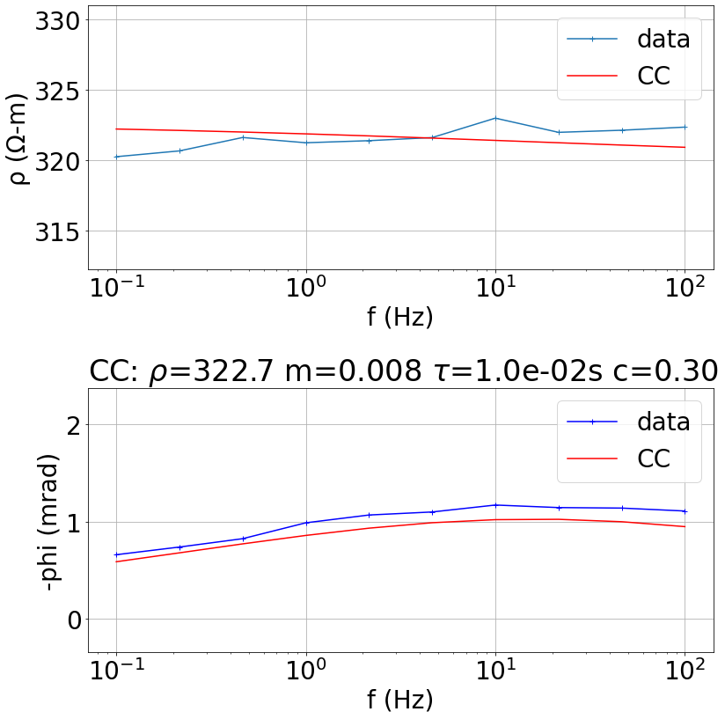
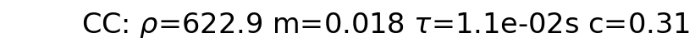
Geophysical properties : Cole-Cole parameters
e.g.
Laboratory result
according to frequency
amplitude
Phase
Fitting model
fitting
amplitude
phase
Extract
Cole-Cole parameter

Slide 7
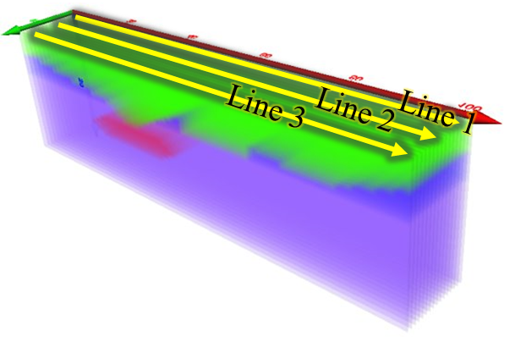

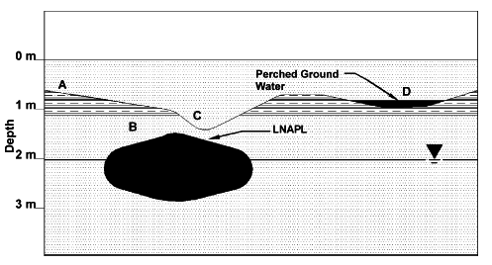
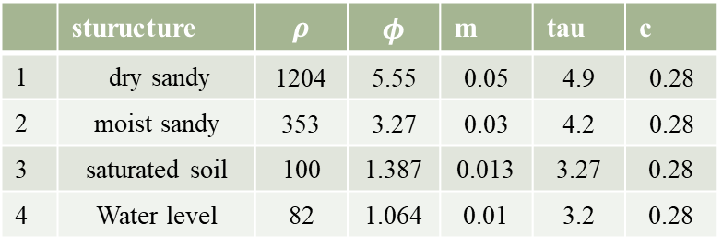
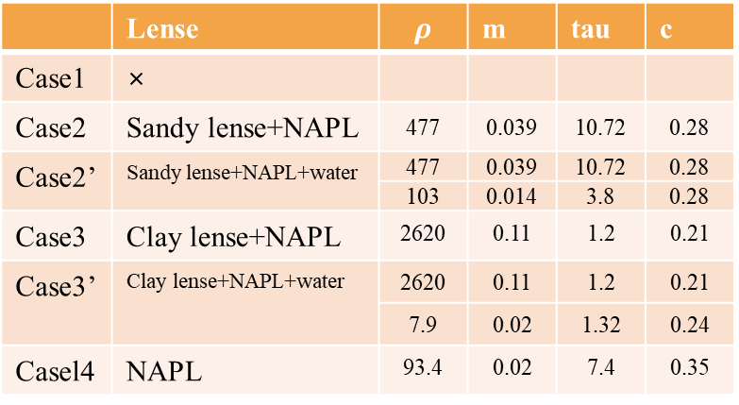
Numerical Model 1 : simple lens
Based model
Constructed model
1
2
3
lense
4
Clay lense
1.0 ~ 2.4 m
 | sturucture | $$ρ$$ | $$φ$$ | m | tau | c
1 | dry sandy | 1204 | 5.55 | 0.05 | 4.9 | 0.28
2 | moist sandy | 353 | 3.27 | 0.03 | 4.2 | 0.28
3 | saturated soil | 100 | 1.387 | 0.013 | 3.27 | 0.28
4 | Water level | 82 | 1.064 | 0.01 | 3.2 | 0.28
(Jordan et al., 2004)
Dry sandy or clayey soil 1 mS/m
Moist sandy : 3 mS/m
Moist clayey soil : 6 mS/m
Saturated soil : 10 mS/m
 | Lense | $$ρ$$ | m | tau | c
Case1 | ×
Case2 | Sandy lense+NAPL | 477 | 0.039 | 10.72 | 0.28
Case2’ | Sandy lense+NAPL+water | 477 | 0.039 | 10.72 | 0.28
 |  | 103 | 0.014 | 3.8 | 0.28
Case3 | Clay lense+NAPL | 2620 | 0.11 | 1.2 | 0.21
Case3’ | Clay lense+NAPL+water | 2620 | 0.11 | 1.2 | 0.21
 |  | 7.9 | 0.02 | 1.32 | 0.24
Casel4 | NAPL | 93.4 | 0.02 | 7.4 | 0.35
Depends on the existence of groundwater
x×y×z : 50×28×3.4 [m]
Array : dipole-dipole
Pole interval : 2.0 m
N-unit : 13
3 profile interval : 4 m
Notes:
Jordan et al.이 수행한 수치 실험을 기반으로 CR, SIP, TDIP에 대한 모델을 구성하였다.
Clay lense가 존재하는 경우
기존 모델과 달리, lense가 채워진 매질의 종류를 sand와 clay를 가정한 모델과 함께, NAPL 오염원이 가해졌을 때의 모델을 구성하였으며
이 모델들이 지하수위가 상승하거나 하강했을 때 지지하수이와 잔류하는 NAPL 의 영향을 분석하고자 하였다.
물성은 각 매질의 실험값과 colecole model fittin을 이용하여 설정하였다.

Slide 8
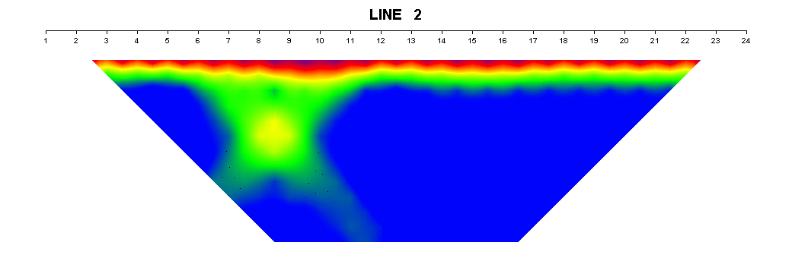
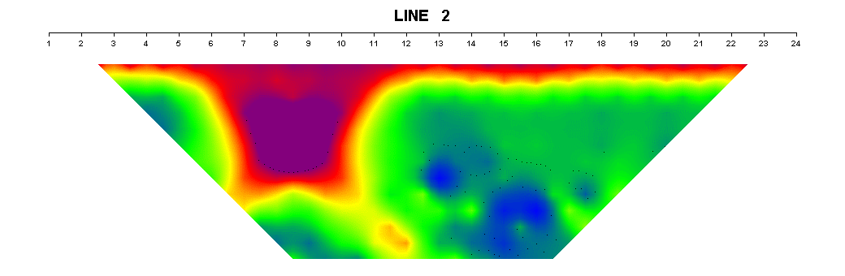
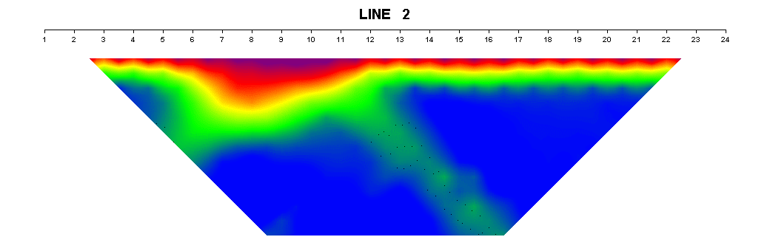
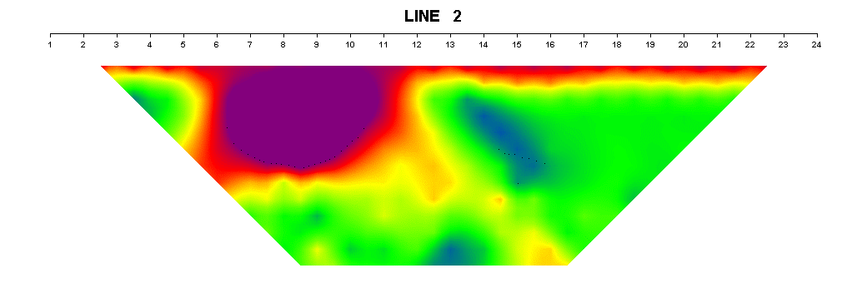
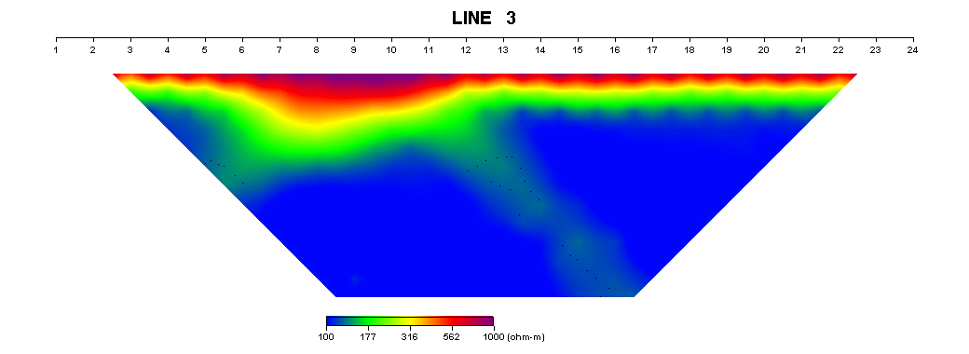
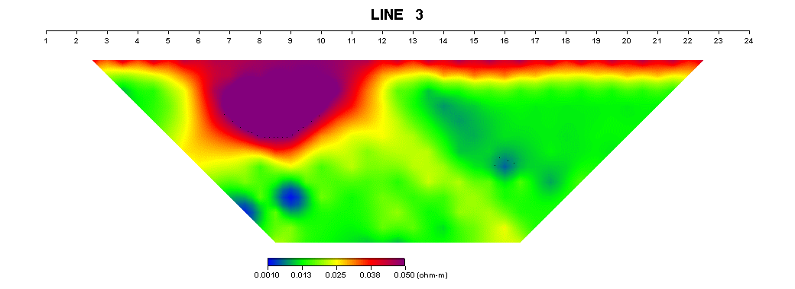
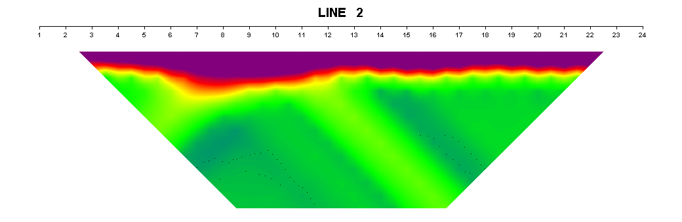
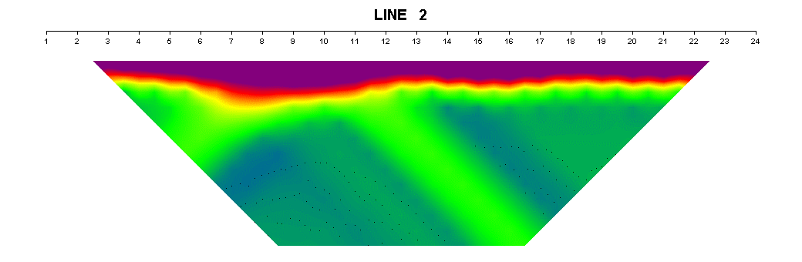
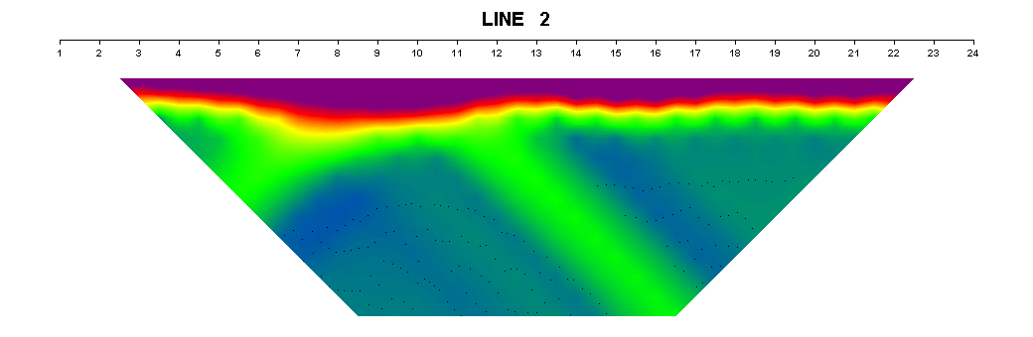
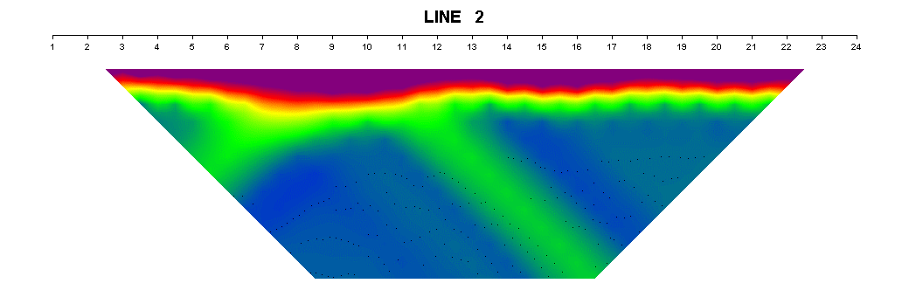
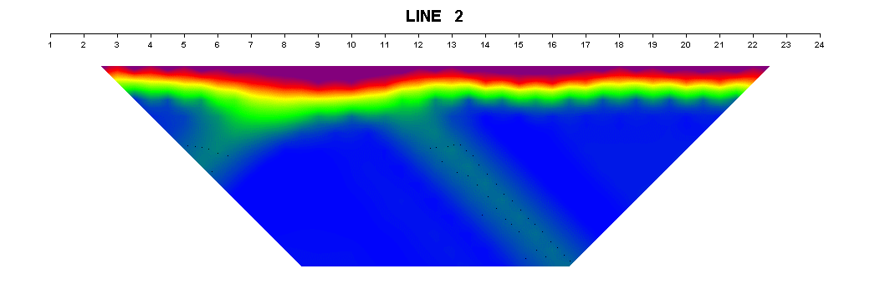
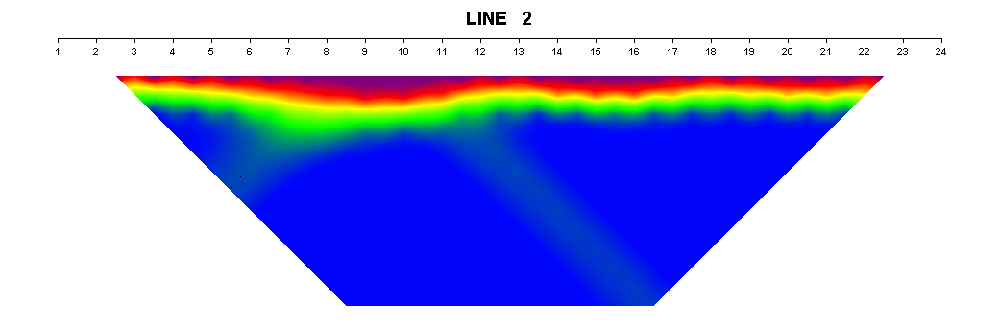
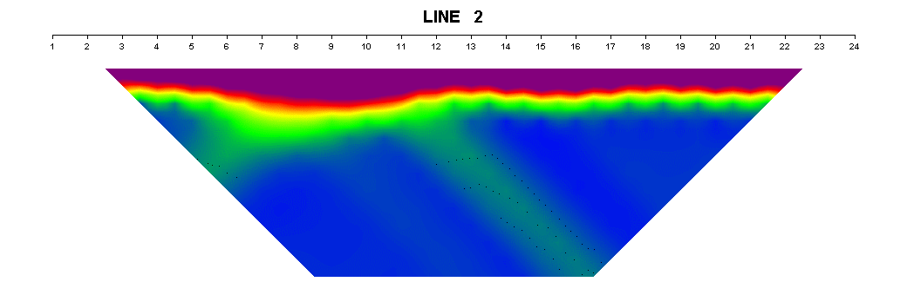
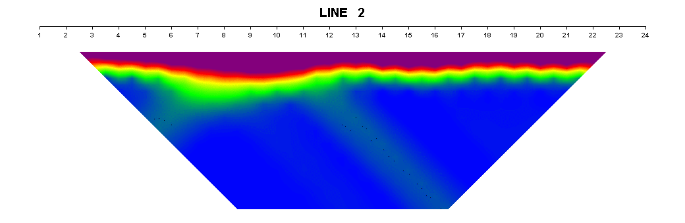

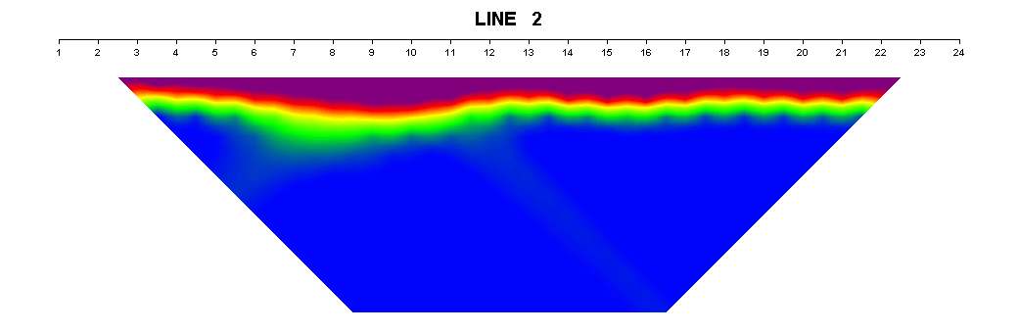
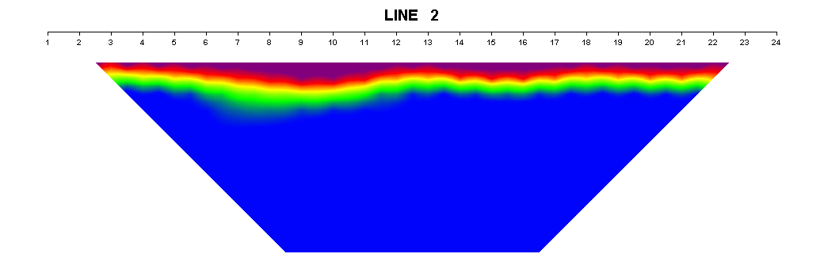
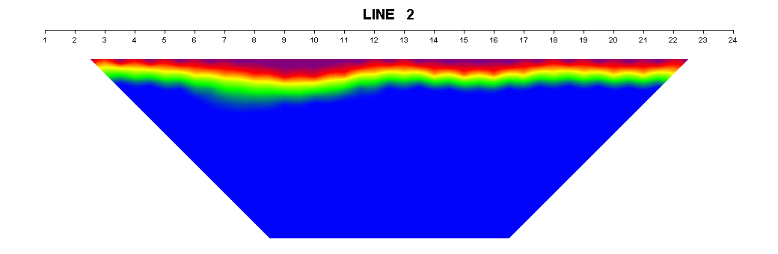
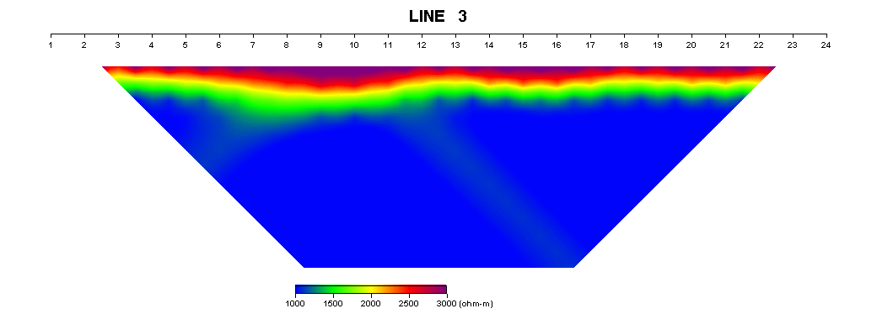
Result
1
2
3
lense
4
Time-domain
: Case 3 & 3’ (Clay lens+NAPL)
amplitude
Chargeability
amplitude
Chargeability
Watertable
Watertable X
When, water table ➔ Focusing to lense
SIP
: Case 2 & 2’ (Sand lens+NAPL)
[Hz]
0.125
0.375
0.625
1
3
5
Case 2
Case 2’
According to frequency, When without watertable ➔ Phase deviation ↑

Slide 9
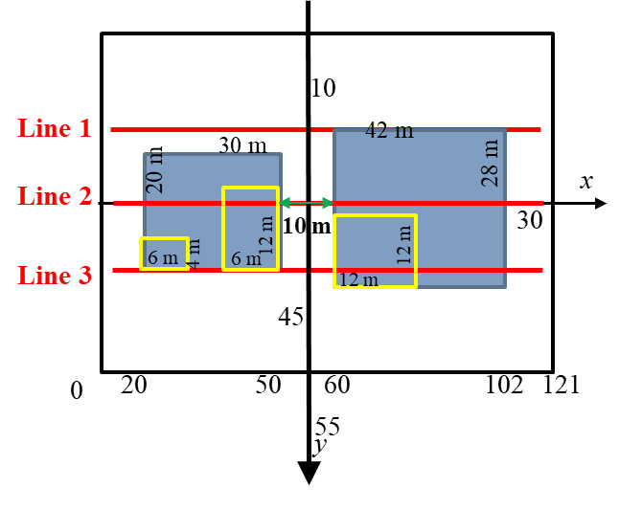
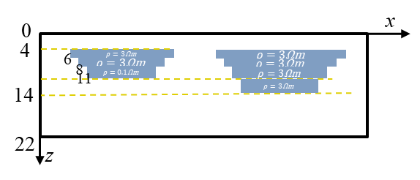
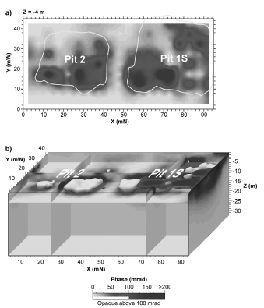
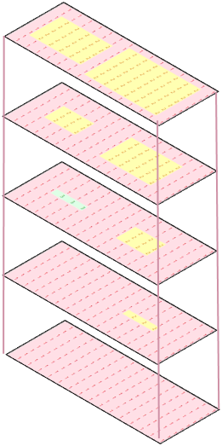
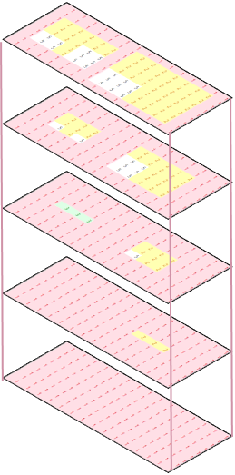
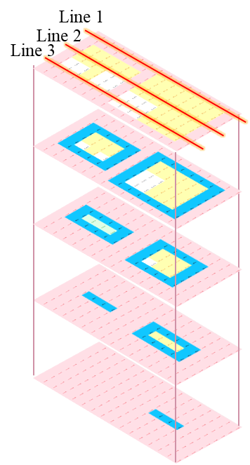

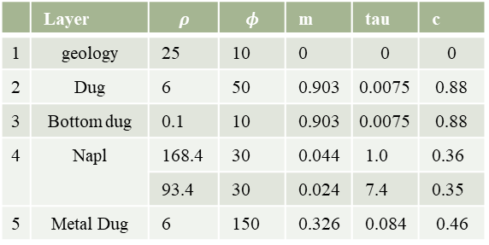
Numerical Model 2 : dug with anomaly
Real Field
Basic model
Aerial photograph
Resistivity tomogram
@0.6 Hz
waste filled
6$Ωm$
x×y×z : 110 ×44 ×20 [m]
Array : dipole-dipole
Pole interval : 4 m
N-unit : 13
3 profile interval : 8 m
Infer geometrics
IP response zone
(Chambers et al., 2005)
Waste stack
- Water level : 2 ~ 5 m
- Benzol, pits piled up with acid tar
- waste from refining oil
- includes oil saturated clay
- waste containing heavy metals
- Array : dipole-dipole
- N-unit : 18
Phase @0.6 Hz
 | Layer | $$ρ$$ | $$φ$$ | m | tau | c
1 | geology | 25 | 10 | 0 | 0 | 0
2 | Dug | 6 | 50 | 0.903 | 0.0075 | 0.88
3 | Bottom dug | 0.1 | 10 | 0.903 | 0.0075 | 0.88
4 | Napl | 168.4 | 30 | 0.044 | 1.0 | 0.36
 |  | 93.4 | 30 | 0.024 | 7.4 | 0.35
5 | Metal Dug | 6 | 150 | 0.326 | 0.084 | 0.46
Case1:dug
Case2:IP contain dug
Case3:NAPL leakage
Case4: degraded NAPL leakage
Notes:
정유 후 발생한 폐기물(waste from refining oil) 을 버렸던 dug임.
환경 복원의 일환으로 정화 작업을 하기 전 오염 정도 파악을 위해 물리탐사를 수행함.
오염 예상 지역 보다 더 넓고 깊은 지역에서 전기비저항이 낮게 나타남. 유체상체의 NAPL 이 스며든 것으로 보임.
폐기물 중 heavy metal 이 섞여 있어 일부 부분에서 IP 반응이 나타나기도 함.
이 모델을 기반으로, NAPL 이 IP 반응 이상체가 존재하지 않을 때의 leakage 되지 않은 모델, IP 반응 이상체가 있는 모델, NAPL 이 누출 된 모델, 그리고 그 NAPL 이 생분해 됐을 때를 가정한 모델을 구성하였다.
물성은 앞선 방법을 이용하여 실험값을 기반으로 cole-cole equation fitting으로 구한 값을 각각 적용하였다.

Slide 10
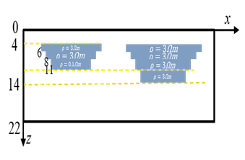
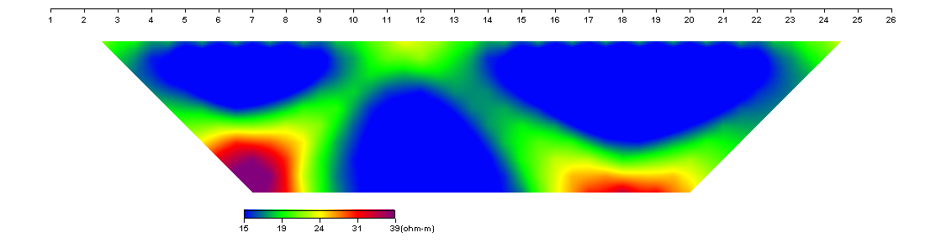
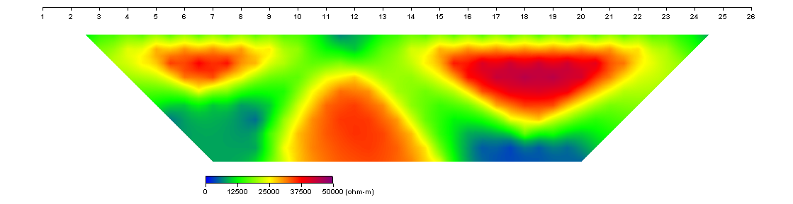
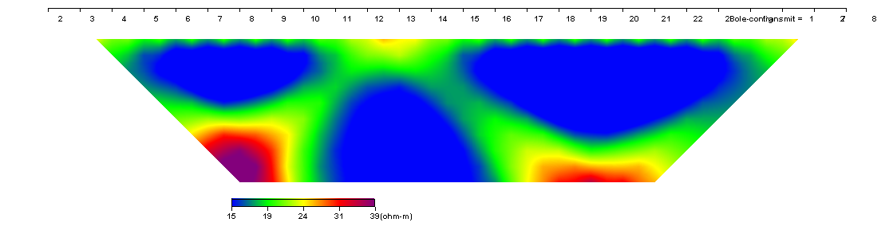
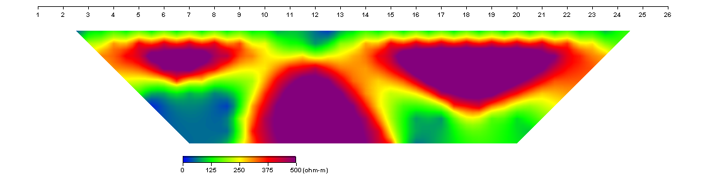
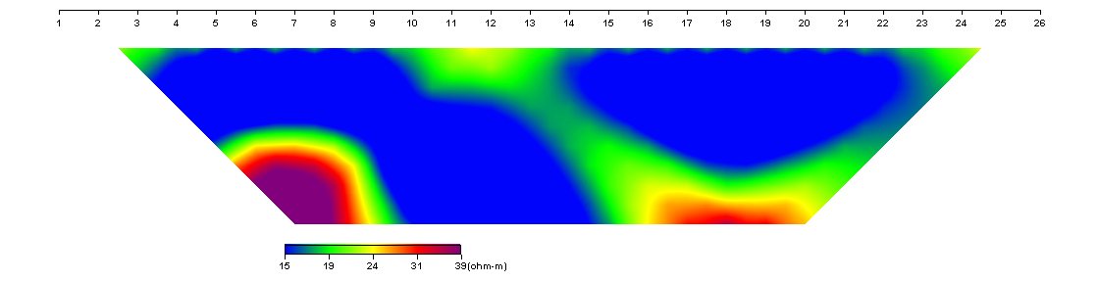
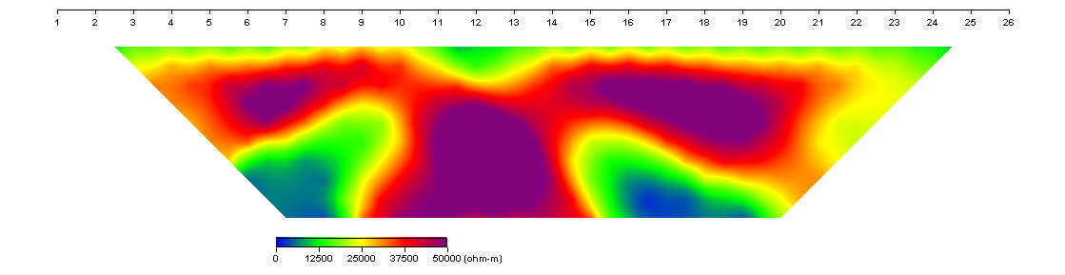























Result
CR
TDIP
Amplitude
Phase
Amplitude
Chargeability
Pseudo
Clear boundary
Clear boundary
ambiguous
High $ρ ($NAPL)
Not so different
Bio-degraded
inversion
Different response
Ambiguous result in pseudo section but, inversion ➔ clear to deviation

Slide 11








Numerical Model3 : internal leakage
Real Field
Basic model
x×y×z : 60×15×15 [m]
Array : dipole-dipole
Pole interval : 1.8 m
N-unit : 15
3profile interval : 4.8 m
3
2
1
Case1:begin leak
Case2: permeate
continental, fluvial, and alluvial sediments
Quaternary alluviums (gravel, sand, and clay)
Groundwater : 161 m ➔ DEEP
ERT : Dipole-dipole
tank
Case3: extend
Case4: biodegraded
(Rosales et al., 2012)
Line 1
WET SEASON
Line 1
DRY SEASON
B | Layer | $$ρ$$ | $$φ$$ | m | tau | c
1 | near surface | 329 | 10 | 0 | 0 | 0
2 | conductive zone | 98.73 | 10 | 0.903 | 0.0075 | 0.88
3 | resistive layer | 416 | 150 | 0.326 | 0.084 | 0.46
4 | NAPL | 168.4 | 30 | 0.044 | 1.0 | 0.36
 |  | 93.4 | 30 | 0.024 | 7.4 | 0.35
Line 2
Line 2
Line 3
Line 3
Geophysical properties
Geological structure > NAPL
Notes:
내부 심겨진 tank에서 NAPL이 누출된 현장 탐사 결과를 기반으로 모델을 구성함.
이 모델은 지하수위가 상당히 깊어 상당히 고비저항의 층서 구조를 가진다.

Slide 12






















Result
CR
Amp
time
Phase
Anomaly response : not react from amplitude but phase
72829
< 74829
Not that so much difference
TDIP
Chargeability
Not that so much different in both pseudo section and inversion
➔ hard to figure out contamination
Pseudo
mV/m
inversion
time
mV/m
Notes:
모델 변화에 따른 complex resistivity에서 진폭은 이상체의 반응이 크지 않은 반면, 위상은 이상체가 존재하는 영역에서 위상 이상이 나타났다.
하지만 오염원의 크기가 다르더라도 그 차이는 크지 않은 것으로 평가된다.
선형 TDIP는 pseudo section에서 오염원에 대한 반응이 크게 나타나지 않았지만, 역산 결과에서 모델링보다 그 변화가 더 적게 나타났다.
따라서 물성이 오염원보다 더 큰 지질구조를 가진 경우 오염원을 탐사하는 데 한계가 있음을 짐작할 수 있다.

Slide 13












Numerical Model 4 : complicate geology model
Real Field
model
SIP & TDIP
# of profile : 9
Annual profile length : 90 m
parallel 2.5 m interval
Pole-dipole
Pole interval : 2.5 m
leakage
extension
time
- NAPL
4
1
- Spread @ 5.5 m depth
3
2
NAPL
Mid-biodegradation
Resistivity
-Phase
3 survey profile
Array : dipole-dipole
Pole distance:2.5&5m
N-unit : 13
3 profile interval : 2.5m
A
Degraded NAPL
Fully biodegradation
C
NAPL Side : less biodegraded
 | Layer | $$ρ$$ | $$φ$$ | m | tau | C
1 | Top soil | 32 | 0 | 0.017 | 0.96 | 0.60
2 | Peat | 8.5 | 2.9 | 0.03 | 0.75 | 0.6
3 | Varved clay | 21 | 0.366 | 0.006 | 0.86 | 0.25
4 | Sandy chalk til | 50 | 1.28 | 0.014 | 0.9 | 0.9
5 | NAPL | 168.4 | 1.28 | 0.044 | 1.0 | 0.36
6 | Degraded NAPL | 93.4 | 1.28 | 0.024 | 7.4 | 0.35
7 | NAPL Side | 50 | 4.66 | 1.06 | 0.9 | 0.63
NAPL
NAPL
G
Resistivity : low at NAPL zone
Phase : low at side of NAPL

Slide 14







































Result
SIP
Line 3
Mid-biodegradation
Pole : 2.5 m
Resolution : 5 > 2.5
2.5 m : anomaly
5 m : anomaly
& structure
Pole : 5 m
Only for anomaly :
➔interval 2.5 m
fully biodegradation
Pole : 2.5 m
side
Pole : 5 m
Wide spread NAPL
Coexist biodegradaed or not
Misidentify 2 anomaly
Time-domain
time
structure
Spread NAPL
Mid
fully
Not so differ according to dipole interval
Existence of NAPL ➔ clear
Amp
$$Ω^{−}m$$
Variation according to model
➔ amplitude < chargeability
Charg
$$mV/m$$

Slide 15
Conclusion
Consideration for geophysical survey in contaminated zone
Electrode distance :
longer ➔ high sensitivity
shorter ➔ when physical properties contrasting : anomaly cognition ↑00
Not only resistivity, but also chargeability, phase
➔ TDIP & CR & SIP gives various information
When, geological structure much higher or lower electrical properties
➔ short to recognize anomaly
Check pseudo & inversion procedure is necessary
➔ special case, one of both shows anomalous information
Future work
Simulate other geophysics method(e.g. GPR, seismic) to get structural result
Suggest various condition, case ➔ for predict what’s going forward

Slide 16
Thank you for attention ^0^

