Slide 1
A Numerically-integrated Approach of Residential Flood Loss Estimation at Community Level
Rubayet Bin Mostafiz
Department of Oceanography & Coastal Sciences
School of the Cost & Environment
Louisiana State University (LSU)

Slide 2
Background
Flood is one of the most devastating hazards worldwide.
Many flood loss assessment methodologies exist.
Building inventory, flood depth grid and depth-damage function (DDFs) are basic components for calculating flood damage.
Generally, most models calculate the building and content loss.

Slide 3
Objectives
Calculate average annual loss (AAL) of flood at community scale for different occupant-types (i.e., homeowners vs. landlords vs. tenants)
Estimates the mean reduction of AAL with increasing freeboard for different occupant-types
Recommend the optimal freeboard at individual and community scale
Notes:
Freeboard is the elevation of a building's lowest floor above the base flood elevation (BFE). According to the federal government requirement in the USA, every building lowest flood should construct at least in the Base Flood Elevation, which is equal to 100-year flood depth.

Slide 4
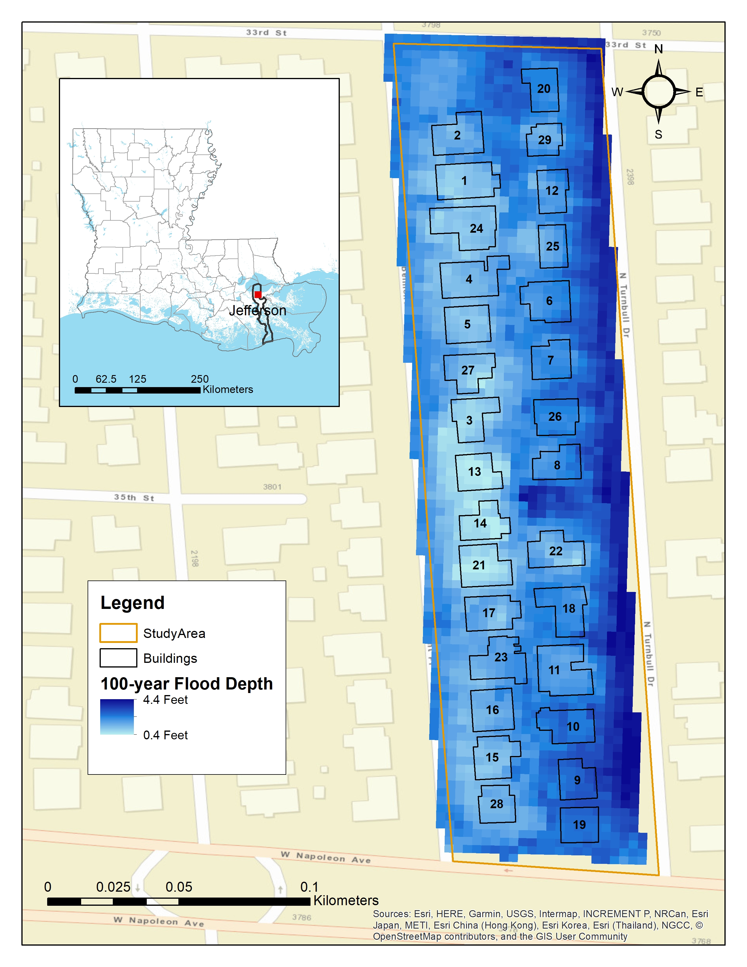
Study Area
Census block 220510220012004, in Metairie, Louisiana, U.S.A
Severe flooding and populated
Multiple return periods flood depths
Diverse in respects to flood depth in structure and building characteristics

Slide 5
Data
Number of stories
Basement existence
Square footage area (A)
Unit area repair cost (CR) (in USD/sf)
Multiple return period flood depths
Depth-damage functions (DDFs)
USACE (2000) mean depth damage function for one-story, no-basement residential building

Slide 6
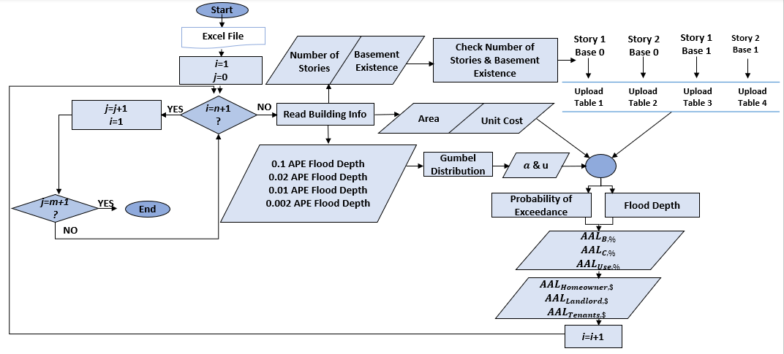
Methodology
Step 1
Upload input data (Excel File):
Step 2
Read building information
Step 3
Calculate flood depth & probability of exceedance
Flood depth- Return periods 2.Cost price per unit 3.Number of stories 4.Basement existence 5.Area
Step 5
Define DDF
Determine Gumbel distribution parameters
Calculate building, contents, and use risk
Calculate homeowner, landlord, and tenant risk
Step 4
Increase building number by 1
Repeat Step 1 , Step 2, and Step 3
Increase freeboard by 1’
Repeat steps 1,2, 3, and 4
At the end of this step, all the risk calculation for different occupant type is completed at FFH for the whole study area
At the end of this step, all the risk calculation for different occupant type is completed at FFH + freeboard increment (1,2,3,and 4)for the whole study area

Slide 7

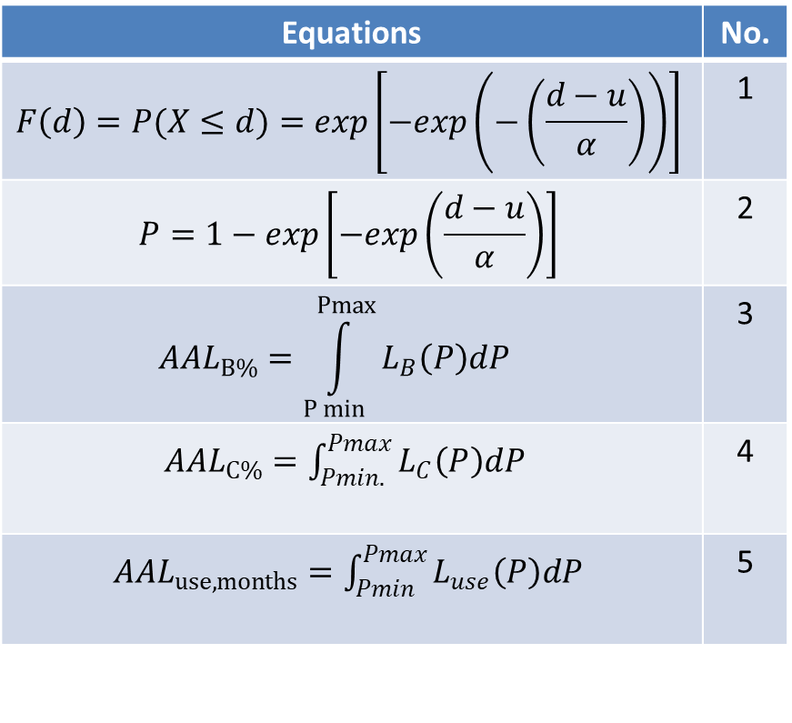
Equations
Equations | No.
$$F\left(d\right)=P(X≤d)=\exp\left[−exp\left(−\left(\frac{d−u}{α}\right)\right)\right]$$ | 1
$$P=1−exp\left[−exp\left(\frac{d−u}{α}\right)\right]$$ | 2
$${AAL}_{B\%}=\int_{P min}^{Pmax}{L_{B}\left(P\right)dP }$$ | 3
${AAL}_{C\%}=\int_{Pmin. }^{Pmax}{L_{C}\left(P\right)dP }$ | 4
${AAL}_{use,months}=\int_{Pmin}^{Pmax}{L_{use}\left(P\right)dP }$ | 5
Gumbel Extreme Value Distribution
Flood depth (y)=u- α *ln(-ln(1-1/return period))
Flood depth-annual exceedance probability relationship

Slide 8
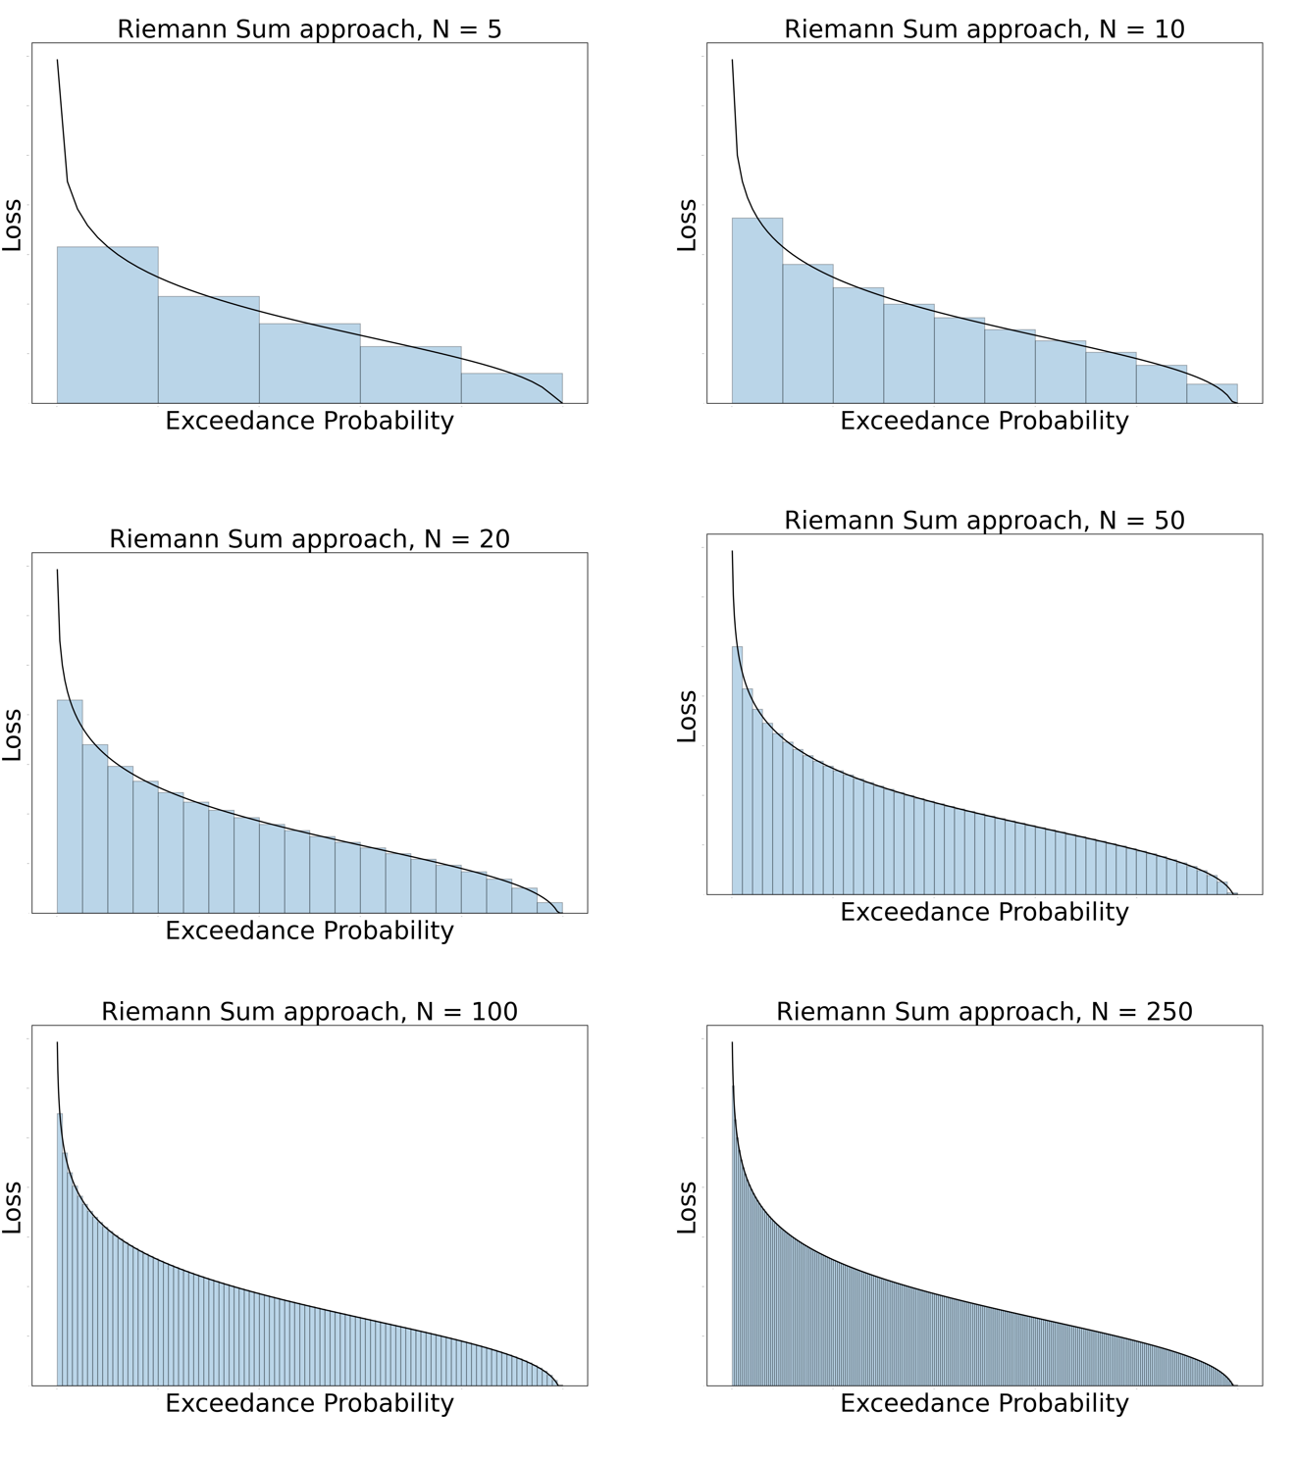
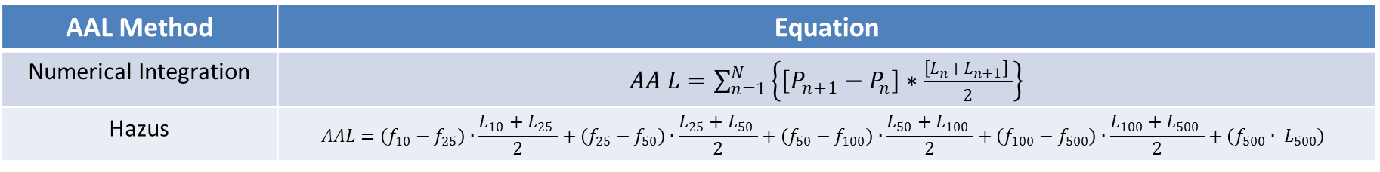
Comparison with Hazus
AAL Method | Equation
Numerical Integration | $AA L=\sum_{n=1}^{N}{\left\{\left[P_{n+1}−P_{n}\right]∗\frac{\left[L_{n}+L_{n+1}\right] }{2}\right\}}$
Hazus | $$AAL=\left(f_{10}−f_{25}\right)∙\frac{L_{10}+L_{25} }{2}+\left(f_{25}−f_{50}\right)∙\frac{L_{25}+L_{50} }{2}+\left(f_{50}−f_{100}\right)∙\frac{L_{50}+L_{100} }{2}+\left(f_{100}−f_{500}\right)∙\frac{L_{100}+L_{500} }{2}+\left(f_{500}{∙ L}_{500}\right)$$
Hazus
Numerical Integration

Slide 9
Results
Building, content, and use AAL at BFE, by building
Building and contents AAL by freeboard increment, as a % of replacement cost
AAL for Building, content, and use by owner-occupant type
${AAL}_{T }$reduction by freeboard increment for owner-occupant type

Slide 10
Summary
AAL decreases substantially with increasing freeboard.
AAL is higher for homeowner than landlord and tenant.
Hazus underestimates the AAL by 13%.
Two foot of freeboard optimizes as it reduced 90% of AAL.
Notes:
Hazus underestimates the AAL by 13% as it didn’t considered flooding below 10-year and above 500-year return period.

Slide 11
Limitations and Future Works
Includes indirect loss and intangible loss
Consider flood insurance
Includes benefits of other mitigation approach
Site specific depth-damage functions
Content loss should be more explicitly considered

Slide 12



Acknowledgements
Co-authors
Ayat Al Assi
LSU
Dr. Carol J. Friedland
LSU Agricultural Center
Dr. Robert V. Rohli
LSU
Md Adilur Rahim
LSU
Funding Source

Slide 13
Thank you!
Rubayet Bin Mostafiz
Department of Oceanography & Coastal Sciences
Louisiana State University
rbinmo1@lsu.edu
https://floodsafehome.lsu.edu/

