Slide 1

Earthworms remodel plant growth-defense trade-off by shaping rhizosphere microbiome
Reporter: Nan Jin
Supervisor: Manqiang Liu
May, 23, 2022
2021203010stu.njau.edu.cn

Slide 2
Report Outline
1
Background
2
Materials and Methods
3
Results
4
Conclusion

Slide 3
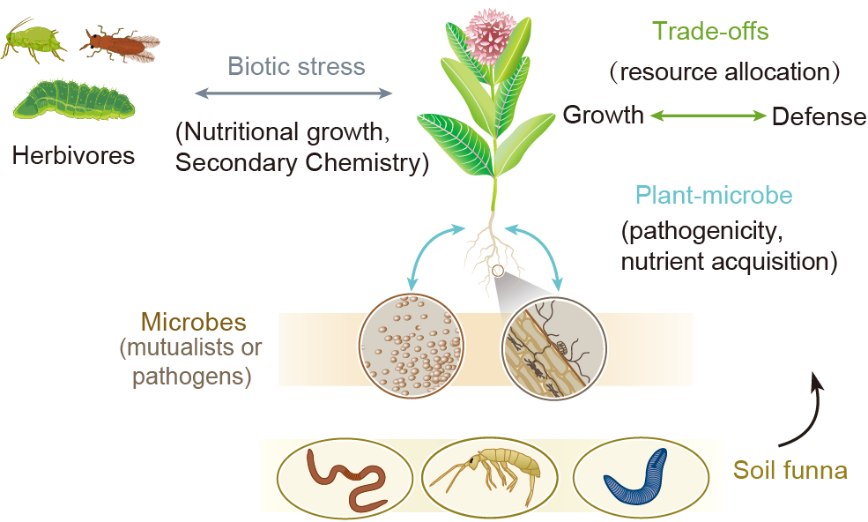

Background
Biotic stress
Resource allocation
Soil microbes
Soil fauna
Plants must integrate various responses to biotic stresses, soil organisms can help them prioritize either growth or defense.
However, the extent to which soil fauna can modulate or even dictate aboveground stress responses remains unknown.
Tobias Z et al., 2017. Annu. Rev. Plant Biol.
Jennifer A et al., 2020. Annu. Rev. Ecol. Evol. Syst.

Slide 4
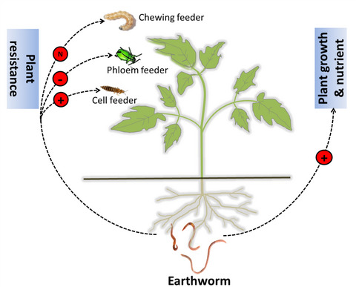
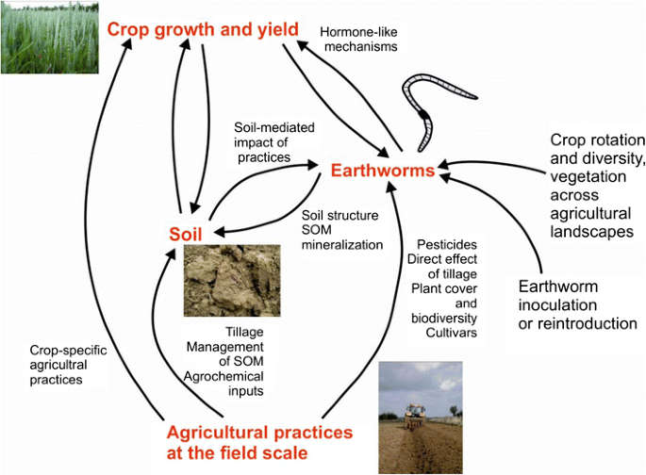
Background
Earthworms are key components of soil and plant health.
Herbivores feeding types - dependent.
What are the molecular and metabolic mechanisms by which earthworm - mediated these variations?
Gruden K et al., 2015. Agronomy for Sustainable Development.
Heinen R et al., 2018. Front Ecol Evol.
Xiao et al., 2018. Funct Ecol.

Slide 5
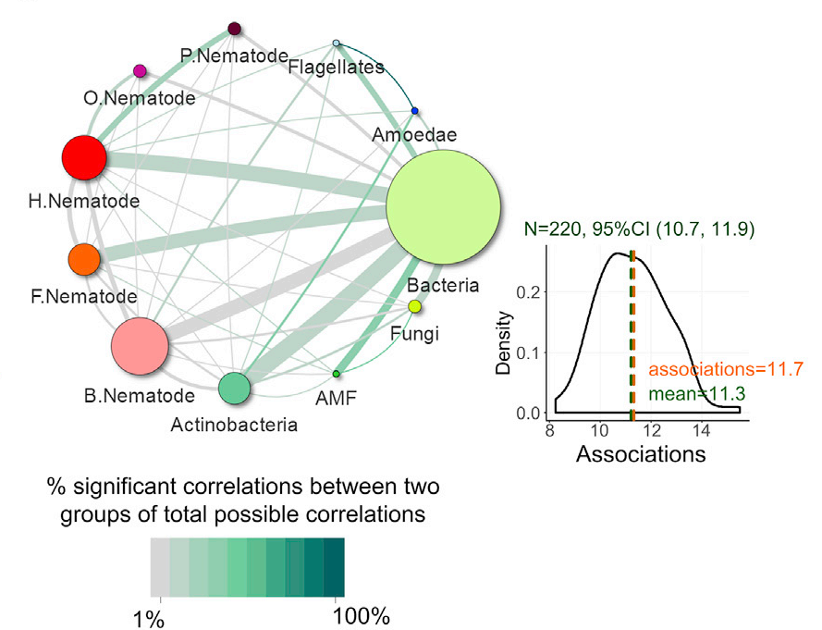
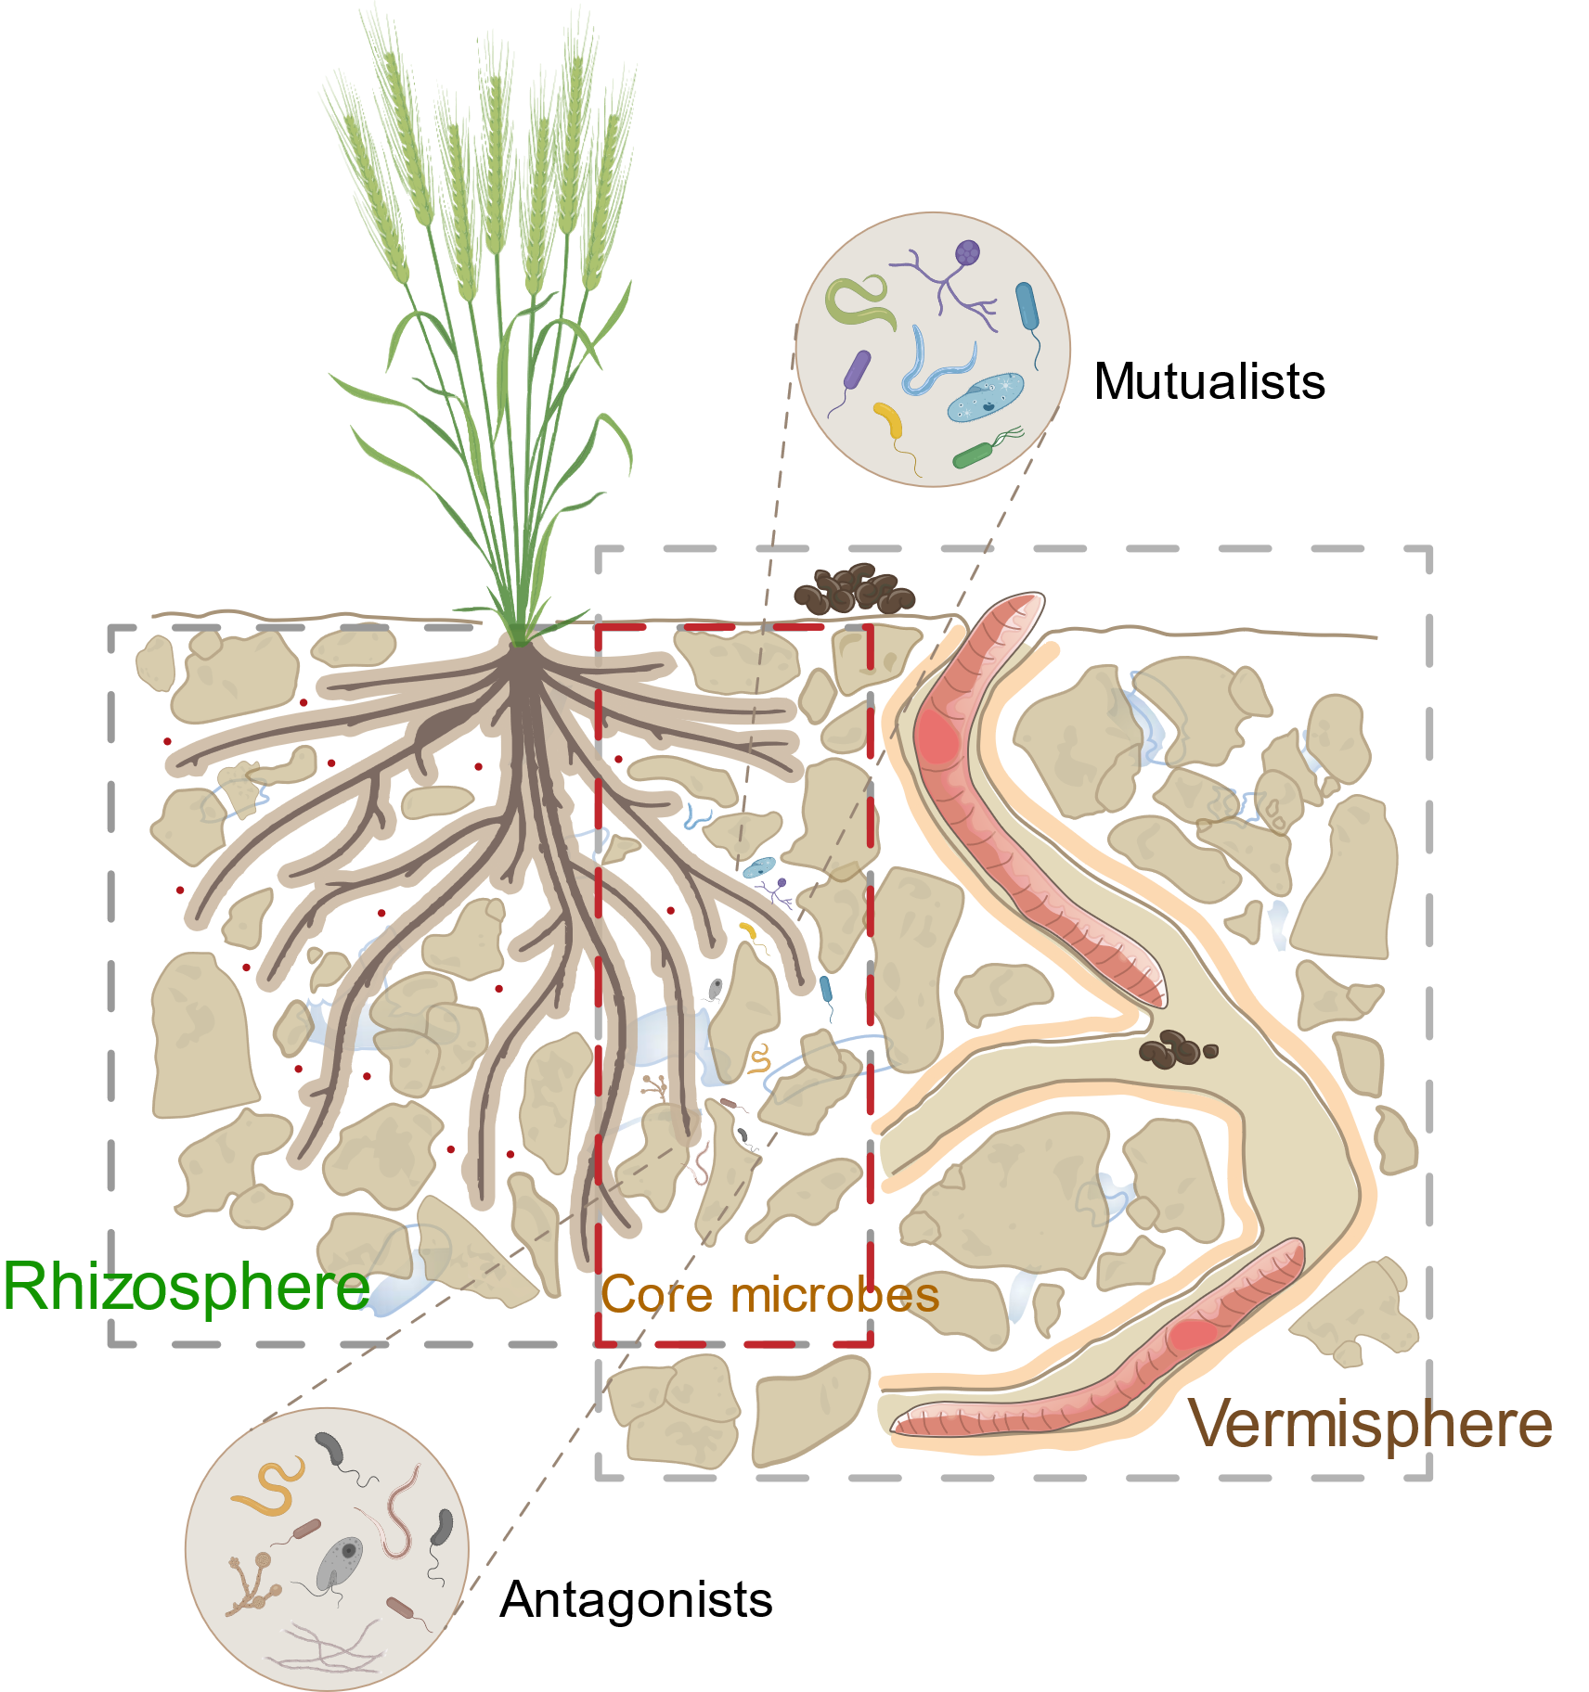
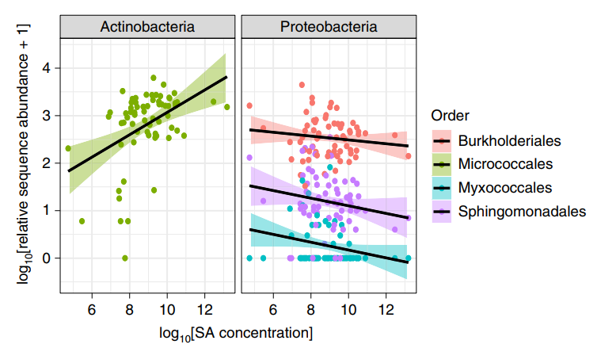
Background
Altered microbiota community composition and its interactions.
The changes of microbes was related to the content of defense hormones.
Earthworm-mediated plant growth is attributed to its influence on soil microbiome.
Whether and how earthworms affect plant growth and defense by driving changes in rhizosphere microbiome?
Liu et al., 2019. Current Biology.
Blundell R et al., 2020. Nature Plants.

Slide 6





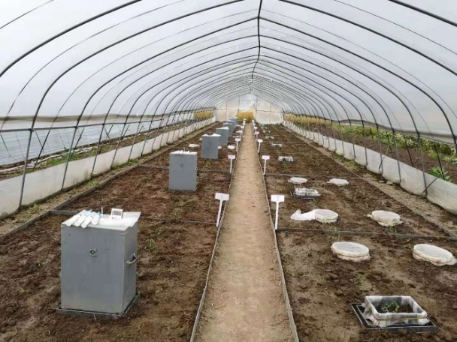


Materials and Methods (field)
Design：2 earthworms× 3 herbivores × 5 replications.
Earthworms：E1 = with earthworms; E0 = no earthworms.
Herbivores：N = No herbivores; W = Thrips; A = Aphids.
N
W
A
40 cm
E0
30 cm
×
E1
Main plot：7.1 m²
Fertilize：60% N
5×6 = 30 Split plot

Slide 7


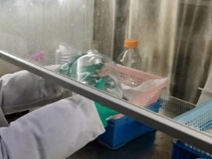
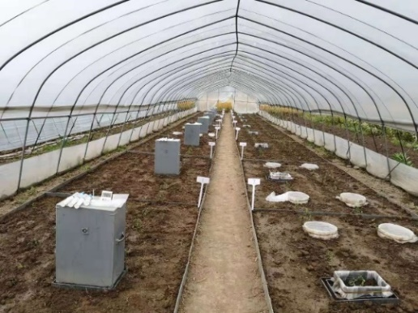



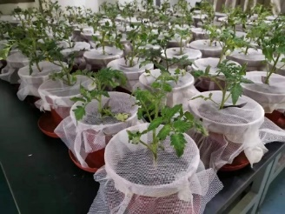

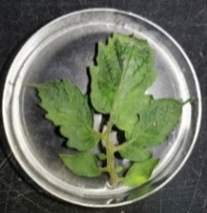
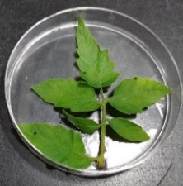

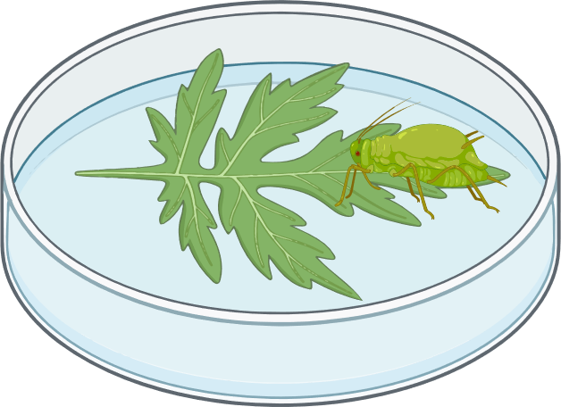
Materials and Methods (microcosm)
Design：2 Conditions × 2 Inoculums × 5 Replications.
Conditions：-E = Tomato without earthworms soil; +E = Tomato with earthworms soil.
Inoculums：Obtaining soil inoculum with (E inoculum) and without (No-E inoculum)
earthworms, respectively.
- Earthworms
+ Earthworms
Sterilization leaching
Greenhouse
No-E inoculum
×
Growth period
Detached-leaf
E inoculum
Sterilized soil
Soil inoculum (5%)
Peach aphids
Bean aphids

Slide 8
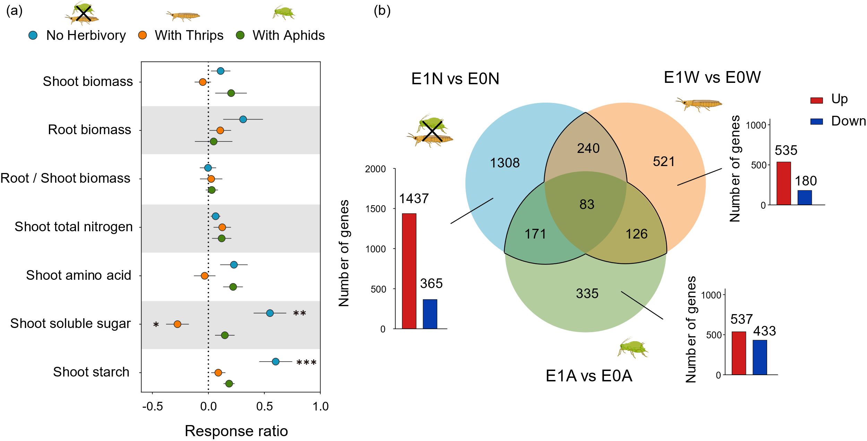
Results - Earthworm-induced metabolic and transcriptional reprogramming in shoots.
Earthworms regulated metabolic and transcriptome responses of plant leaves and most genes are up-regulated.

Slide 9
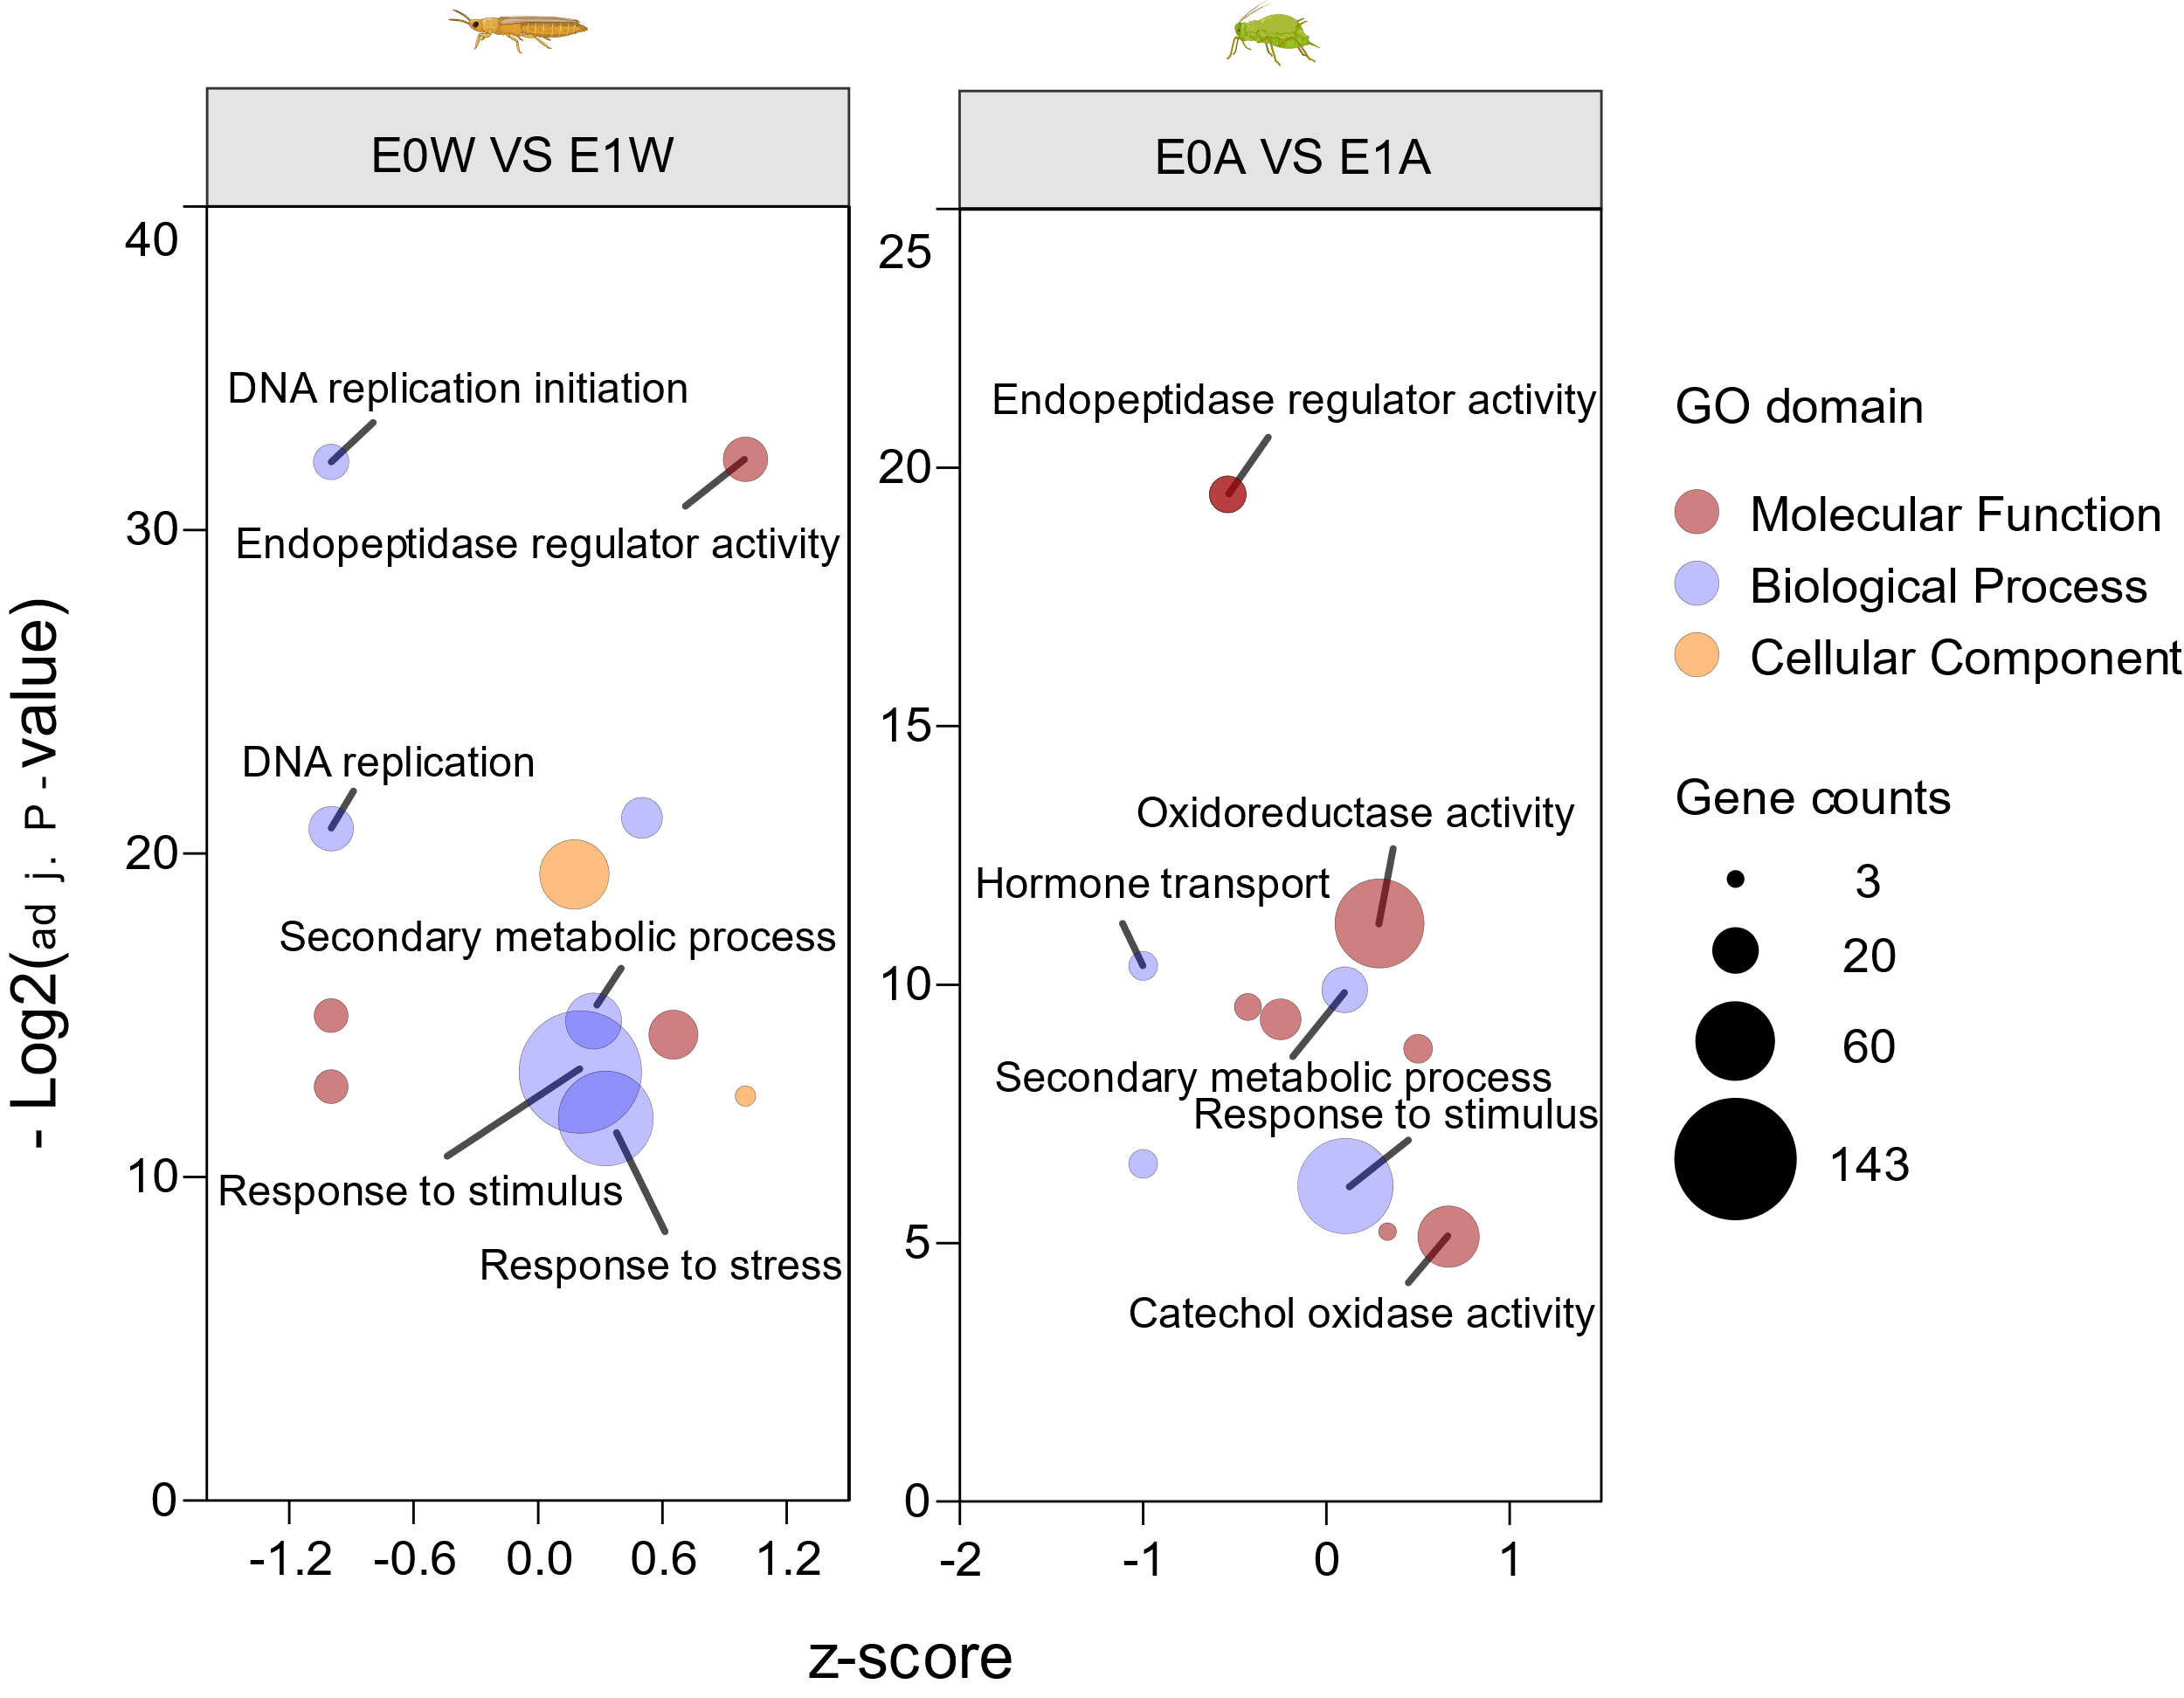

Results - Earthworm-induced metabolic and transcriptional reprogramming in shoots.
GO (Top 12) enrichment:
Earthworms reprogramming plant shoot growth and defense related GO terms enrichment under different herbivores attack.

Slide 10
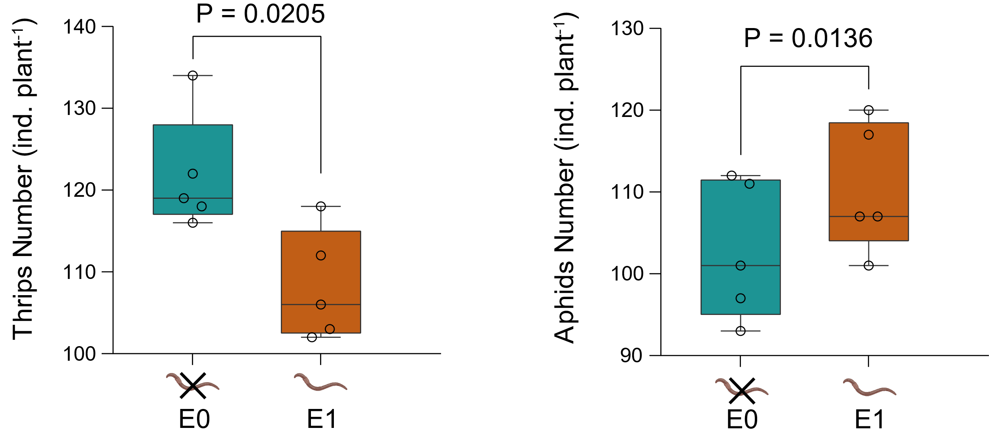
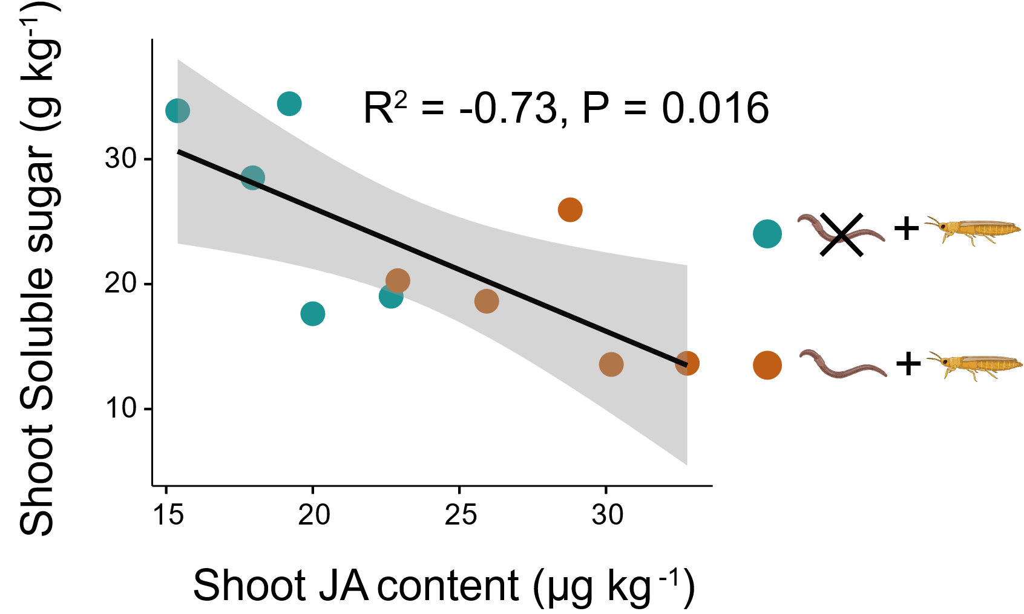

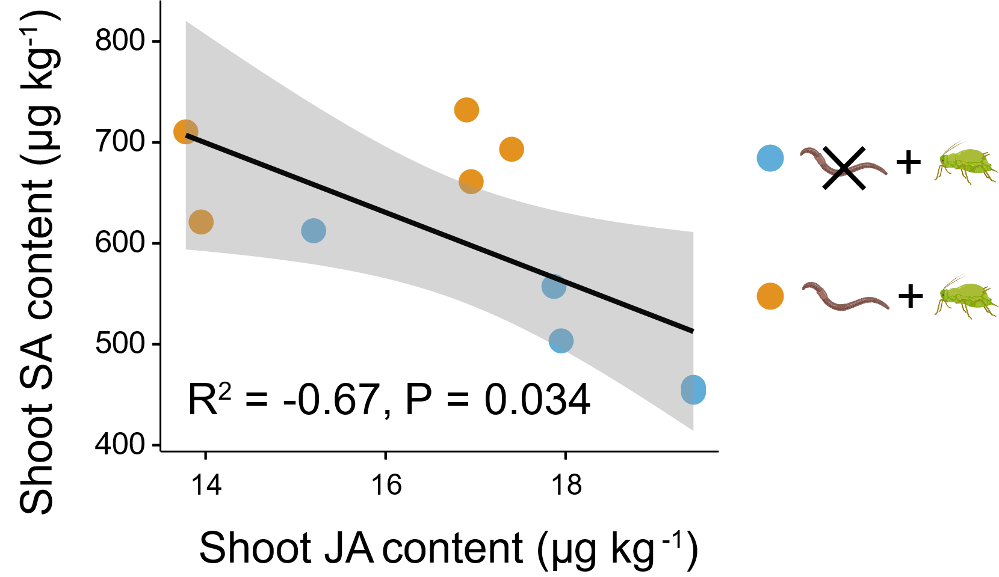
Results - Earthworms remodel plant growth-defense trade-off strategies under different herbivores attack.
Thrips: Resource – cost model.
Aphids: Hormone antagonism model.

Slide 11
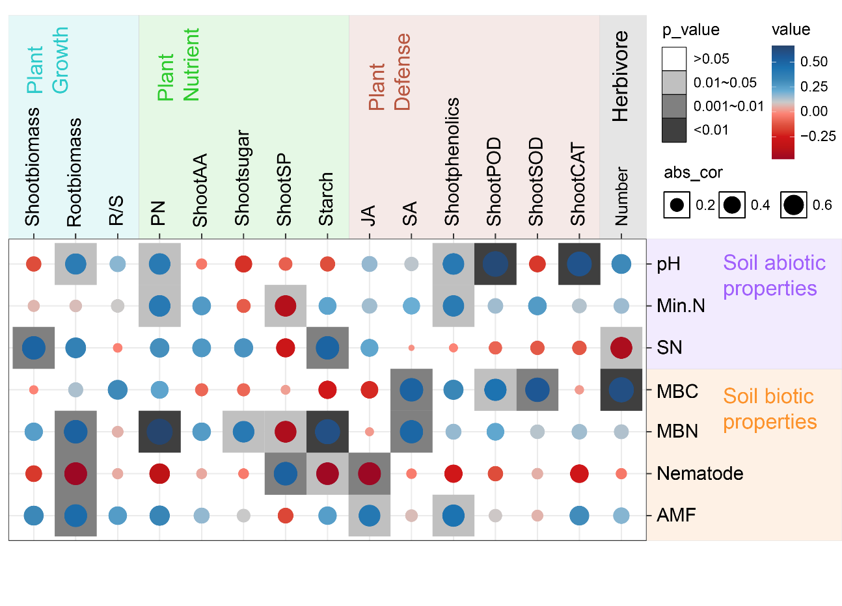
Results - Earthworm-induced relationships of soil biotic and abiotic properties to plant and herbivores traits.
Earthworms significantly altered soil biotic and abiotic properties, improvements in soil biotic properties are more correlated with plant and herbivores performance.

Slide 12
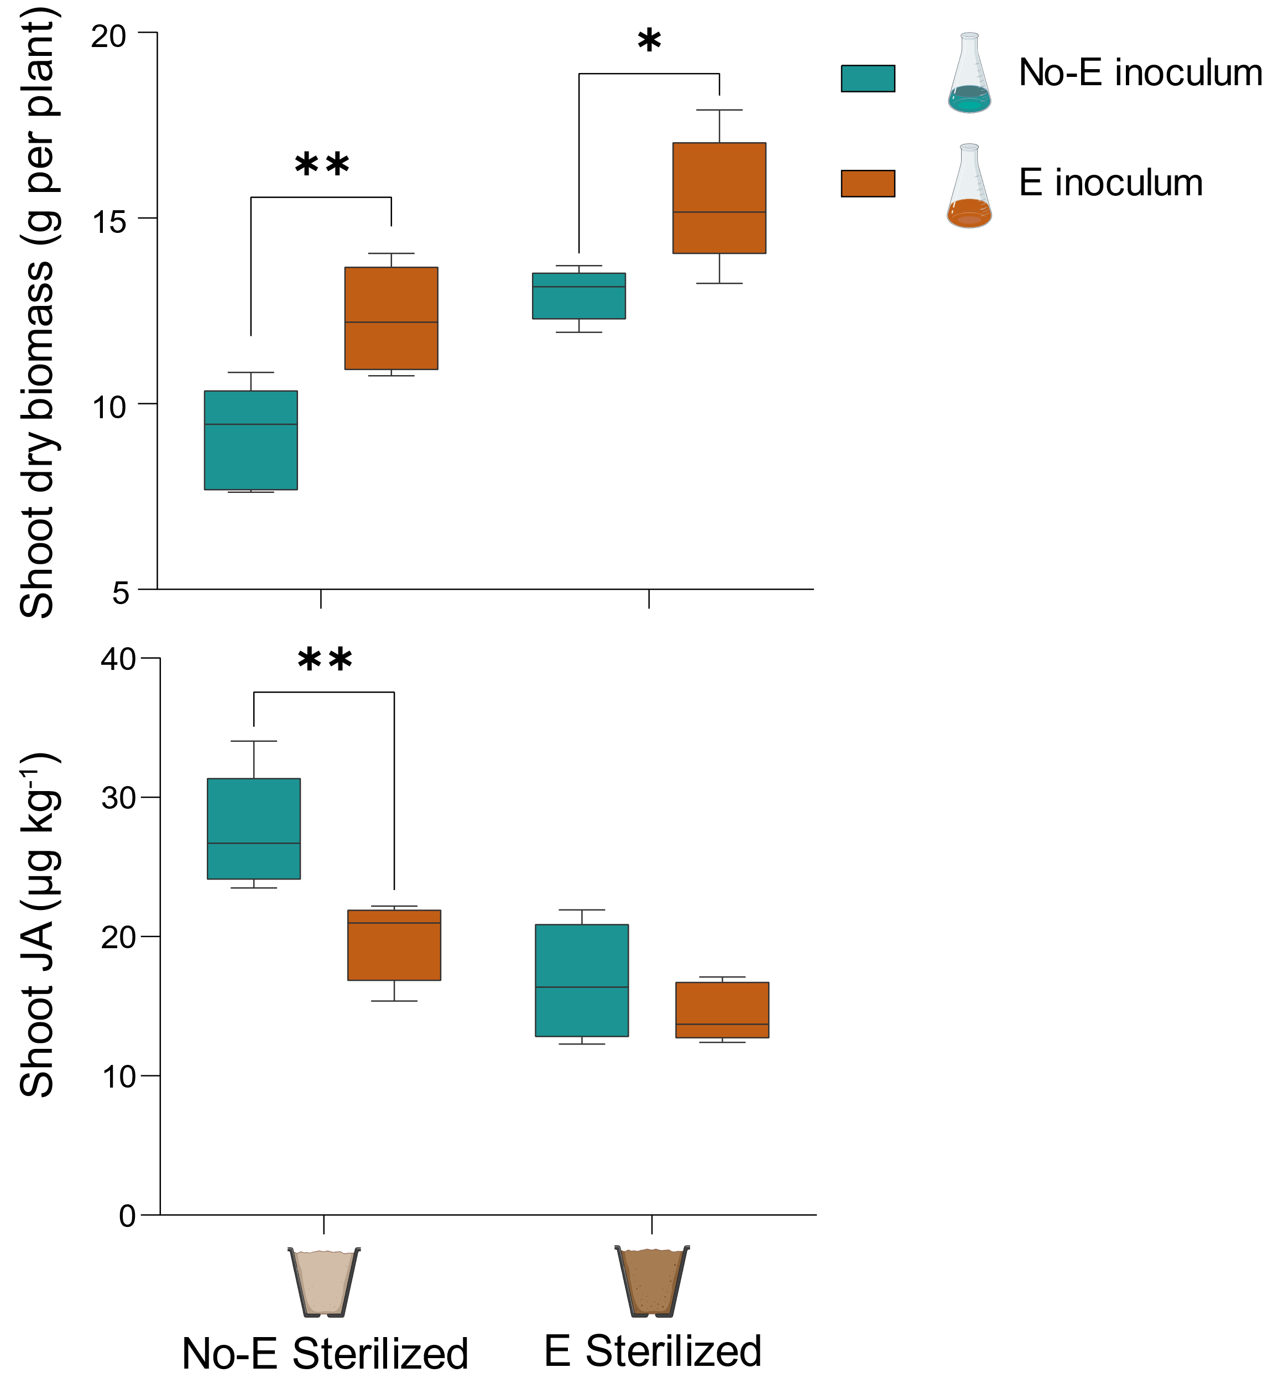


Results - Rhizosphere microbiota shifts by earthworms affecting plant performance.
- Earthworms
+ Earthworms
No-E inoculum
×
E inoculum
Sterilized soil
Soil inoculum (5%)
Earthworm inoculum promoted the accumulation of aboveground biomass, but decreased JA content in plant shoot.

Slide 13
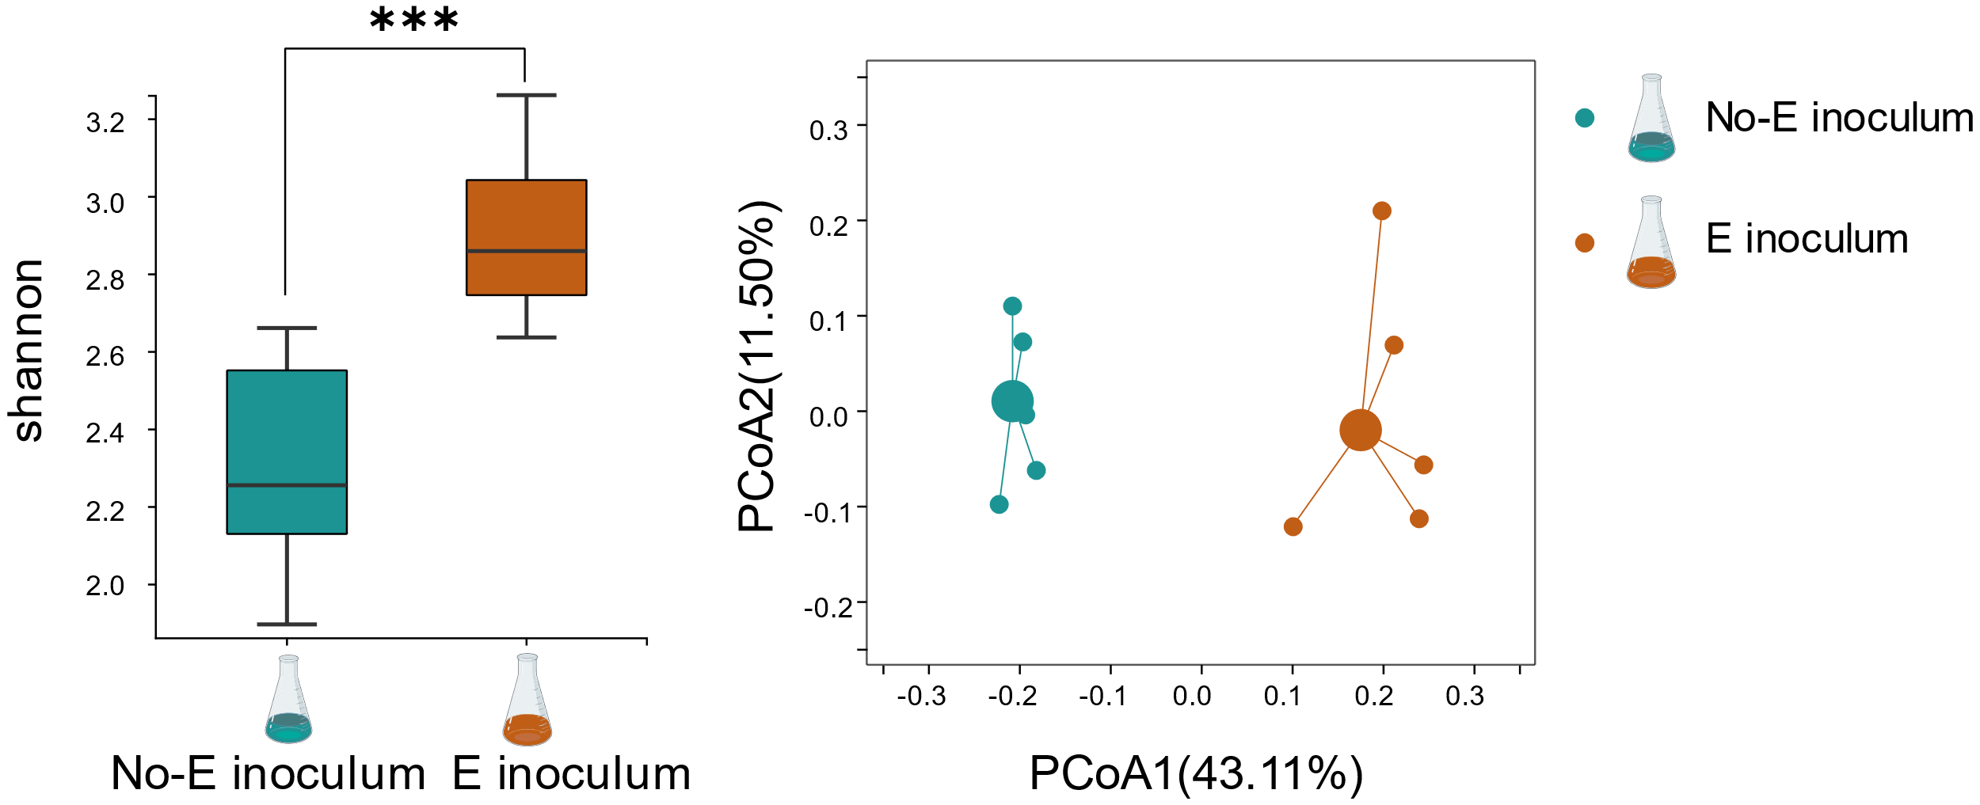

Results - Earthworm-induced growth over defense by altering core rhizosphere microbiome assembly.
Diversity
Composition
Rhizosphere microbiome communities were more diverse under Earthworm inoculum than without earthworm inoculum, and microbiome communities of the two inoculations were significantly different.

Slide 14
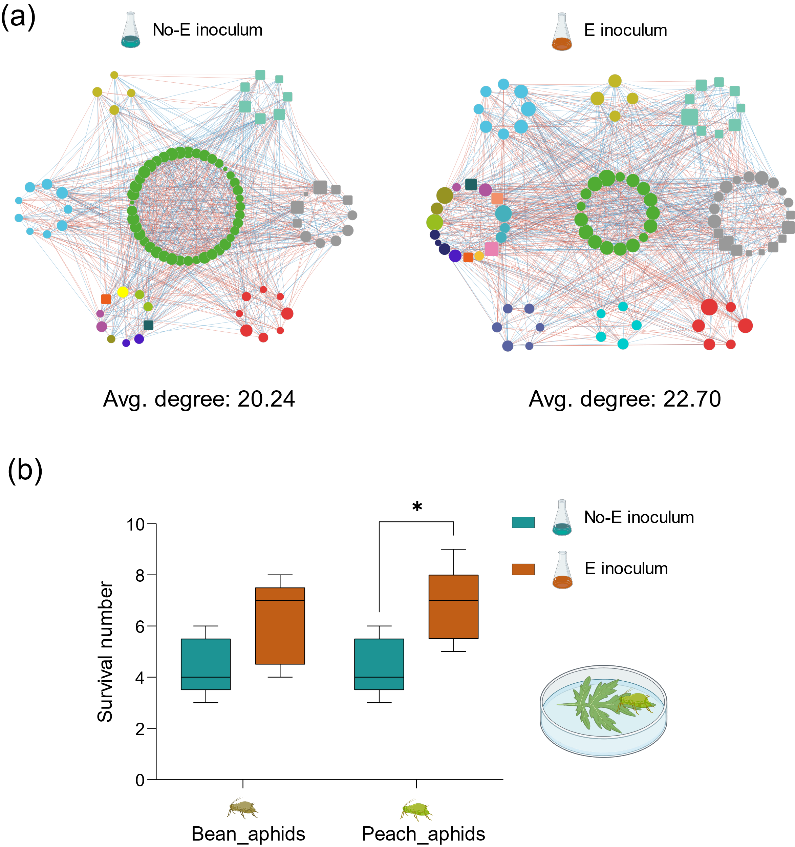
Results - Earthworm-induced growth over defense by altering core rhizosphere microbiome assembly.
Earthworm inoculum enhanced interactions between core microbiome in rhizosphere compared to No-earthworm inoculum, ultimately sensitizing plants to aphids attack.

Slide 15
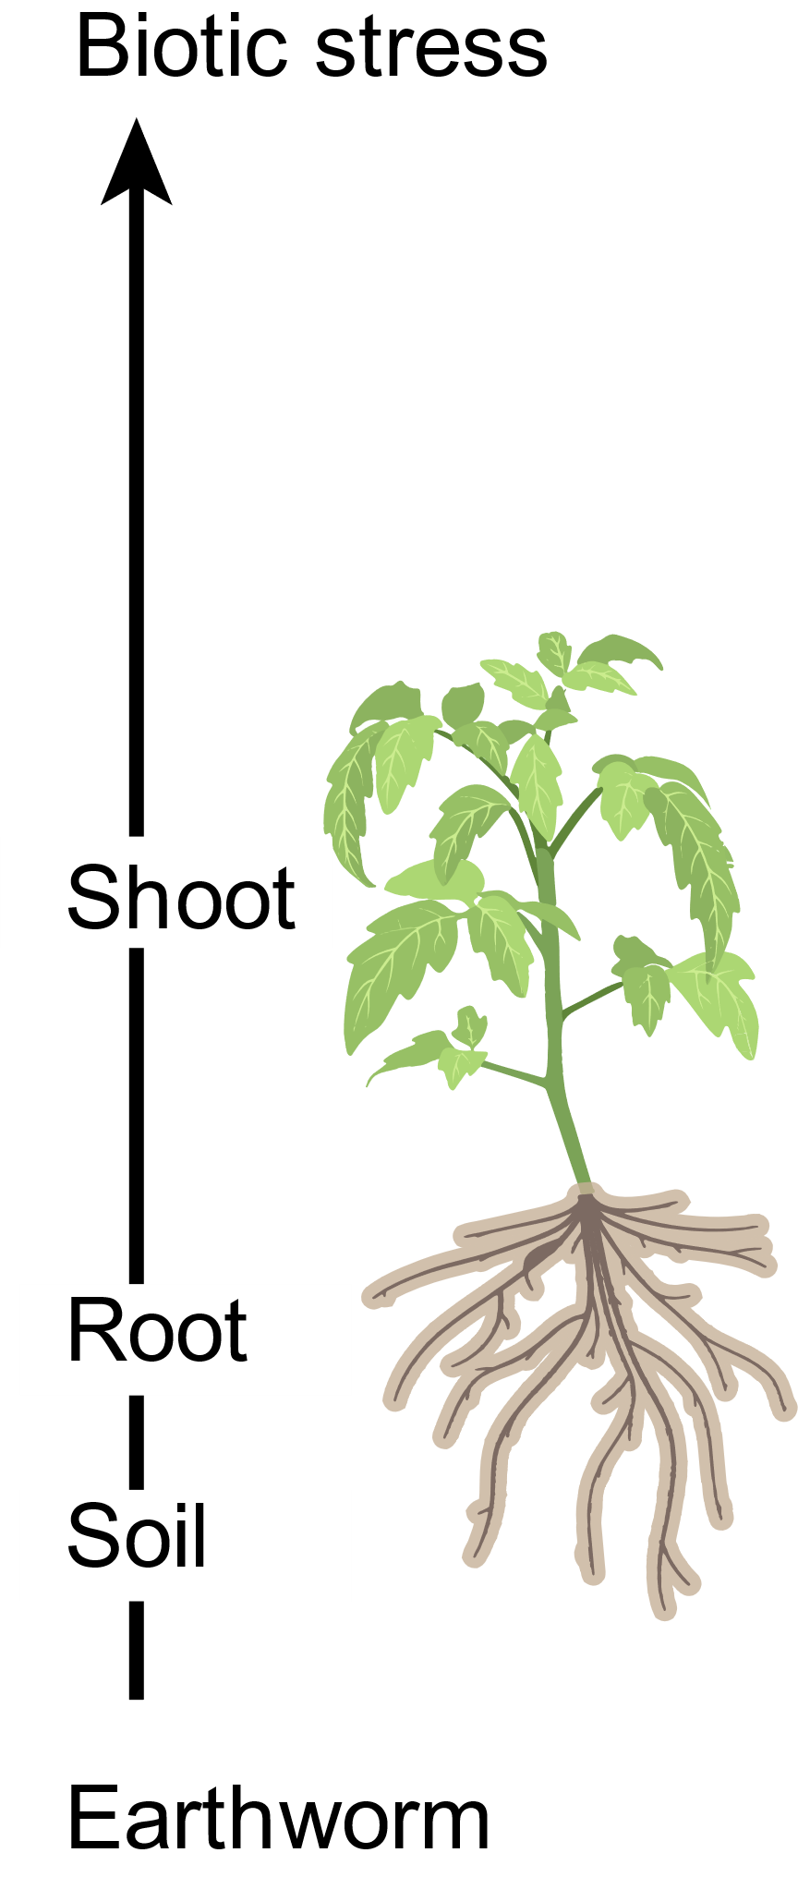
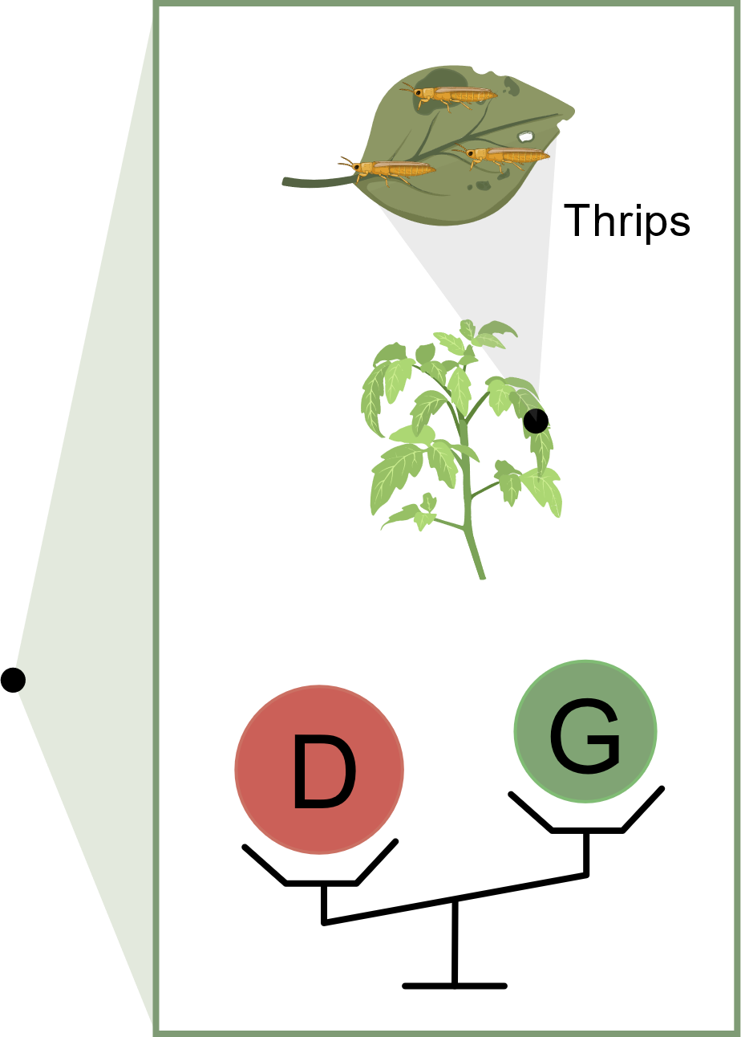
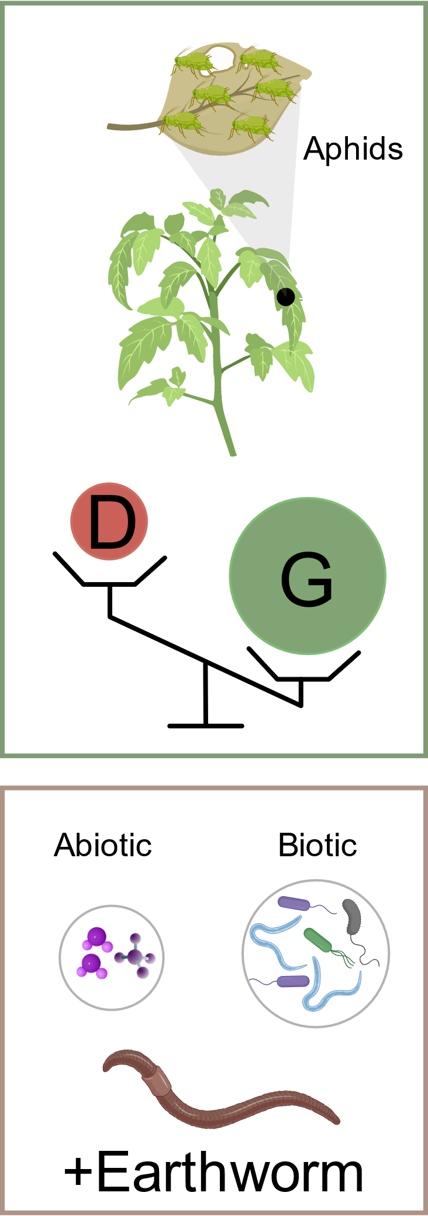
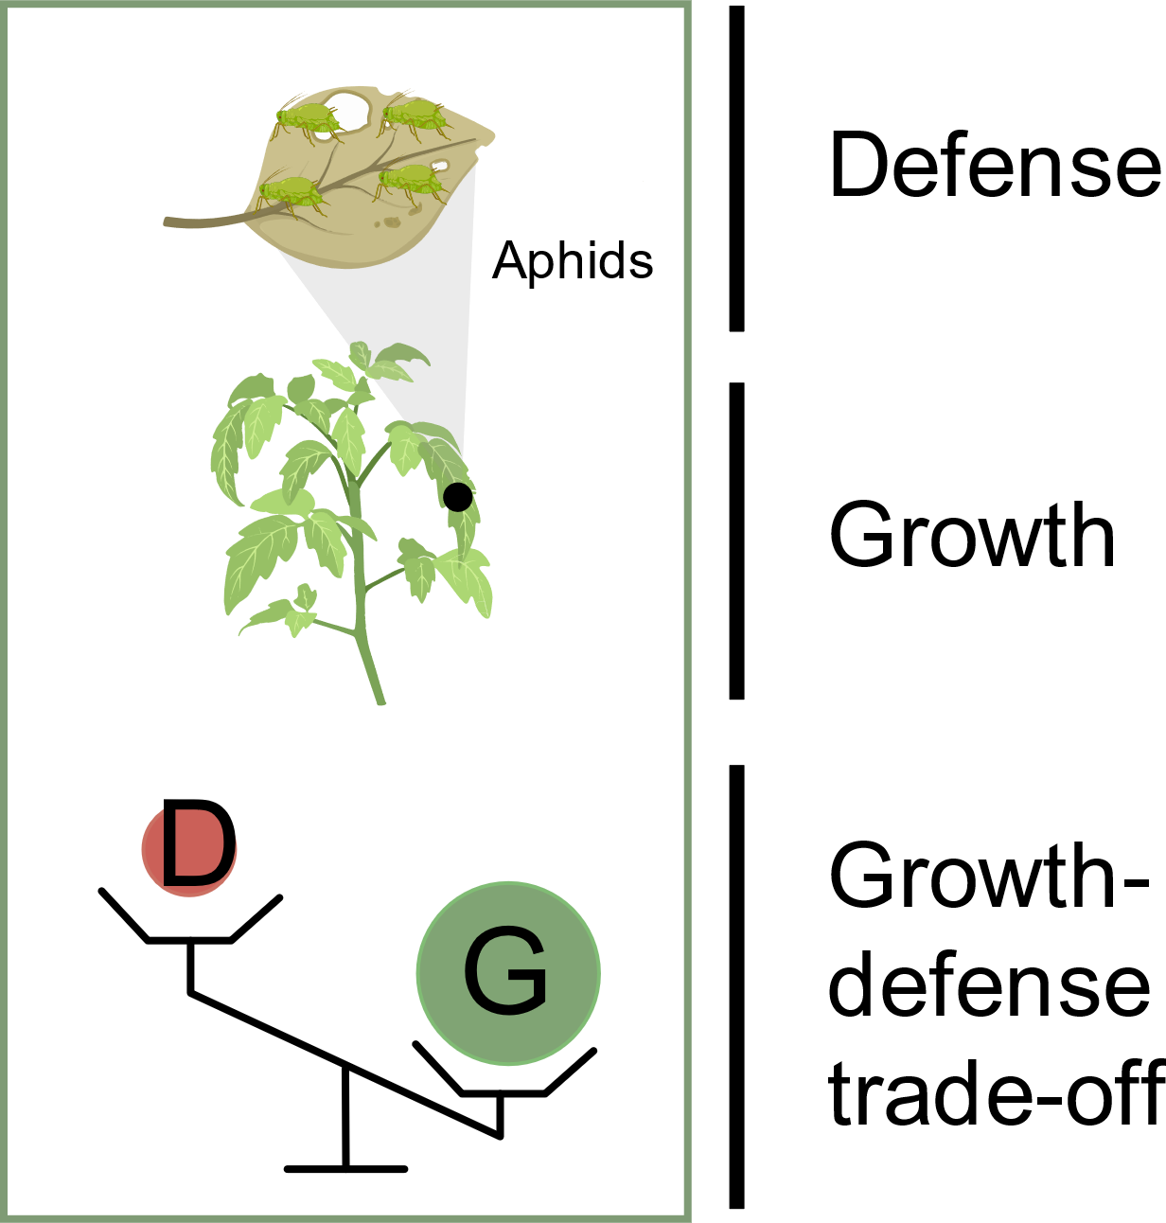
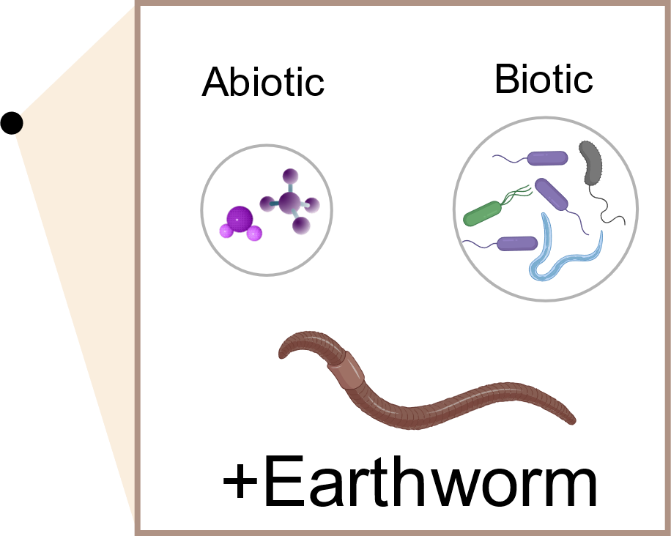
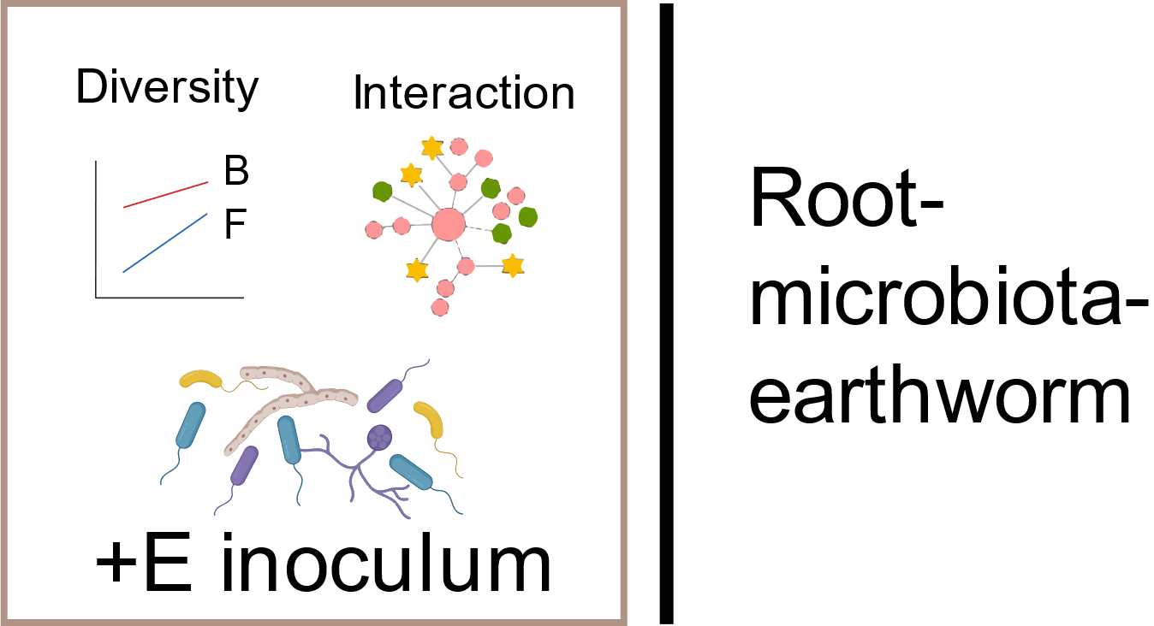
Conclusion
Model for earthworm-induced growth–defense trade-off between different herbivores attack.
Earthworm associated rhizosphere core microbiota were responsible for prioritizing growth over defense of plants.

Slide 16
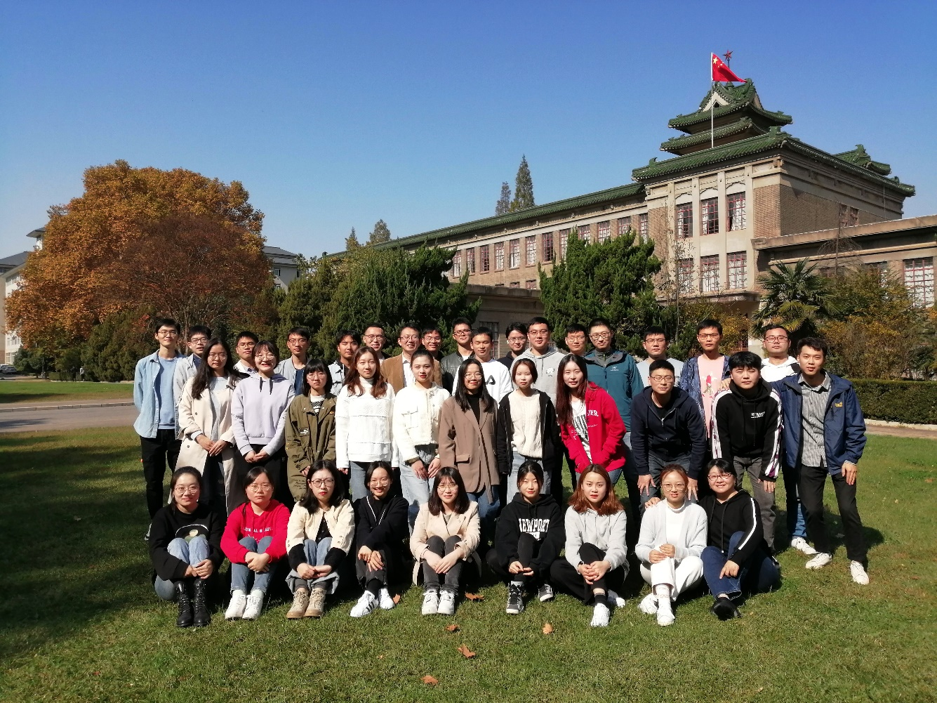
Acknowledgement
Thanks to the National Natural Science Foundation of China.
Thanks to the members of Soil Ecology Lab for their help in the experiment.
Thanks to the EGU conference team.
Thanks for your listening.
Reporter: Nan Jin
2021203010stu.njau.edu.cn

