Slide 1

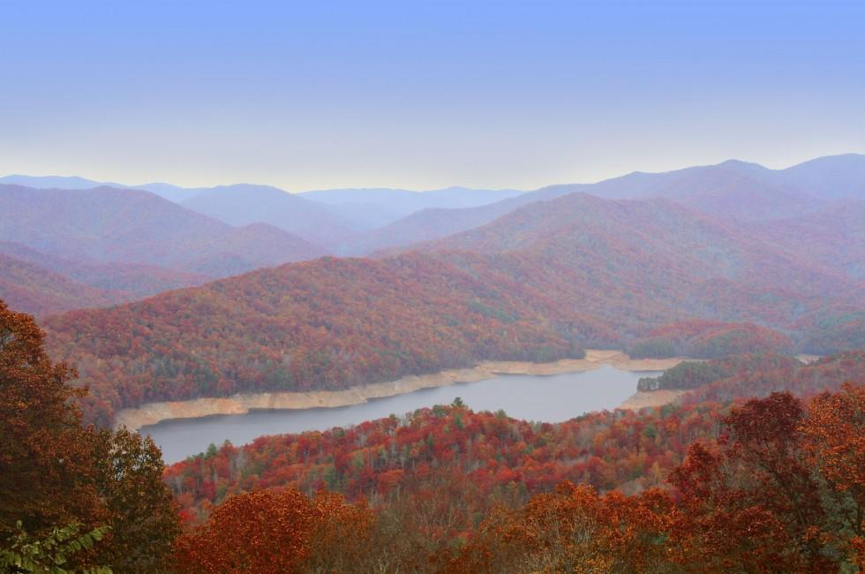



EGU22-10845 – Toward Optimal Rainfall – Hydrology QPE Correction in Headwater Basins
Mochi Liao and Ana P. Barros
Notes:
Good morning, everyone, my name is Mochi Liao. Today I’m going to give a talk about errors in precipitation estimates in headwater basins in remote areas.

Slide 2
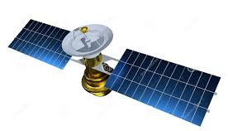
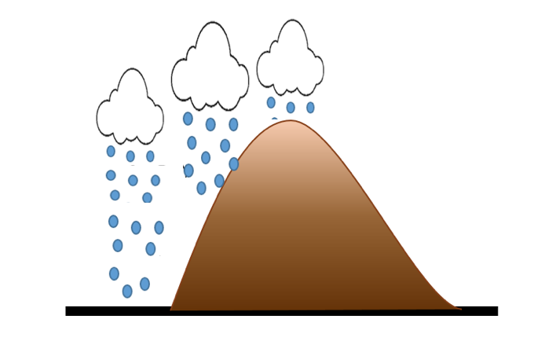

Orographic QPE Measurement Challenges
Space-based radar (Satellite)
Satellite products:
Wide areal rainfall data availability
Retrieval uncertainties (multiple scattering, non-uniform beam filling)
Raingauge
Ground-based radar
Raingauge measurements:
Radar products :
Known accuracy
Data are representative of point-scale processes
Rainfall in complex terrain can vary drastically from ridges to valleys at small spatial scales. Therefore, it would require a very dense network of raingauges.
Areal rainfall data availability
Ground clutter effects, overshooting and spatial variability
Errors in estimating radar reflectivity factor, variations in the reflectivity-rain rate relationship → Radar tend to underestimate heavy rainfall and overestimate light rainfall.
Notes:
As we all know, there are different types of precipitation products. in mountainous regions, satellite products are not really suitable because of the coarse resolution. Also retrieval uncertainty is a issue. Ground clutter effects can greatly contaminate groundbased radar rainfall product. As for raingauges, because it’s hard to access to the remote areas, there is very limited number of raingauges in the mountains in general. So this work started with building a merged product using raingauges and groundbased radars so that we have wide spatial availability and relatively high accuracy.

Slide 3
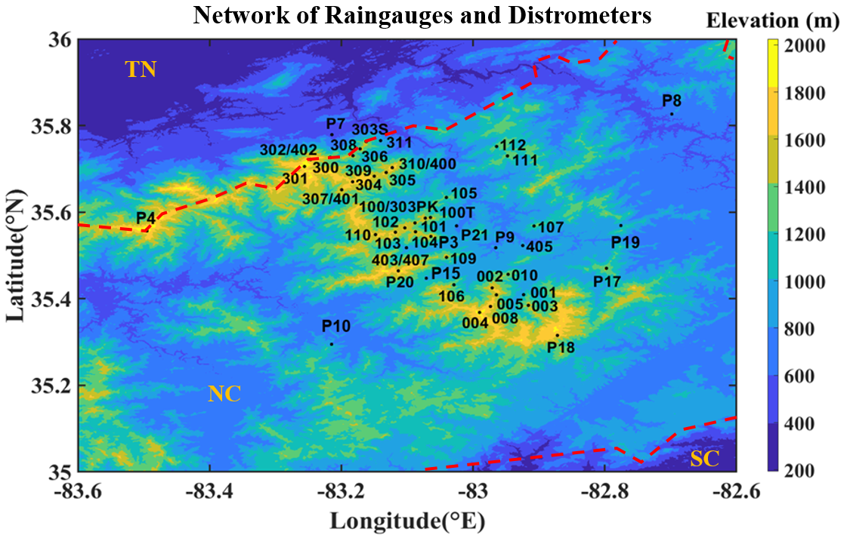
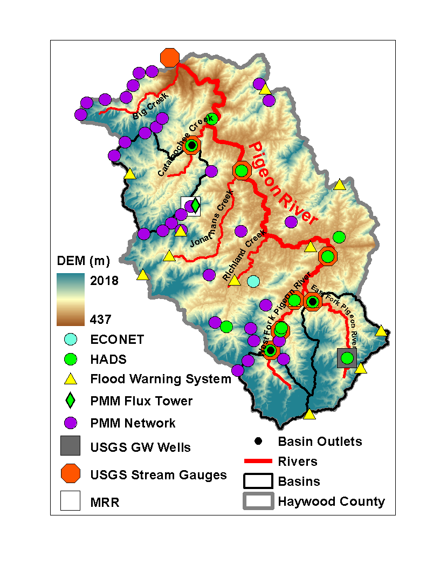
Study Domain
IPHEx IOP
Southern Appalachian Mountains
N
CCB
EFPRB
Small watersheds (<150 km²)
Complex terrain
Radar product: StageIV datasets
IPHEx raingauges and disdrometers
10 year IPHEx Reference product for GPM GV
Notes:
This is our area of interests, the pigeon river basin in southern Appalachian mountain, We are working with small headwater basins with area about 100km2. On the right hand side is the pigeon river basin, The two headwater basins we are working with are cataloochee creek basin and east fork pigeon river basin.
The ground based radar product we are using is stageIV. We also have raingauges network in the pigeon river basin.

Slide 4
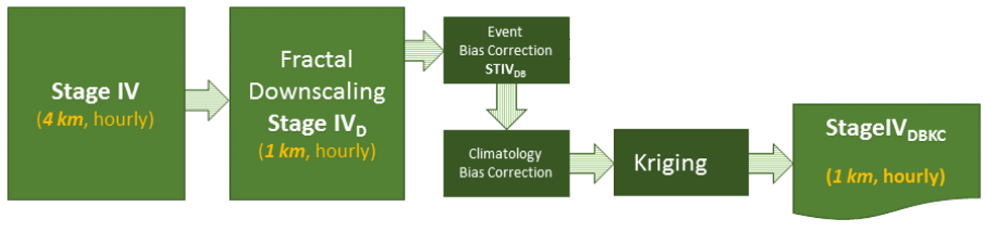
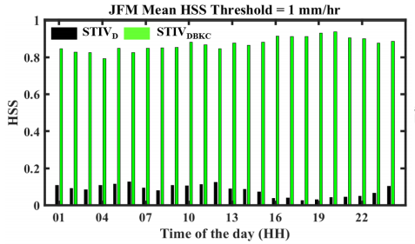
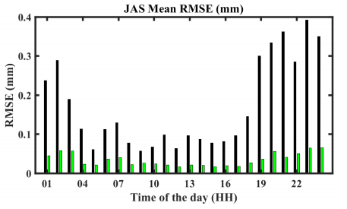
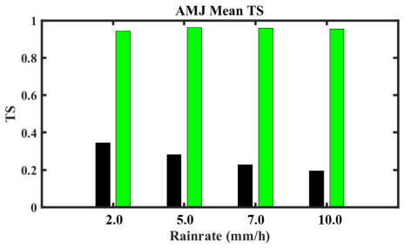
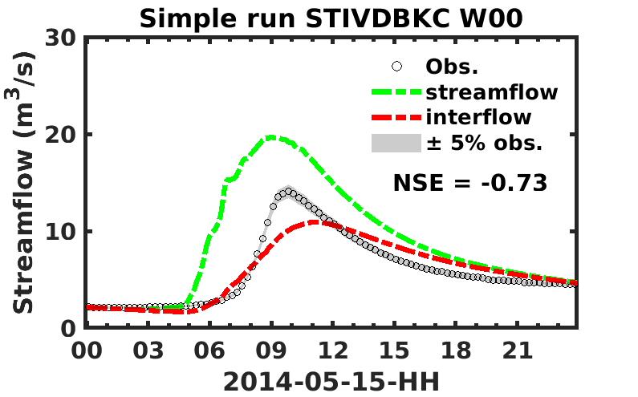
GPM GV IPHEx Reference Product
Reference Product: 10-year Climatology of Corrected NWS StageIV –> StageIVDBKC/STIVDBKC
Spatial Variability
Fractal Downscaling
Kriging
Liao and Barros, 2019
STIVDBKC has very good performance at gauge locations as intended
but where gauges are lacking there is high uncertainty
In space and time
Given the small-scale of headwater basins can we use benchmark streamflow observations to develop physically-meaningful hydraulic corrections to rainfall?
Liao and Barros, IPHEx Report, 2019
Notes:
Here is a flowchart to build the merged dataset. We have original ground-based radar stiv data sets and we apply fractal downscaling, and bias correction to obtain the climatology reference product STIVDBKC. The middle panel shows intercomparison of statistical skill metrics between the original stiv data and stivdbkc. Stivdbkc data have significantly lower rmse and higher threat score with an improvement from < 0.2 to > 0.8 at gauge locations. But if we run a hydrologic simulation, we find there are still substantial errors as shown on the bottom right. The question is: can we use streamflow observations to develop physically-meaningful hydraulic corrections to remotely-sensed spatial rainfall estimates?

Slide 5
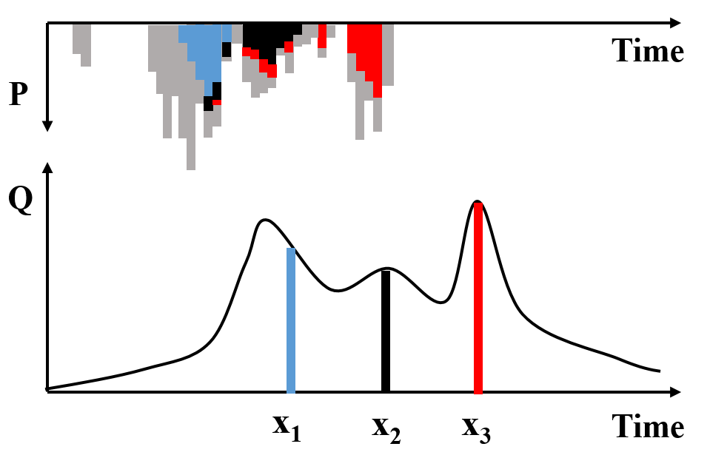
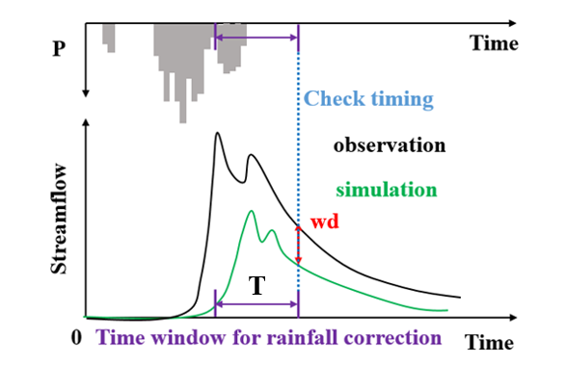
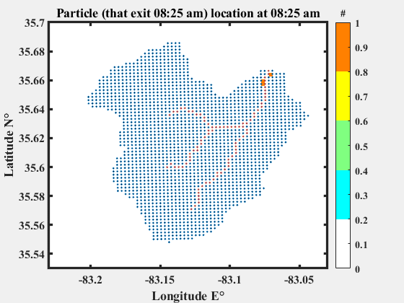
Introduction
Inverse Rainfall Correction (IRC)
x
travel-time Probability Density Function (ttPDF)
At any time point, streamflow at the outlet comes from precipitation at an earlier time somewhere in the watershed, which can be mapped.
The hydrograph residual is attributed to a location and time in the past. This serves as a basis for rainfall corrections to match simulated and observed hydrographs (closing the event water budget).
CCB
Liao and Barros, RSE, pending, 2022
Notes:
So streamflow is an integration of physical processes of precipitation. The upper left drawing is a simple illustration to show how rainfall and streamflow are connected. At any given time point x, water in the channel comes from precipitation happened earlier. For example, water at x1 comes from precipitation in blue, and water at x2 comes from precipitation in black. So, this tells us that if we have errors in streamflow simulation at time point x, we can find corresponding period of rainfall and apply corrections to the rainfall. Specifically, On the upper right hand side, water difference at time point x between streamflow observations and simulations, wd, can be distributed over the course of T hours prior to time point x. This process is called inverse rainfall correction or IRC. We can achieve this by artificially launching particles that flow with the fluids. When we backtrack the water difference, we know when and where the rainfall comes fro.

Slide 6
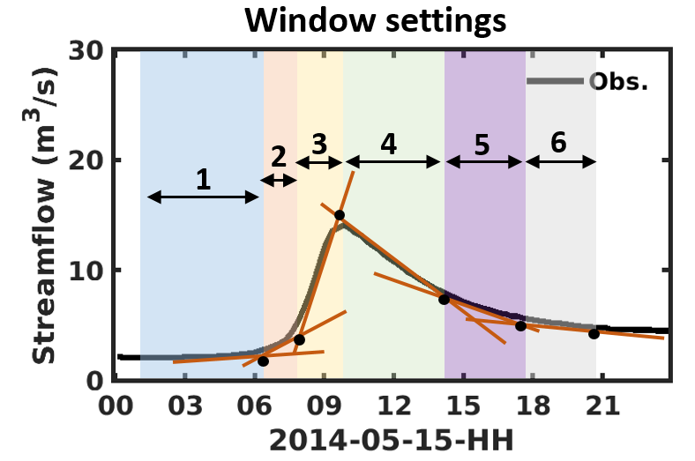
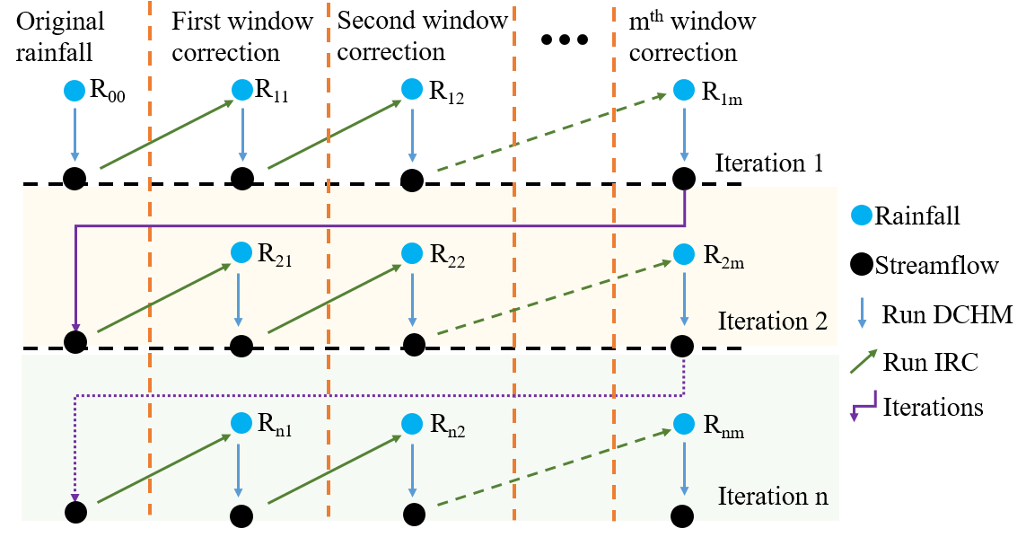
IRC Demonstration – Hydrograph Shape Algorithm
Liao and Barros, RSE, 2022
Notes:
This is a detailed structure of this framework. Noticed that we have different flow regime for different part of hydrograph. Rising limb is different than the recession part. We start with the first window, do the inverse rainfall correction, we then use the updated rainfall and run the hydrology model and we move on to the second window and apply IRC. Then run the hydrology model with the updated rainfall so on and so forth. Till we finish the last window. Then we move to the first window again and do this whole process iteratively.

Slide 7
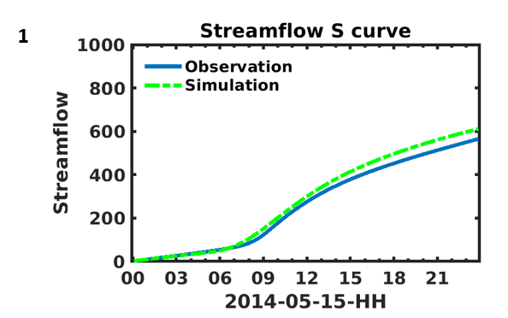
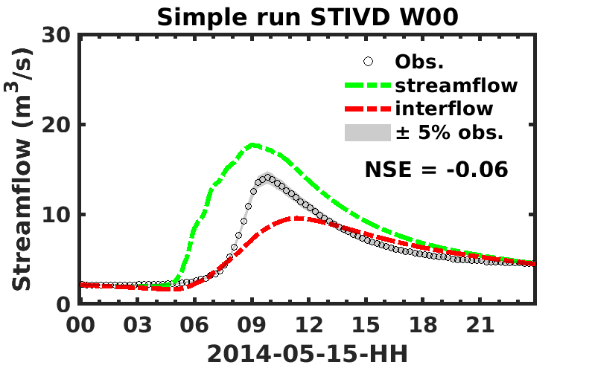
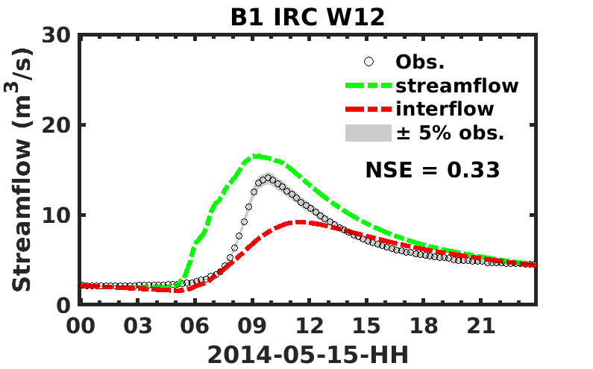
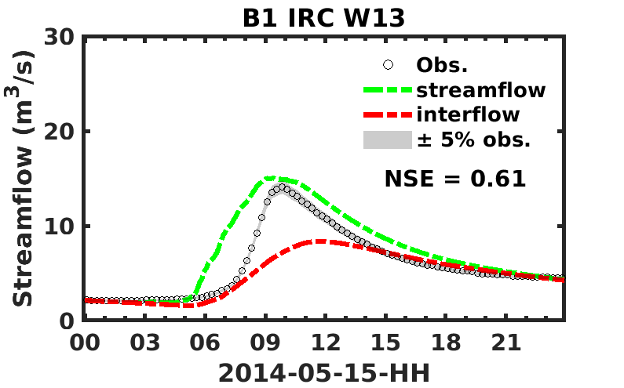
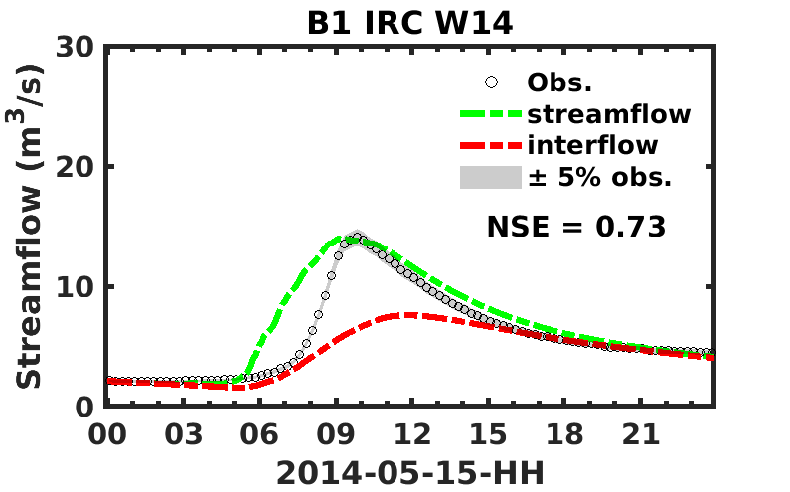
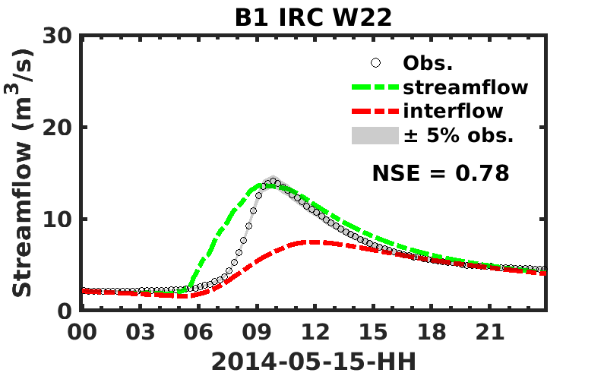






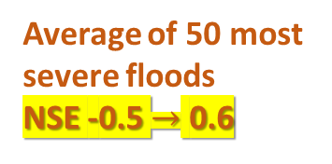
IRC Demonstration – CCB Hydrograph Iterations
STIVDBKC
Δ= 4.3%
NSE -0.06 $→$ 0.85
Average of 50 most
severe floods
NSE -0.5 $→$ 0.6
IRC equilibrium
Wxy – x is the iteration index
y is the window index
Notes:
Here are some of the results, on the upper left, this is the very original simulation. The multiple graph panel consists of the intermediate results from IRC. We have first iteration window 2, first iteration window 3, etc. The process reaches to the equilibrium after three iterations. The NSE is improved from -0.06 to 0.85. The water budget error is reduced to 4.3% for this event. For the largest 50 events from 2008 to 2018 , the average improvement of NSE is from -0.5 to 0.6

Slide 8
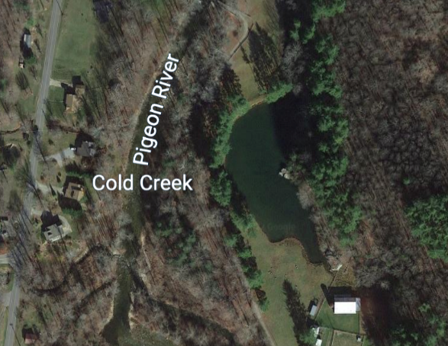
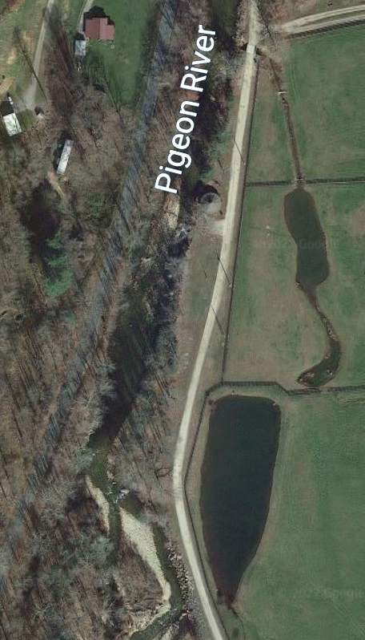
Initial Conditions – ongoing work
IRC equilibrium
Initial conditions
Notes:
Currently, we are focusing on the streamway initial conditions question that result in very fast rising limb. This requires a parameterization of land surface storage such as that in streamway oxbow lakes in the Southern Appalachians to produce accurate hydrological responses.

Slide 9

Conclusions
A space-time varying QPE correction framework (IRC) is developed and analyzed for small-scale basins in complex mountainous terrain.
IRC corrects effectively for radar overestimation at low elevations in the blind-zone of ground-based and satellite based Quantitative Precipitation Estimates (QPE)
IRC results in significant improvement in water budget closure at event-scale.
The discretization of river networks does not capture the complexity of the streamway in mountain streams specifically lateral storage at sub-grid scale. Ongoing work is addressing streamway-channel interactions at the event scale.
Notes:
To summarize what we have just talked about.

