Slide 1

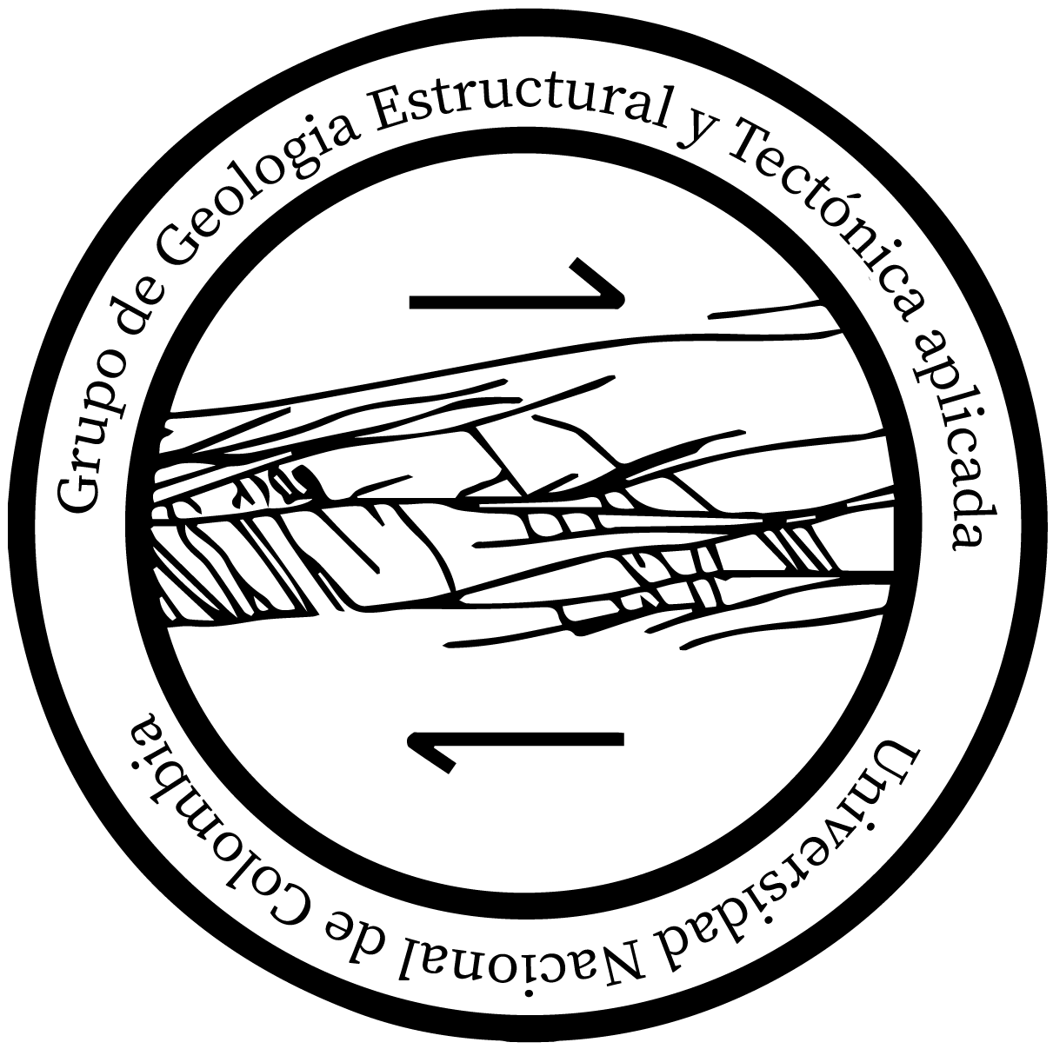

Backarc rifting as a response to a crustal collapse at the western Gondwana margin: The Triassic tectonic setting of the Sierra Nevada de Santa Marta, Northern Andes of Colombia
Europe Geoscience Union General Assembly - EGU 2022
TS6.1 – 'Continental rift evolution: from inception to break-up'
Michael Andrés Avila Paez¹, Andreas Kammer¹, Camilo Andres Conde Carvajal¹, Alejandro Piraquive Bermudez², Cristhian Nicolas Gomez Plata¹
¹Group of Applied Structural Geology and Tectonics. Universidad Nacional de Colombia, Bogotá. Department of Geosciences
¹Group of Nuclear studies, Nuclear sub direction, Geological service of Colombia, Bogotá.
2022

Slide 2
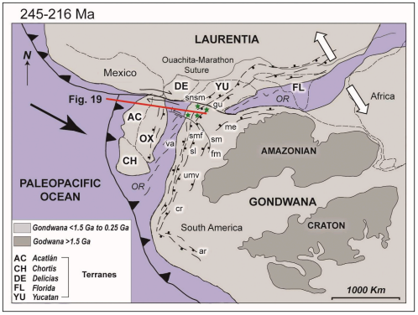
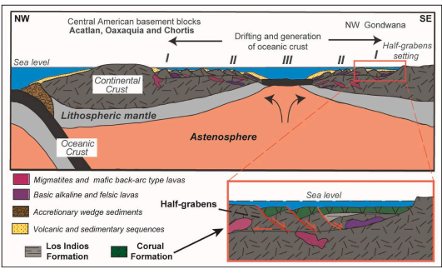
Europe Geoscience Union General Assembly - EGU 2022
TS6.1 – 'Continental rift evolution: from inception to break-up'
Triassic metamorphism and gravitational collapse
SNSM massif
Questions and results
Conclusions
Figure 1. Triassic tectonic at northern of Gondwana (Gomez et al, 2021)
Figure 2. Schematic profile of backarc rift and depositional basin for SNSM Triassic sediments (Gomez et al., 2021)

Slide 3
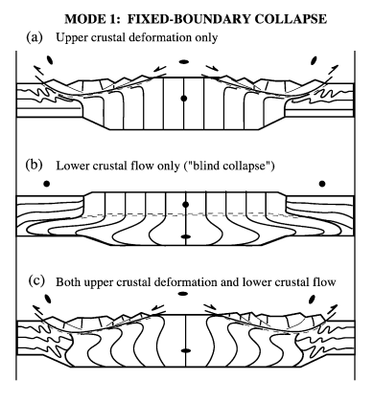
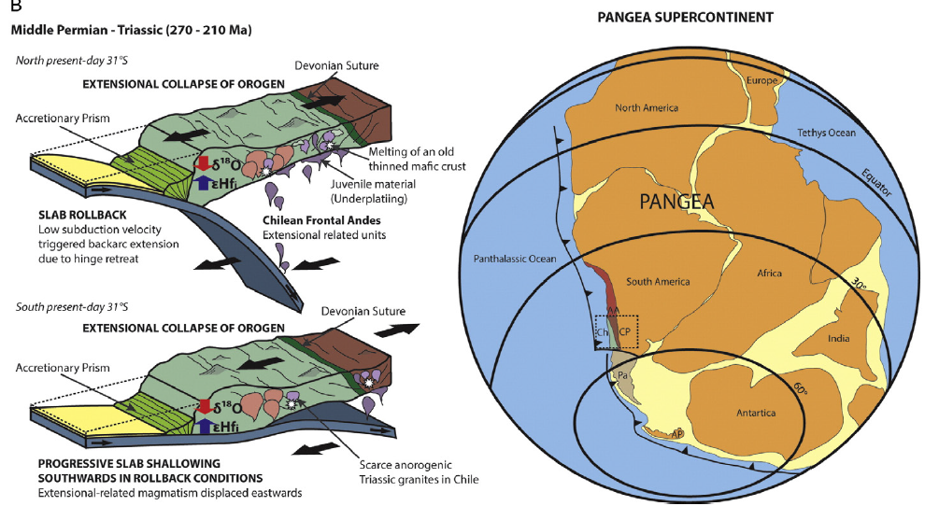
Europe Geoscience Union General Assembly - EGU 2022
TS6.1 – 'Continental rift evolution: from inception to break-up'
Triassic metamorphism and gravitational collapse
SNSM massif
Questions and results
Conclusions
Figure 4. Crustal collapse and magmatism at Chilean Andes (Rey et al., 2016)
Figure 3. Crustal collapse and lateral imbrication as a result to fixed boundary (Rey et al., 2001)

Slide 4
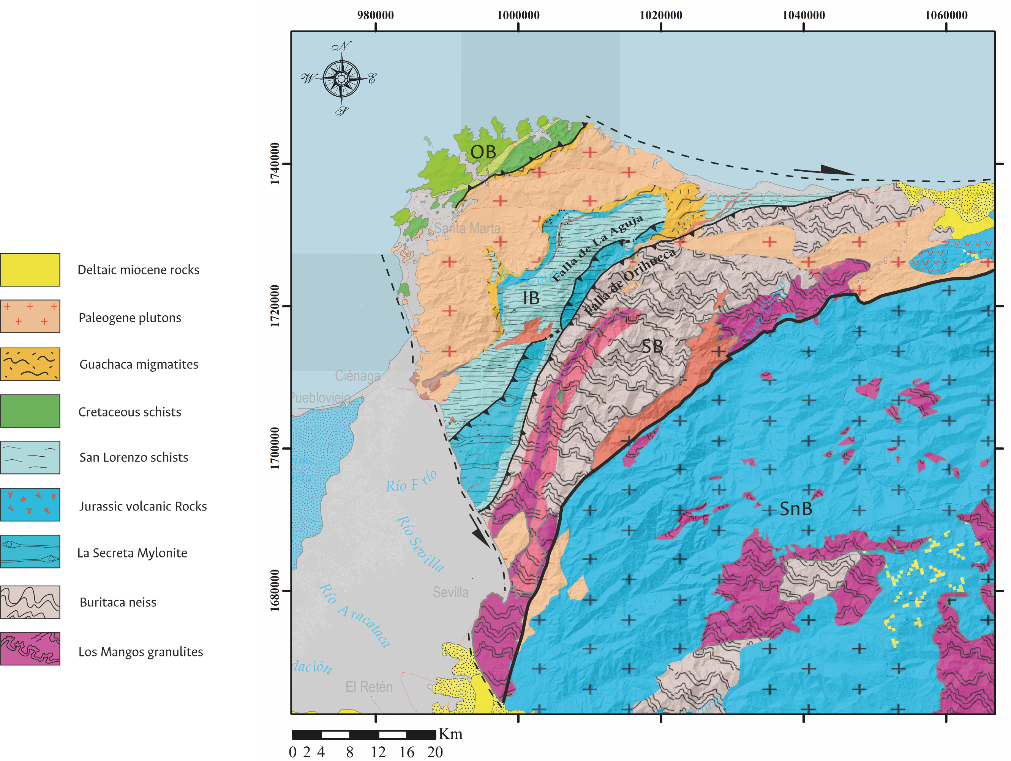
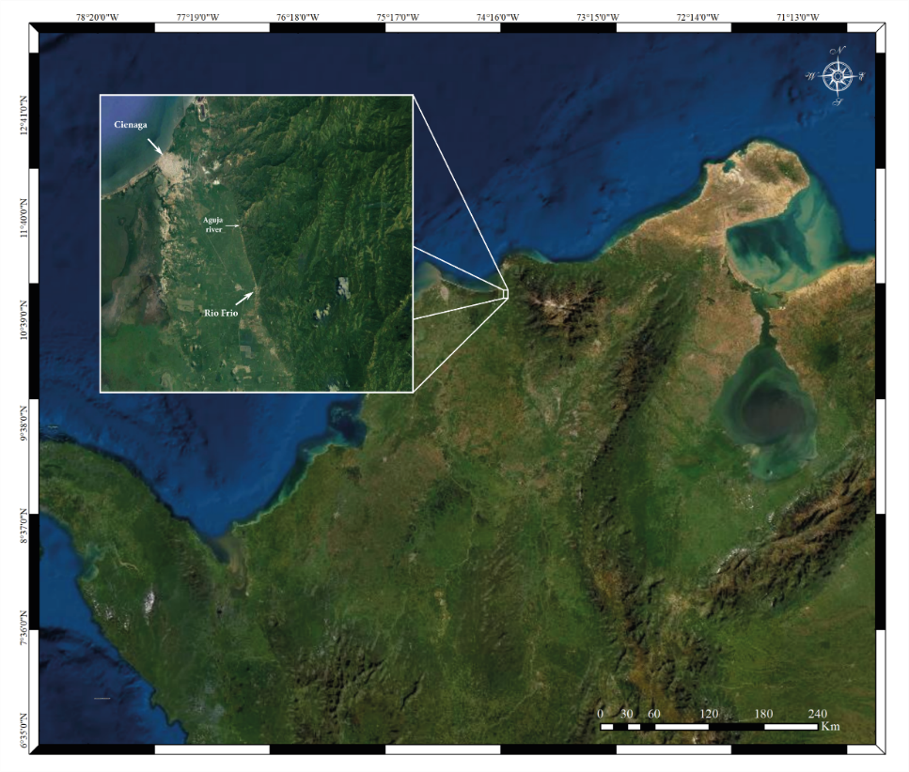
Europe Geoscience Union General Assembly - EGU 2022
TS6.1 – 'Continental rift evolution: from inception to break-up'
Triassic metamorphism and gravitational collapse
SNSM massif
Questions and results
Conclusions
Figure 6. Location of Sierra Nevada de Santa Marta and the study area
Triangular massif bounded by Oca and Santa Marta-Bucaramanga system faults
Figure 5. Geological map of Sierra Nevada de Santa Marta. OB: Outer belt; IB: Inner belt; SB: Sevilla Belt; SnB: Sierra Nevada belt

Slide 5
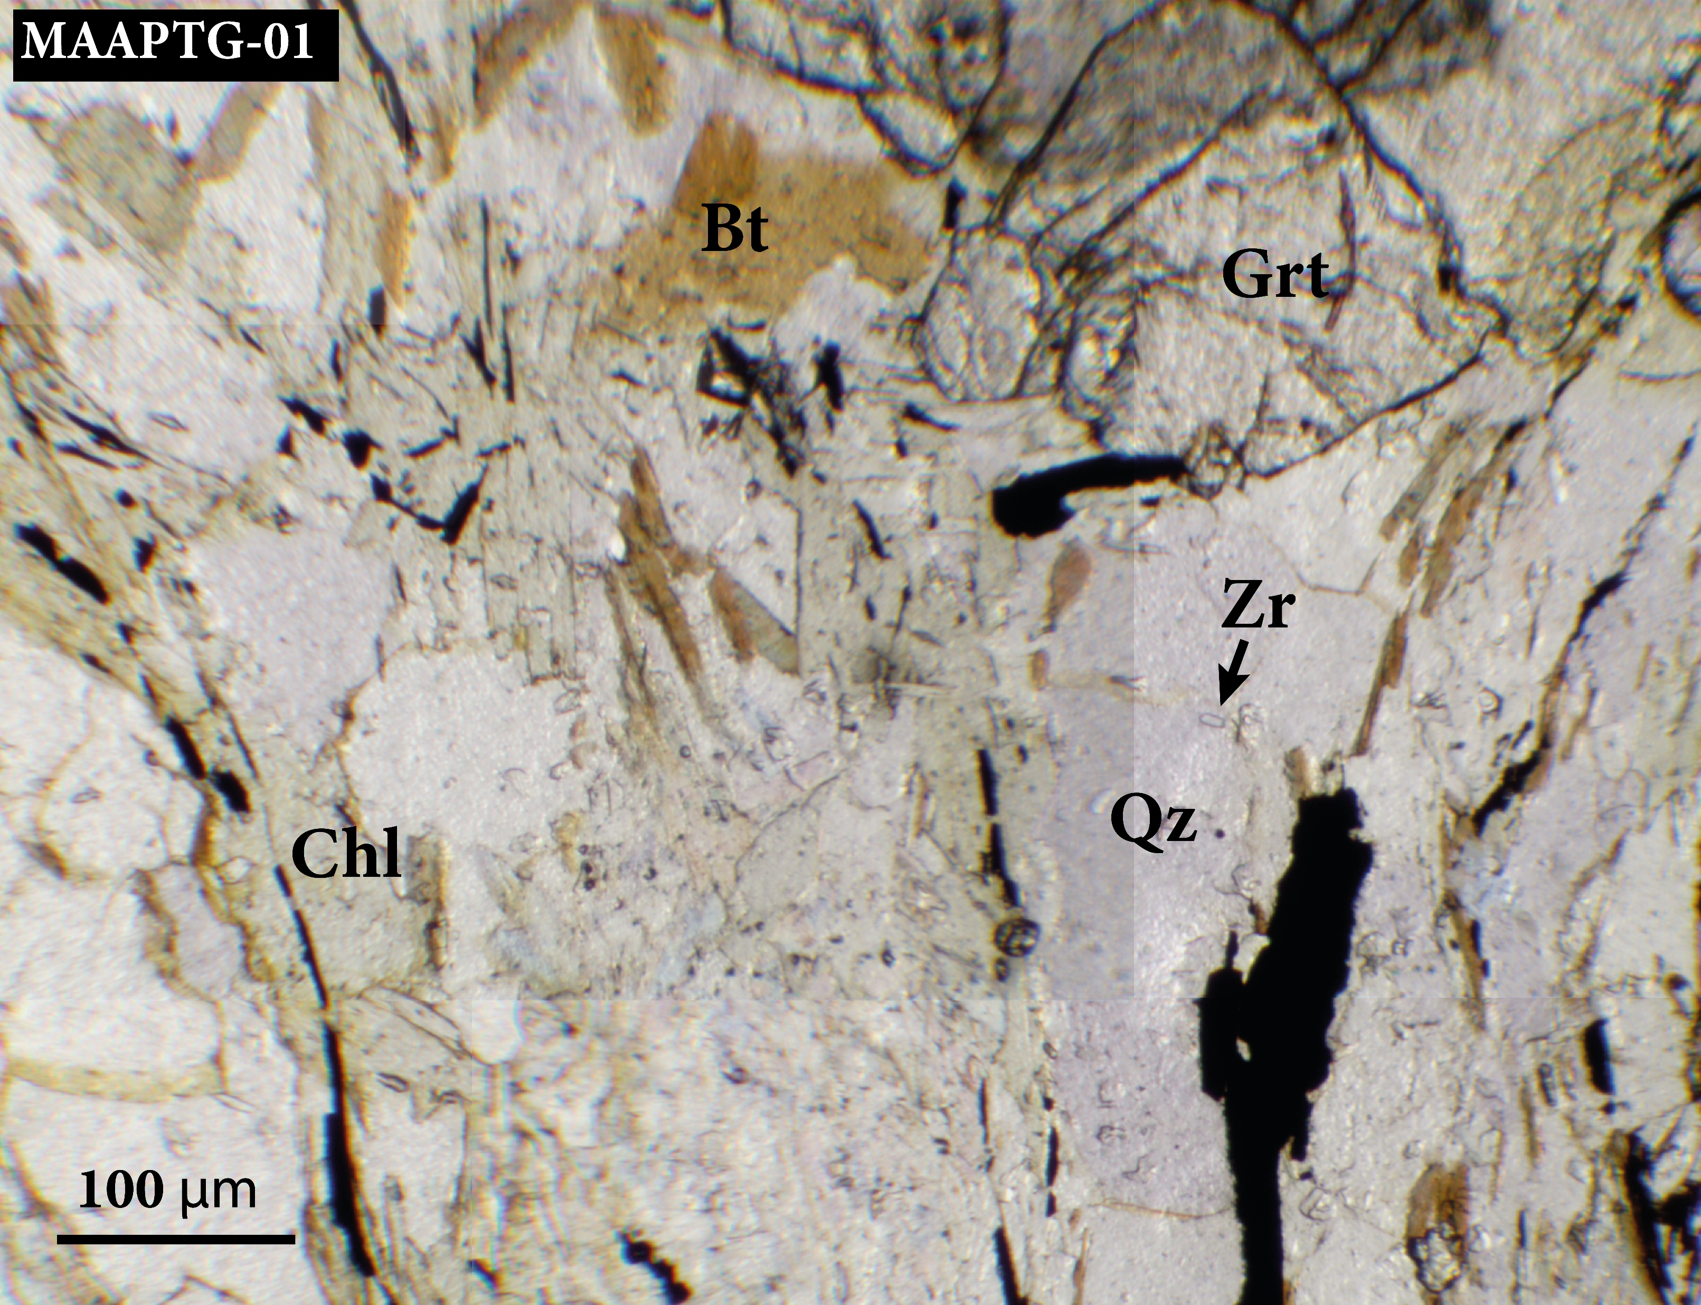
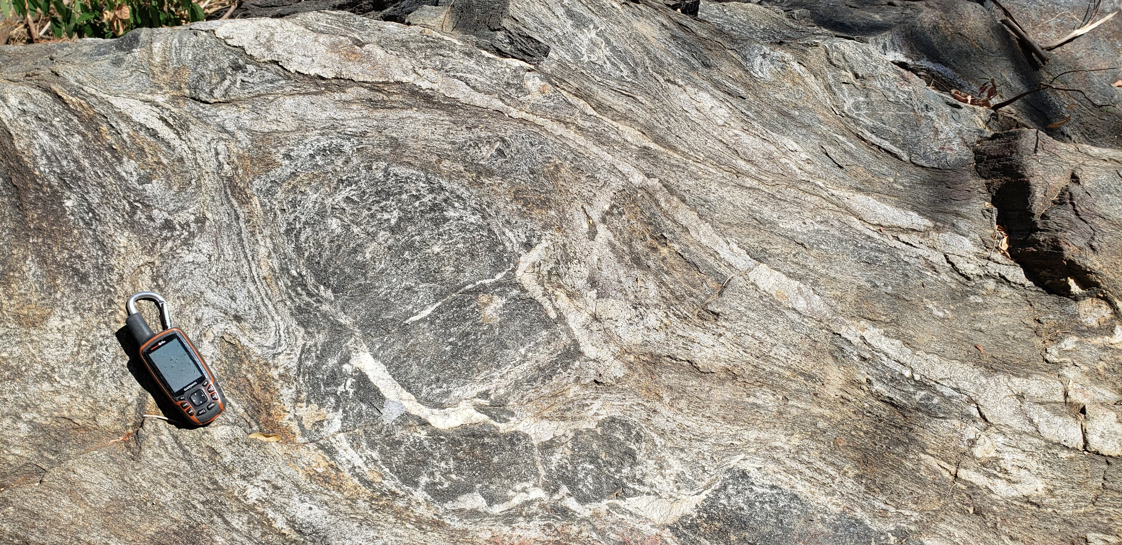
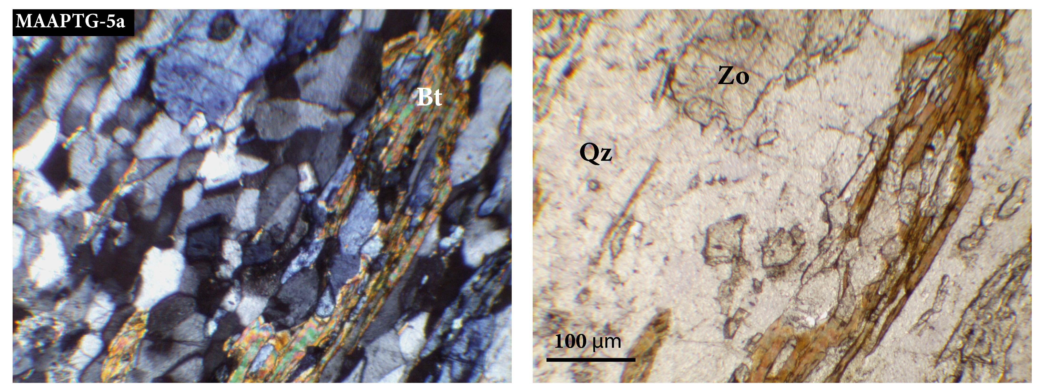
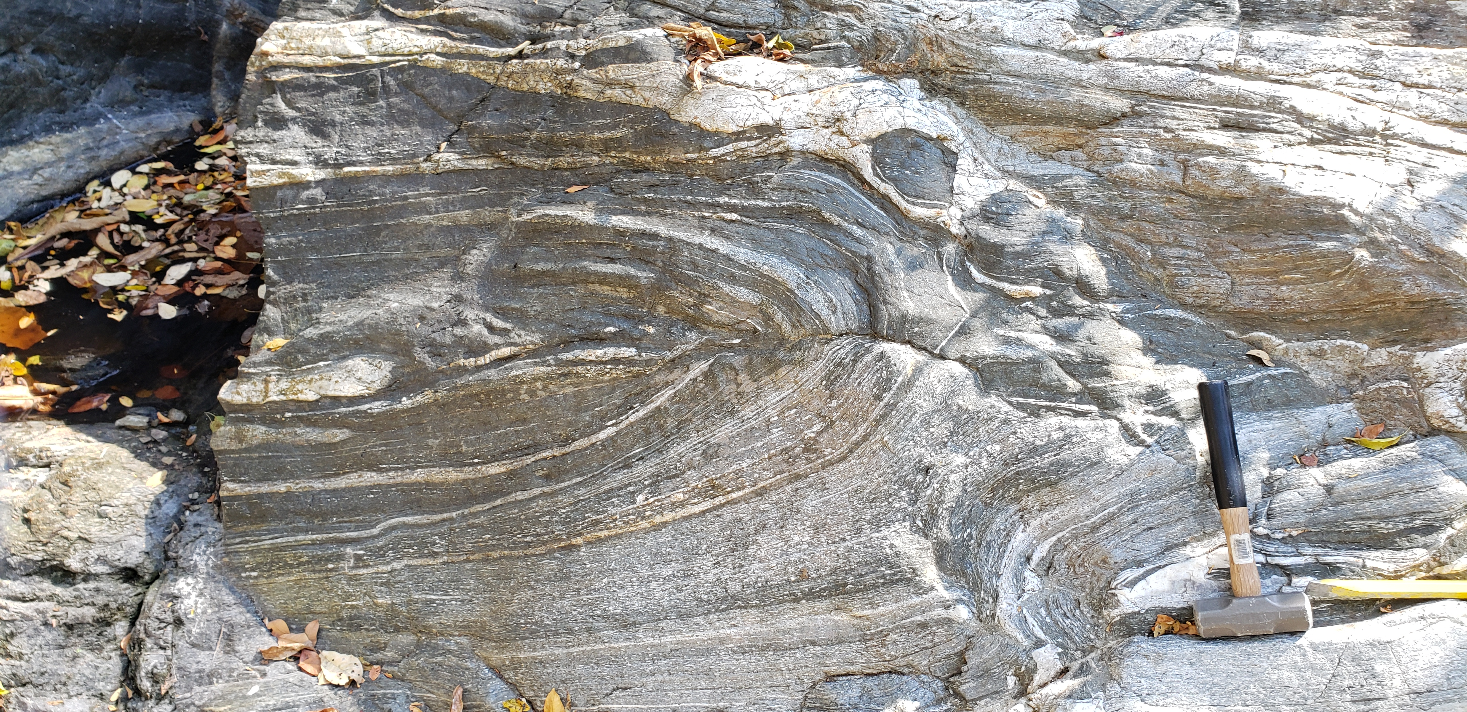
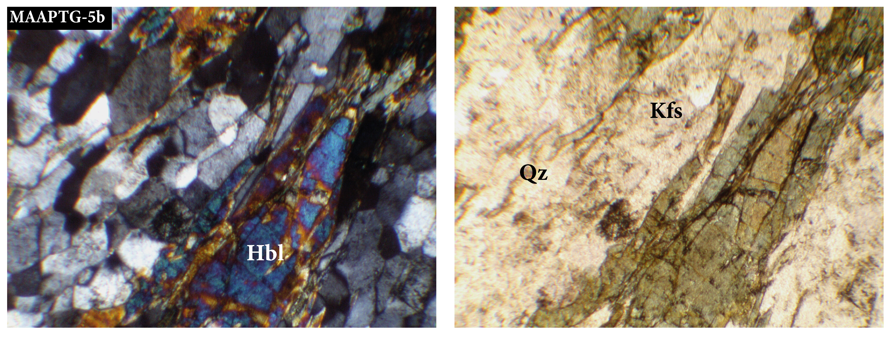
Europe Geoscience Union General Assembly - EGU 2022
TS6.1 – 'Continental rift evolution: from inception to break-up'
Triassic metamorphism and gravitational collapse
SNSM massif
Questions and results
Conclusions
La Secreta Mylonite
Grt+Bt+Qz+Chl
+Sill+Pl
San Lorenzo schists
1, Qz+Bi+Pl+Zo
2. Kfs+Qz+Hbl±Plc
2
1

Slide 6
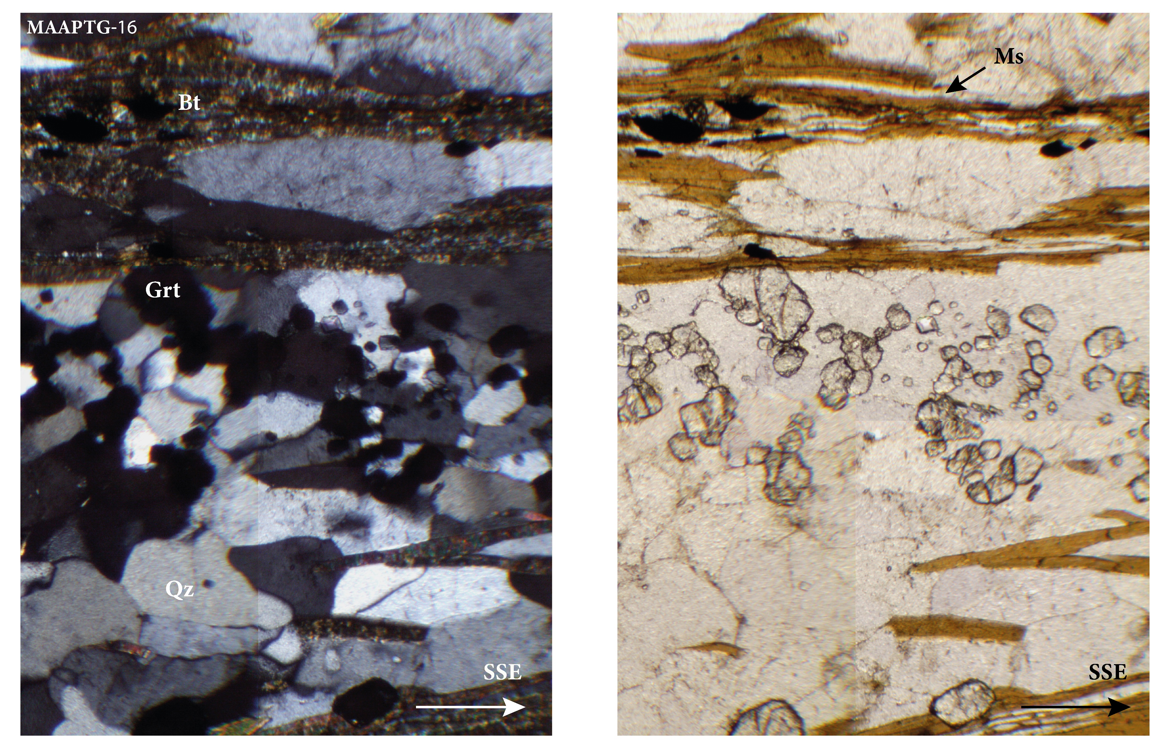
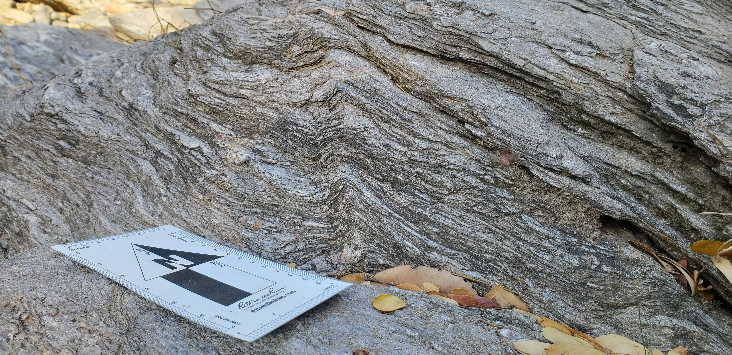
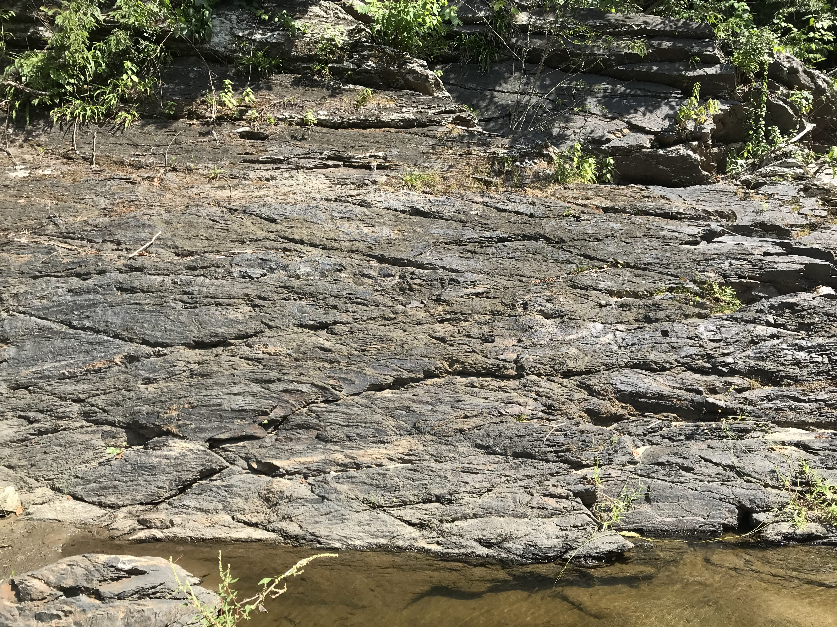
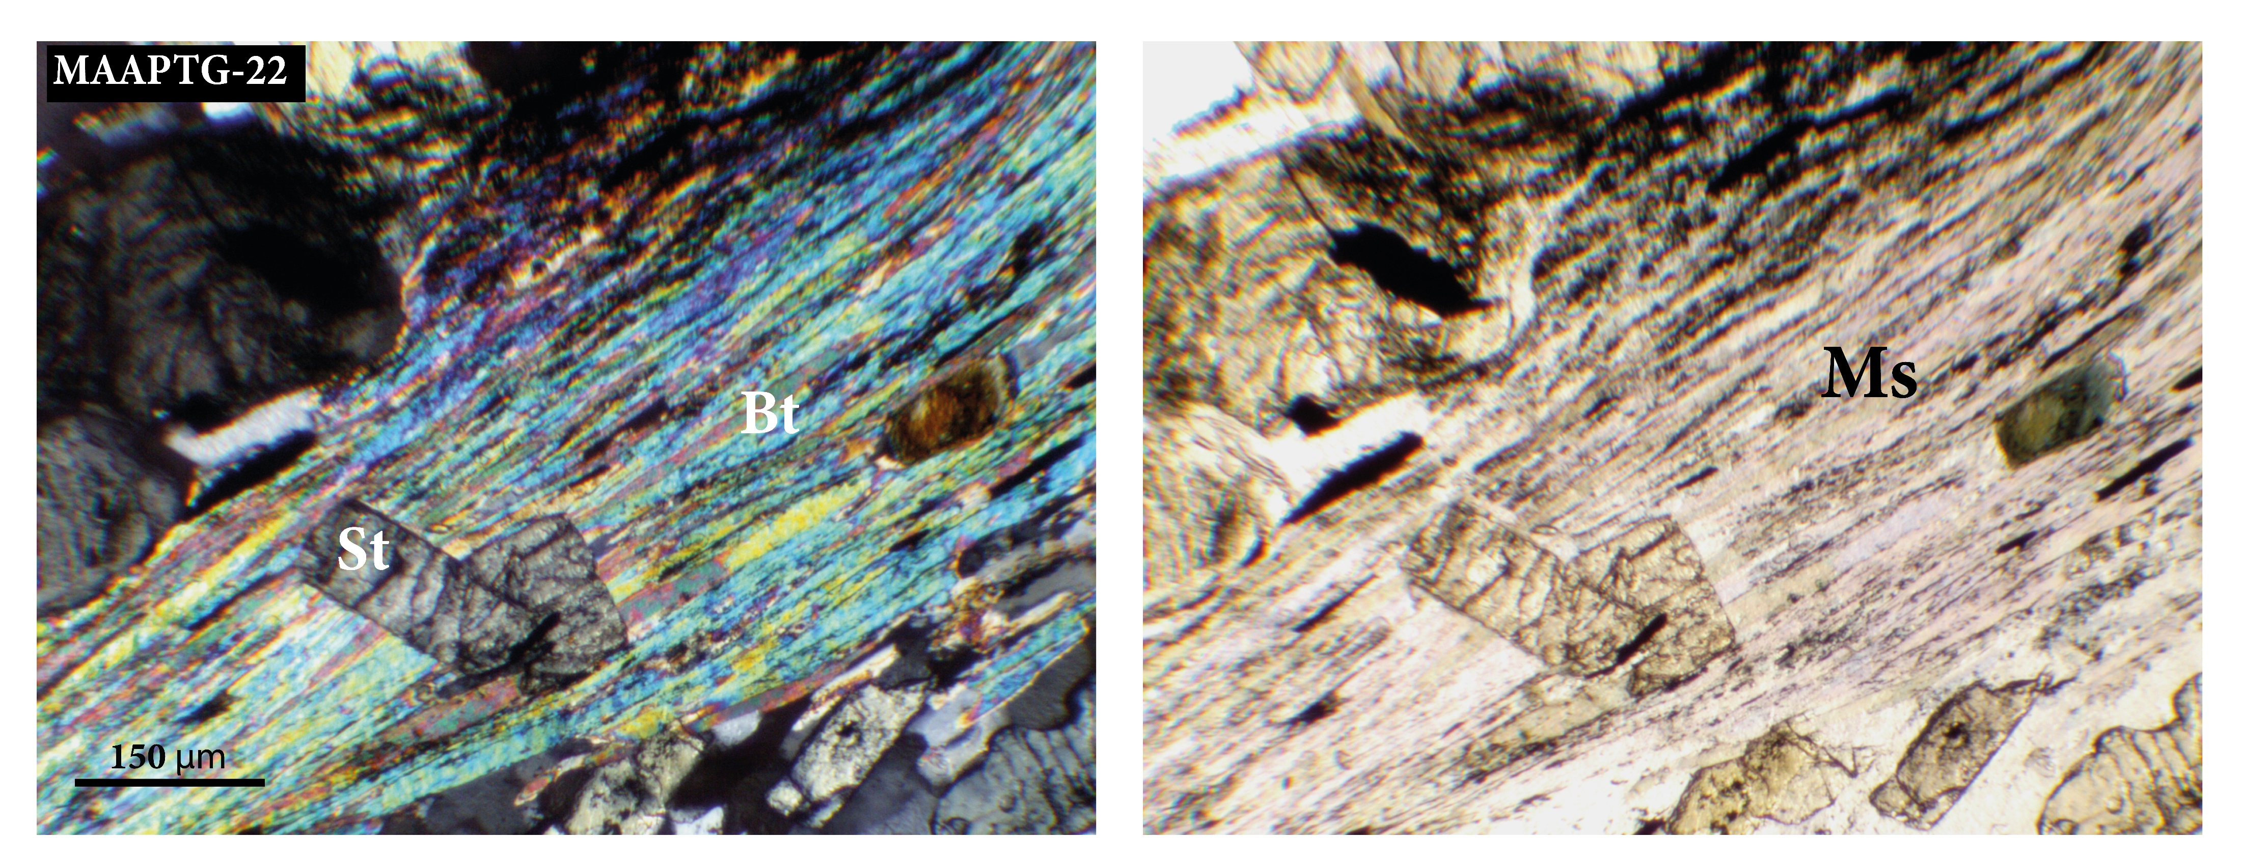
Europe Geoscience Union General Assembly - EGU 2022
TS6.1 – 'Continental rift evolution: from inception to break-up'
Triassic metamorphism and gravitational collapse
SNSM massif
Questions and results
Conclusions
San Lorenzo schists
Grt+Bt+Ms+Qz±Plc
San Lorenzo schists
St+Grt+Bt+Ms+Qz±Plc

Slide 7
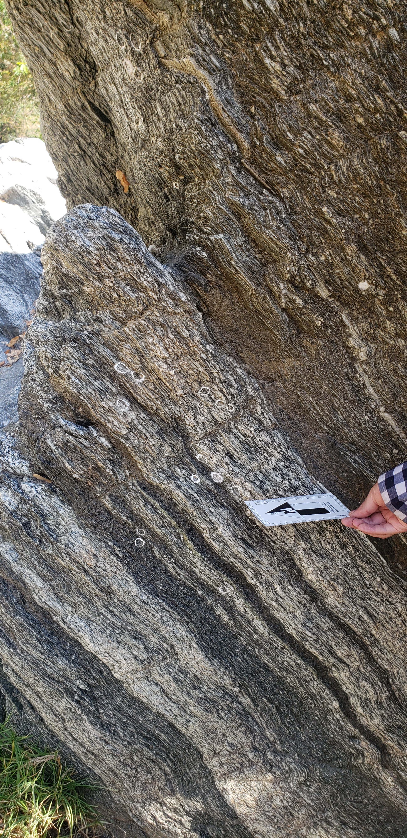
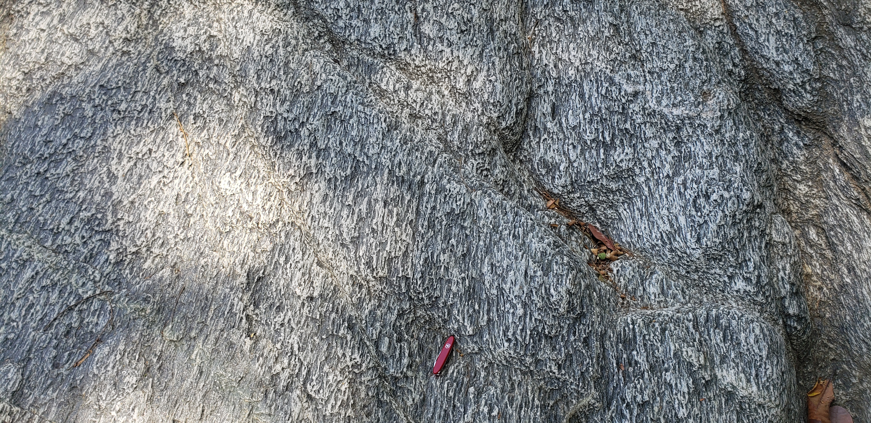
Europe Geoscience Union General Assembly - EGU 2022
TS6.1 – 'Continental rift evolution: from inception to break-up'
Triassic metamorphism and gravitational collapse
SNSM massif
Questions and results
Conclusions
Ortogneiss El Encanto
Since now it will be incluided to San Lorenzo schist as a metavolcanic rock
Pl+Hbl+Qz+Bt

Slide 8
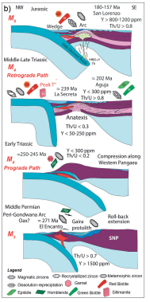
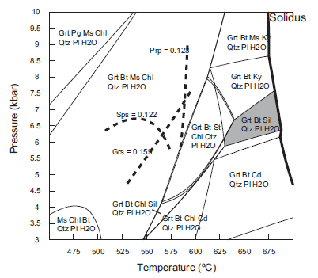
Europe Geoscience Union General Assembly - EGU 2022
TS6.1 – 'Continental rift evolution: from inception to break-up'
Triassic metamorphism and gravitational collapse
SNSM massif
Questions and results
Conclusions
What do we know?
Tectonometamorphic events at the inner Santa Marta belt (Piraquive et al., 2021)
La Secreta Mylonite P-T conditions: 5.6 ± 1.3 Kbar (Zuluaga and Stowell, 2012)

Slide 9
Europe Geoscience Union General Assembly - EGU 2022
TS6.1 – 'Continental rift evolution: from inception to break-up'
Triassic metamorphism and gravitational collapse
SNSM massif
Questions and results
Conclusions
What are we working now?
Establishing thermodynamic properties of San Lorenzo schists, La Secreta Mylonite and Sevilla belt to limit and differentiate among the units:
  Thermocalc - pseduosections and PTtd trajectory
Detailed mapping and structural relationships to defined possible phases of deformation
  Meso and microstructural analysis

Slide 10
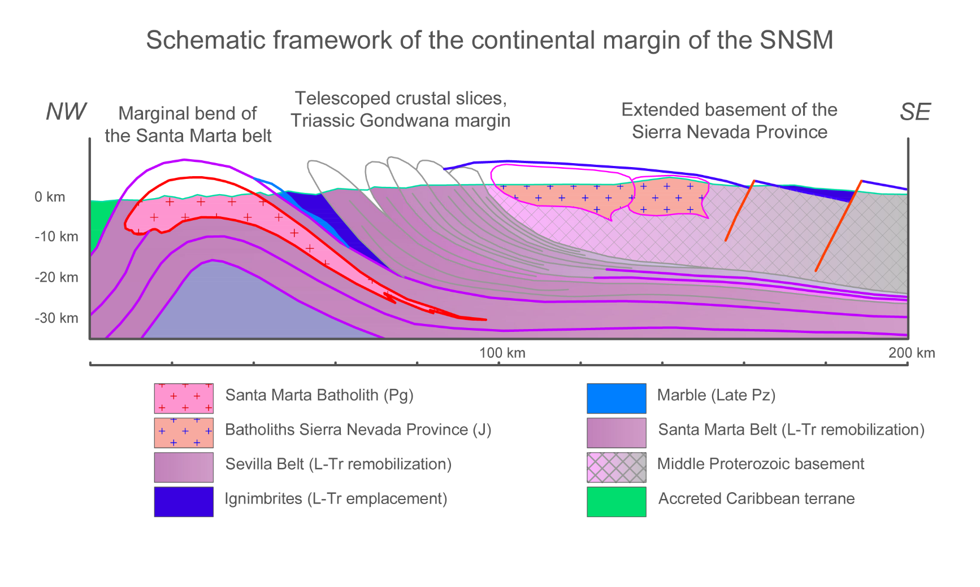
Europe Geoscience Union General Assembly - EGU 2022
TS6.1 – 'Continental rift evolution: from inception to break-up'
Triassic metamorphism and gravitational collapse
SNSM massif
Questions and results
Conclusions
The SNSM could be an example of a adjacent inbricate slices related to a cristal collapse and rift during Triassic-Jurassic.

Slide 11
Europe Geoscience Union General Assembly - EGU 2022
TS6.1 – 'Continental rift evolution: from inception to break-up'
Triassic metamorphism and gravitational collapse
SNSM massif
Questions and results
Conclusions
Thank you!

