Slide 1


EGU General assembly 2022
A
Presentation
on
Numerical study of 2D & 3D ERT with sensitivity analysis for subsidence in the coal mining area
Rupesh
(EGU22-10871 )
(Ph.D. Research scholar from department of Geology & Geophysics, IIT Kharagpur, India)

Slide 2
Outline
2D Numerical study associated to coal mining area
2D model without coal barrier
2D model with coal barrier
Inversion results and Sensitivity section of Wenner, Wenner-Schlumberger and Dipole-dipole array
3D Numerical study associated to coal mining area
3D model with coal barrier
Inversion results in horizontal x-z plane
Subsurface 3D volume of Wenner-Schlumberger and Dipole-dipole array
3D model without coal barrier
Inversion results in horizontal x-z plane
Subsurface 3D volume of Dipole-dipole array
Conclusions
References

Slide 3
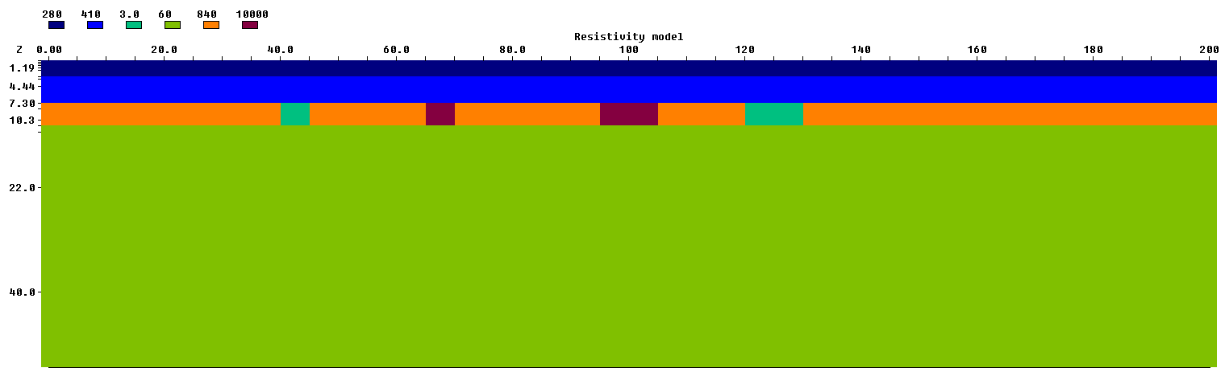
2D model without coal barrier
Coal
W1
A1
A2
W2
Coal
(Water filled cavity)
(Air filled cavity)
Model layers | Resistivity (ohm-m) | Dimensions (m)
Loose sand and alluvium | 280 | 200×2.8
Weathered rock | 410 | 200×4.5
Shale | 60 | 200×27.7
Water filled cavities | 3.0 | 5×3, 10×3
Coal Pillars | 5000 | 40×3, 20×3, 15×3,70×3
Air filled cavities | 10000 | 5×3, 10×3
Table 1: Selected parameters for different features in model

Slide 4
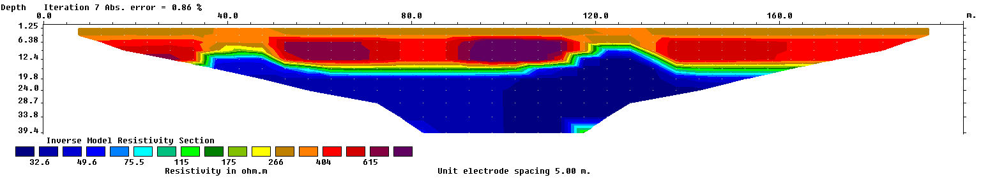
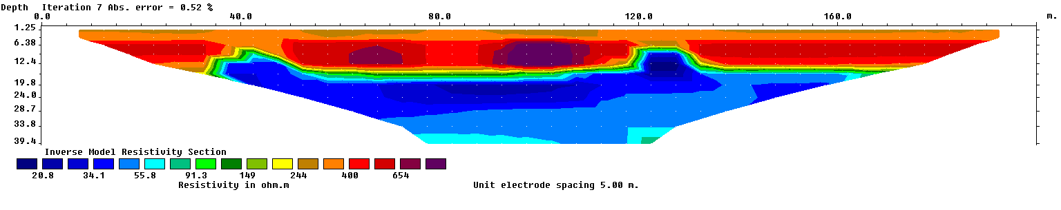
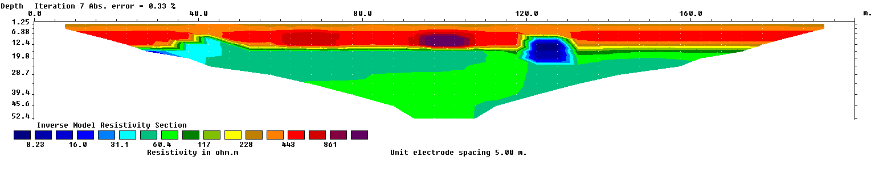
Inversion results
Wenner array
Coal
A1
A2
Coal
W2
Schlumberger array
Coal
W1
Dipole-Dipole array

Slide 5

2D model with coal barrier
Coal
W1
A1
A2
W2
Coal
Coal barrier is of 1.0 m
Model parameters are same except thickness of anomalies is of 2.0 m

Slide 6
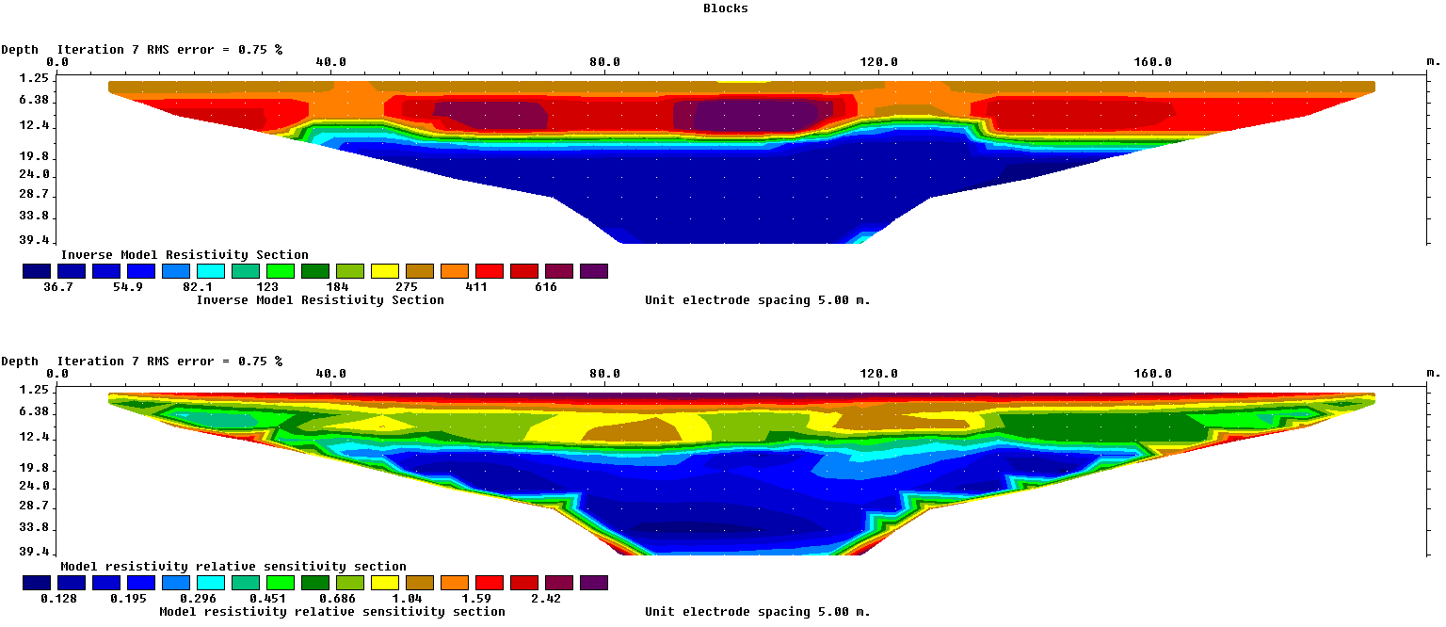
Inversion result and Sensitivity section of Wenner array
Coal
W1
A1
A2
W2

Slide 7
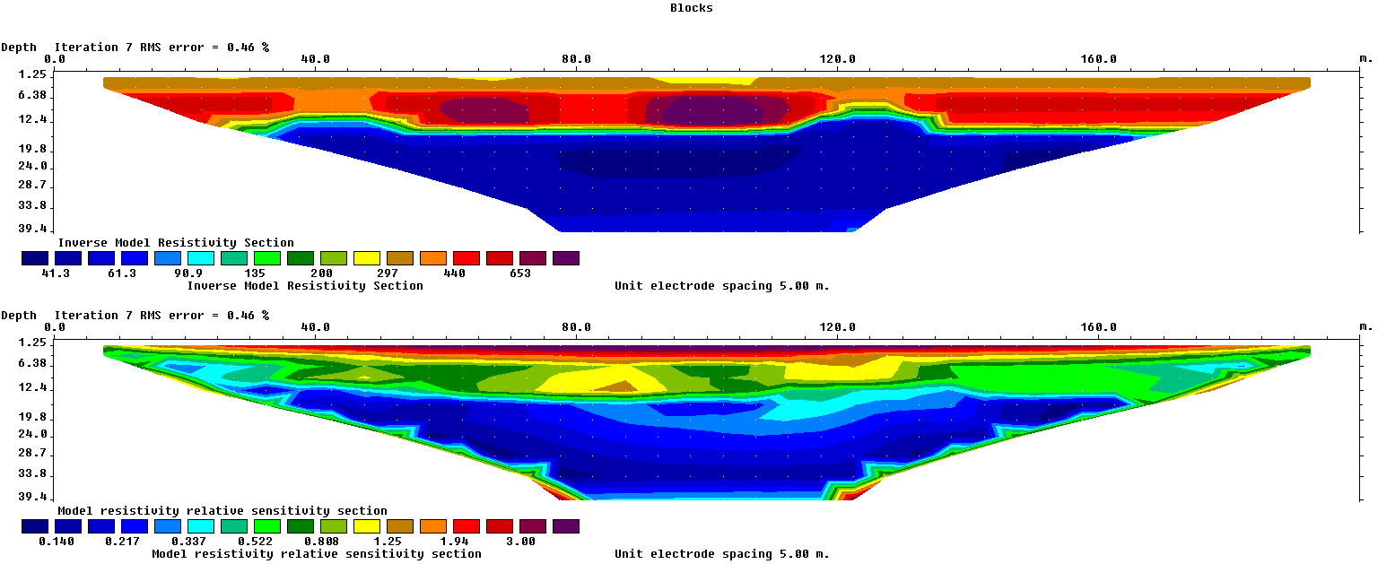
Inversion result and Sensitivity section of Wenner-Schlumburger array

Slide 8
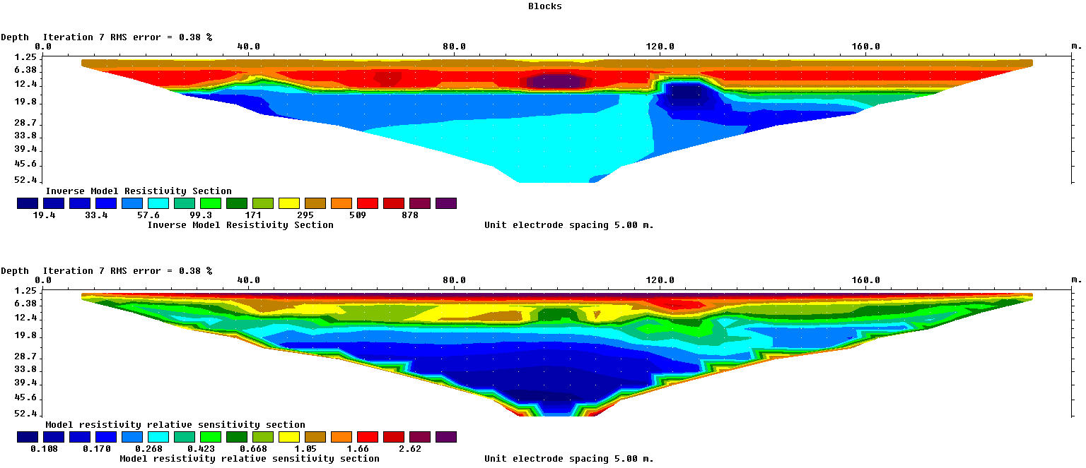
Inversion result and Sensitivity section of Dipole-dipole array

Slide 9
3D model with coal barrier

Slide 10
Inversion result of Wenner-Schlumberger (Horizontal x-z plane)

Slide 12
Inversion result of Dipole-dipole (Horizontal x-z plane)

Slide 14
3D model without coal barrier

Slide 15
Inversion result of Dipole-dipole array (Horizontal x-z plane)

Slide 17
Conclusions
2d model without coal barrier
Results from the Wenner and Wenner-Schlumberger array not able to differentiate water filled cavities (W1,W2) and low resistive layer but Dipole-dipole is able to resolve them, as sensitivity section for dipole-dipole array shows is more sensitive to included anomalies in the model.
2d model with coal barrier
Dipole-dipole also gives good results with coal barrier, as it able to detect all included cavities.
In the Sensitivity sections for all used array , Dipole-dipole shows more sensitive for air-filled (A1 and A2) and water filled cavities (W1 and W2).
3d model without coal barrier
All included cavities are of same dimensions. All cavities are not detected by Wenner-Schlumberger array in horizontal x-z plane but
Dipole-dipole detect all included anomalies.
3d model without coal barrier
Included cavities are well observed in the inverted section of Dipole-dipole array in horizontal x-z plane. 3d volume also gives good response for interpretation of cavities in sub-surface.
The presence of cavities in subsurface could be responsible for ground subsidence.

Slide 18
References
Bharti AK, Pal SK, Priyam P, Kumar S, Srivastava S, Yadav PK (2016) Subsurface cavity detection over Patherdih colliery, Jharia Coalfield, India using electrical resistivity tomography. Environmental Earth Sciences, 75(5), 443.
Das P, Mohanty PR (2016) Resistivity imaging technique to delineate shallow subsurface cavities associated with old coal working: a numerical study. Environmental Earth Sciences, 75(8), 661.
El-Qady, G., Hafez, M., Abdalla, M. A., & Ushijima, K. (2005) Imaging subsurface cavities using geoelectric tomography and ground-penetrating radar. Journal of cave and karst studies, 67(3), 174-181.
Eshaghi, E., Kamkar Rouhani, A., & Esteki, M. (2012, April) Using ERT and GPR methods to detect shallow subsurface targets. In EGU General Assembly Conference Abstracts (p. 803).
Fountain, L. S. (1976) Subsurface Cavity Detection: Field Evaluation of Radar, Gravity, and Earth Resistivity Methods. Transp. Res. Rec, 612, 38-46.
Gambetta, M., Armadillo, E. G. I. D. I. O., Carmisciano, C. O. S. M. O., Stefanelli, P. A. O. L. O., Cocchi, L. U. C. A., & Tontini, F. C. (2011) Determining geophysical properties of a near-surface cave through integrated microgravity vertical gradient and electrical resistivity tomography measurements. Journal of cave and karst studies, 73(1), 11-15.
Hassan, A. A. (2017) Numerical Modelling of Subsurface Cavities Using 2D Electrical Resistivity Tomography Technique. Diyala Journal for Pure Science, 13(2), 197-216.

Slide 19
Mahato PP (2018) Detection of cavity using electrical resistivity tomography (ERT) at Patherdih, Jharia coal field, Dhanbad, India. Universal Journal of Geoscience, 6(4), 114-7.
Okpoli, C. C. (2013). Sensitivity and resolution capacity of electrode configurations. International Journal of Geophysics, 2013.
Rupesh., Tiwari. P., & Sharma. S. P. (2021). High-Resolution Quasi-3D Electric Resistivity Tomography for Deciphering Groundwater Potential Zones in Lateritic Terrain. Natural Resources Research.
Spitzer, K. (1998). The three‐dimensional DC sensitivity for surface and subsurface sources. Geophysical Journal International, 134(3), 736-746.

Slide 20
Thank you

