Slide 1



Water Affordability Challenges in Urban Water Systems
Nazarbayev University, School of Engineering and Digital Sciences, Kazakhstan
Master in Data Science Yeldar Mussatayev Associate Professor Siamac Fazli May 27, 2022

Slide 2
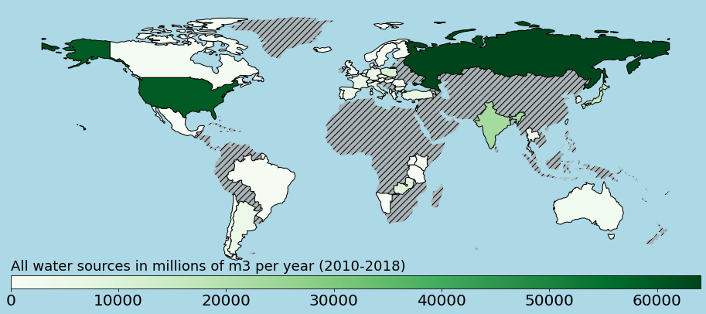
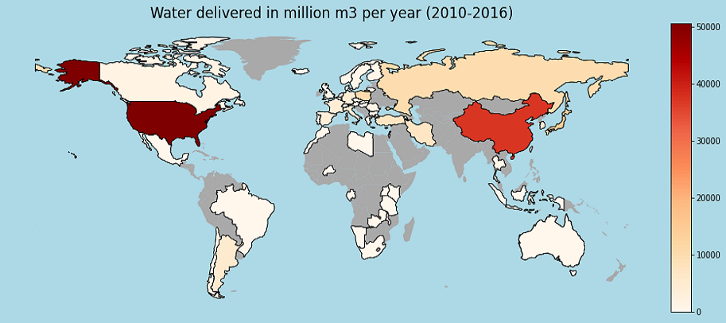
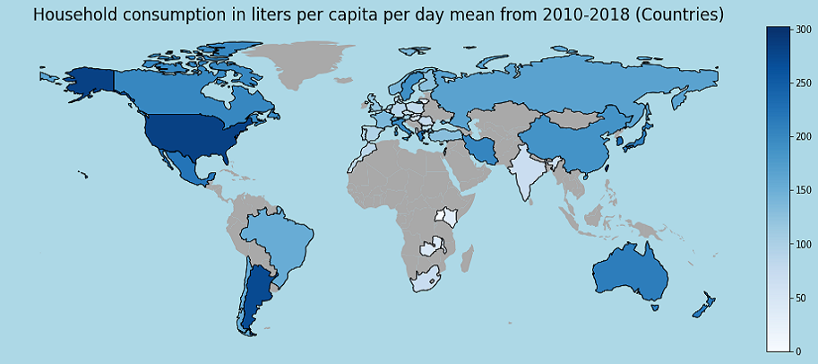
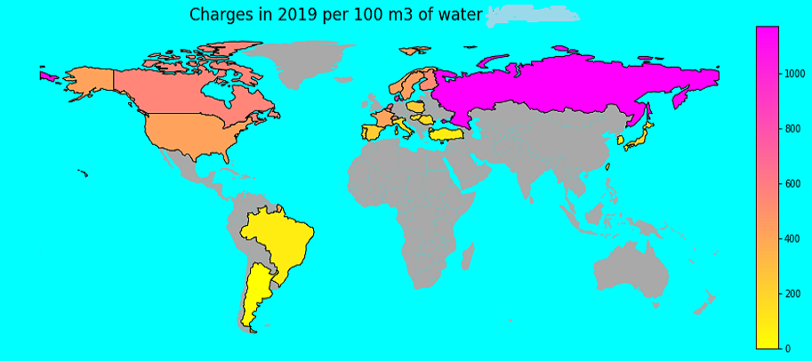
Dataset
provided by the International Water Association Group of Statisticians and Economists.
IWA relies on data from state water authorities, utility operators, consulting firms, and
other organizations involved in water and wastewater services.
The data on the main indicators of water affordability are collected every 2 years. For example, data for 2020 became available in 2021 and beyond.
SOURCE
DELIVERY
CONSUMPTION
CHARGES
49 countries from 5 continents
Survey period: 2010 -2018
Population is 3.34 billion people (44% of the global)
53 countries from 5 continents
Survey period : 2010-2016
Population is 3.39 billion (44% of earth’s population)
283 world’s major cities from 5 continents
Survey period : 2010-2018
191 world’s major cities
Survey period : 2017 and 2019

Slide 3
Dataset visualization
The current situation of Water Affordability Challenges in Urban Water Systems.
The UN [34] and Cruz et al. [12] advise setting the affordability coefficient threshold at 3%.
The average water limit per person per day: 150 liters [10, 16, 30].

Slide 4
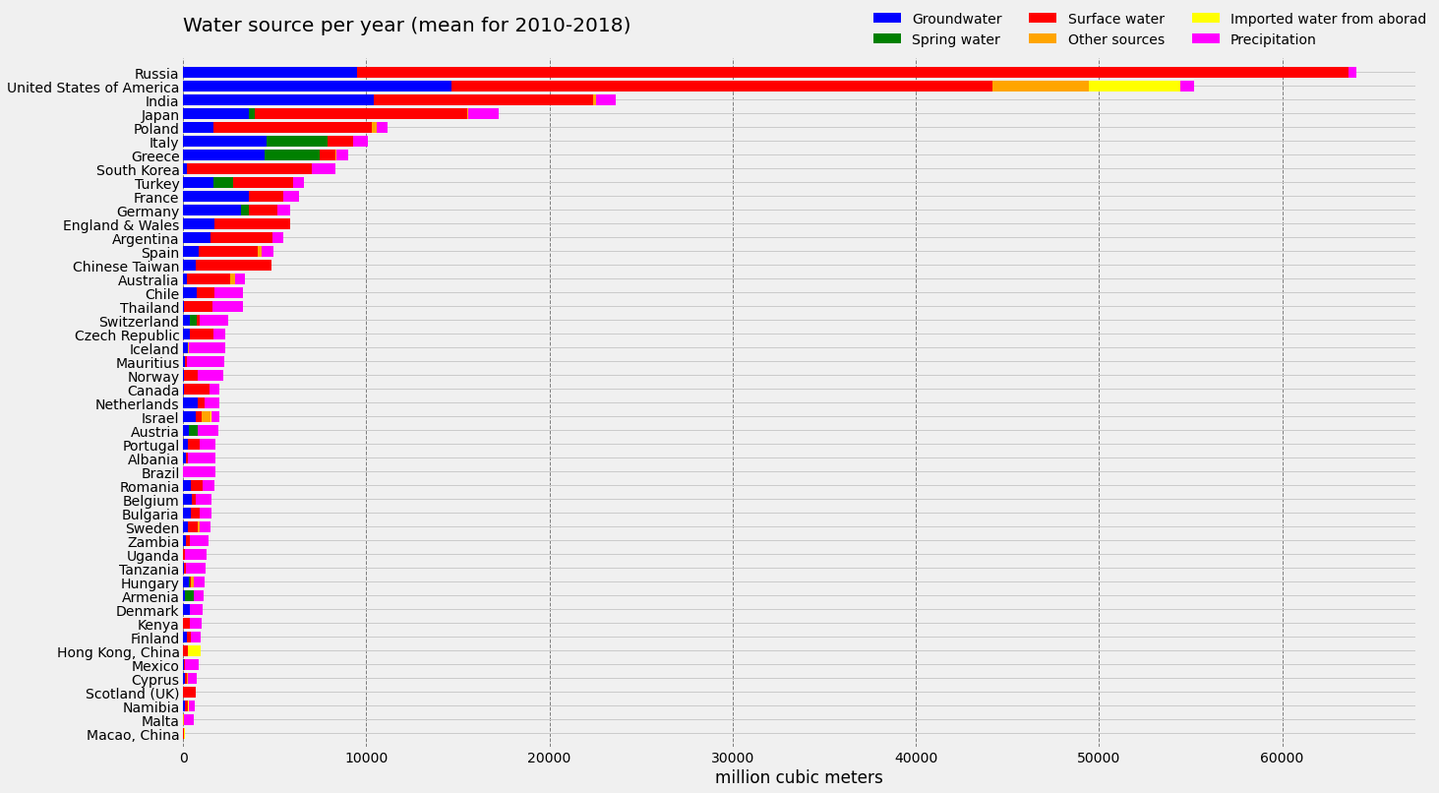
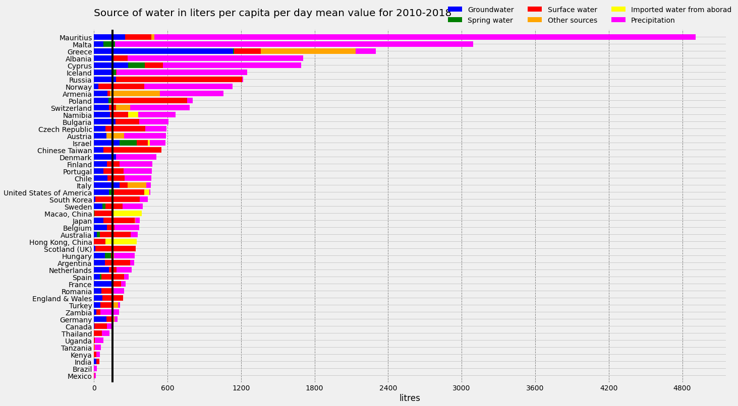
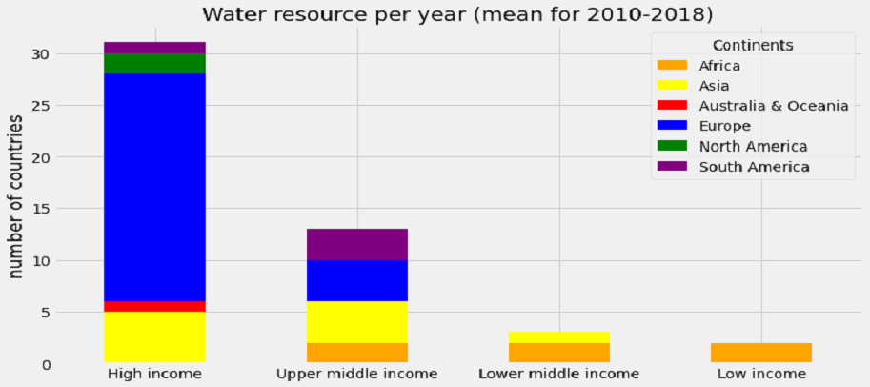
WATER SOURCE
Figure 1. Source of water used by countries (mean for 2010-2018)
Figure 2. Source of water per capita per day (mean for 2010-2018)
Groundwater
2. Spring water
3. Surface water
4. Imported water from abroad
5. Precipitation
6. Other sources
The set water threshold per person is 150 liters
Figure 3. Water source by continent & income (mean for 2010-2018)

Slide 5
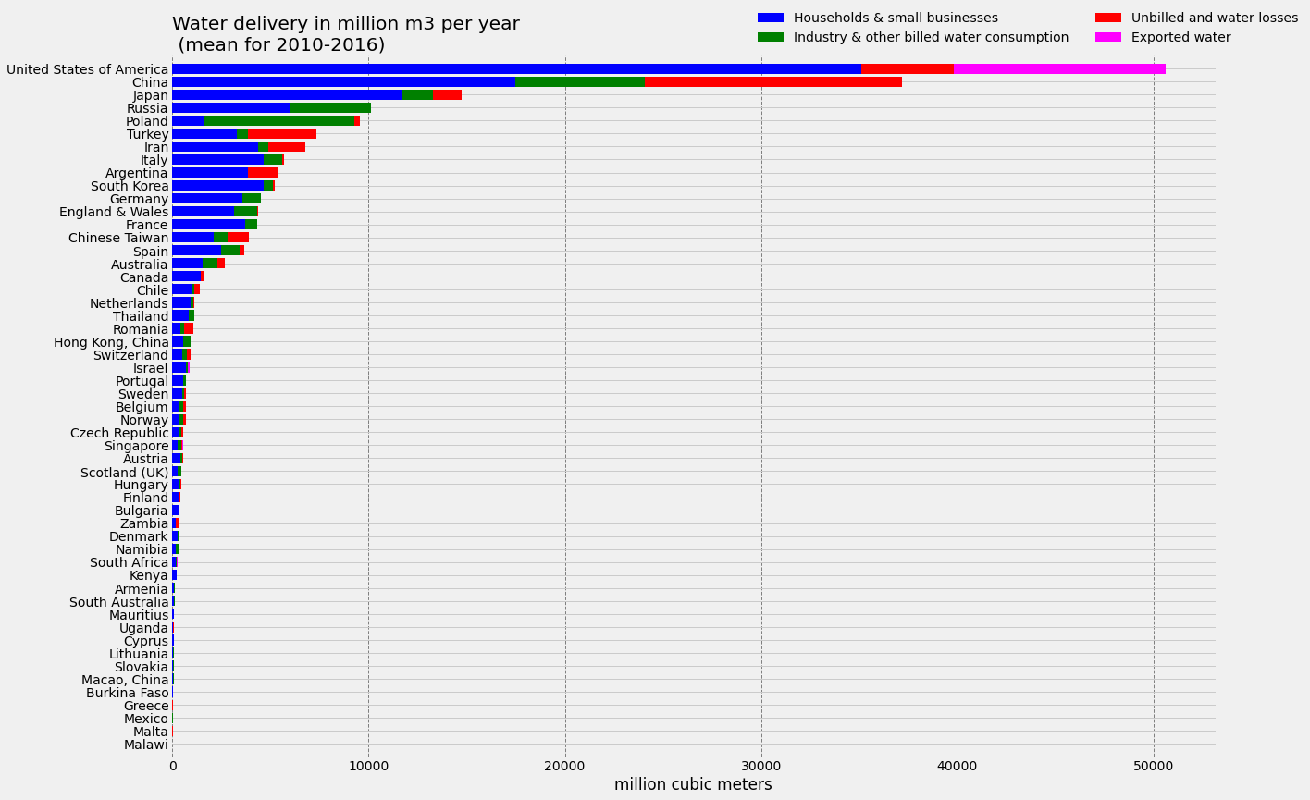
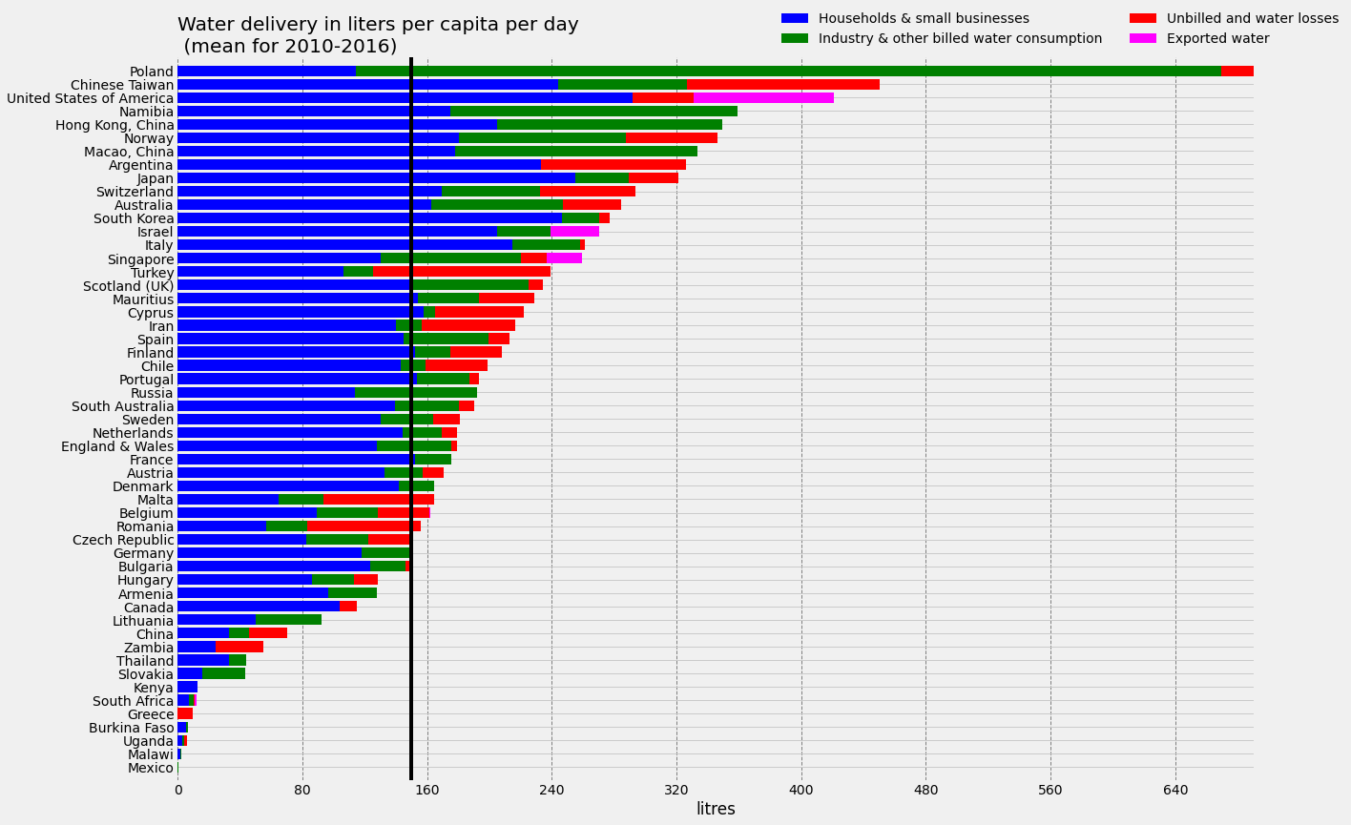
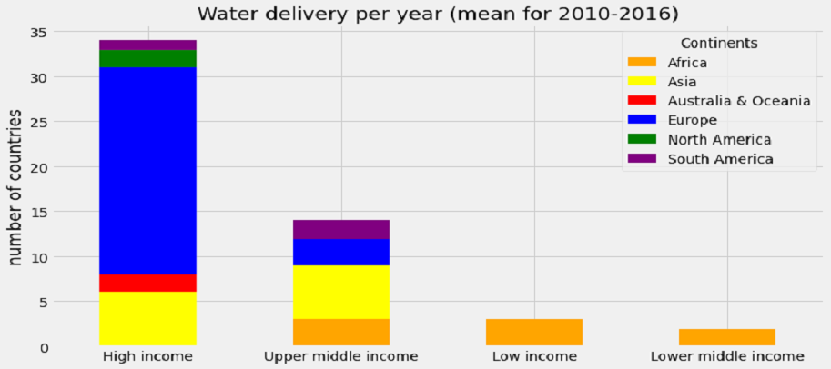
WATER DELIVERY
Figure 4. Water delivery in million cubic meter per year (mean for 2010-2016)
Figure 5. Water delivered per capita per day in liters (2010-2016)
Households and small businesses
Industry and other billed water consumption
Unbilled and water losses
Exported water
Figure 6. Water delivery by continent & income (mean for 2010-2018)

Slide 6
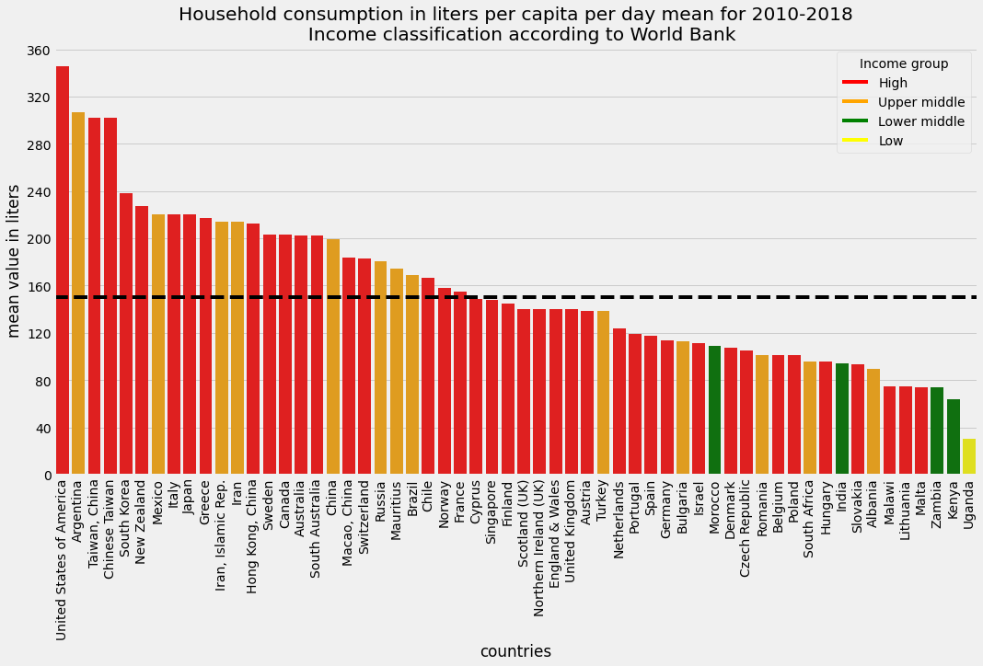
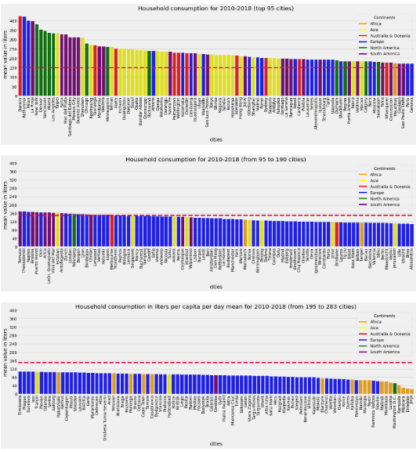
WATER CONSUMPTION
Figure 7. Household consumption by countries in liters per capita per day (mean for 2010-2018)
Total 283 cities
119 consume more than 150 liters per person per day (1 African city Mauritius, 29 Asian, 11 from Australia and Oceania, 34 European, 13 North American and 31 South American)
164 cities consume less than the established threshold (Africa represented by 19, Asia with 9, Australia and Oceania with one city, Brisbane, Europe with 131, North America with one city Washington D.C. and South America with 3)
32 out of 58 countries are below the established threshold of 150 liters of water.
Figure 8. Household consumption in liters per capita per day (mean for 2010-2018)

Slide 7
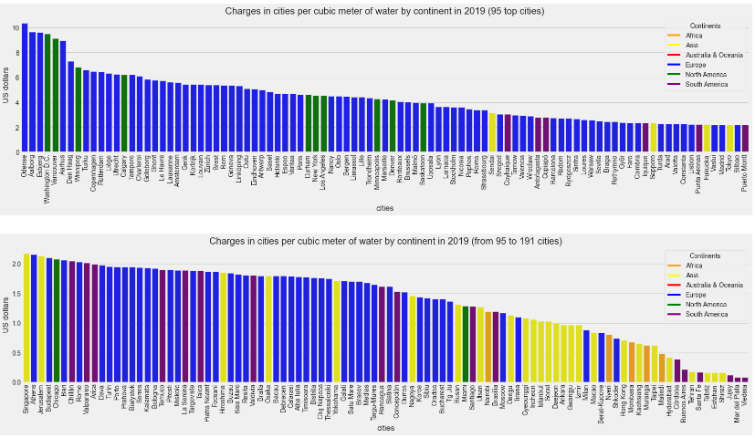
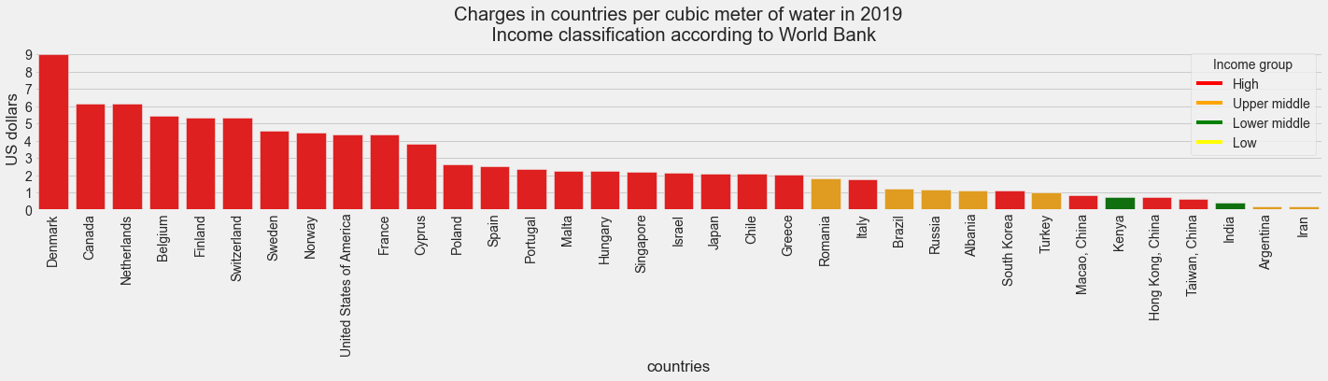
WATER CHARGES
Water charges are based on the following components:
1. Sub-total potable water
2. Sub-total environmental fee
3. Sub-total other fees
Figure 9. Charges in countries per cubic meter in 2019
191 cities:
High - 135 and upper-middle – 50, lower-middle income - 6;
Africa – 5;
Asia – 30;
Europe – 121;
North America – 12;
South America – 23.
34 countries
Figure 10. Charges in cities per cubic meter by continent in 2019
The above data on water charges were presented in the national currencies of the countries. By converting them to the U.S. dollar equivalent, we obtained general data, which allows us to make a comparative analysis.

Slide 8
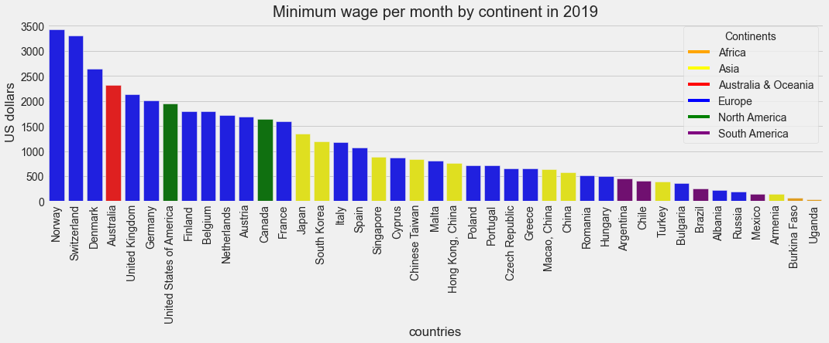
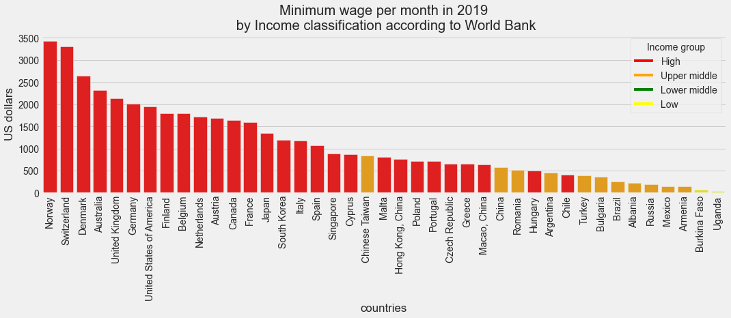

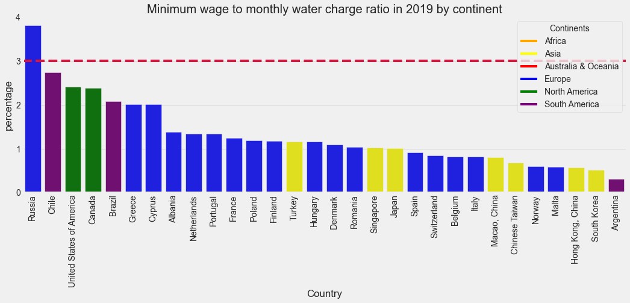
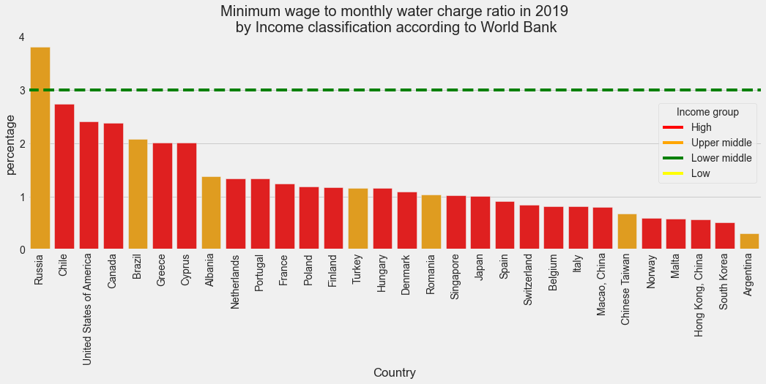
MINIMUM WAGE & AFFORDABILITY RATIO
Figure 11. Charges in cities per cubic meter by continent in 2019
Figure 12. Charges in cities per cubic meter by continent in 2019
The formula for calculation the water affordability ratio (AR) is as follows:
(1)
Figure 13. Tariff affordability in the countries by continent in 2019
Figure 14. Tariff affordability in the countries by income group in 2019

Slide 9
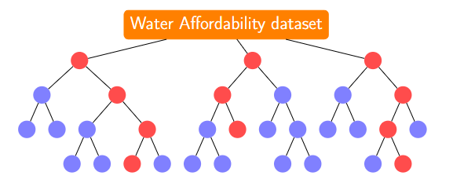
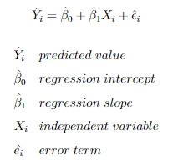
PREDICTION MODELS
To predict the data for the next period, we used two methods:
Without filling in the missing data
With filling in the missing data using kNNimputer
For the first method, we use Linear Regression, and for the second Random Forest.
LINEAR REGRESSION
RANDOM FOREST
Linear regression is a statistical model used to determine the relationship between two or more variables.
We calculated slope and intercept data from the
regression line for this purpose. This process helped us to obtain data for the predicted
periods. We used the following function for our calculations.
Random Forest is one of the most powerful methods for data analysis, which has proven to be yield beneficial results in many studies [21]. Resent studies conducted in the field of forecasts prove the best efficiency of Random Forest [3, 4, 5, 6, 7, 22, 23, 27, 40].
(2)
Figure 15. Random Forrest's workflow

Slide 10
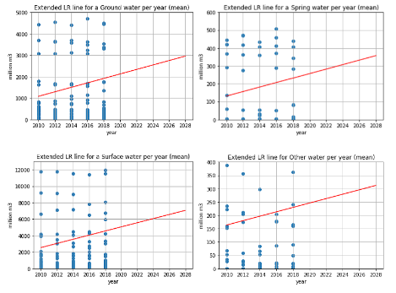
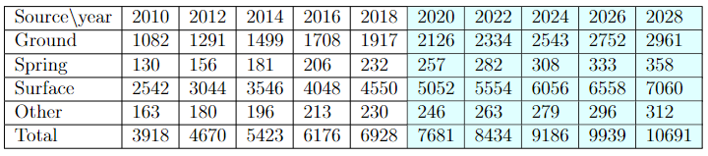
Predictions for Water Source
Figure 16. Linear regression for a water source per year (without imputation)
Table 1. Available (mean for 2010-2018) and Predicted (mean for 2020-2028

Slide 11
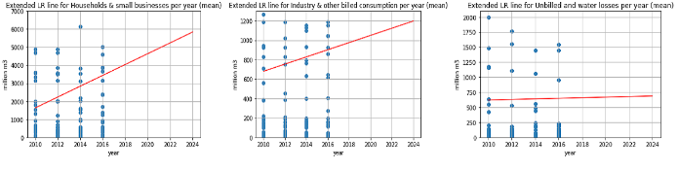
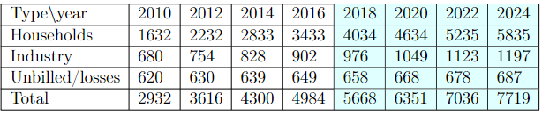
Predictions for Water Delivery
Figure 17. Linear regression for water delivery per year (without imputation)
Table 2. Available (mean for 2010-2016) and Predicted (mean for 2018-2024) water delivery

Slide 12
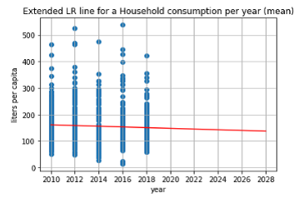
Prediction for Water Consumption
Figure 18. Linear regression for water consumption per year (without imputation)
Table 3. Available (mean for 2010-2018) and Predicted (mean for 2020-2028) water consumption

Slide 13
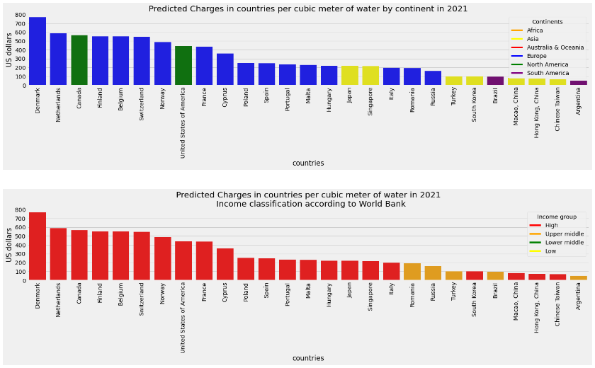
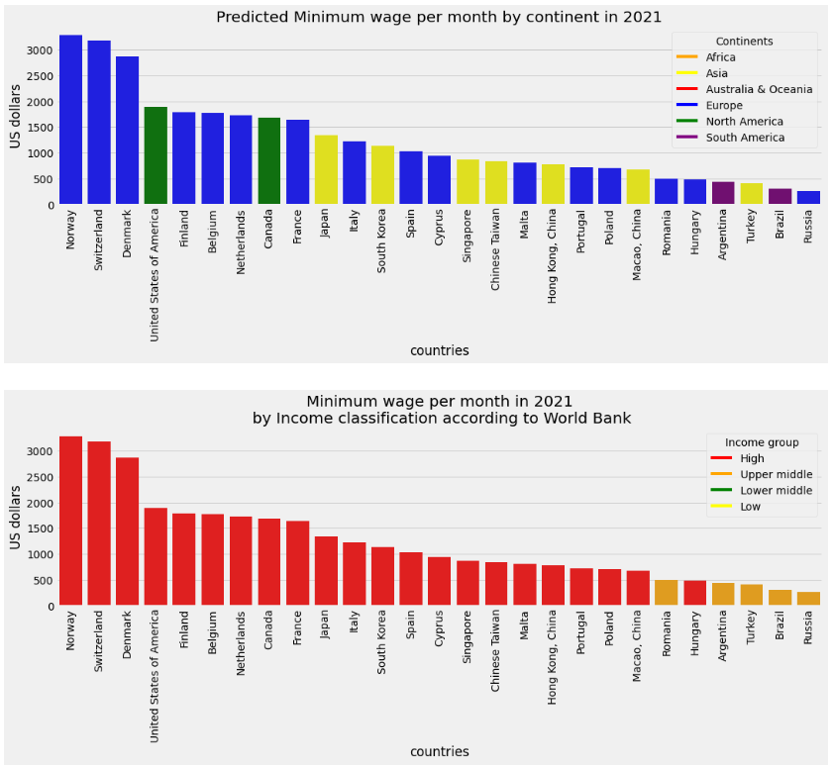
Predictions for charges and minimum wages
Figure 19. Predicted Charges in countries per cubic meter of water in 2021
A matrix of 27 countries is available for the water charge and the minimum wage:
High - 22 and upper-middle income – 5;
Asia – 7;
Europe – 16;
North America – 2;
South America – 2.
Figure 20. Predicted Minimum Wage per month in 2021

Slide 14
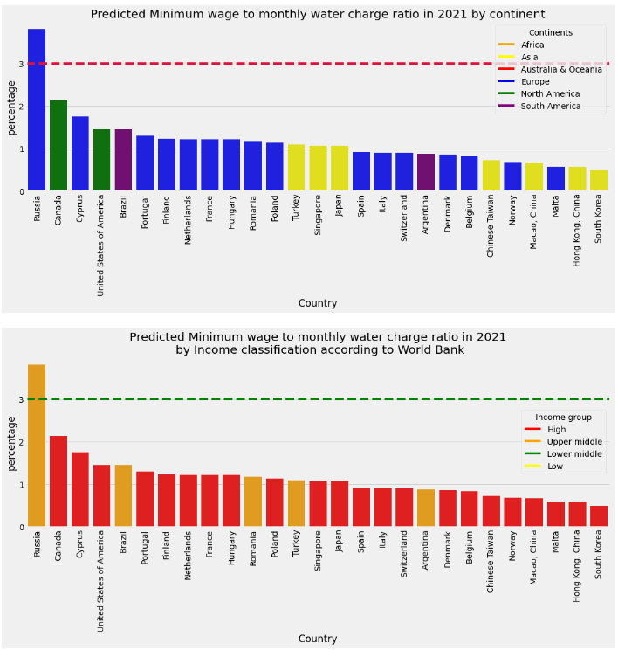
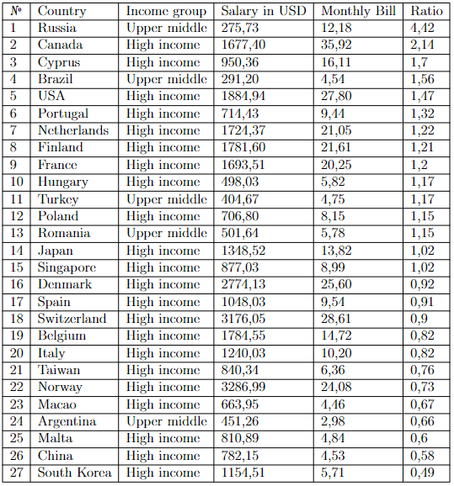
Predicted Affordability Ratio
Table 4. List of countries according to predicted Affordability Ratio
Figure 21. Predicted affordability ratio

Slide 15
CONCLUSION
Identified two methods of predicting possible water unavailability factors, such as without filling in missing data and with imputation using machine learning algorithms.
It was able to collect incomplete data on the water source and consumption from 2010 to 2018, water delivery from 2010 to 2016, and water charges for 2019. In general, the dataset is up to date.
Analysis of country water affordability based on data from capitals and major cities.
It is proved that, in general, the water is quite accessible practically in all countries and cities. Due to the low minimum wage and being represented only by its capital Moscow, the exception is Russia.
The developed model can be applied in practice to predict water unavailability.
The research can be optimized by forming or obtaining the entire dataset conducted in subsequent work.

Slide 16
Thank you for your attention!
If you have any questions, please do not hesitate to contact us:
siamac.fazli@nu.edu.kz
yeldar.mussatayev@nu.edu.kz
How to cite: Mussatayev, Y. and Fazli, S.: ­Water Affordability Challenges in Urban Water Systems, EGU General Assembly 2022, Vienna, Austria, 23–27 May 2022, EGU22-10872, https://doi.org/10.5194/egusphere-egu22-10872, 2022.

