Slide 1


The effect of (NH₄)₂SO₄ on the freezing properties of non-mineral dust ice nucleating substances of atmospheric relevance
Soleil E. Worthy¹, Anand Kumar¹, Yu Xi¹, Jingwei Yun¹, Jessie Chen¹, Cuishan Xu¹, Victoria E. Irish¹, Pierre Amato², Allan K. Bertram¹
¹Department of Chemistry, University of British Columbia, Vancouver, BC, V6T1Z1, Canada
²Institut de Chimie de Clermont-Ferrand, Université Clermont Auvergne, CNRS, Sigma-Clermont, 63000 Clermont-Ferrand, France
EGU General Assembly, May 25th, 2022
Worthy, S. E., Kumar, A., Xi, Y., Yun, J., Chen, J., Xu, C., Irish, V. E., Amato, P., and Bertram, A. K.: The effect of (NH₄)₂SO₄on the freezing properties of non-mineral dust ice-nucleating substances of atmospheric relevance, 2021.

Slide 2
The relevance of solutes to ice nucleation
During atmospheric transport, ice nucleating substances (INSs) may become coated with organic or inorganic solutes such as:
  NH₄⁺, SO₄²⁻, NO₃⁻, Na⁺
Solutes may impact ice nucleation in the following ways:
  Decrease freezing temperature by reducing solution water activity¹
  Increase or decrease freezing temperature by interacting with and/or modifying INS surfaces
Many studies on impacts of solutes on mineral dust ice nucleation²⁻⁶
Few studies on impacts of solutes on non-mineral dust ice nucleation
INS emitted
INS coated
with solute
Coated INS interacts with clouds
1. Koop T. et. al., Nature, 2000
2. Kumar A. et. al., Atmos. Chem. Phys., 2019a
3. Kumar A. et. al., Atmos. Chem. Phys., 2019b
4. Kumar A. et. al., Atmos. Chem, Phys., 2018
5. Whale, T. F. et. al., Chem. Sci., 2018.
6. Reischel M. T., and Vali G., Tellus , 1975
Worthy, S. E., Kumar, A., Xi, Y., Yun, J., Chen, J., Xu, C., Irish, V. E., Amato, P., and Bertram, A. K.: The effect of (NH₄)₂SO₄on the freezing properties of non-mineral dust ice-nucleating substances of atmospheric relevance, 2021.
Notes:
Aqueous NH₃ and NH₄⁺ improve ice nucleation ability of feldspars, micas, gibbsite, quartz, kaolinite²⁻⁶
Have little to no effect on ice nucleation ability of amorphous silica²

Slide 3
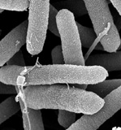

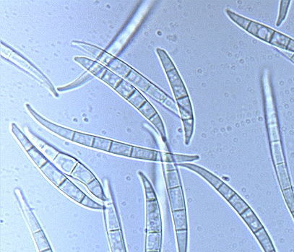
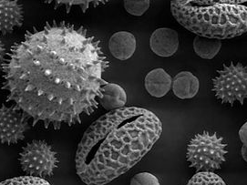
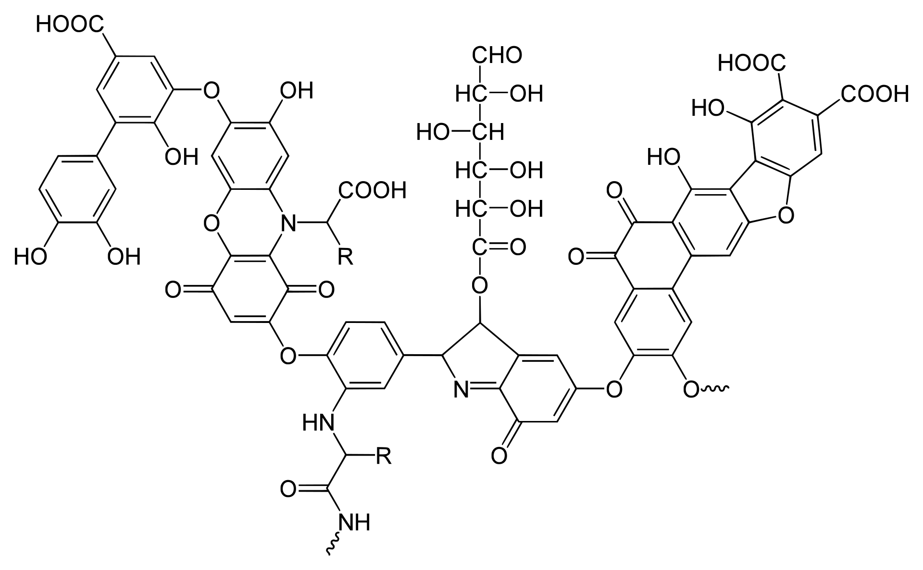
Research question:
What effect does the inorganic solute (NH₄)₂SO₄ have on the ice nucleating ability of non-mineral dust INSs?
3 Bacteria
  Pseudomonas syringae¹, Xanthomonas campestris, and Snomax²
2 Fungi
  Fusarium acuminatum, and Fusarium avenaceum
3 Environmental samples
  Antarctic sea ice diatom exudate sample from 1 location
  Arctic sea surface microlayer (SML) samples from 2 locations
2 Humic substances
  Humic acid³ and fulvic acid
4 Mineral dusts (for comparison)
  Arizona Test Dust (ATD)³, K-feldspar^{3, 4}, kaolinite⁵, and montmorillonite
All samples studied with and without 0.05M (NH₄)₂SO₄ using droplet freezing technique⁶
https://microbewiki.kenyon.edu/index.php/Bacterial_nucleation_in_pseudomonas_syringae
https://www.telegraph.co.uk/travel/tours/desert-tours-to-try-in-your-lifetime/
https://en.wikipedia.org/wiki/Gibberella_avenacea
https://en.wikipedia.org/wiki/Pollen
1. Amato P. et. al., Atmos. Chem. Phys., 2015
2. Koop T. and Zobrist B., Phys. Chem. Chem. Phys., 2009
3. Whale, T. F. et. al., Chem. Sci., 2018.
4. Kumar A. et. al., Atmos. Chem, Phys., 2018
5. Kumar A. et. al., Atmos. Chem. Phys., 2019
6. Whale, T. F. et. al., Atmos. Meas. Tech., 2015
Worthy, S. E., Kumar, A., Xi, Y., Yun, J., Chen, J., Xu, C., Irish, V. E., Amato, P., and Bertram, A. K.: The effect of (NH₄)₂SO₄on the freezing properties of non-mineral dust ice-nucleating substances of atmospheric relevance, 2021.

Slide 4
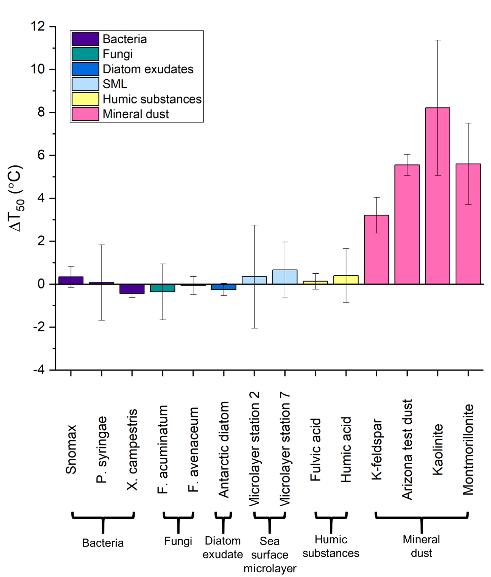
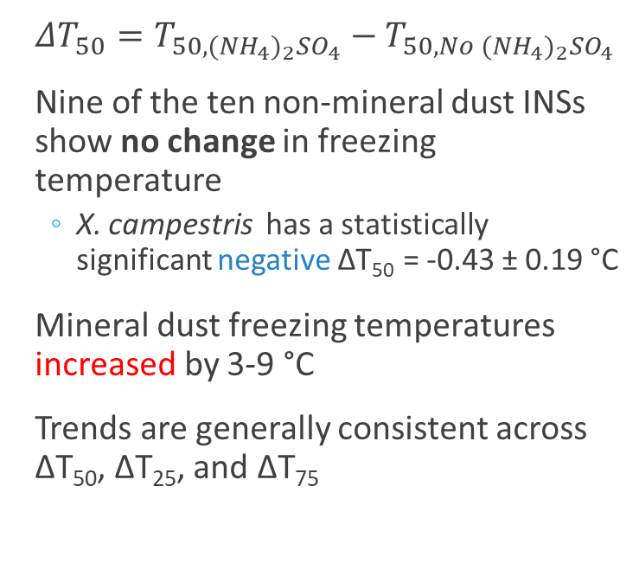
Comparison of (NH₄)₂SO₄ effects on different INS types
Enhanced
$ΔT_{50}=T_{{50,(NH}_{4})_{2}{SO}_{4}}−T_{{50,No (NH}_{4})_{2}{SO}_{4} }$
Nine of the ten non-mineral dust INSs show no change in freezing temperature
  X. campestris has a statistically significant negative ΔT₅₀ = -0.43 ± 0.19 °C
Mineral dust freezing temperatures increased by 3-9 °C
Trends are generally consistent across ΔT₅₀, ΔT₂₅, and ΔT₇₅
No effect
Small
suppression
Worthy, S. E., Kumar, A., Xi, Y., Yun, J., Chen, J., Xu, C., Irish, V. E., Amato, P., and Bertram, A. K.: The effect of (NH₄)₂SO₄on the freezing properties of non-mineral dust ice-nucleating substances of atmospheric relevance, 2021.

Slide 5
Implications
The non-mineral INSs studied either do not interact with (NH₄)₂SO₄ or do so in a way that does not significantly impact ice nucleation
Potential for 0.05 M (NH₄)₂SO₄ to be used as an assay for the presence of mineral dust INSs
(NH₄)₂SO₄ effect on freezing
10
Enhanced
ΔT (°C)
No effect
0
Non-mineral INS
Biological INS
Organic INS
Mineral dust INS
The relative importance of mineral dust to non-mineral dust INSs in mixed phase clouds could increase as particles become coated with (NH₄)₂SO₄ in the atmosphere
Worthy, S. E., Kumar, A., Xi, Y., Yun, J., Chen, J., Xu, C., Irish, V. E., Amato, P., and Bertram, A. K.: The effect of (NH₄)₂SO₄on the freezing properties of non-mineral dust ice-nucleating substances of atmospheric relevance, 2021.

Slide 6

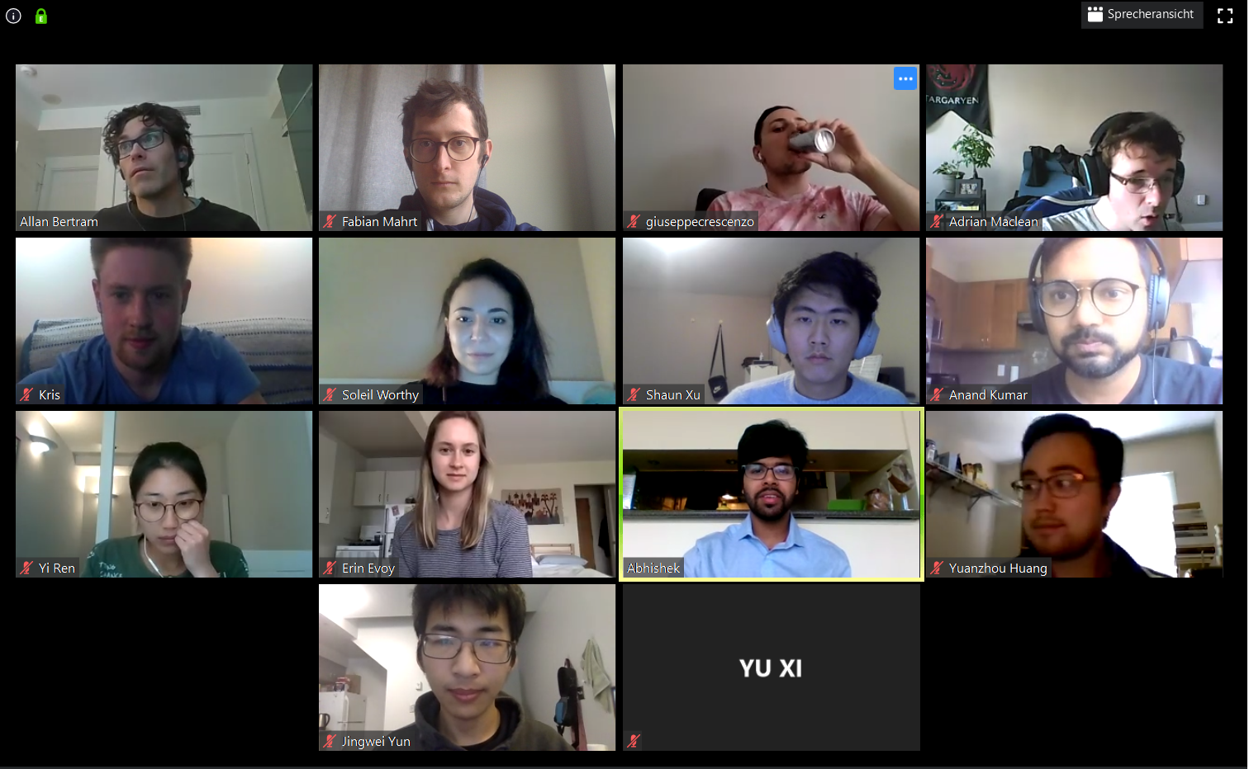
Acknowledgements
Thank you to:
Dr. Allan Bertram and the Bertram Group
Dr. Elena Polishchuk and Jessie Chen
Dr. Pierre Amato
Dr. Steven Lindow
Dr. James Raymond

Slide 7
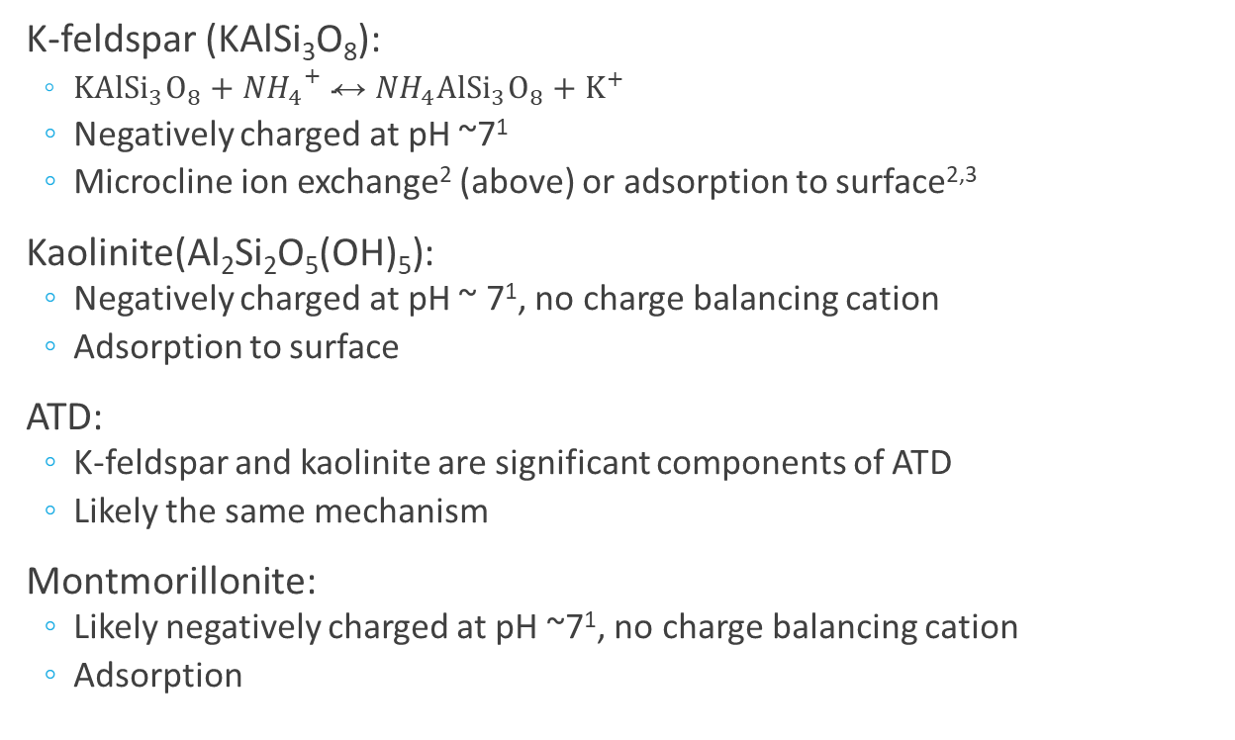
Possible mechanisms for the effect of (NH₄)₂SO₄ on mineral dust ice nucleation
K-feldspar (KAlSi₃O₈):
  $KAl{Si}_{3}O_{8}+{{NH}_{4}}^{+}↔{NH}_{4}Al{Si}_{3}O_{8}+K^{+}$
  Negatively charged at pH ~7¹
  Microcline ion exchange² (above) or adsorption to surface^{2,3}
Kaolinite(Al₂Si₂O₅(OH)₅):
  Negatively charged at pH ~ 7¹, no charge balancing cation
  Adsorption to surface
ATD:
  K-feldspar and kaolinite are significant components of ATD
  Likely the same mechanism
Montmorillonite:
  Likely negatively charged at pH ~7¹, no charge balancing cation
  Adsorption
1. Kosmulski M., Surface Charging and Points of Zero Charge, 2009
2. Nash V. E. and Marshall C. E., Soil Sci. Soc. Am. J., 1957
3. Kumar A. et. al., Atmos. Chem. Phys., 2018

Slide 8
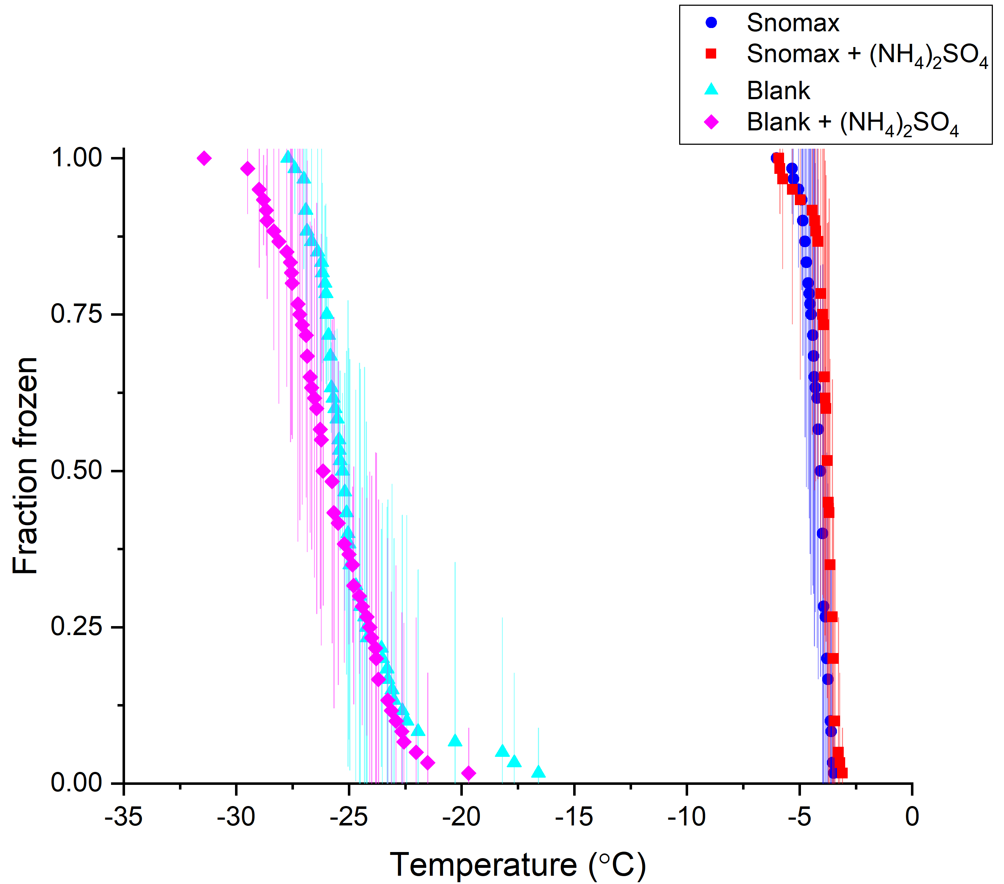
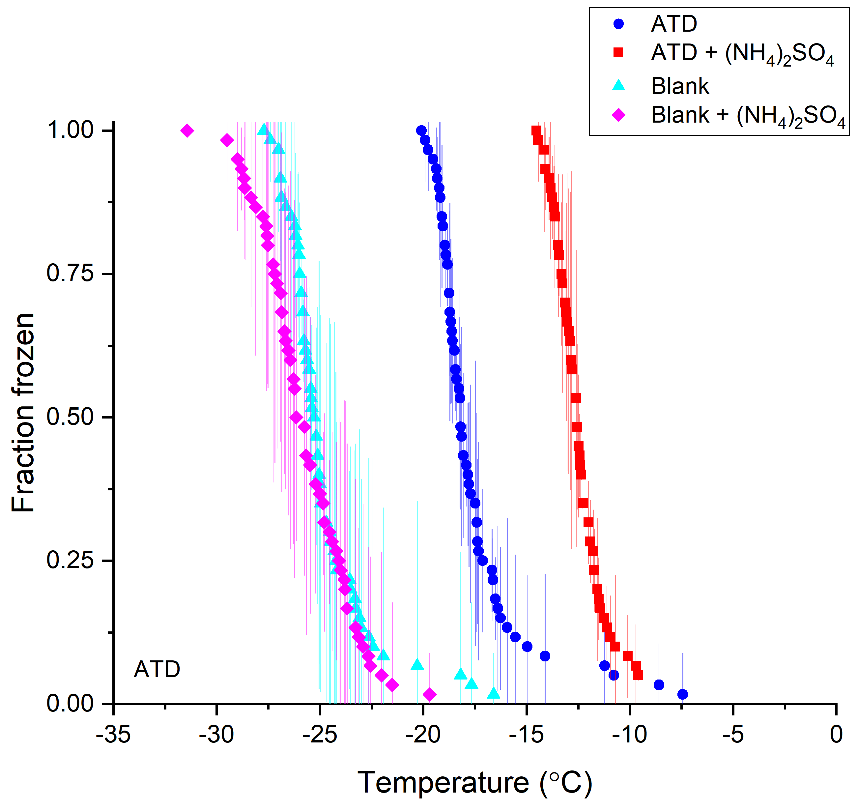
Effects of (NH₄)₂SO₄ on bacterial vs mineral dust INSs
No effect
Enhanced

Slide 9
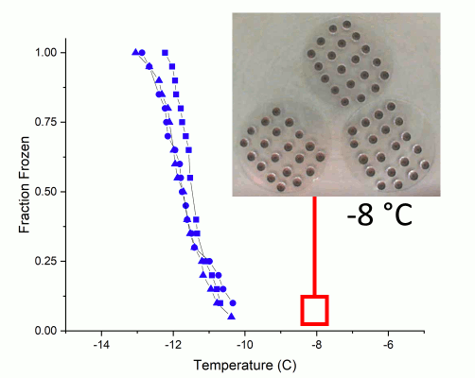
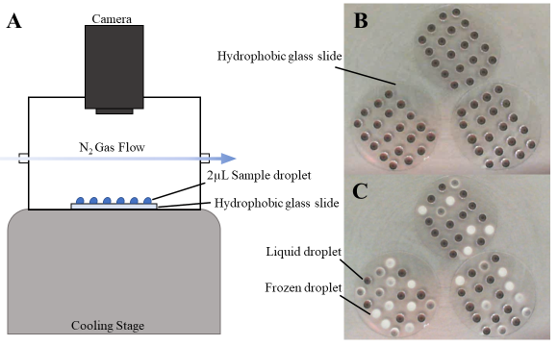
Droplet freezing technique
Mat-lab
script
Whale, T. F. et. al., Atmos. Meas. Tech., 2015

Slide 10
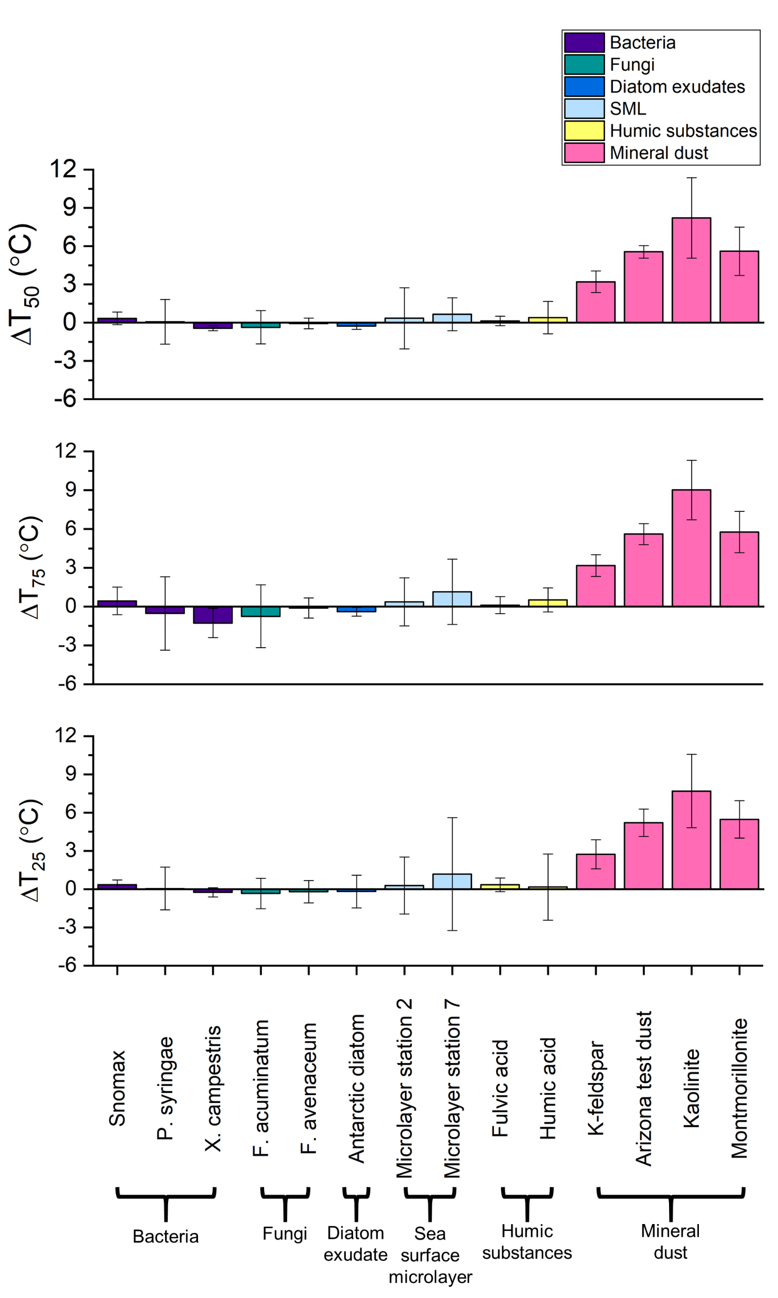
ΔT₅₀, ΔT₂₅, and ΔT₇₅ Data

