Slide 1


Progressing the global samples community through the new partnership between
IGSN and DataCite
Sarah Ramdeen¹, Kerstin Lehnert¹, Jens Klump², Matt Buys³, Sarala Wimalaratne³, and Lesley Wyborn⁴
¹Lamont Doherty Earth Observatory, Columbia University, New York, USA
²Commonwealth Scientific and Industrial Research Organisation, Perth, Australia
³DataCite, Hannover, Germany
⁴Australian National University, Canberra, Australia

Slide 2
IGSN 2040 and why we sought/partnered with DataCite
IGSN e.V. conducted a thorough review of its business model and technical architecture to ensure the sustainability and longevity of its operations.
The project was called the IGSN 2040 project.
A key output of the IGSN 2040 project was the recommendation that IGSN e.V. should partner with an established research infrastructure provider to consolidate common services.

Slide 3
The proposed partnership between DataCite and the IGSN e.V
In October 2021, DataCite and the IGSN e.V. signed an agreement to form a partnership to support the global adoption, implementation, and use of the IGSN physical sample identifiers.
Both DataCite and IGSN currently offer the ability to provide Globally Unique Persistent, Resolvable Identifiers (GUPRIs) within the overall research ecosystem.
The proposed collaboration will bring together the strengths of each organization.

Slide 4
What are the Strengths of DataCite?
DataCite is a community-led organisation that has been providing the means to create, find, cite, connect, and use research across 47 countries globally since 2009.
DataCite provides persistent identifiers (DOIs) for research data and other research outputs, and supports the efforts of several identifier communities.
DataCite also develops services that make it easier for researchers to connect and share their DOIs with the broader research ecosystem.

Slide 5
What are the strengths of the IGSN and the IGSN e.V.
IGSN e.V. is an international, non-profit organization with more than 20 members.
Since 2008, IGSN has provided a central registration system that enables researchers to apply a globally unique and persistent identifier for physical samples.
The core purpose of IGSN is to enable transparent and traceable connections from samples to instruments, grants, data, publications, people and organizations by offering IGSN IDs as anchors.

Slide 6
The Proposed Partnership will:
Enable IGSN to leverage DataCite DOI registration services
DataCite will provide:
  The IGSN ID registration services.
  Support to ensure the ongoing sustainability of the IGSN PID infrastructure and its integration with the global PID ecosystem.
The Partnership will allow IGSN to focus on community efforts such as:
  Promoting and expanding the global samples ecosystem.
  Supporting new research and best practice in methods of identifying, citing, and locating physical samples.

Slide 7
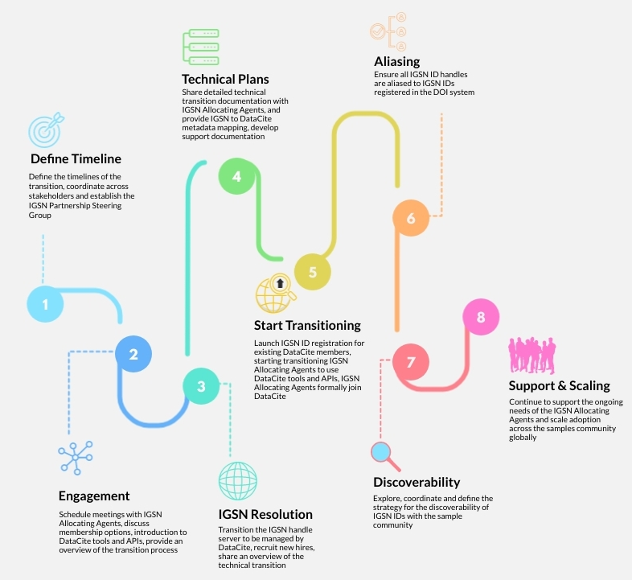
Partnership and Transition Plan
Transitioning the IGSN ID minting service from its original infrastructure to DataCite services is underway.
Minting of IGSN IDs through DataCite will soon be available to all members of DataCite.

Slide 8
What this means for the future IGSN Community of Communities
The IGSN Samples Community (IGSN SC) aspires to be a collaborative space for community development that promotes the use of samples and their connections to any derived observations, images, and analytical data.
The IGSN plans to develop an international ‘Community of Communities’ which will include members from the global samples community across multiple disciplines.
Different research communities have a wide range of requirements towards metadata and identification of samples.
The community will support varying levels of skills with PIDs and metadata.
It will enable cohesion around the use of IGSN thus enabling greater research discovery, innovation and advancement for samples.

Slide 9
Contact us for more information!
Rorie Edmunds (DataCite Samples Community Manager) rorie.edmunds@datacite.org
Kerstin Lehnert (IGSN): lehnert@ldeo.columbia.edu
Jens Klump (IGSN): jens.klump@csiro.au
Matt Buys (DataCite): mattbuys@datacite.org
Sarala Wimalaratne (DataCite): sarala@datacite.org

