Slide 1


GPS data reveal the evolution of liquid water
retention within the Greenland Ice Sheet
at the seasonal and inter-annual time scale
Jiangjun Ran¹ and Pavel Ditmar²
¹ Southern University of Science and Technology
² Delft University of Technology
EGU 2022

Slide 2
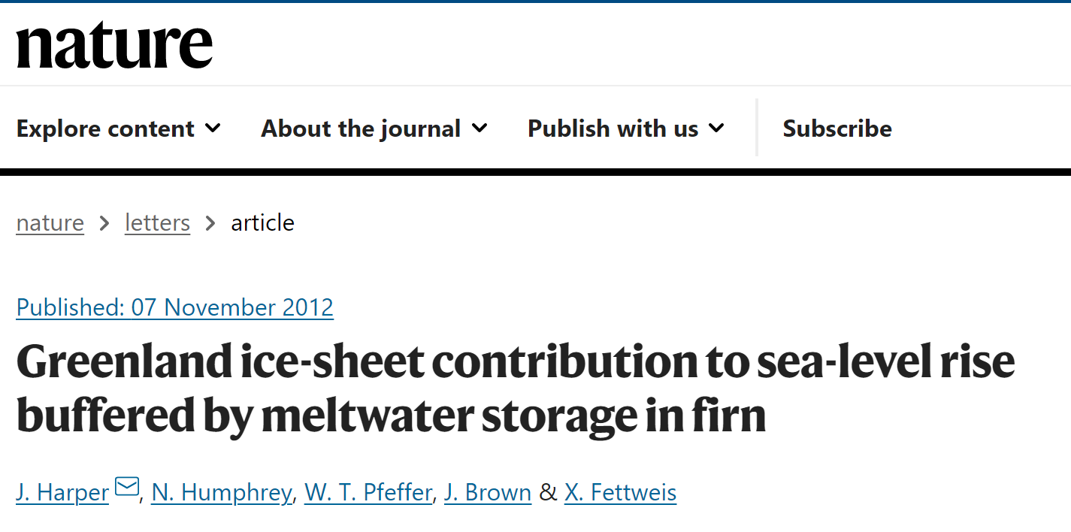
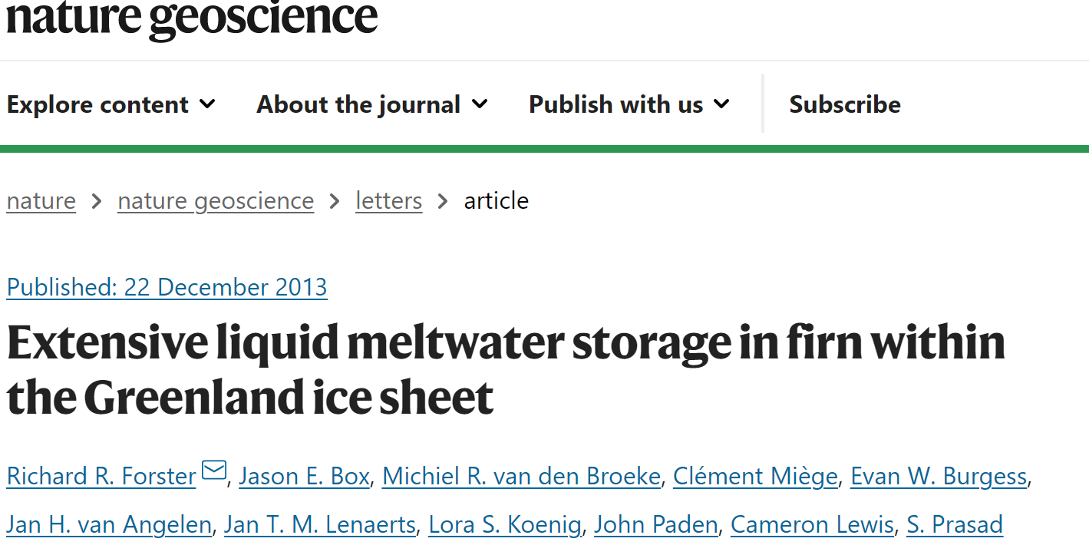
Research background
The Greenland ice sheet (GrIS) is currently losing mass, as a result of complex mechanisms of ice-climate interaction that need to be understood for reliable projections of future sea level rise.
Snow/ice melting with a subsequent meltwater runoff is one of the largest contributors (~55%) to the total mass loss of GrIS.
Previous studies analyzed the in-situ ice core, ground or/and airborne radar profile data, and find that significant liquid meltwater percolates into the firn layer, filling in the available pore space (Harper et al., 2012; Machguth et al., 2016; Forster et al., 2013; Culberg et al., 2021).
The spatiotemporal evolution of meltwater is poorly constrained.
Notes:
The Greenland ice sheet (GrIS) is currently losing mass, as a result of complex mechanisms of ice-climate interaction that need to be understood for reliable projections of future sea level rise. However, the processes about the liquid meltwater inside the ice sheet, e.g., melt water retention, basal melt water production, subglacier hydrology, etc., are poorly constrainted.
The pore spaces in firn — a type of partly compacted snow — can be filled by meltwater and thus act as a temporary reservoir. quantify the existing water storage capacity of the percolation zone of the Greenland ice sheet. buffer several hundred gigatonnes of meltwater for several decades. Although this buffering capacity is only temporary, and cannot be easily regained, it has the potential to delay the pace of near-term sea level rise.
We collected in situ observations of firn structure and meltwater retention along a roughly 85-kilometre-long transect of the melting accumulation area.

Slide 3
GNSS Data and models
GPS： the Greenland Global Positioning System Network (GNET) contain information about bedrock’s elastic response to mass variations in the vicinity of a given GNSS station.
1. the Nevada Geodetic Laboratory
2. Khan et al. (2010)
SMB: surface mass balance models
1. RACMO 2.3p2
2. MAR v3.9
Geophysical models: non-ice sources (see Table A1): atmospheric pressure loading (ATM), land water storage (LWS), non-tidal ocean loading (NTOL), and thermal elastic expansion (TEM).
Satellite gravimetry: GRACE mascon products
1. GSFC mascon
2.CSR mascon
3. JPL mascon
Notes:
The Greenland ice sheet (GrIS) is currently losing mass, as a result of complex mechanisms of ice-climate interaction that need to be understood for reliable projections of future sea level rise. However, the processes about the liquid meltwater inside the ice sheet, e.g., melt water retention, basal melt water production, subglacier hydrology, etc., are poorly constrainted.
The pore spaces in firn — a type of partly compacted snow — can be filled by meltwater and thus act as a temporary reservoir. quantify the existing water storage capacity of the percolation zone of the Greenland ice sheet. buffer several hundred gigatonnes of meltwater for several decades. Although this buffering capacity is only temporary, and cannot be easily regained, it has the potential to delay the pace of near-term sea level rise.
We collected in situ observations of firn structure and meltwater retention along a roughly 85-kilometre-long transect of the melting accumulation area.

Slide 4
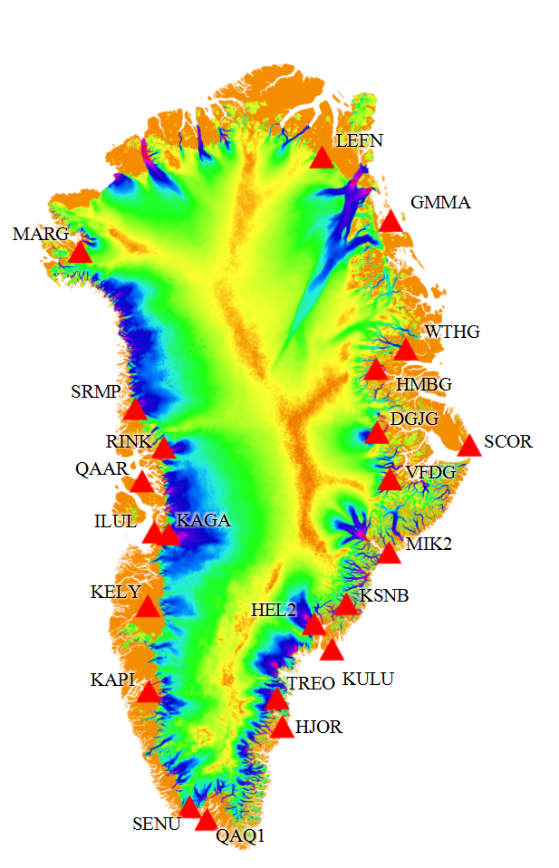
GNSS Data
Vertical displacement data contain information about bedrock’s elastic response to mass variations in the vicinity of a given observation point
Time-series from 23 Greenland Global Positioning System Network (GNET) stations were considered (2009-2015)
Data source:
1. Khan et al. (2010)
2. Nevada Geodetic Labo-ratory (NGL) – alternative dataset
Notes:
The Greenland ice sheet (GrIS) is currently losing mass, as a result of complex mechanisms of ice-climate interaction that need to be understood for reliable projections of future sea level rise. However, the processes about the liquid meltwater inside the ice sheet, e.g., melt water retention, basal melt water production, subglacier hydrology, etc., are poorly constrainted.
The pore spaces in firn — a type of partly compacted snow — can be filled by meltwater and thus act as a temporary reservoir. quantify the existing water storage capacity of the percolation zone of the Greenland ice sheet. buffer several hundred gigatonnes of meltwater for several decades. Although this buffering capacity is only temporary, and cannot be easily regained, it has the potential to delay the pace of near-term sea level rise.
We collected in situ observations of firn structure and meltwater retention along a roughly 85-kilometre-long transect of the melting accumulation area.

Slide 5
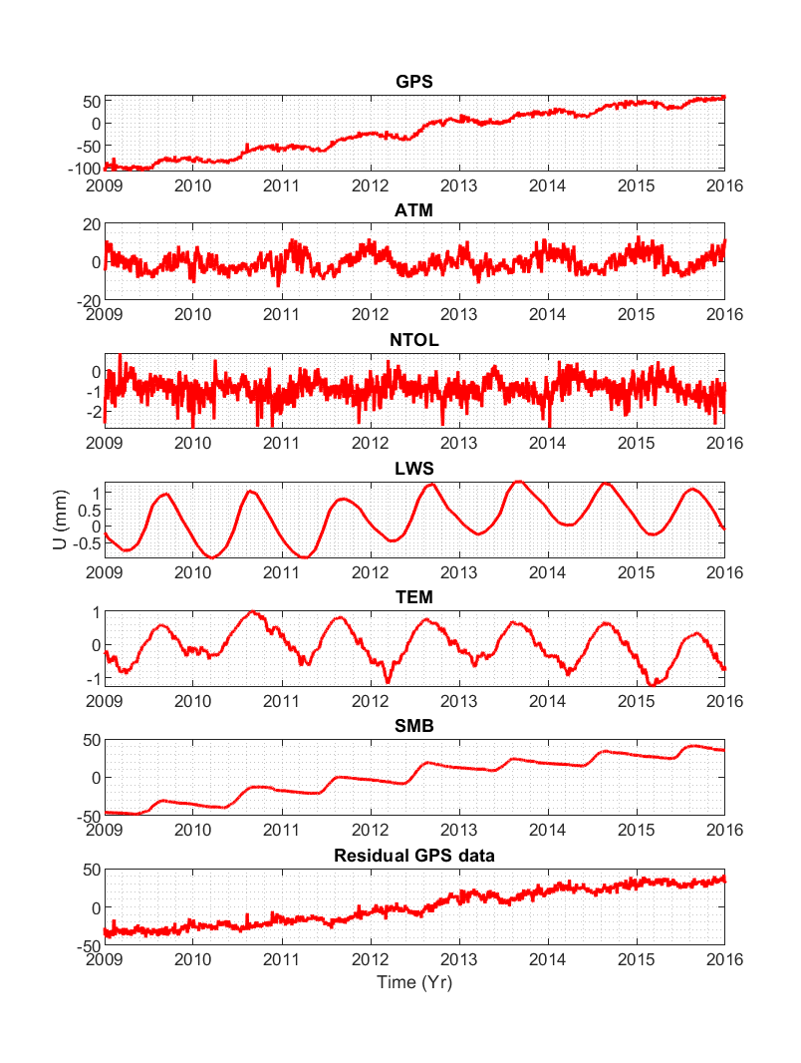
Subtraction of nuisance signals
KAGA station
Atmospheric pressure loading (ATM)
Non-tidal ocean loading (NTOL)
Loading of land water storage (LWS)
Thermal elastic expansion (TEM)
SMB loading (SMB)
Notes:
The Greenland ice sheet (GrIS) is currently losing mass, as a result of complex mechanisms of ice-climate interaction that need to be understood for reliable projections of future sea level rise. However, the processes about the liquid meltwater inside the ice sheet, e.g., melt water retention, basal melt water production, subglacier hydrology, etc., are poorly constrainted.
The pore spaces in firn — a type of partly compacted snow — can be filled by meltwater and thus act as a temporary reservoir. quantify the existing water storage capacity of the percolation zone of the Greenland ice sheet. buffer several hundred gigatonnes of meltwater for several decades. Although this buffering capacity is only temporary, and cannot be easily regained, it has the potential to delay the pace of near-term sea level rise.
We collected in situ observations of firn structure and meltwater retention along a roughly 85-kilometre-long transect of the melting accumulation area.

Slide 6
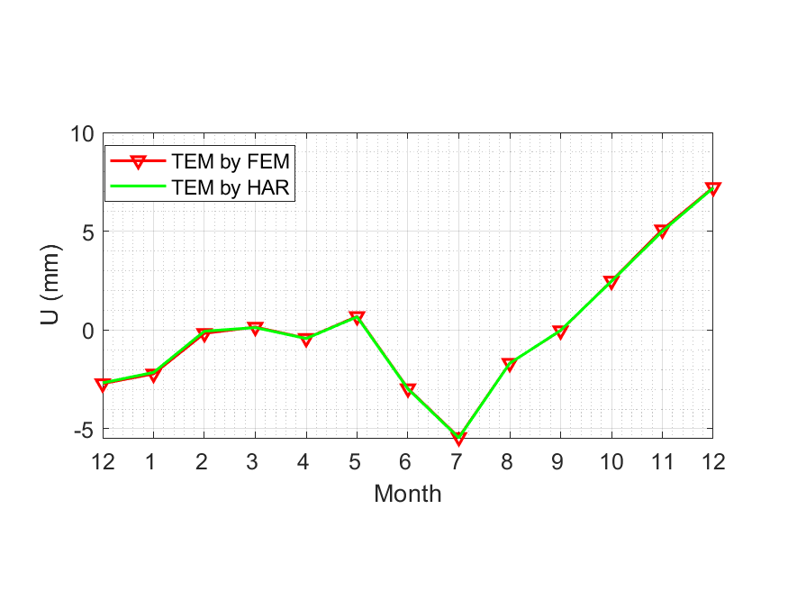
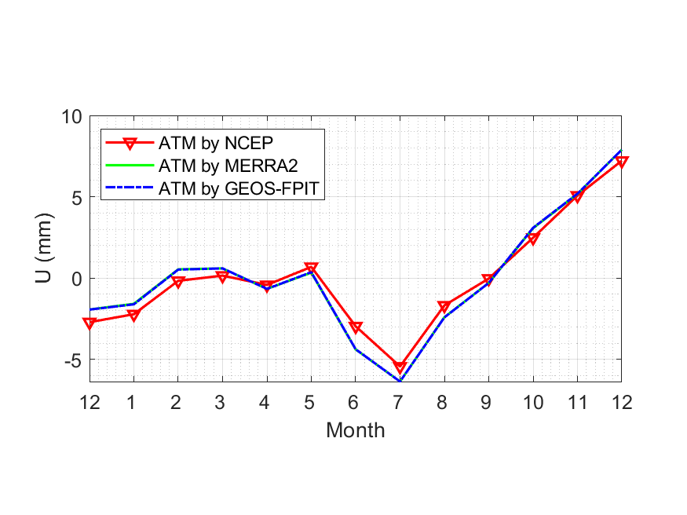
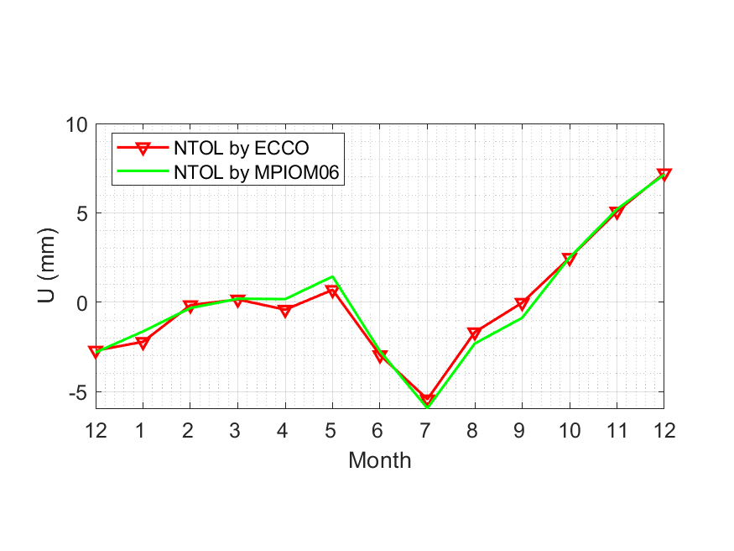
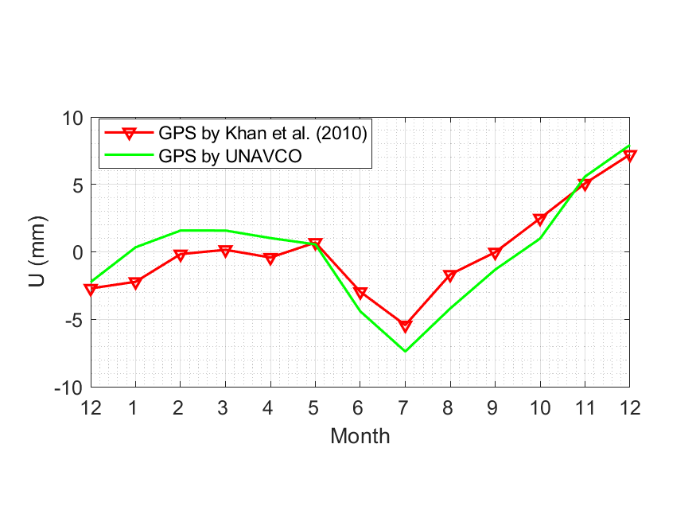
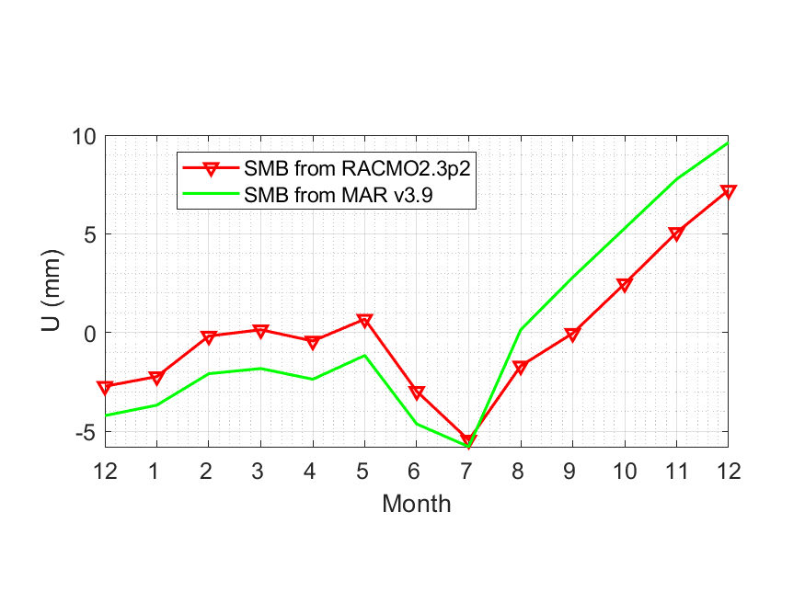
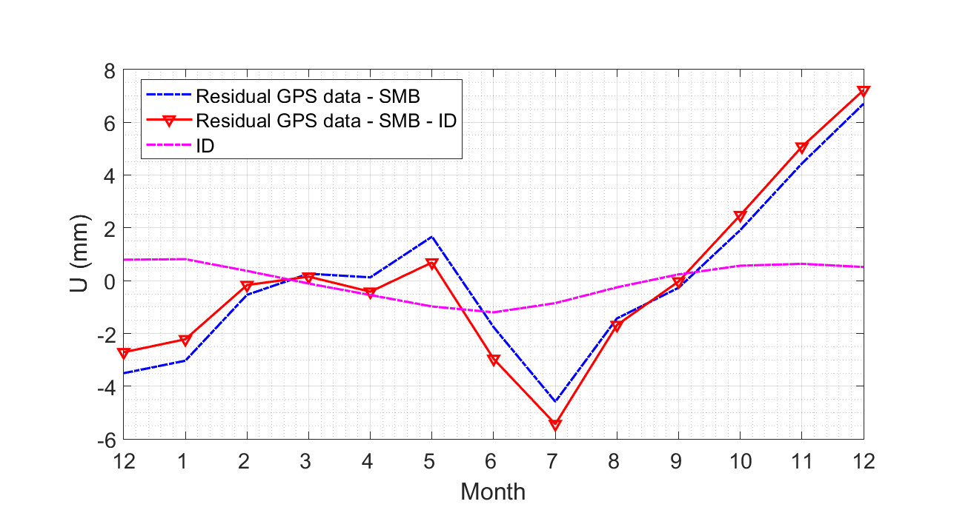
Mean seasonal cycle of residual vertical displacements and robustness analysis (KAGA station)
ATM
TEM
NTOL
GPS
from NGL
SMB
Ice Dis-charge
Notes:
The Greenland ice sheet (GrIS) is currently losing mass, as a result of complex mechanisms of ice-climate interaction that need to be understood for reliable projections of future sea level rise. However, the processes about the liquid meltwater inside the ice sheet, e.g., melt water retention, basal melt water production, subglacier hydrology, etc., are poorly constrainted.
The pore spaces in firn — a type of partly compacted snow — can be filled by meltwater and thus act as a temporary reservoir. quantify the existing water storage capacity of the percolation zone of the Greenland ice sheet. buffer several hundred gigatonnes of meltwater for several decades. Although this buffering capacity is only temporary, and cannot be easily regained, it has the potential to delay the pace of near-term sea level rise.
We collected in situ observations of firn structure and meltwater retention along a roughly 85-kilometre-long transect of the melting accumulation area.

Slide 7
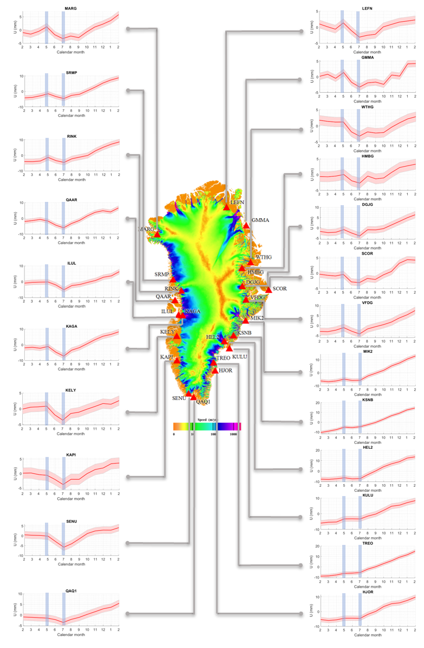
Mean seasonal cycles of
vertical displacements
KAGA station
Likely cause of the observed
positive mass anomaly in
summer: accumulation and
runoff of meltwater
Typical water storage time:
6 – 15 weeks
Notes:
The Greenland ice sheet (GrIS) is currently losing mass, as a result of complex mechanisms of ice-climate interaction that need to be understood for reliable projections of future sea level rise. However, the processes about the liquid meltwater inside the ice sheet, e.g., melt water retention, basal melt water production, subglacier hydrology, etc., are poorly constrainted.
The pore spaces in firn — a type of partly compacted snow — can be filled by meltwater and thus act as a temporary reservoir. quantify the existing water storage capacity of the percolation zone of the Greenland ice sheet. buffer several hundred gigatonnes of meltwater for several decades. Although this buffering capacity is only temporary, and cannot be easily regained, it has the potential to delay the pace of near-term sea level rise.
We collected in situ observations of firn structure and meltwater retention along a roughly 85-kilometre-long transect of the melting accumulation area.

Slide 8
Mean seasonal cycles of
vertical displacements: GPS vs GRACE
KAGA station
GRACE (entire Greenland)
Ran et al (The Cryosphere, 2018)
Notes:
The Greenland ice sheet (GrIS) is currently losing mass, as a result of complex mechanisms of ice-climate interaction that need to be understood for reliable projections of future sea level rise. However, the processes about the liquid meltwater inside the ice sheet, e.g., melt water retention, basal melt water production, subglacier hydrology, etc., are poorly constrainted.
The pore spaces in firn — a type of partly compacted snow — can be filled by meltwater and thus act as a temporary reservoir. quantify the existing water storage capacity of the percolation zone of the Greenland ice sheet. buffer several hundred gigatonnes of meltwater for several decades. Although this buffering capacity is only temporary, and cannot be easily regained, it has the potential to delay the pace of near-term sea level rise.
We collected in situ observations of firn structure and meltwater retention along a roughly 85-kilometre-long transect of the melting accumulation area.

Slide 9
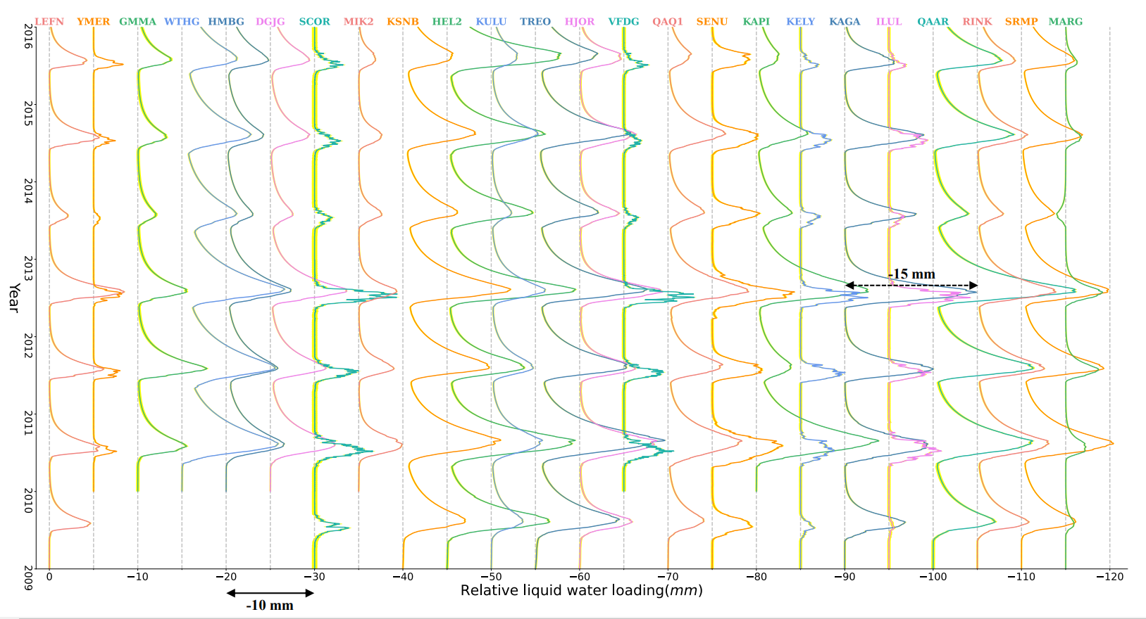
Results: Empirical model to extract meltwater retention signal
$$c+at−\sum_{k=1}^{K\left(t\right)}{ε_{k}}\int_{t_{k_{0}}}^{t_{ke}}{r_{0}\left(τ\right)dτ}+θ\sum_{k=1}^{K\left(t\right)}{\left(1+ε_{k}\right)}\int_{t_{k_{0}}}^{t_{ke}}{r_{0}\left(τ\right)e^{−\frac{t−τ}{T}}dτ}=m\left(t\right)−\int_{t_{0}}^{t}{b_{0}\left(τ\right)dτ}$$
Notes:
The Greenland ice sheet (GrIS) is currently losing mass, as a result of complex mechanisms of ice-climate interaction that need to be understood for reliable projections of future sea level rise. However, the processes about the liquid meltwater inside the ice sheet, e.g., melt water retention, basal melt water production, subglacier hydrology, etc., are poorly constrainted.
The pore spaces in firn — a type of partly compacted snow — can be filled by meltwater and thus act as a temporary reservoir. quantify the existing water storage capacity of the percolation zone of the Greenland ice sheet. buffer several hundred gigatonnes of meltwater for several decades. Although this buffering capacity is only temporary, and cannot be easily regained, it has the potential to delay the pace of near-term sea level rise.
We collected in situ observations of firn structure and meltwater retention along a roughly 85-kilometre-long transect of the melting accumulation area.

Slide 10
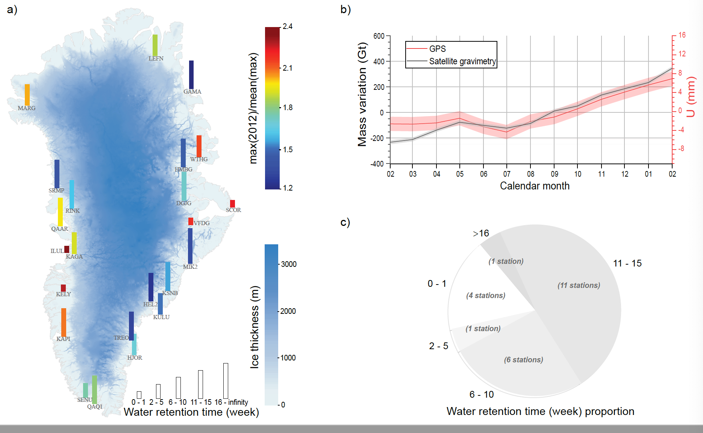
Results: Statistical analysis
Notes:
The Greenland ice sheet (GrIS) is currently losing mass, as a result of complex mechanisms of ice-climate interaction that need to be understood for reliable projections of future sea level rise. However, the processes about the liquid meltwater inside the ice sheet, e.g., melt water retention, basal melt water production, subglacier hydrology, etc., are poorly constrainted.
The pore spaces in firn — a type of partly compacted snow — can be filled by meltwater and thus act as a temporary reservoir. quantify the existing water storage capacity of the percolation zone of the Greenland ice sheet. buffer several hundred gigatonnes of meltwater for several decades. Although this buffering capacity is only temporary, and cannot be easily regained, it has the potential to delay the pace of near-term sea level rise.
We collected in situ observations of firn structure and meltwater retention along a roughly 85-kilometre-long transect of the melting accumulation area.

Slide 11
Conclusions
A combination of GNSS data from GNET with an SMB model reveals vertical displacements that are likely caused by an accumulation and runoff of meltwater
The signal extracted from GNSS data is consistent with GRACE data, but offers a higher accuracy and spatial resolution
Typical water storage time: 6 – 15 weeks
Thank you for your attention!
Notes:
The Greenland ice sheet (GrIS) is currently losing mass, as a result of complex mechanisms of ice-climate interaction that need to be understood for reliable projections of future sea level rise. However, the processes about the liquid meltwater inside the ice sheet, e.g., melt water retention, basal melt water production, subglacier hydrology, etc., are poorly constrainted.
The pore spaces in firn — a type of partly compacted snow — can be filled by meltwater and thus act as a temporary reservoir. quantify the existing water storage capacity of the percolation zone of the Greenland ice sheet. buffer several hundred gigatonnes of meltwater for several decades. Although this buffering capacity is only temporary, and cannot be easily regained, it has the potential to delay the pace of near-term sea level rise.
We collected in situ observations of firn structure and meltwater retention along a roughly 85-kilometre-long transect of the melting accumulation area.

