Slide 1



Impacts of climate change in pacific islands catchments: sediment contribution due to tropical cyclones and depressions
https://artsyus.wordpress.com/tag/mangrove/
Eliana Jorquera, Jose F. Rodriguez, Patricia M. Saco, and Danielle Verdon-Kidd

Slide 2
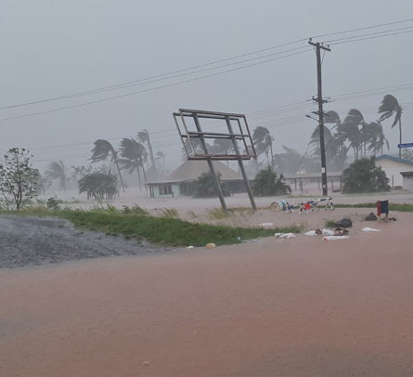
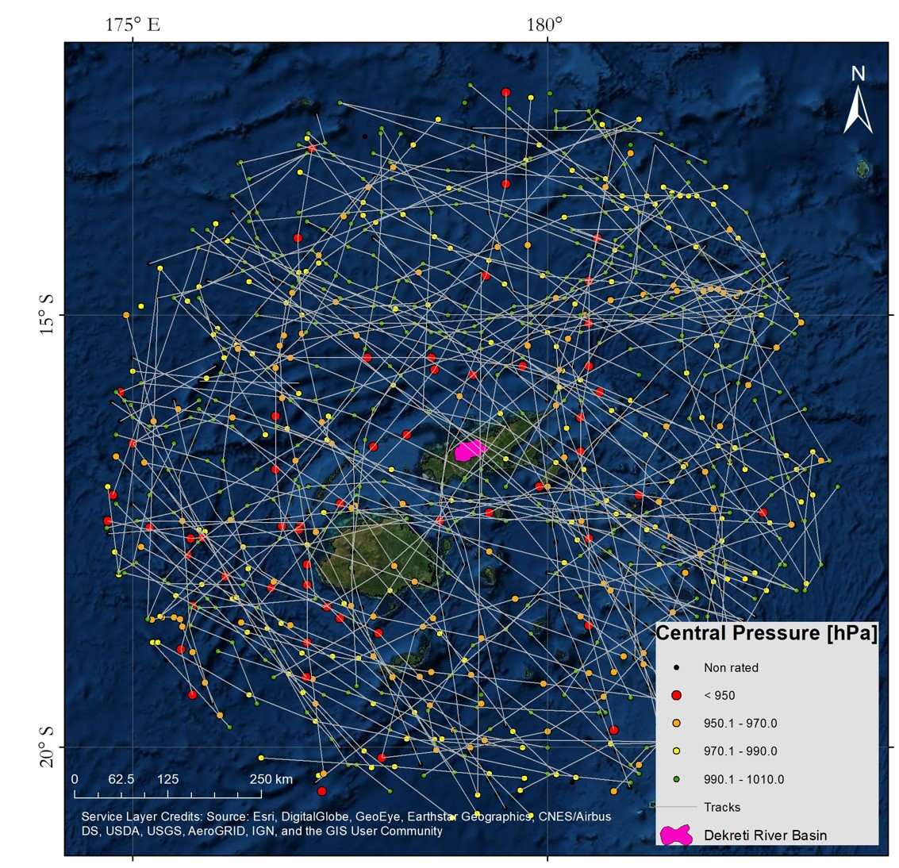
INTRODUCTION
The Republic of Fiji has an extended history of flooding linked to tropical cyclones and depressions; and those floods export a considerable amount of sediment to coastal wetlands.
Long term measurements of sediments are not available in most cases.
Hence, hydro-sedimentological models became a valuable tool to quantify them.

Slide 3



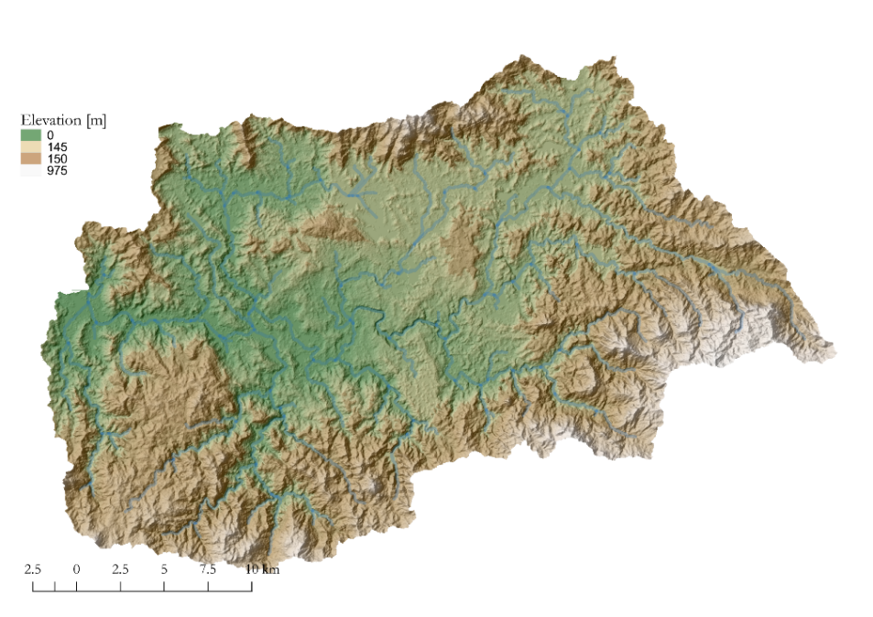
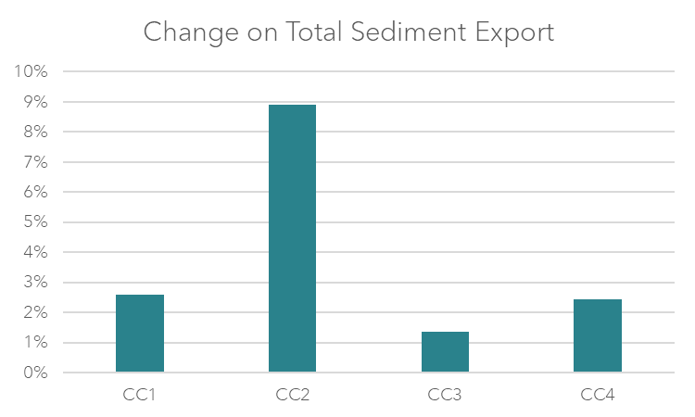
METHODOLOGY
CALIBRATE Hydro-sedimentological models
QUANTIFY the impact of TC&D on the annual sediment export
SET UP four CLIMATE CHANGE SCENARIOS based on IPCC 5th Report and analysed the change on sediment export.

Slide 4
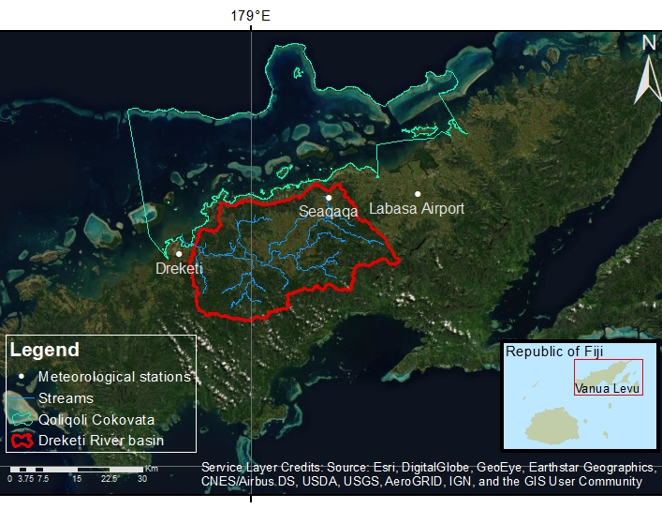
METHODOLOGY: Study case

Slide 5
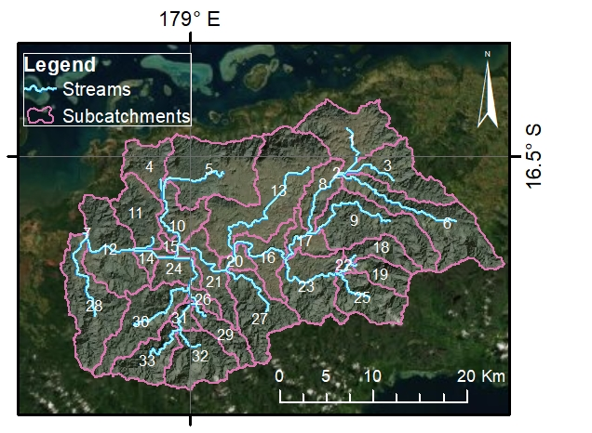
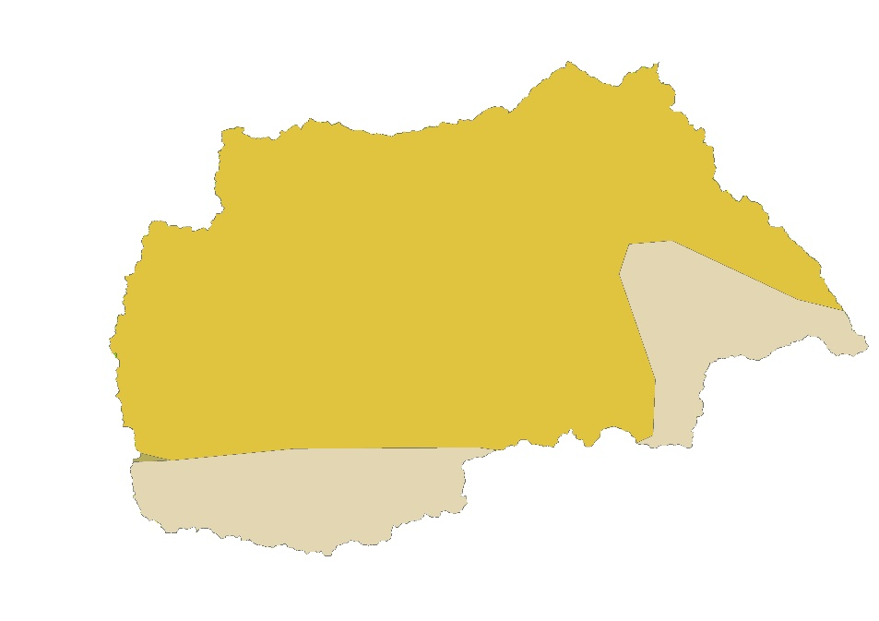
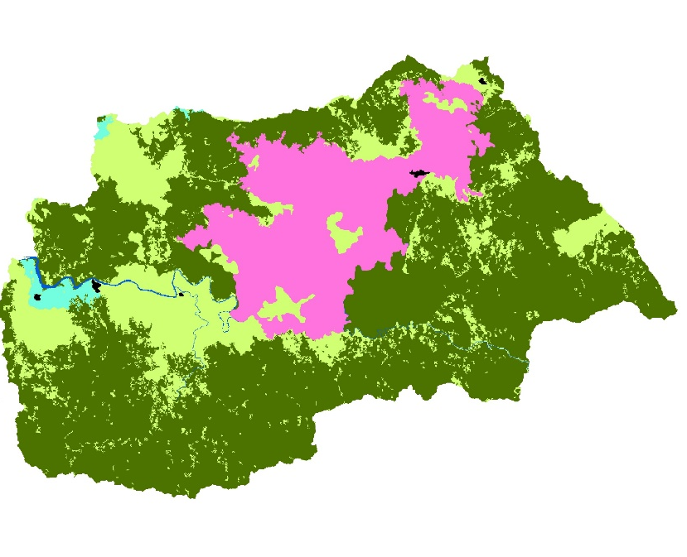
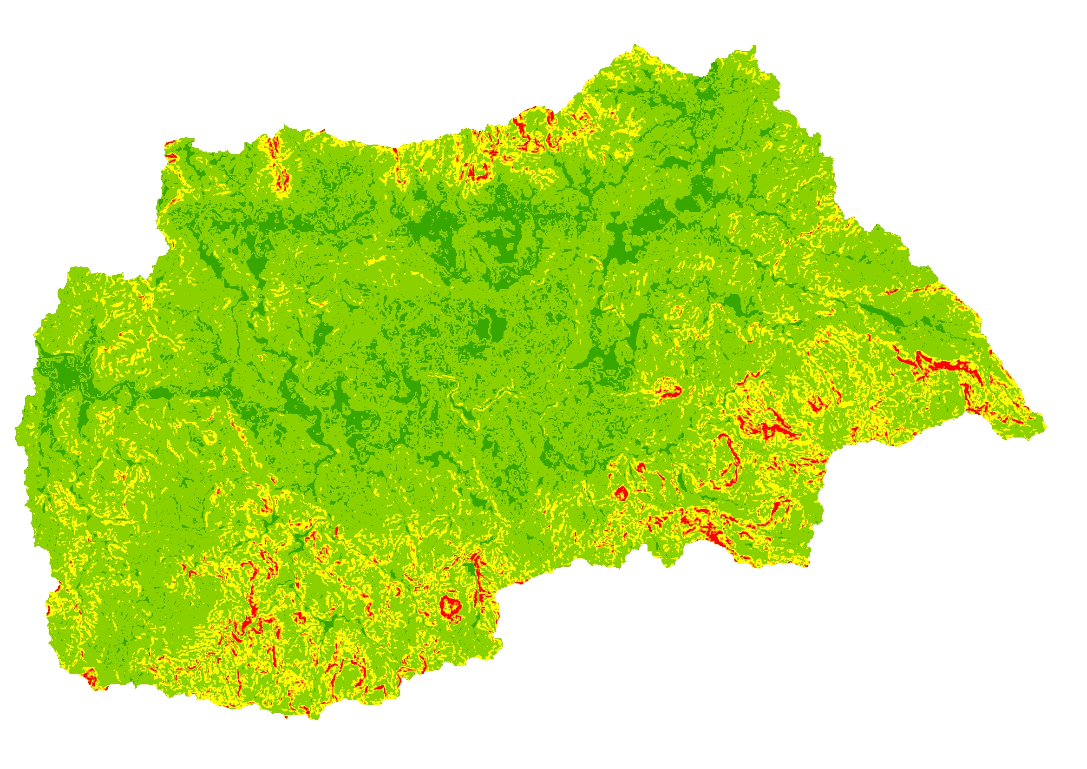
METHODOLOGY: Hydro-sedimentological model (SWAT)
Southwest Pacific Enhanced Archive of Tropical Cyclones, SPEArTC (Diamond et al., 2012)
Hydrologic Response Units (HRUs)
+
Soil Types
Land Use
Slope
Overlaying
HRUs
+
+
=

Slide 6
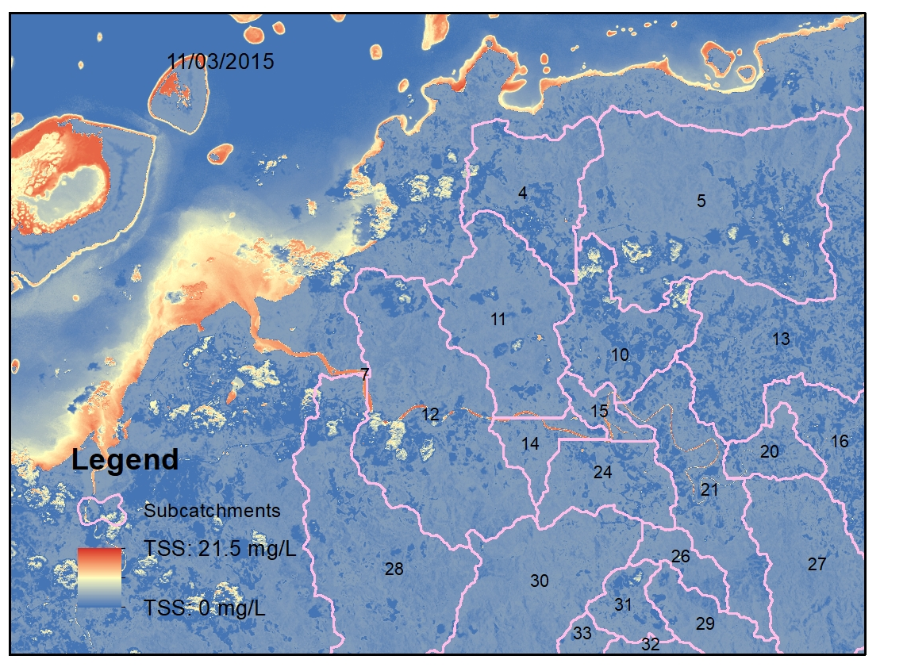
RESULTS CALIBRATION
From Landsat and Sentinel-2, we applied the Case-2 Regional CoastColour (C2RCC) processor (Brockmann et al., 2016).
NSE = 0.79 PBIAS = 7.28% RSR = 0.45
C2RCC: it is composed of a set of additional neural networks performing specific tasks and special neural networks have been trained to cover extreme ranges of scattering and absorption. It is available through ESA’s Sentinel toolbox SNAP (https://step.esa.int/).

Slide 7
RESULTS CALIBRATION – total sediment export

Slide 8
RESULTS CALIBRATION – contribution of TC&D to annual sediment export

Slide 9
METHODOLOGY: climate change scenarios
 |  |  | CC1 | CC2 | CC3 | CC4
TC Rainfall Rate increase |  |  | 7% | 3.50% | 16% | 14%
Frequency increase |  |  | -18% | -9% | No Change | -14%
Proportion of Cat 4-5 |  |  | Increase | Increase | Increase | Increase
Average Temperature |  |  | 1.6C | 0.8C | 3C | 2C

Slide 10
RESULTS Climate change scenarios

Slide 11
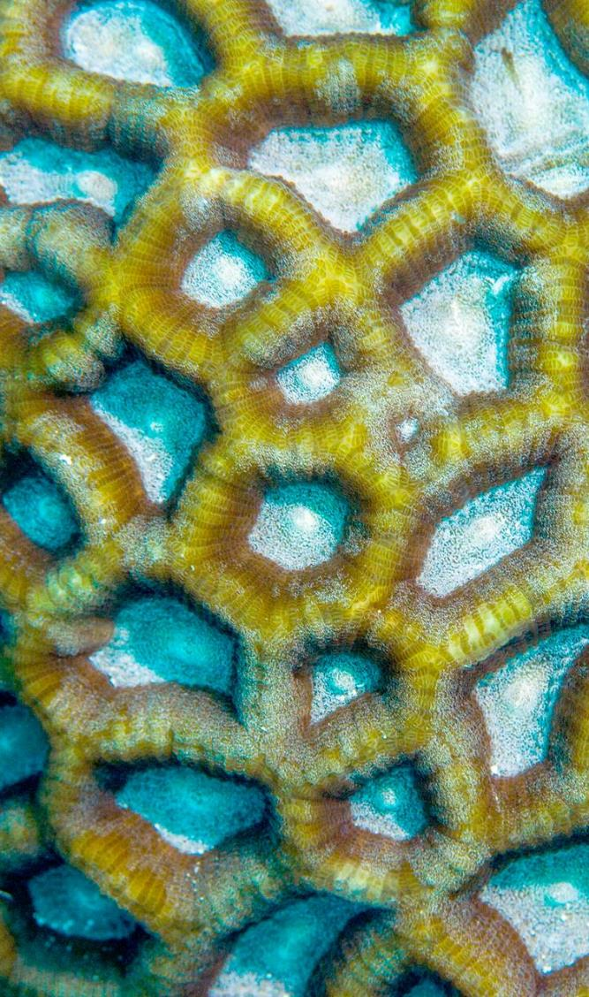

CONCLUSION
Increase on Total Sediment Export
Increase on maximum sediment concentration
Stronger impact of TC and TD in most of the scenarios analysed.

Slide 12

Thank you
Questions?

