Slide 1


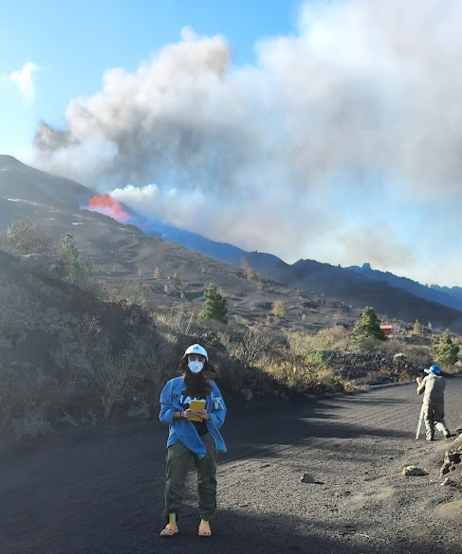
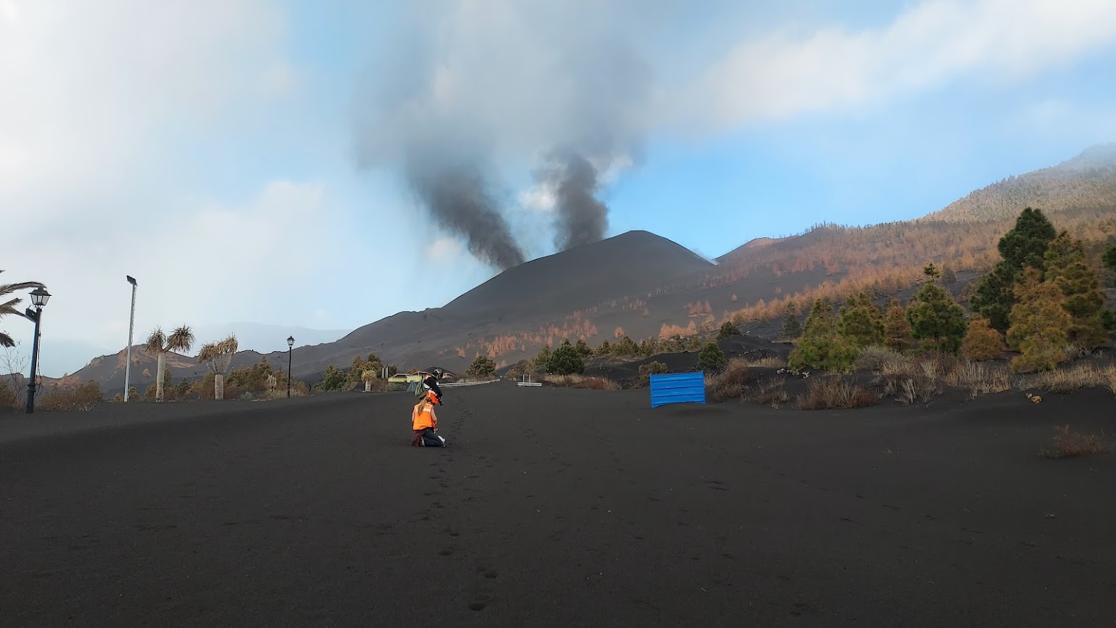
Reactivation of Cumbre Vieja volcano:
Insights from a paired tephra glass and olivine crystal record
Samantha Tramontano^{1,2}, Marc-Antoine. Longpré^{1,2}, Franco Cortese^{1,2}, Fátima Rodríguez³, Beverley Coldwell^{3,4}, Alba Martín-Lorenzo^{3,4}, Olivia Barbee³, and Matthew Pankhurst^{3,4}
¹The Graduate Center & ²Queens College, City University of New York, USA
³Instituto Volcanológico de Canarias, Canary Islands, Spain
⁴Instituto Tecnológico y de Energías Renovables, Canary Islands, Spain
EGU22-10914

Slide 2
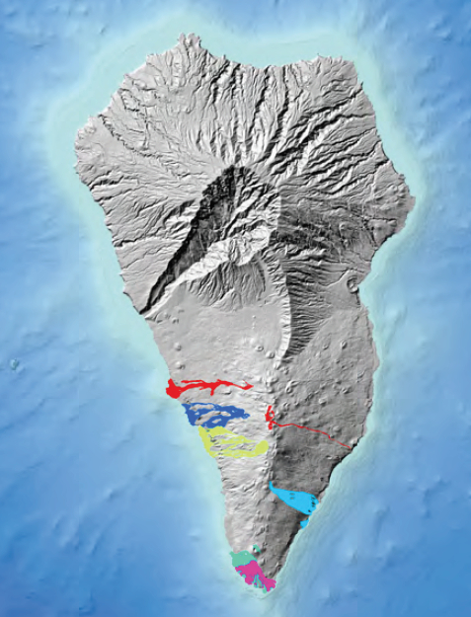
2021
1971
1949
Q: What processes influence reactivation at Cumbre Vieja?
1712
1677
1646
1585
Longpré & Felpeto, 2021

Slide 3
OLIVINE
RESULTS:
2021
1971
1949
Point analyses from 124 crystals across 7 eruptions reveal similar compositions
1585-1971 represent the end of each eruption
2021 samples collected from the first four weeks of the eruption
Mg
1712
1677
1646
1585
Notes:
2021 analyses from early eruption; rest from end of eruption

Slide 4
OLIVINE
RESULTS:
Crystals can be divided into two populations:
Lower Fo% core, reverse zone
Higher Fo% core, absence of reverse zone
Interdiffusion chronometry calculations on samples from historic eruptions reveal that recharge events take place days to months before eruption
POPULATION 1
POPULATION 2

Slide 5
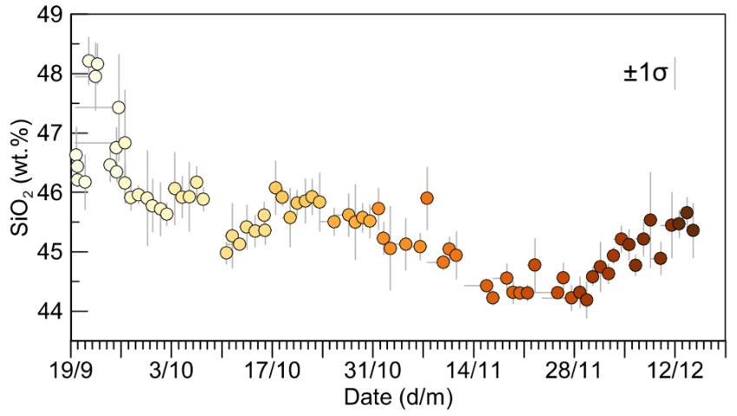
OLIVINE + GLASS
RESULTS:
Matrix glass measurements on daily-sampled tephra shards reveal changes in melt chemistry over the course of the 2021 eruption

Slide 6
OLIVINE + GLASS
RESULTS:
Preliminary work
Olivine chemical variability decreases with time

Slide 7
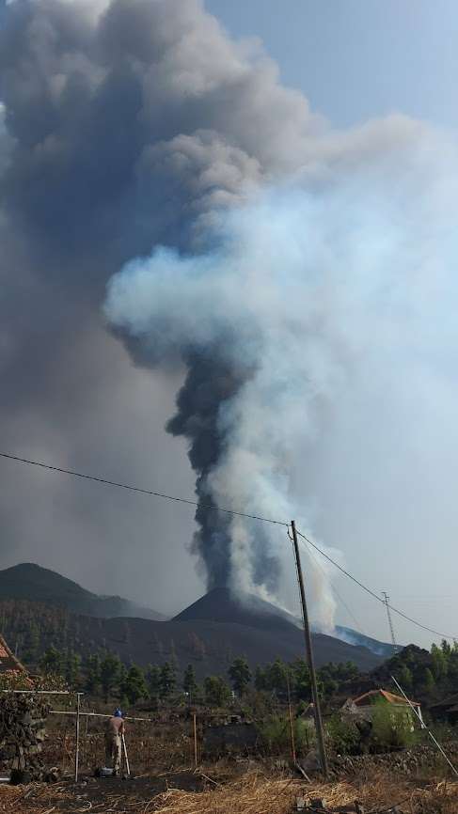
INTERPRETATIONS & QUESTIONS:
The 2021 eruptive products chemically similar to historic eruptions
We propose that it is the timing and volume of primitive melt generation and extraction in the upper mantle that strongly influences volcano reactivation - may influence eruption style and duration???
High temporal resolution petrologic analyses important!

Slide 8
2021
BULK ROCK
RESULTS:
1971
1949
1712
1677
1646
1585
Longpré & Felpeto, 2021

Slide 9
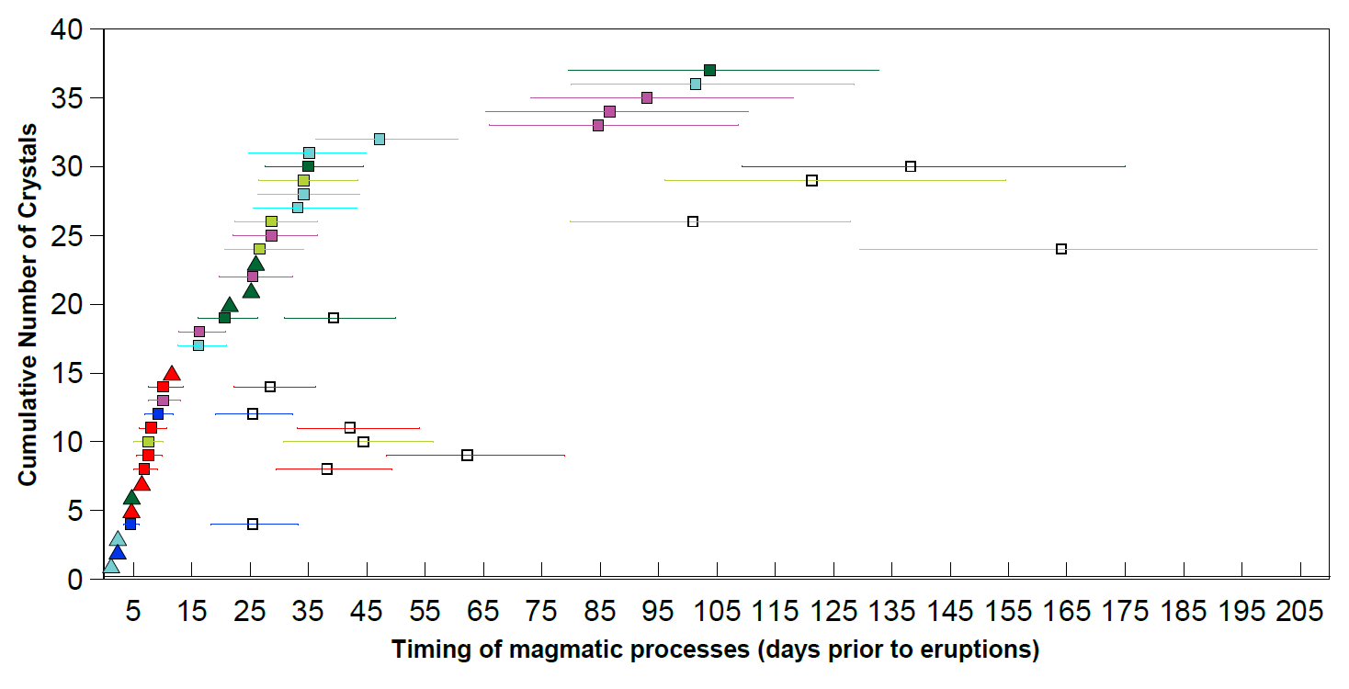
2021
1971
1949
TIMESCALE
RESULTS:
Ongoing work; does not include 2021 models (yet)
1 week
1 month
3 months
6 months
1712
1677
1646
1585
CPX: Cr zone-edge growth
OL: rim-edge diffusion
OL: MAX rim-edge diffusion
Timing of primitive recharge event (prior to eruptions)

