Slide 1
An Improved Micro Scale Average Annual Flood Loss Implementation Approach
Presented by: Md Adilur Rahim
Engineering Science Program
Louisiana State University (LSU)

Slide 2
Objective
Present an improved micro-scale average annual loss (AAL) estimation method.
Analyze the effectiveness of freeboard in reducing the flood AAL.
Perform a sensitivity analysis using different Depth Damage Functions.

Slide 3
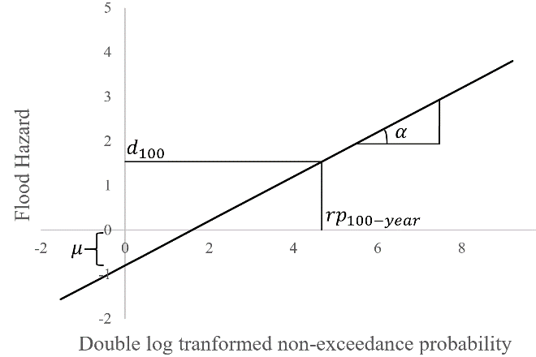
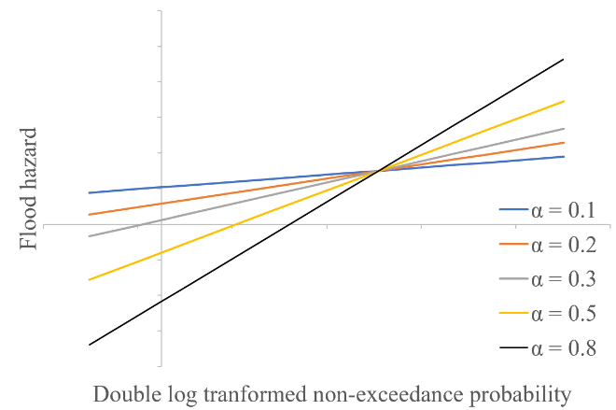

AAL Estimation Method
Flood Hazard Estimation
Gumbel Extreme Value Distribution with location (μ) and scale (α) parameters.
Fig. (a) Sample curve showing the location (μ) and scale (α) parameters (Equation 2). (b) Changing the location (μ) and scale (α) parameter of a house without changing the first-floor height (i.e. base flood elevation).
CDF of Gumbel Distribution: $p=\exp\left[−exp\left(−\left(\frac{D−u}{α}\right)\right)\right]$ … (1)
Quantile of the Distribution: ${D=F}^{−1}\left(F\left(D\right)\right)=u−α (ln (−ln\left(p\right)))$ … (2)
Flood Vulnerability Estimation
The USACE (2000) DDF is fitted using polynomial regression to get loss functions (𝐿).
Fig. USACE 2006 depth-damage functions (DDFs) for (a) Building (R² = 0.9971) ,
and (b) Content (R² = 0.9979).
Building Loss Function: 𝐿(𝐷)=0.0015 𝐷^3−0.3373 𝐷^2+9.0339 𝐷+15.413 … (3)
Content Loss Function: 𝐿(𝐷)=0.0014 𝐷^3−0.2105 𝐷^2+4.9117 𝐷+8.9651 … (4)

Slide 4
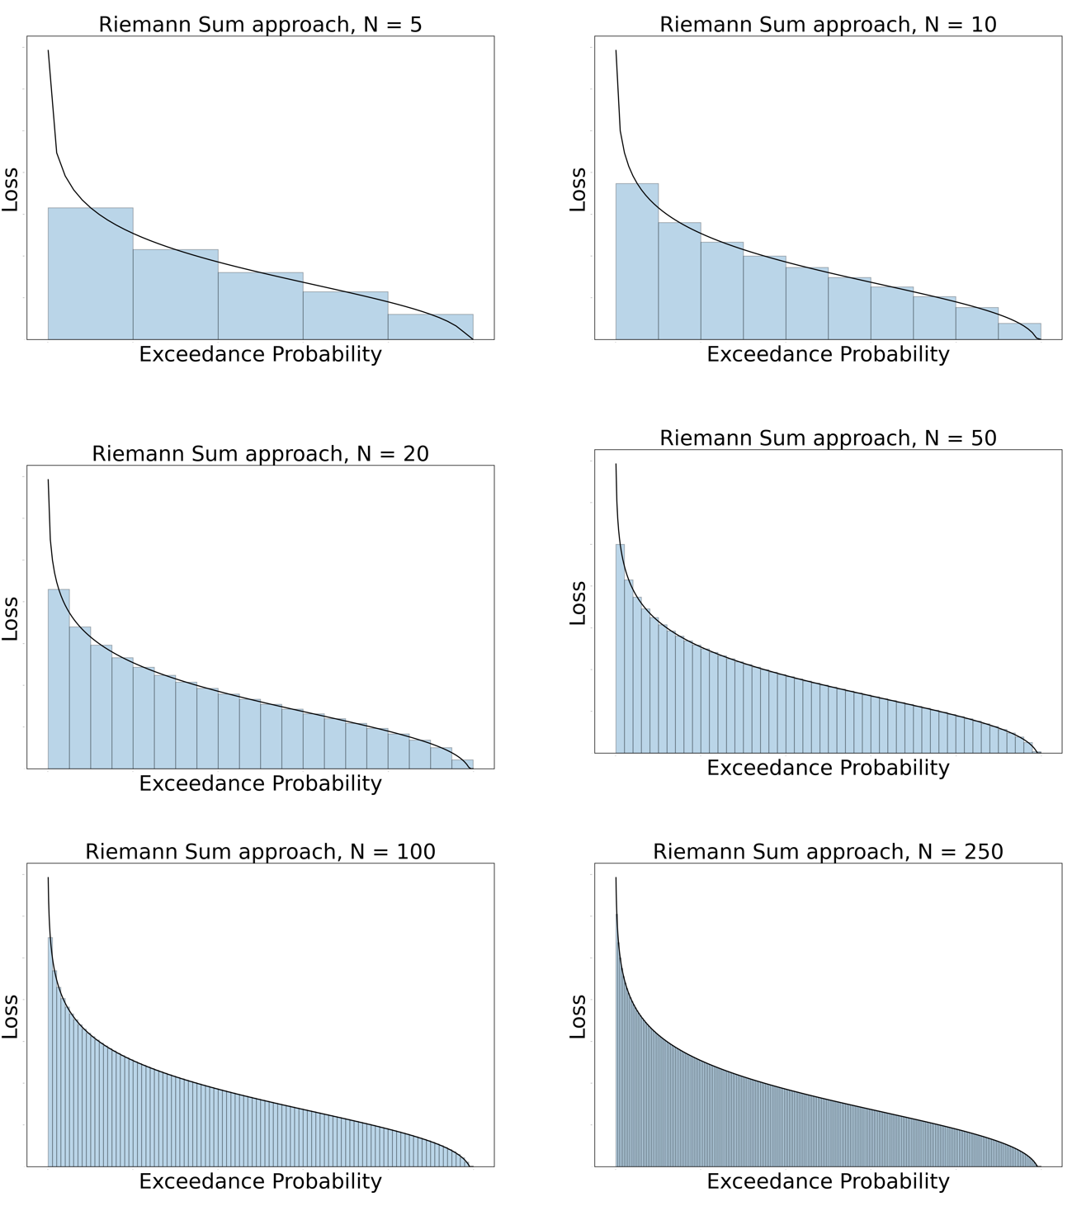

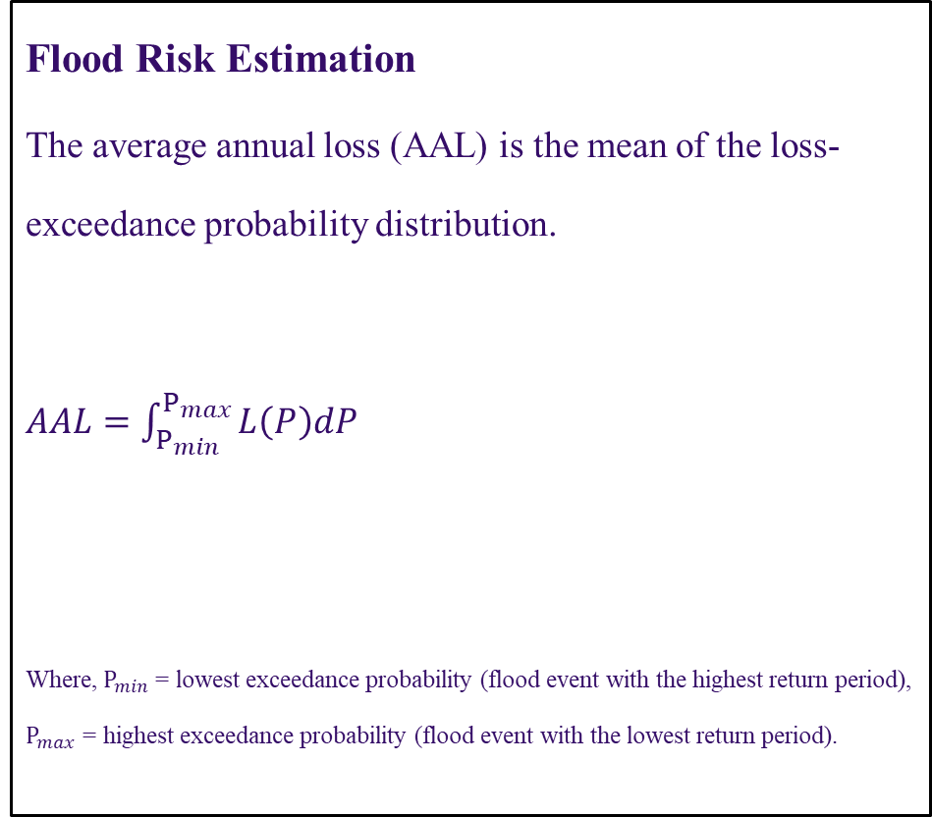
AAL Estimation Method
Flood Risk Estimation
The average annual loss (AAL) is the mean of the loss-exceedance probability distribution.
$AAL=\int_{P_{min}}^{P_{max}}{L\left(P\right)dP}$
Where, $P_{min}$= lowest exceedance probability (flood event with the highest return period),
$P_{max}$ = highest exceedance probability (flood event with the lowest return period).
Riemann Sum:$AAL=\sum_{n=1}^{N}{\left(\frac{L_{n}+L_{n+1}}{2}∙\left(P_{n+1}−P_{n}\right)\right)}$…(5)

Slide 5
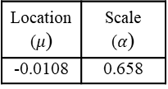
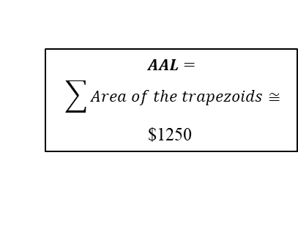
AAL Estimation: Case Study
Flood Depth | Non- Exceedance Probability (Equation 1) | Building Loss (Equation 3) | Area of Trapezoid (Equation 5)
FFH-1.5 | 0.9042 | 1830 | 296
FFH-1.0 | 0.9540 | 10,055 | 339
FFH-0.5 | 0.9782 | 17,995 | 253
FFH | 0.9898 | 25,655 | 158
FFH+0.5 | 0.9952 | 33,035 | 94
…… | …… | …… | ……
…… | …… | …… | ……
…… | …… | …… | ……
Exceedance Probability | Flood Depth (ft.)
0.002 | 3.6
0.01 | 3.1
0.02 | 2.8
0.1 | 2.3
$$AAL=$$
$$\sum{Area of the trapezoids}≅$$
$1250
Equation 2
First-Floor Height (FFH) (ft.) | Building Cost ($)
3.0 | 166,450
Location ($μ$) | Scale ($α$)
-0.0108 | 0.658
Fig. Flowchart of the proposed methodology with case study.

Slide 6
AAL Estimation: Result
(a)
(b)
(c)
Fig. Estimated AAL values for different freeboard scenarios and damage initiation point of -2.
DDFs used are (a) USACE 2000, (b) USACE 2006, and (c) Nofal et al. (2020)

Slide 7
AAL Estimation: Result
(a)
(b)
Fig. Effects of changing damage initiation point of DDFs. Damage initiation points: (a) -1, and (b) 0

Slide 8
Conclusion
An improved micro-scale average annual loss (AAL) estimation method is presented.
The increasing freeboard reduces the flood AAL significantly.
The sensitivity analysis of Depth Damage Functions shows similar result for USACE 2000 and Nofal et al. (2020) DDF. The USACE 2006 DDF yields higher values of AAL.
A large amount of risk is calculated when using DDFs with damage initiation below FFH. Future research should focus on identifying the correct damage initiation point - ideally by foundation type.
Due to the nature of the study, the risk assessment covered only direct economic losses and did not consider indirect economic losses (e.g., loss of working hours, mental health).

Slide 9



Acknowledgements
Co-authors:
Ehab S Gnan, LSU
Dr. Carol J. Friedland, LSU Agricultural Center
Dr. Robert V. Rohli, LSU
Rubayet Bin Mostafiz, LSU
Funding Sources:

Slide 10
Thank you!
Md Adilur Rahim
Engineering Science Program
Louisiana State University
mrahim6@lsu.edu
https://floodsafehome.lsu.edu/

