Slide 1

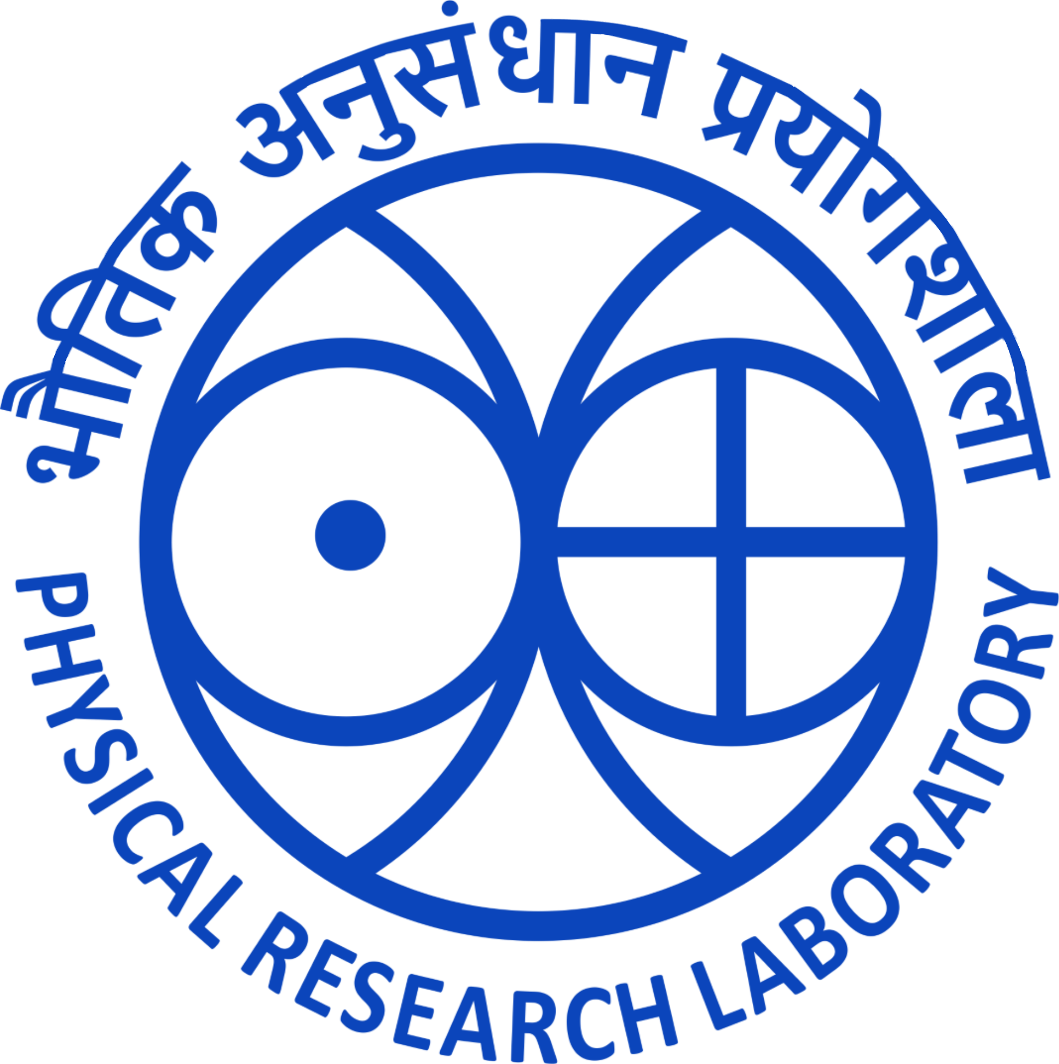

Age and Geochemistry of Kamthai carbonatites, Rajasthan, western India
Milan K. Mahala and Jyotiranjan S. Ray
Physical Research Laboratory, Ahmedabad, India
Presenting Author- Milan Kumar Mahala

Slide 2
Carbonatites of India
2400-65 Ma
Sarnu-Dandali/Kamthai
Mundwara
Newania
Chhota Udaipur (Amba Dongar-Siriwasan)
Kutni-Beldih
Swangkre
Sung Valley
Jasra
Samchampi
Elchuru
Kunavaram
Hogenakal
Sevattur
Samalpatti
Pakkanadu-Malakkadu
Munnar
Khambamettu
69-65 Ma
1453 Ma
115-108 Ma
2400-700 Ma

Slide 3
Sarnu-Dandali (Kamthai) Carbonatites
Carbonatite-Alkaline Silicate Rock Association
Multiple episodes of alkaline magmatism (89 Ma & 68.5 Ma)
Single episode of carbonatite (68.5 Ma?)
Carbonatites: Calciocarbonatite with minor Ferrocarbonatite
Alkaline rocks: Syenites, (mela) nephelinite, phonolite
Predates Deccan Flood Basalts eruptions
Believed to be linked to Reunion-Deccan Plume – pre-Deccan alkaline activity?

Slide 4
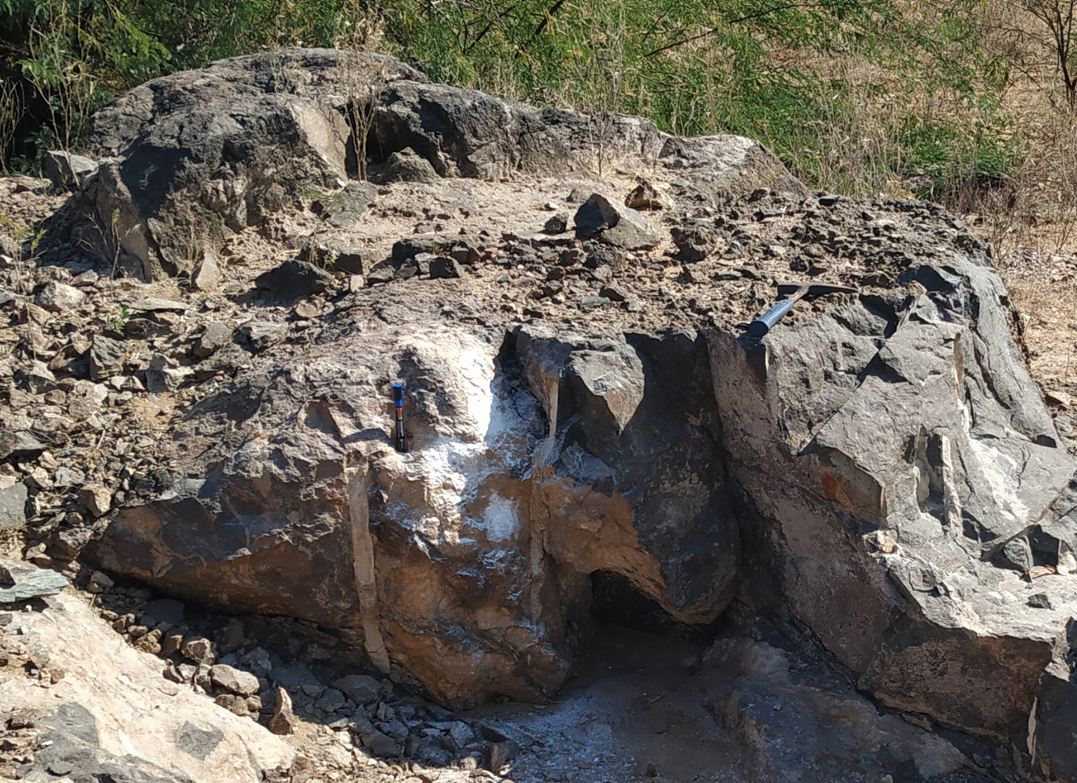
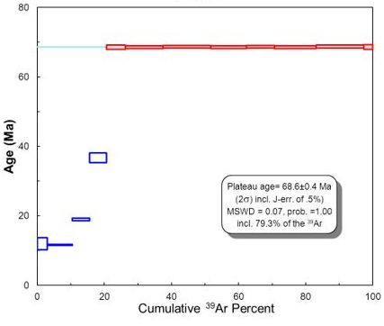
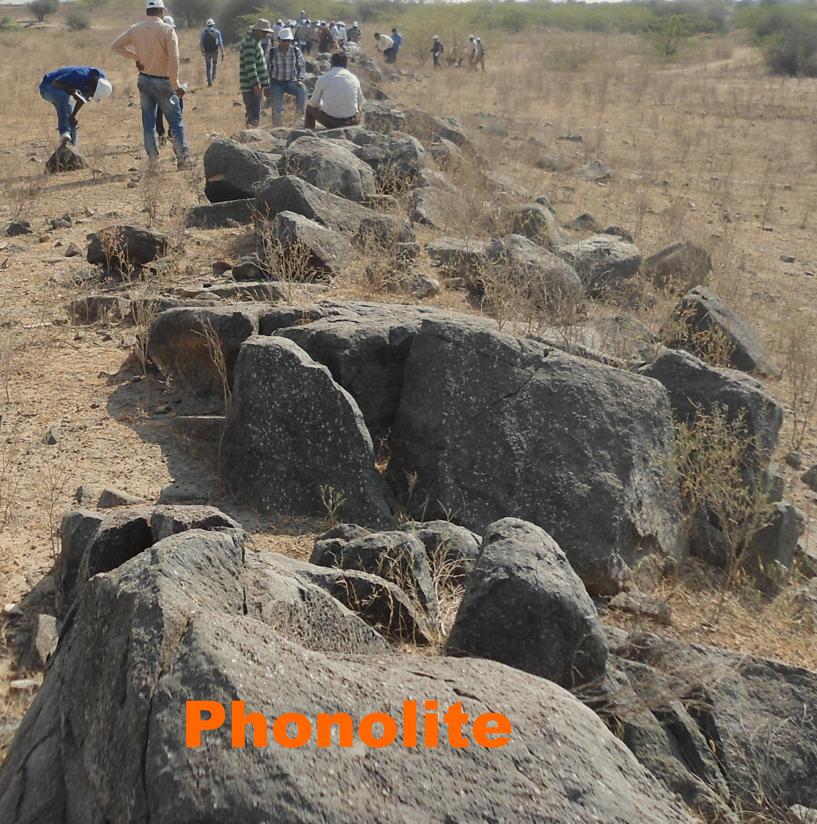
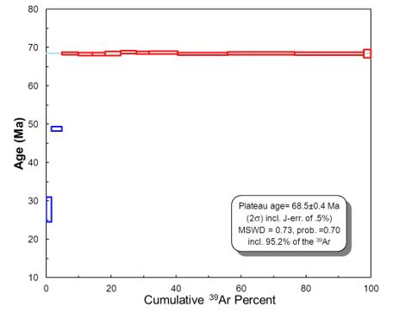
⁴⁰Ar/³⁹Ar geochronology
68.6 Ma
melanephelinite
carbonatite
68.5 Ma
Phonolite dike

Slide 5
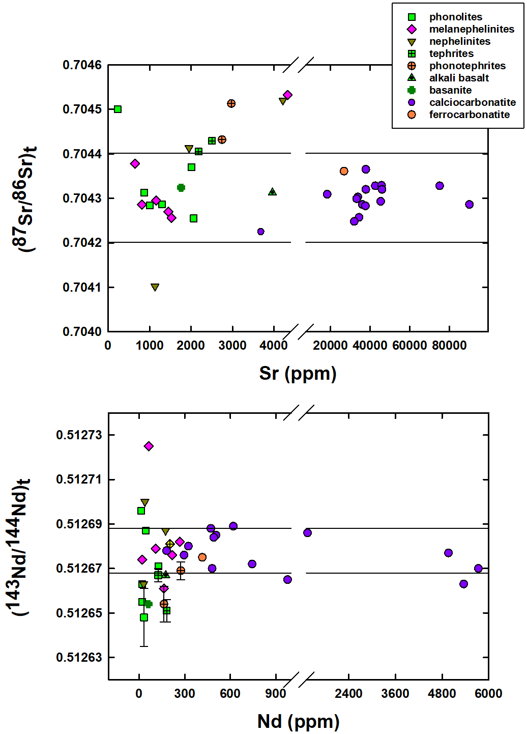
Isotopic Characteristics
Genetic relationship between carbonatites & alkaline silicate rocks
Larger variations in Sr-Nd initial ratios in alkaline rocks hint at crustal contamination and/or source heterogeneity.
Carbonatites, because of their very high Sr-Nd contents, buffered these variations.

Slide 6
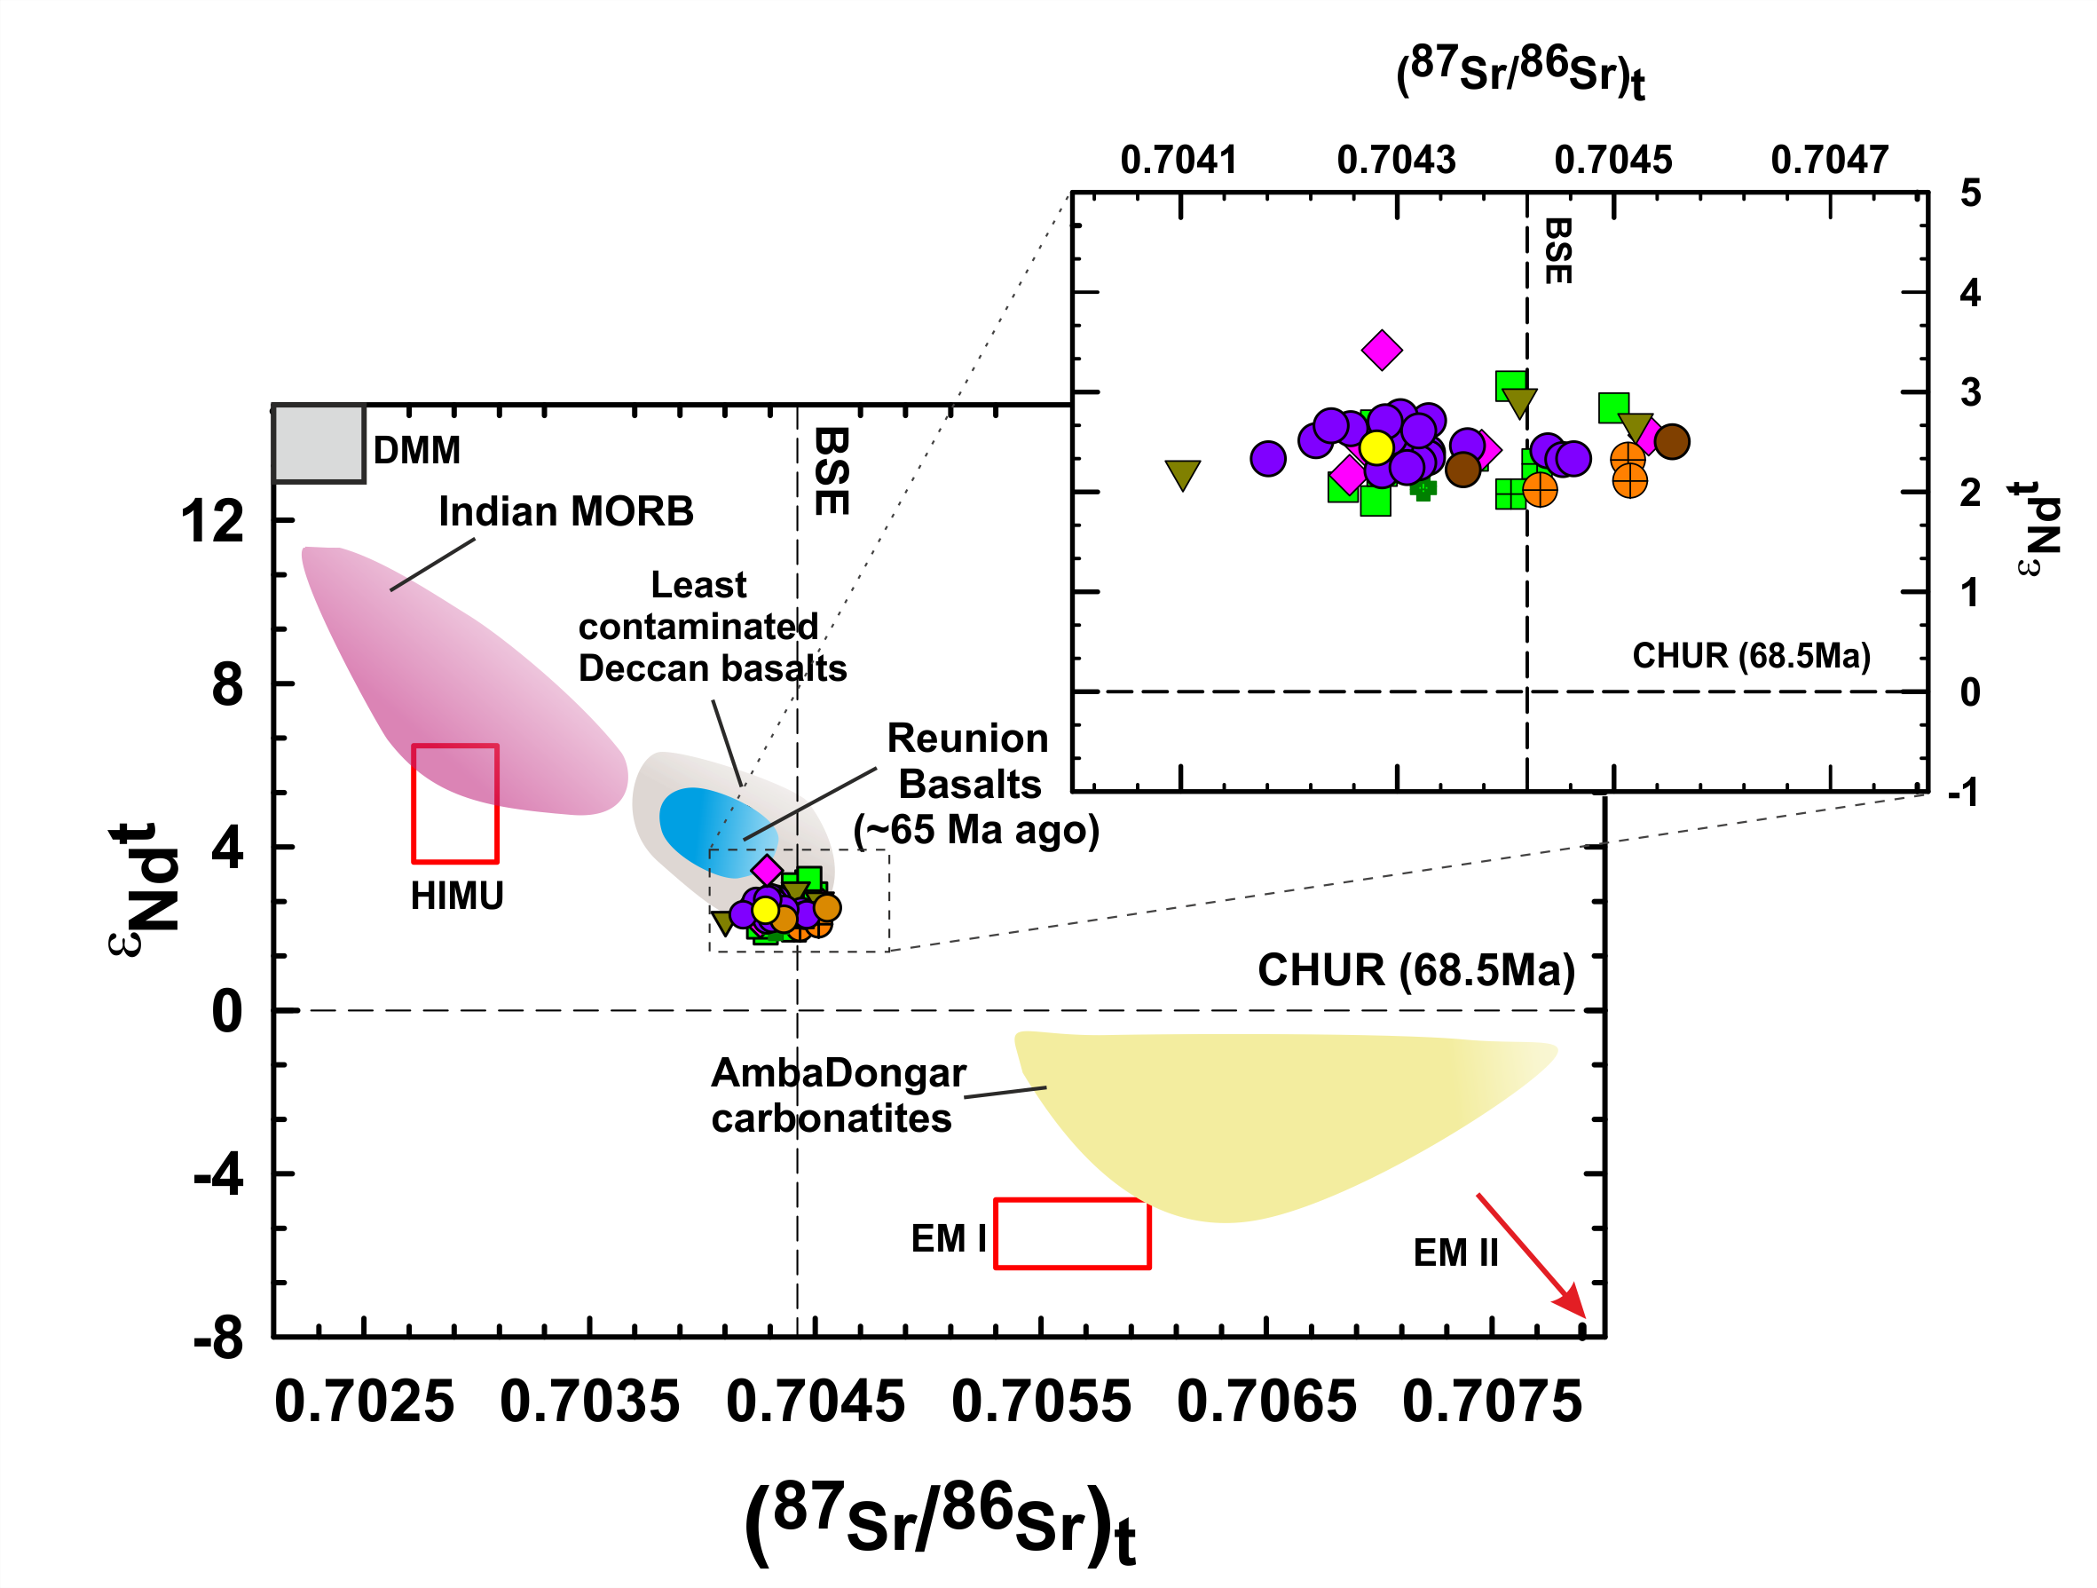
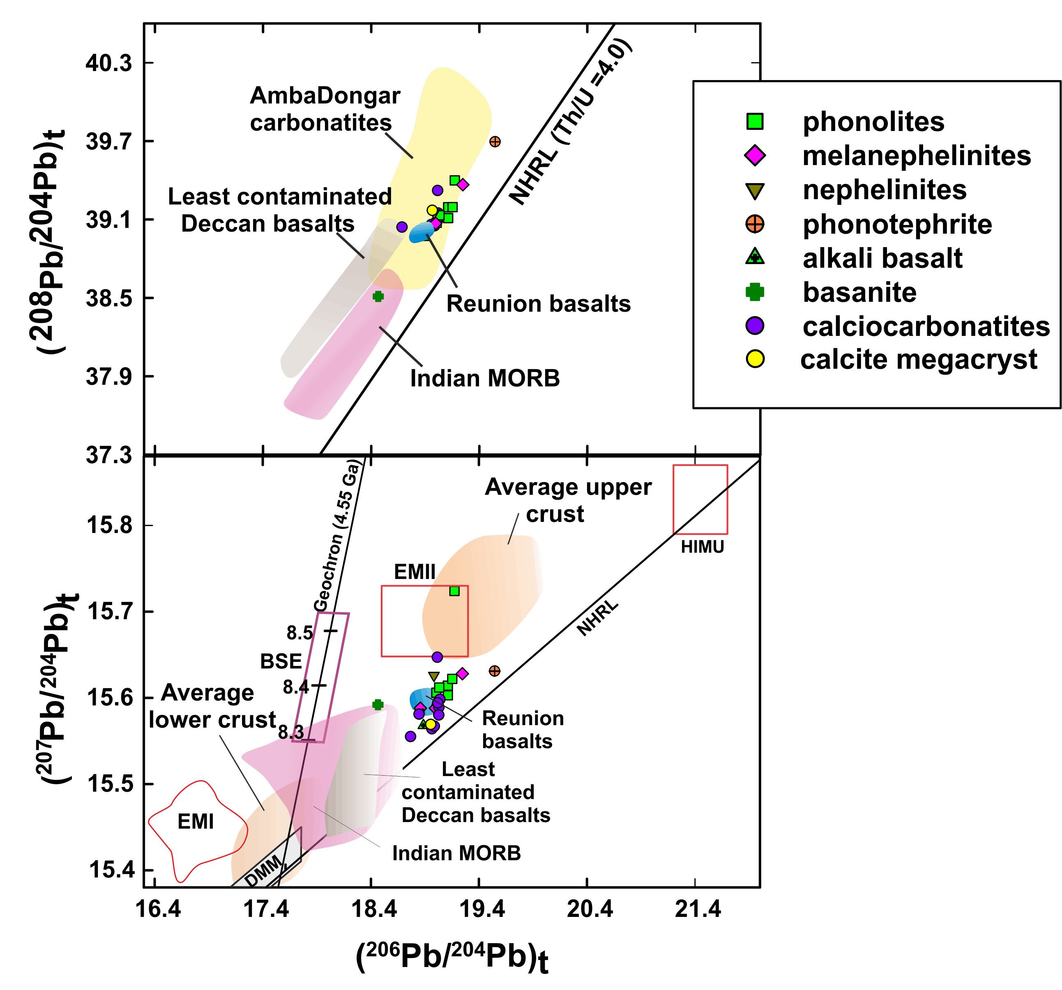
Mantle Source
Heterogeneous isotopic ratios point towards derivation from SCLM.
Overlapping compositions suggest Reunion Plume-SCLM interaction

