Slide 1






Peatbogs to the rescue!
Opportunities and challenges in using ombrotrophic peat cores for a reconstruction of paleo-storms during the Holocene in eastern Canada
Antoine Lachance¹, Matthew Peros², Jeannine-Marie St-Jacques¹ & Pierre Francus³
¹ Department of Geography, Planning and Environment, Concordia University, Montreal, Canada
² Department of Geography, Bishops University, Sherbrooke, Canada
³ Institut National de la recherche Scientifique
EGU Annual meeting conference, May 2022

Slide 2
Using peatbogs for paleostorm reconstructions
Storm Wind
Sea spray
Aeolian sand
Deposition
Ombrotrophic peatbog
Dune
Ocean/Sea

Slide 3
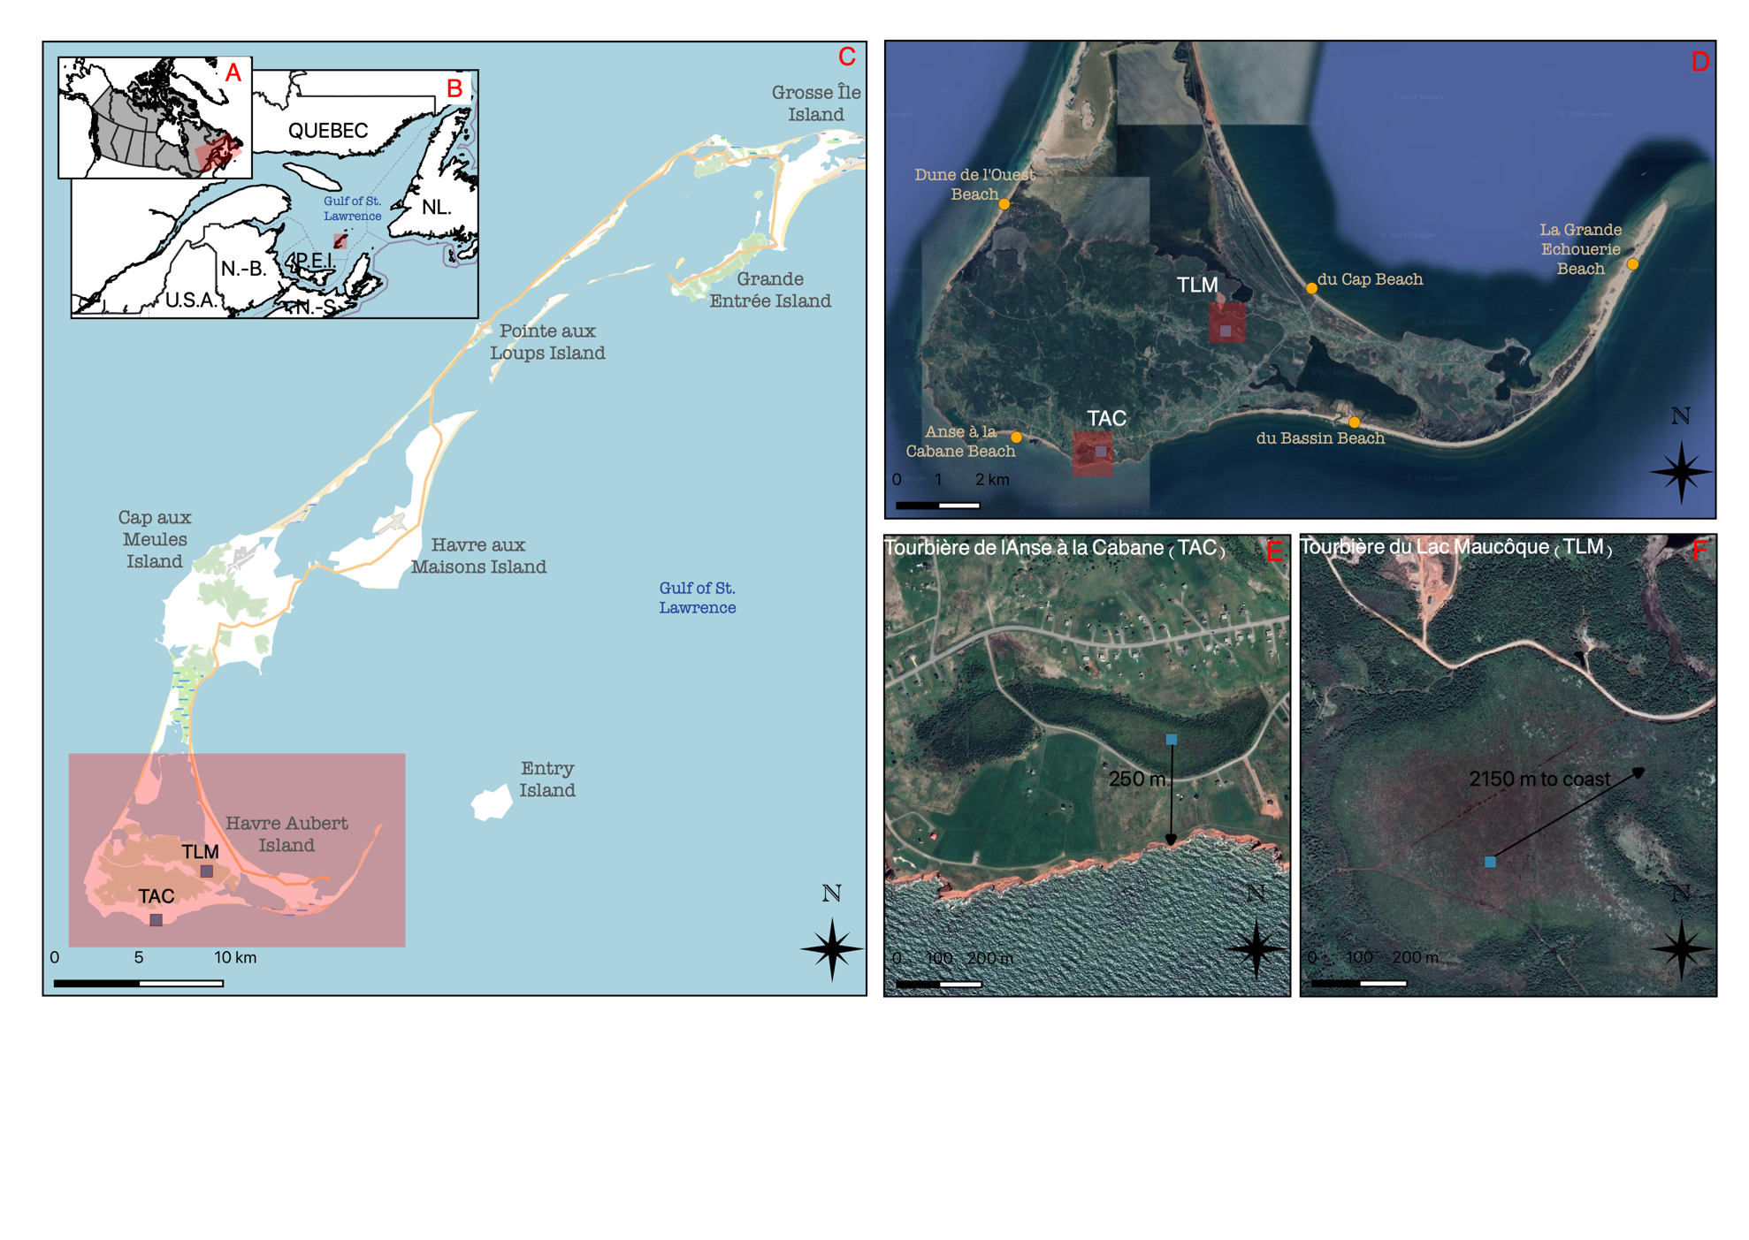
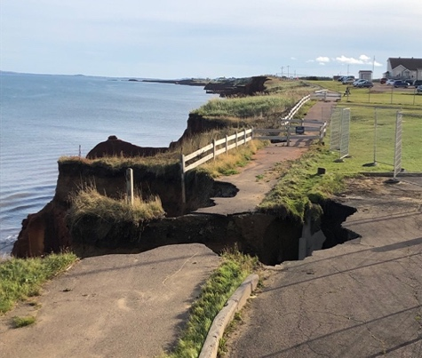

Objectives & regional
context
Test potential of ombrotrophic peatbogs for paleostorm studies in eastern Canada
Reconstruct Holocene paleostorm records
Erosion on the Magdalen Islands
Regional context

Slide 4
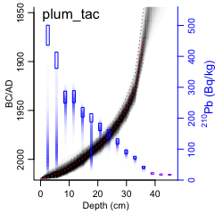
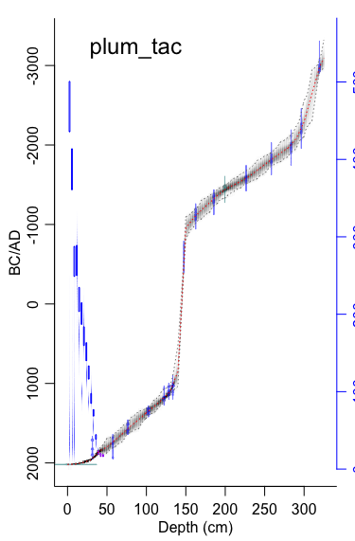
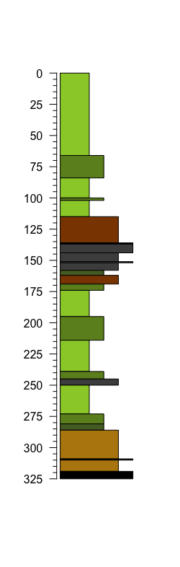
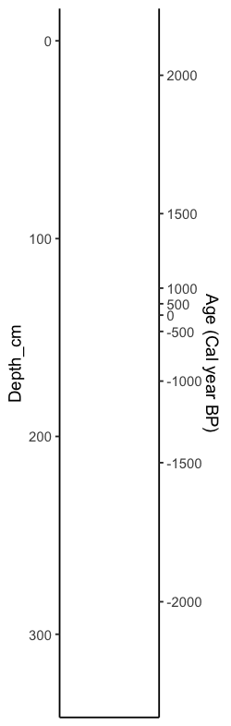
Field sites & core description
A
Depth (cm)
X-Ray
Age (BCE/CE)
Layers
BCE/CE
Sphagnum peat
BCE/CE
Detritus/ mineral peat
Hiatus?
B
C
Sphagnum peat
Herbaceous peat
Coarse sediment
Coring sites
Core description
Age-model

Slide 5
Identifying possible storm proxies - methods
Hypotheses:
Storminess expressed by short-term variation in:
Terrigenous elements (Ti, K, Zr, Si)
Elements associated with sea spray (Br, Cl, S)
Aeolian Sand Influx
ITRAX Core-Scanner
Geochemical profile (µ-XRF) at the mm-scale
Loss-on-ignition (LOI)
Mineral fraction (% of peat dry weight) at cm-scale
Aeolian Sand Influx (g/cm²/yr) by sieving mineral fraction at 125 µm.

Slide 6
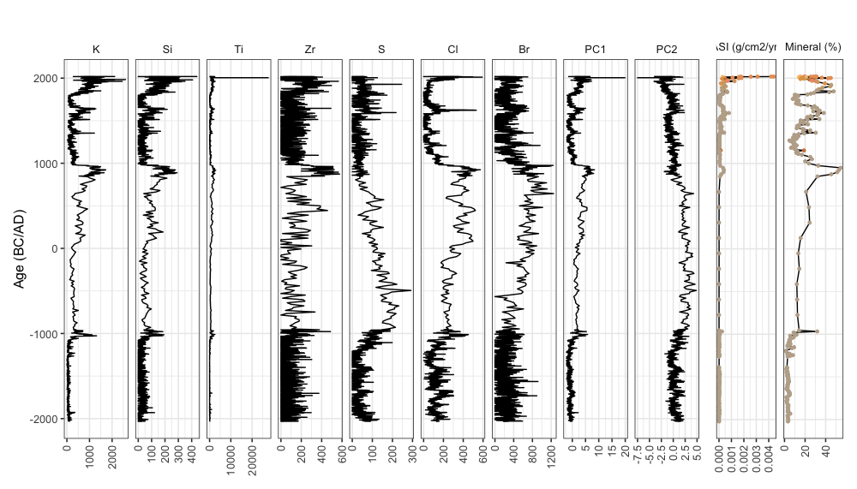
Identifying possible storm proxies - results
Hypotheses:
Storminess expressed by short-term variation in:
Terrigenous elements (Ti, K, Zr, Si)
Elements associated with sea spray (Br, Cl, S)
Aeolian Sand Influx

Slide 7
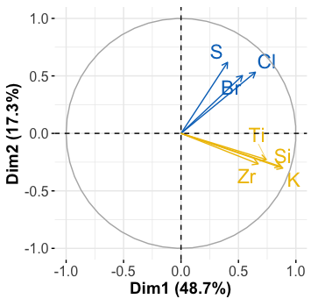
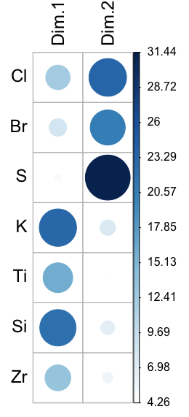
Identifying possible storm proxies - results
Hypotheses:
Storminess expressed by short-term variation in:
Terrigenous elements (Ti, K, Zr, Si)
Elements associated with sea spray (Br, Cl, S)
Aeolian Sand Influx
%
Storms:
+ PC1
+ PC2
Supported by peak in Aeolian Sand Influx

Slide 8
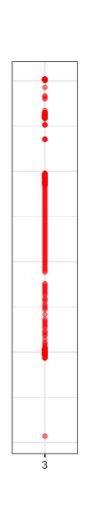
Identifying possible storm proxies - summary
ITRAX-CS (counts/s)
PCA
LOI
PC1 + PC2 +
ASI (g/cm²/yr)
Storm induced hiatus?
BCE/CE

Slide 9

Conclusion
Contact me:
antoine.lachance@concordia.ca
Potential:
  Identify marine and terrestrial influence
  Relate to aeolian sand influx
  Precise chronology
Challenges:
  Needs care to distinguish between climate and storm signal
  Identify the source of aeolian sand
  Overlay the paleo-record with the instrumental/historical record of storms

