Slide 1

Numerical analysis for dispersion characteristic from time domain induced polarization based on laboratory measurement data of complex resistivity
Juyeon Jeong¹ · Bitnarae Kim¹ · Desy Caesary¹ · YoungSam Mun² · Doukhee Won³· Myung Jin Nam^{1, 4*}
¹Department of Energy and Mineral Resources Engineering, Sejong University, South Korea
²DevBox Inc.
³C&H Inc.
⁴Department of Energy Resources and Geosystems Engineering, Sejong University, South Korea

Slide 2

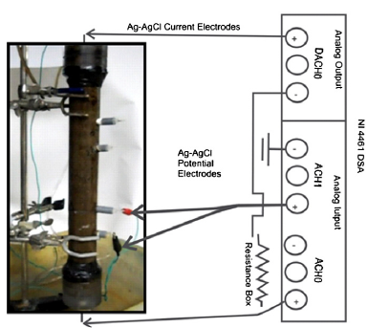
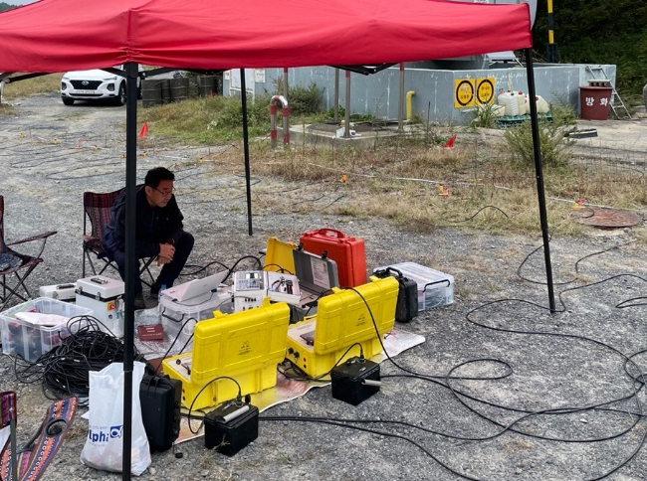

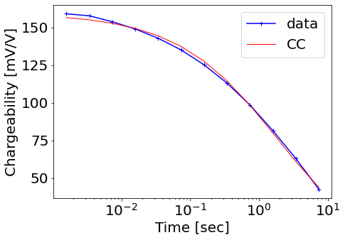
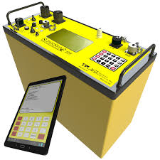
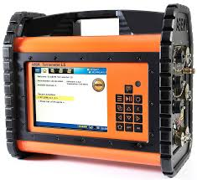
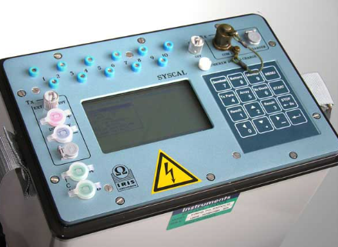
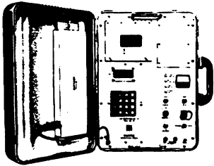


Introduction
Field scale
Laboratory scale
TDIP
easier &
measuring time ↓
core sample
SIP data acquisition
→ analysis on
dispersion characteristics
(Mewafy et al., 2013)
TDIP instrument advance
→ sampling rate ↑
2010s
Time window: 6 ch
2000s
1970-80s
Sampling rate ~ kHz
Time window: 20 ch
Full time decay estimation ↑
M-4
1) site TDIP data dispersion characteristics
Time window: 10 ch
Sampling rate: 70-250 Hz
2) comparison TDIP/SIP estimation parameter

Slide 3
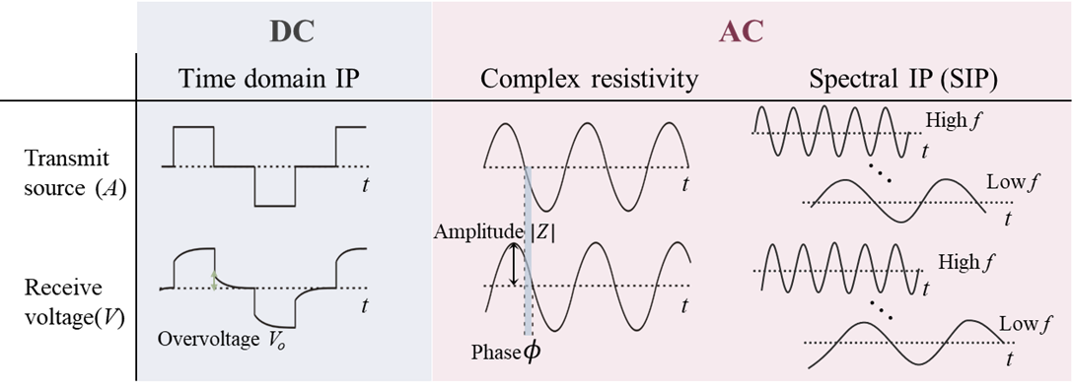
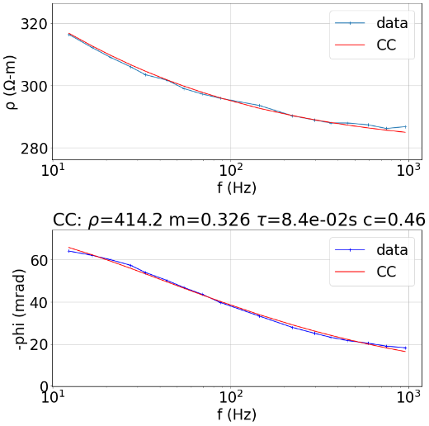
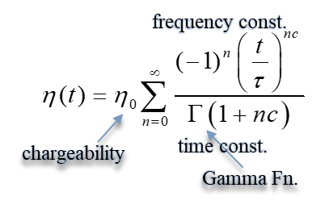
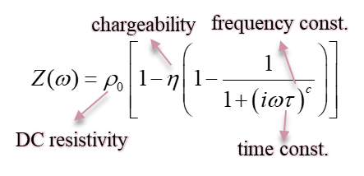


Theory
Induced polarization (IP) methods classification
Cole-Cole (CC) model
Frequency domain CC model
Time domain CC model
(Cole & Cole, 1941; Pelton et al,. 1978)
(Pelton et al,. 1978)

Slide 4

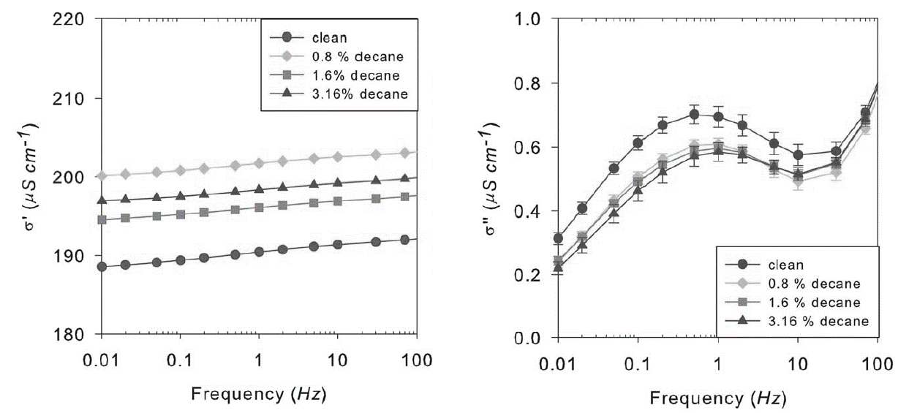
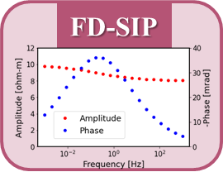

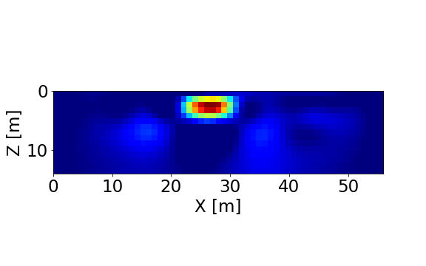
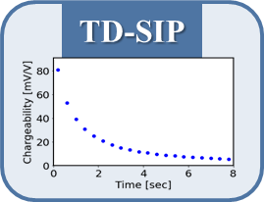
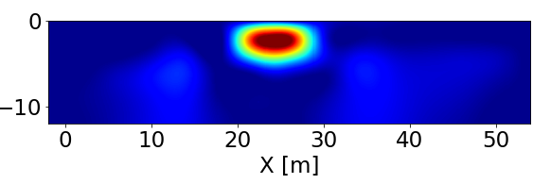



schematic of research process
Research process sequence
2) SIP parameters are used for
constructing the numerical simulation
1) Digitizing SIP data & parameter fitting
100 ohm-m, 1 mv/v,
$τ=$ $0.2$ s, $c=$ 0.8
1 ohm-m, 200 mv/v,
$τ=$ $10$ s, $c=$ 0.4
3) Time-channel inversion
(Shefer et al,. 2013)
4) TD CC parameter fitting from inversion results
inversion result
CC
parameter
modified
$$get η, τ, c$$

Slide 5
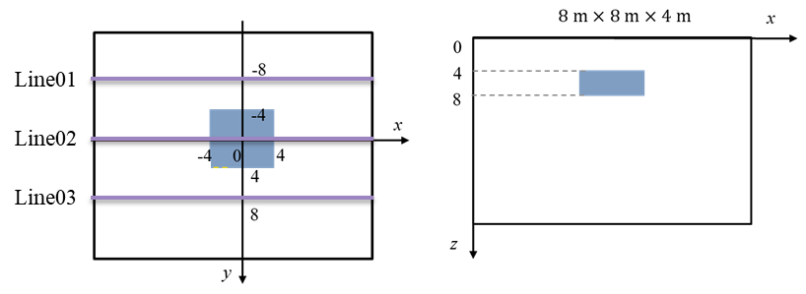
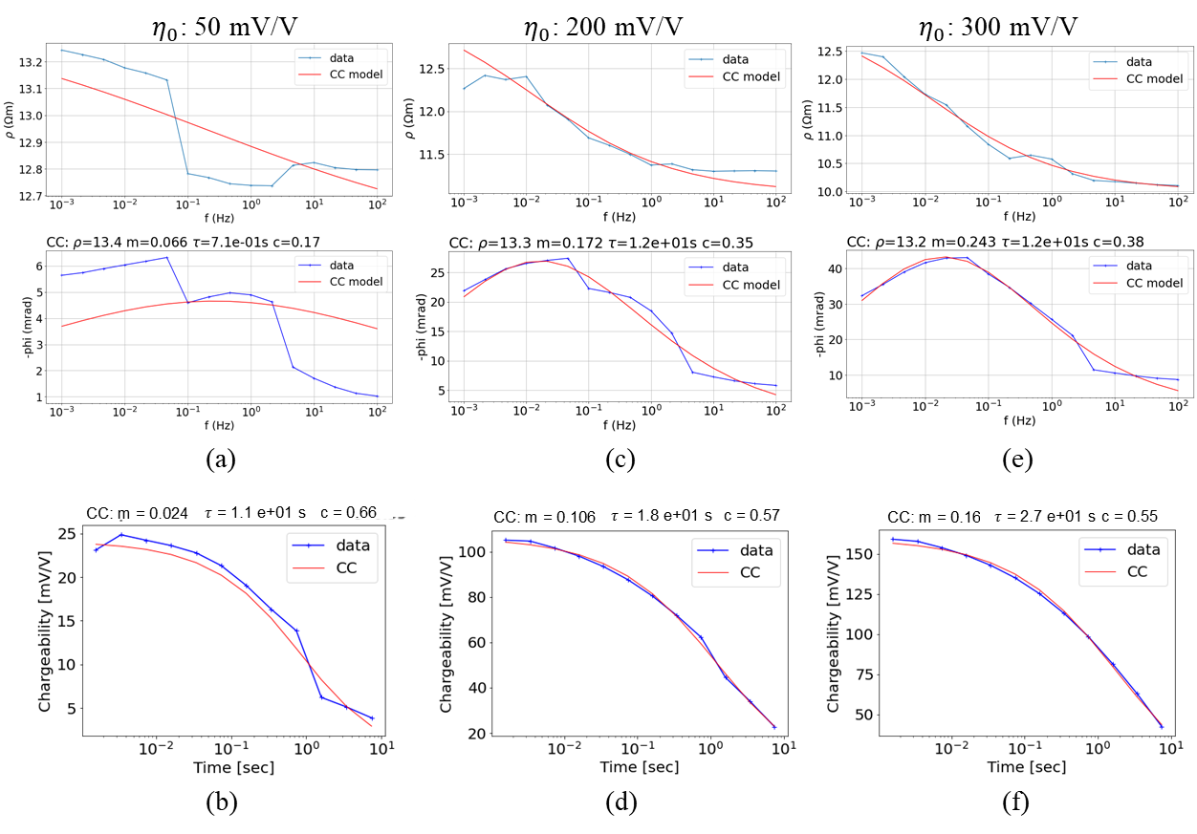
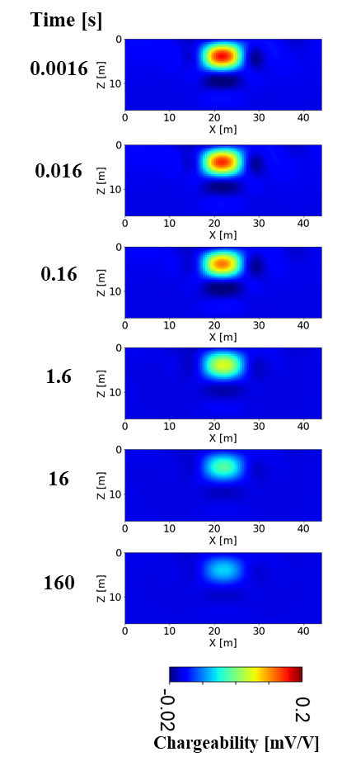

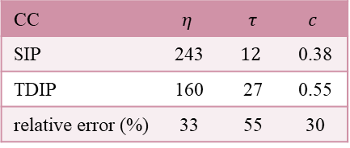

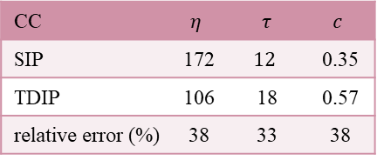

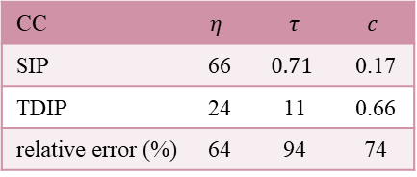

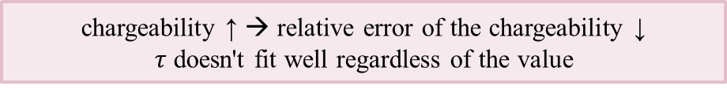

Verification of a single anomaly
$ρ=10$ ohm-m, $η$,
$τ=$ $10$ sec, $c=$ 0.4
SIP fitting parameter by chargeability
$η$ = 200 mV/V inversion results
Chargeability[mV/V]
TDIP fitting parameter by chargeability
$η$ = 50 mV/V
$η$ = 200 mV/V
$η$ = 300 mV/V
CC | $$η$$ | $$τ$$ | $$c$$
SIP | 66 | $$0.71$$ | 0.17
TDIP | 24 | 11 | 0.66
relative error (%) | 64 | 94 | 74
CC | $$η$$ | $$τ$$ | $$c$$
SIP | 172 | $$12$$ | 0.35
TDIP | 106 | 18 | 0.57
relative error (%) | 38 | 33 | 38
CC | $$η$$ | $$τ$$ | $$c$$
SIP | 243 | $$12$$ | 0.38
TDIP | 160 | 27 | 0.55
relative error (%) | 33 | 55 | 30
chargeability ↑ → relative error of the chargeability ↓
$τ$ doesn't fit well regardless of the value

Slide 6
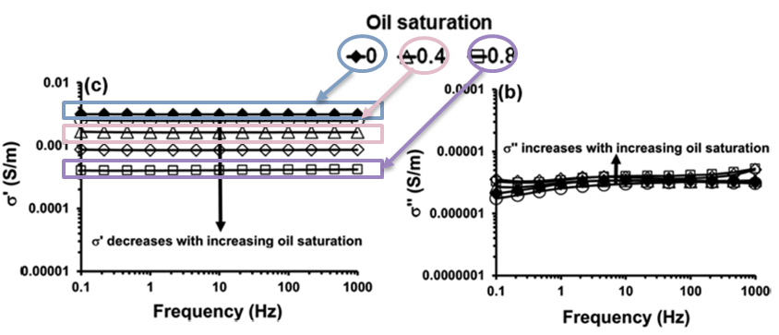
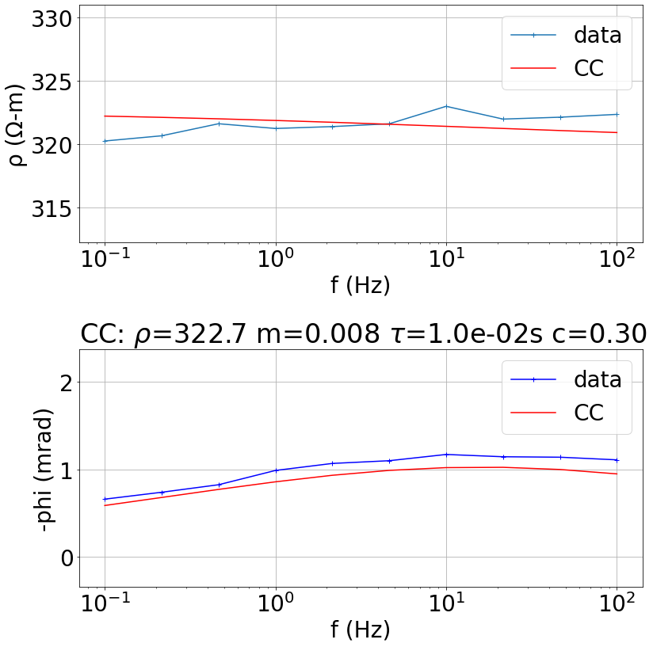
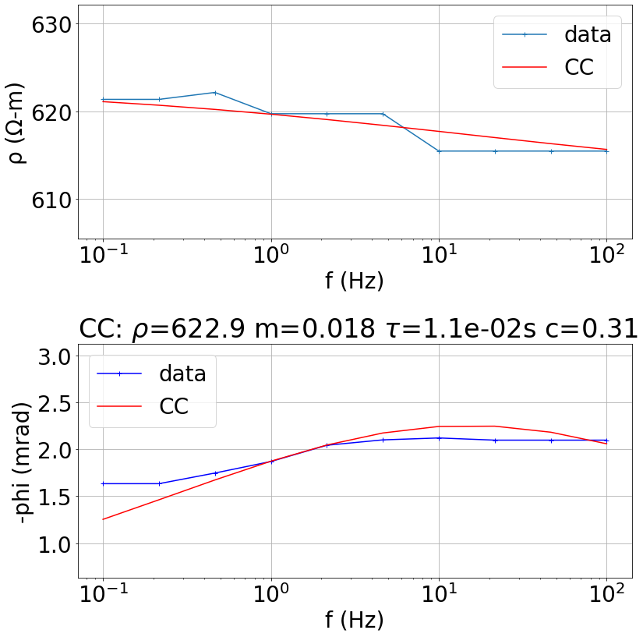
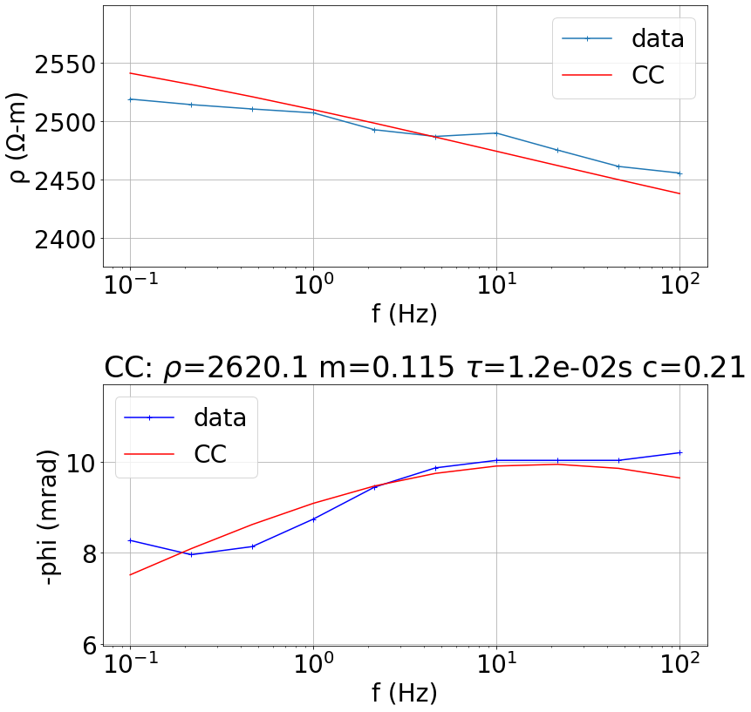
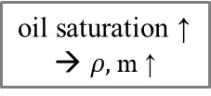



Mode1: NAPL contamination site
Sample
SIP Response by Biodegraded Oil Saturation
(Cozzarelli et al. 2010)
(Abdel Aal et al., 2014)
LNAPL; BTEX, Aromatic Hydrocarbon mixture
30 Years of Active Biodegradable Oil
Oil saturation (S_{o}) → 0/0.4/0.8
0.1 ~ 1000 Hz measurements
13 equal logarithmic intervals
SIP CC parameter fitting
Difficult to describe with CC
→ use only range 0.1 - 100 Hz
$$S_{o} 0$$
$$S_{o} 0.4$$
$$S_{o} 0.8$$
amplitude
oil saturation ↑
→ $ρ,$m ↑
phase

Slide 7
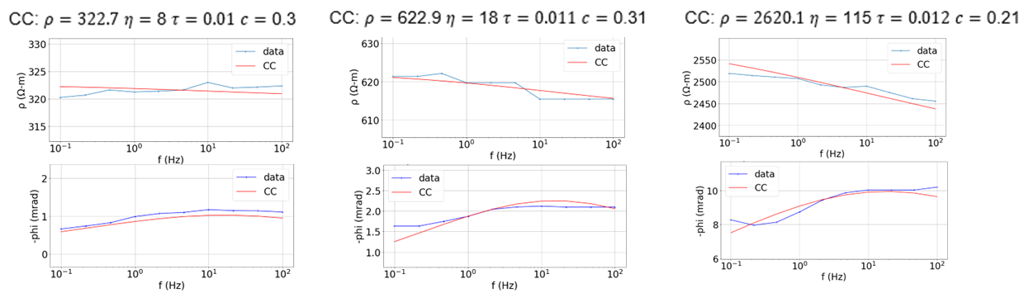
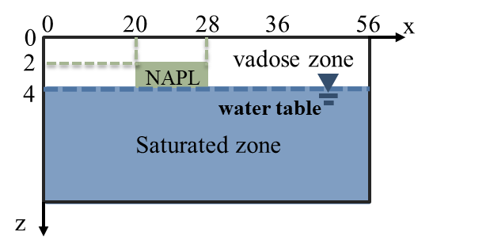
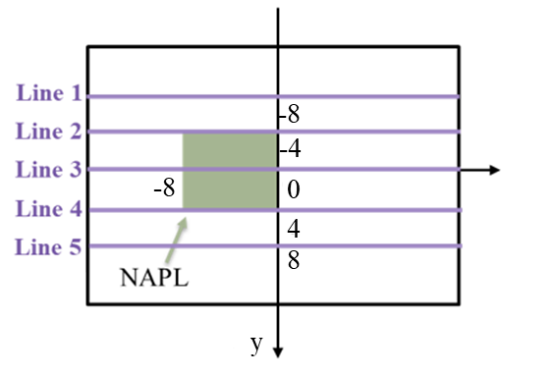
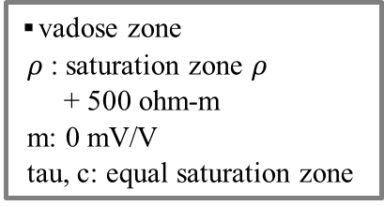
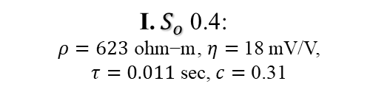
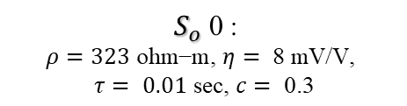
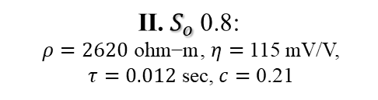
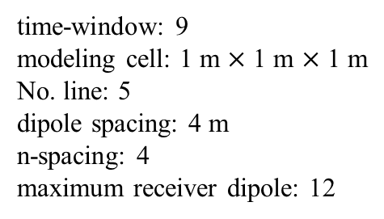
Mode1-model description
Model description
▪vadose zone
$ρ$: saturation zone $ρ$
+ 500 ohm-m
m: 0 mV/V
tau, c: equal saturation zone
Saturated zone
$$\text{Ⅰ.}{ S}_{o} \text{0.}\text{4}\text{: }$$
$ρ=\text{623} \text{ohm}\text{−}\text{m}$, $η=$ 18 mV/V,
$τ=$ $0.011$ sec, $c=$ 0.31
${ S}_{o} \text{0}$:
$ρ=\text{323} \text{ohm}\text{−}\text{m}\text{, }η= \text{8 }\text{mV}\text{/}\text{V}\text{, }$
$$τ= 0.\text{01} \text{sec}\text{, }c=\text{ 0.}\text{3}$$
$$\text{Ⅱ.}{ S}_{o} \text{0.}\text{8}\text{:}$$
$ρ=\text{2620} \text{ohm}\text{−}\text{m}$, $η=$ 115 mV/V,
$τ=$ $0.012$ sec, $c=$ 0.21
Model setting
time-window: 9
modeling cell: 1 m $×$ 1 m $×$ 1 m
No. line: 5
dipole spacing: 4 m
n-spacing: 4
maximum receiver dipole: 12
time range: 1.59E-03 ~ 7.39E-01
noise: Gaussian random 2%

Slide 8
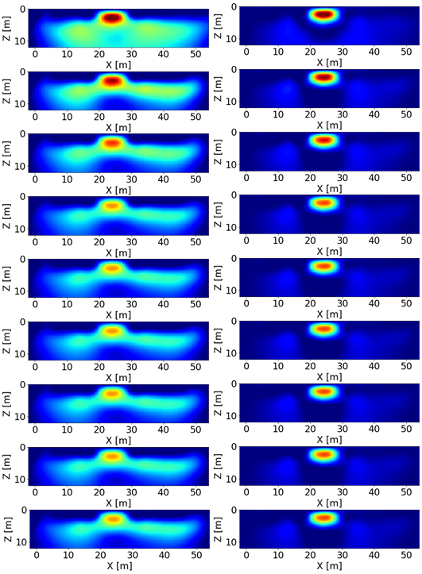
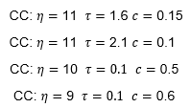
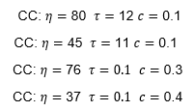
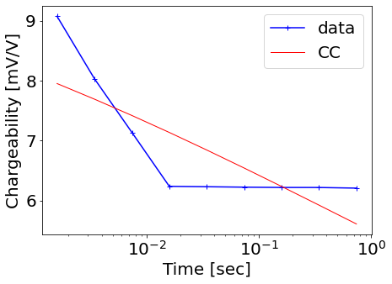
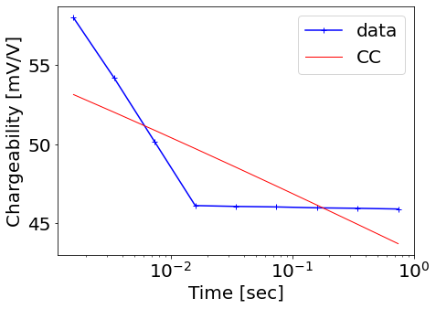
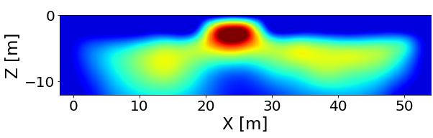
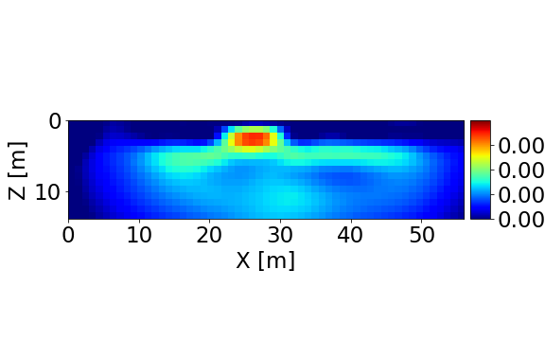
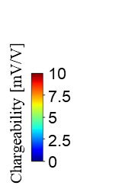

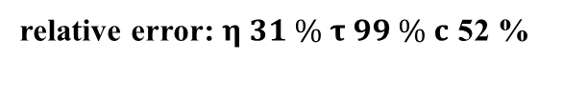
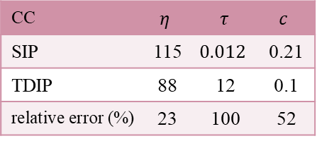
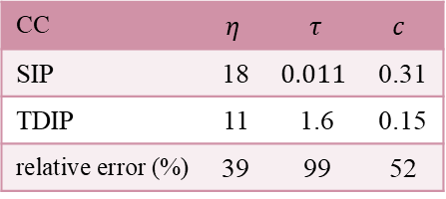
Mode1-TDIP inversion results & TDIP fitting
TDIP inversion results
t (s)
oil saturation 0.4
oil saturation 0.8
TD-CC fitting & comparison
1.59E-03
Ⅰ . oil saturation 0.4
Ⅱ. oil saturation 0.8
3.43E-03
CC | $$η$$ | $$τ$$ | $$c$$
SIP | 18 | $$0.011$$ | 0.31
TDIP | 11 | 1.6 | 0.15
relative error (%) | 39 | 99 | 52
CC | $$η$$ | $$τ$$ | $$c$$
SIP | 115 | $$0.012$$ | 0.21
TDIP | 88 | 12 | 0.1
relative error (%) | 23 | 100 | 52
7.39E-03
1.59E-02
3.43E-02
7.39E-02
1.59E-01
3.43E-01
Chargeability[mV/V]
Chargeability[mV/V]
7.39E-01
3
6
9
0
12
18
35
52
70
0
SIP vs. TDIP CC
relative error: $η 31 \% τ 99 \% c$ 52 %

Slide 9
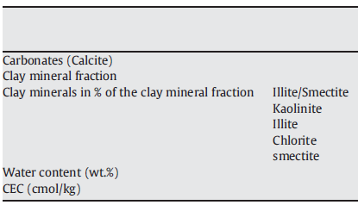
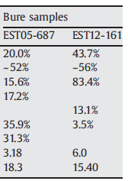
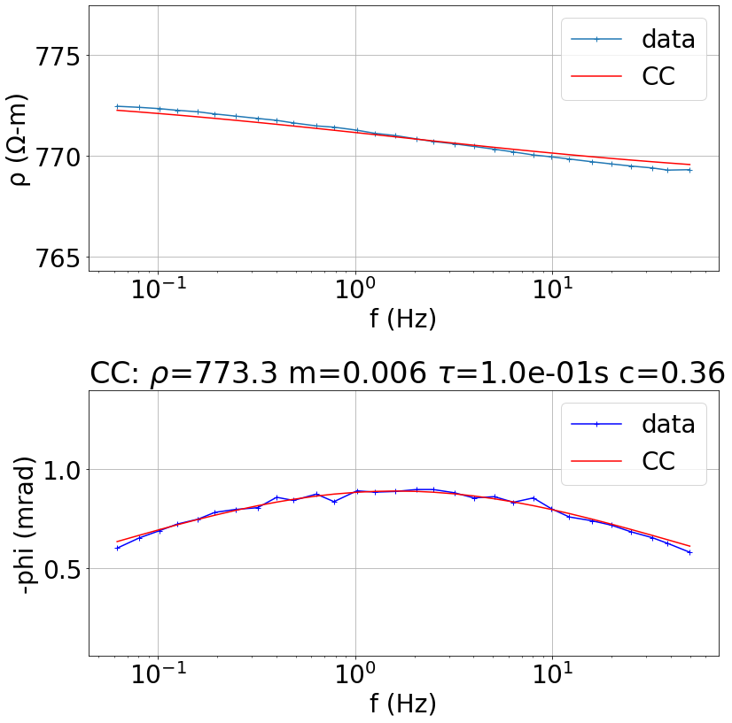




Mode2: mine site
Sample
6.0 % vol. chalcopyrite
mixed with Quartz sand
Porosity: 42.46 %
Radii of conducting particles: 500 ~ 425 $μm$
Silica sand sample
(Mahan et al., 1986)
Silica sand sample
grain size: 125-250 μm
Radii of conducting particles: 500 ~ 425 $μm$
(Chen et al., 2008)
(Ghorbani et al., 2009)
SIP CC parameter fitting
SIP Response by several samples
Difficult to describe with CC
→ use only range 0.1 - 100 Hz
mineral → chalcopyrite
clay
background
amplitude
phase

Slide 10





Mode2-model description
Model description
460
overburden
clay
halo
mineral
halo, overburden
→ Kang & Oldenburg et al., 2019
background
parameter substitution
Layer | $$ρ$$ | m | tau | c
mineral | 414 | 347 | 0.012 | 0.9
Clay | 30.6 | 105 | $$0.86$$ | 0.26
background | 773 | 0.01 | 0.1 | 0.36
halo | 500 | 0.1 | 0.5 | 0.5
Overburden | 900 | 0.01 | 0.1 | 1
fitting
parameter
literature reference
(Kang & Oldenburg et al., 2019)
Model setting
time-window: 14
modeling cell: 4 m $×$ 4 m $×$ 4 m
No. line: 1
dipole spacing: 5 m
maximum receiver dipole: 19
time range: 0.16 ~ 1.6
(use Syscal Pro semi log time range)
noise: Gaussian random 2%

Slide 11


















Mode2-TDIP inversion results & TDIP fitting
TDIP inversion results
t (s)
TD-CC fitting & comparison
0.16
Ⅰ . clay
Ⅱ. mineral
CC | $$η$$ | $$τ$$ | $$c$$
SIP | 105 | $$0.86$$ | 0.31
TDIP | 102 | 2.4 | 0.26
relative error (%) | 2.9 | 64 | 16
CC | $$η$$ | $$τ$$ | $$c$$
SIP | 115 | $$0.012$$ | 0.46
TDIP | 112 | 1.7 | 0.28
relative error (%) | 2.6 | 99 | 39
0.24
0.32
0.4
0.48
0.56
0.64
anomaly
appeared well
0.72
0.8
SIP vs. TDIP CC
relative error: $η 2.8 \% τ 82 \% c$ 28 %

Slide 12

Conclusions & further research
Conclusions
Chargeability ($η$): TDIP inversion results & TDIP fitting well matched with the constructed model by SIP parameters
Time constant ($τ$): $τ$ $↑(>1 s)$ – well fitted as TDIP fitting within 1 period $τ$ $↓(<0.1 s)$ – incorrectly fitting
Most of experimental IP data $τ$ $↓↓$
TDIP Cole-Cole model → limited range for $τ$
Further research
Comparisons 3D SIP parameters model from TD and FD
Using Fourier transform rather than time-domain CC model

