Slide 1


European Geosciences Union
A Preliminary Assessment of the Indonesian Tsunami Ready Communities
SUCI DEWI ANUGRAH, Admiral Musa Julius, Daryono Daryono, Hidayanti Hidayanti, Weniza Weniza, Tribowo Kriswinarso, Gloria Simangunsong, Resti Herdiani Rahayu, Mila Apriani, Tatok Yatimantoro, Purnomo Hawati, Dwikorita Karnawati, Muhamad Sadly, and Bambang Setiyo Prayitno
BMKG, Earthquake and Tsunami Center, Jakarta, Indonesia (suci.dewi.sda@gmail.com)

Slide 2
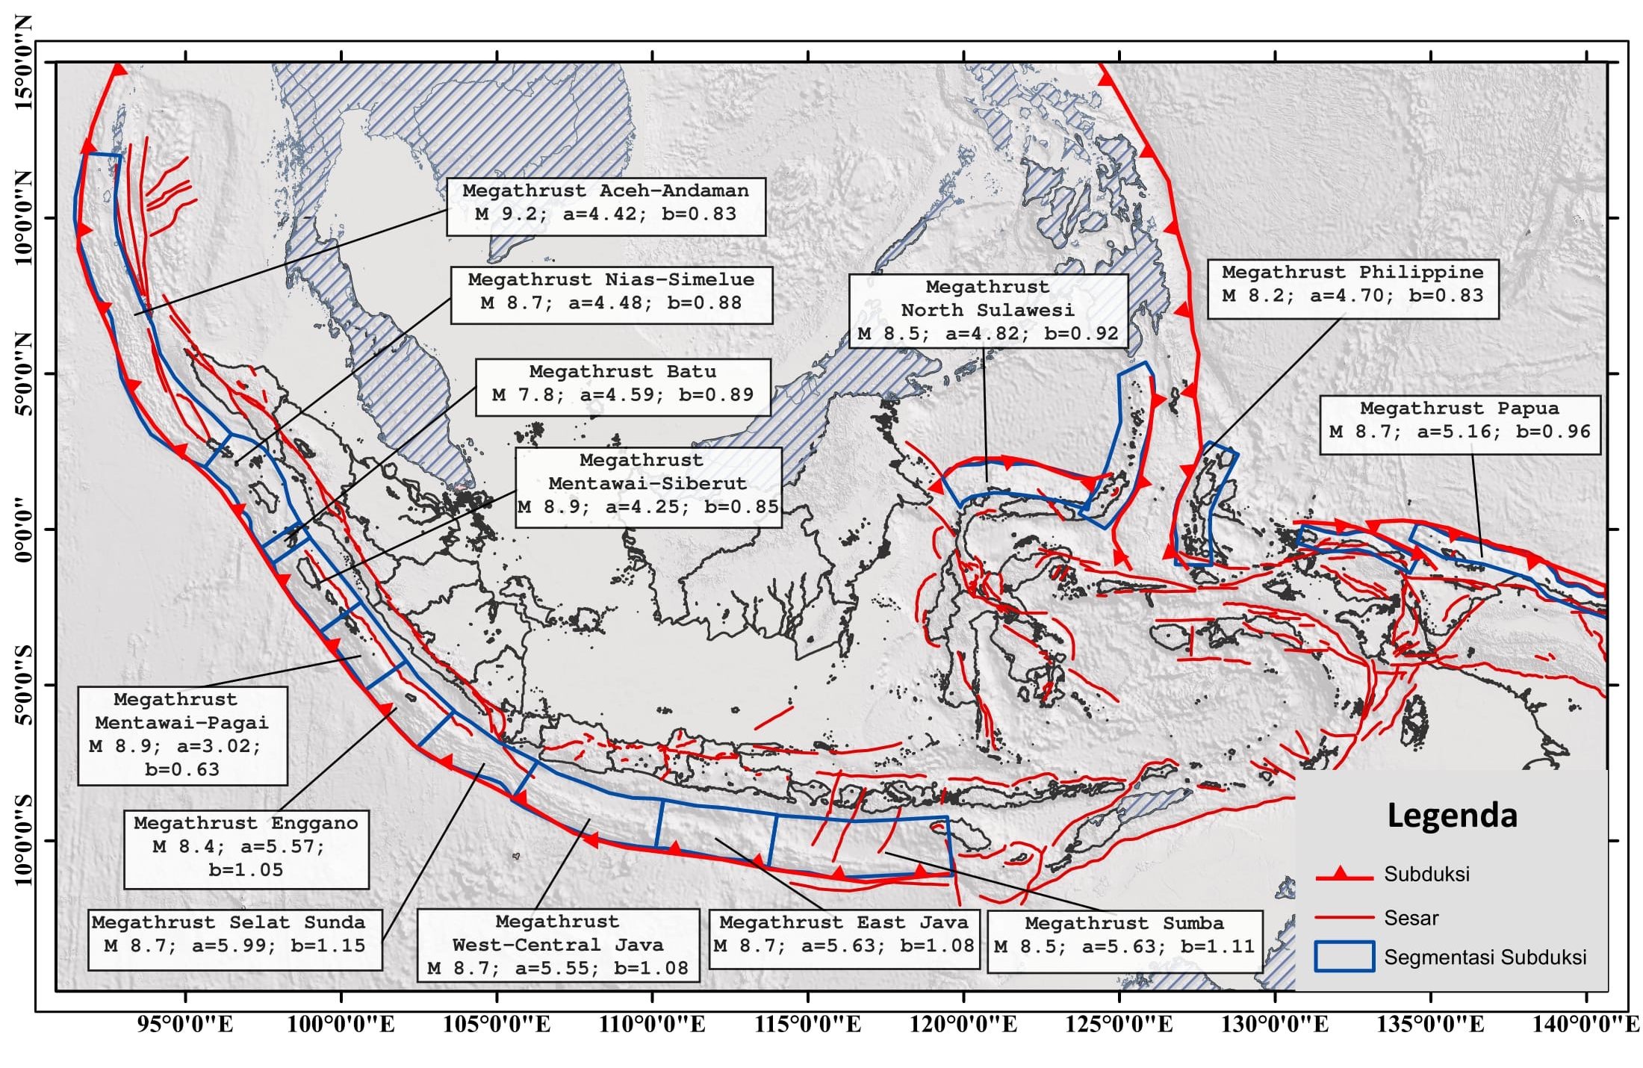
European Geosciences Union
Introduction: Megathrust Earthquake Sources in Indonesia
Source: Indonesian National Center for Earthquake Study (2017)

Slide 3
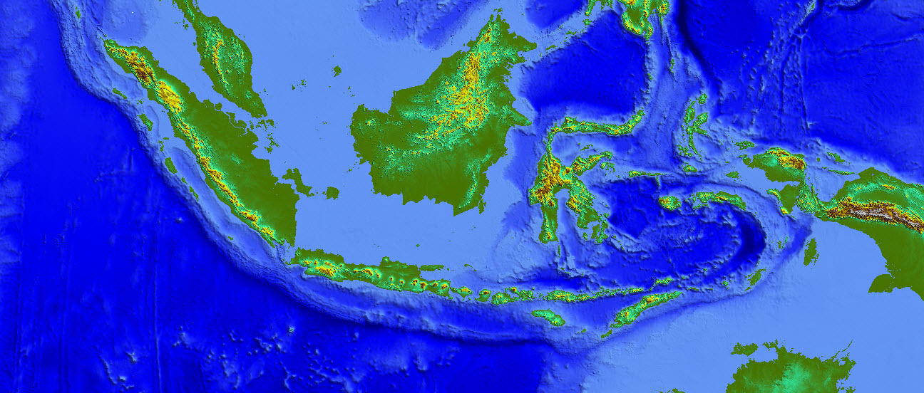
HISTORICAL TSUNAMI IN INDONESIA 1674-2018
1886
2004
1907
1907
1889
1996
1936
1852
2005
1968
1904
1907
1857
1843
1921
1845
1939
1885
2018
1938
1871
1859
1608
1994
1864
1996
1861
1938
1674
1998
1979
1907
1908
1927
2000
1965
1994
1861
2007
1965
1845
1754
1802
2002
1914
1797
1969
1885
1802
1932
1899
1938
1900
2016
2010
1648
1711
1841
1833
2018
1967
2006
1657
1629
1818
1925
1674
1852
1854
Sumatra 15 kali
Jawa 8 kali
Bali NTB NTT 16 kali
Sulawesi 21 kali
Banda 14 kali
Maluku Utara 10 kali
Papua 8 kali
1836
1820
1897
1975
1938
1883
1889
1815
1815
1992
1982
1896
1991
1673
1710
1856
2004
1950
1763
2009
1818
1919
1975
1957
1840
2018
1908
2006
1859
1891
1917
1814
Sumber: Soloviev and Go (1974); Wichmann (1918); Sieberg (1932); Heck (1934); Iida et al. (1967); Berninghausen (1969); NOAA; BMKG.
1994
1921
1977
There have been more than 99 tsunamis in Indonesia since 1674-2018

Slide 4

INTRODUCTION
Tsunami Ready, The program is based on community performance in building tsunami preparedness with active collaboration from the community, community leaders, tsunami early warning centers and disaster management agencies (local and national).
Tsunami Ready Approach
Participatory
Systematic and measureble
Science and evidence based.
Collaborative working
Standardized

Slide 5
UNESCO-IOC Tsunami Ready Indicators
European Geosciences Union
ASSESSMENT
1 | Tsunami hazard zones are mapped and designated
2 | The number of people at risk in the tsunami hazard zone is estimated
3 | Economic, infrastructural, political, and social resources are identified
PREPAREDNESS
4 | Easily understood tsunami evacuation maps are approved
5 | Tsunami information including signage is publicly displayed
6 | Outreach and public awareness and education resources are available and distributed.
7 | Outreach or educational activities are held at least 3 times a year
8 | A community tsunami exercise is conducted at least every two years
RESPONSE
9 | A community tsunami emergency response plan is approved
10 | The capacity to manage emergency response operations during a tsunami is in place
11 | Redundant and reliable means to timely receive 24-hour official tsunami alerts are in place.
12 | Redundant and reliable means to timely disseminate 24-hour official tsunami alerts to the public are in place
UNESCO-IOC recognizes that the community have built their capacity and implemented measures in accordance to the agreed indicators of UNESCO-IOC Tsunami Ready Programme, and that they will continue to maintain and ensure the sustainability of this preparedness level.

Slide 6
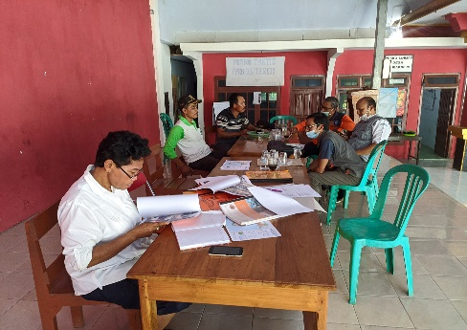
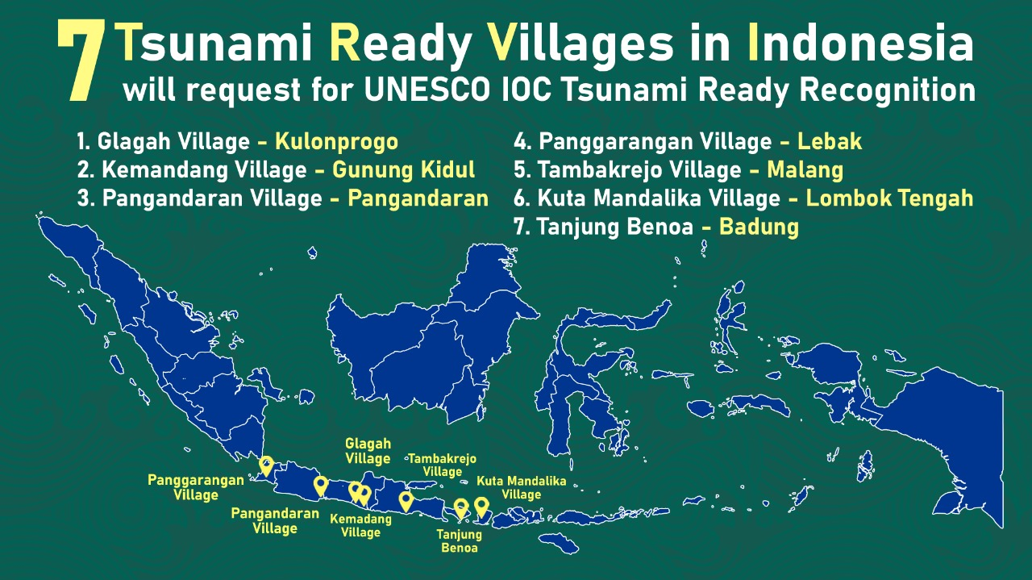
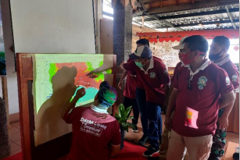
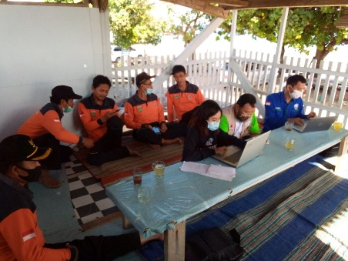
INDONESIA TSUNAMI READY
Advocacy of the compliance of the 12 indicators
Developing Tsunami Hazard Map
Through the Tsunami Ready School Activities the Agency for Meteorology, Climatology and Geophysics advocated the community to implement the Tsunami Ready
Developing Emergency Plan

Slide 7
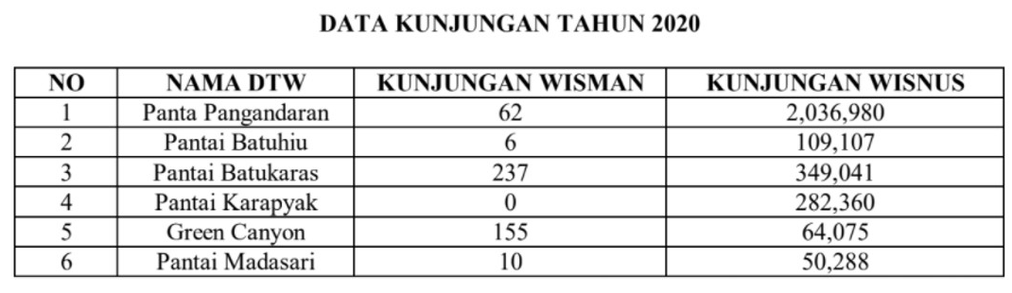
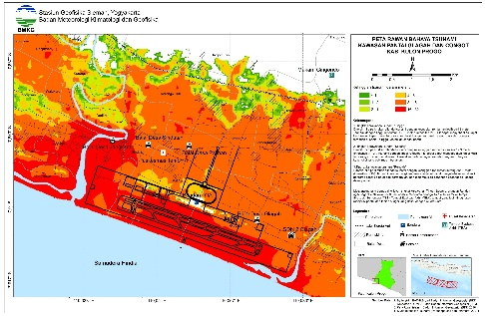
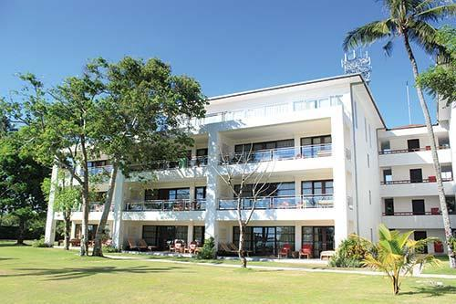
European Geosciences Union
IMPLEMENTATION OF ASSESSMENT INDICATORS
Number of tourist to complete the data of people at risk
Tsunami Hazard Map
The communities have the hazard map based on the topography data. A Tsunami hazard map based on a tsunami modelling was mapped to revise the previous map.
The Communities have a simple data of number of people living in the prone area od tsunami. The data of number of people at should be detailed with number of vulnerable people, tourists, and workers
The Communities had been involving private sector, local governmet, university, and NGO
Roof Top Hotel utilized for tsunami evacuation vertical

Slide 8
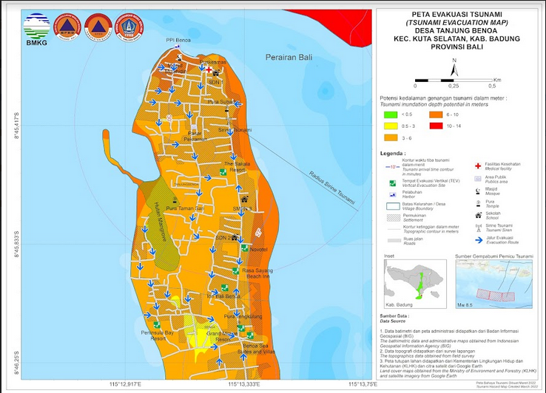
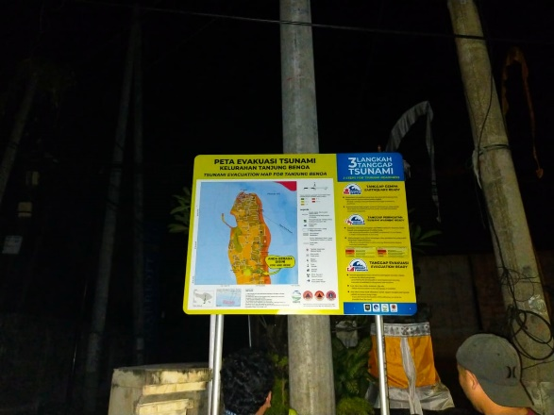
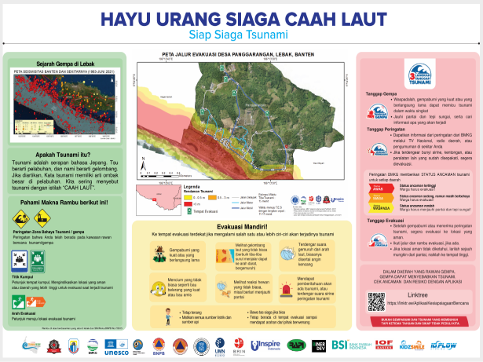
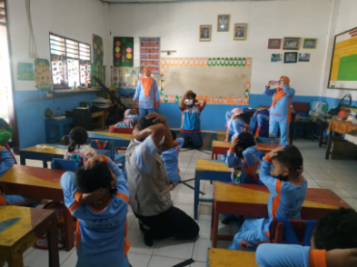
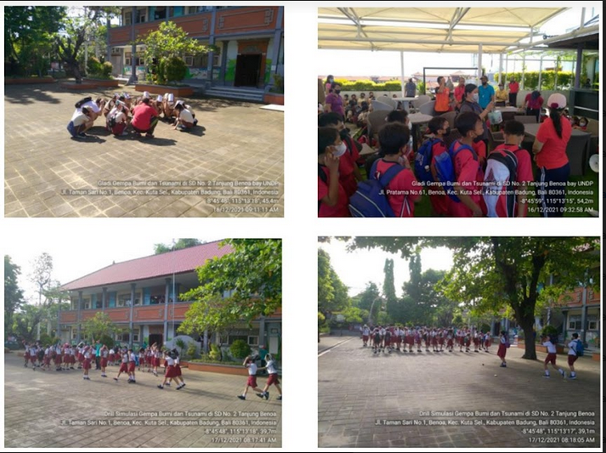
IMPLEMENTATION OF PREPAREDNESS INDICATORS
Tsunami Evacuation Map based on hazard map
Tsunami Information Board
Local Tsunami education material
The communities should have tsunami evacuation map based on tsunami hazard modelling
The Communities have to developed a local based education material.
The community in general had conducted earthquake and tsunami drill regularly, however the drill should involving the tsunami warning exercise
Regular education for student
Earthquake and Tsunami Drill

Slide 9
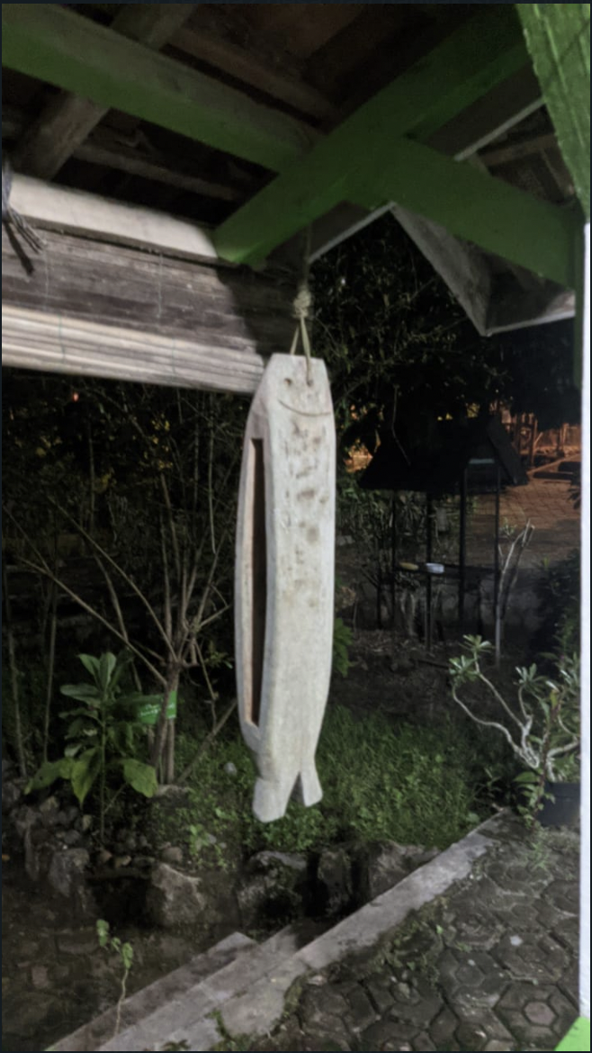
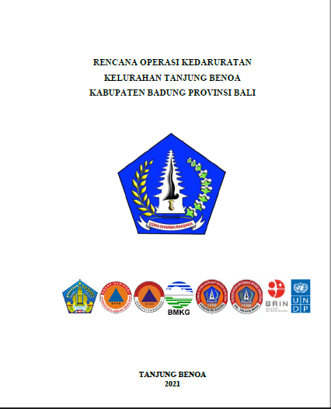
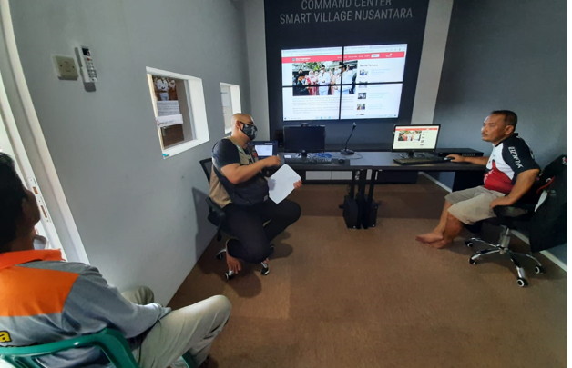
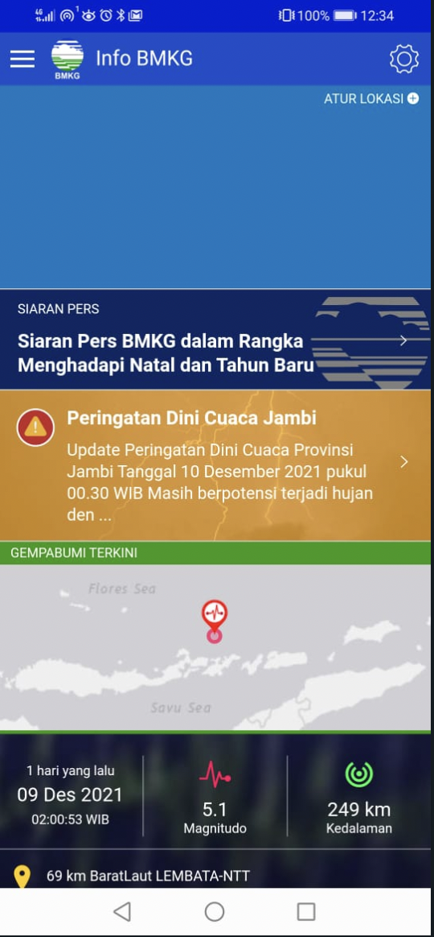
IMPLEMENTATION OF RESPONSE INDICATORS
24/7 emergency center
Kentongan, Traditional tool from bamboo to provide alarm
Emergency operation plan
Mobile application for earthquake information and tsunami warning
The communities do not have tsunami Emergency operation plan
The Communities have to developed a local based education material.
The community in general had conducted earthquake and tsunami drill regularly, however the drill should involving the tsunami warning exercise

Slide 10
THANK YOU
European Geosciences Union
Further Communication:
Email: suci.dewi.sda@gmail.com
http://inatews.bmkg.go.id
Mobile Application Info BMKG, WRS-BMKG, BMKG-AEIC

