Slide 1
The extreme sea-level event of 14-15 October 2016 on the coasts of British Columbia and Washington State caused by Typhoon "Songda"
Alexander Rabinovich, Jadranka Šepić, Richard Thomson

Slide 2
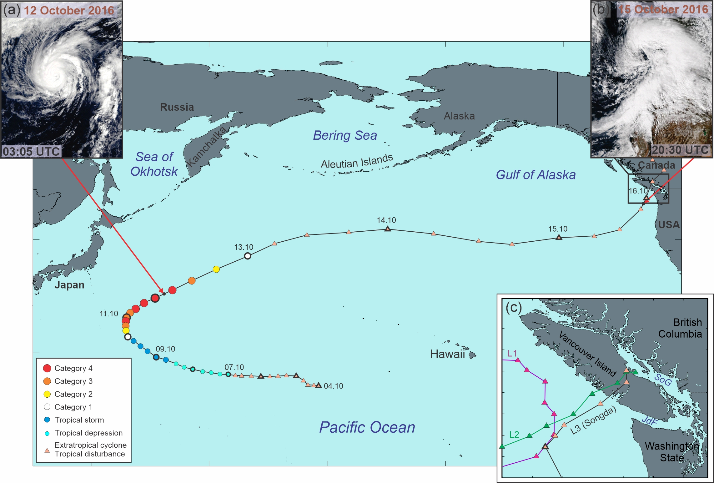
Pathways
Typhoon Songda was generated on 2 October west of Hawaii
It travelled northward along the coast of Japan, and then turned eastward towards north America
Near coast of Washington State and British Columbia, it merged with two extratropical cyclones
All three systems crossed Vancouver Islands causing storm surge, meteotsunamis and infragravity waves

Slide 3
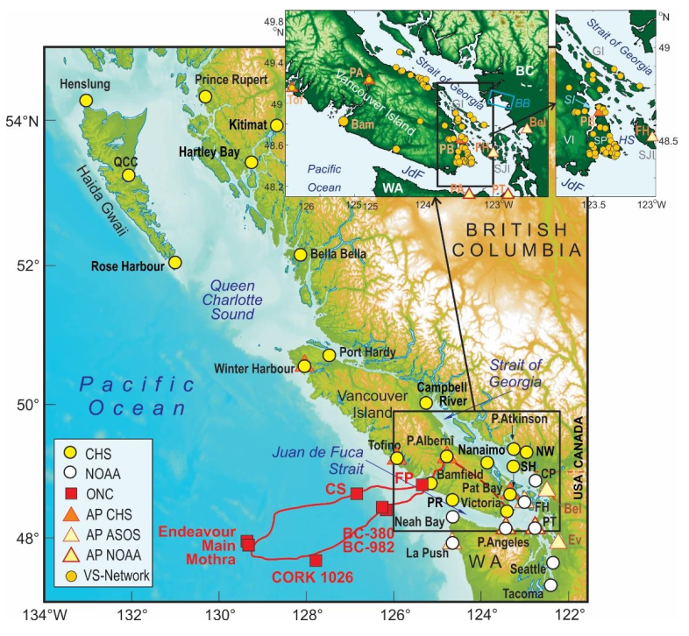
Abundant data available for research of the event
20 Canadian and 10 US coastal tide gauges
182 high-resolution weather (wind and air pressure) stations within the Victoria School Network and other sources;
7 open North Pacific bottom pressure recorders (BPRs);
High-altitude global reanalysis
Numerical ocean model

Slide 4
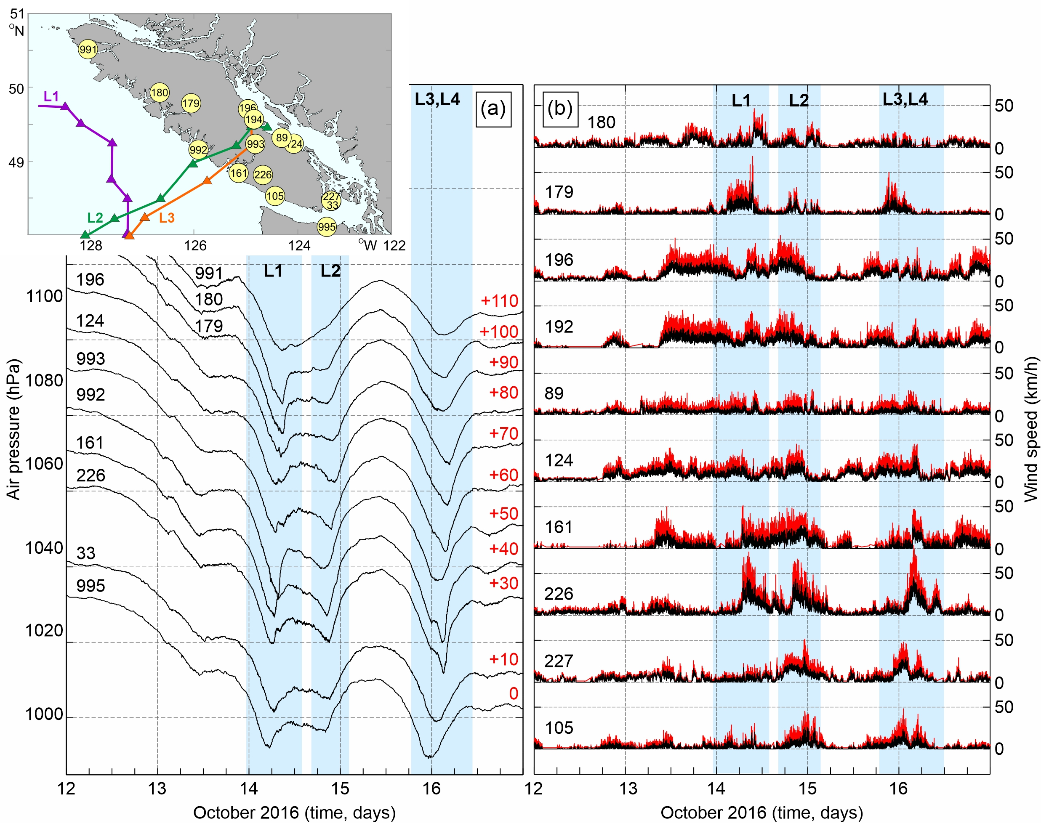
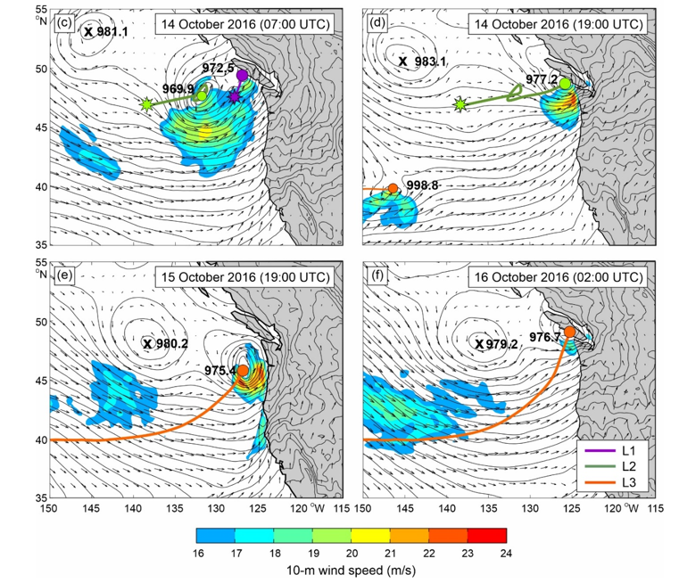
Pathway of three lows
Measured data
ERA5 Reanalysis

Slide 5
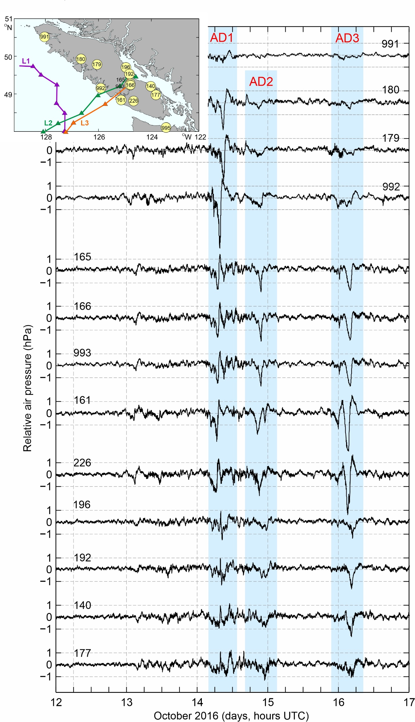
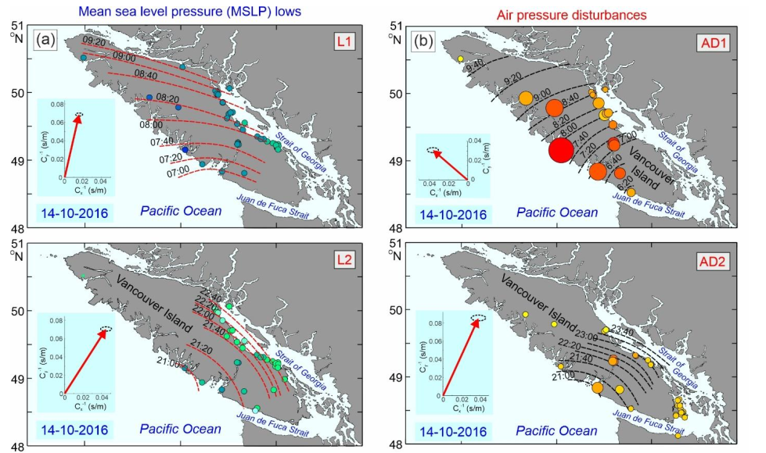
Pathway of air pressure disturbances

Slide 6
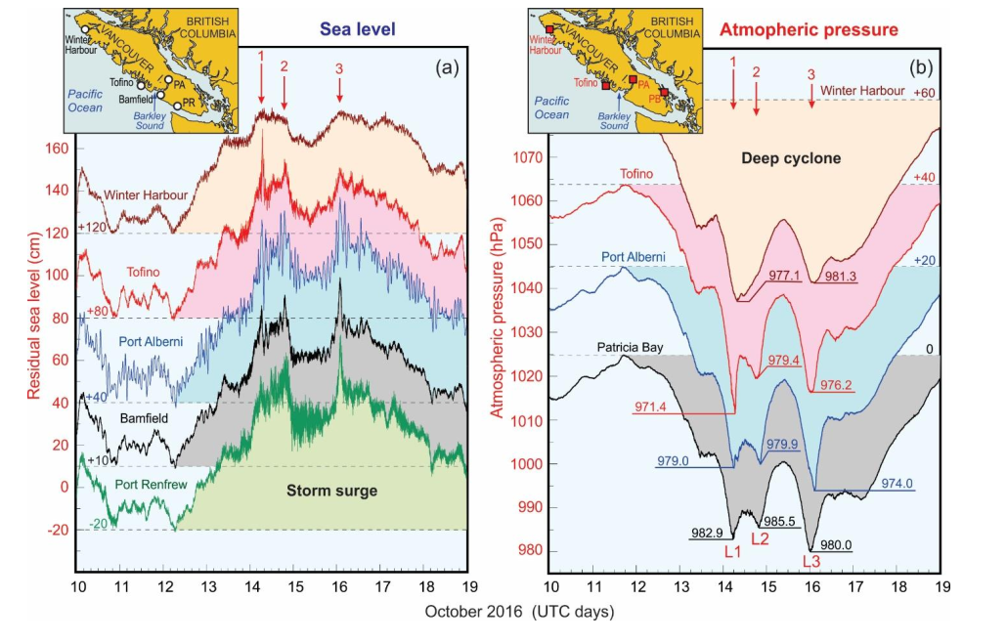
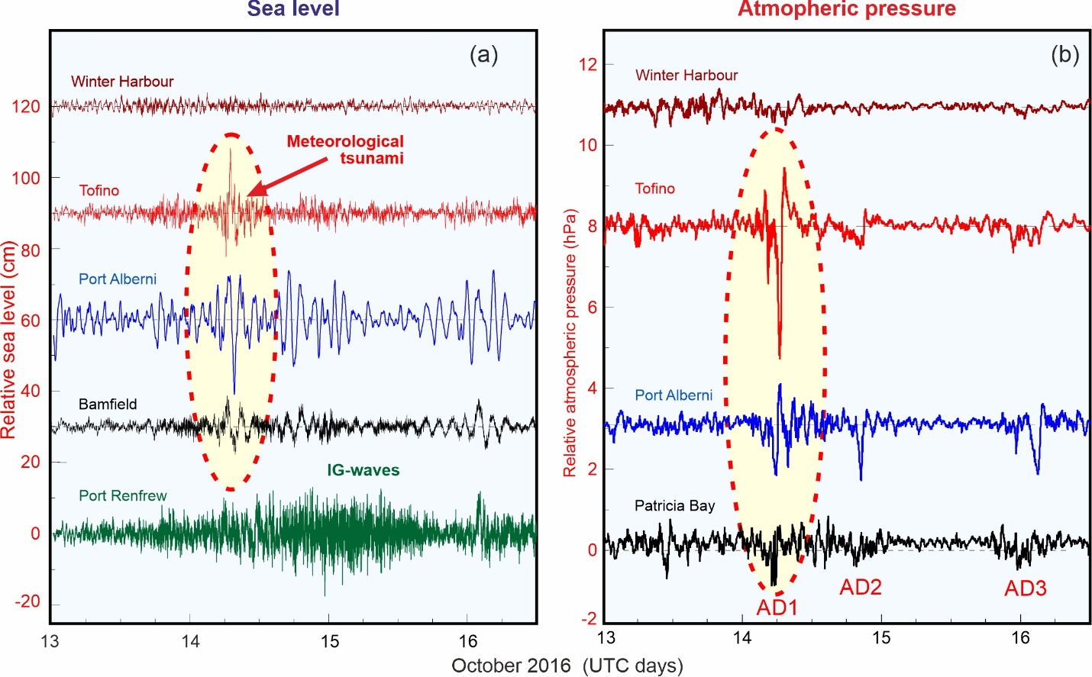
Sea level response to atmospheric forcing
Original series
High-frequency series

Slide 7
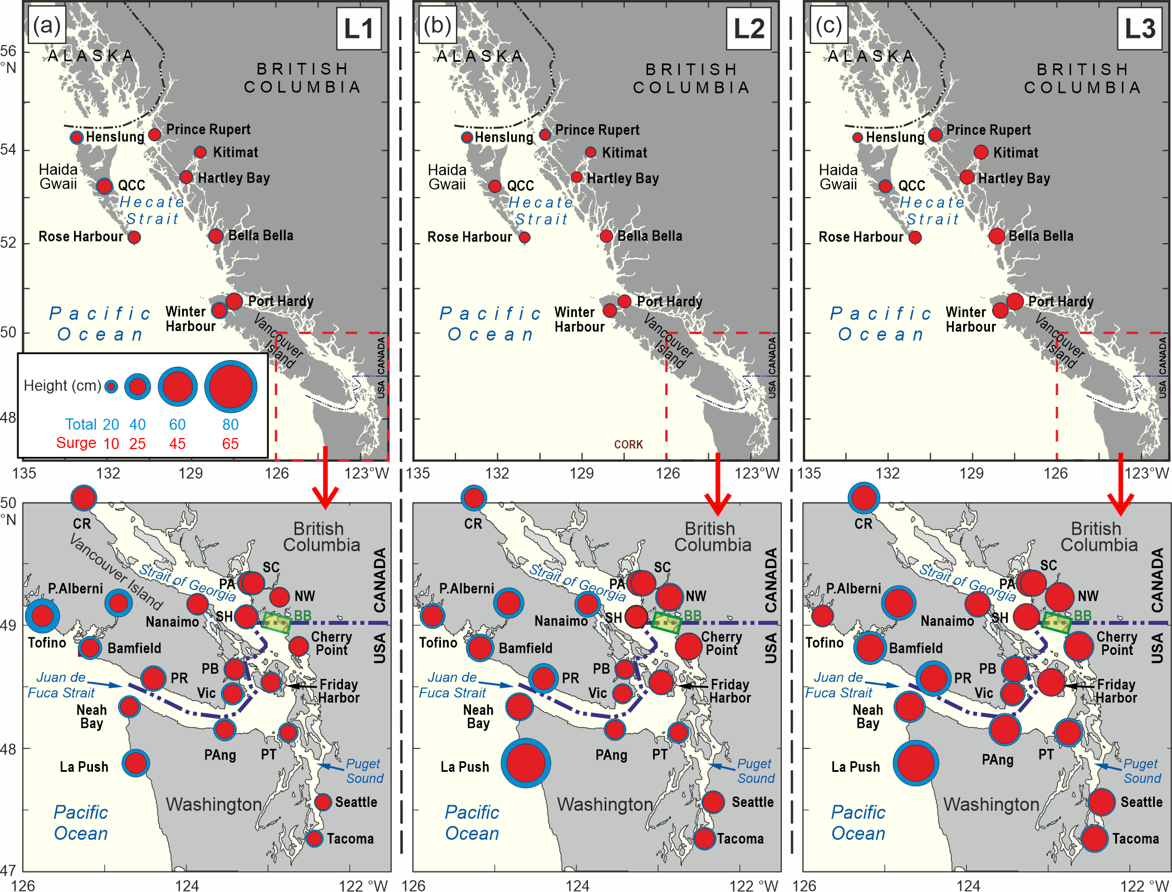
Coastal stations
Strongly site-dependant sea level response to atmospheric processes resulting with:
Storm surges
Meteotsunamis
Infragravity waves

Slide 8
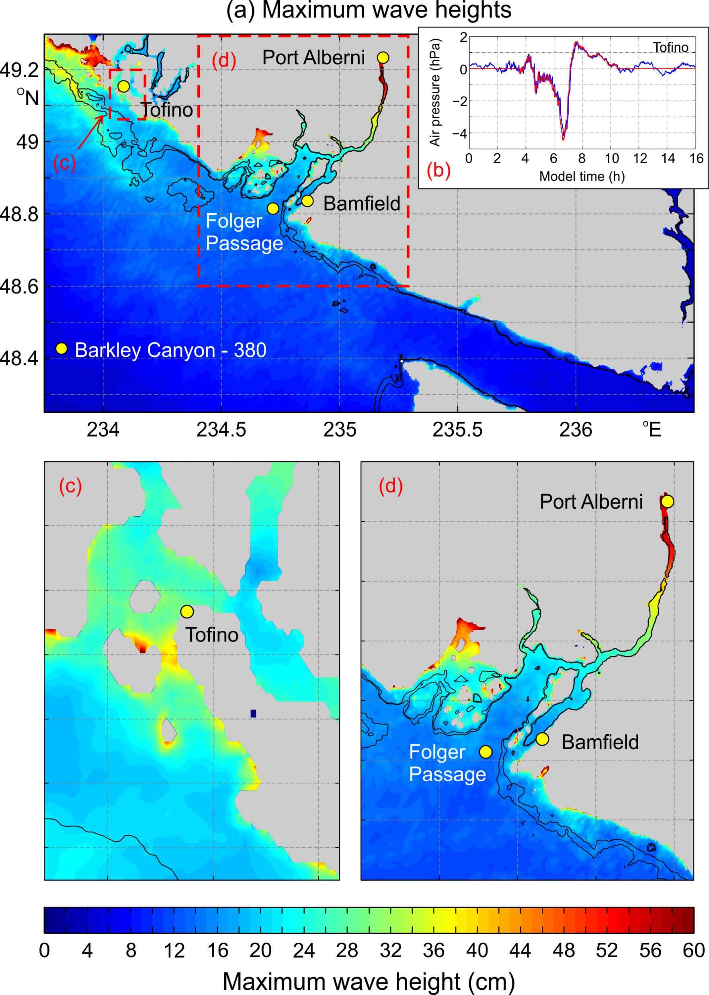
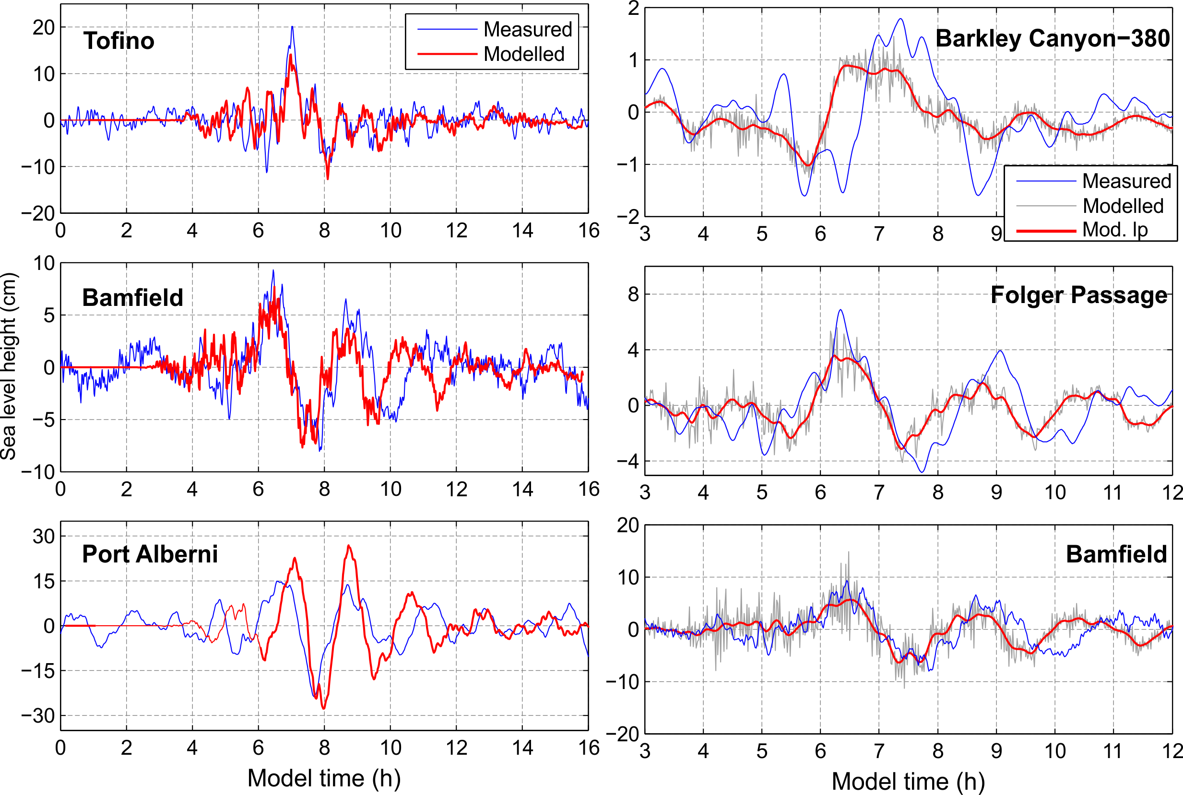
Numerical modelling

Slide 9
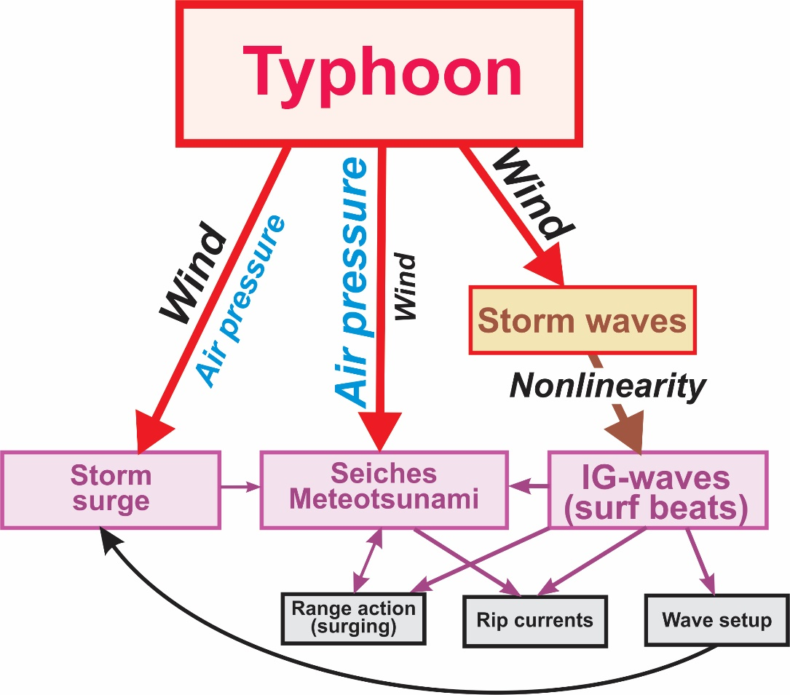
Conclusion
Various types of hazardous sea level oscillations (storm surge, meteotsunamis, IG-waves) and related phenomena (range action, rip currents, wave setup) can be generated by tropical cyclones (typhoons, hurricanes) and by extratropical cyclones.
(Medvedev et al., 2022)

Slide 10
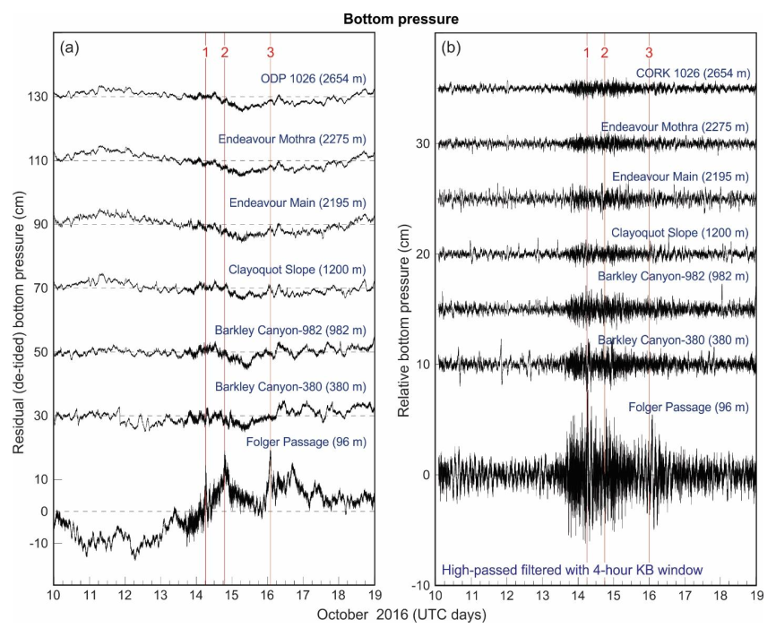
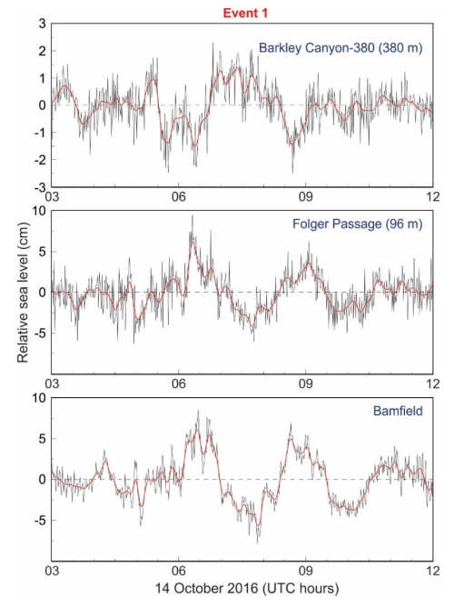
Open ocean: standing shelf waves

