Slide 1
Oscillations induced by crack growth in compression, and morphology of fracture surfaces
EGU General Assembly
23 – 27 May 2022
Presented by Broadus Jeffcoat-Sacco
Content developed by Broadus Jeffcoat-Sacco, Arcady Dyskin, Elena Pasternak, Phil Dight and Hongyu Wang
Notes:
1

Slide 2
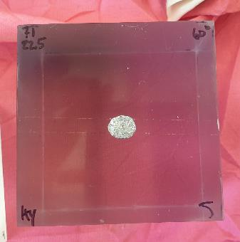
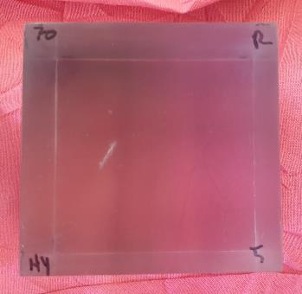
Crack-growth samples with inclined penny shaped flaws
Flaw:
Two aluminium foil circles, 10mm diameter
Silicone grease separating foil layers, and surrounding them
Mounted with fine copper wire
Sample mass:
Clear polyester casting resin (1% MEK-P)
Frozen 48hrs at -40° to ensure brittleness
70mm cube
σ₁
Side view (facing σ₂)
σ₁
σ₂
Front view (facing σ₃=0)
σ₃= 0
Notes:
-Round flaw: classic fracture mechanics shape
-Grease: minimize friction between flaw “walls”
-Clear/transparent: allows growing crack to be observed
-Polyester resin: pourable at room temperature

Slide 3
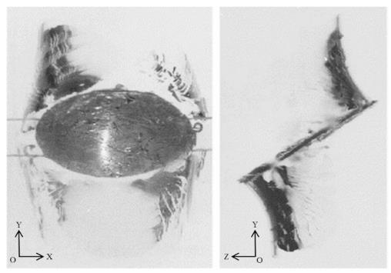
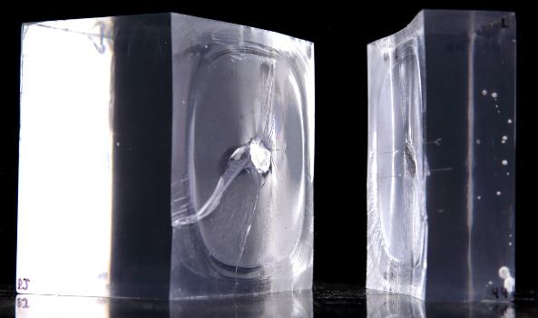
Uniaxial vs biaxial compression
σ₁
σ₁
σ₂
Uniaxial compression
Wrapping crack
Terminates at similar size to initial flaw
Crack(s) grow further only once UCS is reached & sample shatters
Biaxial compression (σ₂ > 6% of σ₁)
Planar crack (σ₁ – σ₂ plane)
Terminates when approaching sample boundary (>> than flaw) – prominent ridge
Outermost part of crack grows as sample is being unloaded (not part of main crack growth)
Uniaxial image from Dyskin et al. (2003), “Study of 3-D Mechanisms of Crack Growth and Interaction in Uniaxial Compression,” Eng Frac Mech, 70.
Biaxial criteria (6% cutoff) based on Wang et al. (2018), “Effect of the intermediate principal stress on 3-D crack growth,” Eng Frac Mech, 204.
Notes:
Uniaxial case: Crack “wraps,” following the circumference of the flaw. When the new crack(s) are similar in size to the initial flaw, they stop growing – until the material UCS is reached, and the entire sample shatters.
Biaxial case (σ₂ along flaw’s strike): Wrapping does not occur, and a (nearly) planar crack opens in the σ1-σ2 plane. The crack grows quickly, to a size much larger than the initial flaw, but terminates near sample boundary. Outermost part of the crack, between the prominent oblong-shaped arrest line and the sample boundary, grows only as the sample is being unloaded

Slide 4
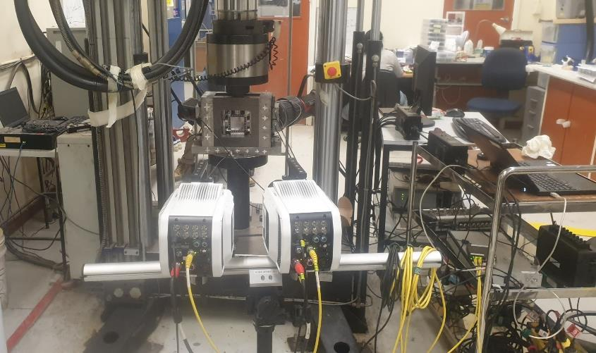
Experimental apparatus 1: video & data collection
Instron 8035
Load rate 0.2 to 0.4 mm/minute
Biaxial plane-strain restraint
High-speed cameras (Phantom V1212)
Transmitted light
Dantec Istra software & control
PAC DiSP AE System
Graphtec logger
Instron 8035
Spotlights
AE Computer & Android microphone
Sample
Biaxial Frame
Video Computer & dataloggers
High-speed cameras
Notes:
Tests run in displacement control, 2mm to 4mm in 10 minutes, and stopped manually when cracking was heard, or when upper loading limit 500 kN was reached (approx. 100 MPa).
Biaxial restraint device restrains lateral expansion due to the vertical compression (Poisson’s ratio) resulting in a lateral load (σ₂). Recall a σ₂/σ₁ ratio of only 6% is required to make “biaxial” case (Wang et al. 2019)
Second camera used for redundancy. Transmitted light to highlight crack placement, from 2x Aputure LED spotlights. 100,000 frames per second greyscale images. Synchronized data streams to ~100 μs precision via Arduino device. This is enough to link AE waveforms to the video observations of cracking – but, since the extensive cracking process takes ~100 μs to occur, the synch is not precise enough to link *portions* of the AE waveforms to specific video frames.

Slide 5
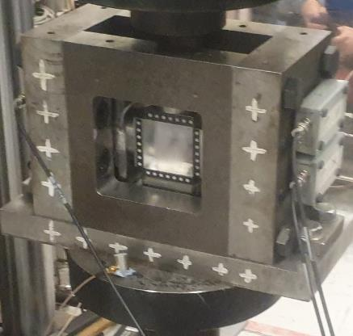
Experimental apparatus 2: AE sensor placement
Sample: front free face
R3α sensor
Blu-tak
One sensor in air
PAC R3α
100mm from front face
2 sensors in contact with rear face
PAC R3α & S9220
Spring-loaded mounting device
Notes:
Prior to these experiments, the target frequency of interest wasn’t known, so a pair of different sensors was chosen to cover more total frequencies: R3α for lower frequencies (audible to ~ 100 kHz) and S9220 for higher frequencies (to > 500 kHz).
Early experiments with microphone indicated ~ 11 kHz audible sound. In-air R3α attempts to capture that sound, on a common time scale with the two AE sensors contacting the sample.

Slide 6
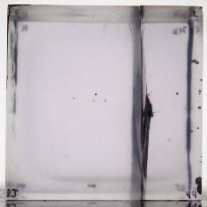
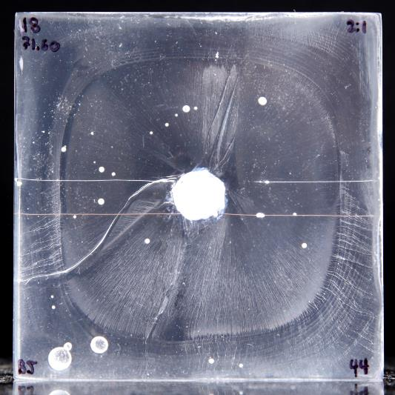
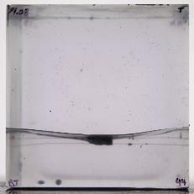
General morphology of extensive crack in biaxial compression
σ₁
σ₁
Ubiquitous features
Convex profile
Radial hackles (extensive growth at peak load)
Prominent ribs near sample edge (start-stop growth during unloading)
Hackles merge into river lines
Prominent radial features
Overlaps, twist hackles, “moustache” shaped features
One wing crack starts growing first. A second wing crack sometimes starts after a short delay (a few 10s of μs)
Growing wing crack(s) affected by the flaw and cracks that have grown
Complex 3D geometric interactions that change with time
Side view (facing σ₂)
σ₃= 0
σ₂
σ₃= 0
Top view (facing σ₁)
σ₂
Notes:
Ubiquitous features:
--Convex crack profile. Crack “avoids” free face. Greater curvature in σ₂ direction.
--Open crack (not shown in image) – several cracks were sectioned and measured with feeler gauge; crack aperture is 0.1 mm to 0.3 mm (sample size is 70mm).
--Fractographic zonation
----Region I: radial hackles (tension) ubiquitous. Merge near Region II creating “river lines.” Sometimes also circumferential, wave-like features (Wallner lines?)
----Region II: Circumferential ribs indicating start-stop cyclic crack growth (similar to fatigue). Occurs during unloading. Possibly due to fluctuations of friction on the sample/platen contacts, possibly also due to material property changes where the frozen resin is in contact with room-temperature platens.
Non-ubiquitous features
--Prominent radial features: twist hackles, overlaps, etc. are due to sample-specific, 3D geometry of flaw and growing crack.
--Most common feature is crack overlap:
A wing crack starts at one point on the flaw (usually top, or bottom) and grows in an elliptical shape.
At some time later, while the first crack is partially occluded by the flaw footprint, a second crack begins from the other side of the flaw.
These cracks grow together, offset by the flaw’s inclination, overlapping but not merging. Their outer edges follow the generally elliptical shape described above.

Slide 7
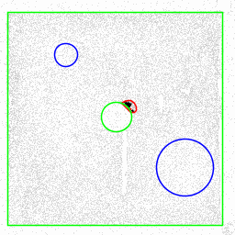
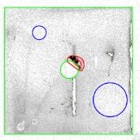
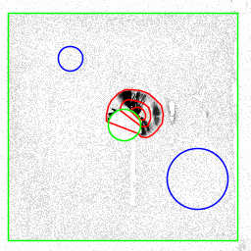
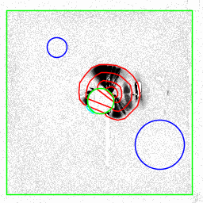
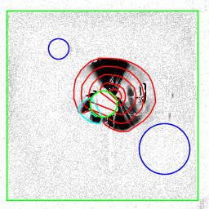
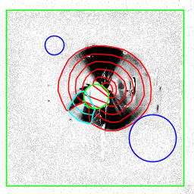
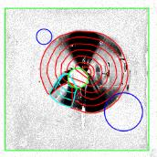
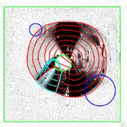
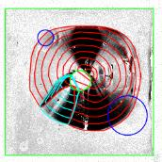
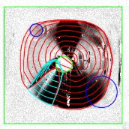
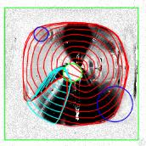
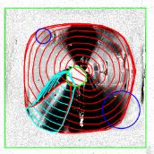
Crack growth process in biaxial compression
σ₁
First wing crack starts; second wing starts 40 μs later
Both cracks grow together, maintaining elliptical shape, 300-500 m/s
Cracks slow near sample boundary, and elliptical shape becomes rounded rectangle
Outer part of crack (rib area) grows only after load is removed
During crack growth, load remains constant (σ1 = 43 MPa)
σ₂
False-colour stills from high-speed video, Sample 44 with 10 μs interval per frame
Green – flaw and sample outlines. Blue circles – approximate AE sensor locations. Contours show isochrones of crack front: red – first wing; cyan – second wing crack.
Notes:
Single pulse of crack growth – once a sufficient load is reached, the crack starts, and it doesn’t stop until it reaches the ultimate limits near the edge (although the final area of crack grows only as sample is unloaded).
Crack front takes roughly elliptical shape, approximately centered on the initiation point, even when occluded by the flaw footprint, and even when two overlapping cracks grow apace. Crack speed is ~ 300 m/s – 500 m/s and remains roughly consistent for an individual sample while crack grows through the sample’s bulk.
Crack only starts to slow, and to depart from the elliptical shape, when it approaches the sample boundary (the ultimate Region I / Region II boundary).
Crack always accompanied by audible noise (ringing-shattering) and a small but noticeable deflection of the recorded load in σ₂ direction.

Slide 8
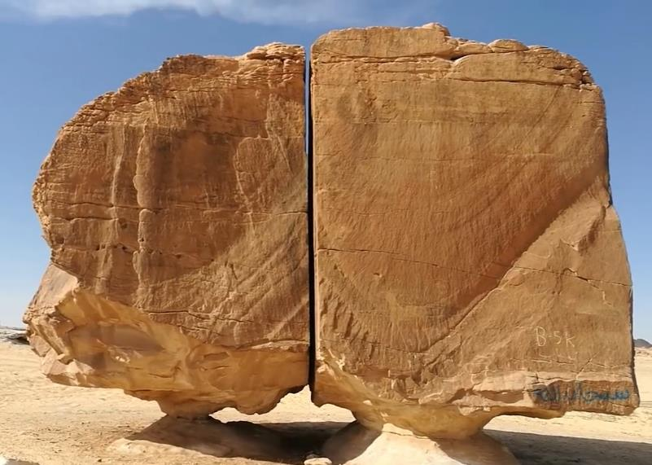
Crack morphology: resin samples vs. natural rocks
Al Naslaa site (KSA)
Similarities to resin experiments:
Radial hackles merging into river lines
Circumferential ribs
Difference:
No obvious flaw at the inferred fracture origin
Possible fracture origin?
Un-related cracks?
Hackles?
Radial lines and concentric arcs
Horse decoration
Arrest lines?
River lines, merging down & left
Photo credit: Rudra, Anand Kumar (2018), “Rock of Naslaa AKA laser cut rock!” YouTube [video file accessed 2022-02-17 from http://www.youtube.com/watch?v=GD8u6HmUtls]
Notes:
Natural fractures (joints) in sandstone. Two faces in foreground are not coplanar.
Main body of the cracks, especially the right face, appear very similar to the extensive cracks grown in biaxial compression experiments. There are radial hackles, concentric arcs, and river lines, which suggest tensile origin. As with the resin, the local tension could have arisen within a completely compressive far-field stress regime.
The outer areas (with river lines and more-prominent ribs) are similar to the outer area of the resin samples, they might represent a slowing crack front approaching its limits, and/or a start-stop crack front growing as the rock is unloaded.
Some features appear un-related to the main crack growth.
A major difference to the resin samples is the lack of an obvious structure at the fracture origin, analogous to the inclined flaw. This is common in field studies of joints – even if the fracture origin can be inferred (e.g. from fractography), an initial flaw or perturbance causing the fracture to nucleate can not always be found.

Slide 9
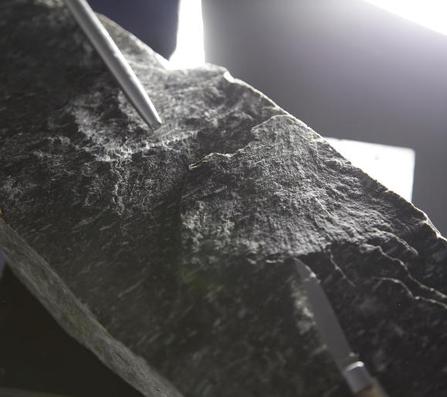
Crack morphology: resin samples vs. natural rocks
Rock ejected in a rockburst - Australian underground mine
2x parallel but non-coplanar tensile cracks
Similar fractography to biaxial resin experiments:
Radial hackles
Circular/ellipsoidal boundary
Ribs offsetting hackles
Faint radial hackles, offset by ribs
Radial hackles, circular boundary (crack edge?)
Notes:
Rock was one of many ejected by a strainburst in an Australian underground mining tunnel.
Dimensions approx. 200mm x 200mm x 500mm.
Hypothesis is that strainburst is rapid Mode I fracturing, which ejects rock fragments and causes detectable seismicity (and audible sound). Near an underground excavation boundary, the stress field is biaxial.

Slide 10
Load vs. flaw location and inclination
σ₁
d
θ
σ₁
θ
Load to initiate cracking is increased when the flaw is:
More steeply inclined
Closer to the free face
σ₁
d
Notes:
Cracks with steeper inclinations (all greater than 45deg) have higher stress required to initiate extensive cracking. This was expected, because the tensile stress that opens the crack is created by shear displacement across the flaw. Steeper flaws have a smaller horizontal component and thus create less tensile stress per unit of vertical load.
Cracks closer to the free face were expected to have been easier to initiate cracking, as indicated by some theoretical work on the interaction between growing Mode I cracks and free faces (refs below), which suggested that the presence of the free surface would increase stress intensity factor at the edge of a crack near to the free surface. Instead, the load required to initiate cracking was increased, when flaws were near the free surface – to the extent that the Instron reached its load limit (about 100 MPa) for flaws located 5mm from the surface, and they could not be cracked. This is interpreted as something preventing slip / shear along the flaw surface, and a numerical modelling exercise is planned for near future to investigate.
Crack & free face interaction:
Sahouryeh et al (2002), “Crack growth in biaxial compression,” Eng Frac Mech, 69.
Wang et al. (2022), “Fracture mechanics of spallation,” Eng Frac Mech, 260.

Slide 11
Vibrations 1: AE at sample’s rear face
Transient envelope
Initial low-amplitude wave(s)
Quiet Pause
High amplitude:
Spike/impulse
Smooth sinusoid
High-amplitude: spikes & sinusoid
Quiet pause
Initial wave
Notes:
Characteristic shape of AE at face:
Initial low-amplitude wave(s) – with “first motion” always negative voltage
Quiet pause – approx. 40 μs to 65 μs
High-amplitude motion – spike/impulse overprinted on smoother sinusoid
Total duration approx. 10 ms
The quiet pause is not s:p separation, as the lag time is too long. For this sample, the lag time is 75 μs, which gives a source-to-receiver distance estimate of around 200mm. But the source(s) -- the flaw, and the crack growing from it -- are only about 50mm from the receivers.

Slide 12
Vibrations 2: in-air vibrations (audible and superaudible)
Microphone
300 ms duration
Only sensitive < 24 kHz (audible)
AE in air
10 ms duration (similar to in-contact AE)
Sensitive to signals > 100 kHz
Both
Transient shape
Similar dominant frequencies
Notes:
Microphone: Samsung Galaxy S9 in waterproof case at approx. 2m distance from sample side. Sensitive to audible frequencies only (sampled 48 kHz)
AE sensor: R3α mounted in air approx. 100mm from sample front face. Sensitive to audible and superaudible frequencies.
In-air AE transient is similar duration to in-contact AE, but significantly shorter in duration than the microphone (by more than an order of magnitude).

Slide 13
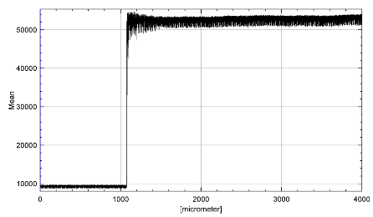
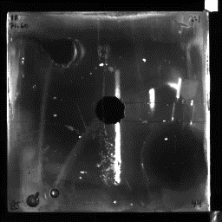
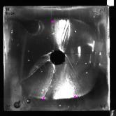
Vibrations 3: visible vibrations
Intensity (greyscale brightness)
Background noise
Abrupt change: crack front passing
Visible oscillations, reducing with time (3 ms duration)
Small deflections of sample & surfaces (including 2x new crack surfaces) – which change the transmitted raypaths
New background
Post-cracking oscillations
16b intensity
Crack front passes analysis region
Background
Video frame (10 μs intervals)
Analysis region: 3x3 pixel square selection near lower left
Image analysis using FIJI: Schindelin et al (2012), “Fiji: an open-source platform for biological-image analysis,” Nat Methods, 9
Notes:
Variations of image intensity with time, for selected regions within high-speed video images. Recall light is transmitted from 2x LED lamps at rear of sample.
Starting out: background noise, may be physical (vibrating load frame and/or lighting) or electronic (sensor and/or LED output)
Abrupt change in brightness when crack front passes a region, and two new surfaces are created, which reflect and refract the transmitted light.
Transient oscillations immediately post cracking, decreasing with time.
Vibrations diminish over time, reverting to background noise, albeit with a changed mean value due to the presence of the crack front.
Visible vibration duration approx. 3 ms (300 frames) – much less than AE or microphone.

Slide 14
Vibrations 4: frequency domain
AE: like seismograms?
Low frequency plateau
Exponential high-frequency falloff
Different “source parameters” from different sensors
Position? Near-field? Something else?
10 kHz spike
In-air
AE sensor again like seismogram, but again different Ω₀, f_{c}, and n
Microphone has more low-frequency definition, but clipping above 20 kHz
10 kHz spike
Visible
Several spikes, also seen in noise
10 kHz spike “real”
10 kHz spike consistent across samples and data streams
Notes:
AE sensors calibrated to displacement using Ono, K. (2016), “Receiving Sensitivities of Acoustic Emission Sensors: A data Compilation,” J Acoustic Emission, 36.
Spectra from sensors in contact with the sample are sensibly similar to displacement spectra seen in seismicity. If we disregard the lower frequencies there is a clear low-frequency plateau (Ω₀), an obvious corner frequency (f_{c}), and a high-frequency falloff following an exponential model (ω^{-n}), which plots as a straight line on a log-log plot. However, the estimated values of Ω₀, f_{c}, and n are different for each sensor. This is problematic, since each sensor should be recording the same “seismic” source. TO CHECK – IF THERE IS TIME – THE RELATIVE POSITION OF SENSORS VS THE RADIATION PATTERNS FOR THE TWO POSSIBLE SOURCES – TENSILE VERTICAL, AND DOUBLE-COUPLE ON THE FLAW.
The in-air spectra recorded by the R3α AE sensor is similar to the AE sensors in contact, and to a seismic displacement spectrum. However, again, the different sensor provides different estimates of . The in-air spectrum from the microphone shows evidence of the different sampling rate, with much greater definition at low frequencies. But there is significant clipping of frequencies > 20 kHz. The apparently steep frequency falloff (n) may be artificial.
The three AE sensors, and the microphone, all show a frequency spike at approx. 10 kHz.
The visible vibration spectrum is nearly uniformly distributed across frequencies, with isolated spikes that appear in both the background noise and in the crack-related signal. An exception is the spike at 10 kHz, which is much stronger in the crack-related signal than in the background, and is thus “real.”
The 10 kHz frequency spike appears consistently across all data streams, and all samples. THE CAUSE ISN’T KNOWN – MIGHT BE A CUBE FUNDAMENTAL, MIGHT BE THE CRACK GROWHT TIME, MIGHT BE SOMETHING IN THE LOADING SYSTEM – will look at this a bit, but prepared to leave this an open question if need be

Slide 15
Conclusions
Crack growth observations
Single, unstable crack growth event, constant loads (self-sustaining)
2x wing cracks are not simultaneous
Explain some morphologic features in terms of fracture growth geometry (overlaps, ribs near sample boundary)
Morphology similar to rocks in the field
Load to instigate cracking increases when flaw close to free face
Extensive crack curves away from free face
Vibration observations
AE in contact: “seismic” event with known, visible source
Characteristic shape of crack-related AE signals
Audible and visible vibrations, similarities and differences to AE in contact
May be useful in fieldwork (smartphones)
Notes:
Video observation extends the previous work by showing that the crack growth is a single, rapid process, with constant loads. There is no evidence of “stable” vs “unstable” crack growth; once the initial flaw slips, the crack radius is sufficiently large that no extra energy input is required to keep the crack expanding. Self-sustaining crack behavior is found in many rock mechanics observations.
Several features long seen in resin experiments are explained. The prominent, circumferential ribs are evidence of start-stop crack growth during unloading. The moustache-shaped overlaps arise because of the geometry of the flaw and the growing crack(s), as one wing crack initiates prior to the second wing crack.
Similar fracture morphology between rocks in the field, and the resin models, provides some justification of the applicability of the approach.
The increase in crack-initiation load as the flaw approaches the free face requires further research to explain; however, it has some implications for development of spallation around mine excavations – as does the convex shape of the crack. In the field, slab-shaped rocks are often ejected into the opening. This requires that cracks actually intersect the opening (to define the blocks), and that areas near the opening “fail” prior to areas deeper into the wall/face/roof (else, the rocks wouldn’t be thin slabs).
The AE allows study of near-field “seismograms” from a known and independently observable source. The characteristic shape of the cracking-related AE waveforms suggests a way to determine crack-related vs. non-crack-related AE in opaque samples.
The audible and visible vibrations provide alternative ways to acquire “seismic” data. Such data may be very useful in field work, since smartphones are now ubiquitous, and videos of rock failures abound even from areas without coverage of a local seismic network.

Slide 16
Thank you!

