Slide 1


Composition of the kimberlite melt
of the Komsomolskaya-Magnitnaya pipe (Upper Muna field, Siberian craton)
A.D. Kalugina, I.S. Sharygin, K.A. Solovev, A.V. Golovin, A. M. Dymshits
This work was supported by the Russian Foundation for Basic Research (grant No. 20-35-70058) and the Russian Science Foundation (grant No 18-77-10062).

Slide 2
Geologic Setting
Here we present the results of study on secondary crystallized melt inclusions in olivines in two partially serpentinized xenoliths of sheared peridotites (samples AKM-42n and AKM-56 ).
1/4
1 - Boundaries of the Siberian Craton;
2 - Anabar Shield;
3
- kimberlite fields of the Paleozoic (3) and Mesozoic (4) ages;
4
5 - area of the distribution of the Cambrian
salt-bearing deposits on the Siberian Platform.
modified after [Sharygin, Golovin, Pokhilenko, 2011]

Slide 3
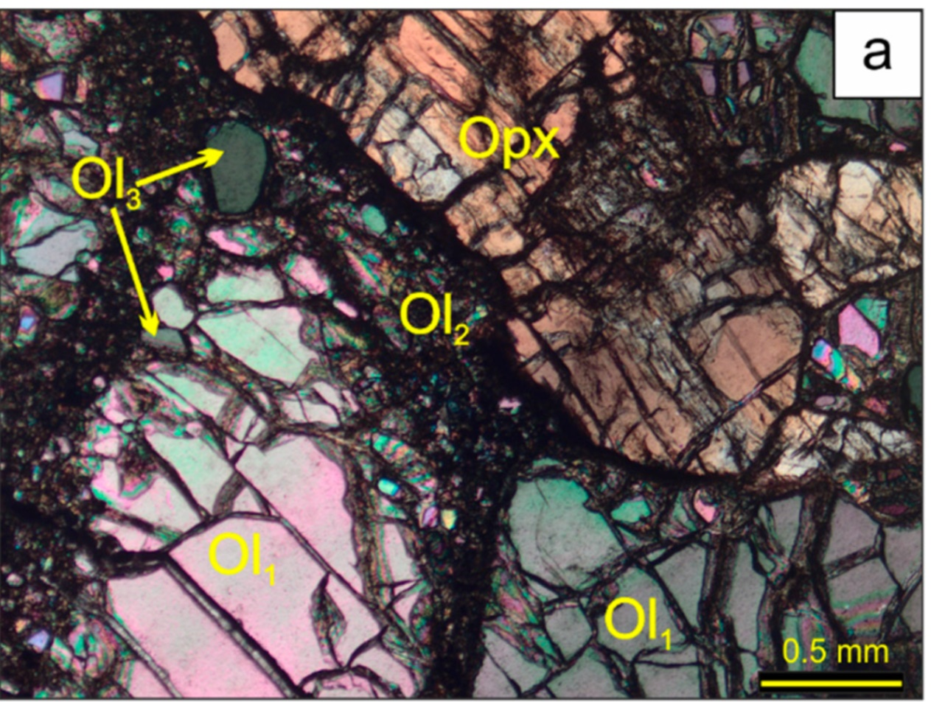
SAMPLES
Diagram showing two possible scenarios of the infiltration of an alkali–carbonate melt into the sheared peridotites (shown by dashed wavy arrows), followed by the formation of melt inclusions:
(1) interaction of the kimberlite melt with xenoliths upon their transportation to the surface;
(2) infiltration of the melt through peridotites and the formation of fractures in olivine in situ at the depths of rock occurrence.
2/4
The mantle residence P-T conditions
AKM-42n: 6.4 GPa and 1380°C
AKM-56: 6.7 GPa and 1395°C

Slide 4
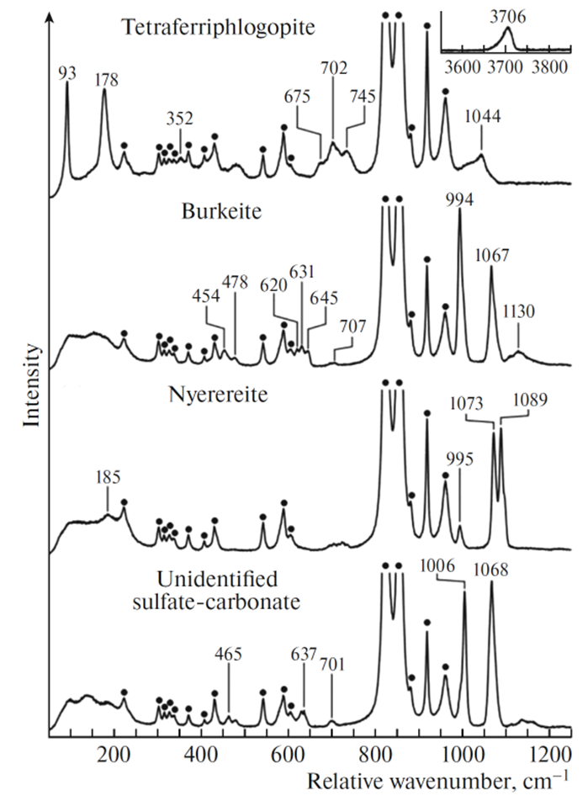
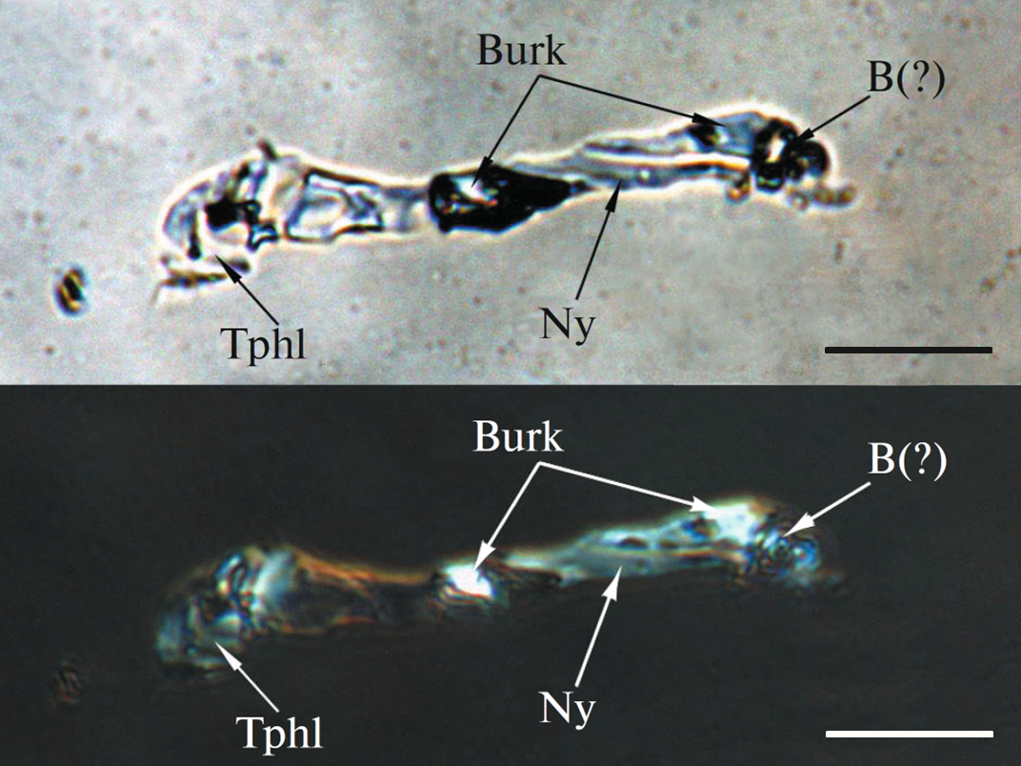
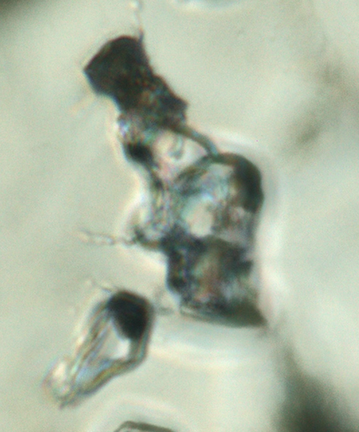
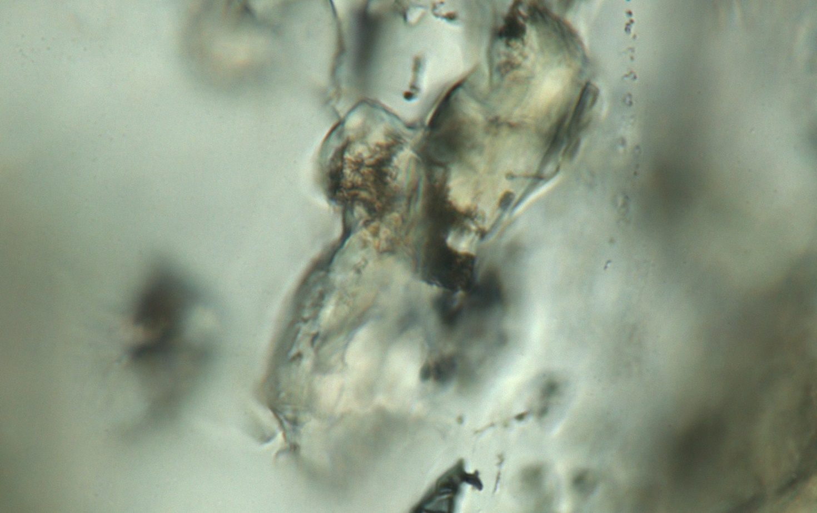
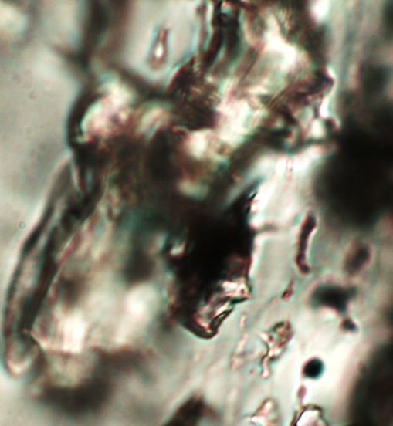
DAUGHTER MINERALS IN THE MELT INCLUSIONS
We identified twenty-one daughter minerals in the inclusions using Raman spectroscopy and scanning electron microscopy.
Ny
10 µm
Burk
2 µm
10 µm
3/4
Aph
20 µm
* the circles mark the bands of the host olivine.
Notes:
Reconstruction of kimberlite melt composition is especially important to understand the processes of mantle-derived magmatism and the Earth’s mantle evolution. This task seems to be very complicated because mantle melts during ascent and emplacement changed their initial characteristics due to degassing and contamination by both mantle and crustal xenogenic materials. Mantle magmatic rocks often are subjected to secondary alteration. Melt inclusions in minerals of mantle xenoliths can preserve information about the initial characteristics of mantle melts.

Slide 5
DAUGHTER MINERALS IN THE MELT INCLUSIONS
Carbonates with additional anions
Burkeite Na₆CO₃(SO₄)₂
Tychite Na₆Mg₂(CO₃)₄(SO₄)
Chlorides
Sylvite KCl
Halite NaCl
Silicates
Tetraferriphlogopite KMg₃Fe³⁺Si₃O₁₀(OH,F)₂
Phlogopite KMg₃AlSi₃O₁₀(OH,F)₂
Olivine (Mg,Fe)₂SiO₄
Clinopyroxene (Ca,Mg,Fe)₂Si₂O₆
Monticellite Ca(Mg,Fe)SiO₄
Carbonates
Nyerereite (Na,K)₂Ca(CO₃)₂
Shortite Na₂Ca₂(CO₃)₃
Eitelite Na₂Mg(CO₃)₂
Dolomite CaMg(CO₃)₂
Calcite CaCO₃
Magnesite MgCO₃
Sulphates
Aphthitalite K₃Na(SO₄)₂
Thenardite Na₂SO₄
Others: fluorapatite Ca₅(PO₄)₃F, sulfides (pyrrhotite Fe_{1-x}S and djerfisherite K₆(Fe,Ni,Cu)₂₅S₂₆Cl), and magnetite FeFe₂O₄
The studied melt inclusions are considered to be relics of a near‐primary or primitive kimberlite melt that formed the Komsomolskaya-Magnitnaya pipe. The assemblage of the daughter minerals indicates that the melt had an alkali-carbonatitic composition and was enriched in Cl and S.
4/4

