Slide 1
Rehearsing Disaster
Can video games help young adults prepare for earthquakes?
Elizabeth Safran, Environmental Studies
Peter Drake, Mathematical Sciences
Erik Nilsen, Psychology
Bryan Sebok, Rhetoric and Media Studies
Lewis & Clark College, Portland, Oregon U.S.A.
Notes:
Liz Safran is a geologist, Peter Drake is a computer scientist, Erik Nilsen is a psychologist, and Bryan Sebok is a media scholar.
We work with undergraduate researchers to develop the games and conduct the experiments that comprise this project. See acknowledgement slide for all those who contributed to this experiment.

Slide 2
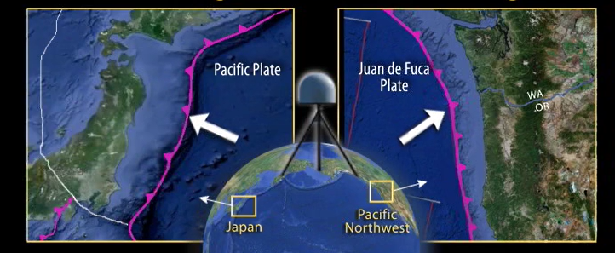
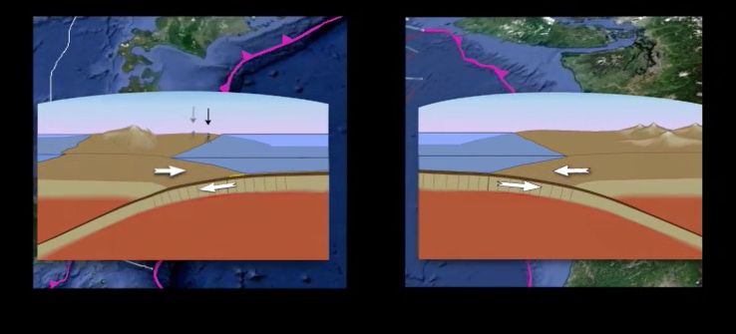
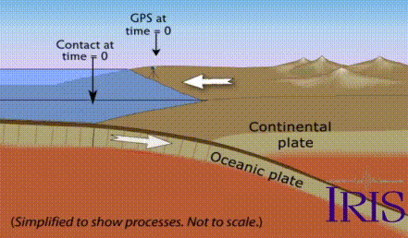
Project Motivation
Pacific Northwest is subject to great earthquakes
Lacks an earthquake culture
Individual and community resilience especially important
Young adults (ages 18-29) are an overlooked group
Iris.edu
Notes:
The Pacific Northwest (PNW) experiences megathrust earthquakes and associated tsunamis like the 2011 Great East Japan and 2004 Indian Ocean events.
https://www.iris.edu/hq/inclass/animation/pacific_northwest_vs_japan_similar_tectonic_settings
https://www.iris.edu/hq/inclass/animation/subduction_zone_simplified_model_of_elastic_rebound

Slide 3
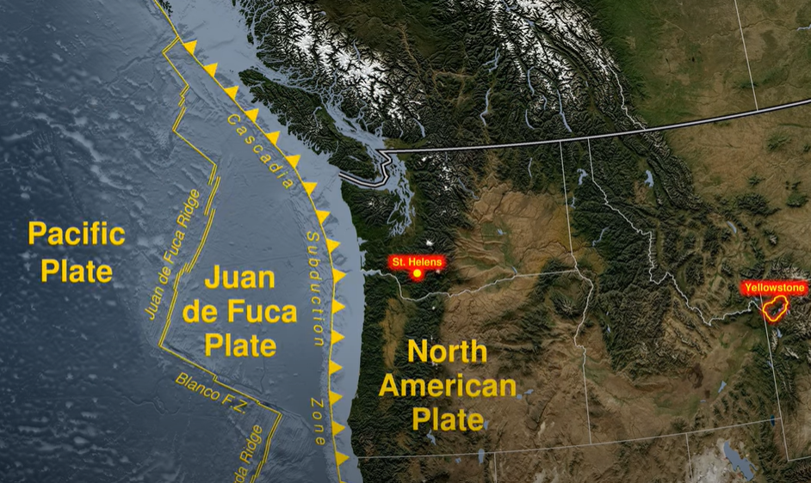
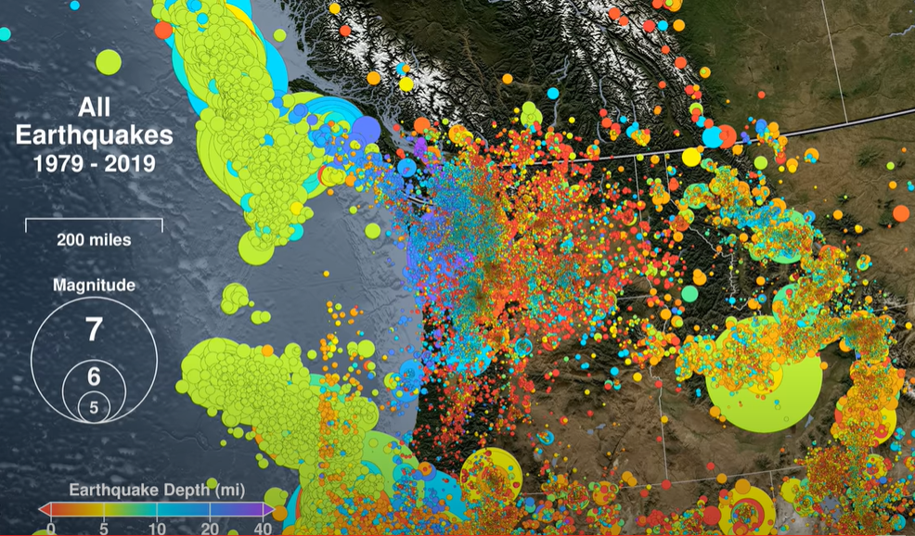
Project Motivation
Pacific Northwest is subject to great earthquakes
Lacks an earthquake culture
Few moderate-sized earthquakes
Individual and community resilience especially important
Young adults (ages 18-29) are an overlooked group
NOAA/NWS Tsunami Warning Center
Notes:
My personal experience: I’ve felt 2 earthquakes in the 20+ years I’ve lived in Portland, OR…..And about 10 in the past 2 months I’ve spent in Japan!
Images are screenshots from this video: https://www.youtube.com/watch?v=wAJcLtBhNEM

Slide 4

Project Motivation
Pacific Northwest is subject to great earthquakes
Lacks an earthquake culture
Recurrence interval between Big Ones is long
Last event 300 years ago, recorded in Native American stories and Japanese writings
Individual and community resilience especially important
Young adults (ages 18-29) are an overlooked group
pubs.er.usgs.gov
Notes:
Book cover is from Atwater et al., 2016, https://pubs.er.usgs.gov/publication/pp1707

Slide 5
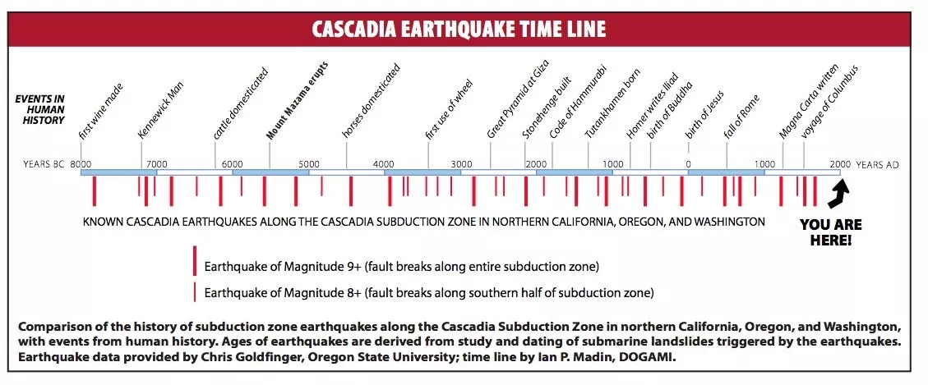
Earthquake History Along Cascadia Subduction Zone
Oregon State University and DOGAMI
Notes:
The geologic record of events on the Cascadia subduction zone goes back 10,000 years, showing evidence for over 40 M8s and M9s in the past (see, e.g., Goldfinger et al. 2012). The average recurrence interval of any sized event is 240 years. It has been 322 years since the last event.

Slide 6
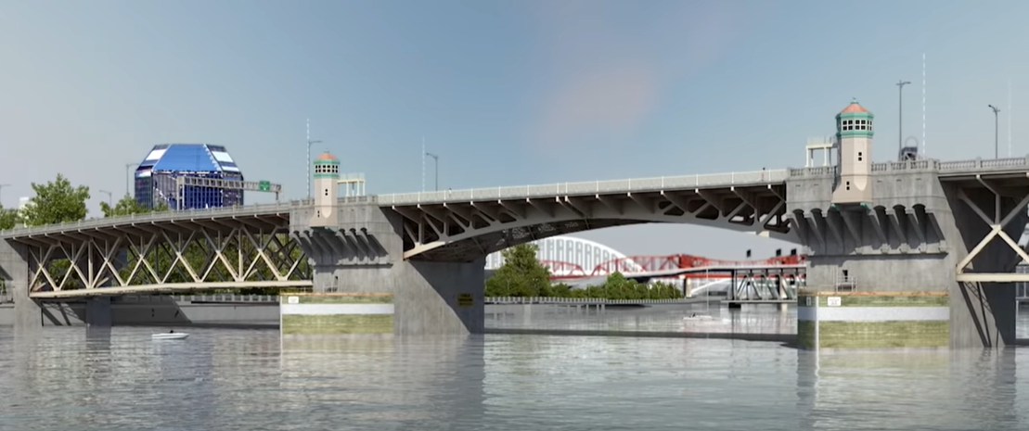
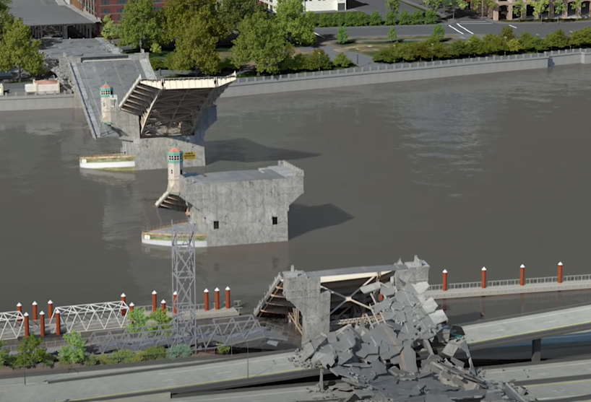
Project Motivation
BEFORE
Pacific Northwest is subject to great earthquakes
Lacks an earthquake culture
Individual and community resilience especially important
Much infrastructure not resilient
Young adults (ages 18-29) are an overlooked group
AFTER
Earthquake Ready Burnside Bridge, Multnomah County (simulation)
Notes:
As eloquently summarized in the Oregon Resilience Plan (2013), essential systems in the PNW developed without recognition of the true magnitude of the regional seismic hazard, which even geologists didn’t appreciate until the mid 1980s. Building codes did not reflect a Cascadia event until the 1990s. Because power, sewer, water, fuel, healthcare, and transportation systems will all be heavily impacted and will take weeks to months to be restored, local emergency managers are urging residents to be prepared to fully support themselves for 2 weeks. Individual and community resilience will be critical as infrastructure is gradually made more resilient (e.g., through construction of a new Burnside Bridge in Portland, OR).
Images are screenshots from video at https://www.multco.us/earthquake-ready-burnside-bridge

Slide 7
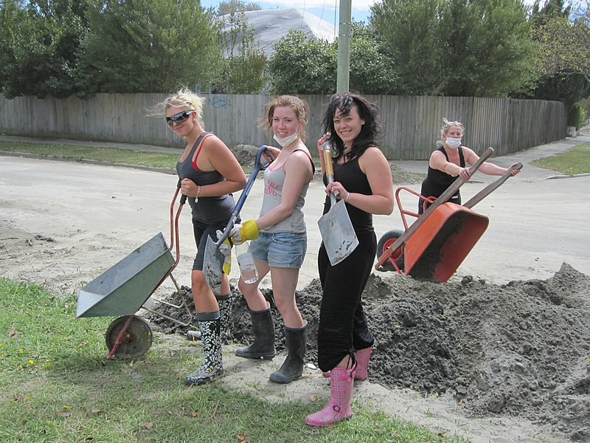
Project Motivation
Pacific Northwest is subject to great earthquakes
Lacks an earthquake culture
Individual and community resilience especially important
Young adults (ages 18-29) are a hard-to-reach and overlooked group
Significant capabilities and vulnerabilities
Jane Ross CC BY-SA 2.0
Notes:
We’re interested in engaging young adults in preparing for disaster. As the Student Volunteer Army showed after the earthquakes near Christchurch, New Zealand in 2010 and 2011, young adults have much to contribute to disaster response (e.g., Mutch, 2013; Nissen et al., 2020; Carlton et al., 2022).
Key capabilities may include good health/physical strength, multilingualism, education, and/or specialized training related to hobbies, like Wilderness First Responder training.
Key vulnerabilities may include financial insecurity, lack of control over living environment, or lack of connections in the physical community due to frequent relocation.
How can this demographic be encouraged to become more resilient through disaster preparedness (not just response)?
Photo source: https://commons.wikimedia.org/wiki/File:Another_SVA_team.jpg

Slide 8
What Motivates Young Adults to Prepare for Earthquakes?
Notes:
This is the main question that frames our work.

Slide 9

Video Games as Research Tools
Vicarious experience, including media, is all we have in the PNW
Widely accessible and engaging form of media
Not just seeing but in a sense being
Mediated enacted experience
Easy to simulate rare events
Games can emphasize problem-solving and multiple solutions
…….But do they work?
Notes:
Our group is using video games as research tools in specific studies that examine various aspects of that broad question.
Because of our lack of first-hand experience with earthquakes in the PNW, vicarious (or indirect) experience is all we have. Many other places face similar situations with intermittent hazards. Media must therefore play an important role in motivating individual and community preparedness.
Video games can be widely accessible and enjoyable, which can overcome resistance to engaging with this scary and (frankly) sometimes boring content.
The video game experience is distinctive from other forms of media in that participants do not simply read or watch. They are accomplishing tasks in a virtual environment – they are doing and being. Wei Peng (2008) calls video game play a “mediated enacted experience.”
Importantly, rare events can be experienced and the outcomes of one’s transactions in those situations can be played out in video games. Multiple solution pathways are also common in video games, which may provide a healthy antidote to one-size-fits all messaging sometimes adopted by print media or public service announcements for the sake of brevity and consistency.
Disaster related games have been produced and have been summarized in several recent reviews (e.g., Solinska-Nowak et al., 2018, and see the review of reviews by Choudhury et al. in this session!), all of which point to a paucity of research on the impacts of these games. This is a gap our work seeks to address (though see earlier work by Tanes, 2017 and Tanes and Cho, 2013).

Slide 10

Multi-year Research Project
Project funded by National Science Foundation: Humans, Disasters, and the Built Environment program
Four experiments and related focus groups
Collaboration with local emergency managers
Release games when done
Notes:
Our current project is funded by the National Science Foundation, Award 1917148, though the findings, opinions, conclusions, and recommendations expressed in this presentation do not necessarily reflect the views of the National Science Foundation.

Slide 11
Experiments
Experiment 1: Video game play vs. web searching (this presentation)
Experiment 2: Identification with living situation: Location and housing
Experiment 3: Cooperation with other player or non-player character
Experiment 4: Social interaction about the game
Notes:
This presentation focuses on the first experiment of the project, which we have completed. The general focus of future experiments are shown here.

Slide 12



Social Cognitive Theory
Main dependent variables:
Learning: Do you know what to do (and why)?
Self-efficacy (SE): Are you confident you can perform that action?
Outcome expectations (OE): Do you think the action will make a meaningful difference?
Intent to act (ITA): Do you plan to take the action?
Preparedness action: Did you actually take the action?
Behavior
Personal cognitive factors
Socio-environmental factors
Notes:
Information about hazards and mitigation strategies is necessary but not sufficient to motivate preparedness behavior. Among other things, personal cognitive and socio-environmental factors are also important. Social cognitive theory (SCT) was originally articulated by Albert Bandura, and the social cognitive perspective has been applied both to media-driven behavior change and to the disaster context by many researchers. Several of the key constructs seem potentially relevant to the interactive digital medium of video games. So, this framework informed which independent and dependent variables we chose to include in our studies
Our main dependent variables, shown on the slide, reflect key constructs of SCT.
Values of these variables were self-reported and assessed using surveys at the time of an intervention and several months later (see next slide).
Relevant references include Bandura, 1986, 2003, 2004; Paton, 2003; Paton et al., 2005.

Slide 13
Basic Structure of Experiment 1
Follow-up
Conduct experiment
Develop game
Follow-up survey
Consult emergency managers
Focus groups
Pre-test survey
Intervention
Share with emergency managers
Action opportunity
Focus groups
Post-test survey
Notes:
The basic structure of the experiment is shown in this slide.
A minor opportunity for action was offered at the end of the intervention, immediately prior to administering the post-test survey. The follow-up survey was administered 3 months after the intervention.

Slide 14
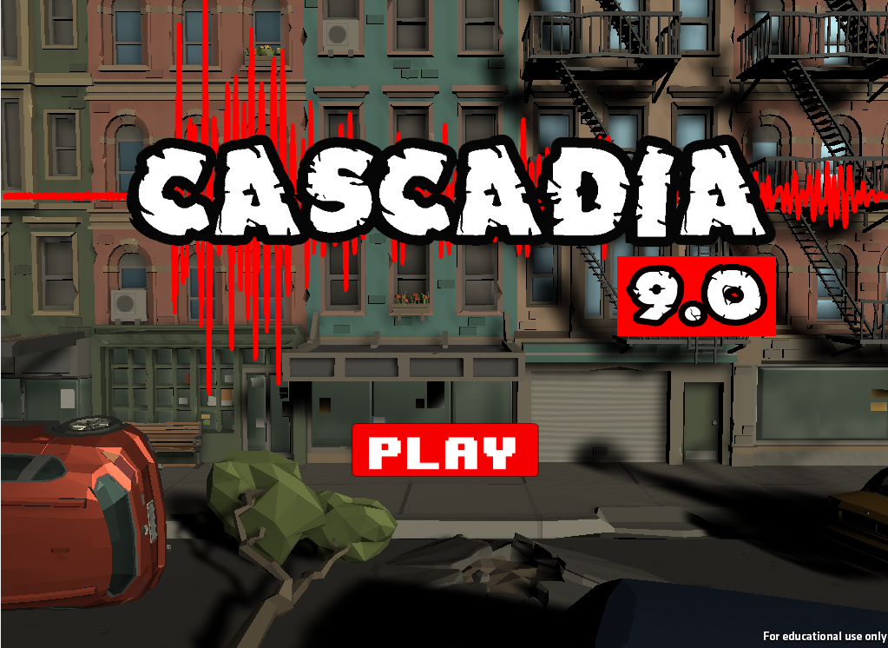
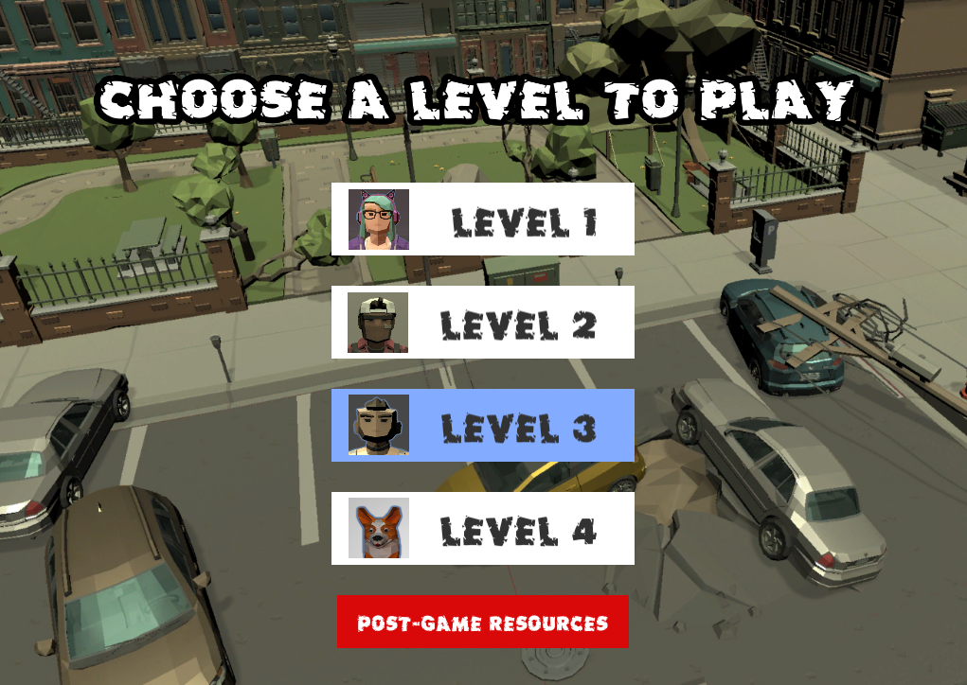
Experiment 1
5-45 minutes on main task
125 participants
REMOTE one-on-one sessions
Main independent variables
GAME PLAY
WEB SEARCH
Action opportunity
Pdf downloads
Training interest forms
Follow-up survey
3 months later
Notes:
In an earlier experiment, we analyzed the impacts of game play alone. In this experiment, we compared the impacts of game play and web search, a more mainstream digital source of earthquake preparedness information.
Participants ages 18-29 were recruited from two institutions of higher education in the city of Portland, OR. Because of the COVID-19 pandemic, all sessions were hosted remotely via Zoom.

Slide 15
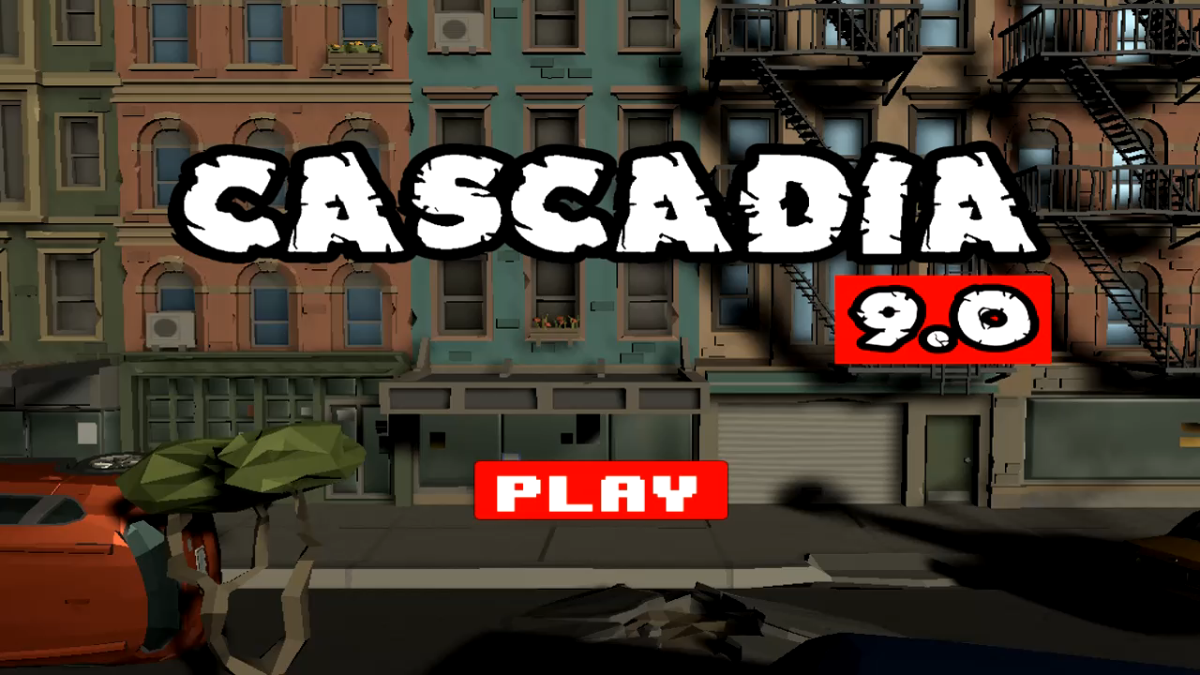
Notes:
Click this slide to play the embedded video, a 1 minute game trailer.
Music credit:
Ludwig van Beethoven, Symphony No. 5 in C minor, Opus 67, Movement I: Allegro con brio. Performed by Skidmore College Orchestra, licensed under CC BY.

Slide 16
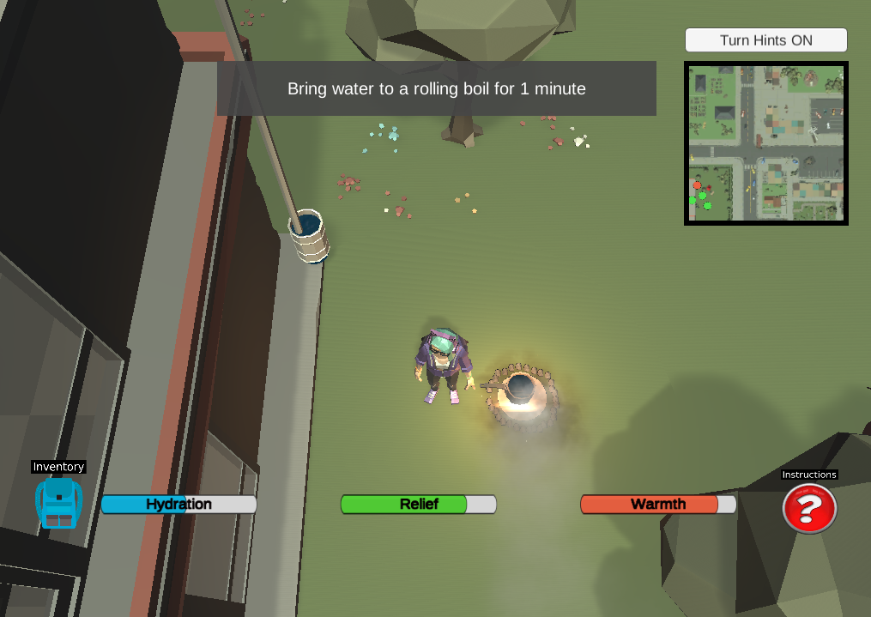
Game Play Condition
Avoid Injury | Get Clean Water | Find Shelter | Manage Human Waste
Drop, cover, hold on | Store water beforehand and treat with bleach | Vehicle | Two-bucket system
Shut off gas valve | Tap water heater and treat with chlorine dioxide | Tent | Pit latrine
Attach bookcase to wall | Collect rainwater and boil (shown) | Public shelter | Composting toilet
Notes:
The game spans a brief period immediately before an earthquake, the earthquake itself, and then different moments during the response period: immediately after the earthquake, roughly one day later, and about a week later.
Playing as three different characters across four levels, participants in the game condition must solve four different kinds of problems. There are three solutions to each of these problems across the levels, and a player who wins the game completes all of them. The screenshot illustrates one example of a solution to the problem of getting drinkable water after the earthquake.

Slide 17

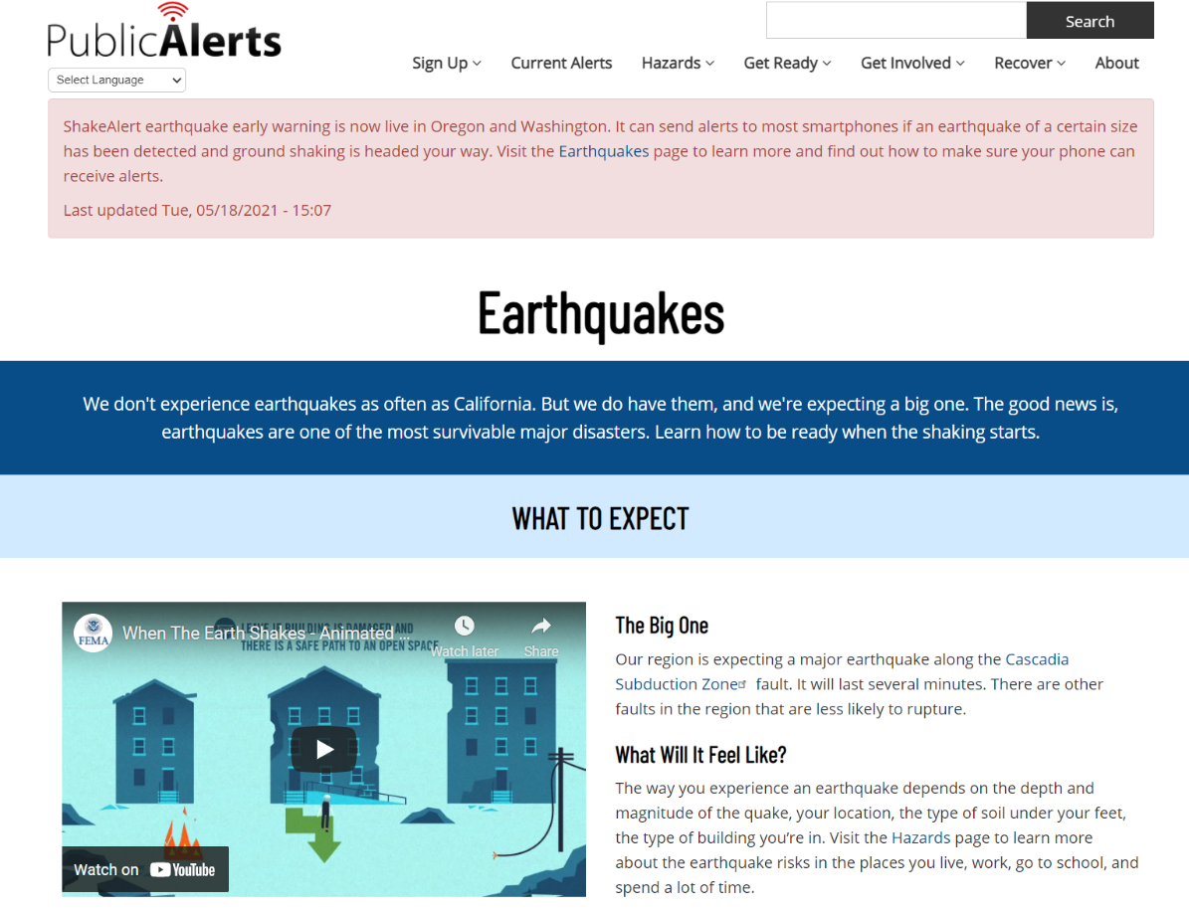
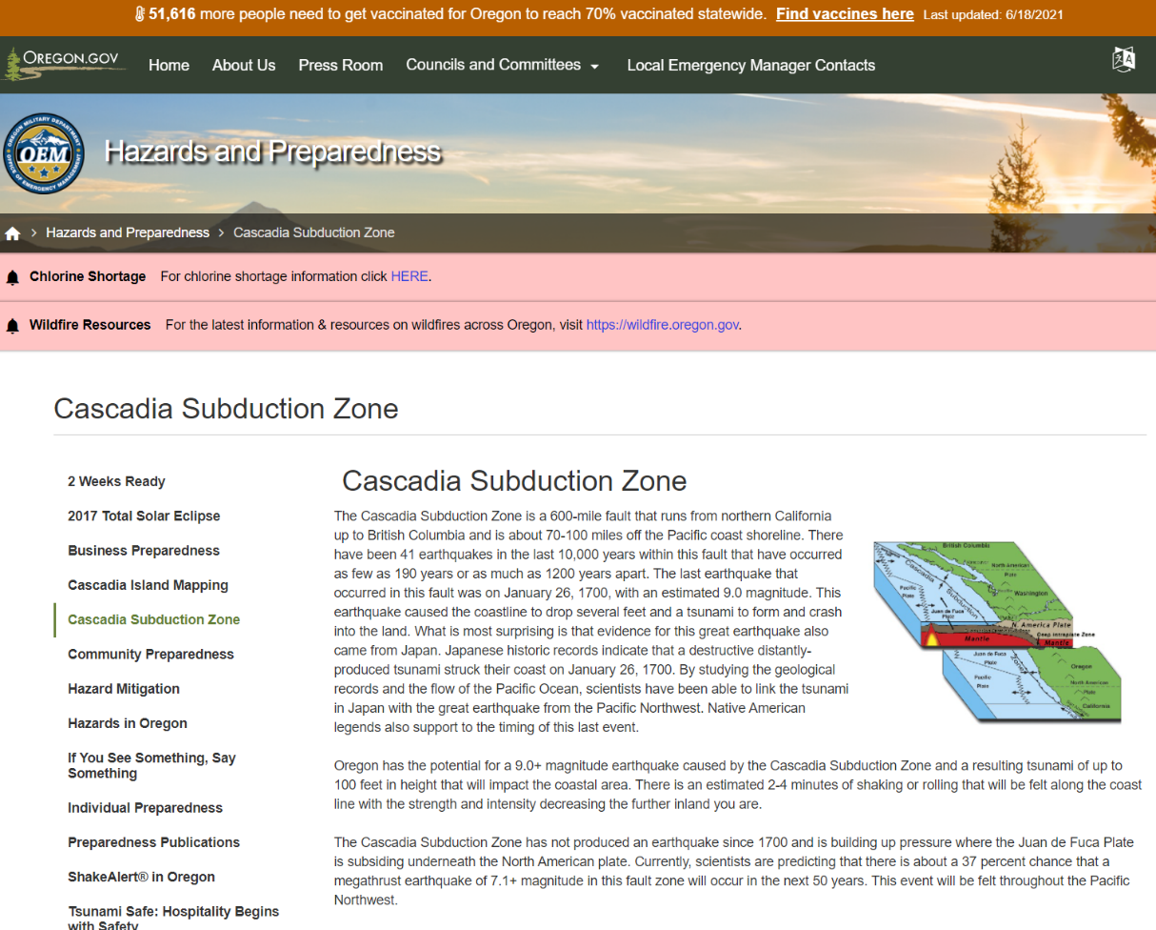
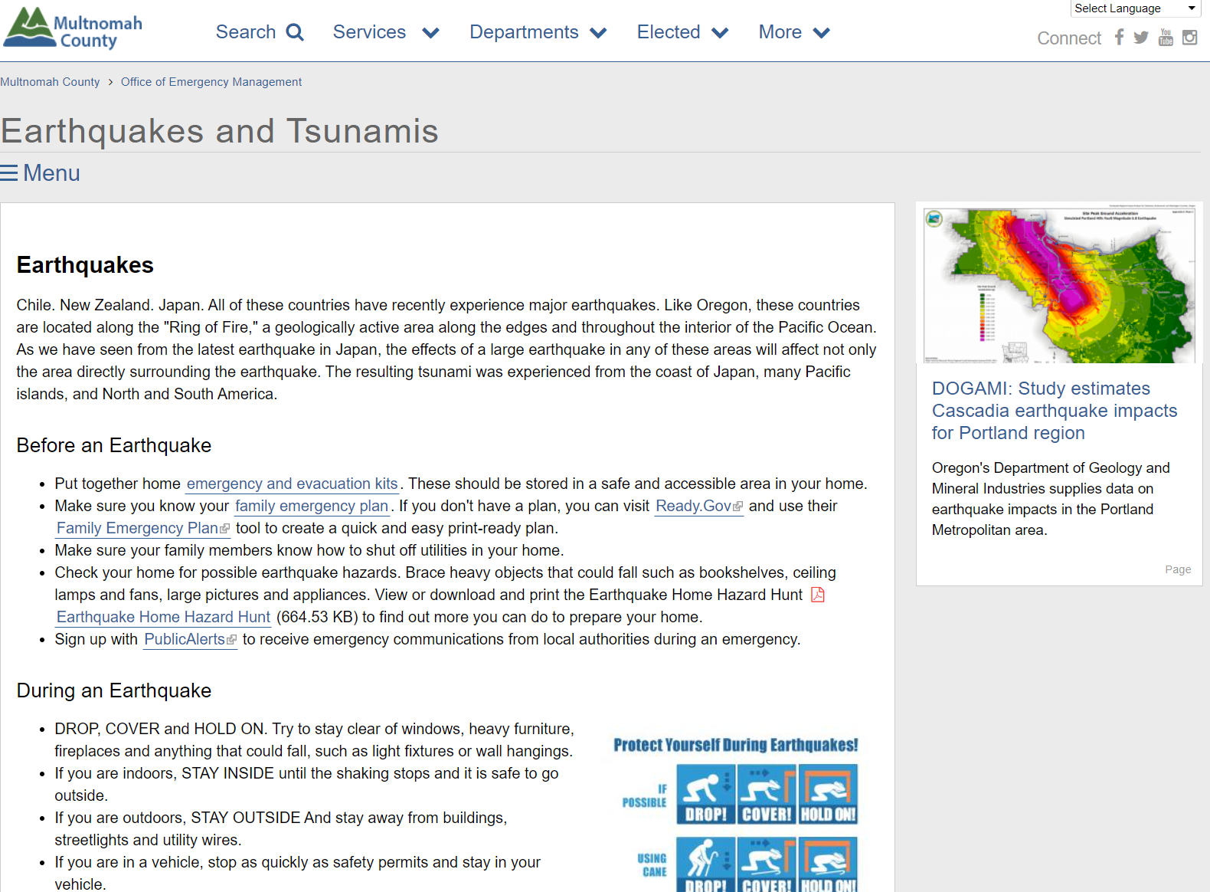
Web Search Condition
Links provided lead to content equivalent to (and more!) what is contained in the game
Free search option: better matches “real life” search behavior
Notes:
Participants in the web search condition were asked to search for solutions to earthquake-related problems in whatever manner they wished. We offered three starter links to the earthquake sections of key local, county, and state-level emergency management websites. These sites contained or linked to all the solutions depicted in the game (and more).

Slide 18
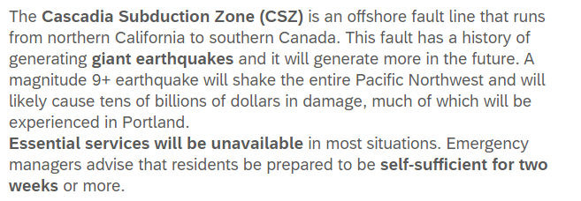
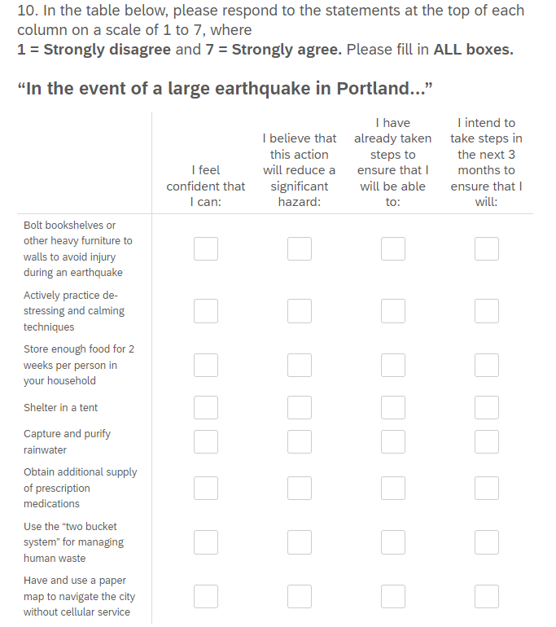
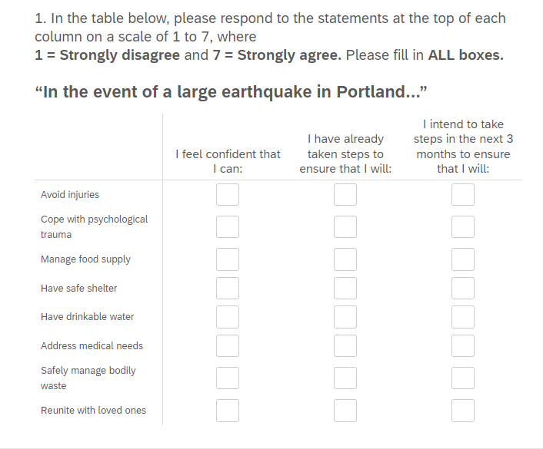
Notes:
All participants were primed before the experiment task with the statement shown in the upper left.
Participants were asked about their perceptions and intentions for eight general categories of earthquake preparedness action (on left) on the pre-test survey, the post-test survey, and the follow-up survey (though “steps taken” was not repeated on the post-test survey).
Participants were asked about eight specific earthquake preparedness actions (on right) on the post-test and follow-up surveys but not on the pre-test survey to avoid priming specific search behaviors.
The statements at the top of the columns each correspond to one of the dependent variables: “confident that I can” = self-efficacy, “will reduce a significant hazard” = outcome expectation, “intend to take steps” = intent to act, “have already taken steps” = preparedness behavior. We deemed outcome expectation to be a more meaningful concept when applied to specific actions, therefore we did not include it in the question involving general categories.

Slide 19
Select Results
Metric | Game | Web | P value
Time spent on activity (minutes) | 31 | 19 | 0.001
Percent of information that is (perceived as) new to participant | 64 | 45 | 0.001
Level of enjoyment (out of 7) | 5.6 | 5 | 0.01
Level of challenge (out of 7) | 4.6 | 2.8 | 0.001
Level of frustration (out of 7) | 3 | 2.4 | 0.03
Level of source trust, perceived reliability, perceived applicability of information | No significant difference
Notes:
Game players performed their task for longer and perceived learning more new information than did web searchers.
It’s interesting to ponder the links between enjoyment, challenge, and frustration, all of which were significantly higher among game players than web searchers. James Gee (2004) describes good video games as “pleasantly frustrating,” challenging but doable.
Surprisingly, levels of source trust were not significantly different between the game and the web. Markers of credibility were discussed in pre-experiment focus groups (which did not involve experiment participants), when the game was still under development.

Slide 20
Changes in SE and ITA After Game Play or Web Search
p = 0.001
p = 0.05
In game
Not in game
Notes:
This slide illustrates changes in pre- to post-test changes in key social cognitive dependent variables: self-efficacy (SE) and intent to act (ITA).
SE is in blue, ITA is in red. Game is the solid line, web is the dotted line.
P values are shown for significant or marginally significant differences.
The eight items across the bottom are categories of action that we ask about on each survey. (put this on a previous slide: – e.g., how confident are you that you will be able to manage bodily waste or be able to have drinkable water?)
The items on the left were the four problems we dealt with in the game, the items on the right were not explicitly in the game.
Among game players, the largest increases in SE are linked to game-related tasks.
SE increases significantly more for game players than for web searchers in two key game task categories (obtaining drinkable water and managing bodily waste), and marginally significantly more for dealing with psychological trauma. This is an unexpected potential benefit of video game play: facing and overcoming stress in the simulated environment may equip people to feel they can face those stresses in a real event.
ITA generally increases more than SE. The responses are less clearly tied to game tasks for those in the game play condition. The differences between the two conditions is marginally significant only in the category of psychological trauma, with web searchers more inclined to pursue ways of being able to manage psychological trauma than game players.

Slide 21
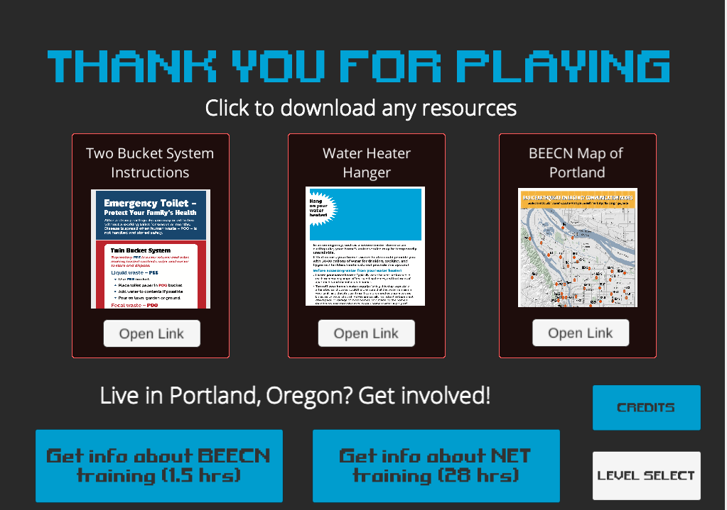
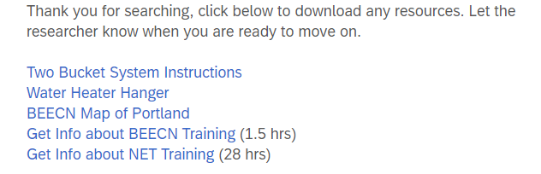
Action Opportunities
p = 0.05
p = 0.001
Notes:
The action opportunity we provided after the intervention was an invitation to download three .pdf resources relating to managing bodily waste via a two bucket system, extracting water from a water heater, or identifying the location of emergency communication nodes in Portland, OR. We also provided links to request information about disaster preparedness trainings offered by the City of Portland’s Bureau of Emergency Management: Basic Earthquake Emergency Communication Node (BEECN) training, which is relatively brief, and Neighborhood Emergency Team training, which is lengthy.
Access to these links were provided at the end of the second survey for web searchers and on a game screen accessible by a button for game players.
The game players downloaded two off the three resources significantly more frequently than the web searchers. Each of the three downloads relate to tasks or environments shown in the game.
Game players and web searchers looked at the training interest form with equal frequency, but only a few participants actually completed the forms. Of the 5 (for NET) or 6 (for BEECN) that did, all but one were in the game condition.

Slide 22
Number and Diversity of Solutions Offered After Task
p = 0.003
p = 0.003
Notes:
We assessed learning in a staged manner in the post-test survey.
First, we gave participants two problem-solving tasks, asking them to produce as many specific solutions to the problem as they could (examples of desired level of specificity were given). One was a “near-transfer” problem, getting clean water in the event that the city’s water supply is temporarily contaminated (which is rare but occasionally happens), which relates closely to content they would have encountered during the experiment. One was a “far-transfer” problem, getting across the Willamette River when the bridges are damaged, which they would have encountered neither in the game nor on the web but which would be a real desire for many after a major earthquake.
Next, we asked participants to recall ANY earthquake-related solutions (mitigation, preparedness, or response) they encountered during their task.
Finally, we listed 42 (?) solutions to earthquake-related problems and asked participants to check off which ones they recognized having encountered during their experiment session (not shown here).
For the first two steps above, written responses were reviewed and thematic categories were established. The responses were then coded for distinct and legitimate solutions. The number as well as the diversity (number of categories) of solutions are shown in the graph.
Game players offered more ways of purifying water than web searchers; no other differences were significant.
Please notice the height of the bars in this graph: e.g., 5.2 for web, 4.4 for web, and about 2 for number of solutions

Slide 23
Number and Diversity of Solutions Offered After 3 Months
Notes:
Now let’s look at learning 3 months later. The response rate for the follow-up survey was 58%, representing approximately equal numbers of game and web search participants.
First, the number of solutions declined from the post-test but is still relatively high, in the neighborhood of 3.5 solutions per respondent on average.
Second, differences between game and web became insignificant.

Slide 24
Self-efficacy Over Time
In game
Not in game
Notes:
What happened to the mean values of social cognitive dependent variables over time (pre-test to post-test to follow-up survey)? This graph focuses on self efficacy only.
Here, we plot mean absolute scores (not differences) for each problem category from the pre-test survey (in red), to the post-test survey (in yellow), to the follow-up survey (in green). Solid squares are game play participants, open squares are web search participants.
Just focus on the colors for the moment instead of the specific details of data for any one category. The main pattern that emerges is that SE increases from the pre-test to the post-test and for the most part stays elevated, for both web and game, 3 months after intervention. The net effect is that SE is higher on average than it was before intervention.

Slide 25
Intent to Act Over Time
In game
Not in game
Notes:
This graph focuses on intent to act only.
The main pattern that emerges is that ITA increases from the pre-test to the post-test but drops back down, in some cases to pre-test levels, 3 months after intervention. Effects on ITA are not persistent.
Why is this happening? We’ll return to this question in the next slide.

Slide 26
Changes in Dependent Variables, Pre-test to Follow-up Survey
**
p ≤ 0.05
*
0.05 < p ≤ 0.1
In game
Not in game
**
*
*
*
*
*
**
**
**
**
**
**
**
**
**
**
**
**
**
**
**
**
**
**
**
Notes:
This graph also documents changes over time but plots differences from the pre-test to the follow-up survey averaged across all participants in the condition (means of within-participant differences). So, this is the net change from right before the task to three months later Solid bars are game players, open bars are web searchers.
SE is blue, ITA is red, and now I’ve added one more important item: self reported steps taken to prepare for an earthquake in green.
Below are the important things to take away from this graph.
The first question to ask is: which of these changes is significantly different than zero? Asterisks show results of t-tests: ** is significant at the 5% level, * is significant at the 10% level (marginally significant).
Almost none of the ITAs are significantly different than zero, with a couple of exceptions. (Of particular interest is the (non-significant) decrease in ITA for obtaining drinkable water.)
Among game players, SE increases are significant for every category of action that is included in the game. Most other increases in SE are not significant, except reunite with loved ones. Since a storyline in the game involves finding a dog belonging to one of the characters, this may (arguably and somewhat inadvertently) have been represented in the game. Among web searchers, increases in SE are significant for a similar proportion of categories (5 out of 8).
Re steps taken to prepare from an earthquake: All increases are significantly different than zero for web searchers. For game players, steps taken increases significantly for three categories of action, marginally significantly for three categories, and not significantly in the categories of addressing medical needs and obtaining drinkable water.
Which differences between web searchers and game players are significant? A set of paired t-tests reveal that:
Although steps taken for web searchers is higher than for game players across the board, the difference is only significant for managing food supply (which is not in the game) and is marginally significant for avoiding injury (which is in the game). These results must be interpreted with caution, because for steps taken only, there is high variability and an exceptionally small n due to a technical glitch in the pre-test survey administration for a portion of the experiment period. For “steps taken,” n = 22 for web searchers and n = 22 for game players. (For SE, n = 37 for game and n = 33 for web; for ITA, n = 36 for game and n = 31 for web.)
Web searchers exhibit marginally greater increases in self-efficacy around meeting medical needs and marginally significantly greater increases in ITA around obtaining drinkable water and coping with psychological trauma than game players.
Returning to the question of ITA: this graph confirms that ITA mostly shows no net increase 3 months after the intervention. We see that steps taken generally increase over the course of 3 months, so one possibility could be that as steps taken increase, intent to act decreases – once you’ve done something, you no longer intend to do it. This would imply negative correlations between differences in intent to act and differences in steps taken, but correlation analyses (not shown here) do not bear that out.
(or in some cases, notably below! Look at drinking water for game.
Our post-experiment focus groups suggest that intent to act may be linked with anxieties stimulated by the intervention, particularly the web search. Earthquake-related anxiety ebbed with time or was eclipsed by other anxieties, leading to declines in intent to act. Unfortunately, pre- and post-test changes in anxiety were not measured during this experiment.
What’s with the decline in intent to act relating to obtaining drinkable water for game players (which is almost marginally significant)??
One hypothesis is that two of the three methods of obtaining water shown in the game were accomplished in the aftermath of the earthquake using repurposed materials: extracting water from a water heater using an empty giant mustard jug and collecting rainwater from building runoff in a barrel by modifying the gutter downspout. This illustration of successful post-earthquake improvisation may have led players to feel they don’t need to make advanced preparations.

Slide 27
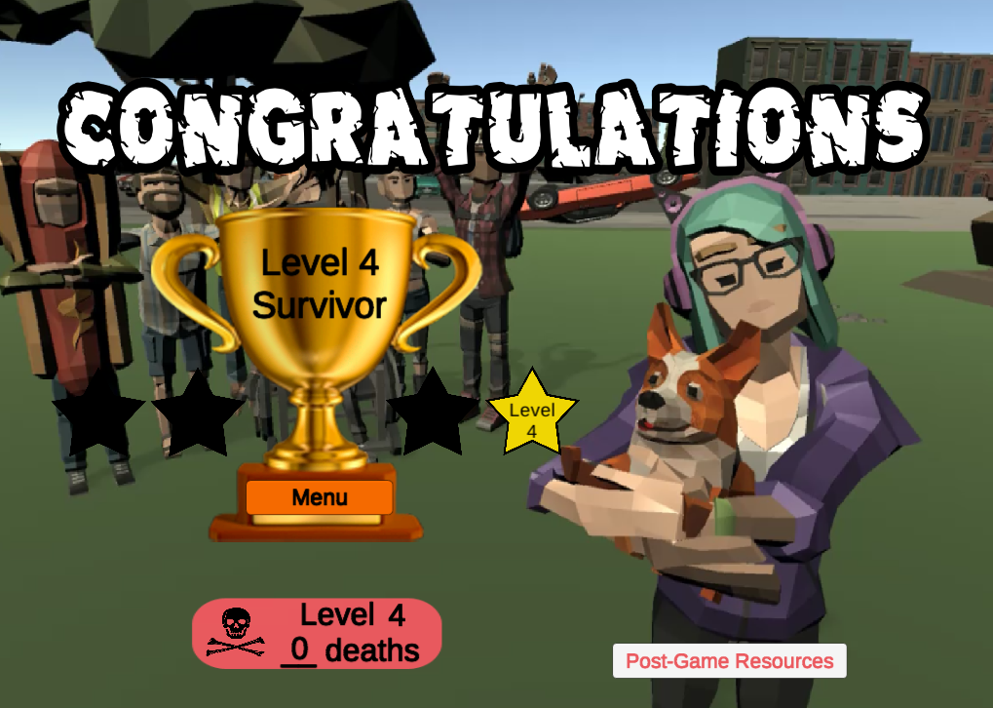
Lessons from Experiment 1
Game is more engaging and has short-term advantages over web
SE related to game tasks
Information-seeking
Solutions to closely related problems
Web searching may stimulate more long-term action
Long-term learning equally effective
Changes in SE persist for general categories of action
Changes in ITA do not
Notes:
Both web searching and game play can be effective forms of intervention that stimulate earthquake preparedness action. Joffe et al. (2019) showed that even control groups who did not receive a face-to-face intervention but knew they were being observed changed their preparedness behavior.
However, the game is demonstrably more engaging so may be more likely to draw people to it in the first place, especially in the target age group
The game stimulated more short-term action and information seeking as well as higher self-efficacy for tasks that are featured in game play. Web may be slightly more effective at stimulating long-term action, possibly through greater anxiety generation (a hypothesis that needs to be tested).
Changes in self-efficacy persist through time, and differences between conditions wane. Changes in intent to act, on the other hand, are not durable.
Though recollection does decline over time, both game and web can produce lasting learning.

Slide 28
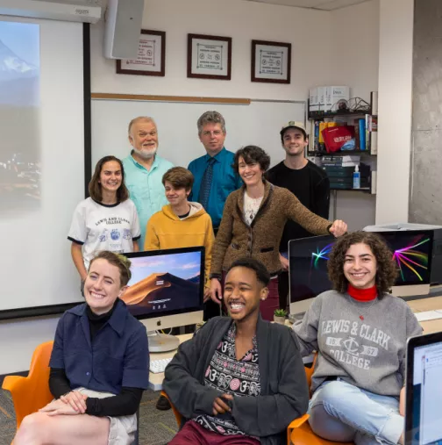
Acknowledgements
Game programmers
Blythe Ballesteros, Aleksa Belic, Liam Beveridge, Liza Clairagneau, Anna DeSmet, Samson Herman, Peter Huizenga, William Lew, Gabe Mertz, Annabel Paris, Lana Parezanin, Ela Pencl, Jaime Quishenberry, Skye Russ, Tristan Saldanha, Zeb Wichert, Sarah Wood
Experiment researchers
Natalie Casson, Elise Gilmore, Jensen Kraus, Sylvia Kunz, Max Udas
Funding sources
National Science Foundation Award 1917148; John S. Rogers Science Research Program at Lewis & Clark College; Levin Family Foundation
Emergency management advisors
Regina Ingabire, Da’Von Angel Wilson, Jeremy Van Keuren, Glenn Devit, Portland Bureau of Emergency Management; Laura Hall, Regional Disaster Preparedness Organization; Jay Wilson, Clackamas County Emergency Management; Justin Ross, Alice Busch, Multnomah County Emergency Management; Chris Walsh, Washington County Emergency Management; Jeff Rubin.
Photo by Blake Ashby
*The findings, opinions, conclusions, and recommendations expressed here do not necessarily reflect the views of the National Science Foundation
Notes:
All of our game programmers and experiment research assistants are (were) undergraduates at Lewis & Clark College. We are grateful to the organizations and programs that have provided funding for this research. We appreciate the important work being done by our emergency manager colleagues and are honored to collaborate with them.

Slide 29
Select References
Bandura, Albert. Social Foundations of Thought and Action: A Social Cognitive Theory. Englewood Cliffs, New Jersey: Prentice Hall, 1986.
Bandura, Albert. “Social Cognitive Theory for Personal and Social Change by Enabling Media.” In Entertainment-Education and Social Change, 75–96. New York: Routledge, 2003.
Bandura, Albert. “Health Promotion by Social Cognitive Means.” Health Education & Behavior 31, no. 2 (April 2004): 143–64. Atwater, Brian F., Satoko Musumi-Rokkaku, Kenji Satake, Yoshinobu Tsuji, Kazue Ueda, and David K. Yamaguchi. The orphan tsunami of 1700: Japanese clues to a parent earthquake in North America. University of Washington Press, 2016.
Gee, James Paul. “Learning by Design: Good Video Games as Learning Machines,” n.d., 12.
Goldfinger, Chris, C. Hans Nelson, Ann E. Morey, Joel E. Johnson, Jason R. Patton, Eugene Karabanov, Julia Gutierrez-Pastor, et al. Turbidite Event History: Methods and Implications for Holocene Paleoseismicity of the Cascadia Subduction Zone. US Department of the Interior, US Geological Survey, 2012.
Joffe, Helene, Henry Potts, Tiziana Rossetto, Ervin Gul Dogulu, and Gabriela Perez-Fuentes. “The Fix-It Face-to-Face Intervention Increases Multi-Hazard Preparedness Cross-Culturally.” Nature Human Behaviour 3, no. 5 (2019): 453–61.
Mutch, Carol. Citizenship in Action: Young People in the Aftermath of the 2010-2011 New Zealand Earthquakes, Sisyphus - Journal of Education, 1, no. 2 (2013): 76–99.
Nissen, Sylvia, Sally Carlton, Jennifer H.K. Wong, and Sam Johnson. “‘Spontaneous’ Volunteers? Factors Enabling the Student Volunteer Army Mobilisation Following the Canterbury Earthquakes, 2010–2011.” International Journal of Disaster Risk Reduction 53 (February 2021): 102008.
Oregon Seismic Safety Policy Advisory Commission. “The Oregon Resilience Plan: Reducing Risk and Improving Recovery for the Next Cascadia Earthquake and Tsunami.” Salem, Oregon, 2013.
Paton, Douglas. “Disaster Preparedness: A Social‐cognitive Perspective.” Disaster Prevention and Management: An International Journal 12, no. 3 (August 2003): 210–16.
Paton, Douglas, Leigh Smith, and David Johnston. “When Good Intentions Turn Bad: Promoting Natural Hazard Preparedness.” Australian Journal of Emergency Management 20, no. 1 (2005): 25–30.
Peng, Wei. “The Mediational Role of Identification in the Relationship between Experience Mode and Self-Efficacy: Enactive Role-Playing versus Passive Observation.” CyberPsychology & Behavior 11, no. 6 (December 2008): 649–52.
Solinska-Nowak, Aleksandra, Piotr Magnuszewski, Margot Curl, Adam French, Adriana Keating, Junko Mochizuki, Wei Liu, Reinhard Mechler, Michalina Kulakowska, and Lukasz Jarzabek. “An Overview of Serious Games for Disaster Risk Management – Prospects and Limitations for Informing Actions to Arrest Increasing Risk.” International Journal of Disaster Risk Reduction 31 (October 2018): 1013–29. https://doi.org/10.1016/j.ijdrr.2018.09.001.
Tanes, Zeynep, and Hyunyi Cho. “Goal Setting Outcomes: Examining the Role of Goal Interaction in Influencing the Experience and Learning Outcomes of Video Game Play for Earthquake Preparedness.” Computers in Human Behavior 29, no. 3 (May 2013): 858–69.
Tanes, Zeynep. “Shall We Play Again? The Effects of Repetitive Gameplay and Self-Efficacy on Behavioural Intentions to Take Earthquake Precautions.” Behaviour & Information Technology 36, no. 10 (2017): 1037–45.

