Slide 1
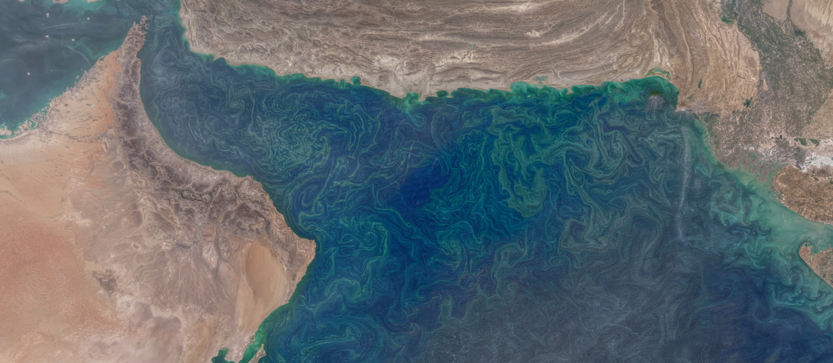
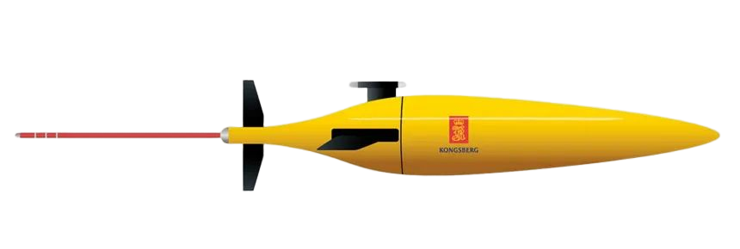



SEASONAL TO INTRASEASONAL VARIABILITY OF THE SURFACE MIXED LAYER IN THE GULF OF OMAN
Estel Font, Bastien Queste & Sebastiaan Swart
estel.font.felez@gu.se

Slide 2
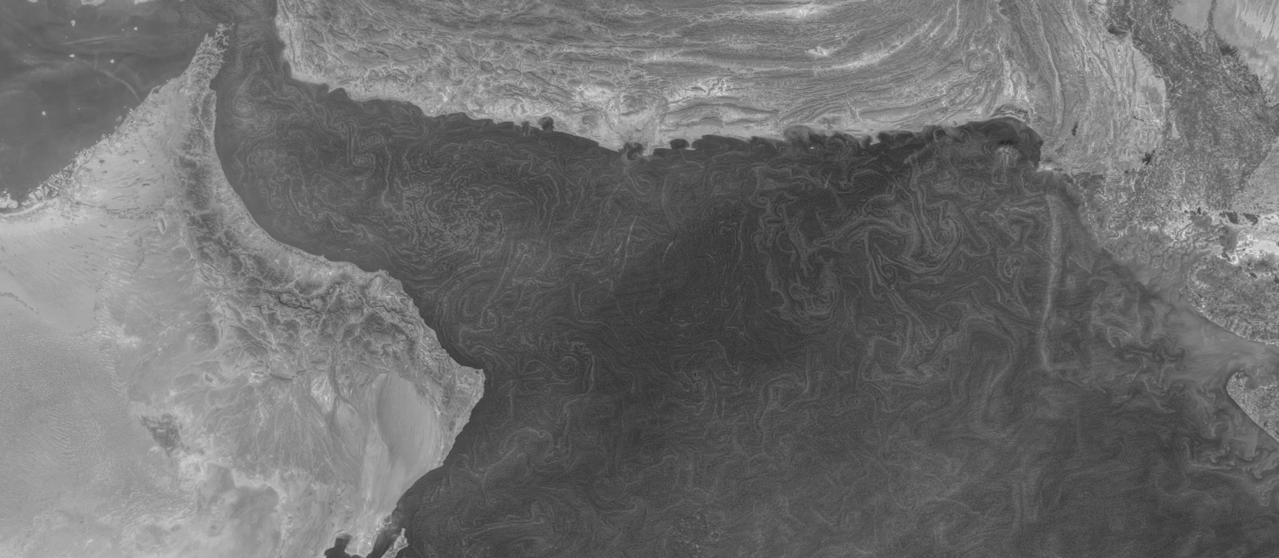
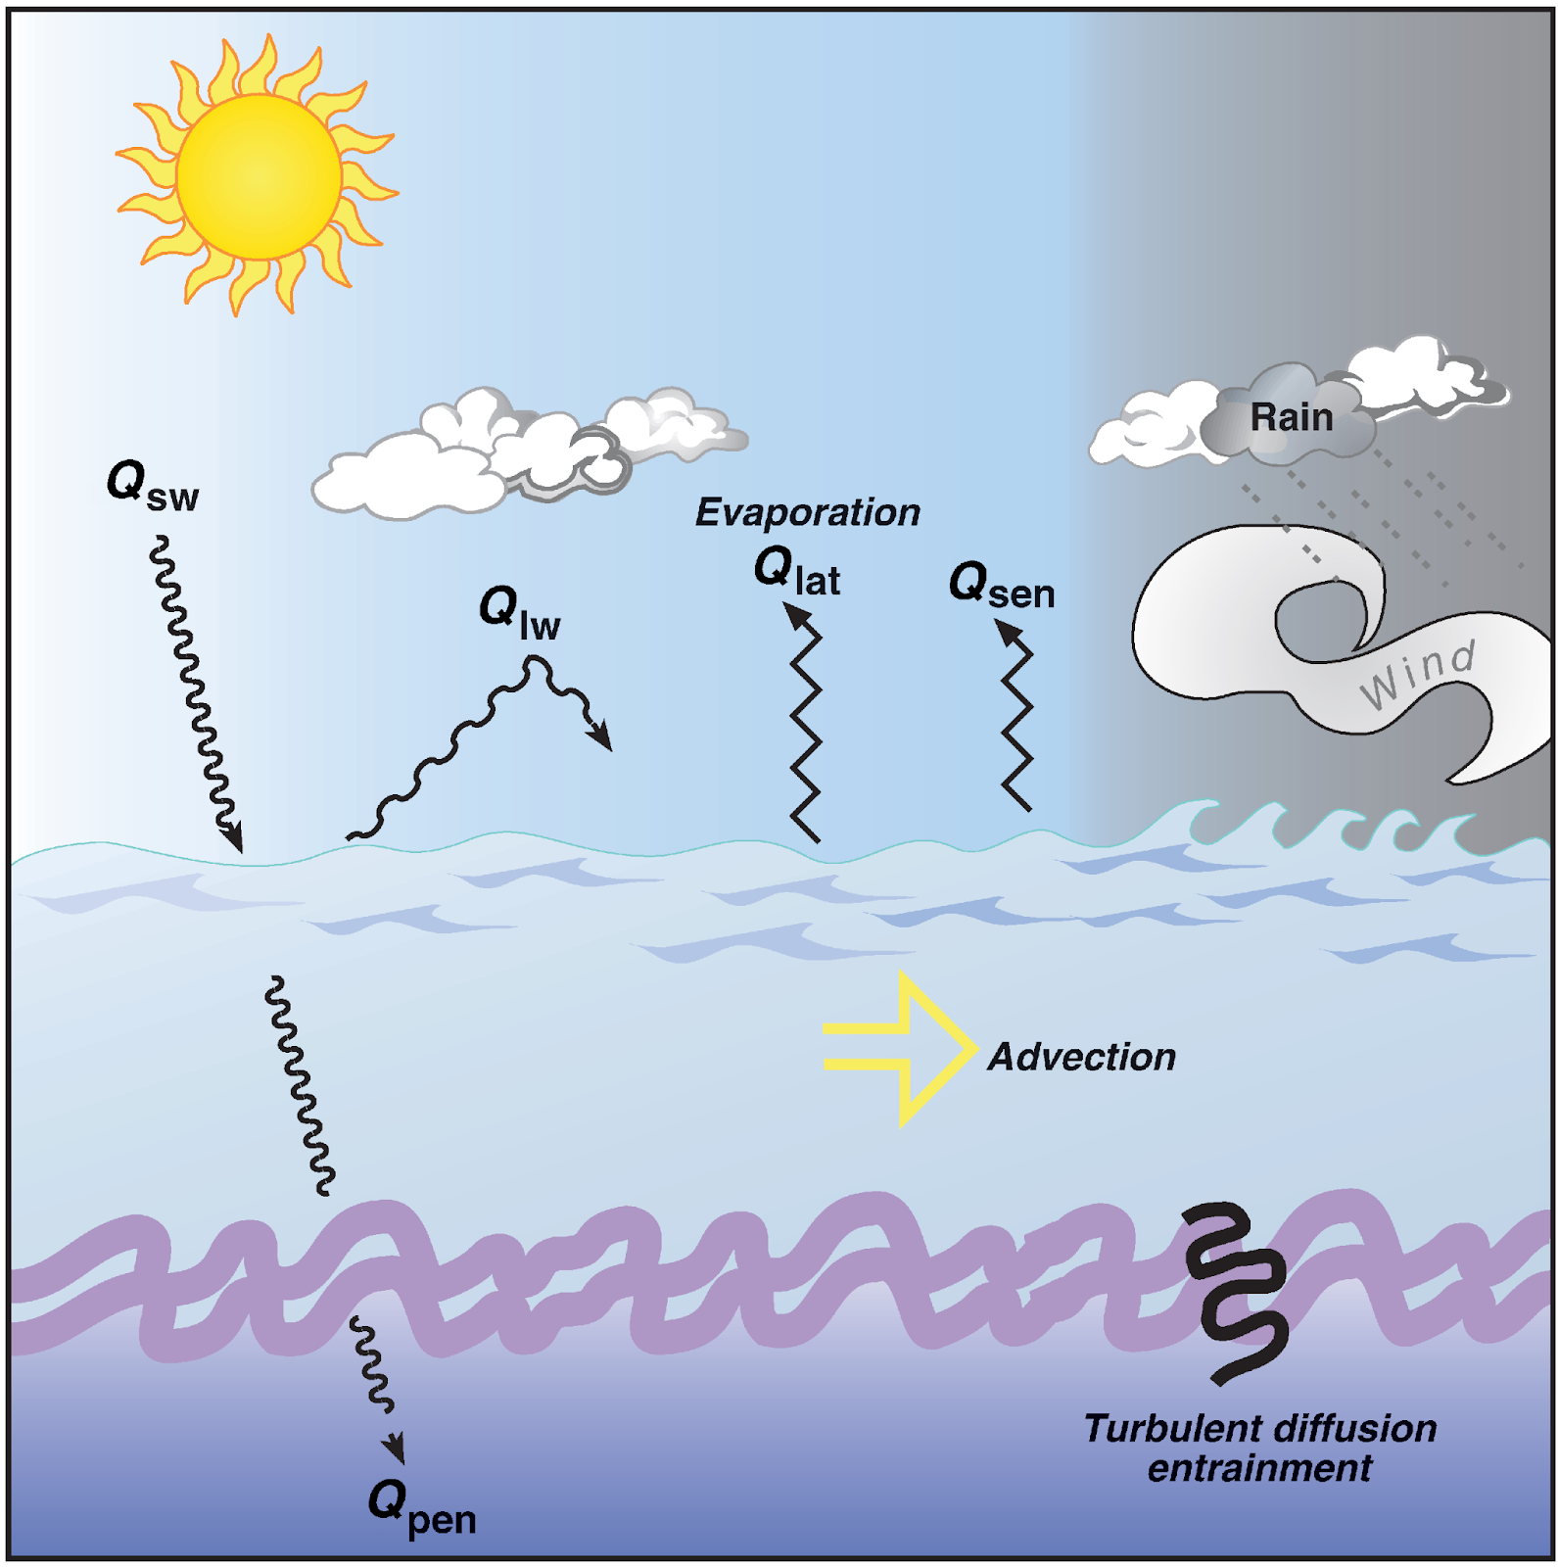
SEASONAL TO INTRASEASONAL VARIABILITY OF THE SURFACE MIXED LAYER IN THE GULF OF OMAN
Estel Font, Bastien Queste & Sebastiaan Swart
estel.font.felez@gu.se
One dimensional buoyancy forcing can explain a significant part of ML variations.
Q_{NET}
Figure adapted from: Cronin et al. (2001)

Slide 3
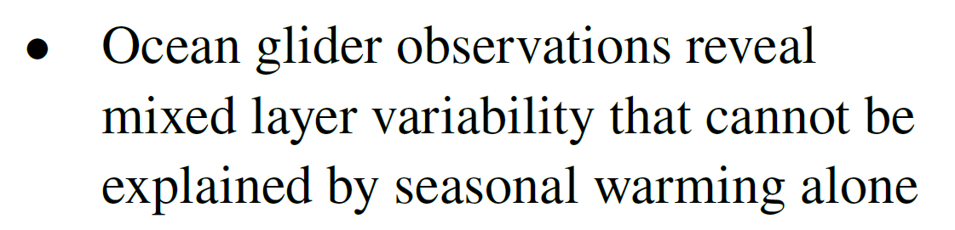
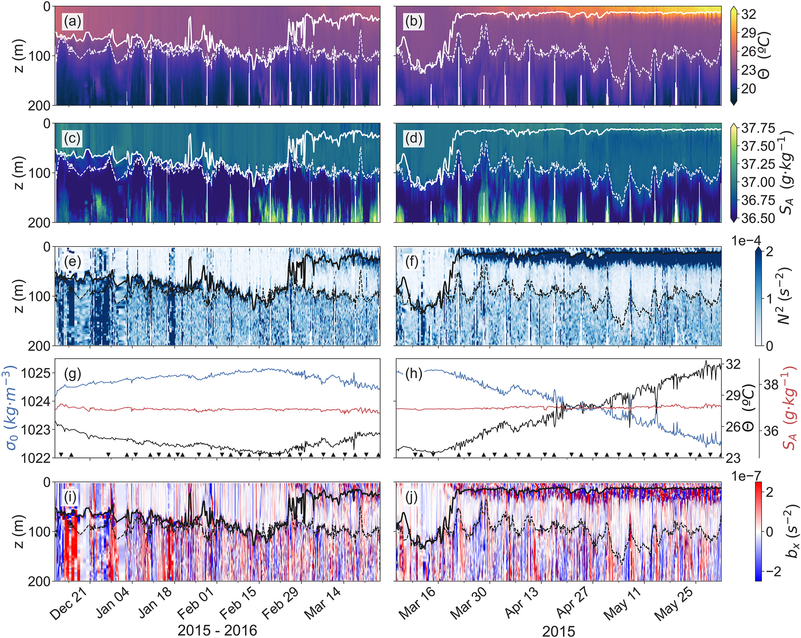
SEASONAL TO INTRASEASONAL VARIABILITY OF THE SURFACE MIXED LAYER IN THE GULF OF OMAN
Estel Font, Bastien Queste & Sebastiaan Swart
estel.font.felez@gu.se
Winter
Spring
MLD
MLD
Winter pycnocline
MLD ~ 100m
MLD ~ 15m

Slide 4
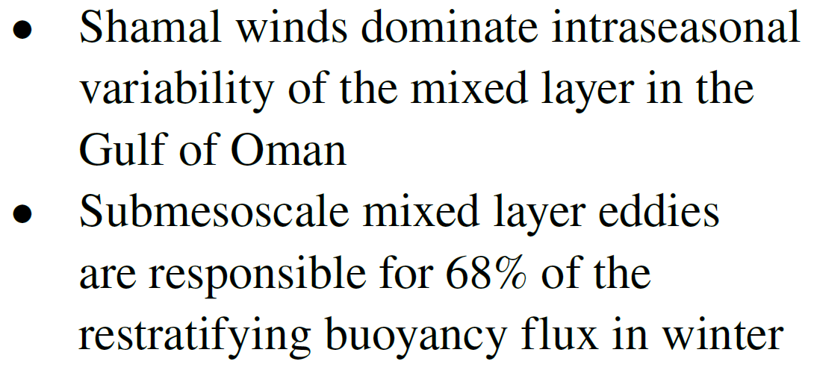
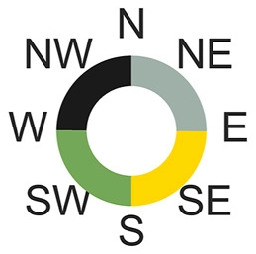
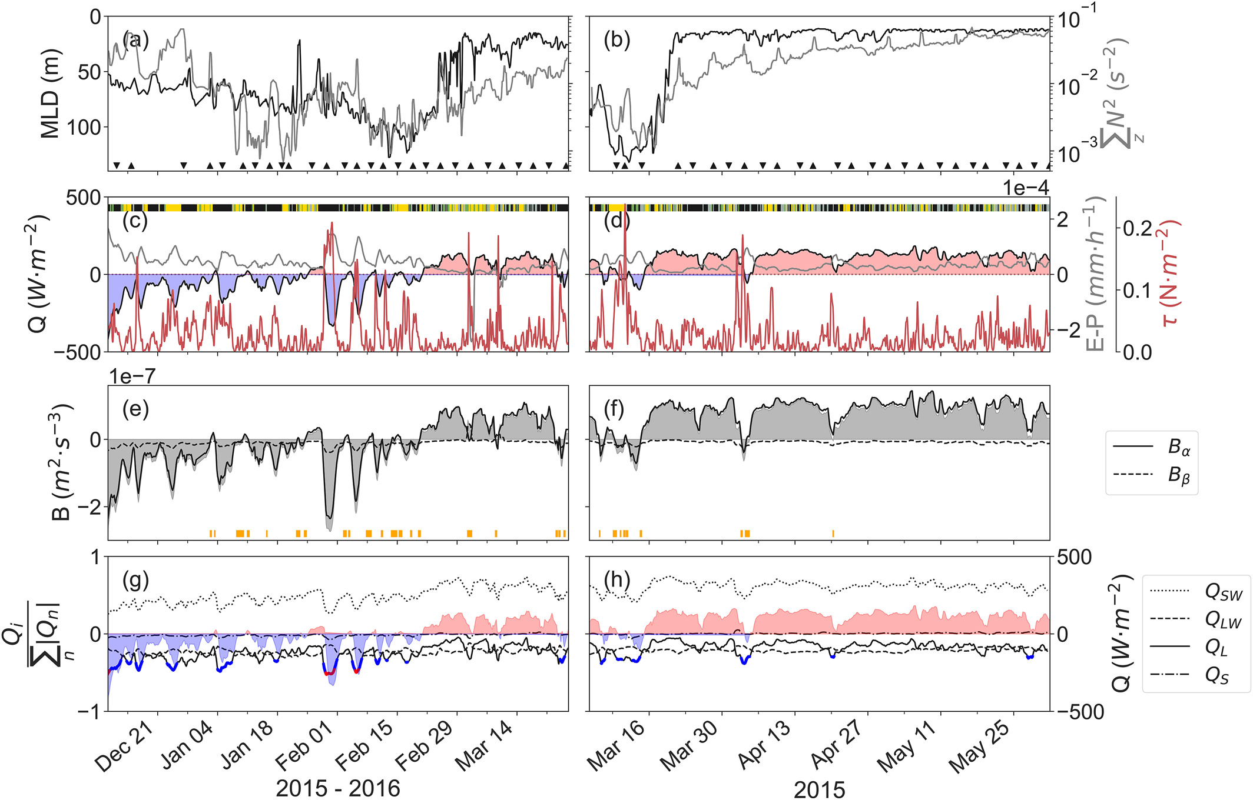
SEASONAL TO INTRASEASONAL VARIABILITY OF THE SURFACE MIXED LAYER IN THE GULF OF OMAN
Estel Font, Bastien Queste & Sebastiaan Swart
estel.font.felez@gu.se
Q_{NET} = Q_{SW} + Q_{LW} + Q_{S} + Q_{L}
MLD
MLD
Winter pycnocline
MLD ~ 100m
MLD ~ 15m
Cooling
Warming

Slide 5
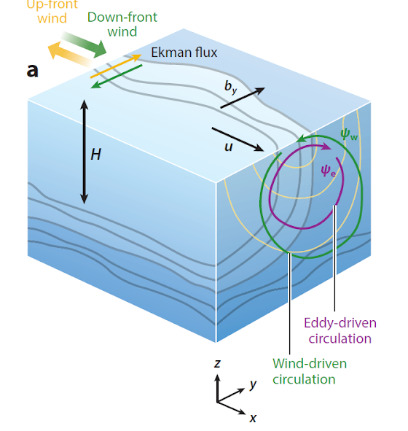
SEASONAL TO INTRASEASONAL VARIABILITY OF THE SURFACE MIXED LAYER IN THE GULF OF OMAN
Estel Font, Bastien Queste & Sebastiaan Swart
estel.font.felez@gu.se
One dimensional buoyancy forcing can explain a significant part of ML variations.
Submesoscale processes related to
fronts & eddies, can also alter ML stratification.
Q_{NET}
Q_{SMS}
Mixed layer eddies
(MLE)
Ekman buoyancy flux
(EBF)
(0.1 - 10 km)
Figure adapted from: Cronin et al. (2001)
Figure adapted from: Mahadevan et al. (2016)

Slide 6
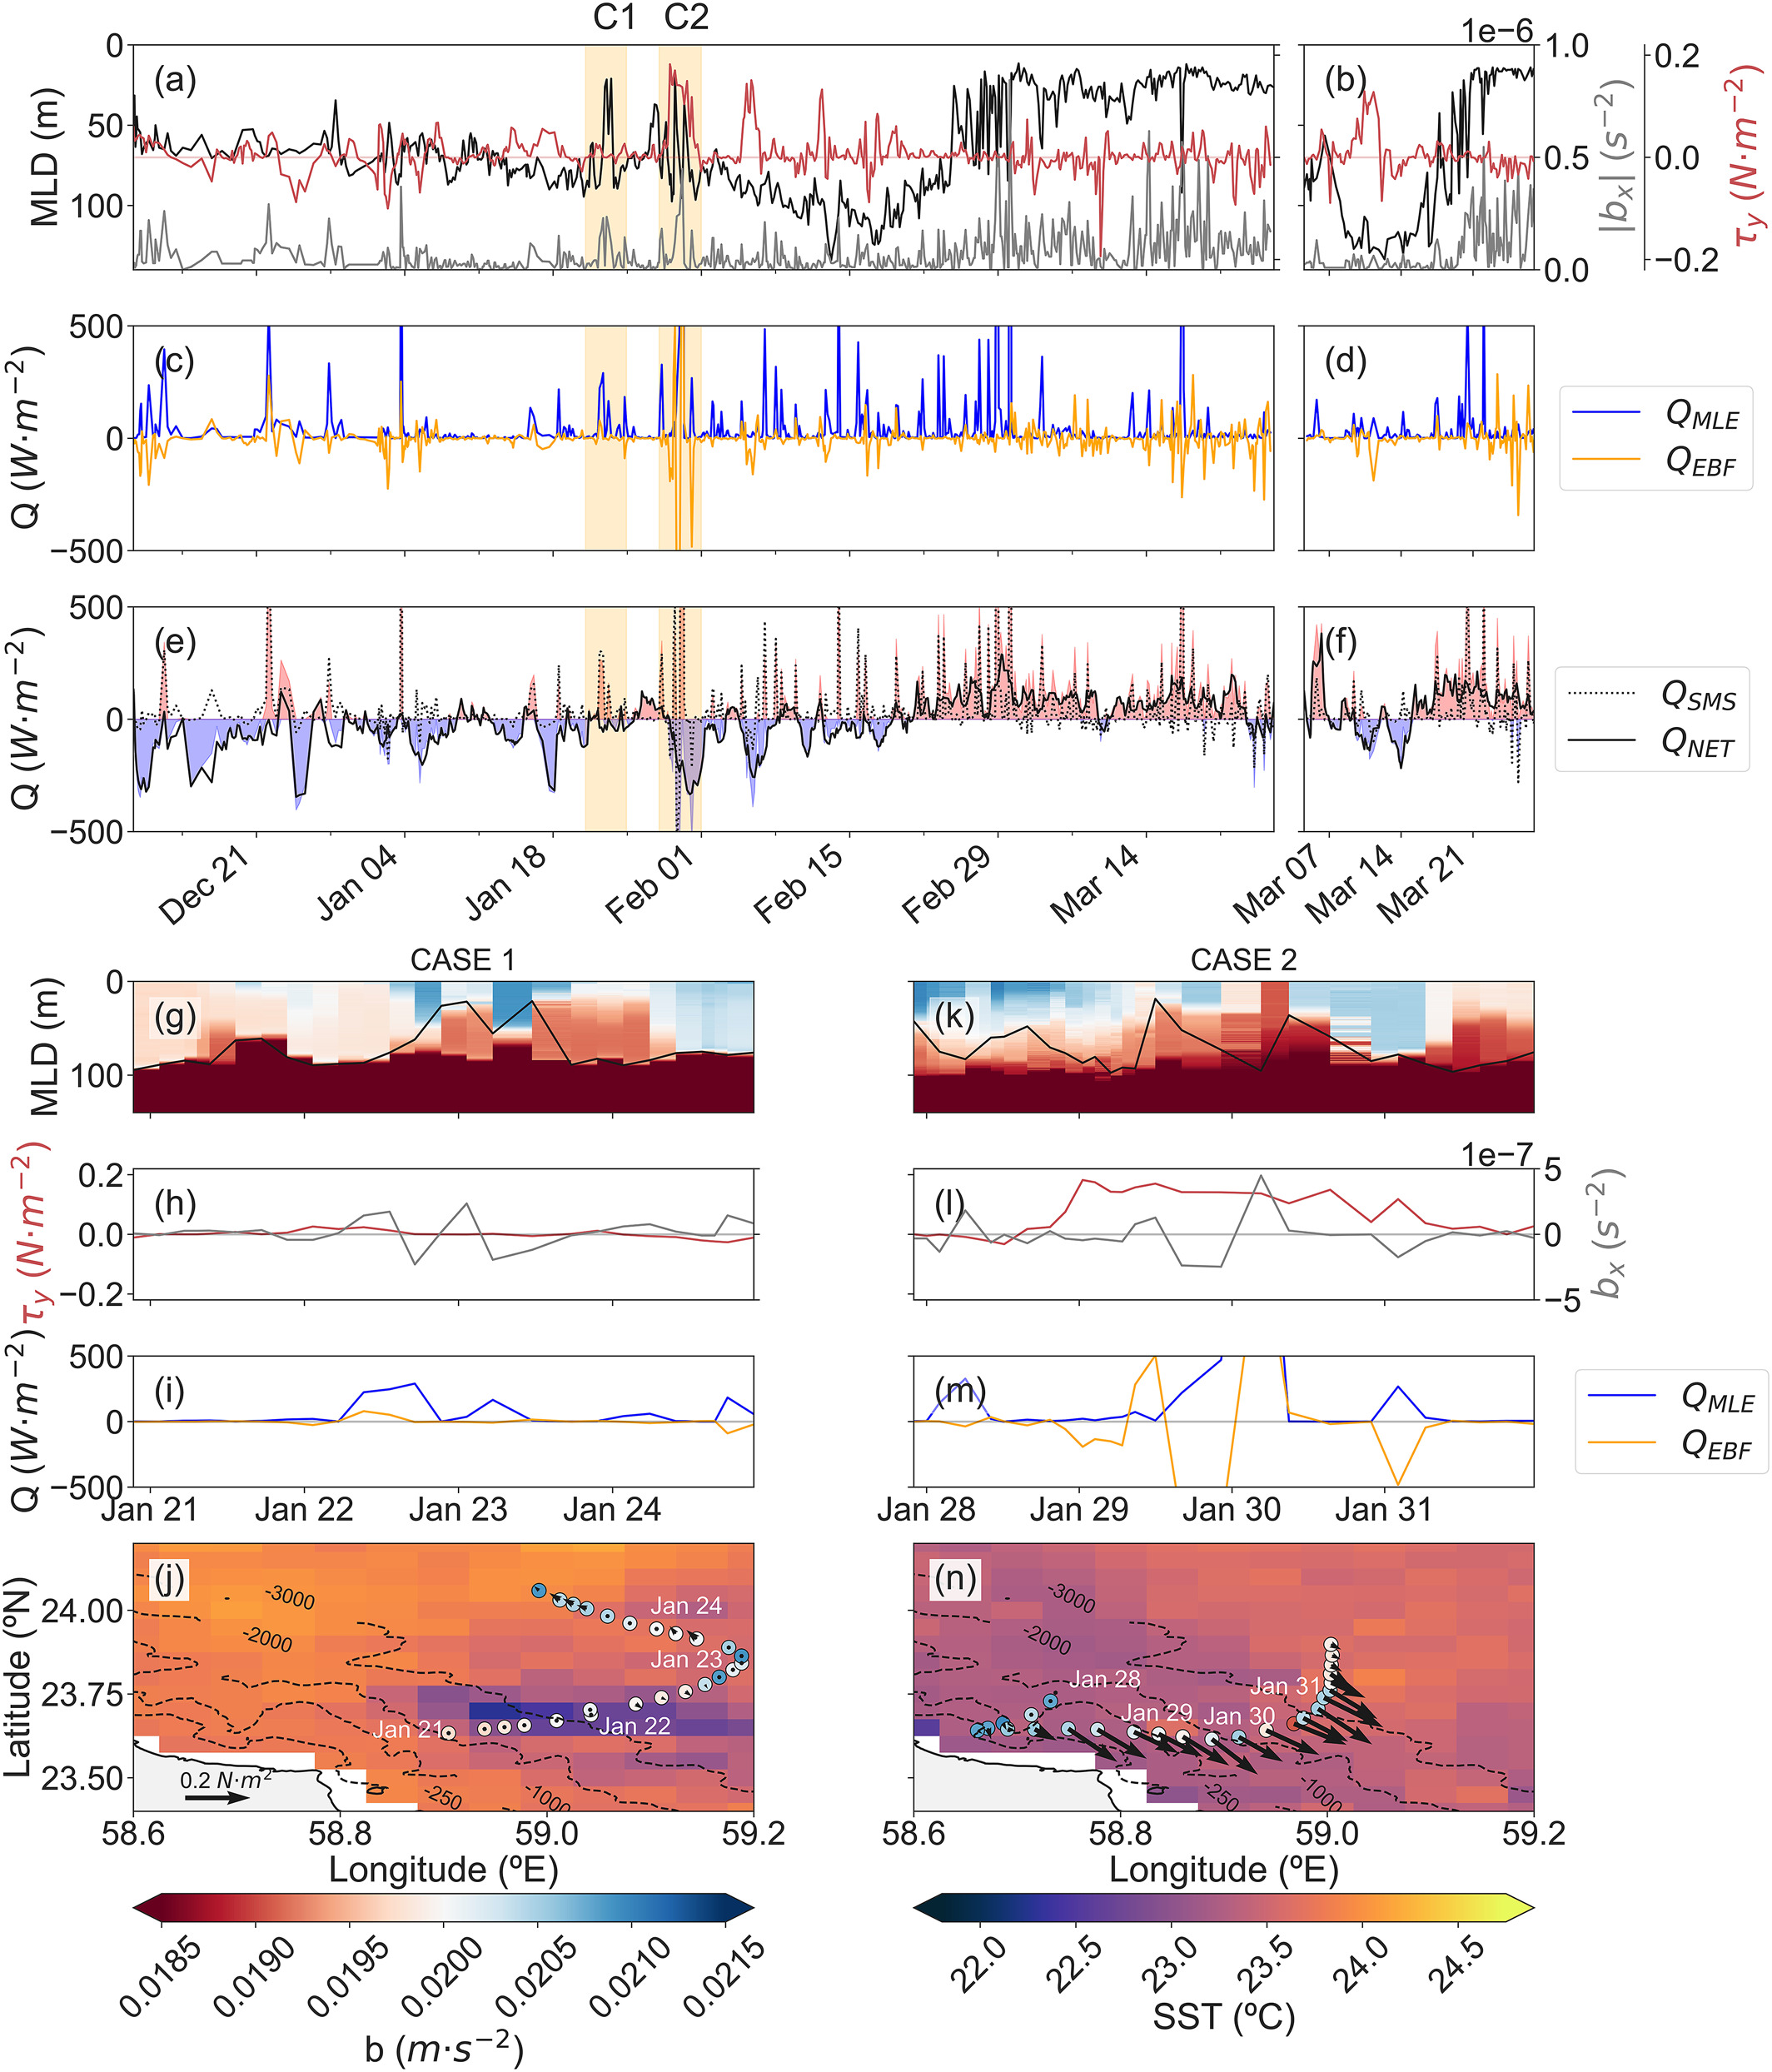
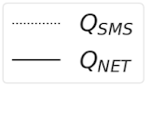
SEASONAL TO INTRASEASONAL VARIABILITY OF THE SURFACE MIXED LAYER IN THE GULF OF OMAN
Estel Font, Bastien Queste & Sebastiaan Swart
estel.font.felez@gu.se
Q_{SMS} = Q_{MLE} + Q_{EBF}
Q_{MLE} Q_{EBF}
QTOTAL

Slide 7
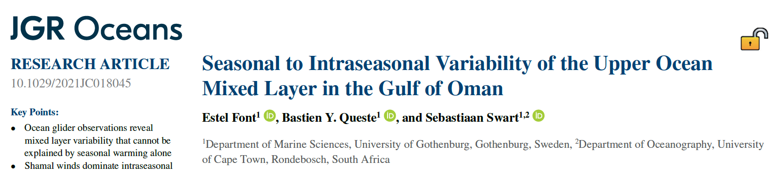

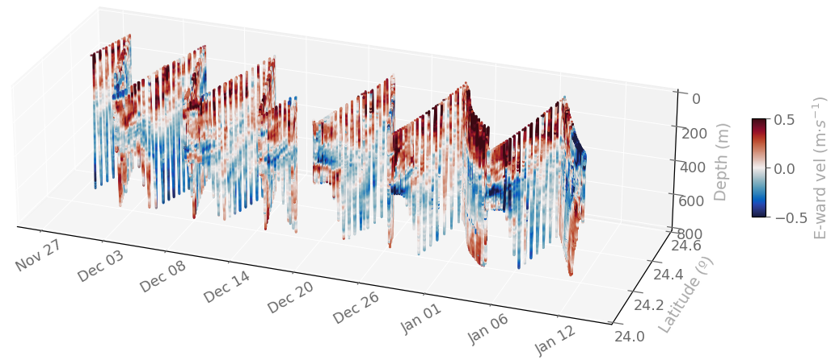



SEASONAL TO INTRASEASONAL VARIABILITY OF THE SURFACE MIXED LAYER IN THE GULF OF OMAN
Estel Font, Bastien Queste & Sebastiaan Swart
estel.font.felez@gu.se
What’s next?
Energetics of the region
  ADCP glider → Oct 21 – Mar 22
DO advective ventilation pathways to the OMZ

