Slide 1

Diagnose the diffractive contributions to GNSS signal scintillation at high latitude during the geomagnetic storm on September 7_{th}-8_{th} 2017
Yuhao Zheng¹, Chao Xiong¹, Yaqi Jin², Dun Liu³, Chunyu Xu¹, Yixun Zhu¹, and Kjellmar OKsavik²
zhengyuhao@whu.edu.cn
1. Department of Space Physics, Electronic Information School, Wuhan University, 430072 Wuhan, China.
2. Department of Physics, University of Oslo, Oslo, Norway.
3. No. 22nd Research Institute, CETC, 266107 Qingdao, Shandong, China.
EGU-2022 Vienna 27 May 2022

Slide 2
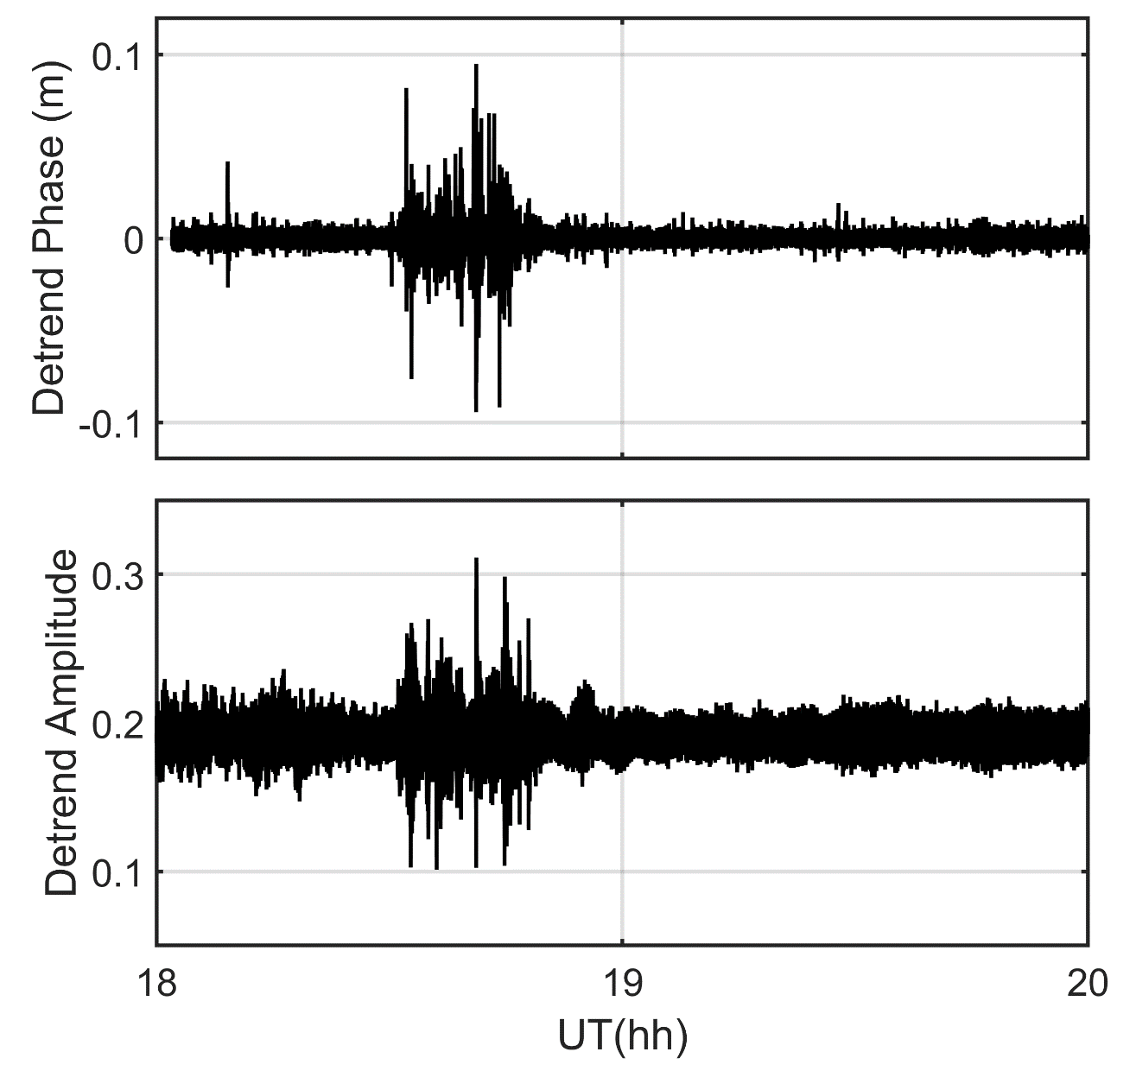
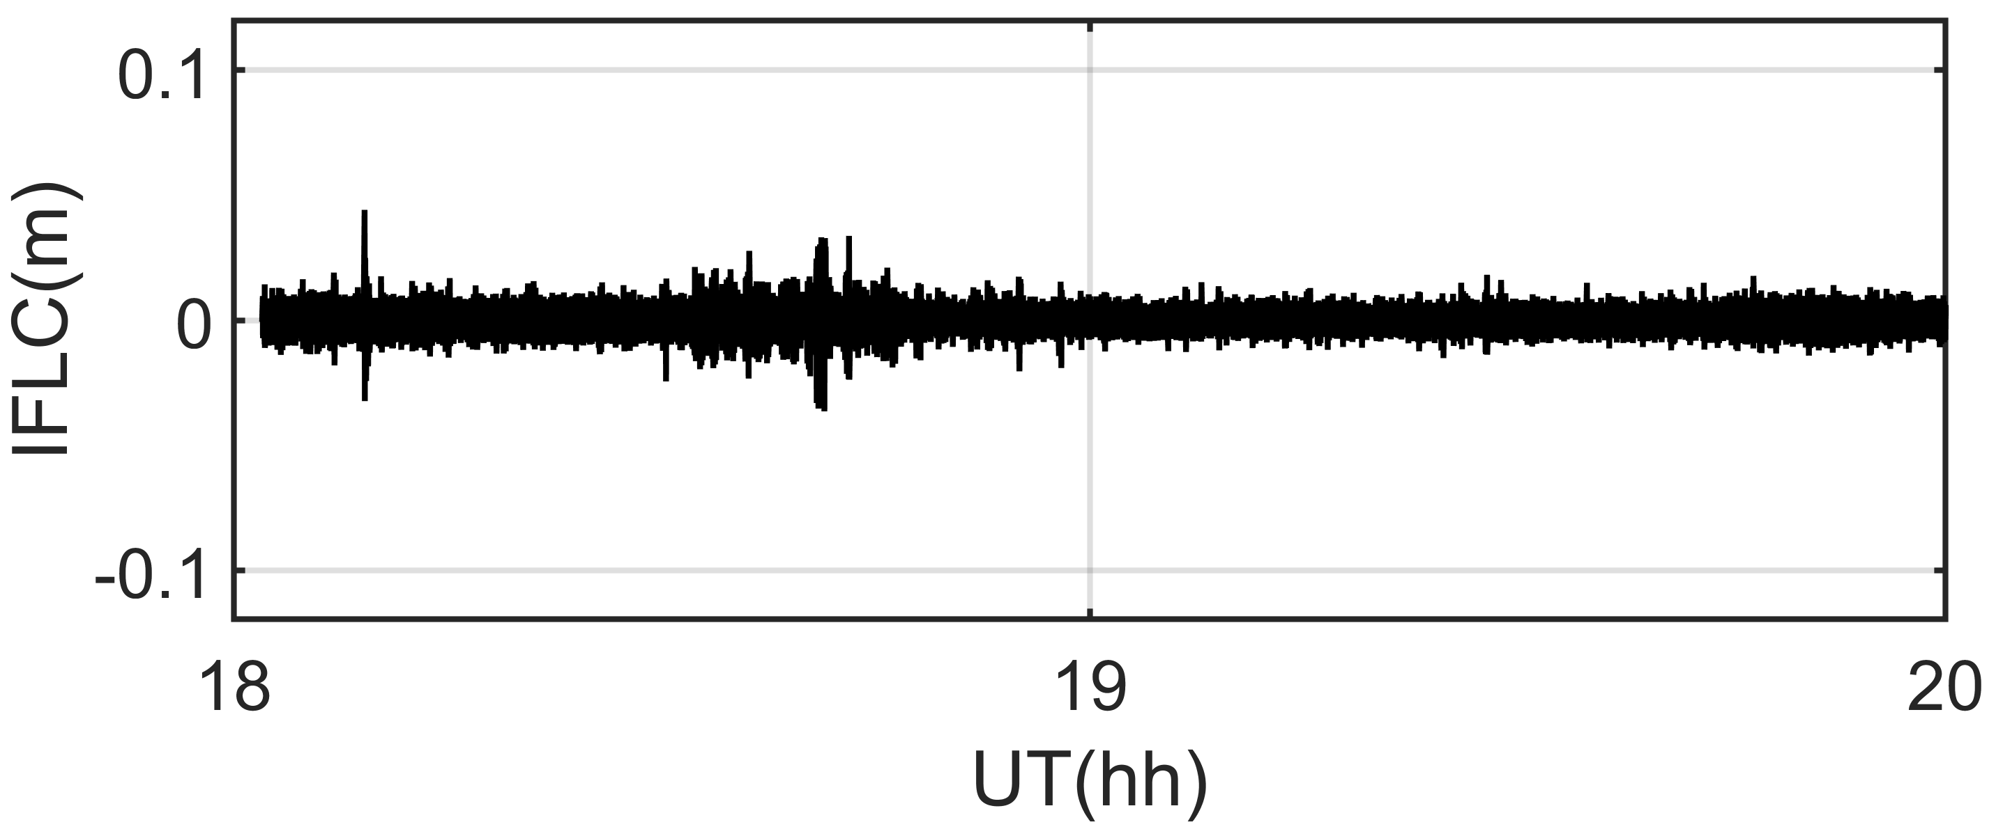
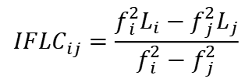

Movtivation
The scintillation effect can be divided into refraction and diffraction.
Refraction and Diffraction→Phase scintillation
Diffraction→Amplitude scintillation
By ignoring the higher-order terms and path curvature, The phase delay caused by refraction satisfies:
$$I=\frac{40.28}{f^{2}}\int{N_{e}}ds$$
To remove the influence of the ionospheric refraction on the phase of the GPS signal, we used the ionosphere‐free linear combination (IFLC) to represent the rest variations:
$$IF{LC}_{ij}=\frac{f_{i}^{2}L_{i}−f_{j}^{2}L_{j}}{f_{i}^{2}−f_{j}^{2}}$$
Notes:
As we known, plasma irregularities can cause interference with radio wave signals across the ionosphere, the signals received by receivers at ground often show rapid fluctuations in both phase and amplitude, which are referred to as the ionospheric scintillation.
This is an example of ionospheric scintillation, where rapid fluctuations in phase and amplitude can be seen.
The scintillation effect can be divided into refraction and diffraction, where the phase perturbation will be caused by refraction and diffraction, while the amplitude perturbation will be caused by diffraction only. However, it has been shown that the refraction effect on the phase of GPS signals is related to the signal carrier frequency (as shown in Eq.), while the diffraction effect is independent of the carrier frequency. This provides a possible way to distinguish the refractive and diffractive effects of phase scintillation. Based on the IFLC method, we can calculate the phase perturbation influenced only by diffraction. By definition, both IFLC and amplitude perturbations correspond to diffraction effects, are they always agree?

Slide 3
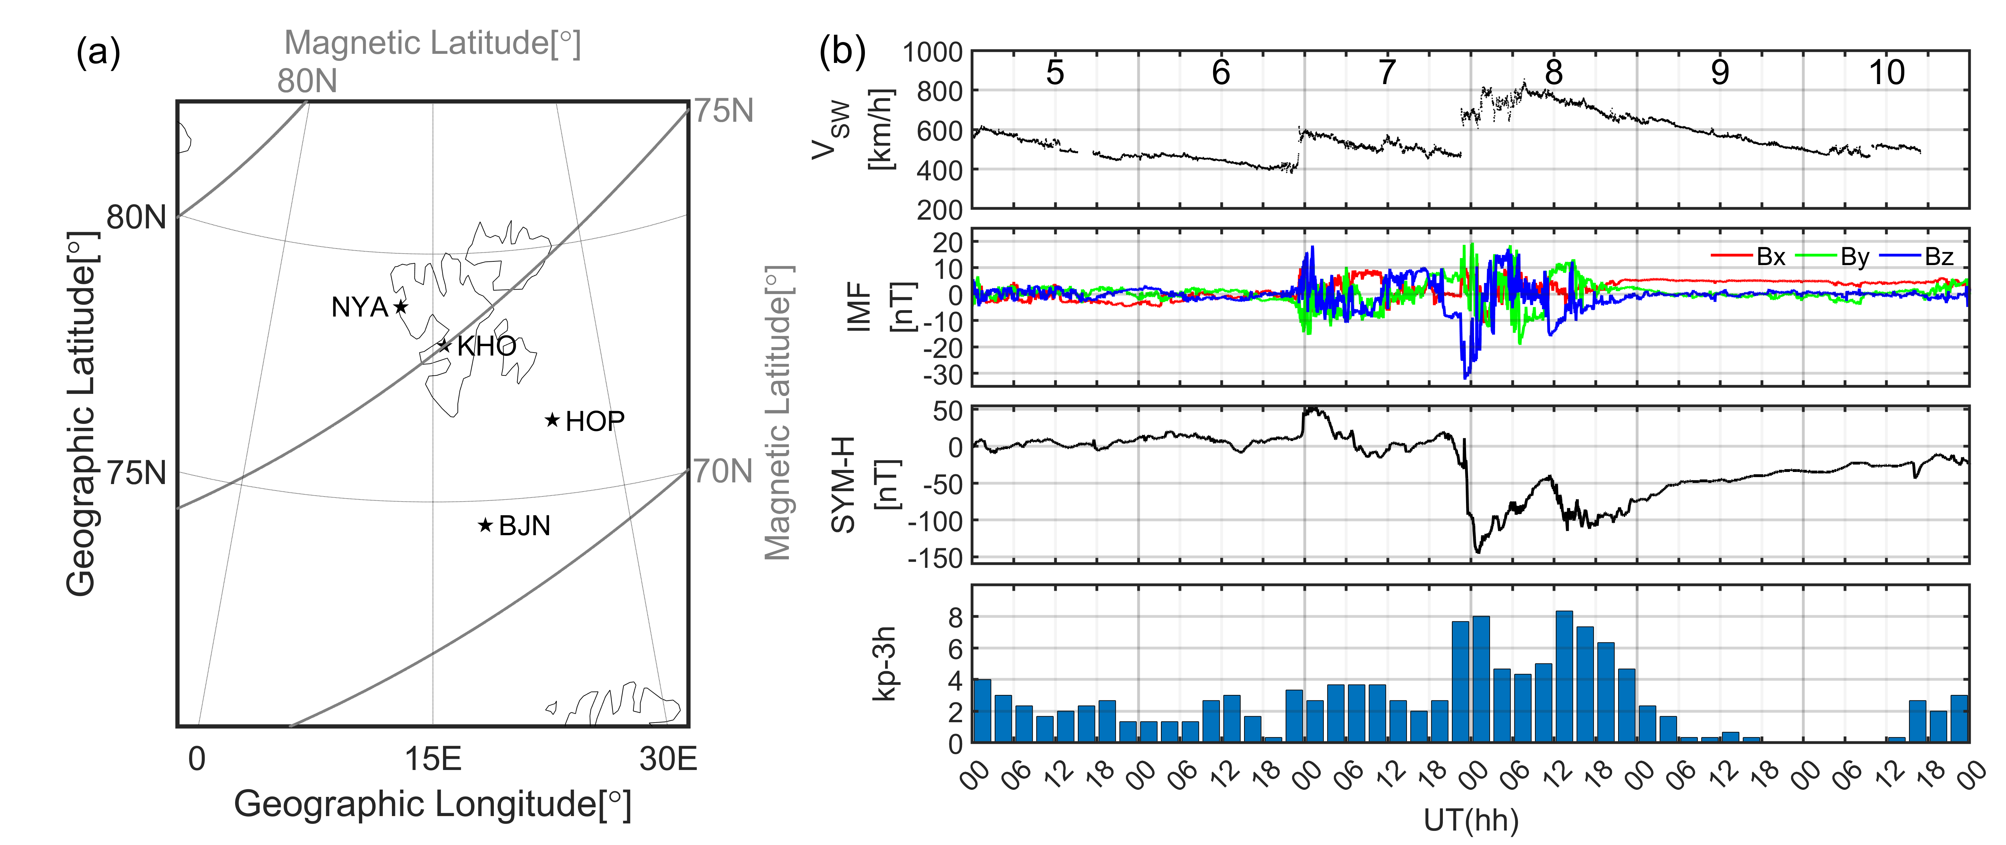
Introduction
Geomagnetic storm September 2017
Notes:
In our study, we used GPS data from these four stations in the Norway region to analyze scintillation events during the geomagnetic storm on September 2017. Midnight of September 7 is the beginning of the main phase of the storm.

Slide 4
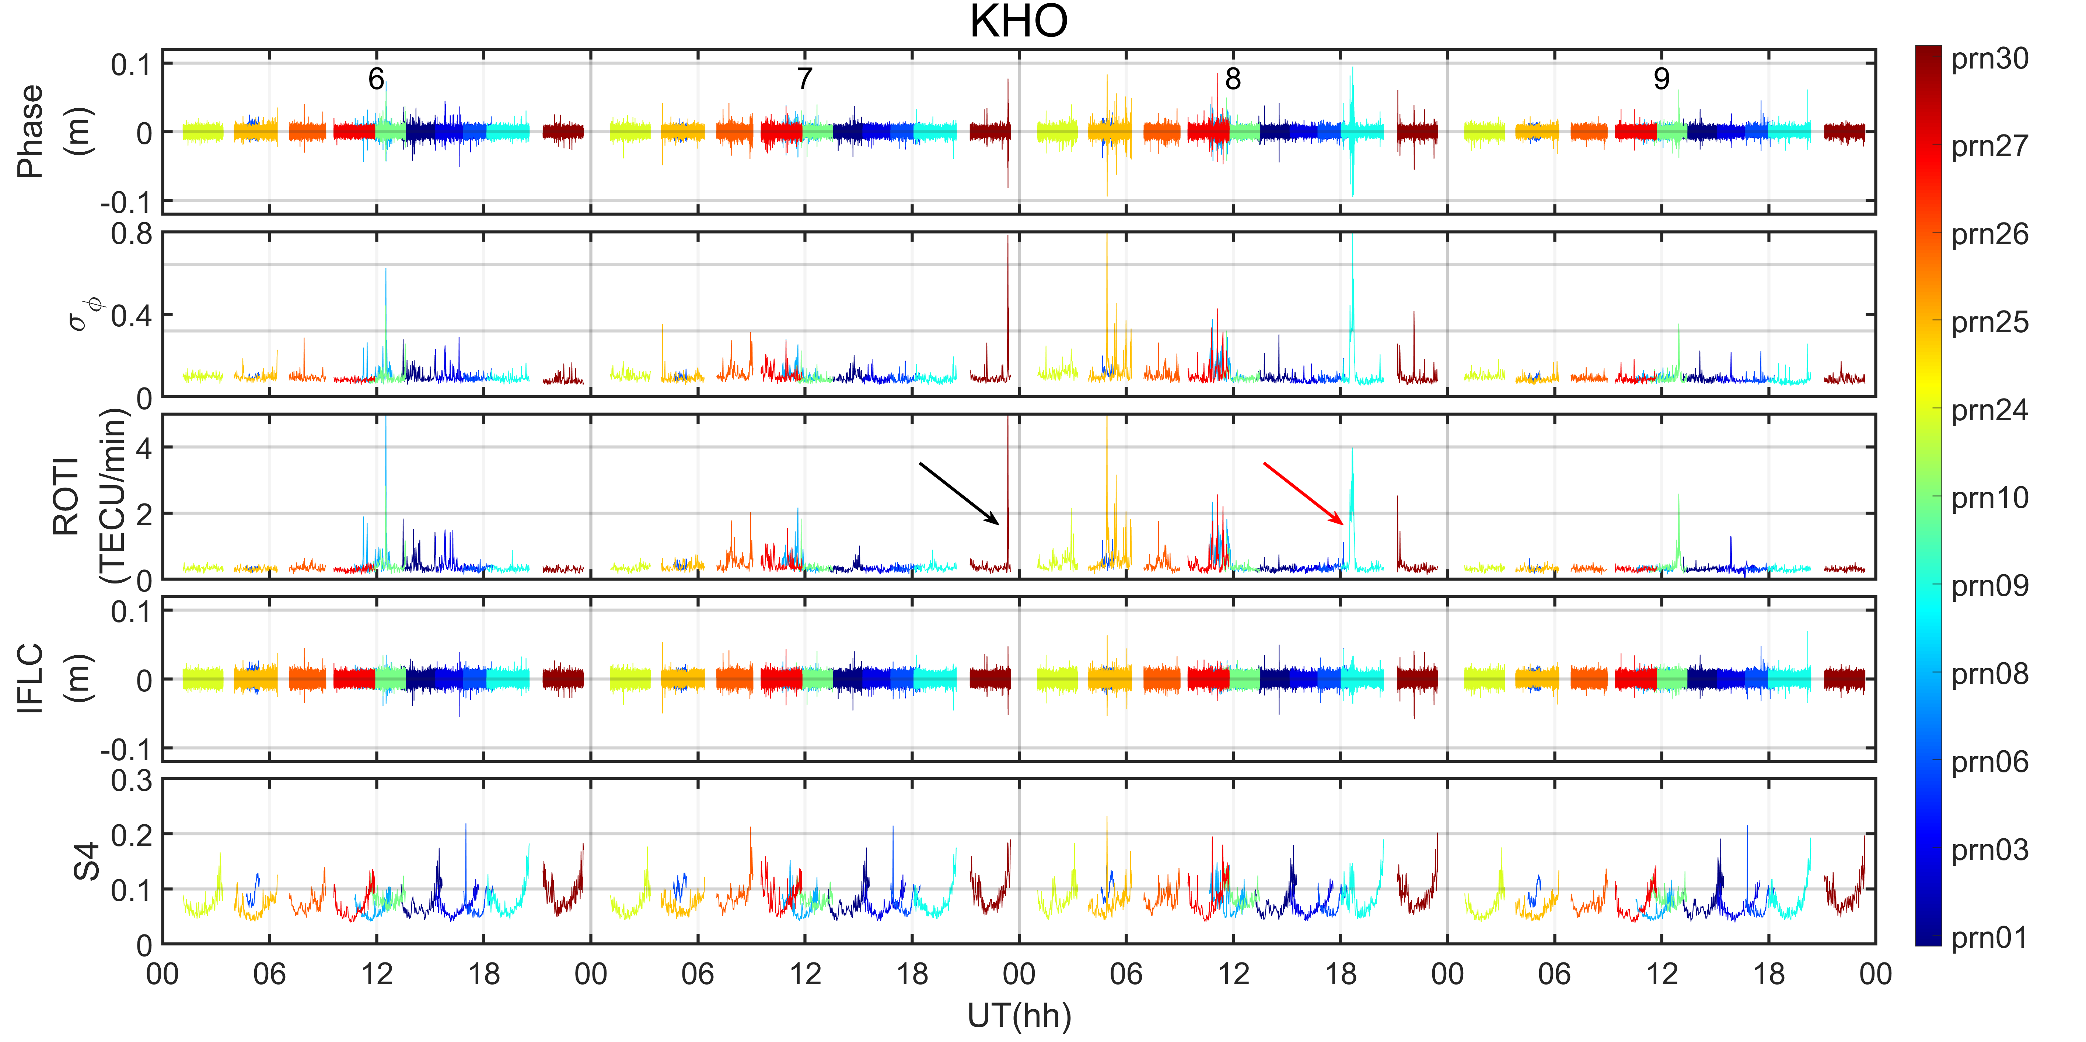
Results
LT=UT+1
Detrended phase, $σ_{φ}$, ROTI, IFLC and S4 at KHO station during September 6_{th}-9_{th}, 2017.
Notes:
This is the result of the KHO station, and for a better analysis of the scintillation events, we also calculated several common scintillation indices, the phase scintillation index sigmaphi, the amplitude scintillation index S4, and ROTI, representing the fluctuation of total electron content.
Here, the scintillation event pointed by the black arrow corresponds to the beginning of the main phase of the storm, The scintillation event pointed by the red arrow is the event we will analyze specifically then.

Slide 5
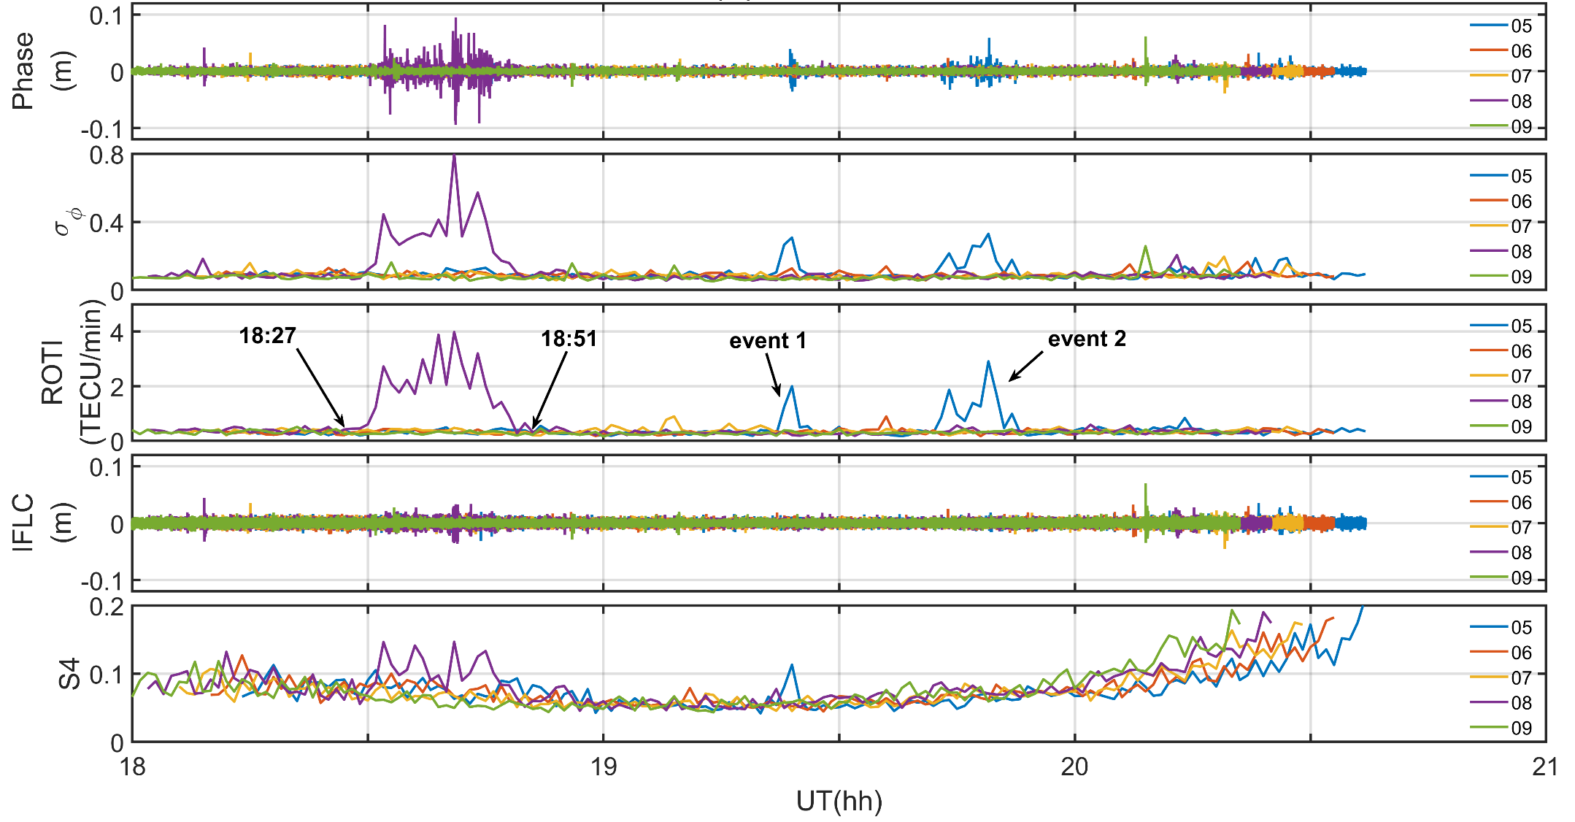
Results
The refraction effect is dominant in the GPS phase fluctuations of the scintillation event on 8_{th}. The remain fluctuations in IFLC as well as the fluctuations in the amplitude scintillation index S4, should be related to the diffraction process
Detrended phase,$σ_{φ}$, ROTI, IFLC and S4 of PRN=09 at KHO station during 18:00-21:00 UT on September 5_{th}-9_{th}, 2017
Notes:
Here, we zoom in on this scintillation event, presented in purple. Different colors represent different dates.
We can see significant phase fluctuations, however, most of these phase fluctuations are not shown in the IFLC, which suggests that the refraction effect is dominant in the GPS phase fluctuations. The remain fluctuations in IFLC as well as the fluctuations in the amplitude scintillation index S4, should be related to the diffraction process.
On the other hand, we need to note two other scintillation event, presented in blue, event 1 and event 2, occurred in September 5 before the storm.
In the event 1, the phase fluctuations are suppressed in IFLC. we see that the IFLC is not significantly different compared to the values in the other days, but the S4 shows significant fluctuations. That is, the IFLC does not correspond well with the results of S4.
Event 2 is much simpler, caused only by refraction

Slide 6
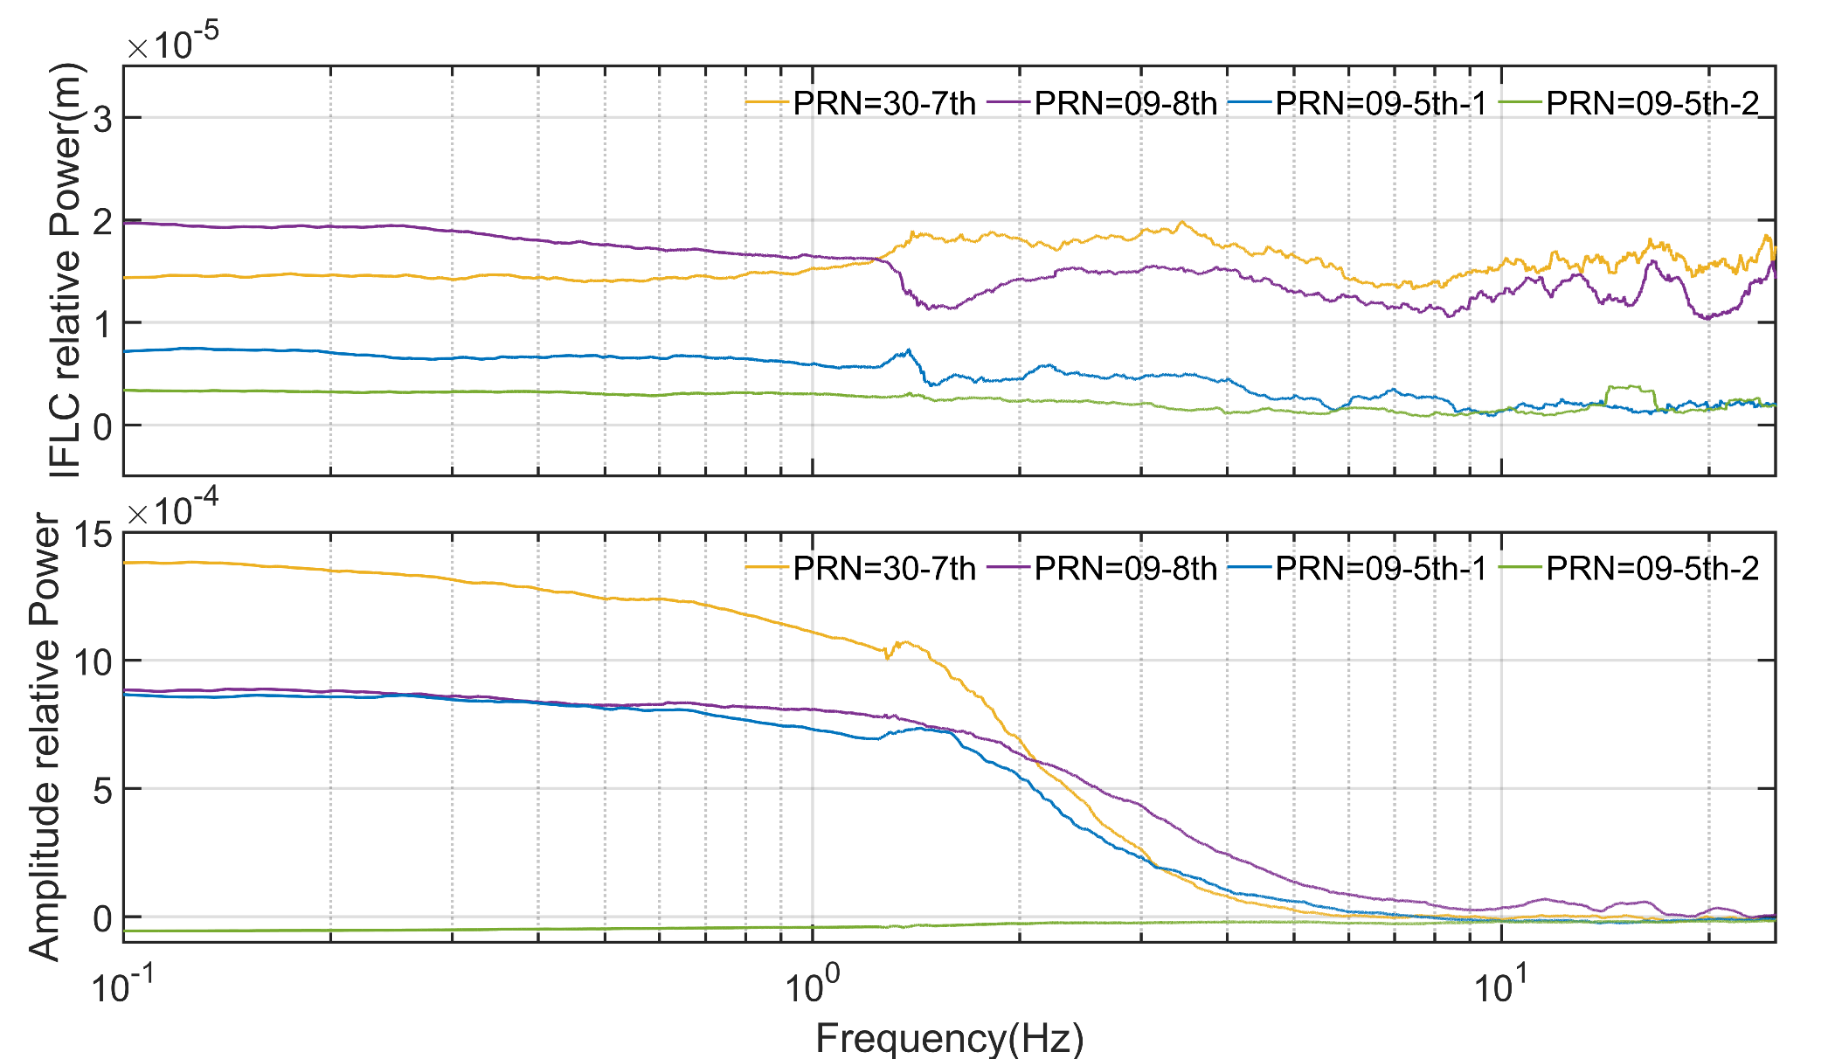
Results
Spectrum of four scintillation events
The effect of diffraction on phase is not agree with the effect on amplitude
Notes:
Further we analyzed the spectrum of these events and added the scintillation event at the beginning of the main phase of the storm. And we subtracted the average of the other days from the spectrum of the scintillation events to better compare the differences across events. We can see in event 1 presented in blue, that IFLC also has small fluctuations compared to the refraction event presented in green. Combined with the apparent fluctuations in amplitude, this indicates that diffraction also occurs in the event 1, and that the effect of diffraction on phase is not agree with the effect on amplitude. Another feature is the higher value of IFLC during the storm.

Slide 7
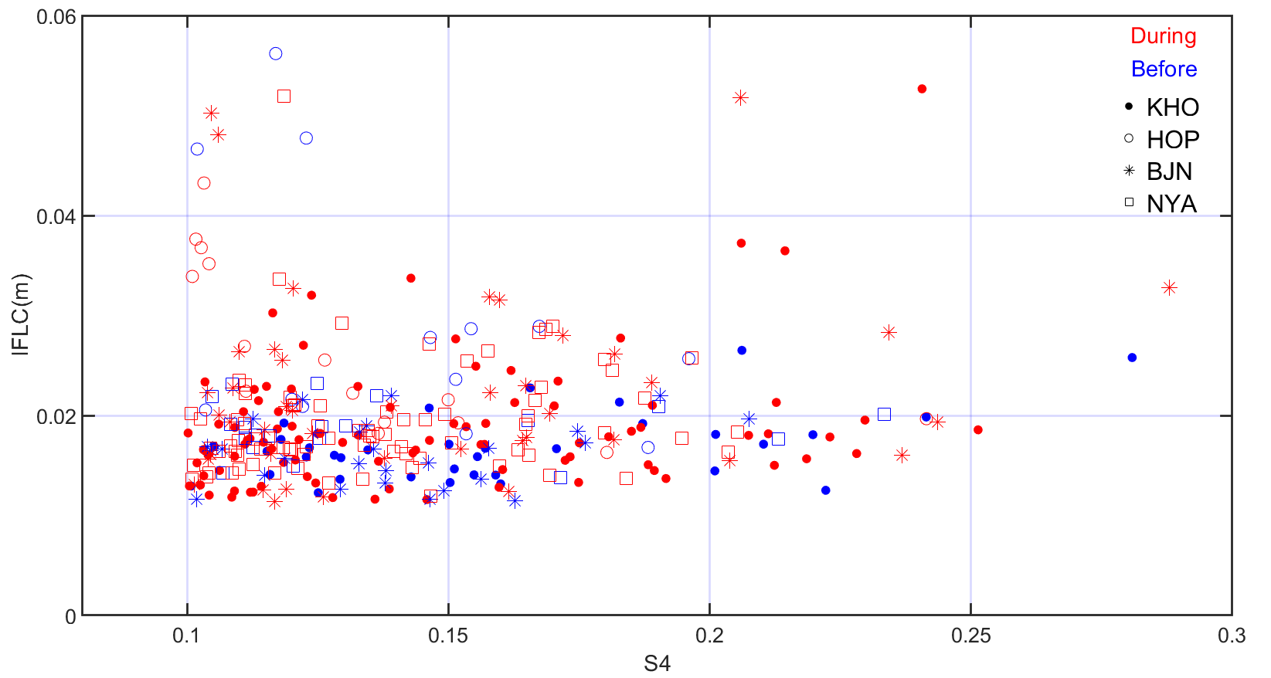
Results
Significant increase in IFLC during geomagnetic storms, but not for S4
The scintillation events before the occurrence of the geomagnetic storm presented in blue, during the geomagnetic storm presented in red.
Notes:
Therefore, we counted the data from all four stations and plotted the correspondence between IFLC and S4 for all scintillation events. We can see IFLC is not agree with S4, and significant increase in IFLC during the storm, but not for S4

Slide 8
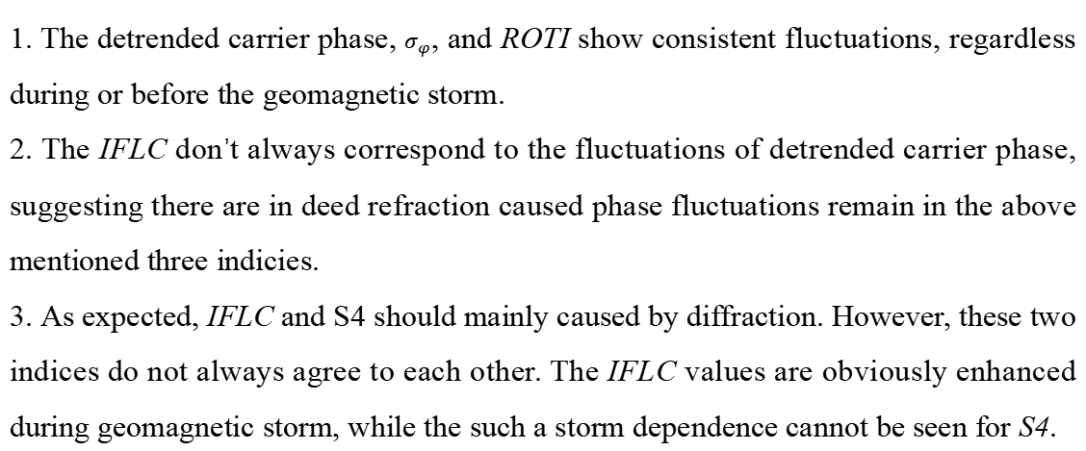
Summary
1. The detrended carrier phase, $σ_{φ}$, and ROTI show consistent fluctuations, regardless during or before the geomagnetic storm.
2. The IFLC don’t always correspond to the fluctuations of detrended carrier phase, suggesting there are in deed refraction caused phase fluctuations remain in the above mentioned three indicies.
3. As expected, IFLC and S4 should mainly caused by diffraction. However, these two indices do not always agree to each other. The IFLC values are obviously enhanced during geomagnetic storm, while the such a storm dependence cannot be seen for S4.
Notes:
This is our summary. The first is the detrended carrier phase, $σ_{φ}$, and ROTI show consistent fluctuations, regardless during or before the geomagnetic storm.
the second is that the IFLC don’t always correspond to the fluctuations of detrended carrier phase, and the third is that IFLC does not agree with S4

