Slide 1

Differential Learning: A method for polar motion time series prediction
Space Geodesy Group
Institute of Geodesy and Photogrammetry
Mostafa Kiani Shahvandi, Matthias Schartner, and Benedikt Soja
EGU General Assembly, May 27, 2022

Slide 2
Table of Contents
Polar motion time series prediction problem
Differential Learning method
Comparative analyses with other methods
Conclusions

Slide 3

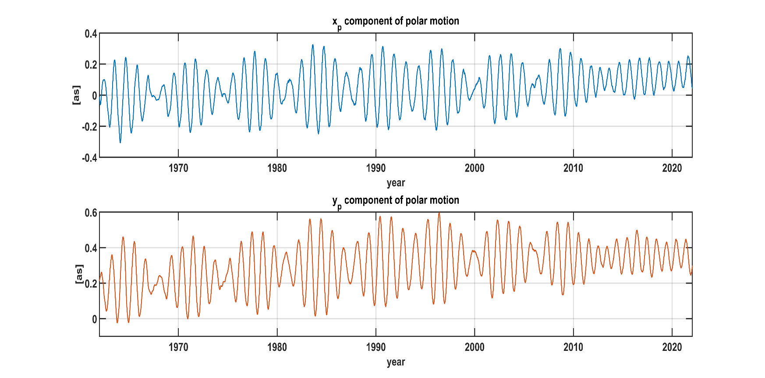
Polar motion time series prediction problem
Polar motion: changes in the earth's rotation axis with respect to the earth's surface, referred to a reference called Conventional Intermediate Pole (CIP)
Determined by different space-geodetic techniques, including Global Navigation Satellite Systems (GNSS)
Not constant!
Earth image from https://giphy.com/gifs/art-earth-speed-3ohhwgrL4KKPIZoTQY

Slide 4
Polar motion time series prediction problem
Polar motion: needed for space application, particularly those requiring transformation between geodetic and celestial coordinate systems
Navigation of spacecrafts
Orientation of deep-space telescopes
One major issue: final, most accurate data come with a latency of up to several days (or weeks)
However : the mentioned applications require instantaneous polar motion information
Solution: using predictions of polar motion
Requirement: predictions be as close as possible to the final polar motion data

Slide 5
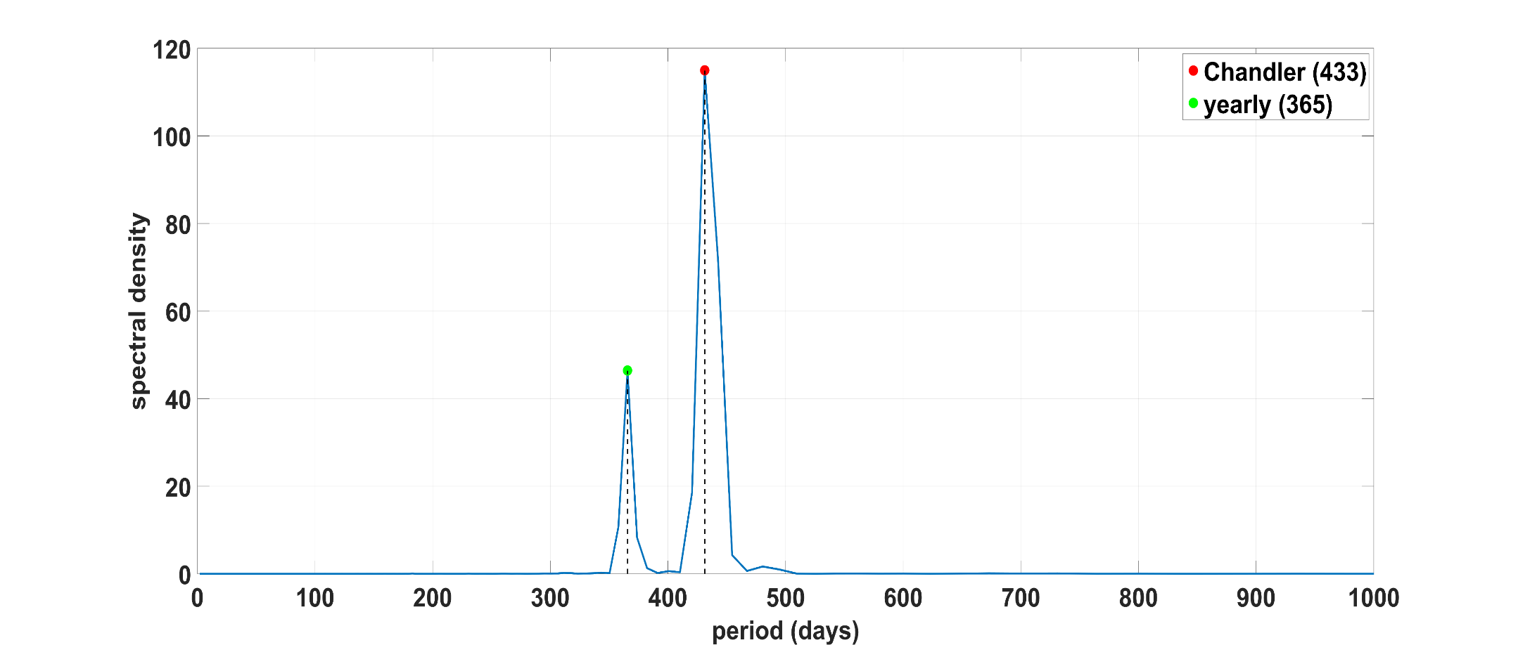
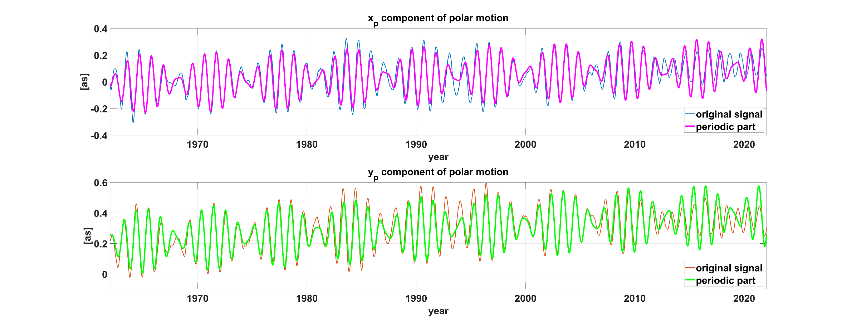
Polar motion time series prediction problem
Polar motion time series characteristics
Major deterministic, periodic signals (and trend)
Chandler (433) and yearly (365)
Basis for harmonic + autoregression models
Achieving best performance in the first Earth Orientation Parameters Prediction Campaign (EOPPCC)

Slide 6




Polar motion time series prediction problem
Polar motion time series characteristics
2. Relation to the Effective Angular Momentum (EAM) functions
Directly related to EAM via Liouville differential equation in complex domain (basis for the method conversion from EAM to polar motion)
Generally not separable in this differential equation → $x_{p},y_{p}$ are related
The main driving factor: Oceanic Angular Momentum (OAM)
Earth's pole region
CIP
$$y_{p}$$
Particle redistributed
Instantaneous pole position
Earth image from https://www.amnh.org/explore/ology/earth/what-is-earth
$$x_{p}$$

Slide 7
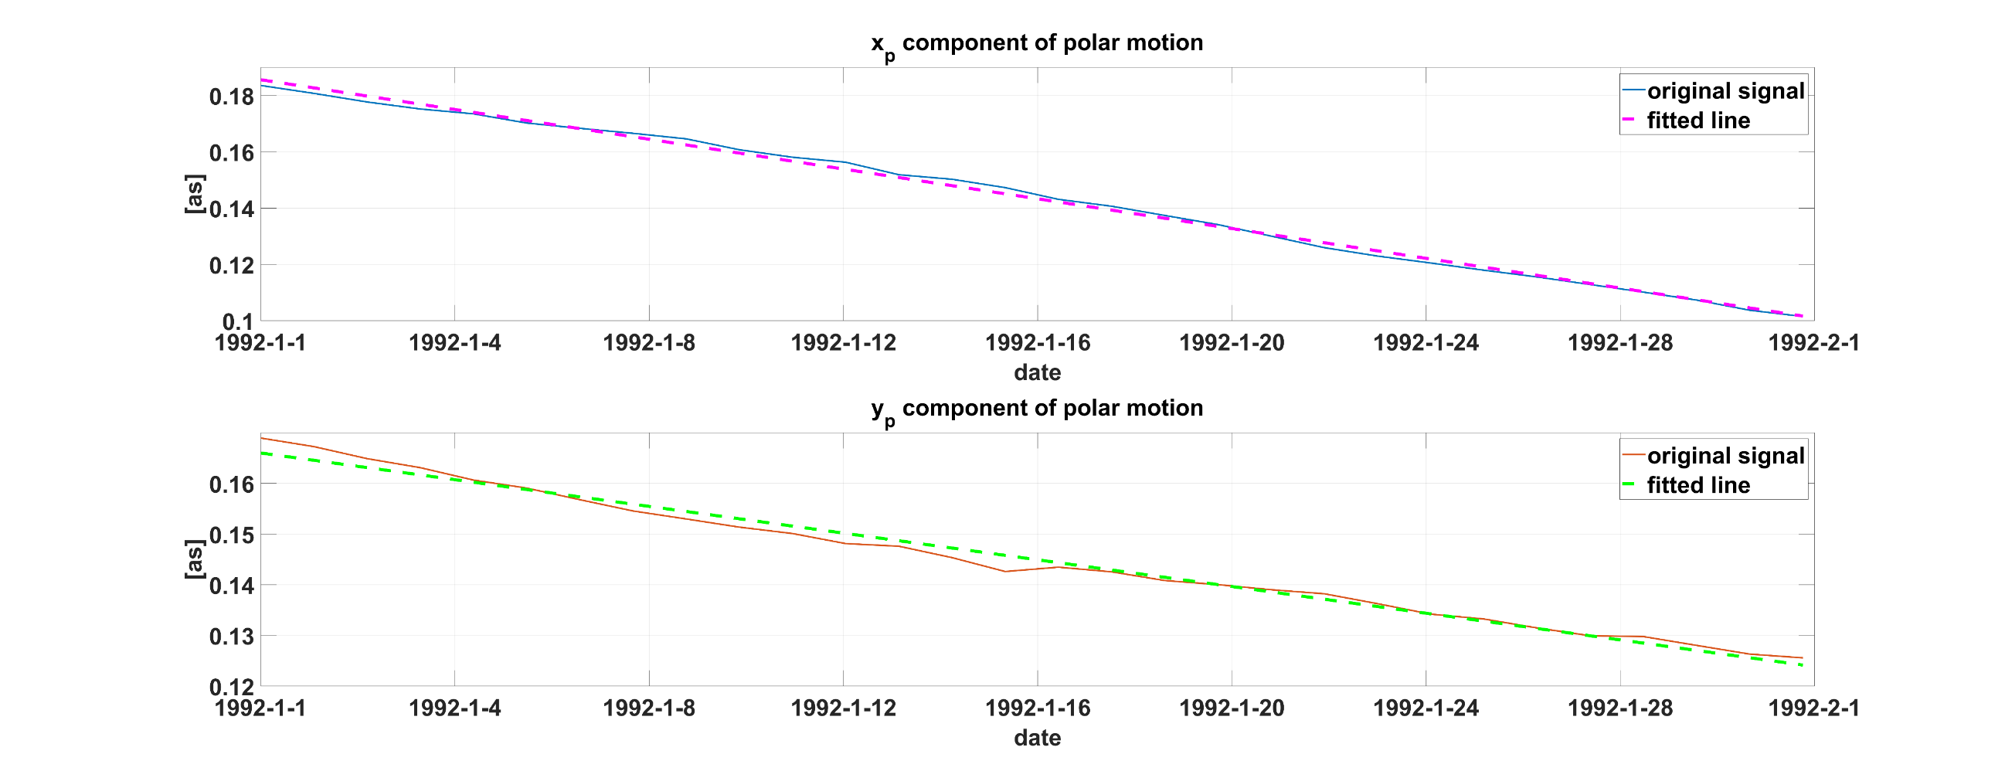
Polar motion time series prediction problem
Polar motion time series characteristics
3. Linearity in short time intervals
Measured through differentiation and fitting of a line
Suitability of linear models
Linear models for the prediction of polar motion work well

Slide 8
Differential Learning method
An appropriate method for polar motion prediction:
Learns the deterministic and stochastic parts (simultaneously)
Takes advantage of different sources of physical information
Selects the suitable model type (linear vs. nonlinear)
Differential Learning
Based on ordinary differential equations (ODE)
No preprocessing required
Using different sources of physical information
Different forms; linear and nonlinear
Dealing with unevenly-spaced time series: combination with Latent ODEs

Slide 9



Differential Learning method
$$y={\left\{y_{t}\right\}}_{t=1}^{N}$$
ODE of order $m$
$$\frac{d^{m}y}{dt^{m}}=f(t,y,y^{\left(1\right)},…,y^{\left(m−1\right)},X)$$
A parametric, neural network
Physical information (EAM, other EOPs)

Slide 10
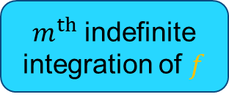
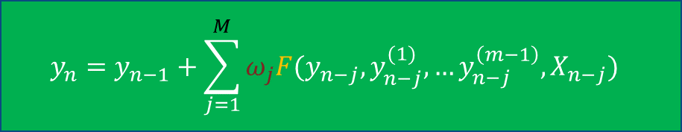
Differential Learning method
General solution
Based on successive integrals, approximation, and numerical integration
$$y_{n}=y_{n−1}+\sum_{j=1}^{M}{ω_{j}F(y_{n−j},}y_{n−j}^{(1)},…y_{n−j}^{\left(m−1\right)},X_{n−j})$$
Input sequence length
Linear weights
$m^{th}$ indefinite integration of $f$

Slide 11
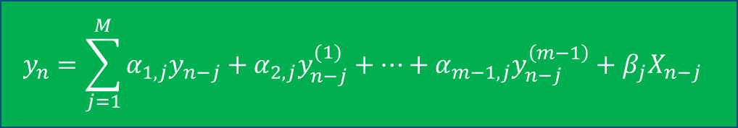
Differential Learning method
Linear Differential Learning
Based on linear form for the neural networks (Dense layers with linear activation functions)
$$y_{n}=\sum_{j=1}^{M}{α_{1,j}y_{n−j}+α_{2,j}y_{n−j}^{(1)}+…+α_{m−1,j}y_{n−j}^{\left(m−1\right)}+β_{j}X_{n−j} }$$
Combination with Latent ODEs possible
Feature importance analysis
Uncertainty propagation analysis

Slide 12
Comparative analyses with other methods
Analysis under the conditions of first EOPPCC
prediction horizon of 10 days (short-term)
time interval for training the model between September 1, 1996 and September 30, 2005
time interval for submitting the predictions from October 1, 2005 to December 31, 2008, every Thursday
possibility of using various data sources, such as EOPs, EAM, etc.
evaluation based on the IERS final EOP data
The best performing method in the first EOPPCC: harmonic analysis + autoregression
We use
Jet Propulsion Laboratory (JPL) polar motion series (containing rates)
EAM data from GFZ German Research Centre for Geosciences
Linear Differential Learning (DL) combined with Latent ODEs

Slide 13
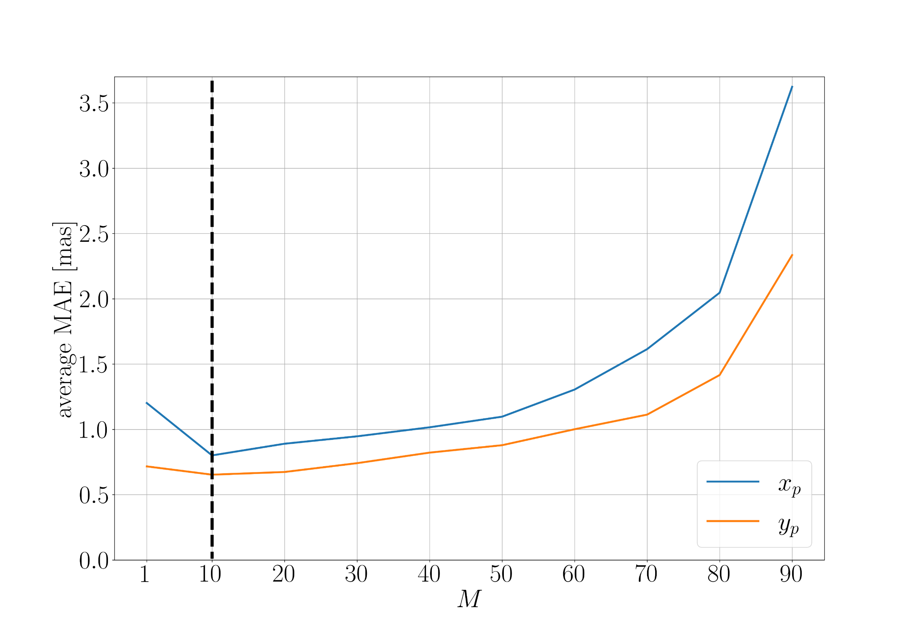

Comparative analyses with other methods
Investigation of the best input sequence length $M$
Based on a validation set (last 20% of the training set)
Empirically determine $M$ → which value for $M$ results in the best prediction performance on the validation set
Start from 1, increase incrementally
L$owest value of MAE for M=10$

Slide 14
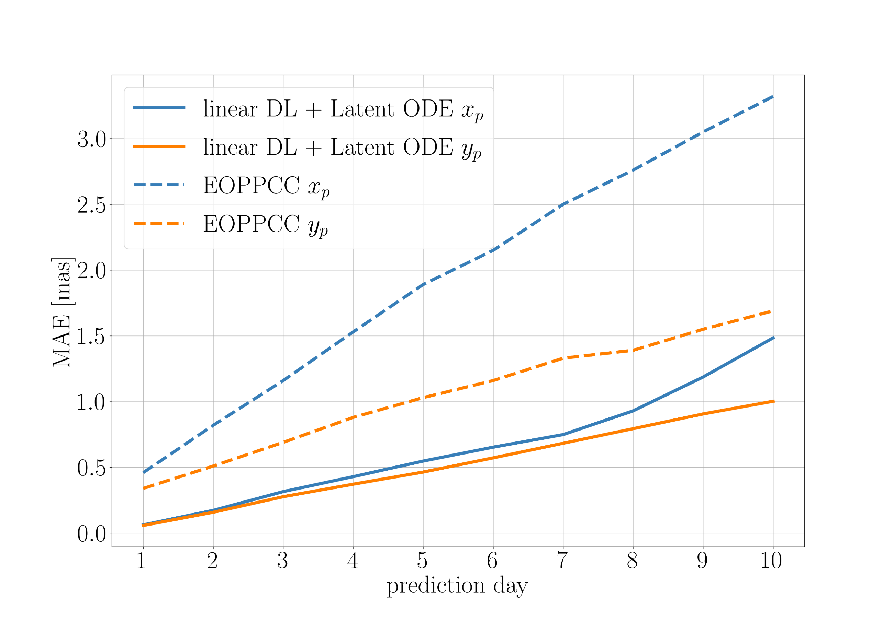
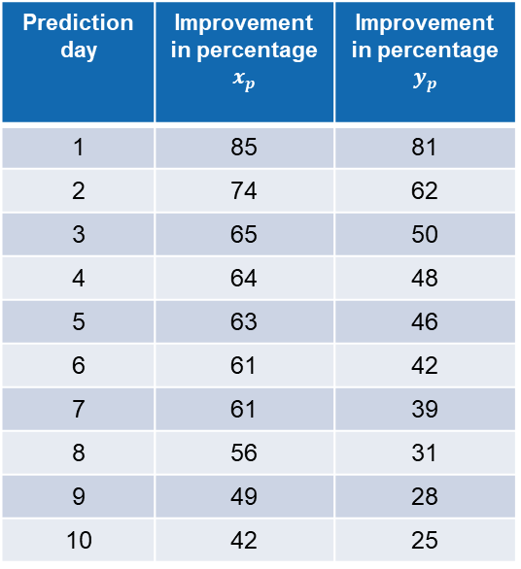
Comparative analyses with other methods
Prediction accuracy assessment based on Mean Absolute Error (MAE, in the milliarcseconds unit)
Prediction day | Improvement in percentage $x_{p}$ | Improvement in percentage $y_{p}$
1 | 85 | 81
2 | 74 | 62
3 | 65 | 50
4 | 64 | 48
5 | 63 | 46
6 | 61 | 42
7 | 61 | 39
8 | 56 | 31
9 | 49 | 28
10 | 42 | 25
Average improvement across both components | 53%

Slide 15
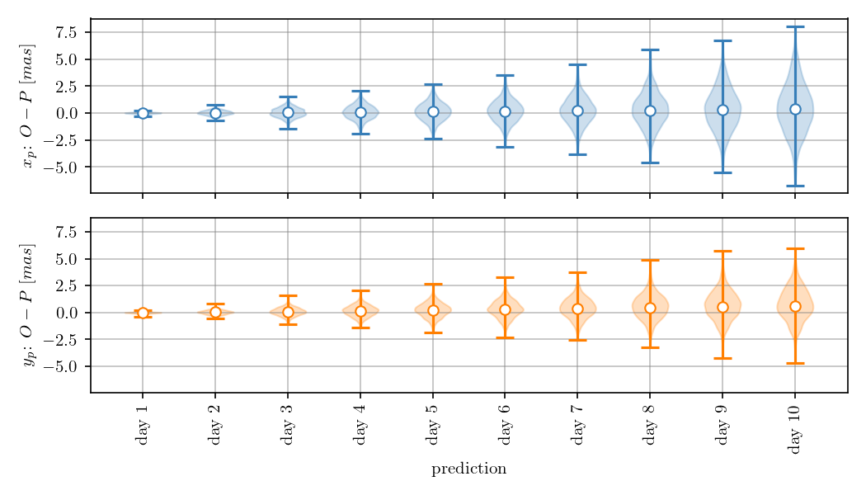
Comparative analyses with other methods
Distribution of residuals (observation minus prediction)
Gaussian distribution with increasing means
Higher standard deviations in later prediction days

Slide 16
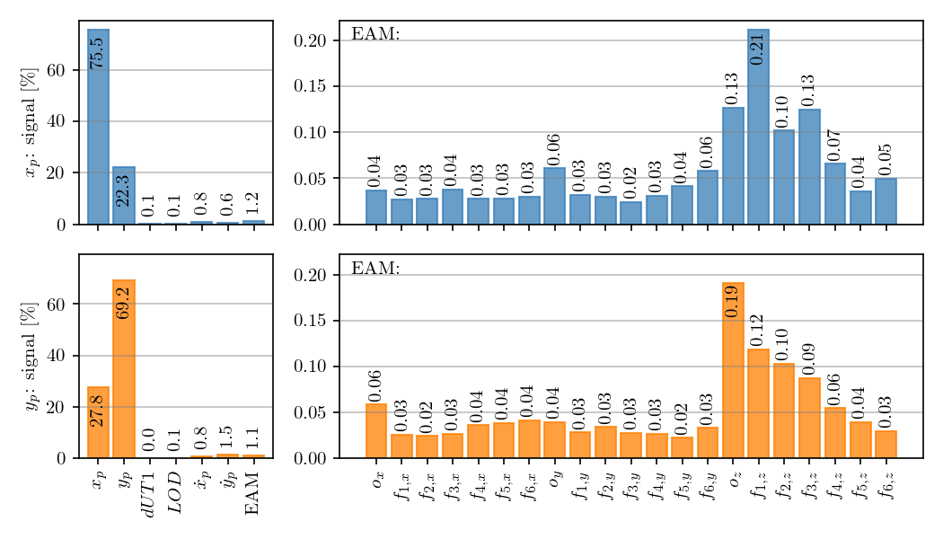

Comparative analyses with other methods
Analysis of the importance of the features
The most important features: $x_{p},y_{p}$ themselves, their rates, and EAM
The rates of polar motion: closely related to Geodetic Angular Momentum (GAM) functions

Slide 17
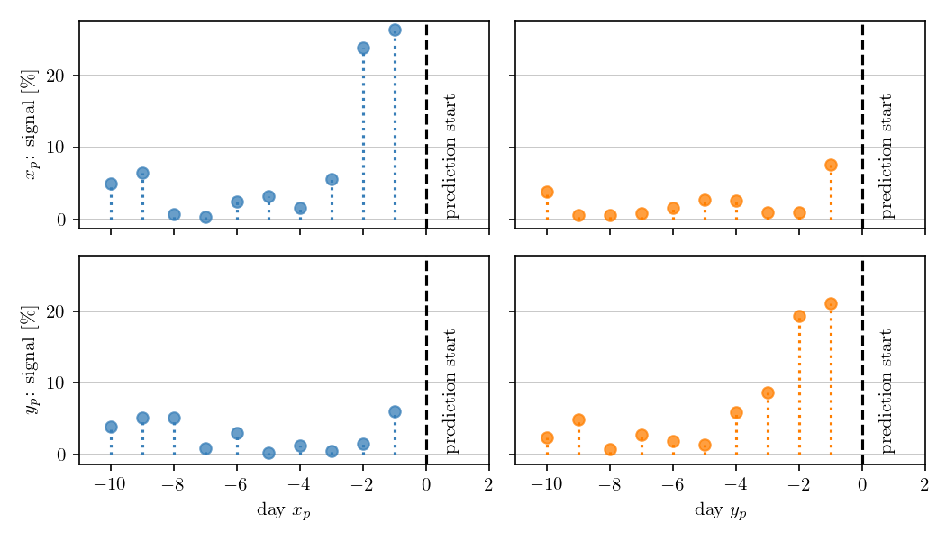

Comparative analyses with other methods
Analysis of the importance of the time steps in the input sequence
The last time step is the most important one
The penultimate time step is also important
Importance of last time step of $y_{p}$ for $x_{p}$ and vice versa

Slide 18
Conclusions
Polar motion time series has major deterministic signals; in addition, it displays stochastic parts
For polar motion phenomenon different physical information exist, the most important of which are the EAM functions
In short-term intervals, polar motion changes linearly, thus making linear models suitable for modelling and prediction of this time series
Differential Learning is a method for learning deterministic and stochastic parts simultaneously, taking advantage of different sources of physical information, including EAM functions
Linear Differential Learning combined with Latent ODEs achieves state-of-the-art accuracy compared to the best performing method in first EOPPCC, improving the results on average by approximately 53%

Slide 19
Mostafa Kiani Shahvandi, Matthias Schartner, Benedikt Soja
{mkiani,mschartner,soja}@ethz.ch
ETH Zürich
Space Geodesy Group,
HPV G51, G56, G54
Robert Gnehm Weg 15
8093 Zürich, Switzerland
www.space.igp.ethz.ch

