Slide 1

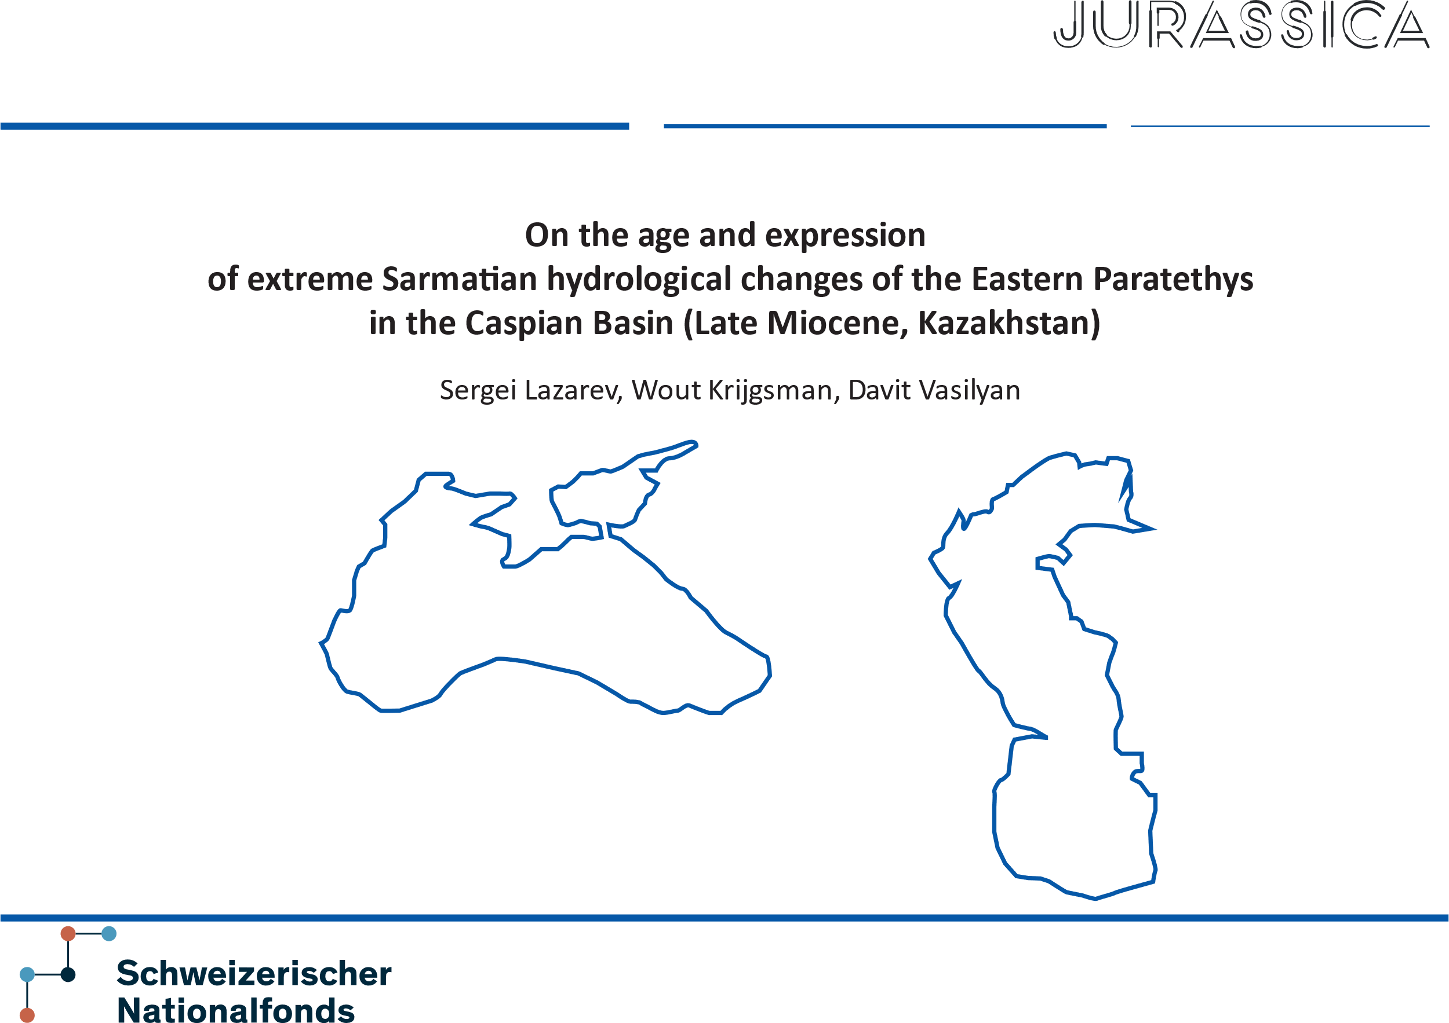
This study is financed by the Swiss National Science Foundation
Project number 200021_197323

Slide 2
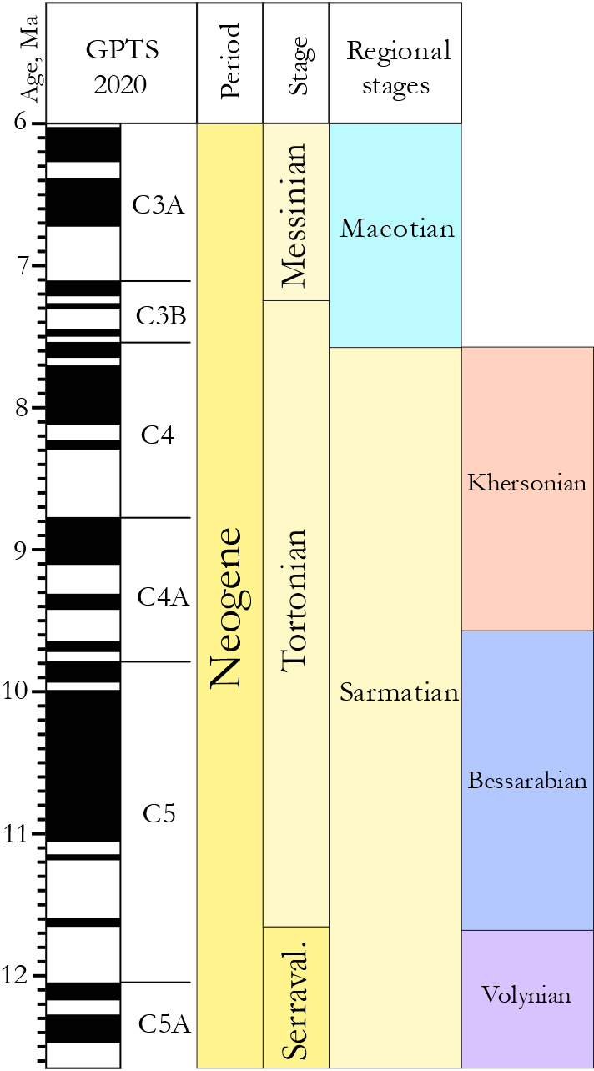

Eastern Paratethys in the late Miocene
The Sarmatian Stage (12.65 – 7.65 Ma) marks:
Hydrological isolation of the EP from the global ocean;
Disruption of the basin water budget leading to extreme
fluctuations of the water level;
Adaptation, radiation and extinction of Sarmatian ecosystems including groups such as whales, dolphins, molluscs, microfauna etc.
Notes:
Introduction.
Eastern Paratethys. Is an epicontinental Sea….
In the latest Midlde Miocene, Eastern Paratethys went isolated… It happened during so-called Sarmatian Stage.

Slide 3
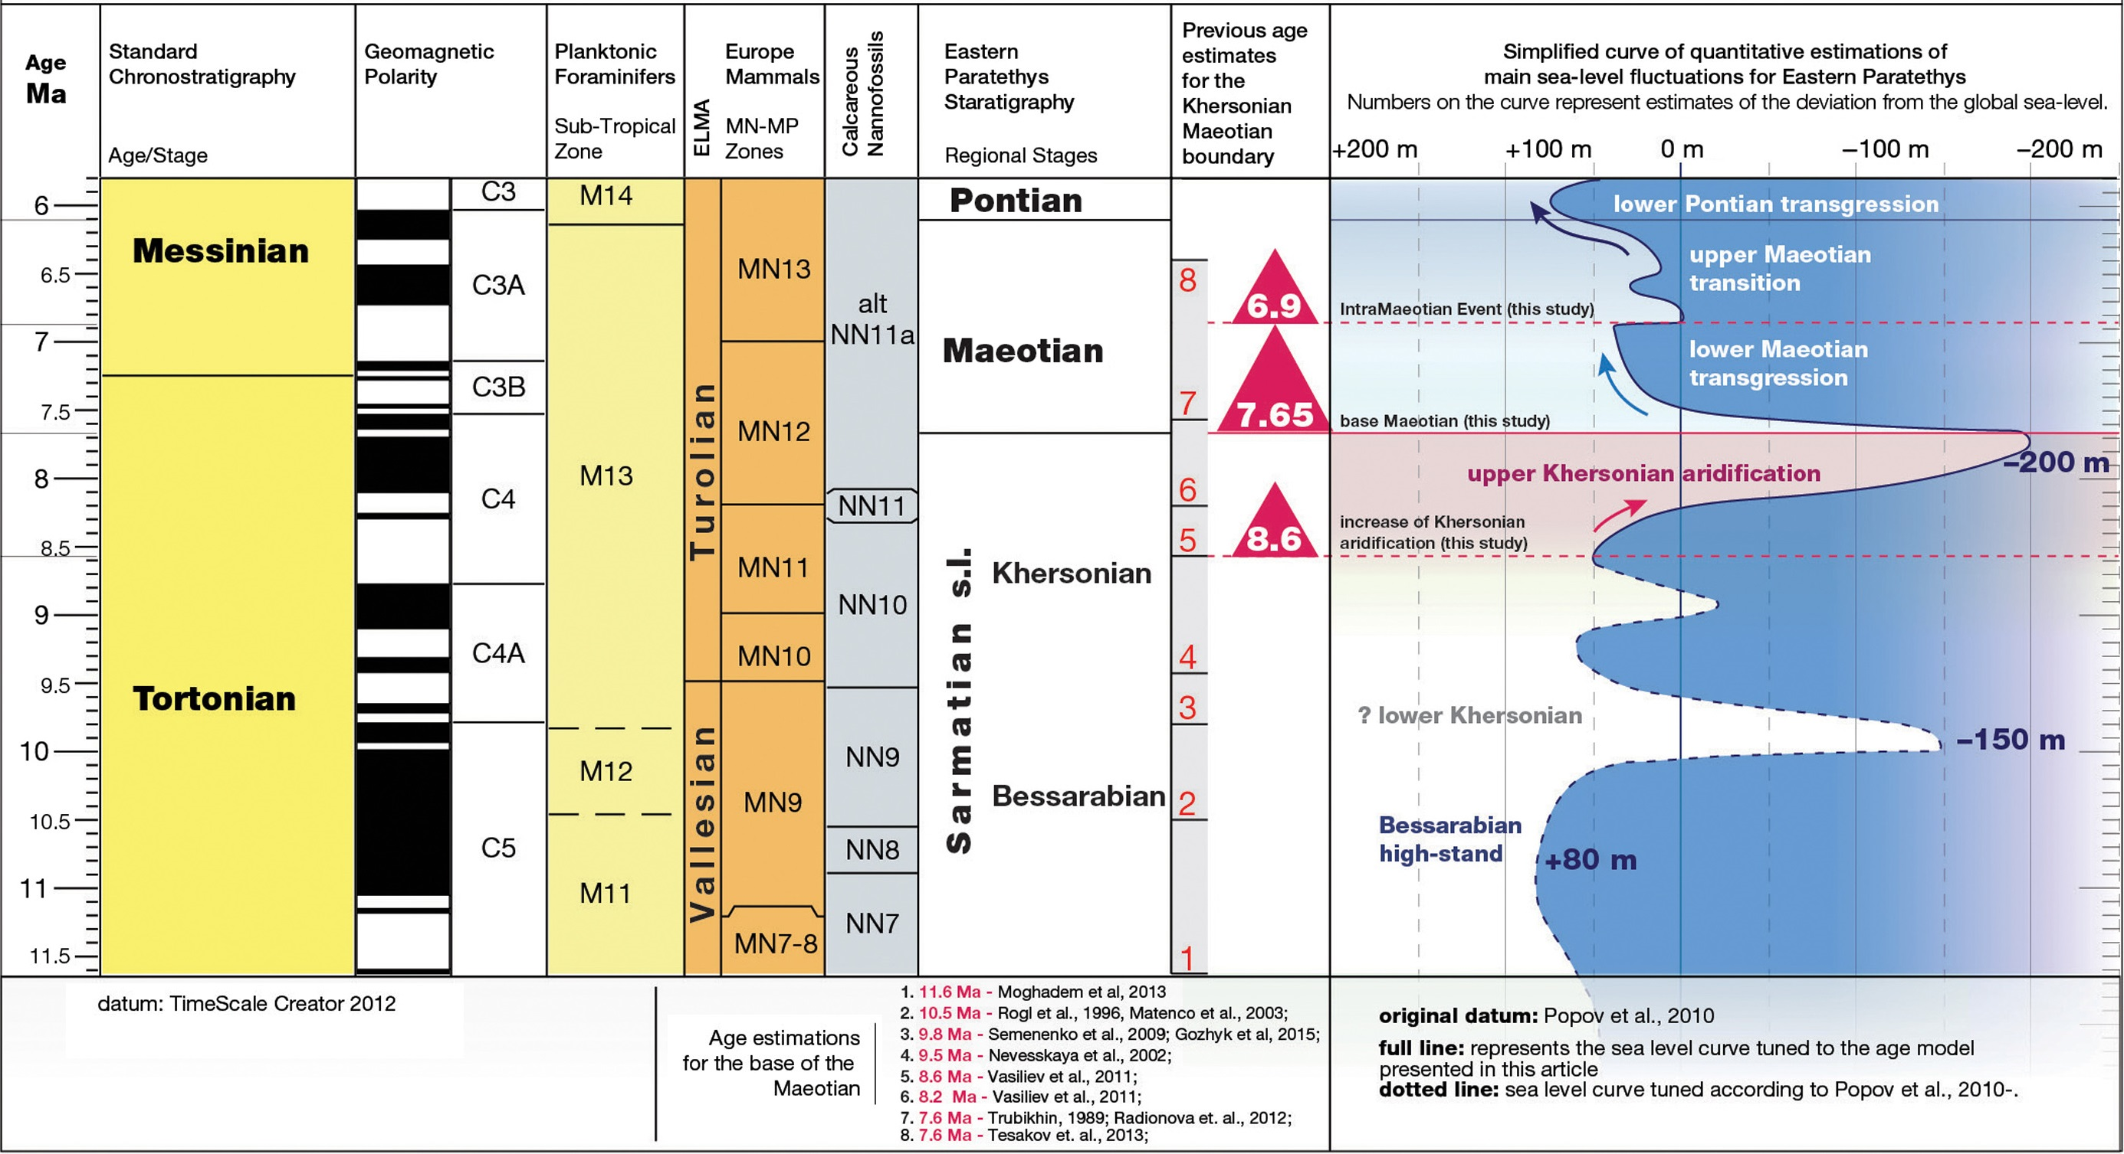
Eastern Paratethys in the late Miocene
(Palcu et al., 2018)
No solid age constraints are yet available for Sarmatian substages
Little understanding of drivers of
palaeoecological crisis and water-level
fluctuations;
Very limited number of suitable outcrops
and no well-studied sections
in the Caspian Basin;
Important case study for modern shrinking of endorheic basins across the globe.
Notes:
Introduction.
Eastern Paratethys. Is an epicontinental Sea….
In the latest Midlde Miocene, Eastern Paratethys went isolated… It happened during so-called Sarmatian Stage.

Slide 4
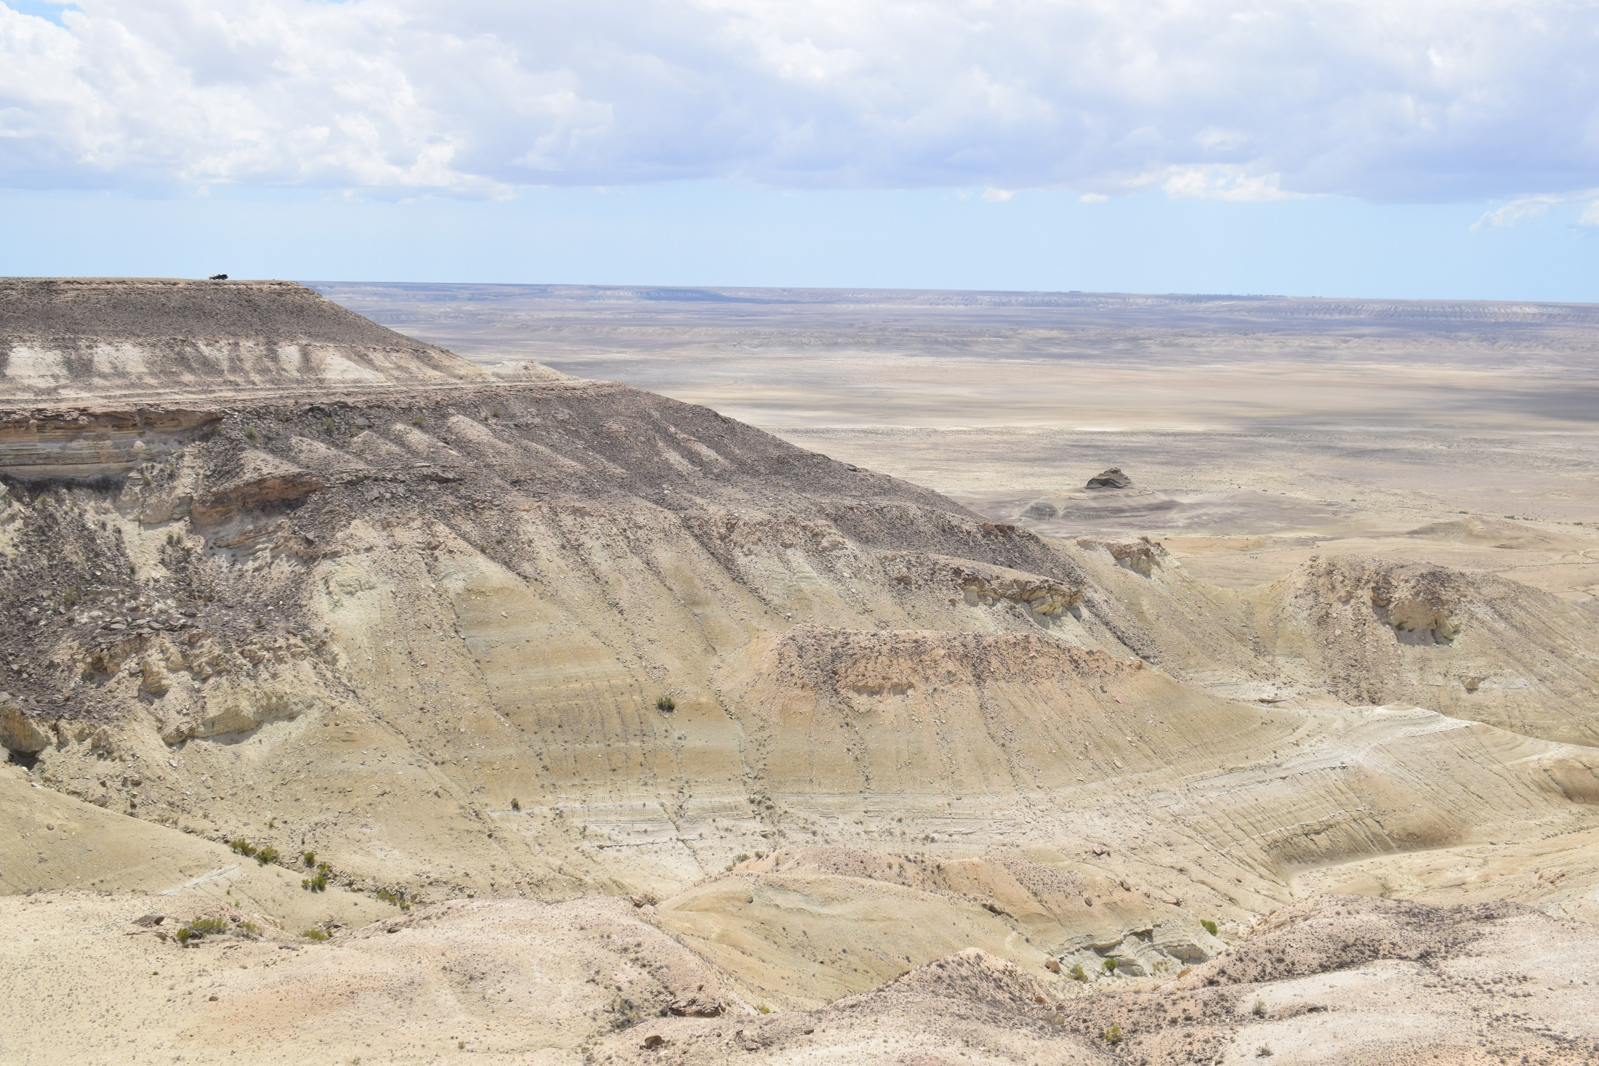

Karagiya Depression, Studied outcrop
Maeotian
Khersonian
Bessarabian
Volynian
Konkian
Oligocene

Slide 5
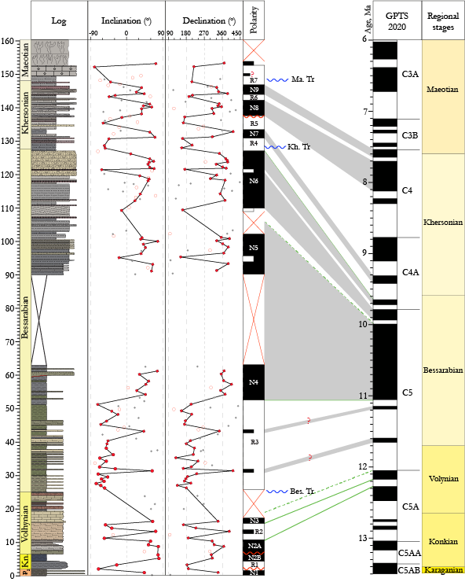
Preliminary age conclusions:
Early Sarmatian (Volynian) is incomplete and comprises an interval between 12.4 and 12.1 Ma.
Bessarabian begins as a remarkable transgression event, which has an age ~11.6 – 11.7 Ma (C5r.2r - C5r.3r) ;
Khersonian begins also as a small-scale transgression, dated at 9.6 Ma (chron C4Ar.2r) and has a time gap of 1 My between 9.1 and 8.1 Ma .
Maeotian transgression on top of Khersonian paleosoils has an age of 7.5 Ma (chron C3Br.3r).
Notes:
Results 2

Slide 6
Further steps
Paleomagnetic age constraints:
still need to be slightly improved;
will soon be accompanied by detailed biostratigraphic data (ostracods, foraminifera and molluscs);
enable further paleoclimatic and palaeoecological analyses.

Slide 7
Thank you for you attention!
This study is financed by the Swiss National Science Foundation
Project number 200021_197323

