Slide 1
Energization of Alpha Particles in the Solar Wind Magnetic Reconnection
Die Duan¹, Jiansen He¹, Xingyu Zhu¹, Rui Zhuo¹, Georgios Nicolaou^{2,3}, Ziqi Wu¹, Liu Yang⁴, SolO/SWA, SolO/MAG
1. School of Earth and Space Sciences, Peking University, China
2. Southwest Research Institute, USA
3. Mullard Space Science Laboratory, University College London, UK
4. Institut für Experimentelle und Angewandte Physik, Christian-Albrechts-Universität zu Kiel, Germany
EGU22-11028 on NP 6.3
May 27, 2022

Slide 2
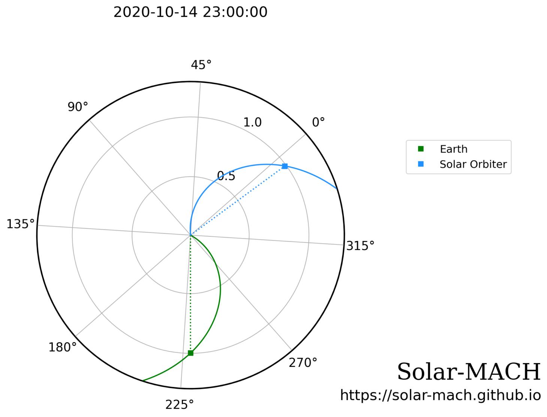
Solar Orbiter (SolO) passes a magnetic exhaust region in the solar wind on Oct 14, 2020 near 1 AU
~120° away from the Earth-Sun line
SolO Measurements:
MAG – magnetic field, 8 Hz
PAS – proton and alpha particle, 0.25 Hz
EAS – electron, 0.01 Hz

Slide 3
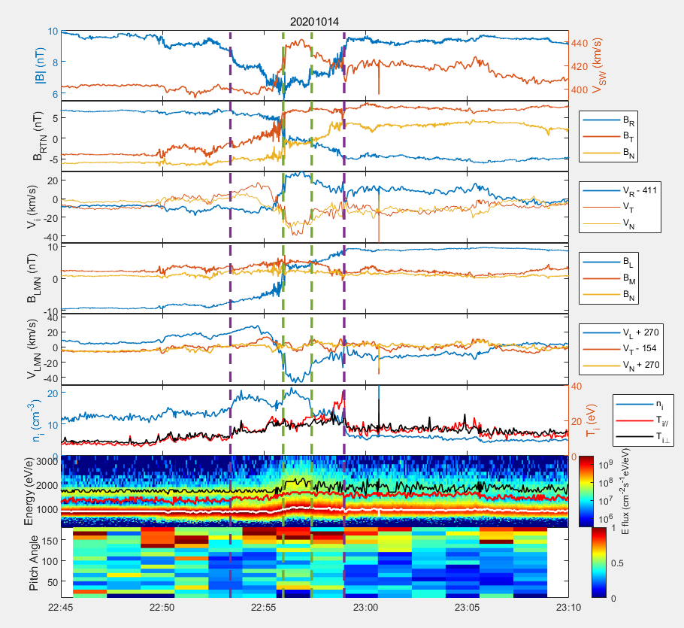
Petschek-like switch-off slow shock/ rotational discontinuity (SO-SS/RD) compound structures (Innocenti et al. 2017)
Reconnection Jet bounded by two
Rotational Discontinuities
Exhuast Region bounded by two slow shocks
Both of protons (p) and alpha particles (α) are heated and accelerated in the exhaust region
Reconnection Jet
Bifurcated Current Sheet
1D ion spectra
White line: peak of proton, Red line: local minimum
Black line: peak of alpha particle
70 eV electron nomarlized
pitch angle distribution (0.01 Hz)

Slide 4
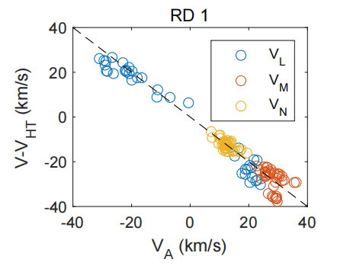
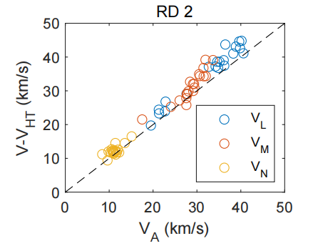
Discontinuity Identification
Walen Test of RD: Good Agreement

Slide 5
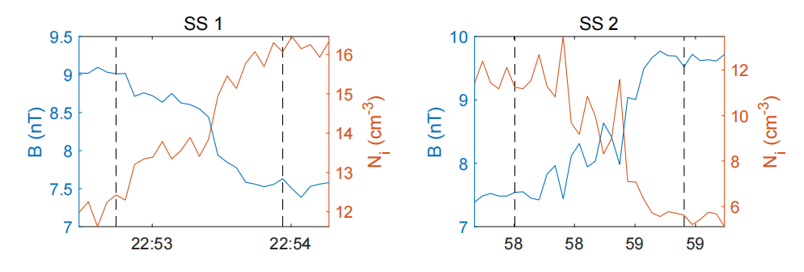
Discontinuity Identification
Shock Fitting of Slow Shocks (Koval and Szabo, 2008):
Two quasi-perpendicular slow shocks
downstream
upstream
upstream
downstream
SS | V_{n,up}/C_{slow} | V_{n,down}/C_{slow} | n direction (RTN) | theta(B_{up},n) | V_{shock}
SS 1 | 1.3 | 0.9 | (0.85,0.33,0.42) | 75° | 352 km/s
SS 2 | 1.1 | 0.5 | (0.72,0.26,0.64) | 60° | 296 km/s

Slide 6
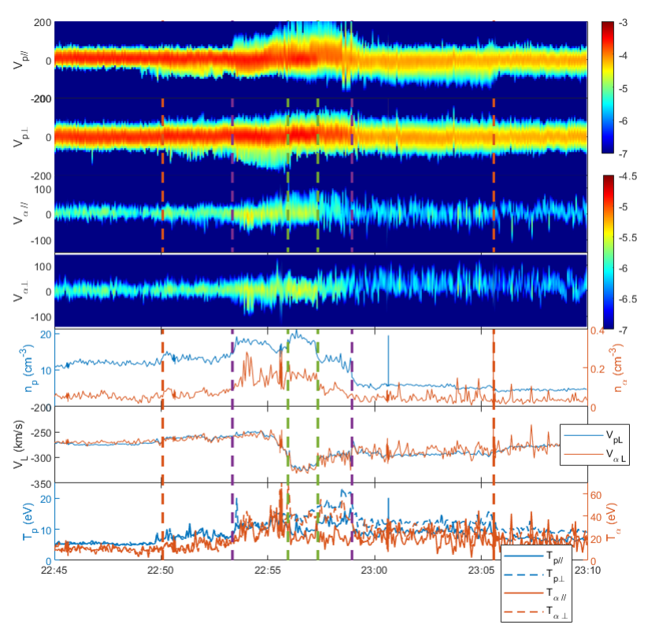
Particle Acceleration and Heating
Log₁₀ 1D proton
VDF // and ⊥
(1) p and αaccelerate to the same speed along L-direction in the
reconnection jet
(2) p and α are heated strongly along
perpendicular direction than parallel
direction in the exhaust region
Log₁₀ 1D α particle
VDF // and ⊥
n_{p}, n_{α}

Slide 7
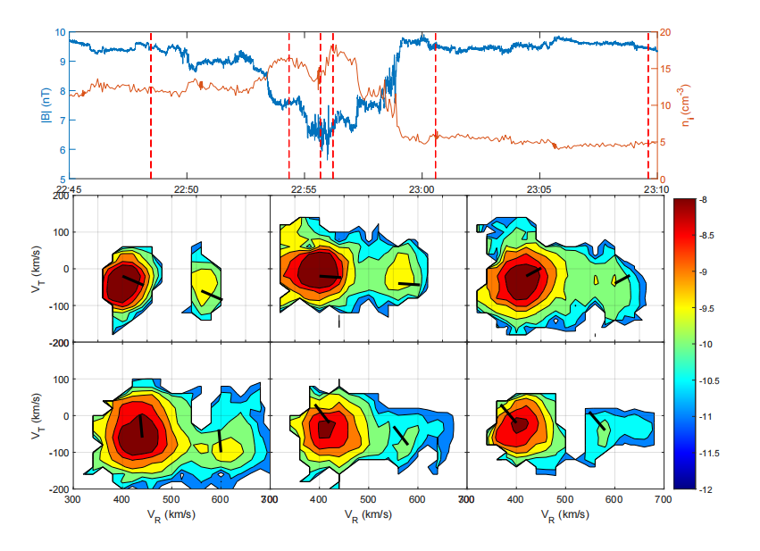
Log₁₀ ion PSD in R-T plane measured by SWA-PAS
1
2
3 4
5
6
Outside the exhaust region (1,6):
p and α are clearly separated
Inside the exhaust region (2,3):
α shows double peaks along the B
direction
Inside the reconnection jet (4):
α shows double peaks perpendicular to the B direction
The double peak of α distribution could sustain at some distance from the exhaust region (5)
p
1
α
2
3
4
5
6
Black line:B direction

Slide 8
Summary
Observe a clear Petschek-like switch-off slow shock/ rotational discontinuity (SO-SS/RD) compound structures in the solar wind reconnection by SolO
Proton and alpha particles are accelerated to the same speed in the reconnection jet
Alpha particles show double peak along the B direction in the downstream of the slow shock, but show double peak perpendicular to the B direction in the reconnection jet

