Slide 1

Characteristics of sun-induced fluorescence in monocot and dicot crop patches with different NDVI and canopy closure
hungarian university of agriculture and life sciences:
Ádám Mészáros, Szilvia Fóti, János Balogh, Krisztina Pintér, Zoltán Nagy, and Kristóf Bene
2022.05.24

Slide 2

Introduction
Monitoring plant production and health:
Remote sensing
Sun-induced chlorophyll fluorescence
O2-B band at 687 nm and O2-A band at 760.4 nm [Meroni et al., 2009]
Satellites designed for atmospheric studies [Joiner et al., 2013]
Strong relations with :
Actual plant photosynthesis
Leaf Area Index (LAI)
Leaf chlorophyll concentration and leaf inclination distribution [Rossini et al., 2016]
GPP [Cheng et al., 2013]

Slide 3
Methods
Field measurements:
5 patches in crop fields
(winter wheat and sunflower)
LAI
SIF
Vegetation indices (NDRE, PRI, FCVI, MTCI, WI)
Chlorophyll and carotenoid content
Lab measurements:
Winter wheat and sunflower in different:
nutrient solutions (Full, N10, N50, N150)
stress conditions (PEG100, PEG200, Heat)
Photosynthetic activity (PN, Evap)
Fluorescence parameters (Rfd, Fs)

Slide 4
Results
 | LAI | SIF A | SIF B | PRI | Pigment
Patch 1 | 1.982 (±0,34) | 1,02 (±0,22) | 0,64 (±0,16) | -0,045 (±0,024) | 43,86 (±8,98)
Patch 2 | 4.01 (±0,92) | 1,71 (±0,16) | 0,41 (±0,12) | 0,002 (±0,015) | 59,17 (±7,24)
Patch 3 | 2.584 (±0,34) | 1,12 (±0,2) | 0,5 (±0,08) | -0,023 (±0,008) | 53 (±2,79)
Patch 4 | 4.31 (±0,25) | 1,71 (±0,17) | 0,34 (±0,09) | 0,007 (±0,006) | 60,2 (±1,61)
Patch 5 | 5.328 (±0,32) | 1,99 (±0,28) | 0,4 (±0,04) | 0,019 (±0,003) | 65,46 (±4,1)
Field measurements (2020): winter wheat

Slide 5
Results
 | LAI | SIF A | SIF B | PRI | Pigment
Patch 1 | 2,65 (±0,41) | 2,3 (±0,28) | 1,3 (±0,13) | 0,0022 (±0,006) | 64,04 (±3,96)
Patch 2 | 4,93 (±0,39) | 2,1 (±0,24) | 1,22 (±0,13) | 0,0014 (±0,003) | 64,6 (±2,43)
Patch 3 | 3,86 (±0,81) | 2,16 (±0,32) | 1,33 (±0,15) | 0,003 (±0,008) | 68,18 (±3,39)
Patch 4 | 3,07 (±0,62) | 2,02 (±0,5) | 1,27 (±0,29) | -0,004 (±0,003) | 66,32 (±3,5)
Patch 5 | 4,53 (±0,58) | 2,12 (±0,42) | 1,33 (±0,24) | 0,0046 (±0,009) | 67,96 (±5,18)
Field measurements (2021): sunflower

Slide 6
Results
Lab measurements: winter wheat
Lab measurements: sunflower

Slide 7
Conclusion
Connecting different NDVI with
LAI
Vegetation indices (PRI, MTCI)
SIF values
Pigment content
Evaporation rate
Flourescence emission is lower in healty and green patches
Succesfully simulated drought stress → Higher Fs, and lower evaporation rate
Heat-stressed plants showed increased photosynthetic activity

Slide 8
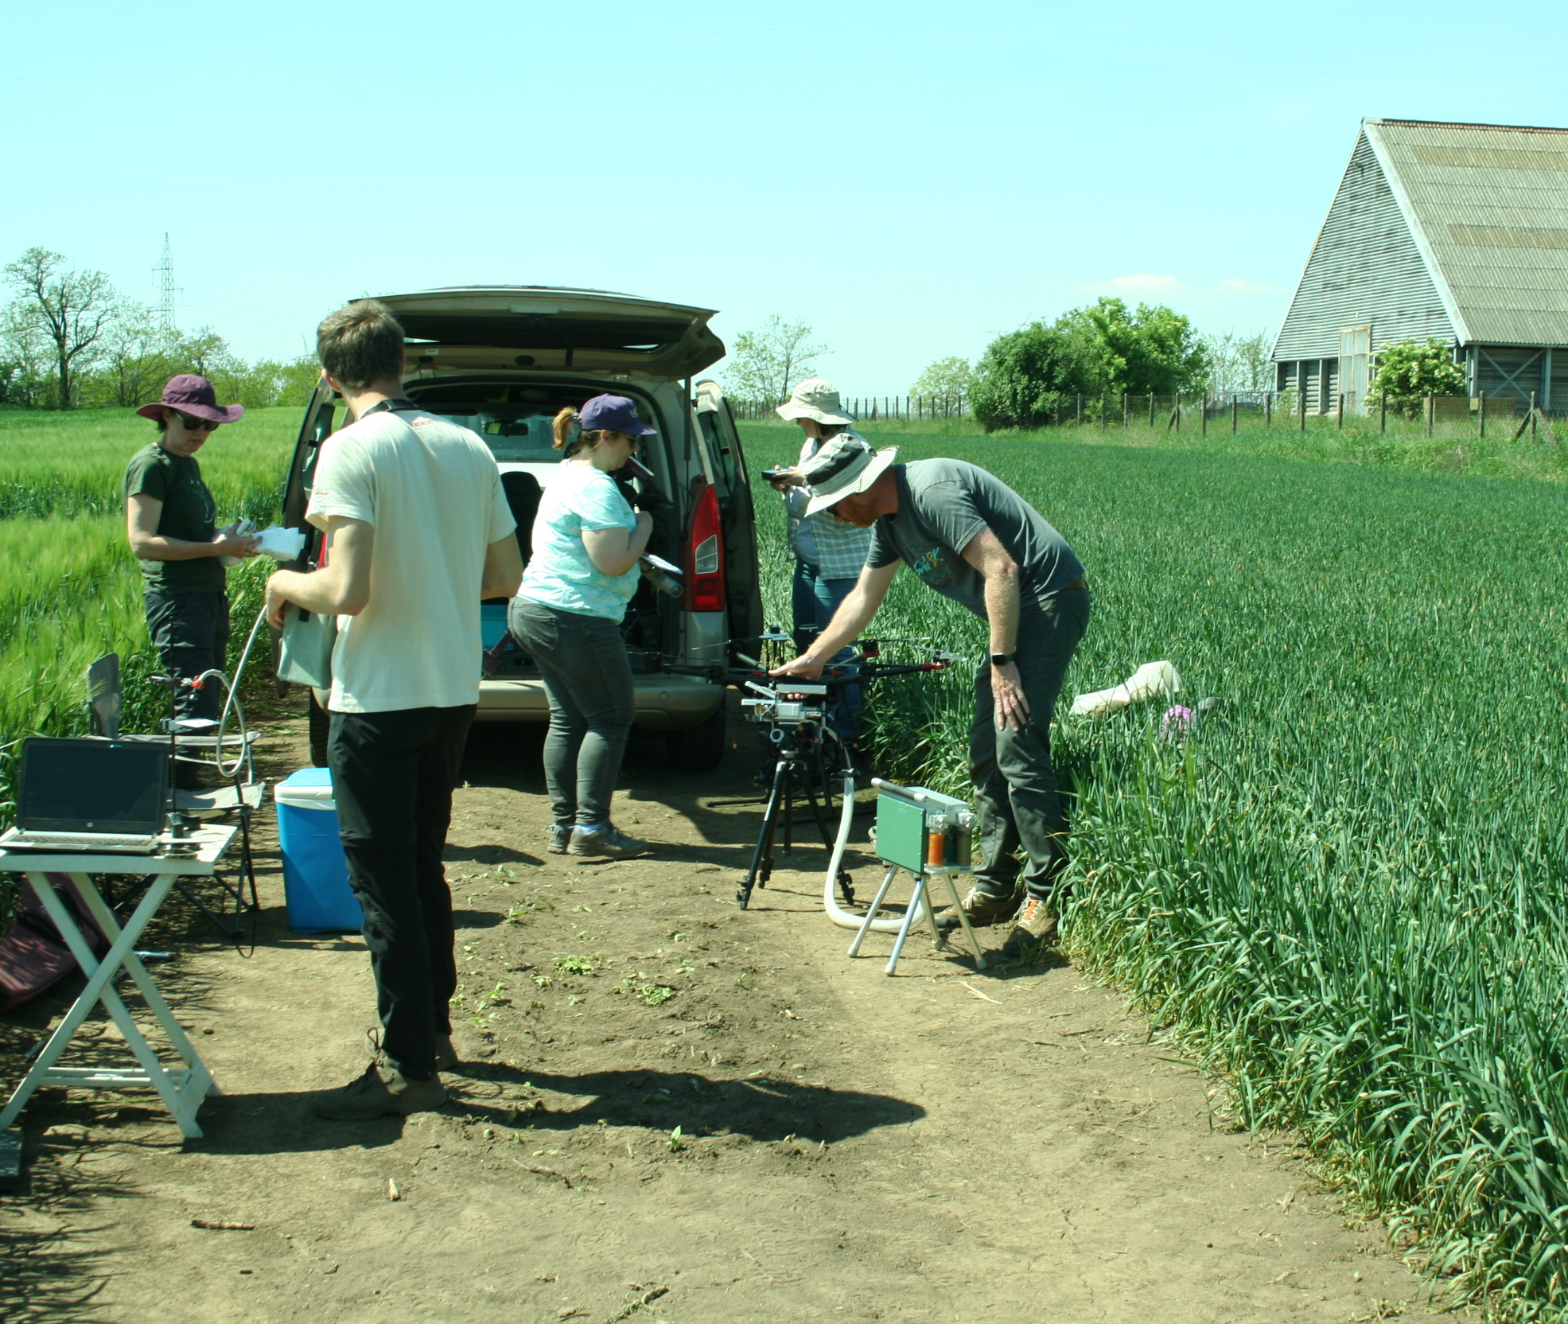
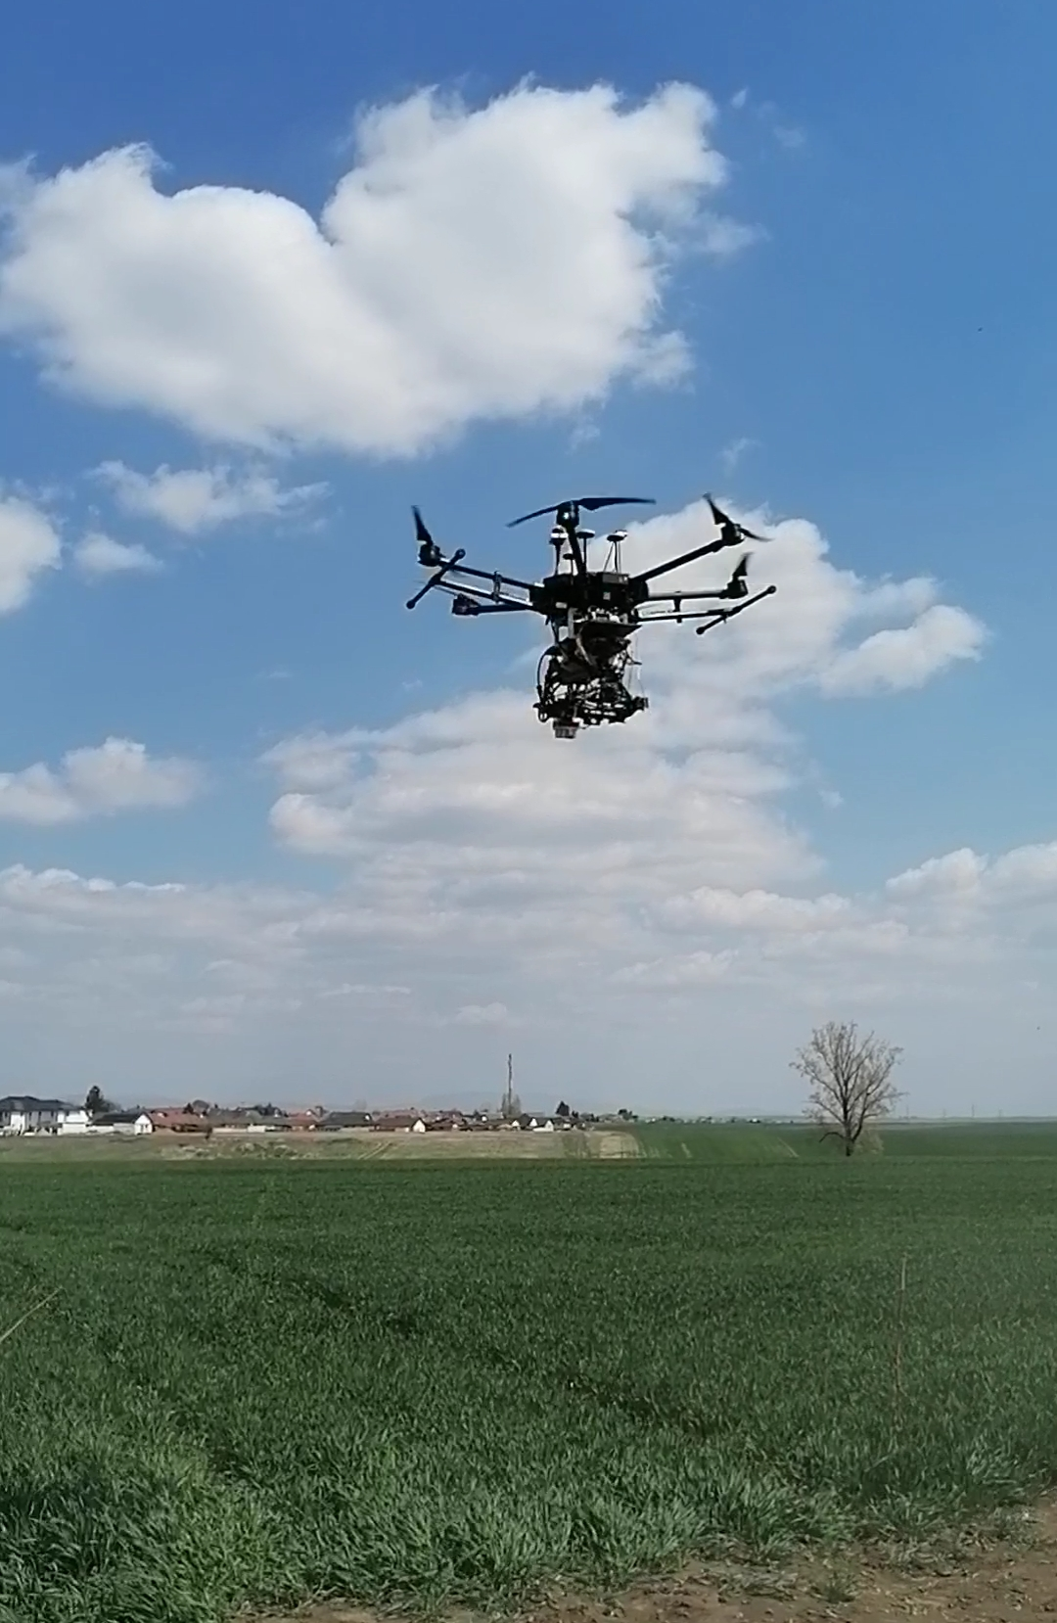
Thank you for your attention!

Slide 9
References
Meroni, M.; Rossini, M.; Guanter, L.; Alonso, L.; Rascher, U.; Colombo, R.; Moreno, J. Remote sensing of solar-induced chlorophyll fluorescence: Review of methods and applications. Remote Sens. Environ. 2009, 113, 2037–2051.
Joiner, J.; Guanter, L.; Lindstrot, R.; Voigt, M.; Vasilkov, A.P.; Middleton, E.M.; Huemmrich, K.F.; Yoshida, Y.; Frankenberg, C. Global monitoring of terrestrial chlorophyll fluorescence from moderate-spectral-resolution near-infrared satellite measurements: Methodology, simulations, and application to GOME-2. Atmos. Meas. Tech. 2013, 6, 2803–2823.
Rossini, M.; Meroni, M.; Celesti, M.; Cogliati, S.; Julitta, T.; Panigada, C.; Rascher, U.; van der Tol, C.; Colombo, R. Analysis of Red and Far-Red Sun-Induced Chlorophyll Fluorescence and Their Ratio in Different Canopies Based on Observed and Modeled Data in Remote Sensing 2016, 8, 412, 1-16
Cheng, Y.-B.; Middleton, E.M.; Zhang, Q.; Huemmrich, K.F.; Campbell, P.K.; Cook, B.D.; Kustas, W.P.; Daughtry, C.S. Integrating Solar Induced Fluorescence and the Photochemical Reflectance Index for Estimating Gross Primary Production in a Cornfield. Remote Sens. 2013, 5, 6857–6879.

Slide 10
Additional tables
 | Fs | Evap | MTCI | PRI
Control | 131,47 (±19,72) | 2,76 (±1,37) | 2,45 (±0,43) | 0,05 (±0,017)
PEG100 | 136 (±20,5) | 1,67 (±0,59) | 2,3 (±0,5) | 0,043 (±0,014)
PEG200 | 143,5 (±14,5) | 0,66 (±0,62) | 2,52 (±0,51) | 0,037 (±0,015)
Heat | 106,5 (±39,14) | 2,36 (±0,93) | 2,17 (±0,46) | 0,044 (±0,019)
 | Fs | Evap | MTCI | PRI
Control | 93,17 (±8,15) | 0,883 (±0,64) | 4,3 (±1,39) | 0,005 (±0,03)
PEG100 | 94,6 (±8,64) | 0,074 (±0,038) | 1,8 (±1,1) | -0,04 (±0,03)
PEG200 | 109,2 (±24,7) | 0,05 (±0,04) | 2,65 (±1,72) | -0,04 (±0,04)
Heat | 90,88 (±19,04) | 0,77 (±1,09) | 3,68 (±1,2) | 0,009 (±0,2)
Lab measurements: winter wheat
Lab measurements: sunflower

