Slide 1
Learned Probabilistic Post-processing of Ensemble Precipitation & 2m Temperature forecasts
—
Climate data discovery & prediction | Accelerated discovery
Akram Zaytar, Bianca Zadrozny, Campbell Watson, Daniel Salles Civitarese, Etienne Eben Vos, Thabang Michael Mathonsi, and Thabang Lukhetho Mashinini.

Slide 2
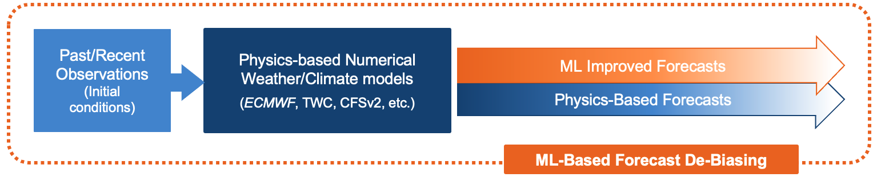
Introduction: Learned ECMWF Postprocessing
Goal: Provide global (.4 deg) & daily probabilistic forecasts of “t2m” and “tp”.
Data Sources: input features & targets were collected using the data archive set by the S2S AI challenge.
Input Features: spatiotemporal (latitude, longitude, target day of year, horizon day); ECMWF anomalies for t2m and tp; recent climatology (characterized by estimated distribution parameters).
Method: natural gradient boosting.
Spatiotemporal Training/Evaluation Domain: global-scale re-forecasts & targets for 20 years (2000 to 2020).
Baselines: debiased ECMWF & reconstructed CPC-based (recent) climatology.
Figure 2: Our models augment State-of-the-Art dynamical forecasts using advanced ML algorithms to uncover new windows of predictability.

Slide 3

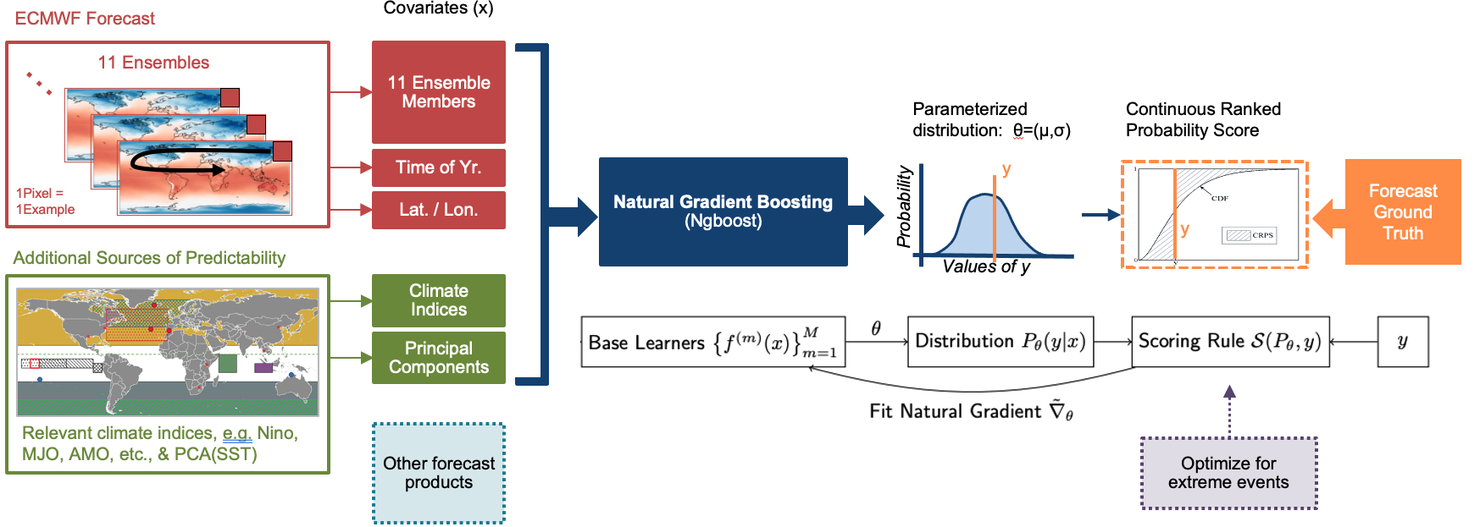
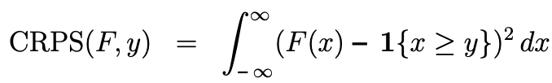
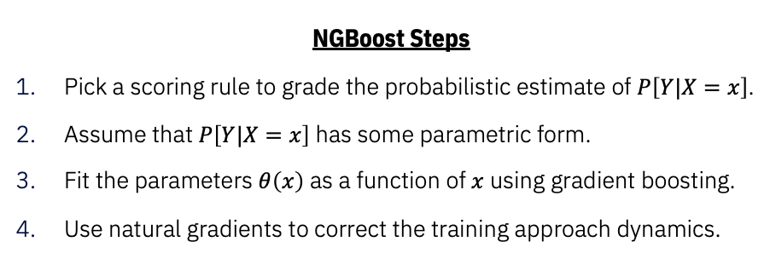
Approach: Natural Gradient Boosting
NGBoost Steps
  Pick a scoring rule to grade the probabilistic estimate of $P\left[Y|X=x\right]$.
  Assume that $P\left[Y|X=x\right]$ has some parametric form.
  Fit the parameters $θ\left(x\right)$ as a function of $x$ using gradient boosting.
  Use natural gradients to correct the training approach dynamics.
Method
Compute the natural gradient in the distributional space by applying a transformation to the normal gradient.

Slide 4
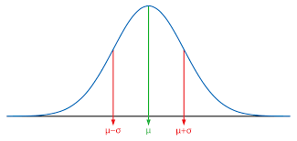
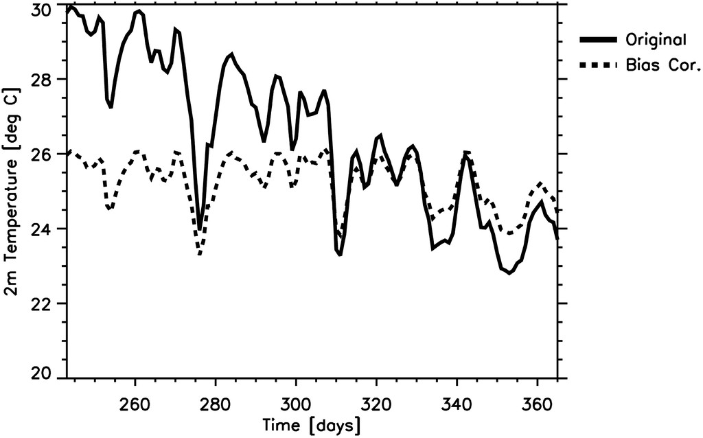
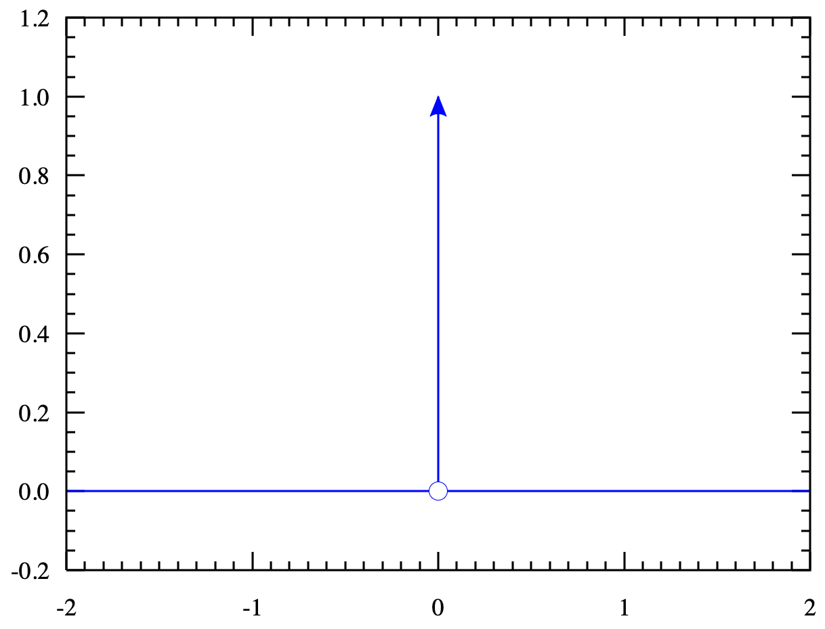
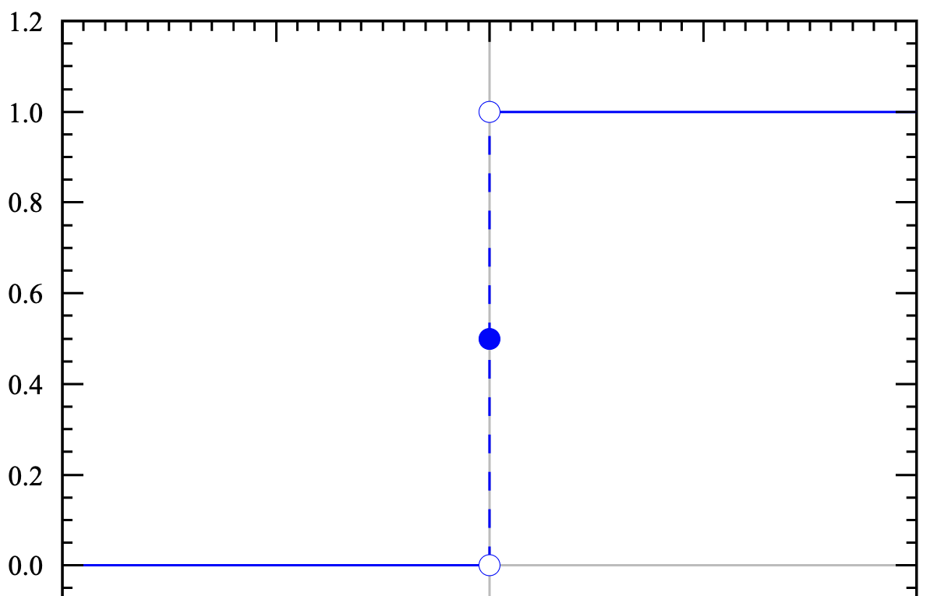
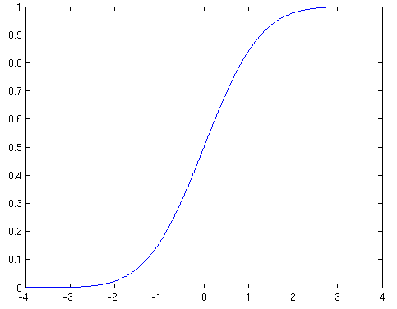
Approach: 2m Temperature modeling
{(doy, lat, lon): (mu, sig)}
Clim estimation based on y
Calculate ECMWF anomalies
[lat, lon, doy, lead,
ens 0, …, ens 10, y]
[lat, lon, doy, lead, clim_mu, clim_sig, anom0, …, anom10, ecmwf_std_anom, y]
Training data:
Calculate std anomalies
Bias estimation
{y}
{(mu_hat, sig_hat)}
Predict
Train NGBoost

Slide 5
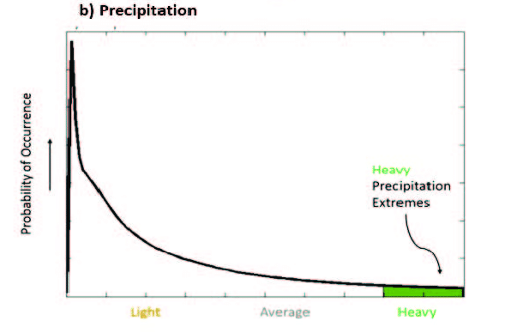

Approach: Total Precipitation modeling
Non-zero Precip. approx. the
Gamma distribution.
Precip. now approximates
Normal/gaussian distribution
Cubic-root transform
Train NGBoost
e.g., $\sqrt[3]{14 \text{mm}}$
e.g., 2.41mm^{0.33}
Predict for each location
dry_prob=0.1=10%
No-rain
rain=1-0.1=90%
Fairly certain of rain
2 stages
dry_prob
mean
stddev
Binomial distribution: B(n=10, dry_prob=0.1)
e.g., dry_prob=0.1
Sample:
1
Rain (90%)
0
No-Rain (10%)
How much?
cube transform
Sample: N(mean, stddev)
Inverse
Precip. that follows gamma distribution (mm)
e.g., 2.8 mm^{0.33}
e.g. (2.8 mm^{0.33})³

Slide 6
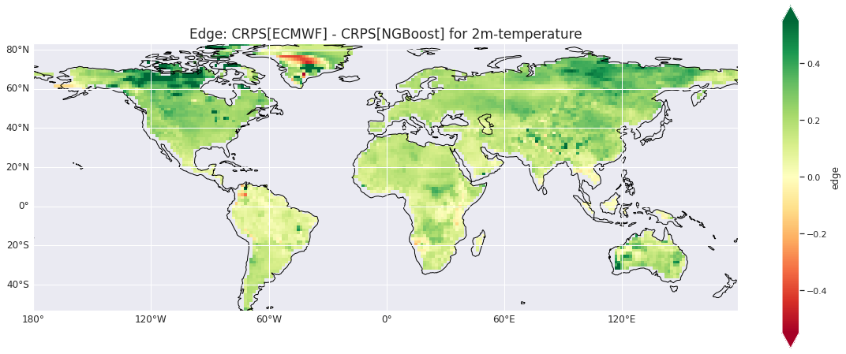
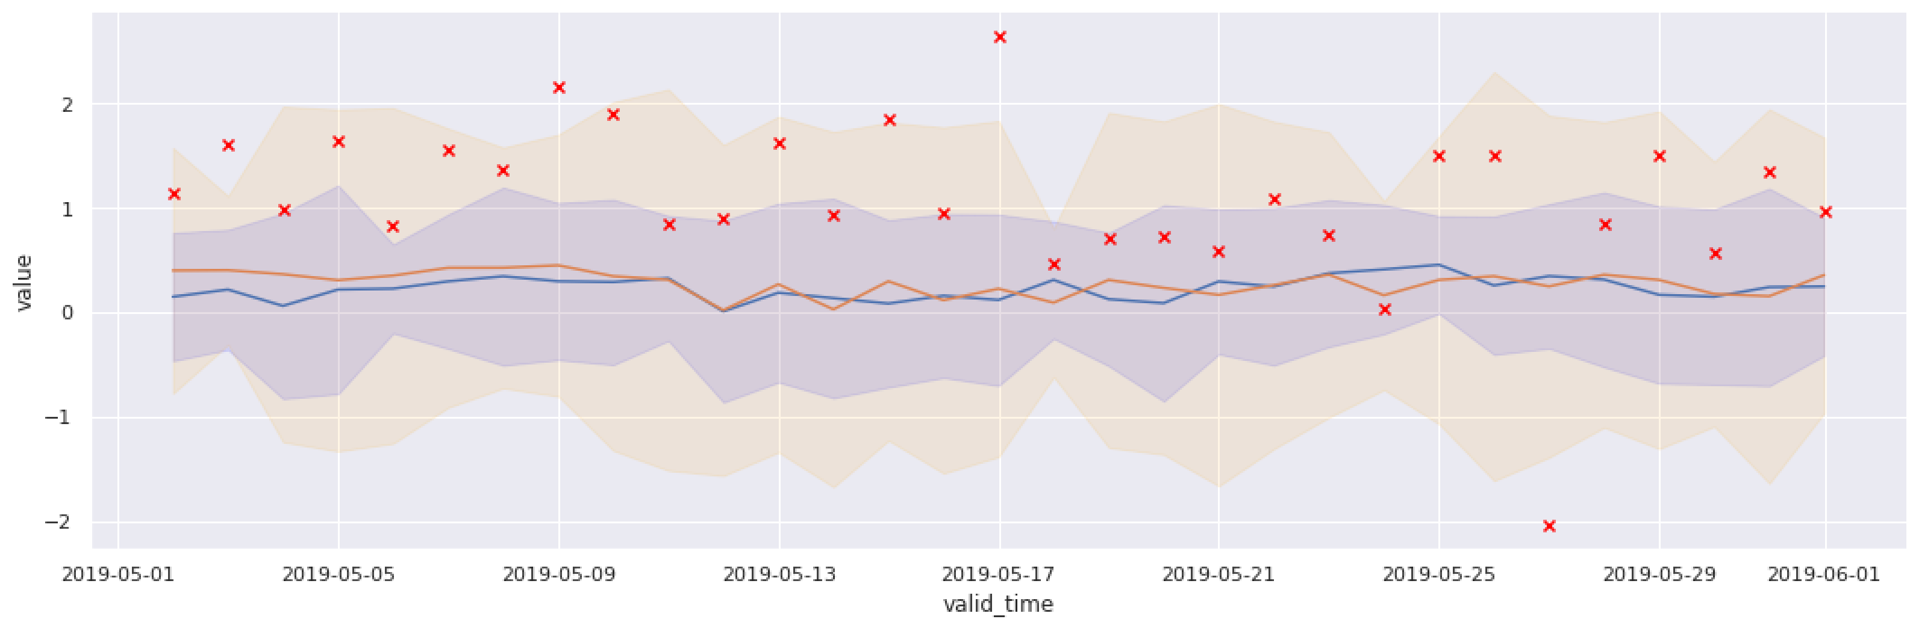
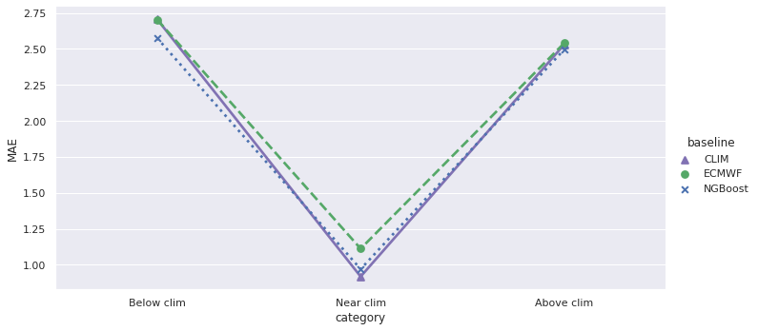
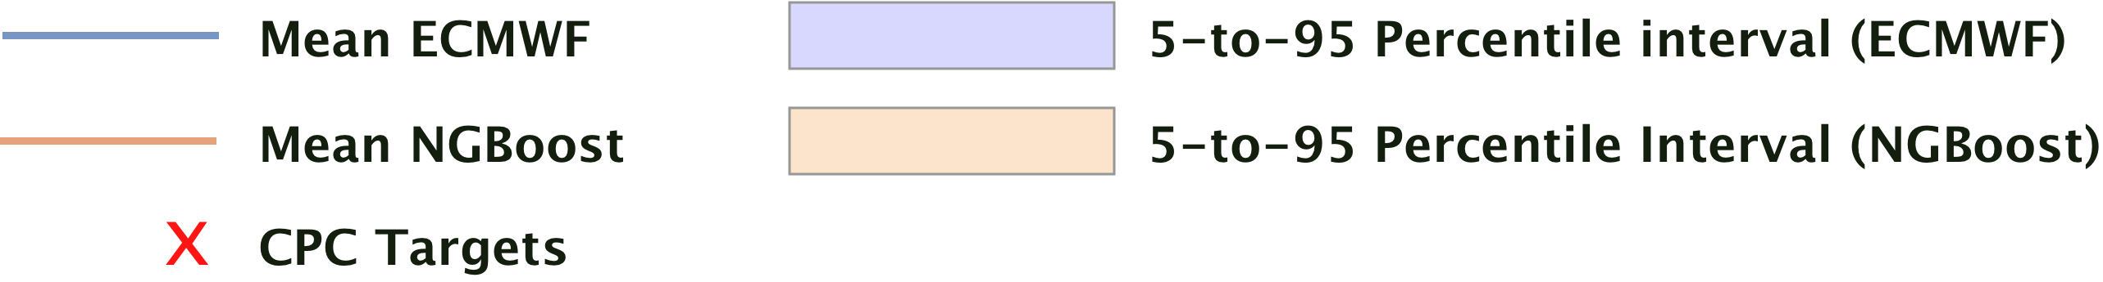
Results: Continuous Ranked Probability Score Comparison
  2m Temperature
    Climatology — CRPS: 2.067
    De-ECMWF — CRPS: 2.144
    NGBoost — CRPS: 2.016
  Total precipitation
    Climatology — CRPS: 1.156
    ECMWF — CRPS: 1.207
    NGBoost — CRPS: 1.160
Forecast run— Watubangga, Kolaka Regency, South-East Sulawesi, Indonesia
Figure 4: Outperforming recent clim on below/above clim and outperforming ECMWF on near climatology.

Slide 7






Operationalization: Deploying to IBM PAIRS
ECMWF 46d weather forecast (ensemble)
ID: 430
Layers: 2t, tp
Temporal res.: 6h
Spatial res: 0.4
Horizon: 366h – 1104h (15 – 46days)
16-46 day ECMWF weather forecast (ML post-processed)
ID: 574
2m Temperature (V0)
Total precipitation 2 stage (V0)
Update interval: Mon/Thu
Query
Download
Transform
Upload
Schedule daily cron jobs
PAIRS area query
Regrid to target res of 1.5x1.5 and apply ocean mask
Convert tercile results to GeoTiff files
UDF: Avg. over weekly forecast horizons for all ensembles
Verify data availability with point queries to all ens. & horizons
Generate feature vectors
Compile metadata json
Post-proc.: Coarse-grain to res. closest to target res. (1.5x1.5)
Load trained ML model and perform inference on downloaded forecast
Upload to COS
Record available & read completed forecasts
Upload to PAIRS
Prioritize most recent available & unprocessed forecasts
Save downloaded fields as netCDF
Train & Validate
Save results
Record completed

