Slide 1

Experimental measurement of kinematic behavior of particle collisions in ambient liquid
——EGU2022
Jiajun Jiao
Yiyang Zhou, Yi An , Qingquan LiU
Beijing Institute of Technology, China
Fluid Mechanics Laboratory
20 May 2022
Notes:
稠密颗粒流指干颗粒流
含液指该问题含有液体，不是saturated，英文翻译为dense granular-liquid mixture flows，即稠密颗粒-液体混合流

Slide 2
1
Background and Current Situation
CONTENTS
2
Applying Imu in Particle Flow
3
Singl Particle Collides with A Wall
4
Results
5
Discussion
6
Conclusions
Notes:
1.
2.single

Slide 3
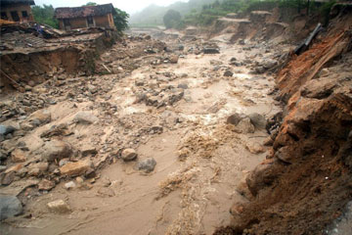
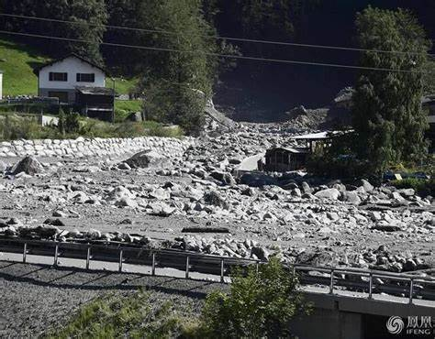
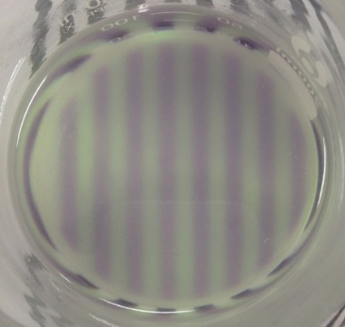
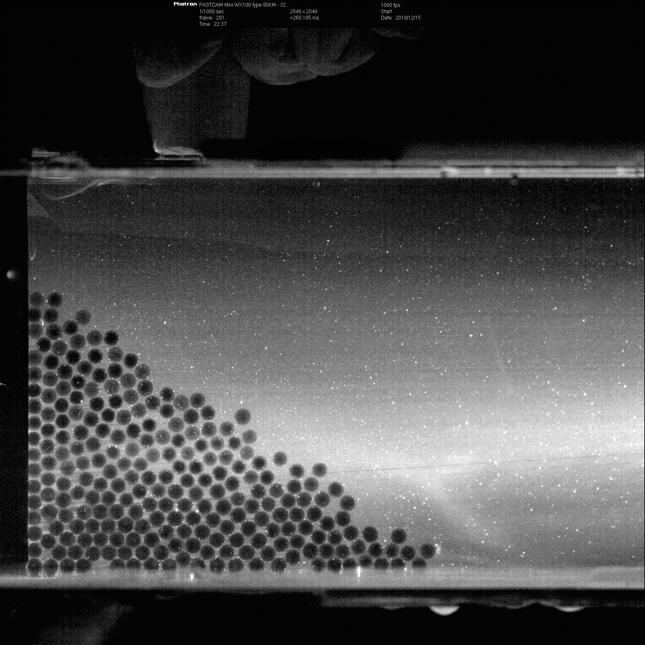
1. Background and Current Situation
Background
Debris Flow
liquid-dense particle mixed flow
particle collision
Current Situation
Internal Observation Experiment Technology
transparent soil
laser
tracer, filter
PIV & PTV
Notes:
只有泥石流为背景引出。泥石流---颗粒碰撞。3、4一页。关注大颗粒碰撞，瑞士大块泥石流图。

Slide 4
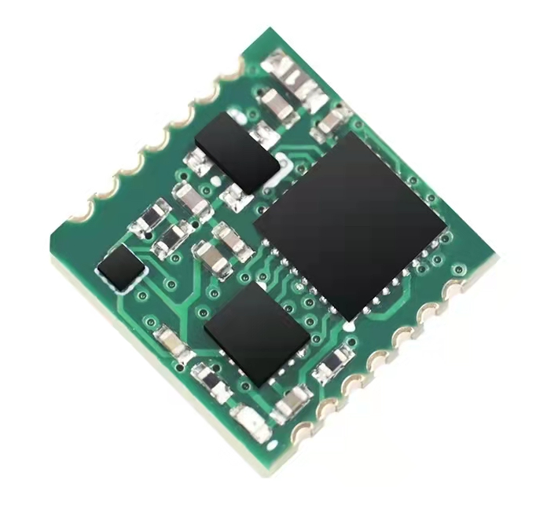
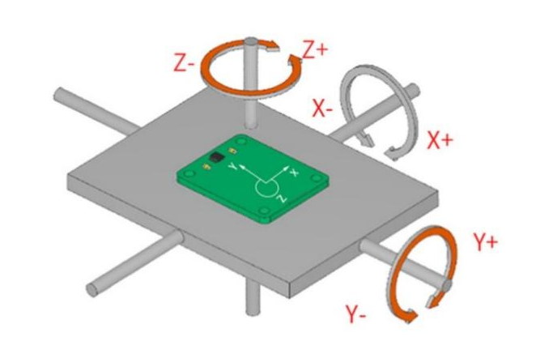
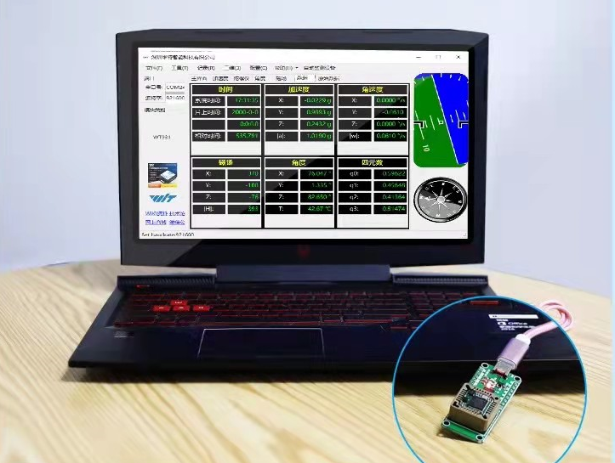
2. Applying Imu in Particle Flow
What is the MEMS-based IMU?
IMU: Inertial measurement unit. With built-in accelerometers and gyroscopes, the IMU measures linear acceleration and rotational angular rates from three directions.
MEMS: Micro-Electro-Mechanical System is a micro-device or system that integrates micro-sensors and electronic integrated devices, and is a high-tech device with a size of several millimeters or even smaller.
12mm×12mm×2.4mm
Acceleration, Angular Velocity, Euler Angles and uaternions

Slide 5
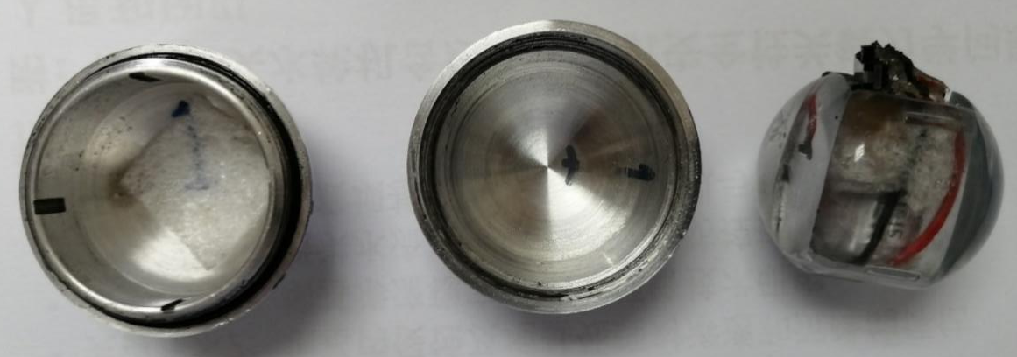
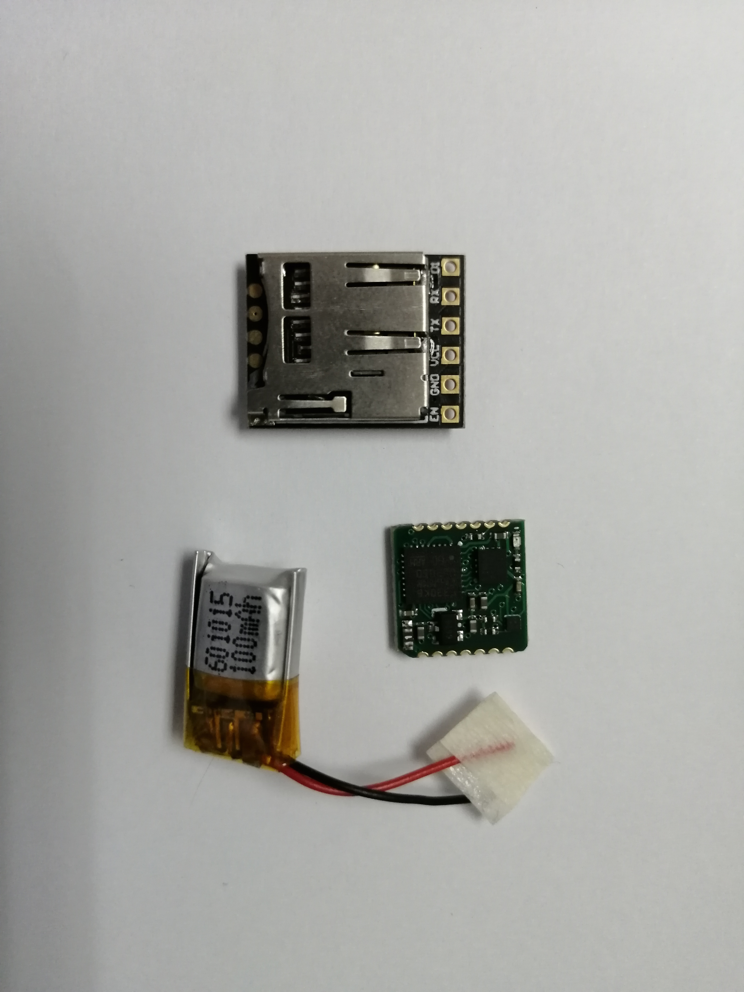
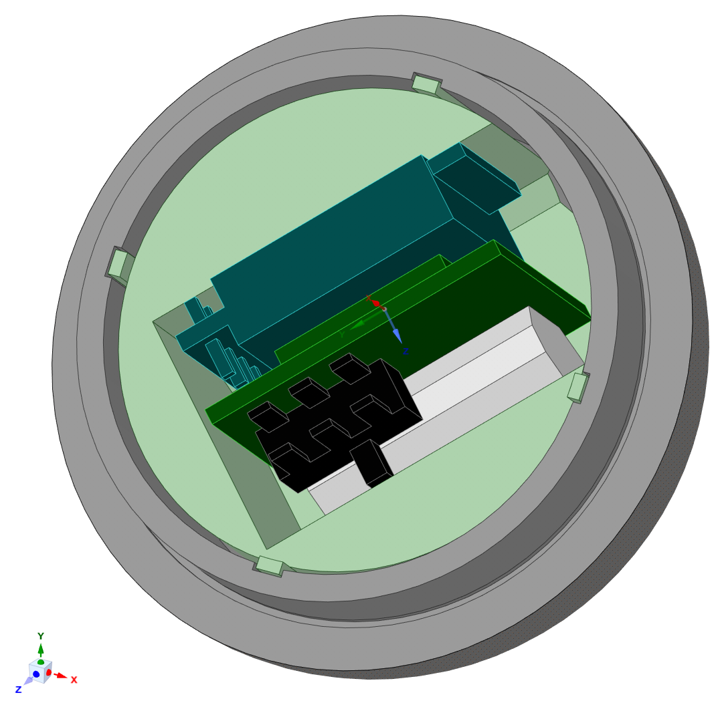
2. Applying Imu in Particle Flow
IMU ball
质量g | 直径mm | 密度g/cm³ | 转动惯量g·mm²
65.77 | 42.00 | 1.72 | 13995.156
Function: record three-axis acceleration and angular velocity in real time
Pros: Enclosed, self-powered
Working time: 30min
Acceleration range: 16g
Angular velocity range: 2000°/s
Data acquisition rate: 1000Hz
Notes:
2-3页：测量设备：1.解释IMU

Slide 6
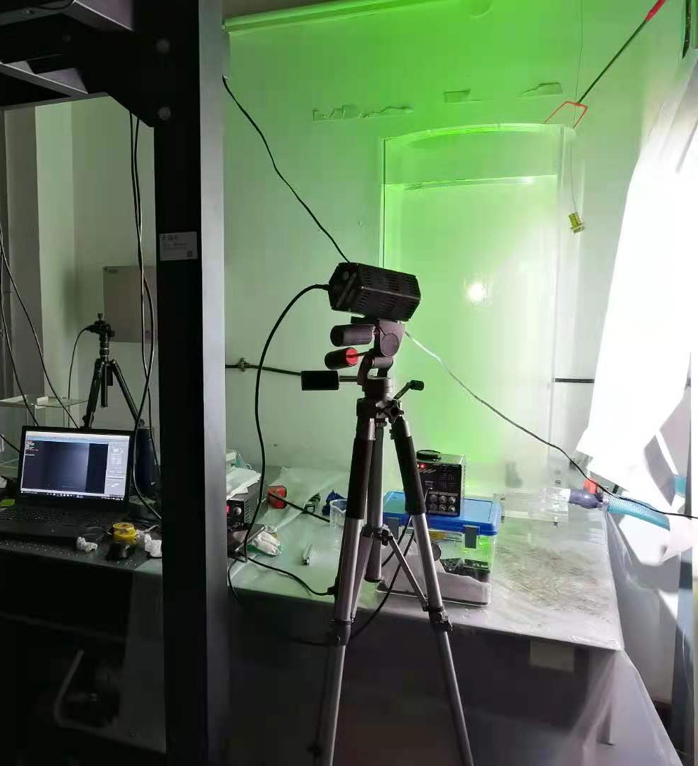
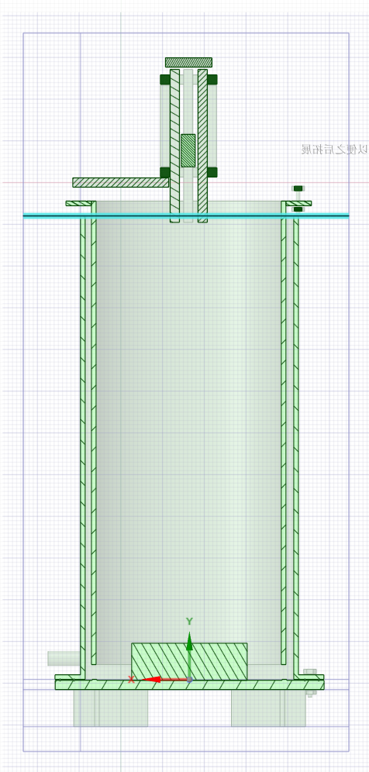

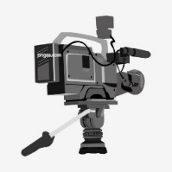
3. Single Particle Strikes the Wall
Experimental conditions
physical parameters of liquid
Num. | Solution viscosity(mPa·s) | Solution density (g/cm³) | Glycerol ratio (%)
1 | 1.0 | 1.01 | 0%
2 | 2.0 | 1.02 | 10%
3 | 12.3 | 1.16 | 60%
4 | 43 | 1.20 | 79%
5 | 94 | 1.22 | 84%
6 | 194 | 1.23 | 88%
7 | 935 | 1.24 | 95%
test bench
schematic
In seven water-glycerol mixed liquids with different viscosities, the IMU ball fells freely from the liquid surface and hit the wall.
Notes:
part3:实验，ball下落动图。粘度，妆前速度

Slide 7
4. Results
Acceleration & Velocity
From the data recorded by the IMU ball, we obtained the triaxial velocity, the triaxial angular velocity, and the angle of rotation around the triaxis when the particle falls and hits the wall.

Slide 8
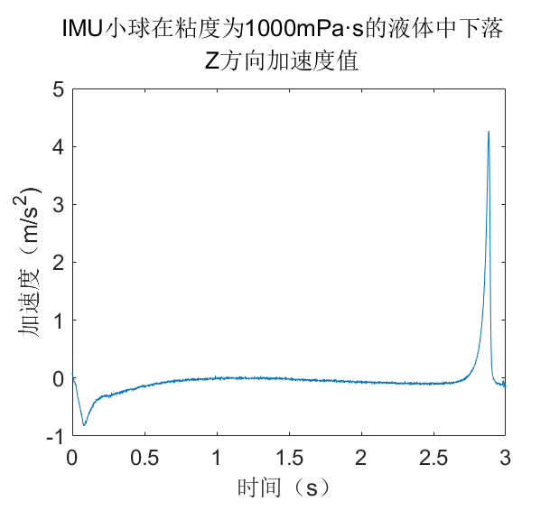

4. Results
How to Define Collision Velocity?
acceleration and velocity in the Z direction
coefficient of restitution: CR=$\frac{v_{sep}}{v_{app}}$；
Num | diff(az) | v(m/s)
1237 | 38.93 | -8.09
1238 | -6.87 | -8.09
1239 | 38.11 | -8.09
1240 | -6.88 | -8.09
1241 | 15.49 | -8.09
1242 | 25.83 | -8.09
1243 | 46.05 | -8.09
··· | ··· | ···
··· | ··· | ···
1271 | 858.19 | -0.776
1272 | 1268.12 | -0.769
1273 | 2369.97 | -0.702
1274 | 119646.03 | -0.609
1275 | -69560.12 | 0.511
1276 | -56355.74 | 0.511
IMU ball hits a plane in a liquid with a viscosity of 935 mPa·s
approach velocity
time of contact
acceleration
separation velocity
time
Notes:
泥石流 碰撞连续Or全部耗散，无高速的颗粒脉动。水石流和泥石流界限。

Slide 9
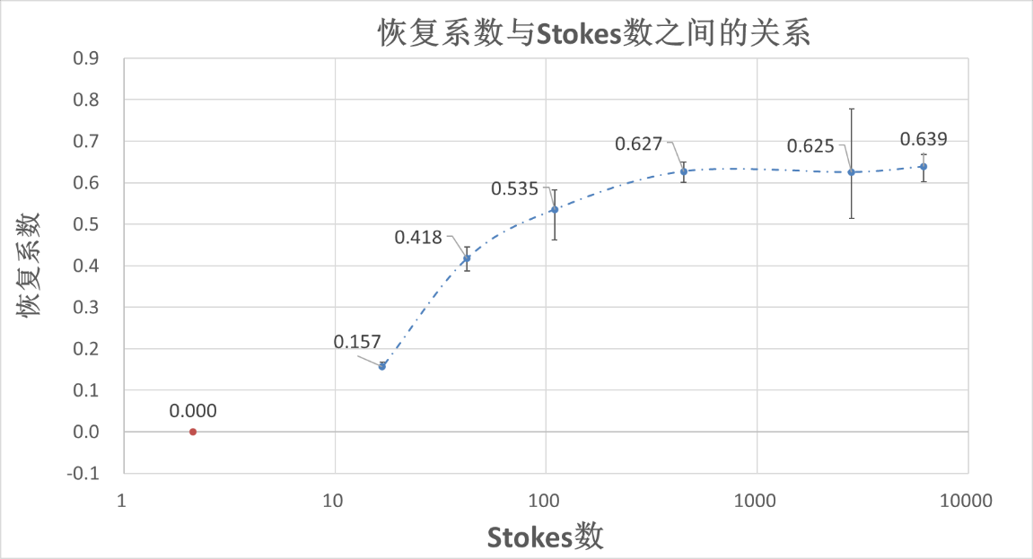
4. Results
coefficient of restitution
The relationship between CR and St
coefficient of restitution
Stokes number
Under the present experimental conditions, the restitution coefficient varied around 0.63 when the Stokes number was greater than the upper critical value (448). While the restitution coefficient decreases rapidly as the Stokes number decreases, and the restitution coefficient becomes 0 at small Stokes numbers.
Notes:
完全非弹性碰撞，粘性很大，碰撞很弱=ST小，能量耗散快。
粘度小，碰撞恢复系数在0.6，损失的能量是多少。泥石流 碰撞连续Or全部耗散，无高速的颗粒脉动。水石流和泥石流界限。
St定义

Slide 10
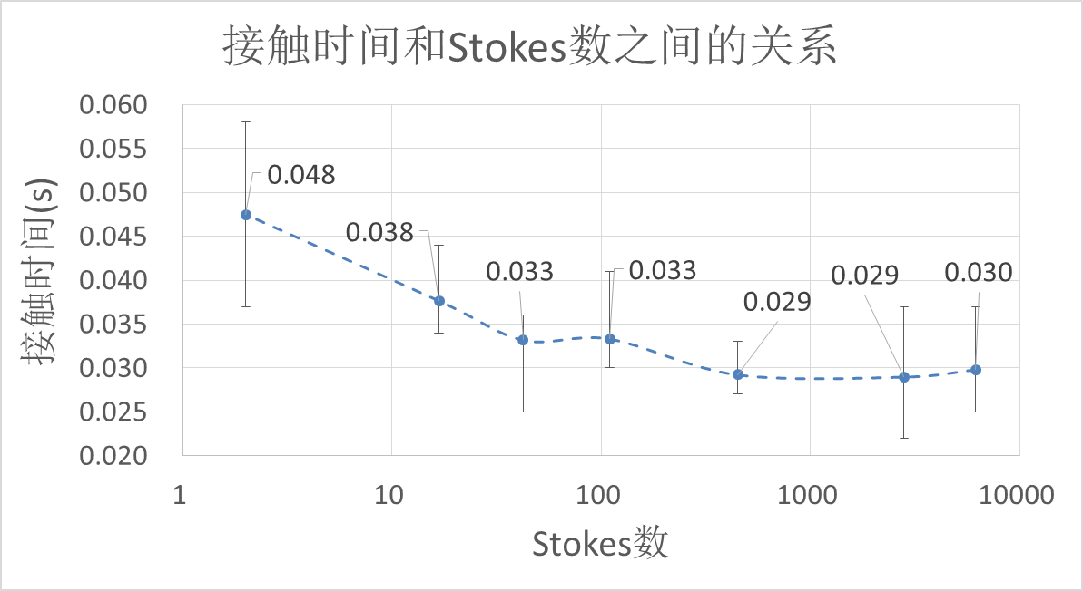
4. Results
time of contact
The relationship between Tc and St
time of contact (s)
Stokes number
When the Stokes number is small, the contact time decreases almost linearly with the increase of the Stokes number. When the Stokes number is large, the contact time of the ball does not change much, and fluctuates around the time of 0.029s.
Notes:
泥石流 碰撞连续Or全部耗散，无高速的颗粒脉动。水石流和泥石流界限。

Slide 11
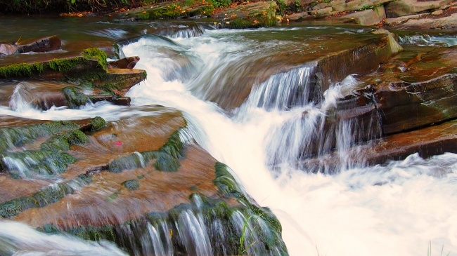
5.Discussion
Why do particles accumulate?
water flow
debris flow
stacked particles
Through experiments, we found that the restitution coefficient of the particles is small when the low Stokes number is small, indicating that the energy dissipation of the particles is more in these cases. In the same way, the debris flow will accumulate particles in a gentle area, but the water flow will not accumulate. This is also a difference between water flow and debris flow.
Notes:
泥石流 碰撞连续Or全部耗散，无高速的颗粒脉动。水石流和泥石流界限。

Slide 12
6.Conclusions
We designed an IMU ball to obtain the kinematic parameters of the particles. This IMU ball has a diameter of 42mm and a density of 1.72g/cm³. It can record three-axis acceleration and three-axis angular velocity in real time.
We carried out the experiment of the IMU ball falling freely in liquids and colliding with a wall. We get the relationship between the coefficient of restitution and the Stokes number for this IMU ball. The trend curve is similar to that of previous studies.
The rotation of the particle and the angle of impact may have an effect on the coefficient of restitution of the particles.
The energy dissipation caused by particle collision may be one of the reasons for the accumulation of debris flow on gentle road sections.
Notes:
IMU球，测量了IMU的CR，cr可以解释泥石流不同形态特点

