Slide 1




Towards fully automated root phenotyping in the field: from Minirhizotron image acquisition to data analysis
Kaining Zhou¹, Adam Soffer², Jhonathan E. Ephrath¹, Ofer Hadar², Naftali Lazarovitch¹
1. French Associates Institute for Agriculture and Biotechnology of Drylands, Jacob Blaustein Institutes for Desert Research, Ben-Gurion University of the Negev, Sede Boqer Campus, 8499000, Israel
2. School of Electrical and Computer Engineering, Ben-Gurion University of the Negev, 8410501 Beer Sheva, Israel
Scan me
to read
the abstract

Slide 2
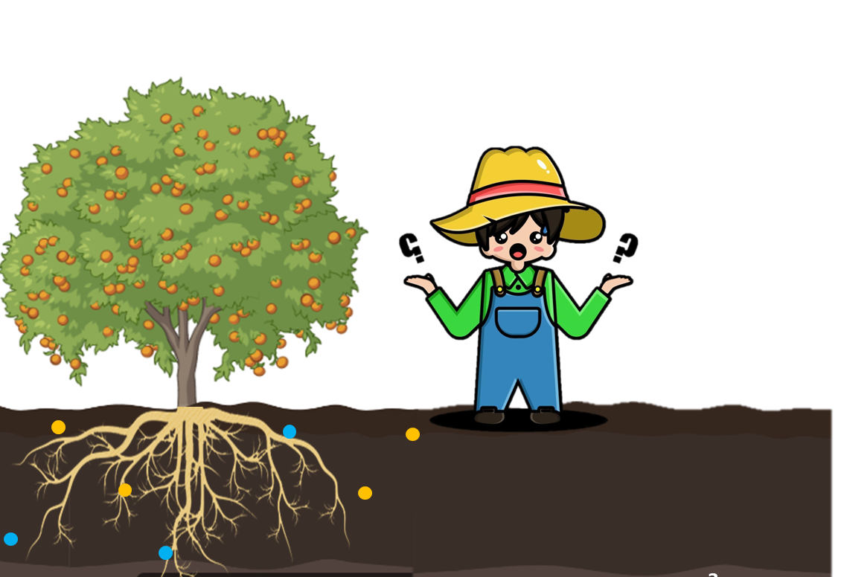
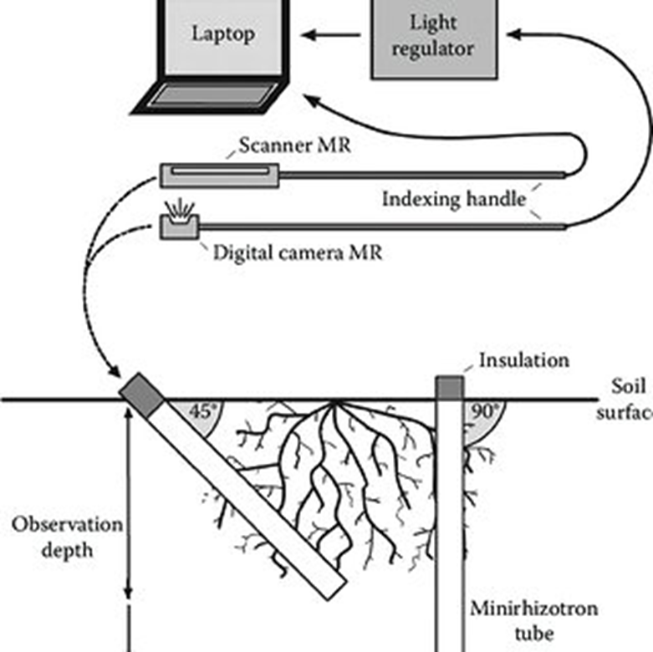
Effective root monitoring in the soil is important for making sound decisions.
Minirhizotron system (MR)
water
Fertilizer

Slide 3

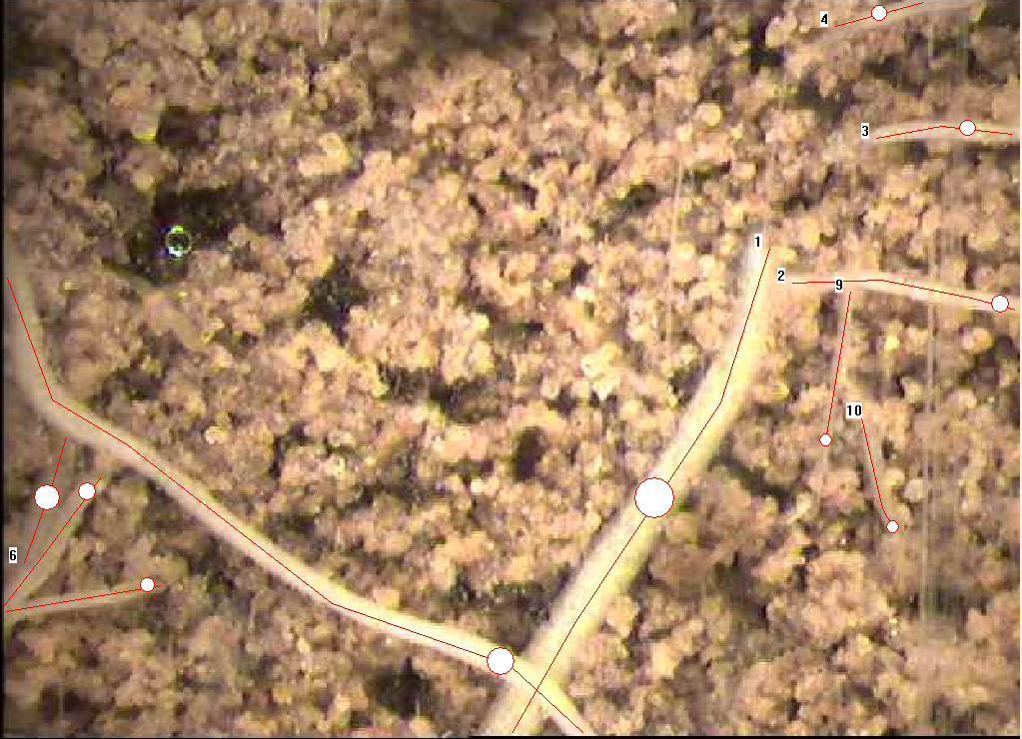

Minirhizotron image annotation is tedious and time-consuming
1.5mins per image
Annotation time for
a long-term experiment:
7,500-15,000 minutes
Observation replicate & frequency
Time & cost

Slide 4
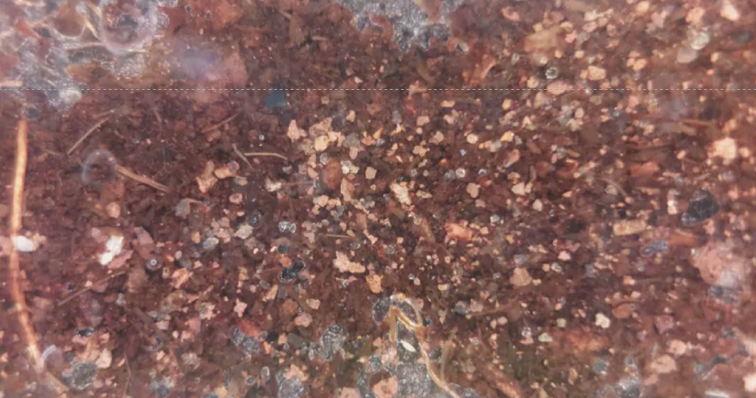
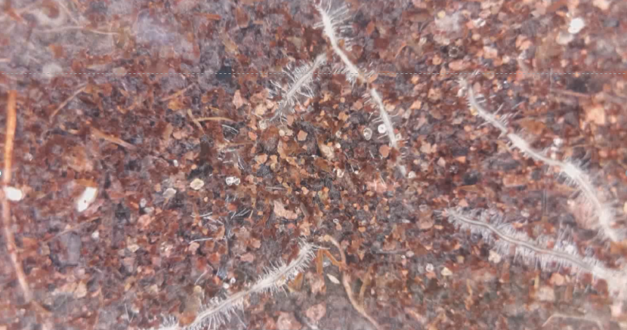
Snapshot vs. Monitor on a continuous basis
Example:
Day 1
Day 11

Slide 5
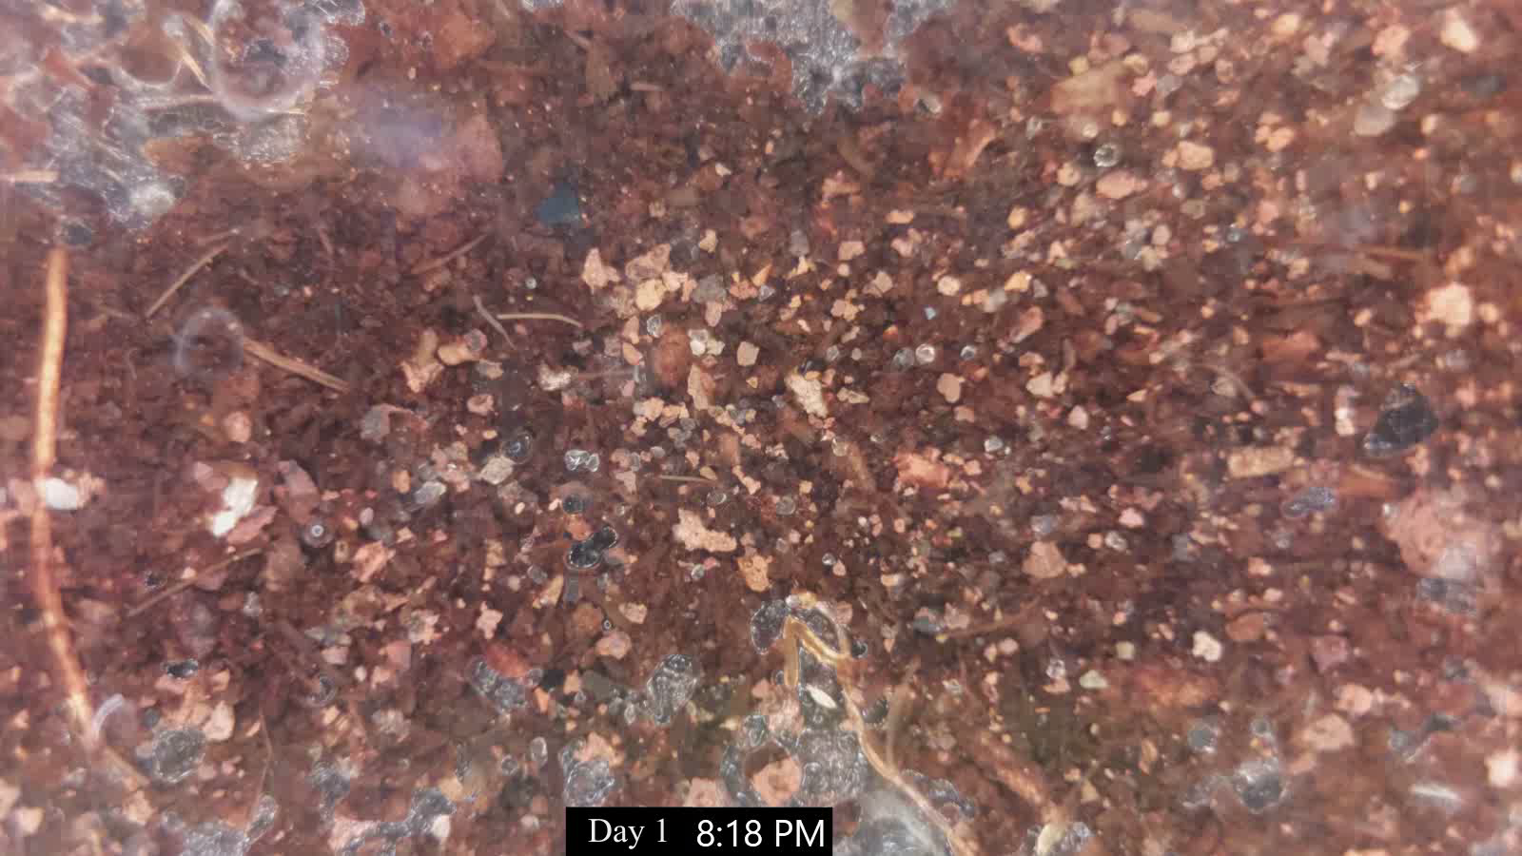
Root growth from Day 1 to Day 11

Slide 6


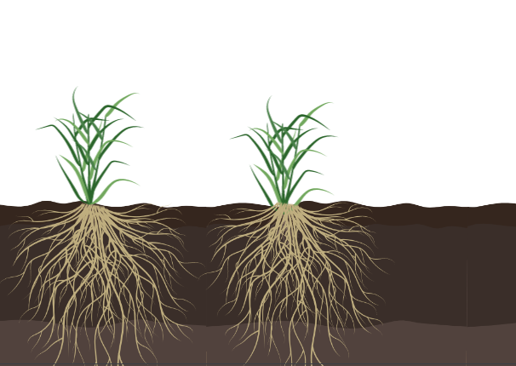
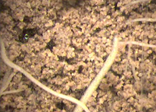


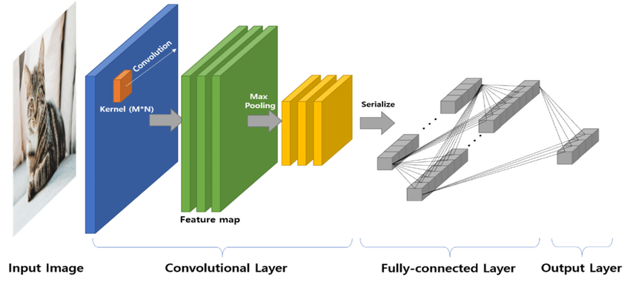
Towards fully automated root phenotyping in the field
Automatic Minirhizotron camera
Field
Decision making
Download image remotely
Image analysis with Convolutional Neural Networks
Estimated root length:
46 mm

Slide 7

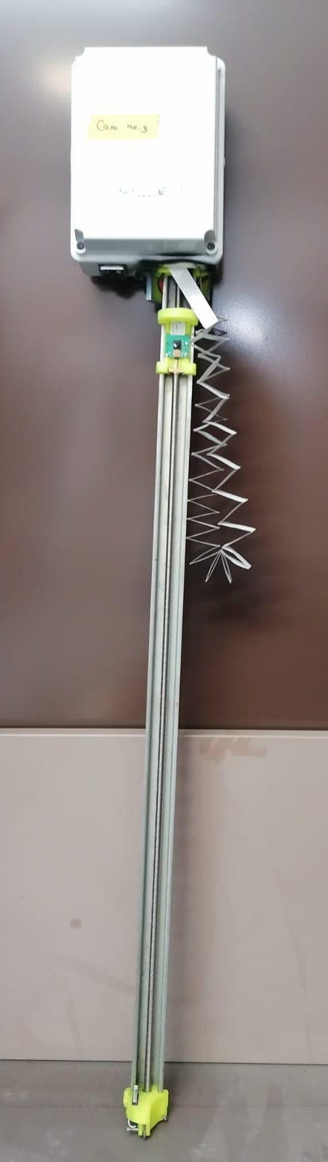
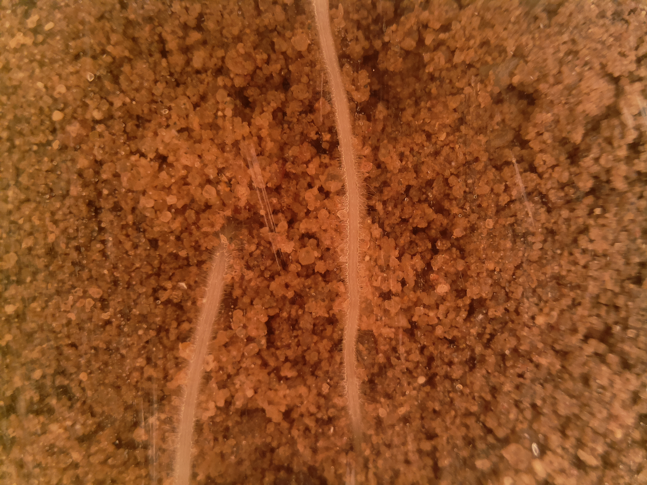
Automated Minirhizotron system: RootCam© by
 | Conventional Minirhizotron system (BTC-ICAP) | RootCam
Image dimensions | 640 × 480 pixels | 2952 × 1944 pixels
Image size | 18 × 13.5 mm² | 25 × 19 mm²
Operation | Manual | Automated
Data acquisition | Copy manually | Download remotely
1 mm

Slide 8
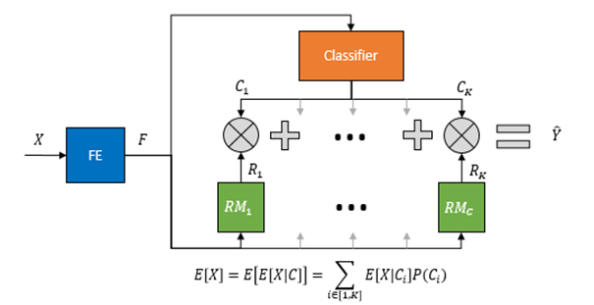

A root length estimation model is developed based on
Convolutional neural networks (CNN)
FE: Feature Extraction Module
CM: Classification Module
RM: Regression Module

Slide 9
Result comparison: manual annotation vs. CNN model
 | Training dataset | Test dataset
Images taken from | Tomato roots | Pepper roots
Image amount | 18,000 | 832
Image acquisition system | Conventional Minirhizotron | Automated Minirhizotron: RootCam

Slide 10

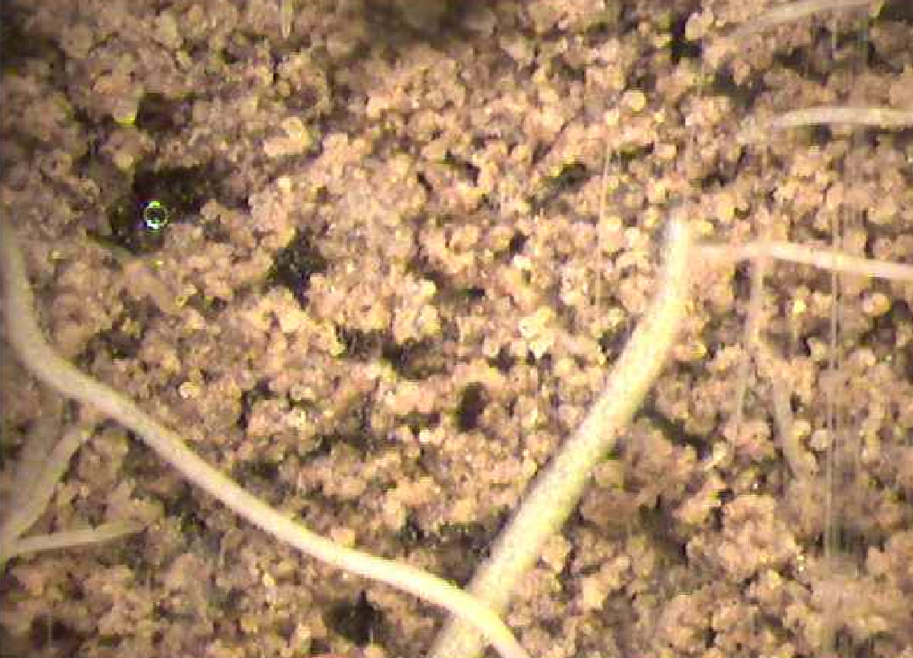
Time used for data analysis: manual annotation vs. CNN model
90s per image
3s per image
Total root length:
46 mm
VS.

Slide 11
Time used for data analysis: manual annotation vs. CNN model

Slide 12
Applications
Monitor rooting depth
Study root hairs
Detect root-knot nematode infection
Monitor root
Dynamics in real time
Evaluate plant stress
with fluorescent roots
Provide timely data
to build models

Slide 13
Take home message
The automated Minirhizotron system greatly facilitates image acquisition.
The CNN model is accurate to estimate root length on Minirhizotron images.
This platform will accelerate high-throughput root phenotyping in the field.

Slide 14
Thank you for your attention! Welcome to contact us if you have any questions.
Kaining Zhou
zhoy@post.bgu.ac.il
French Associates Institute for Agriculture and Biotechnology of Drylands, Jacob Blaustein Institutes for Desert Research, Ben-Gurion University of the Negev, Israel

