Slide 1



Geosites, geomorphosites, and geodiversity in Putna Catchment, Vrancea, Romania
Nicusor Necula¹, Mihai Niculiță², Ionut Vasiliniuc^{1,2}
nicusor.necula@uaic.ro mihai.niculita@uaic.ro ionut.vasiliniuc@uaic.ro
¹ Tulnici Research Station, Alexandru Ioan Cuza University of Iasi
² Department of Geography, Faculty of Geography and Geology, Alexandru Ioan Cuza University of Iasi

Slide 2

Introduction
Study area
Materials and Methods
Results
Conclusions
The reviving interest in geodiversity assessment within the Geosciences community makes it into one relevant topic for the scientific community as it is related to the long-term evolutionary processes and interpretation of recent responses to climate change, as well as for the Nature-Human interactions.
Geodiversity relates to the various aspects of the abiotic environment, which include the lithological, stratigraphic, mineralogical, and tectonic characteristics of an area, as well as their geomorphological, pedological and paleontological characteristics.
The variety of geosites and geomorphosites define the geodiversity, hence the geoheritage of a place, region, or country whose resources, beauty, and other significant values should be maintained as a legacy for future generations. Irrespective of size and location, every place has its values that can be assessed from different points of view such as scientific, educational, aesthetic, recreational, cultural, and other values (Gray 2004, 2005; GSA 2012).
What are the geodiversity resources that the Vrancea region has to offer?
Necula N., Niculiță M., Vasiliniuc I. - Geosites, geomorphosites, and geodiversity in Putna Catchment, Vrancea, Romania

Slide 3
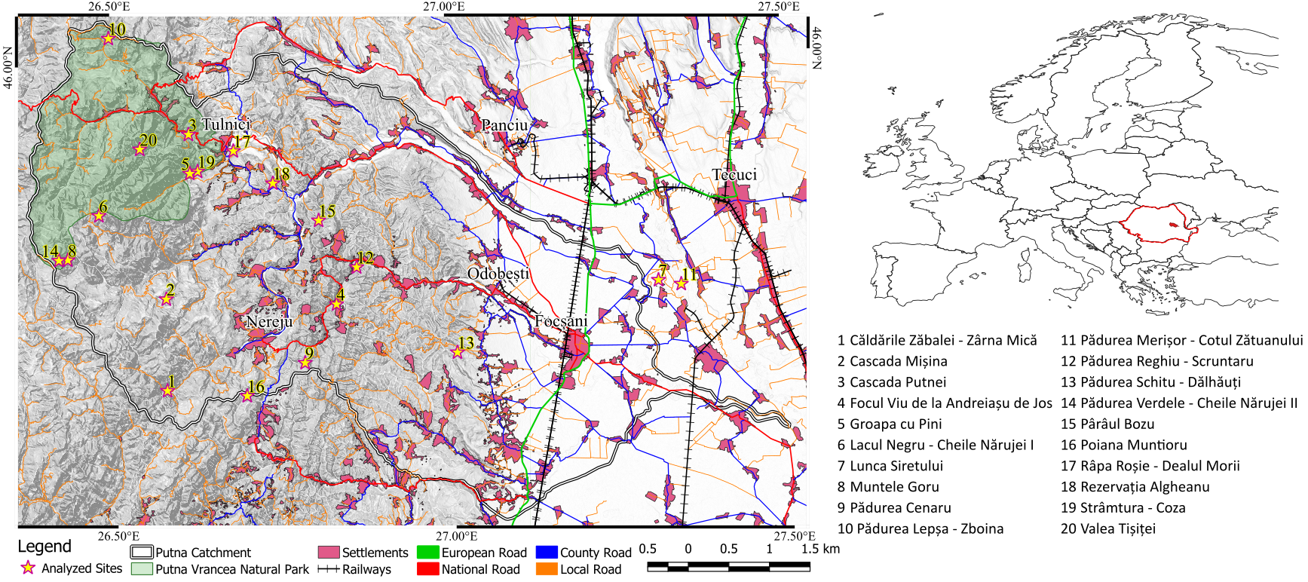
Introduction
Study area
Materials and Methods
Results
Conclusions
The location of the Putna catchment and the transportation system available to reach the investigated sites
Necula N., Niculiță M., Vasiliniuc I. - Geosites, geomorphosites, and geodiversity in Putna Catchment, Vrancea, Romania

Slide 4
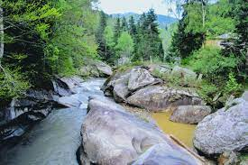
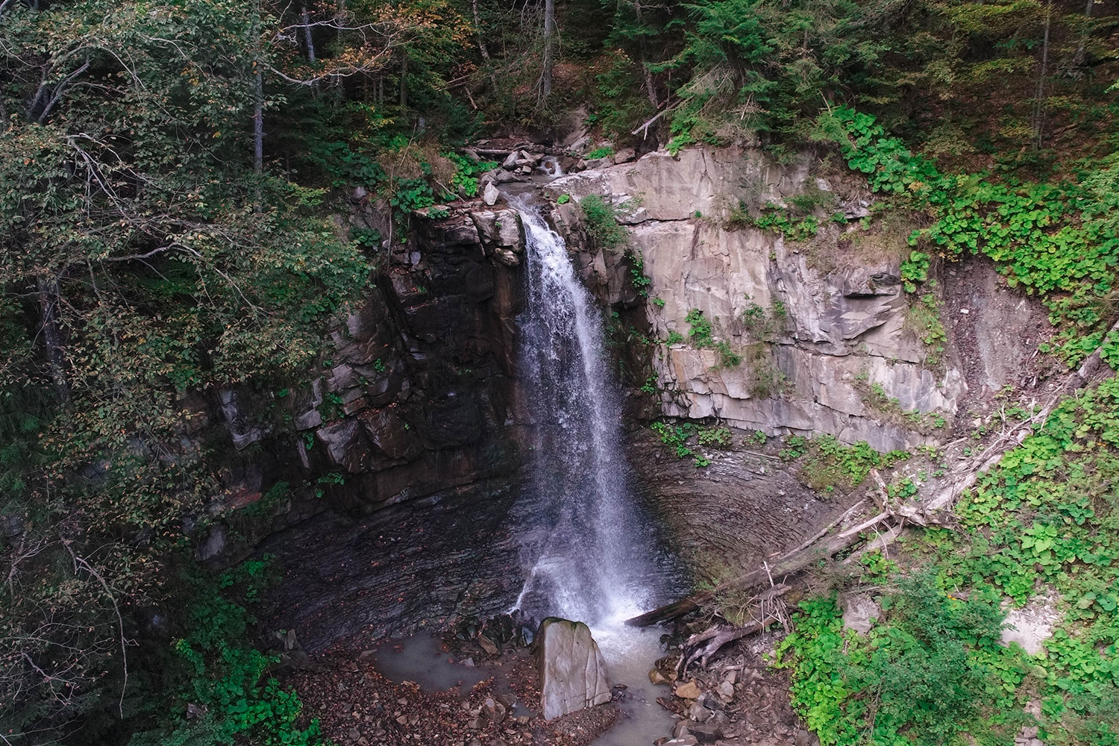
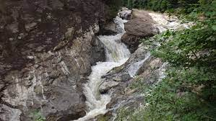
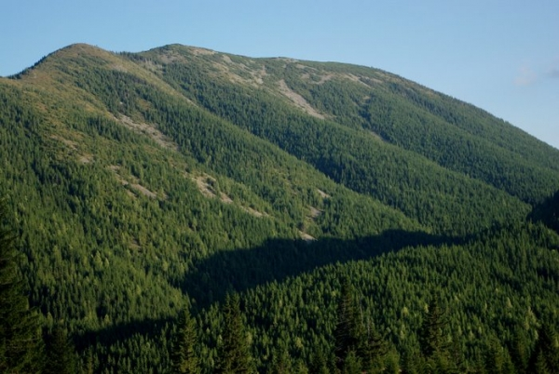
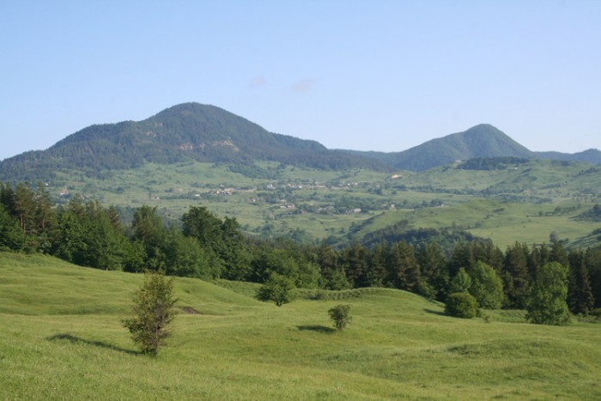
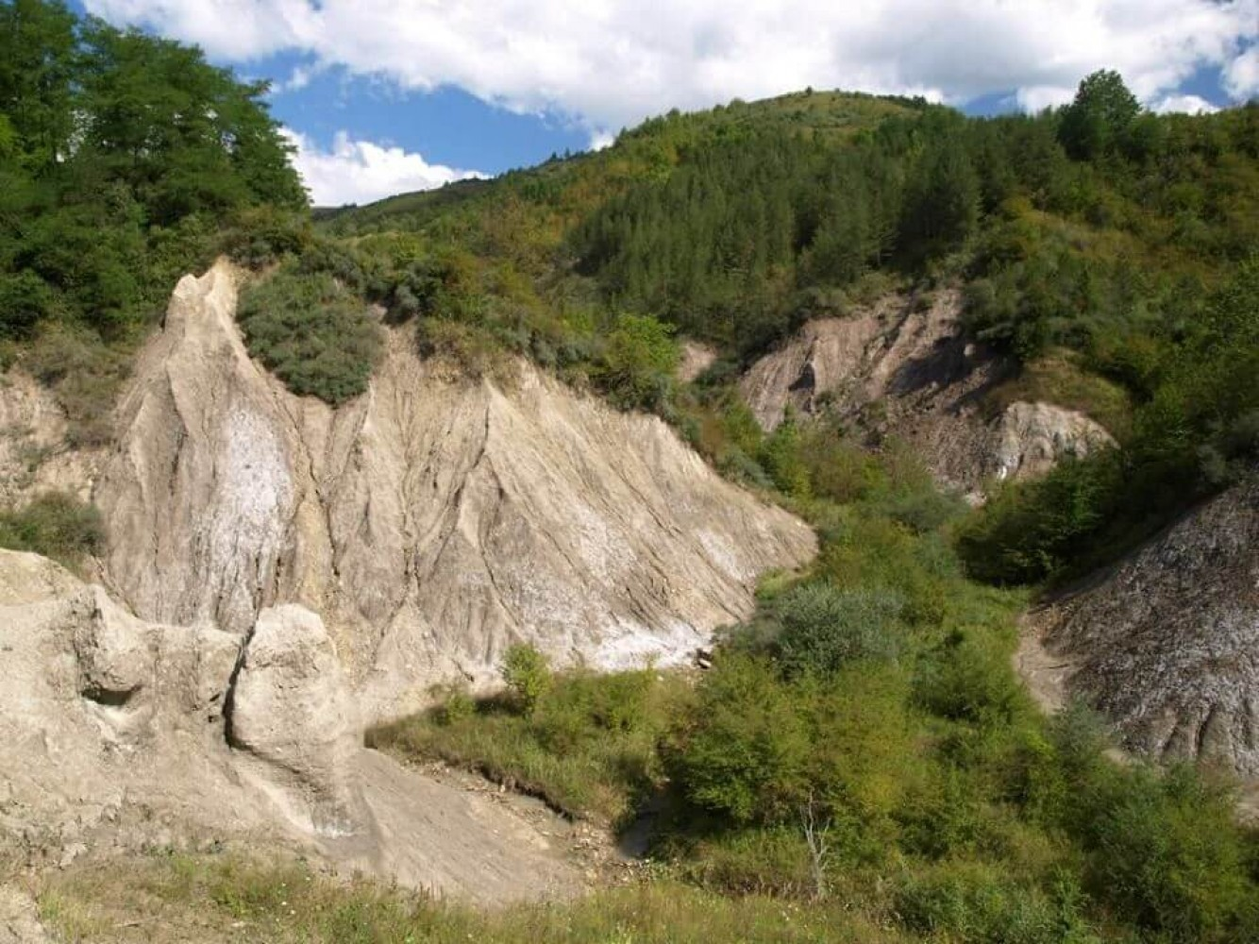
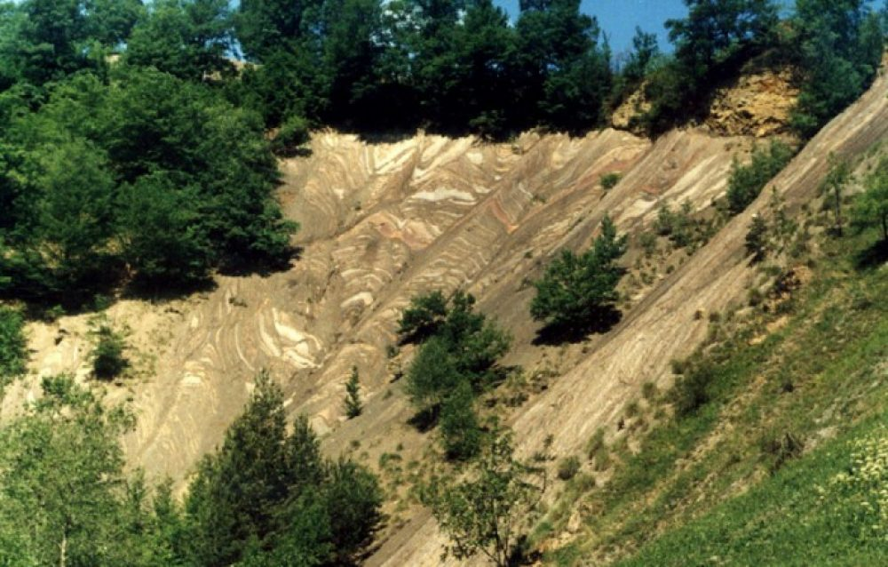
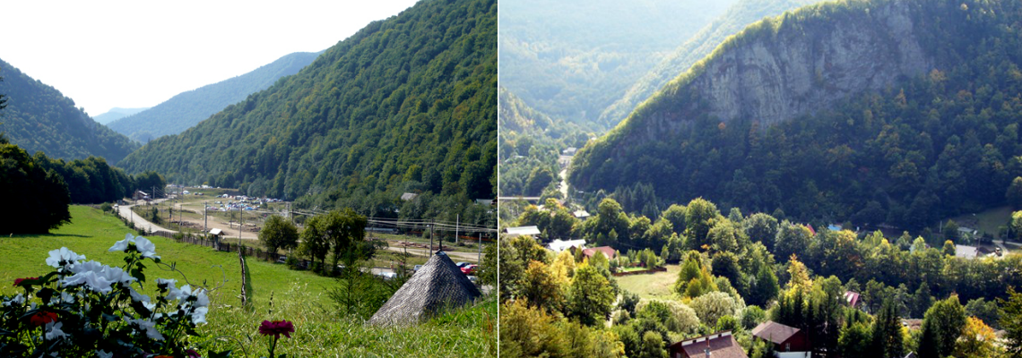
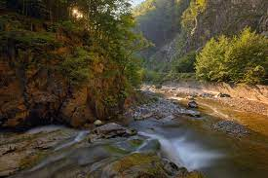
Introduction
Study area
Materials and Methods
Results
Conclusions
1. Căldările Zăbalei - Zârna Mică
2. Cascada Mișina
3. Cascada Putnei
8. Muntele Goru
16. Poiana Muntioru
17. Râpa Roșie - Dealul Morii
19. Strâmtura - Coza
20. Valea Tișiței
Necula N., Niculiță M., Vasiliniuc I. - Geosites, geomorphosites, and geodiversity in Putna Catchment, Vrancea, Romania

Slide 5
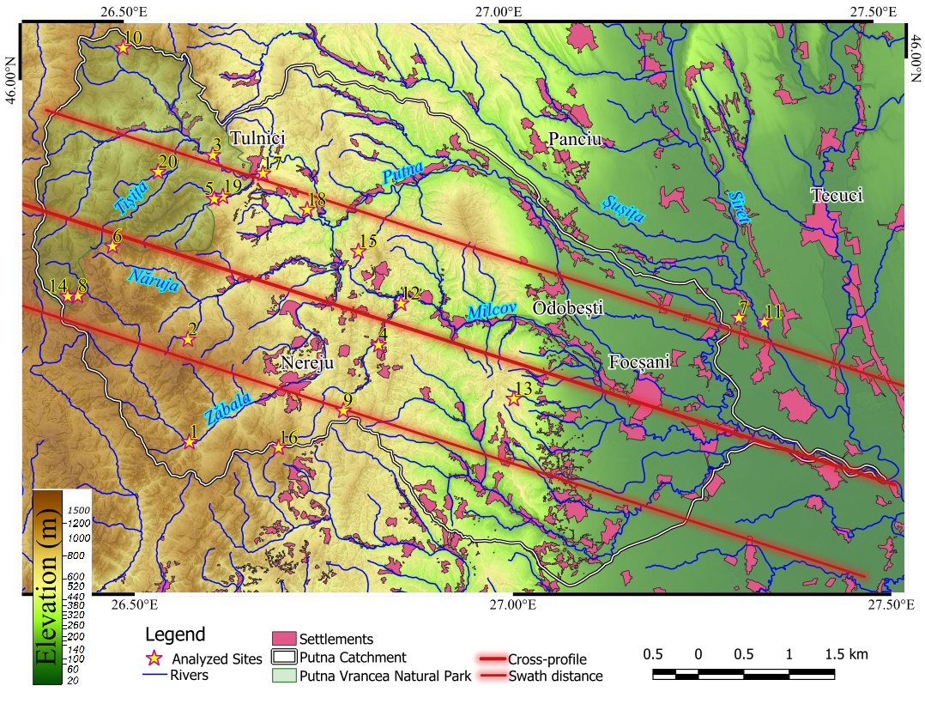
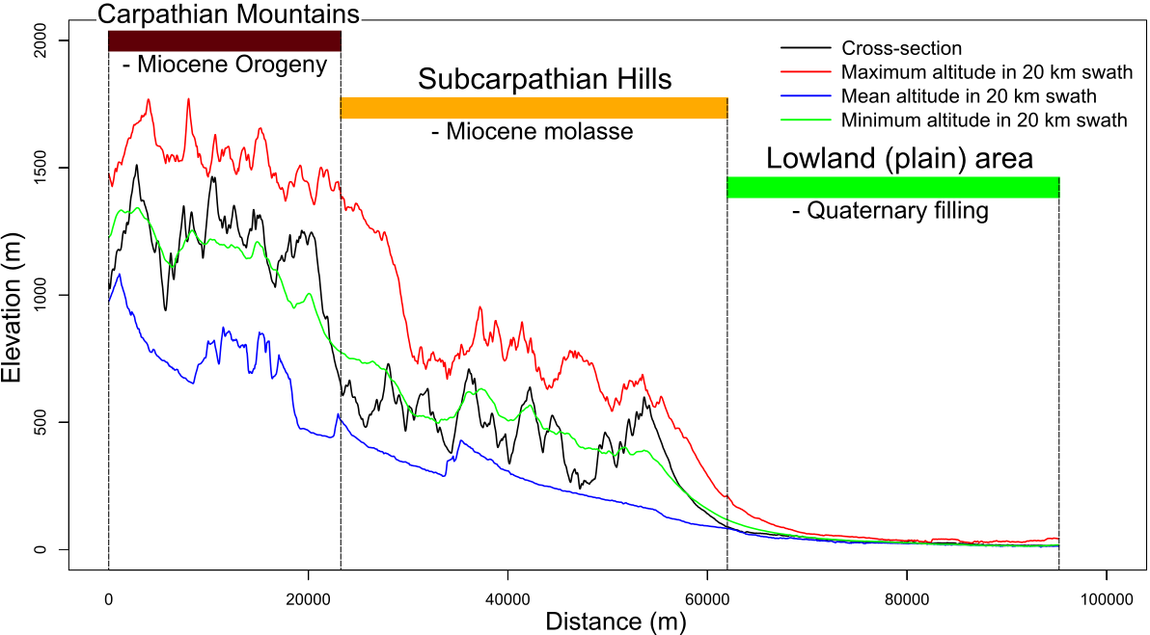
Introduction
Study area
Materials and Methods
Results
Conclusions
Geomorphological aspects of the Putna catchment
The hypsometry map of the studied area at the transition from the Carpathian Mountains to the Subcarpathian Hills to the Lowland area as seen in the swath profile
Necula N., Niculiță M., Vasiliniuc I. - Geosites, geomorphosites, and geodiversity in Putna Catchment, Vrancea, Romania

Slide 6
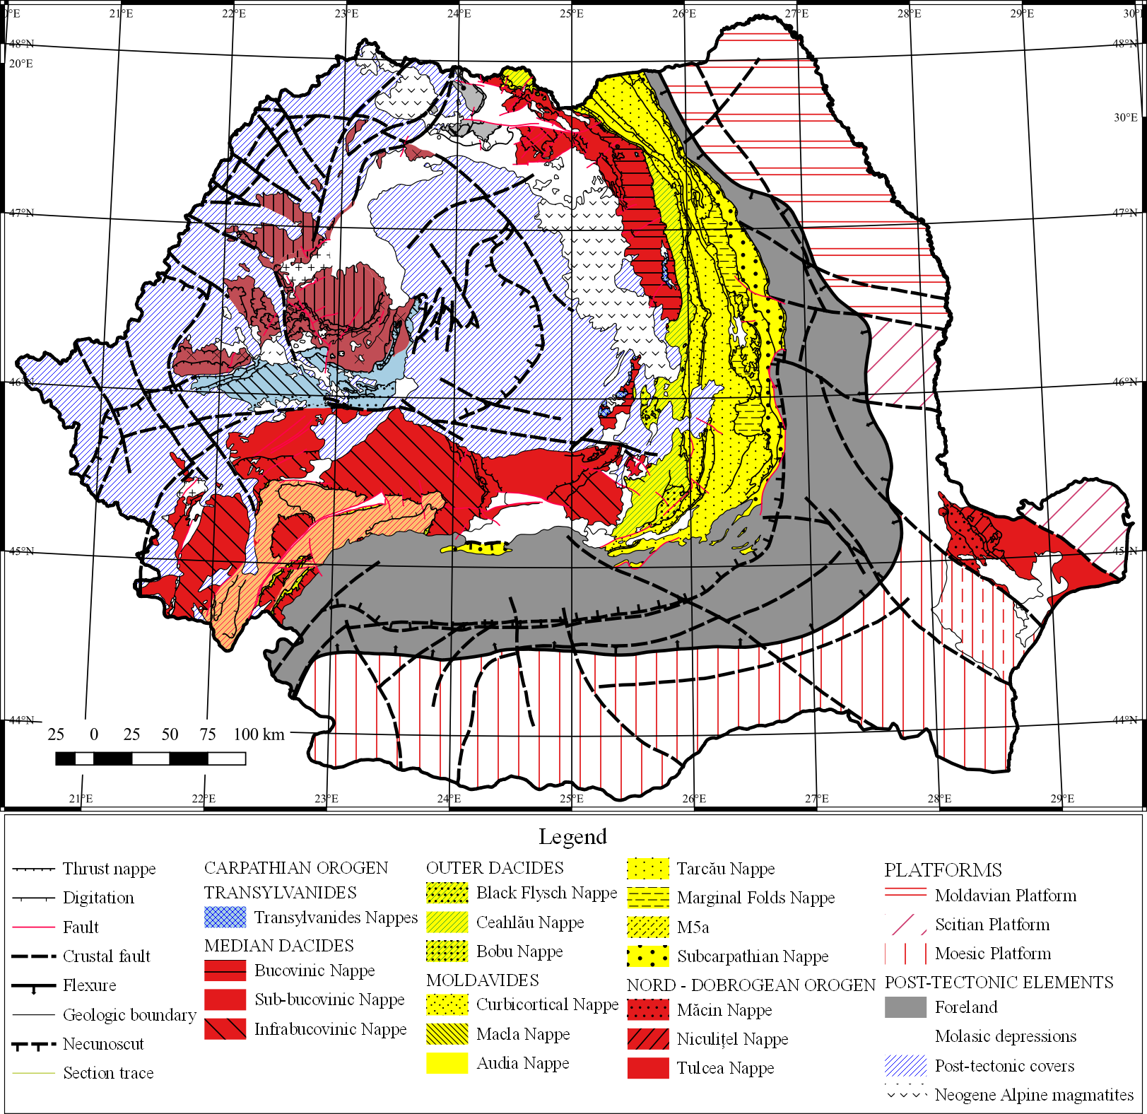
Introduction
Study area
Materials and Methods
Results
Conclusions
Geology of the area
The area was affected by the Miocene deformations of the alpine orogeny during which the nappe system was overlaid over the foreland deposits.
It consists of sedimentary layers made of various types of sandstones, mudstones, and clays which were shaped by the erosional processes.
Tectonic sketch of Romania (after Săndulescu, 1984)
Necula N., Niculiță M., Vasiliniuc I. - Geosites, geomorphosites, and geodiversity in Putna Catchment, Vrancea, Romania

Slide 7
Introduction
Study area
Materials and Methods
Results
Conclusions
Investigated Sites
1. Căldările Zăbalei - Zârna Mică
2. Cascada Mișina
3. Cascada Putnei
4. Focul Viu de la Andreiașu de Jos
5. Groapa cu Pini
6. Lacul Negru - Cheile Nărujei I
7. Lunca Siretului
8. Muntele Goru
9. Pădurea Cenaru
10. Pădurea Lepșa - Zboina
11. Pădurea Merișor - Cotul Zătuanului
12. Pădurea Reghiu - Scruntaru
13. Pădurea Schitu - Dălhăuți
14. Pădurea Verdele - Cheile Nărujei II
15. Pârâul Bozu
16. Poiana Muntioru
17. Râpa Roșie - Dealul Morii
18. Rezervația Algheanu
19. Strâmtura - Coza
20. Valea Tișiței
Putna Vrancea Natural Park
No. | Criteria | Subcriteria
1. | General data (GD) | Our Sites
2. | Descriptive data (DD) | Size/Surface (SS)
 |  | Relief/Elevation amplitude (REA)
 |  | Type (TYPE)
3. | Scientific value (SV) | Degree of preservation/conservation (C)
 |  | Degree of knowledge (K)
 |  | Integrity (INT)
 |  | Representation (REP)
 |  | Abundance/Rarity (RAR)
 |  | Naturalness (NAT)
 |  | Paleogeographic value (PALEO)
 |  | Other associated processes with heritage values (P)
 |  | Diversity of elements (DIV)
4. | Additional values | Ecological value (ECOL)
 |  | Protected site (PS)
 |  | View point locations/observation conditions (VP)
5. | Aesthetic value (AEST) | Structure (STR)
 |  | Colour contrasts (CC)
 |  | Landscape interest (IP)
6. | Cultural value (CULT) | Religious importance (RELI)
 |  | Historical importance (HIST)
 |  | Artistic/literary importance (ART)
 |  | Geohistorical importance (GEOHIST)
7. | Economic value (ECO) | Accessibility (AC)
 |  | Recreational interest (IR)
 |  | Economic significance (EC)
 |  | Global value
8. | Synthesis (SYNTH) | Environmental services (SA)
 |  | Educational value/interest (ID)
 |  | Threats (T)
 |  | Fragility/Vulnerability (FV)
 |  | Related with human issues (H)
 |  | Management measures (MM)
 |  | Present use (PU)
Criterion no. | Label | Subcriterion no. | Label | Score
 |  |  |  | 0 | 0.25 | 0.5 | 0.75 | 1
2 | DD | 2.1 | SS* | spot | <=102 | 102-104 | 104-106 | >106
 |  | 2.2 | REA** | flat | <=10 | 10-50 | 50-100 | >100
3 | SV | 3.1 | C | completely destroyed | intense degradation; loss of the site’s character | medium degradation, without loss of the site's character / absence of protective measures | partially affected, but main character of the site remains / absence of protective measures | well preserved; no degradation observed/presence of protective measures
 |  | 3.2 | K | no publication | newspapers, booklets | regional studies | articles in national scientific journals | articles in international scientific journals
 |  | 3.3 | INT | highly damaged as a result of human activities | damaged as a result of natural processes | damaged but preserving essential geomorphological features | slightly damaged but still maintaining the essential geomorphological features | no visible damage
 |  | 3.4 | REP | degraded forms and/or deposits whose use for interpretation of past processes is difficult | fossil forms and/or deposits whose use for interpretation of past processes is difficult | fossil features and/or deposits which can be used to reconstruct past processes | erosion/deposition features of old/present processes clearly defined | present active process clearly visible/interpretable
 |  | 3.5 | RAR | is not one of the most important occurrences | is not one of the most important 5 occurrences | is one of the most important 3 occurrences | is the most important from the occurrences | is the only occurrence
 |  | 3.6 | NAT | urban centers on the site | >4 urban centers in a radius of 500 m | 2-3 urban centers in a radius of 500 m | 1 or 2 urbane centers in a radius of 500 m | no urban centers in a radius of 500 m
 |  | 3.7 | PALEO | the site is active | the site has only one paleogeomorphological value | the site has at least two paleogeographic values | the site has at least three paleogeographic values | the site has complex paleogeographic value
 |  | 3.8 | P | no other geologic associated process | other geological features but without relation with geomorphology | other geological features with relation to geomorphology | occurrence of other geosites | complex structure of multiple geosites
 |  | 3.9 | DIV | only one element | another element present | another 2 elements present | another 3 element present | more than 3 element present
Principal criteria, subcriteria, and the scale used for the indirect evaluation of the analyzed sites based on Niculiță and Mărgărint (2018) approach

Slide 8
Introduction
Study area
Materials and Methods
Results
Conclusions
Preliminary results
Results of the indirect evaluation for some scientific value subcriteria, additional value and aesthetic value
No. | Name | Scientific value |  |  |  |  | Additional value |  |  | Aesthetic value |  |  | TOTAL
 |  | INT | REP | RAR | PALEO | Total | Ecol | PS | Total | CC | STR | Total
1 | Căldările Zăbalei - Zârna Mică | 1 | 1 | 1 | 0.25 | 0.8125 | 0.25 | 0 | 0.125 | 0.25 | 0 | 0.125 | 0.3542
2 | Cascada Mișina | 1 | 1 | 1 | 0.25 | 0.8125 | 0 | 0.25 | 0.125 | 0.25 | 0 | 0.125 | 0.3542
3 | Cascada Putnei | 1 | 1 | 1 | 0.25 | 0.8125 | 0.25 | 1 | 0.625 | 0.25 | 0 | 0.125 | 0.5208
4 | Focul Viu de la Andreiașu de Jos | 1 | 1 | 1 | 0 | 0.75 | 0 | 0 | 0 | 0.25 | 0 | 0.125 | 0.2917
5 | Groapa cu Pini | 1 | 0.5 | 1 | 0.5 | 0.75 | 0.25 | 1 | 0.625 | 0.25 | 0.25 | 0.25 | 0.5417
6 | Lacul Negru - Cheile Nărujei I | 1 | 0.25 | 1 | 0.25 | 0.625 | 0.25 | 1 | 0.625 | 0.5 | 0 | 0.25 | 0.5
7 | Lunca Siretului | 1 | 1 | 0.25 | 0.25 | 0.625 | 0.25 | 0 | 0.125 | 0.25 | 0 | 0.125 | 0.2917
8 | Muntele Goru | 1 | 0.5 | 0.5 | 0.25 | 0.5625 | 0.25 | 1 | 0.625 | 0.5 | 0.75 | 0.625 | 0.6042
9 | Pădurea Cenaru | 1 | 0.5 | 0.25 | 0.25 | 0.5 | 0.25 | 0 | 0.125 | 0.25 | 0 | 0.125 | 0.25
10 | Pădurea Lepșa - Zboina | 1 | 0.5 | 0.25 | 0.25 | 0.5 | 0.25 | 1 | 0.625 | 0.25 | 0 | 0.125 | 0.4167
11 | Pădurea Merișor - Cotul Zătuanului | 1 | 0.5 | 0.25 | 0.25 | 0.5 | 0.25 | 0 | 0.125 | 0.25 | 0 | 0.125 | 0.25
12 | Pădurea Reghiu - Scruntaru | 1 | 0.5 | 0.25 | 0.25 | 0.5 | 0.25 | 0 | 0.125 | 0.25 | 0 | 0.125 | 0.25
13 | Pădurea Schitu - Dălhăuți | 1 | 0.5 | 0.25 | 0.25 | 0.5 | 0.25 | 0 | 0.125 | 0.25 | 0 | 0.125 | 0.25
14 | Pădurea Verdele - Cheile Nărujei II | 1 | 0.5 | 0.25 | 0.25 | 0.5 | 0.25 | 1 | 0.625 | 0.25 | 0 | 0.125 | 0.4167
15 | Pârâul Bozu | 1 | 1 | 0.25 | 0.25 | 0.625 | 0.25 | 0.25 | 0.25 | 0 | 0.25 | 0.125 | 0.3333
16 | Poiana Muntioru | 1 | 0.75 | 0.25 | 0.25 | 0.5625 | 0.25 | 0 | 0.125 | 0 | 0 | 0 | 0.2292
17 | Râpa Roșie - Dealul Morii | 1 | 1 | 1 | 0.25 | 0.8125 | 0 | 0.75 | 0.375 | 0.5 | 0.25 | 0.375 | 0.5208
18 | Rezervația Algheanu | 1 | 0.75 | 0.25 | 0.25 | 0.5625 | 0.5 | 0.5 | 0.5 | 0.25 | 0 | 0.125 | 0.3958
19 | Strâmtura - Coza | 1 | 1 | 1 | 0.25 | 0.8125 | 0 | 1 | 0.5 | 1 | 1 | 1 | 0.7708
20 | Valea Tișiței | 1 | 1 | 0.5 | 1 | 0.875 | 0.5 | 1 | 0.75 | 0.5 | 0.25 | 0.375 | 0.6667

Slide 9
Introduction
Study area
Materials and Methods
Results
Conclusions
Geodiversity is an important aspect of any landscape, including the Putna catchment, a rich area in geological and geomorphological sites despite its size. A significant number of geosites and geomorphosites reside in the quaternary evolution of the area and its position within the country, at the contact of the Carpathian Mountains with the Subcarpathian Hills and further, the Romanian Plain.
The high variety of the geoheritage sites and their association with the flora and fauna surrounding them, greatly contribute to the biodiversity of the Putna catchment, making it o one of the most impressive and diverse areas within Romania. One good example of this aspect is the Valea Tișiței site which, besides its wonderful landscapes, the site is also home to carnivore animals including wolves and bears, which are protected by law. To all of this, the sounding name of the Vrancea region adds up to the heritage richness that these places have to offer.
The actual status of these sites requires further study regarding the possibilities of protection, planning, and inclusion in national touristic networks. Moreover, as this study is just at the beginning, we planned for July to go to the area in order to properly assess their real geoheritage value.

Slide 10
Introduction
Study area
Materials and Methods
Results
Conclusions
Thank you for your attention!
20. Valea Tișiței
Acknowledgments
We used the computational facilities given by the infrastructure support from the Operational Program Competitiveness 2014–2020, Axis 1, under POC/448/1/1 Research infrastructure projects for public institutions/Sections F 2018, through the Research Center with Integrated Techniques for Atmospheric Aerosol Investigation in Romania (RECENT AIR) project, under grant agreement MySMIS no. 12732.
This research was also funded by the Department of Geography, Faculty of Geography & Geology, “Alexandru Ioan Cuza” University of Iasi (Internal Research Program no. 1/2021).
Travel costs for Nicusor Necula were covered by the 01.99 Research Department of the „Alexandru Ioan Cuza” University of Iasi.

