Slide 1

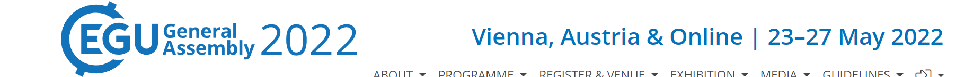
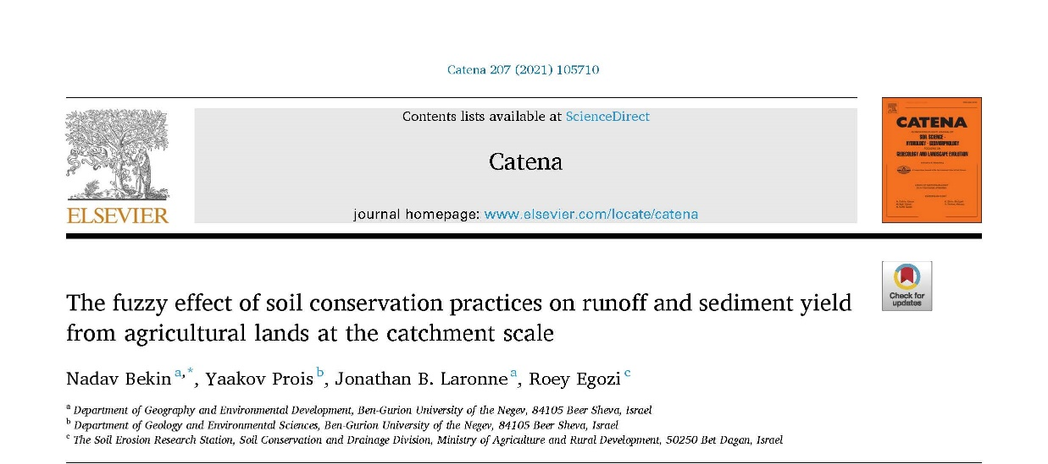
SSS2.3 - Soil Erosion, Land Degradation and Conservation

Slide 2
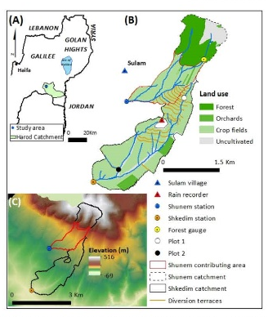
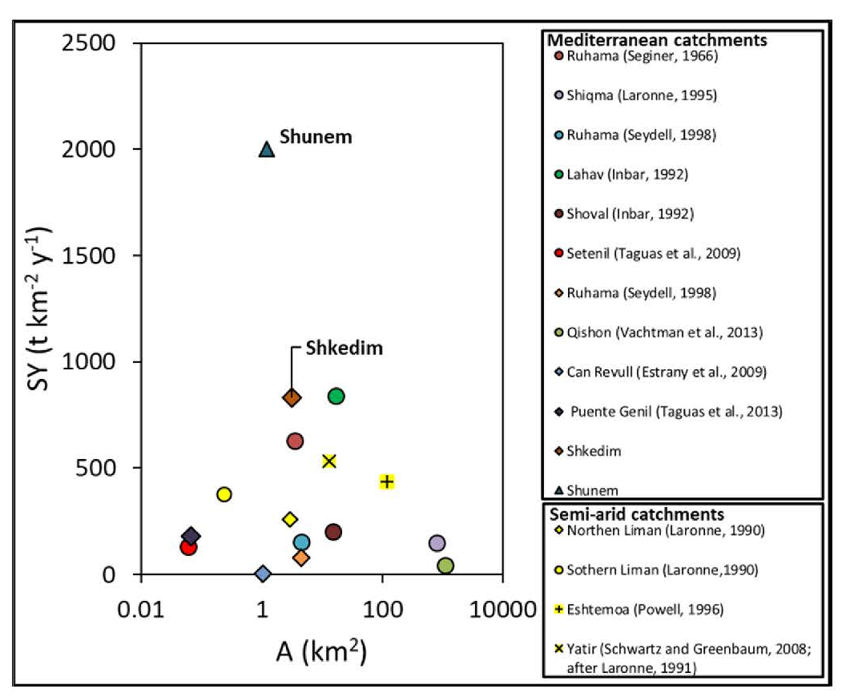
From soil erosion → to soil conservation
?

Slide 3
From soil erosion → to soil conservation

Slide 4
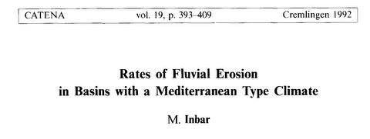
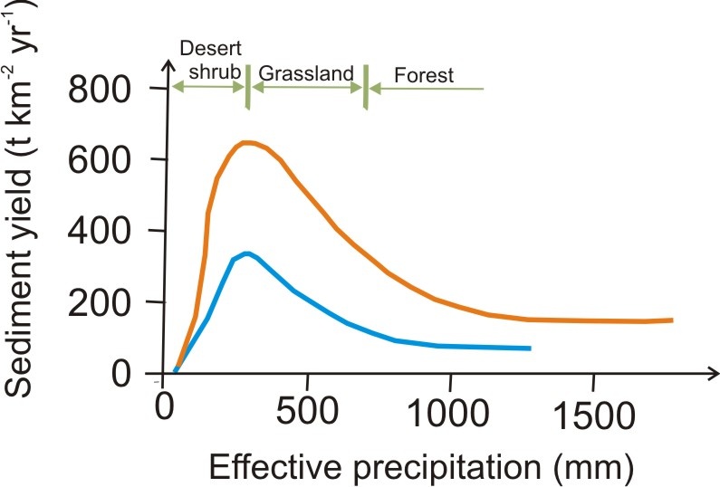
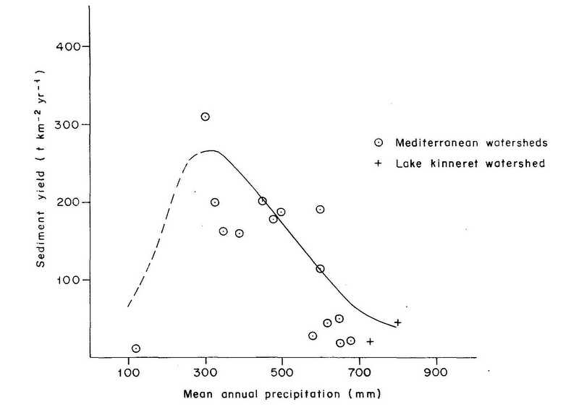
Stream data
Reservoir data
(After Langbein & Schumm, 1958)

Slide 5
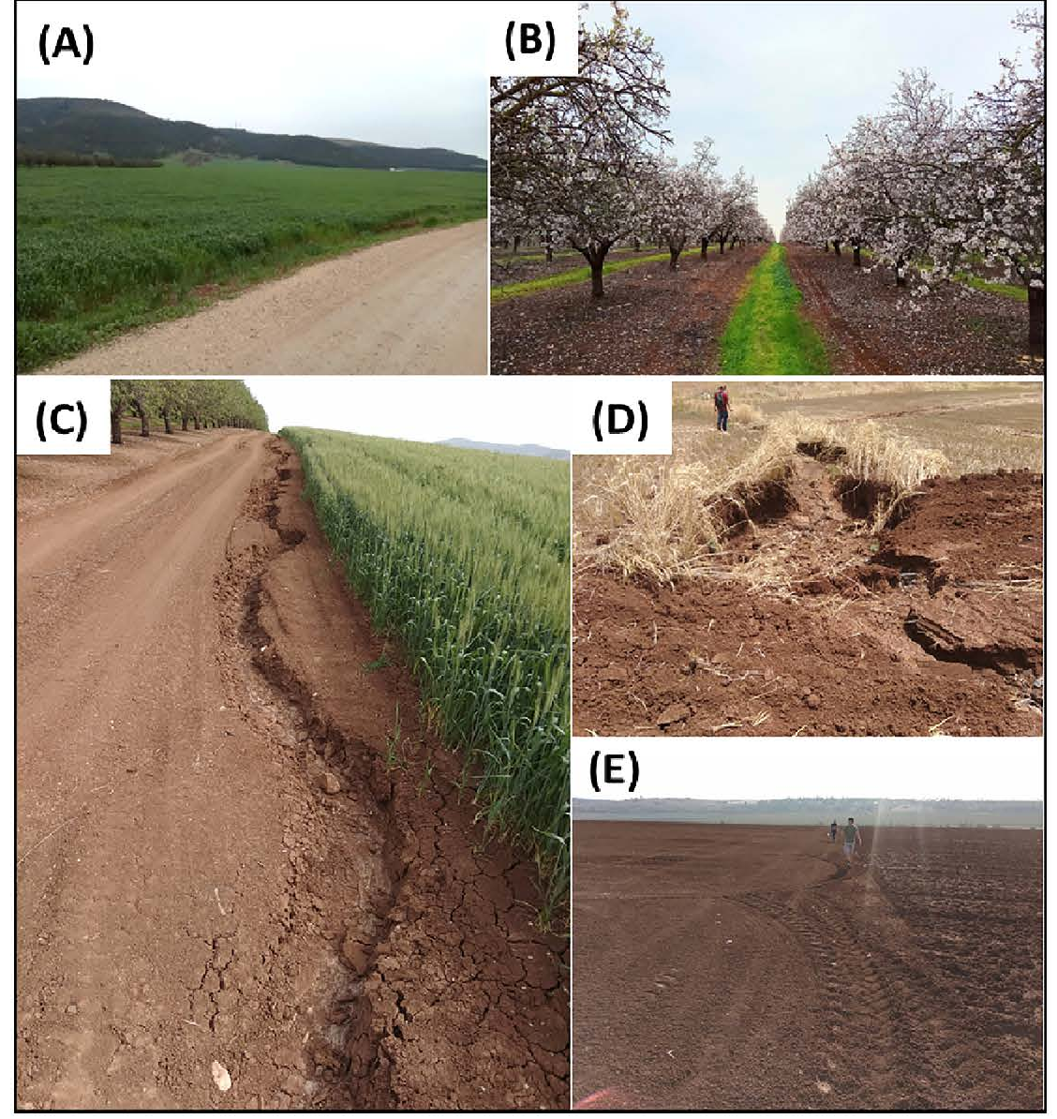
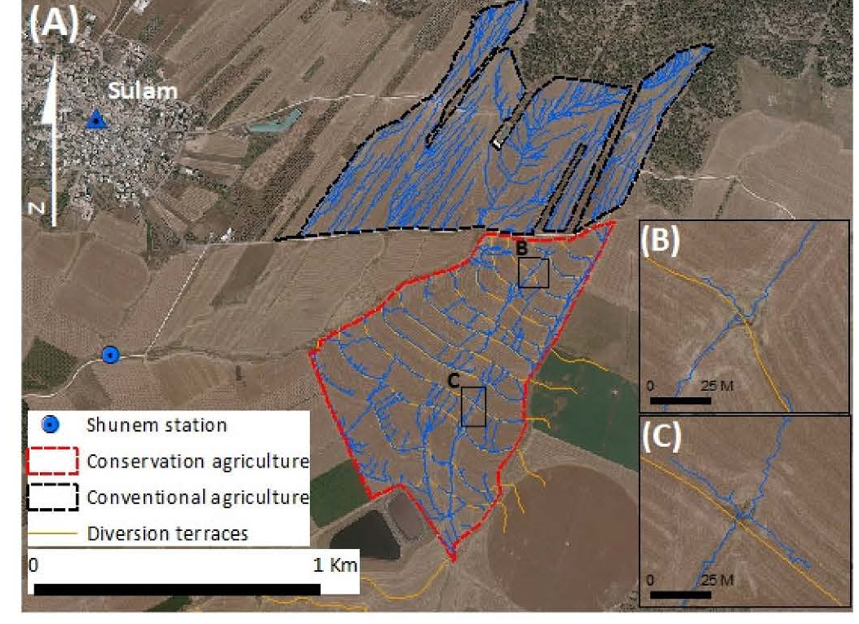

Slide 6
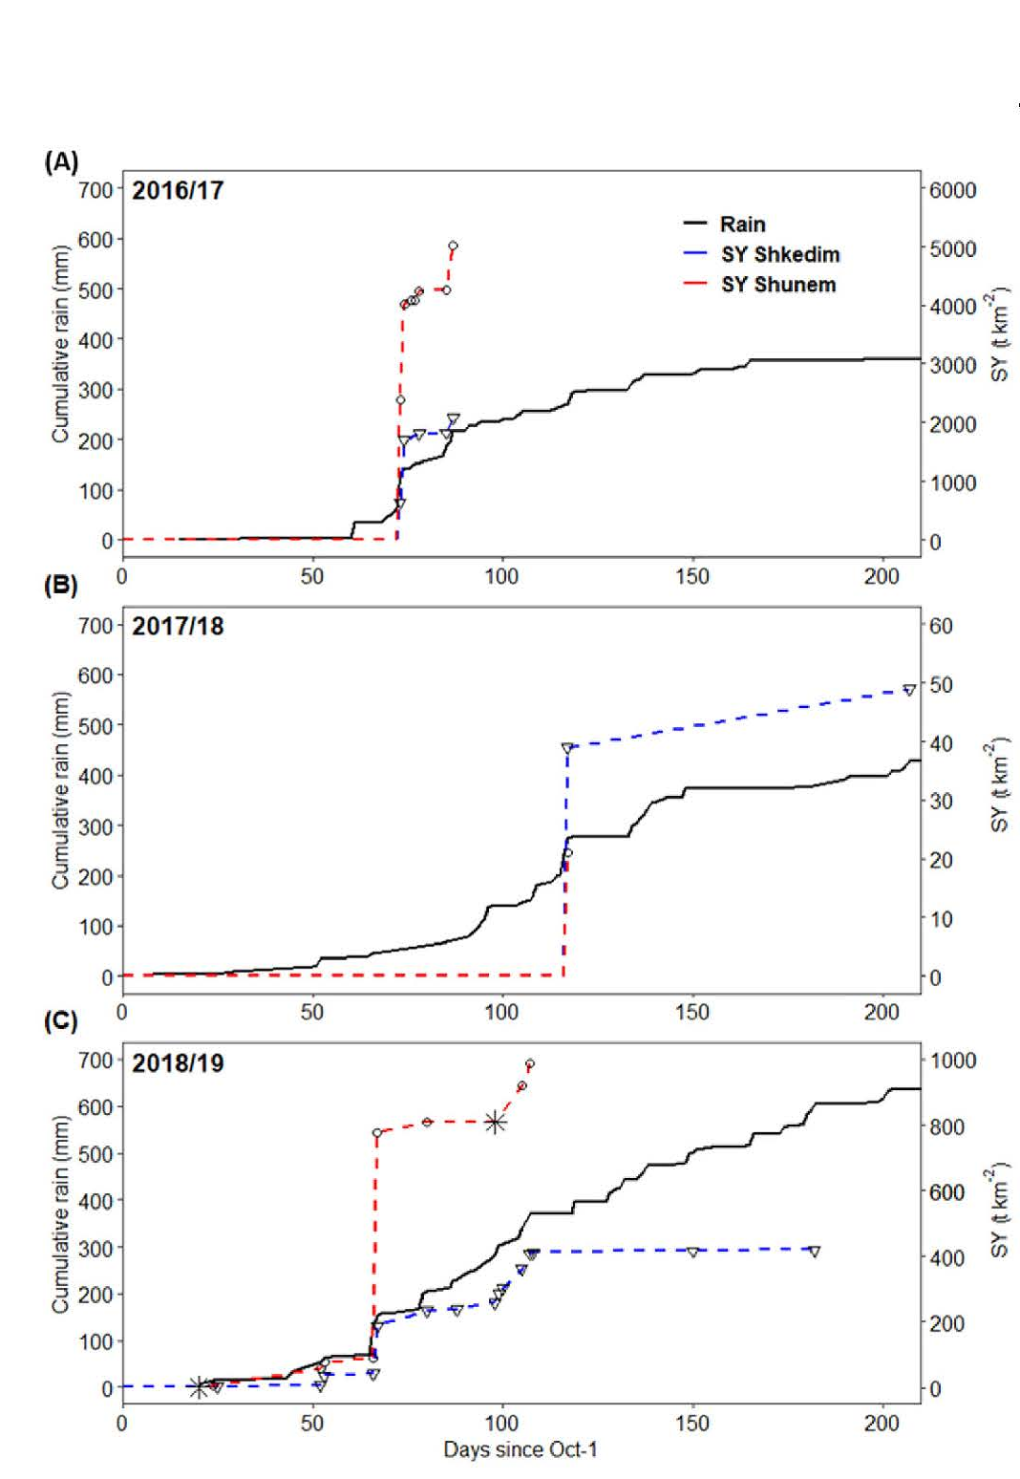
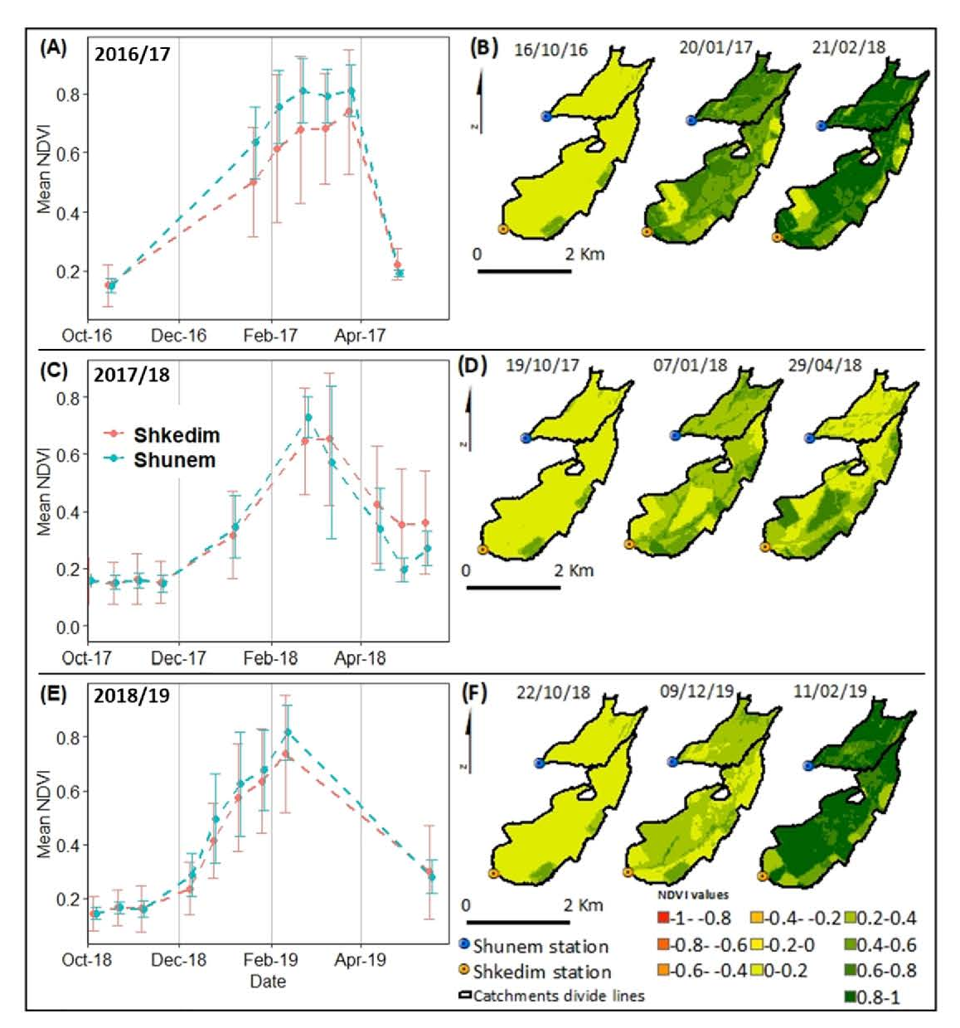

Slide 7
Take home message: Land management practices and highly erodible land features as unpaved roads, cultivation of riparian zones, and breaching of diversion terraces blur the efficiency of land management conservation of cultivated catchments. Soil conservation programs should not be planned and implemented merely on a field scale but must consider the complex nature of cultivated catchments

Slide 8
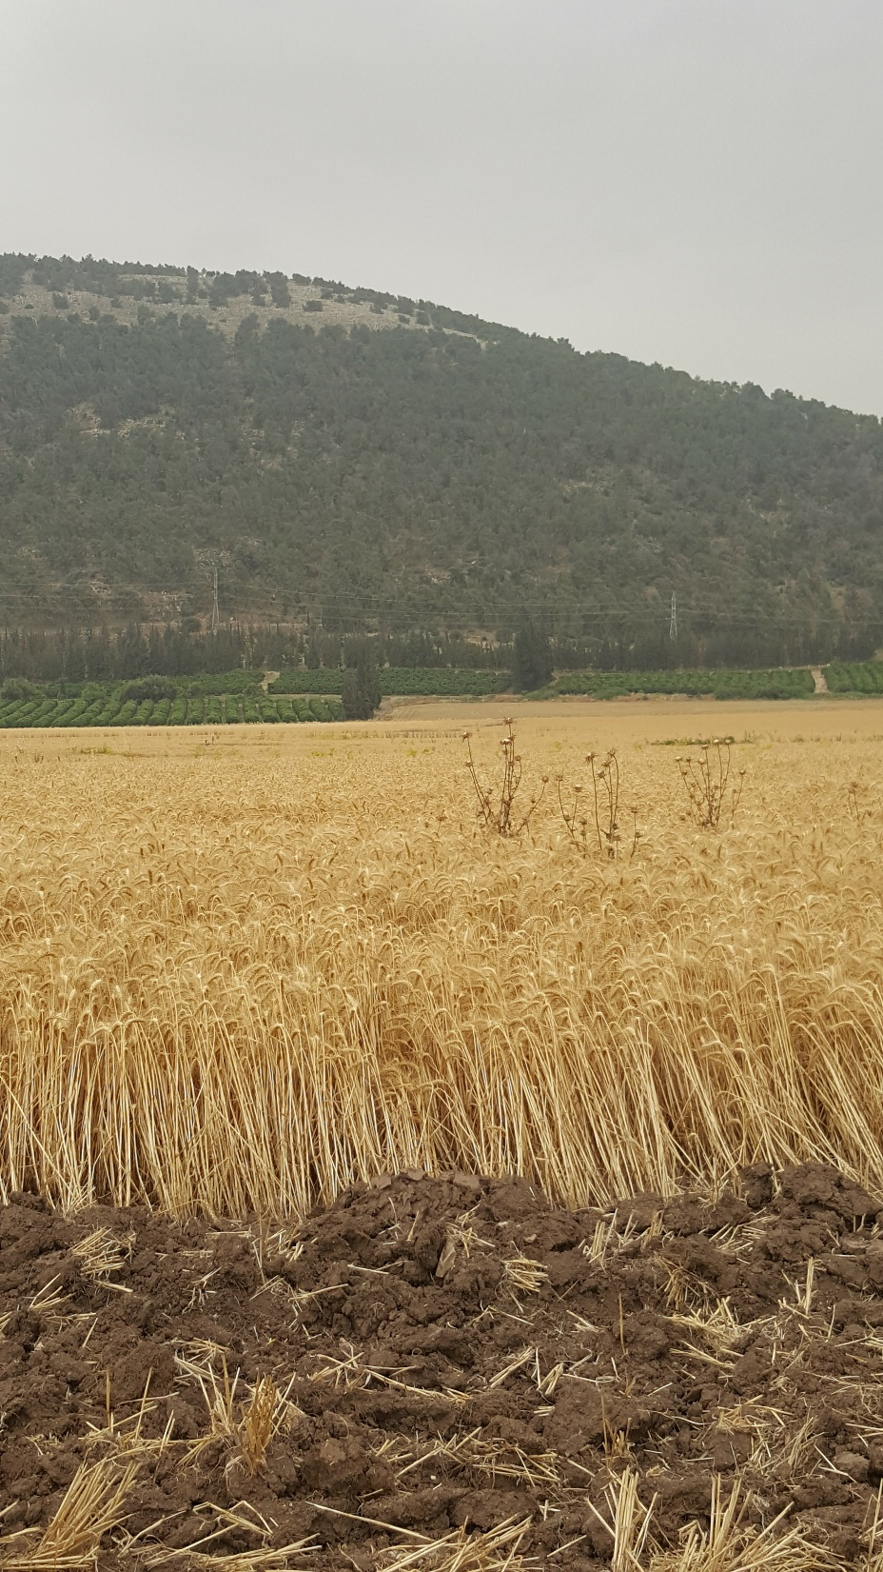


→ Thank you for your attention →Any Questions ?
The research was funded by

