Slide 1
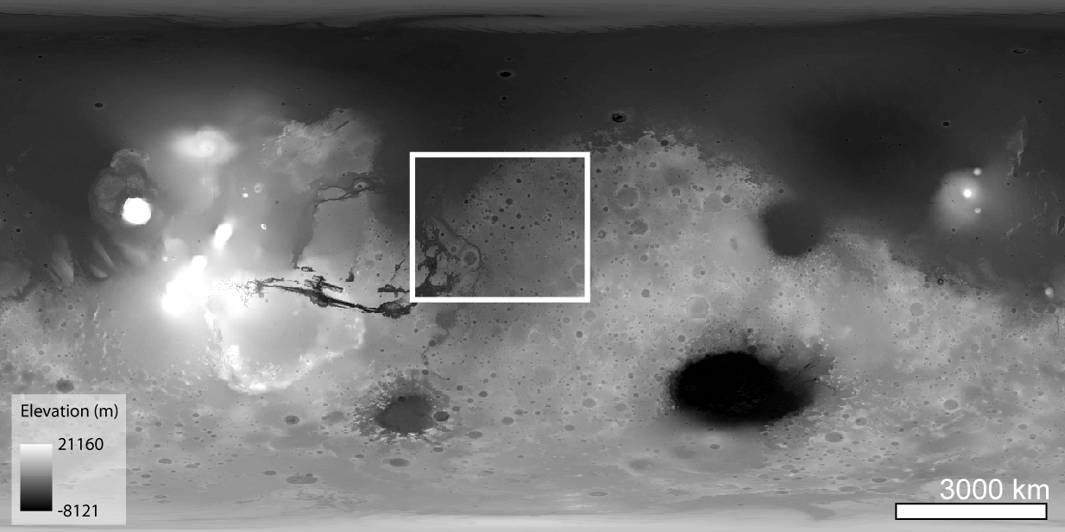
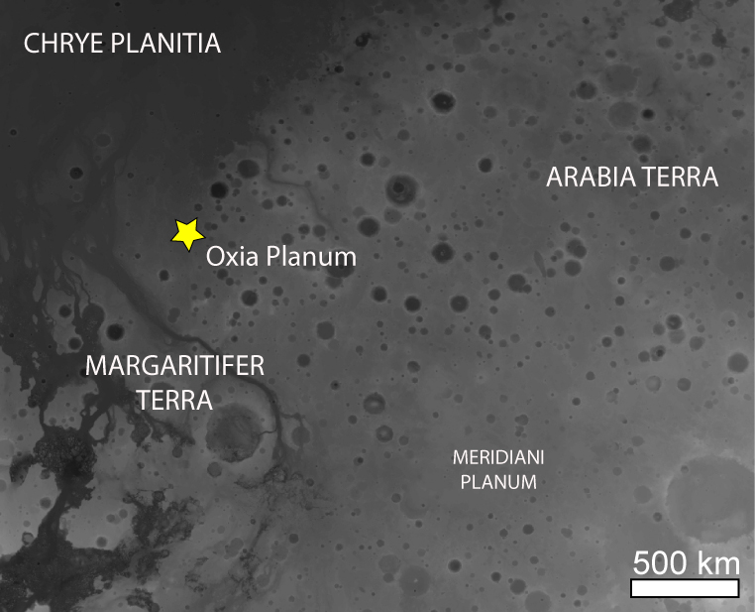
AEOLIAN BEDFORMS IN THE ESA EXOMARS 20??
LANDING SITE: A REGIONAL PERSPECTIVE
S. Silvestro^{1,2} (simone.silvestro@inaf.it),
D.A. Vaz³, M. Chojnacki⁴, A. Pacifici⁵, F. Salese⁶, M. Pajola⁷, C.I. Popa¹, G. Franzese¹, G. Mongelluzzo¹, C. Porto¹, F.Cozzolino¹ and F. Esposito¹,
(1) INAF Osservatorio Astronomico di Capodimonte, Napoli, Italy (2) SETI Institute, Mountain View, CA, USA. (3) Centre for Earth and Space Research of the University of Coimbra, Coimbra, Portugal (4) Planetary Science Institute, Lakewood, CO, USA (5) IRSPS, Università Gabriele D’Annunzio, Pescara, Italy (6) Faculty of Geosciences, Utrecht University, Utrecht, The Netherlands (7) INAF Osservatorio Astronomico di Padova, Italy
Aim:
1) provide age constraints for the formation of periodic bedrock ridges (PBRs) in Oxia Planum
2) check for a major climatic control on aeolian landforms formation

Slide 2
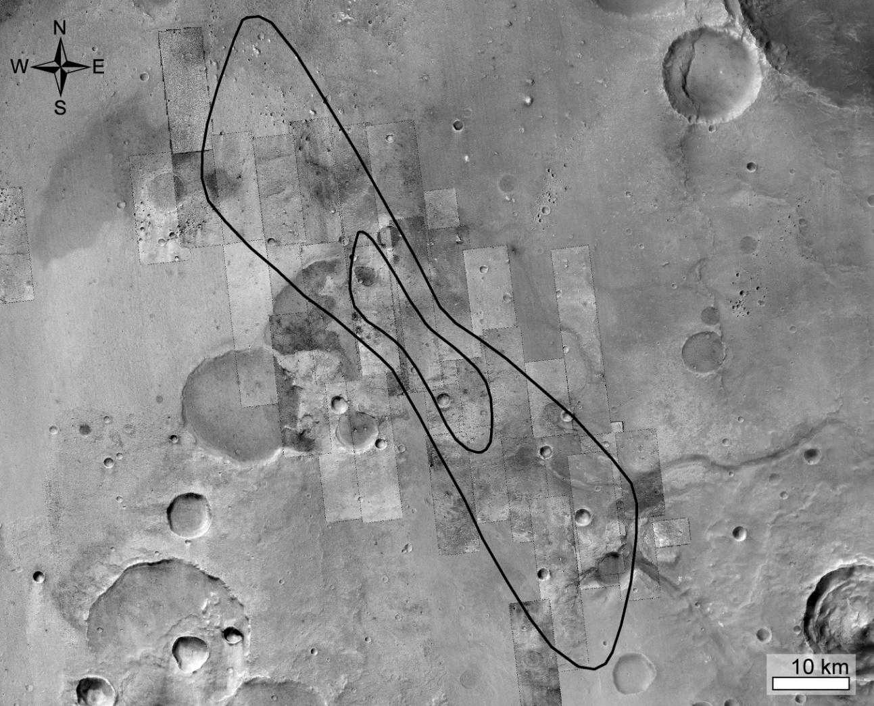
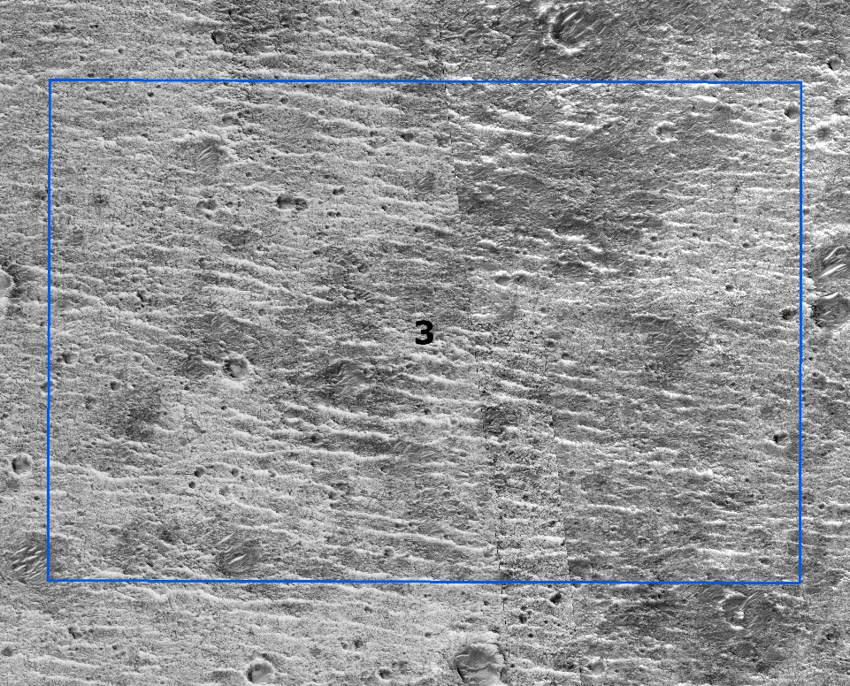
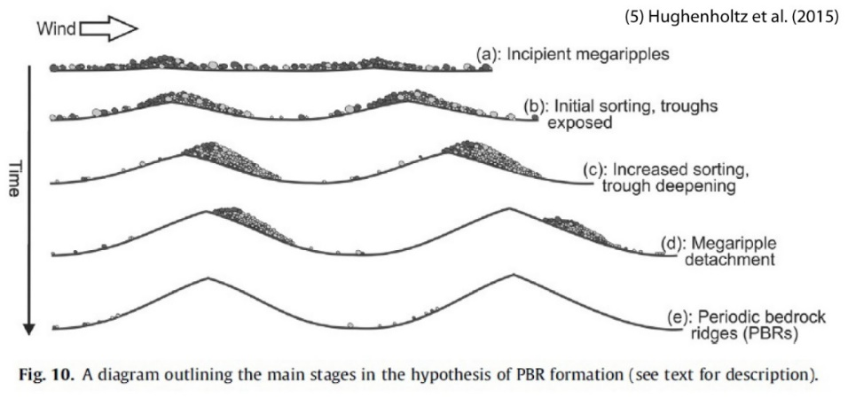
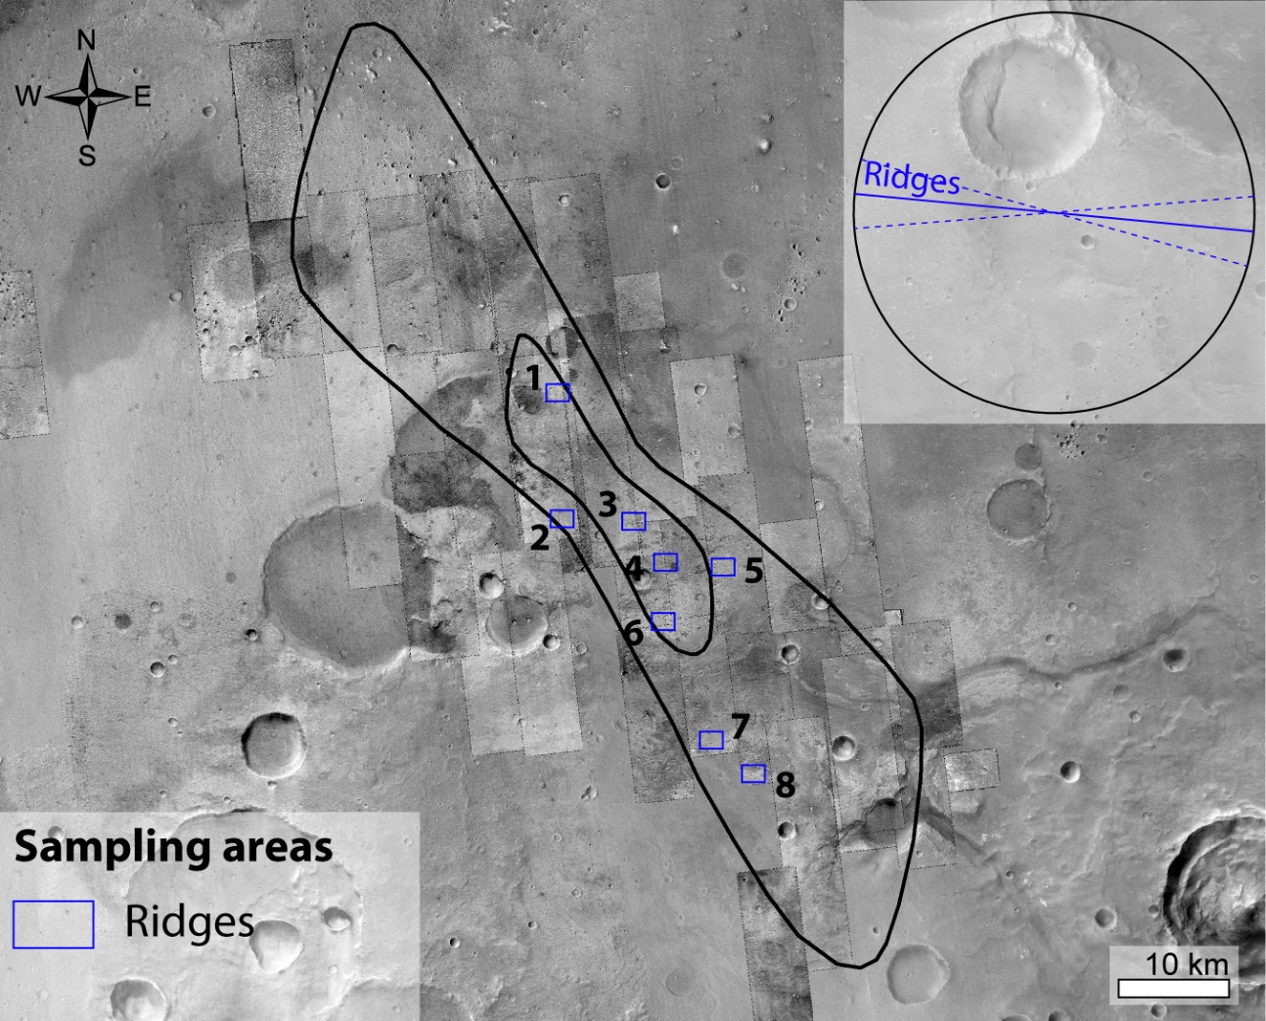
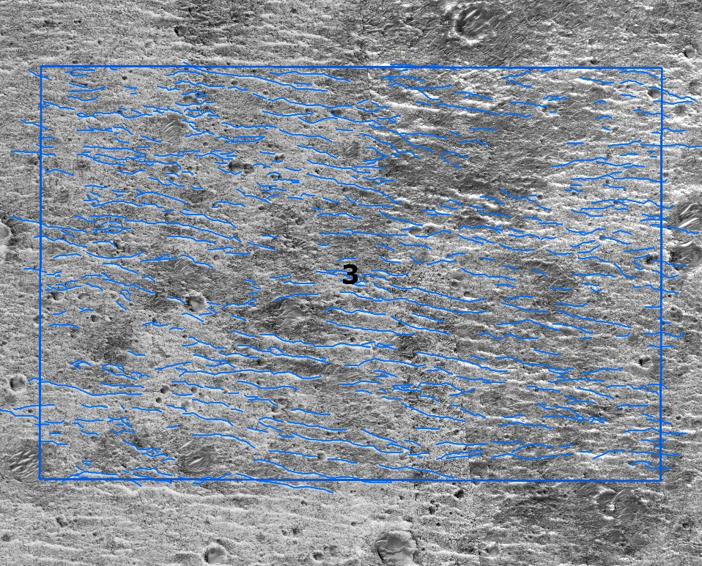
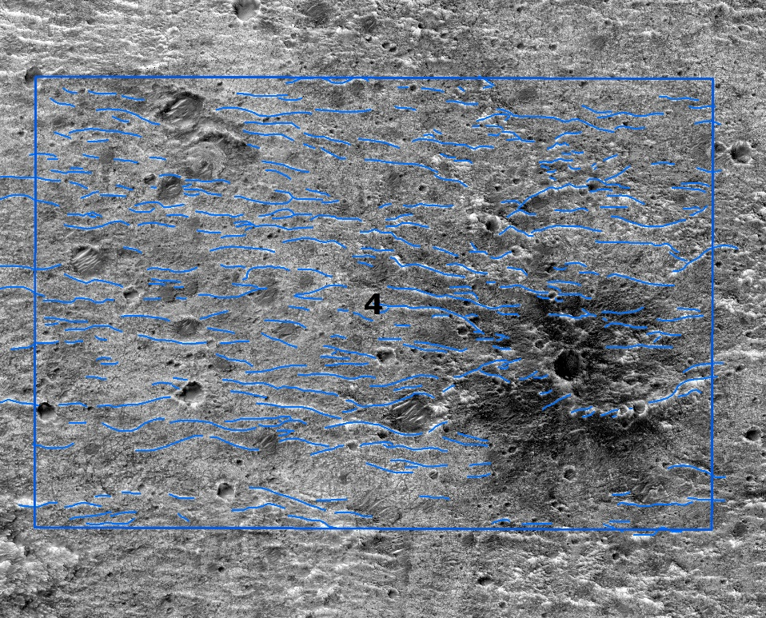
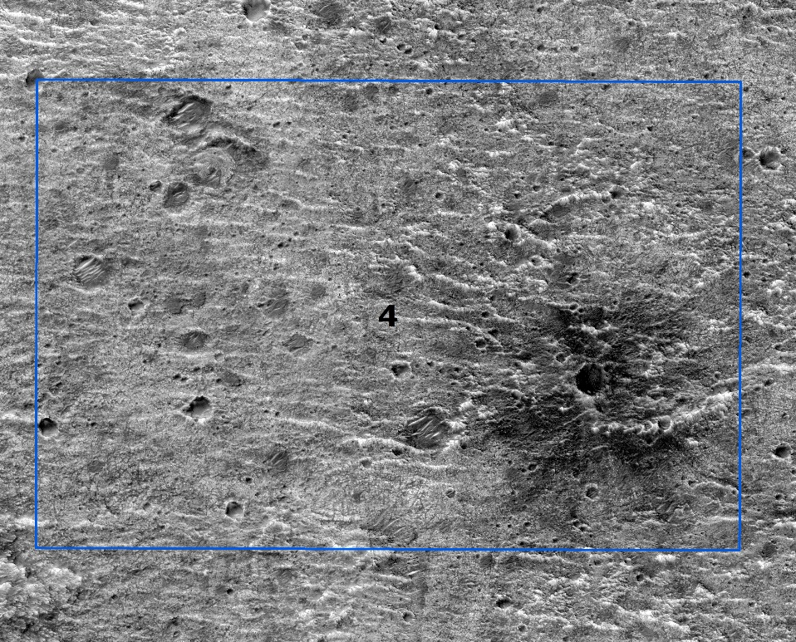
Periodic bedrock ridges (PBRs)
Erosive landforms seeded by megaripples

Slide 3
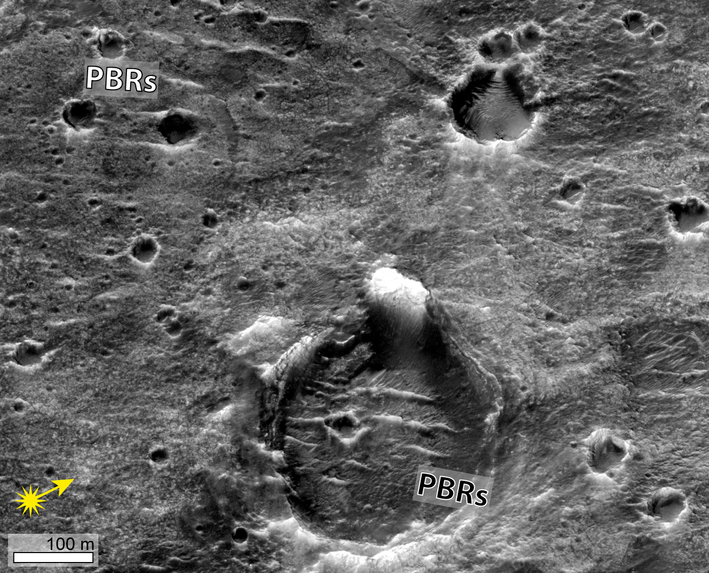
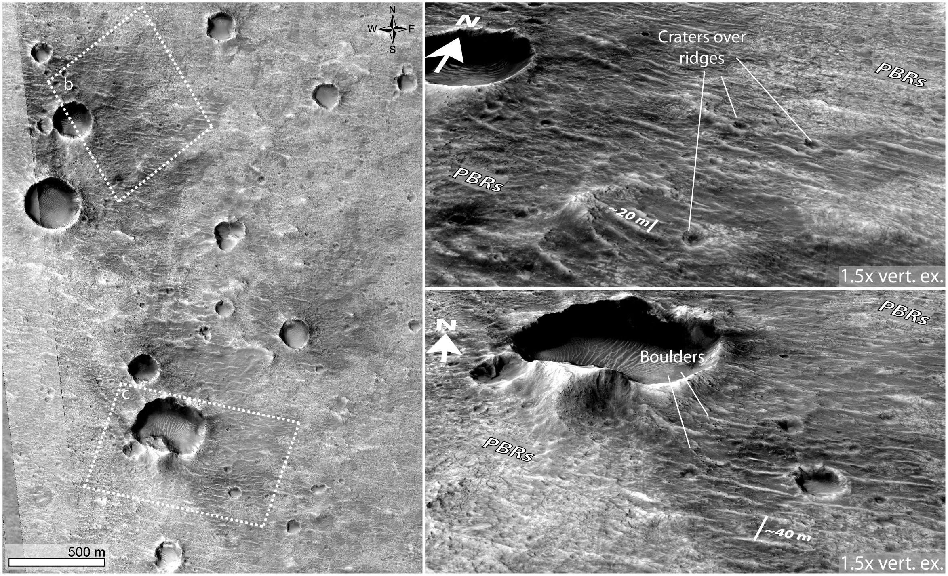
Periodic bedrock ridges (PBRs)
a
b
Relative age:
PBRs older than pristine-looking impact craters
PBRs younger than old eroded craters
c

Slide 4
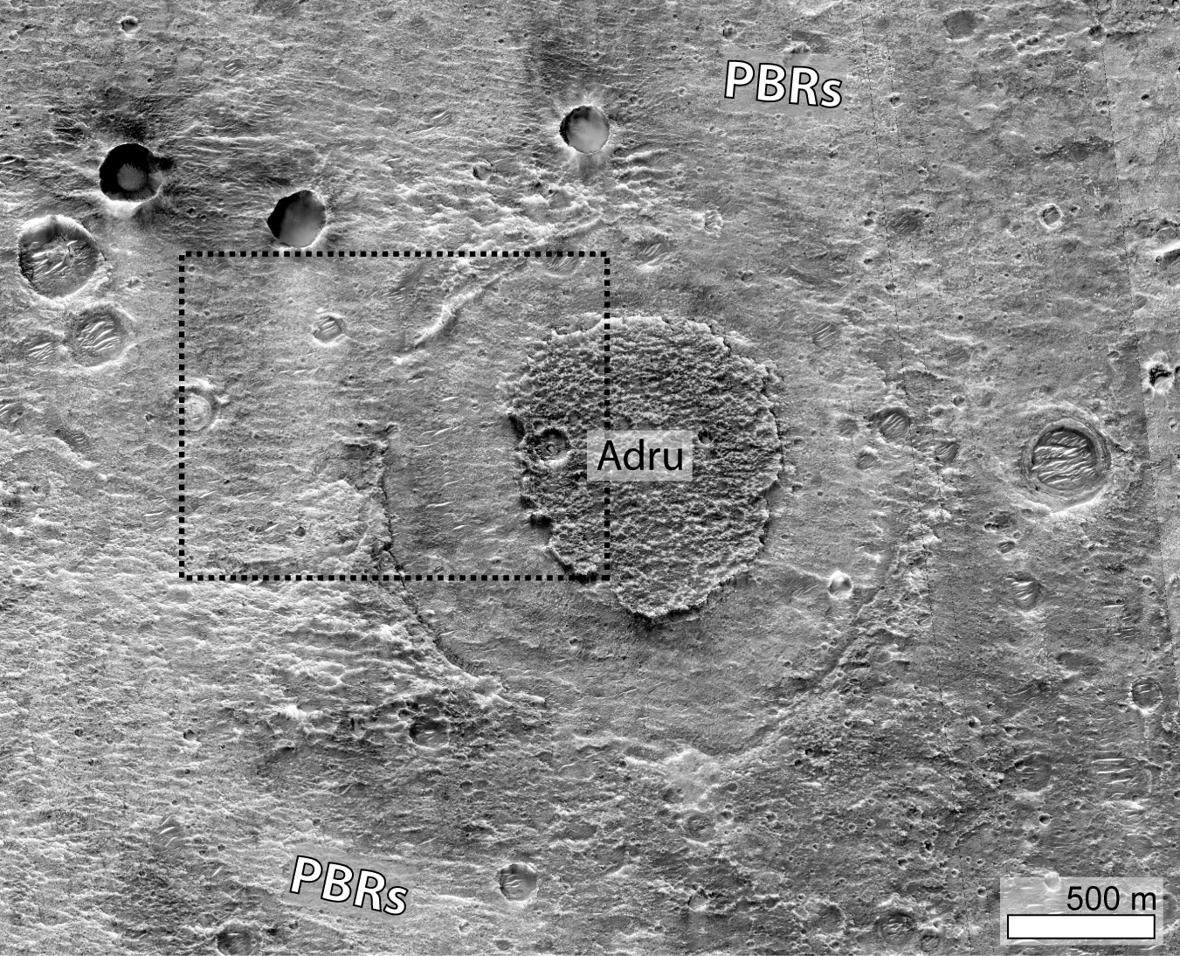
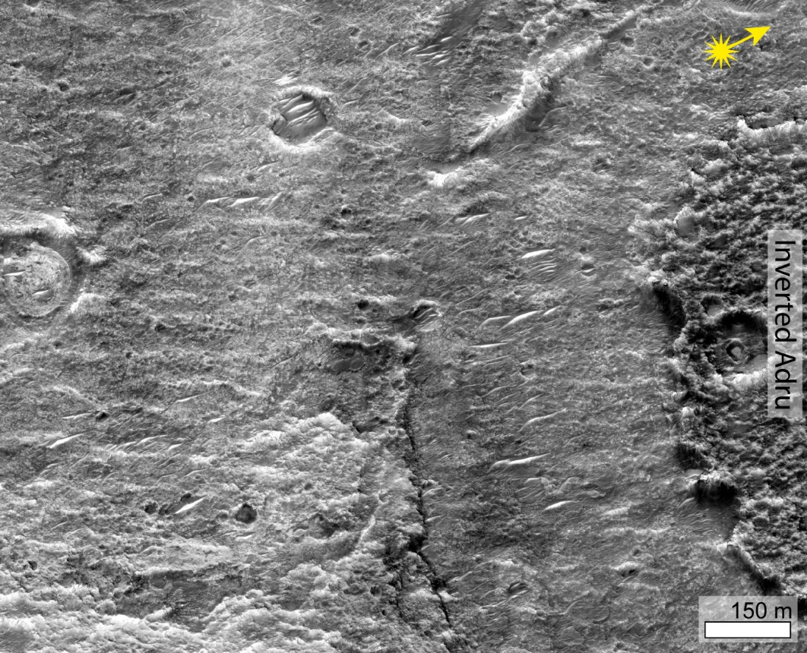
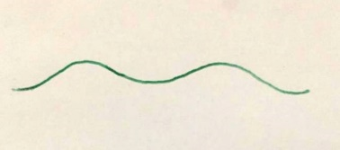
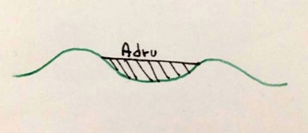
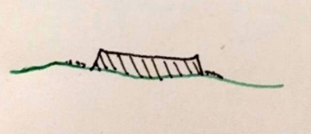
Periodic bedrock ridges (PBRs)
Adru: Amazonian dark resistant unit (Quantin et al., 2021)
4) Deposition of the PBR-seeding megaripples
1) Crater formation
2) Adru deposition
3) Crater eorsion
Early Amazonian
Increasing time

Slide 5
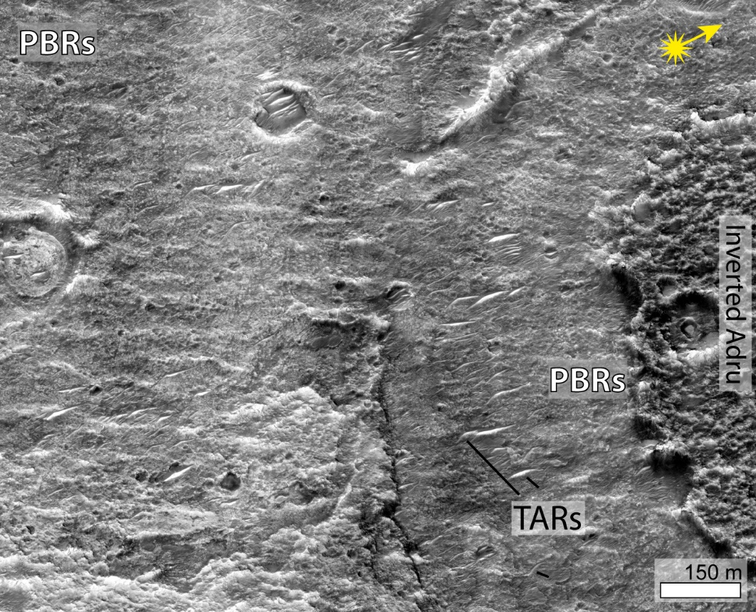
Age of Ridges - PBRs?
Adru: Amazonian dark resistant unit (Quantin et al., 2021)
4) Deposition of the PBR-seeding megaripples
5) Formation of the PBRs
6) TARs (megaripples)
deposition
1) Crater formation
2) Adru deposition
3) Crater eorsion
Early Amazonian
Increasing time

Slide 6
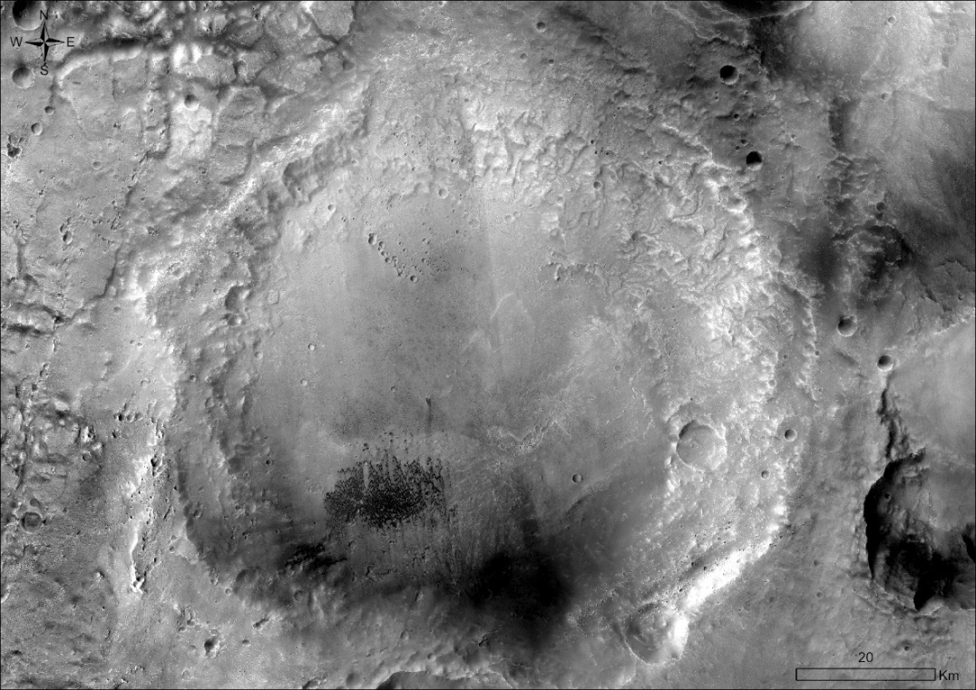
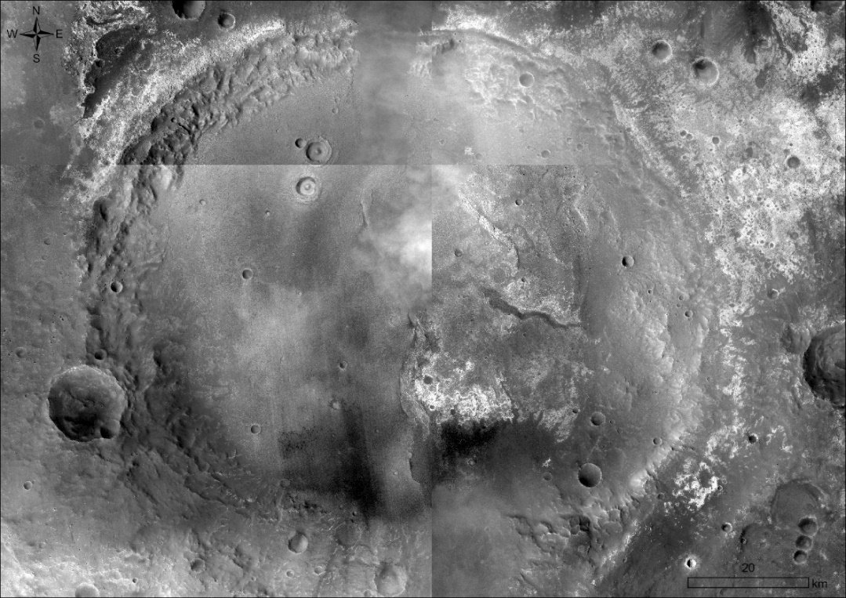
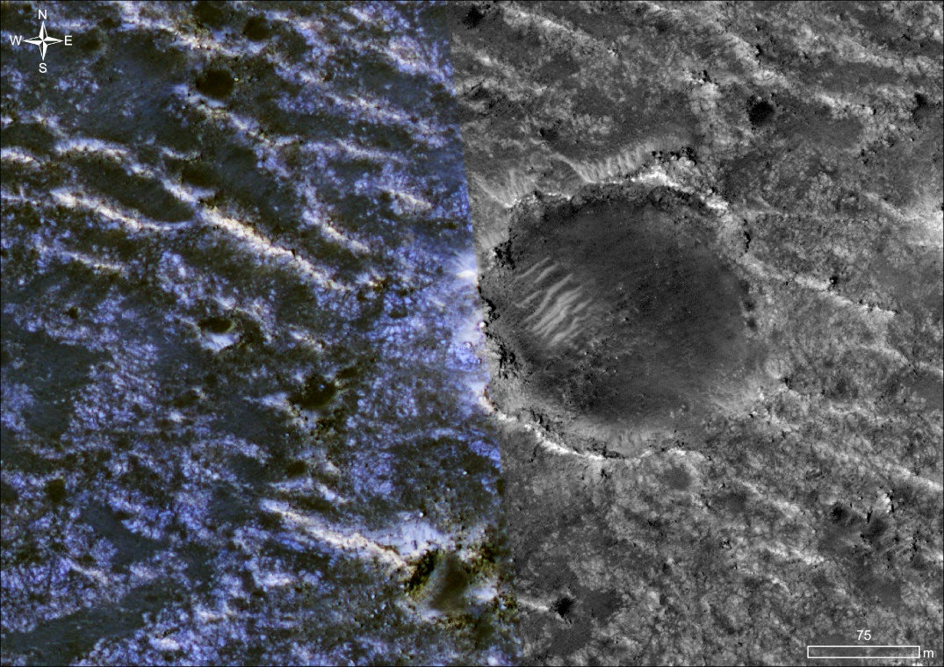
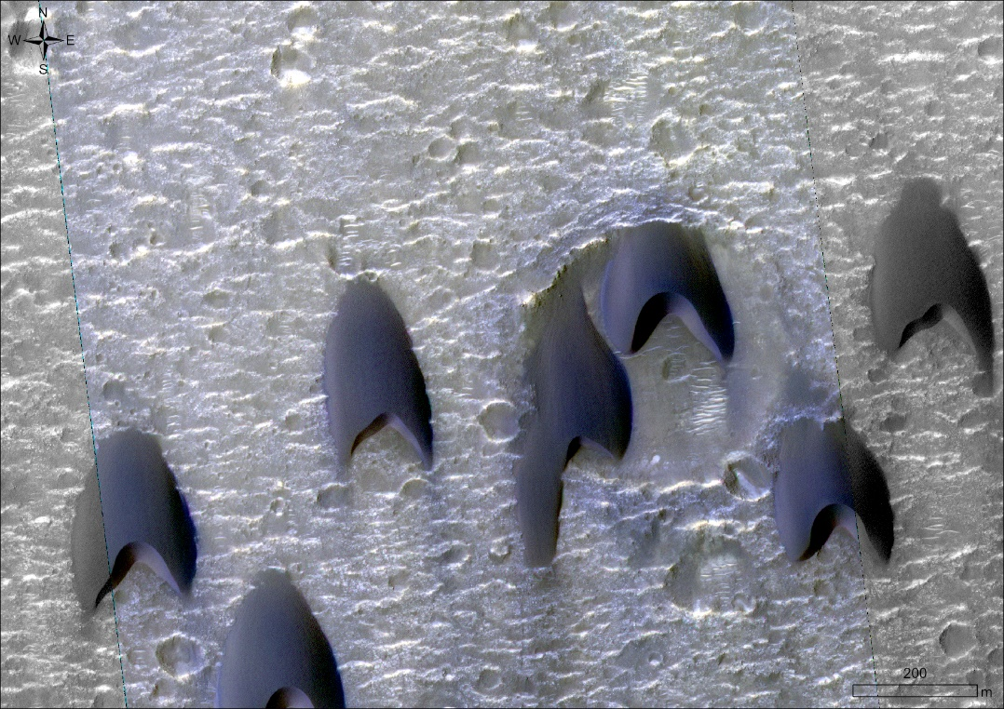
Periodic bedrock ridges (PBRs) and TARs in McLaughlin and Oyama crater
McLaughlin
Oyama
McLaughlin and Oyama craters show ~EW-oriented rocky ridges that can be interpreted as PBRs too!
Superposed by younger TARs (megaripples)!
And dunes…

Slide 7
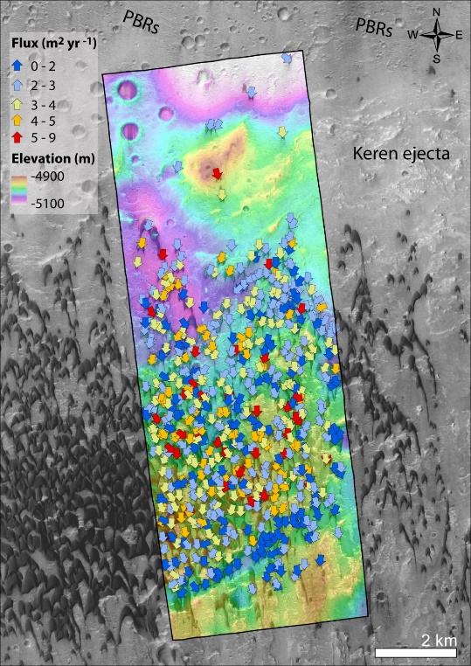
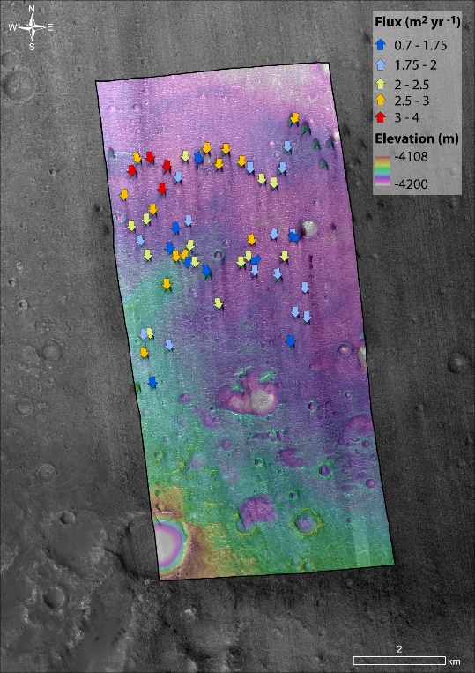
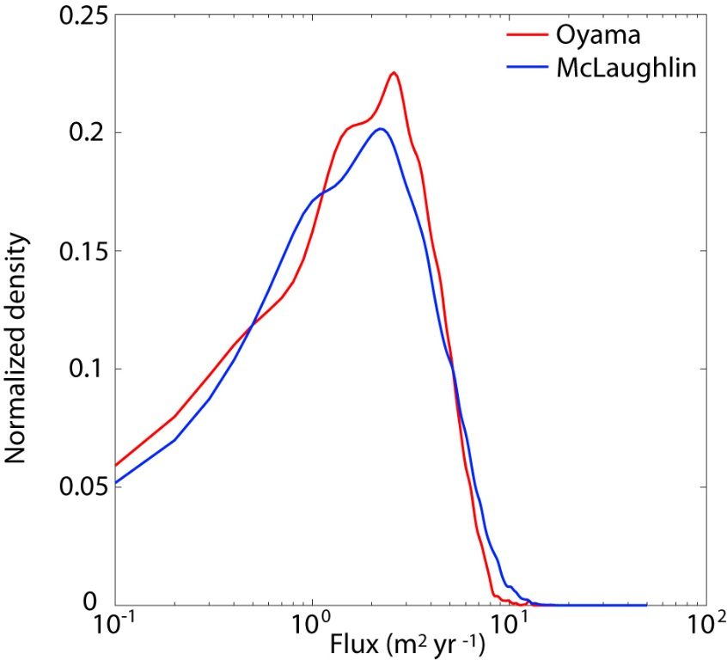
Dunes
McLaughlin
Similar dune fluxes
Topographic controls on dune deposition and fluxes
2008-2019, DT 7.6 yr
Oyama
2013-2019, DT 5.7 yr

Slide 8
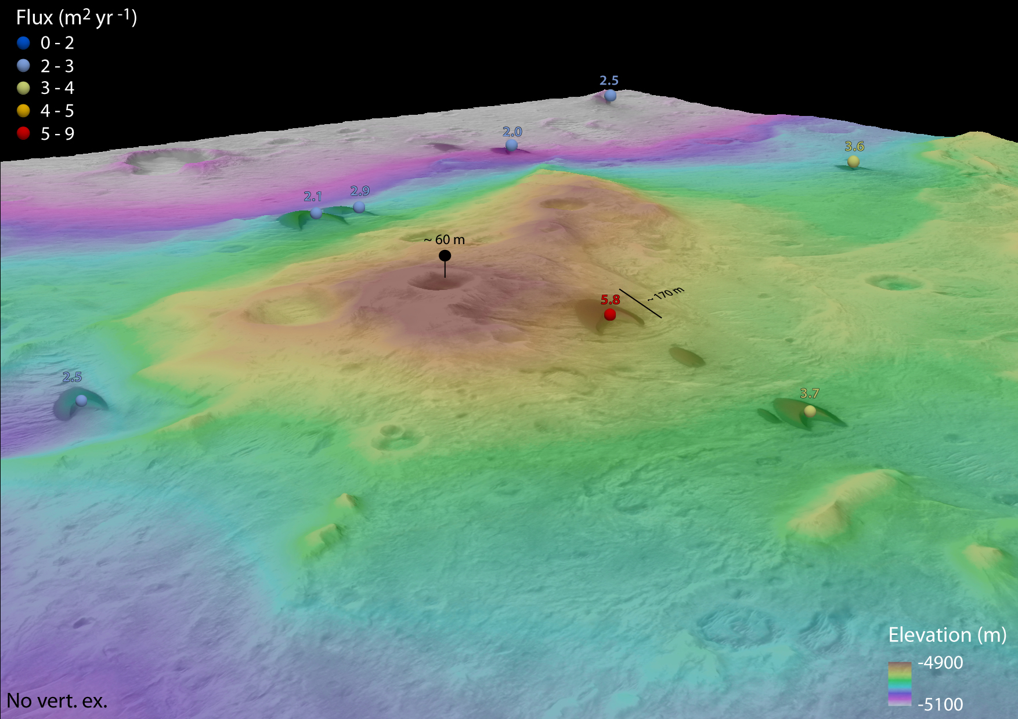
Dunes
Topographic effect on dune crest fluxes in McLaughlin crater: wind and sediment funneling

Slide 9
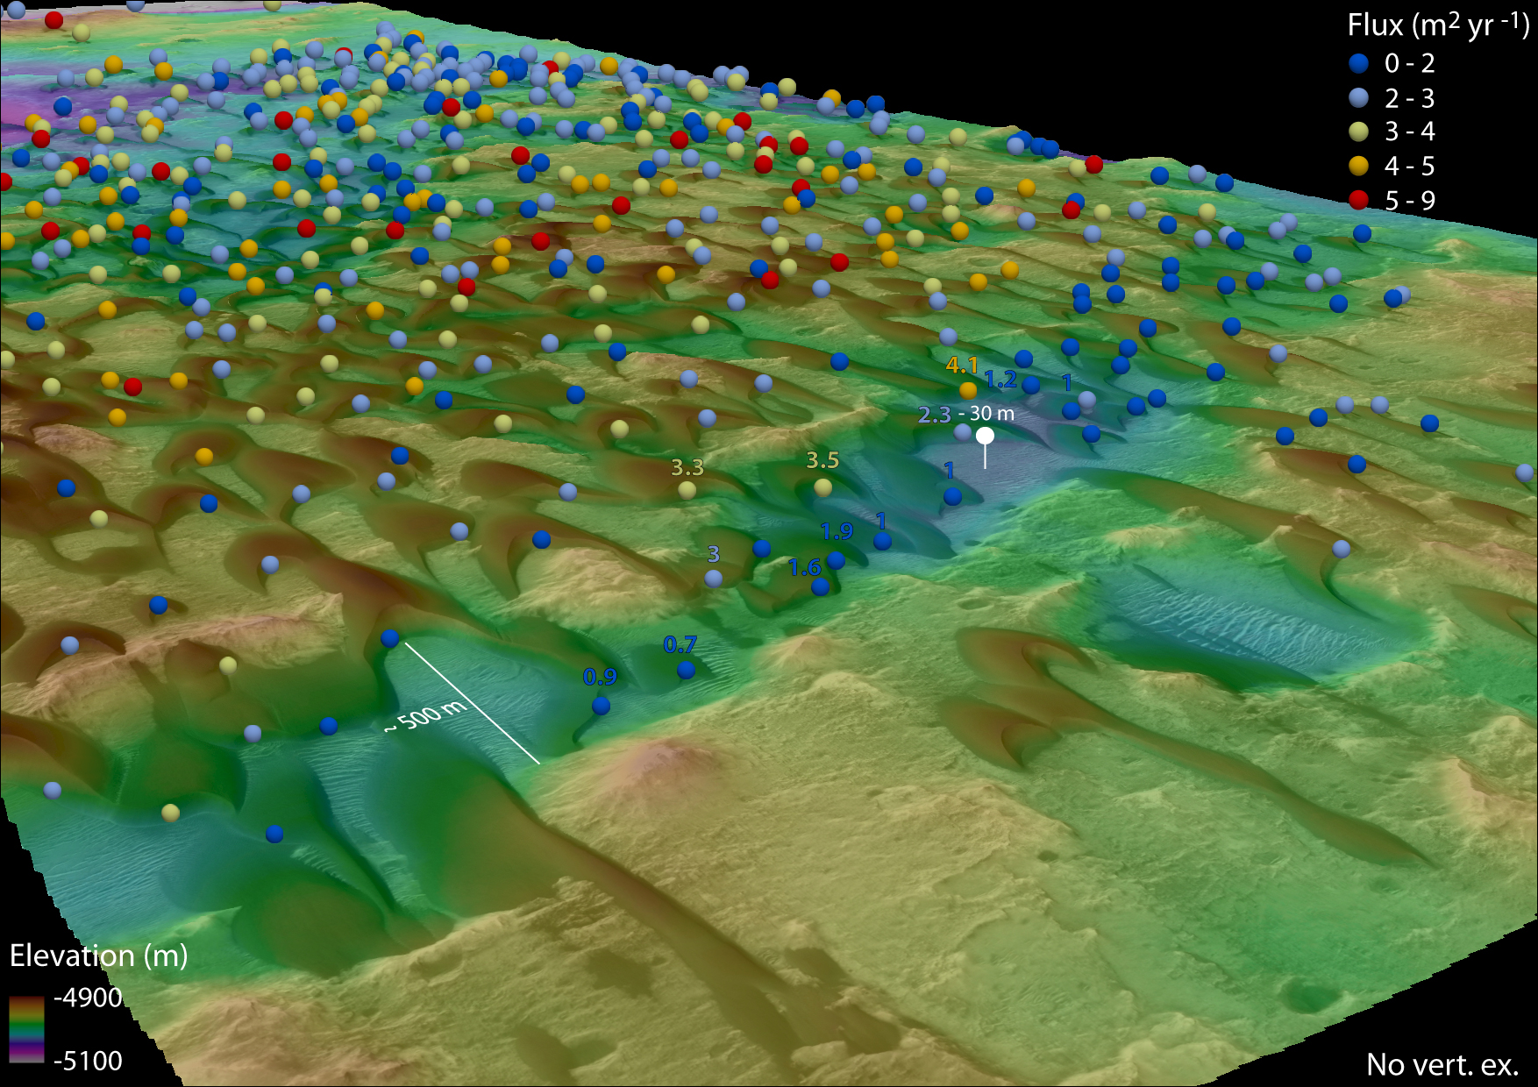
Dunes
Topographic effect on dune crest fluxes in McLaughlin crater: low flux dunes inside trough

Slide 10
Conclusions
Complex hystory of erosion and deposition in Oxia Planum and its surroundings (Oyama and Mclaughlin craters)
We give relative age constraints for the formation of periodic bedrock ridges (PBRs) in Oxia Planum
Winds that formed the PBRs were blowing regionally, as suggested by the presence of PBRs in McLaughlin and Oyama craters
We highlight a major change in the wind regime that, in the Amazonian epoch, led to the formation of TARs
Dunes in McLaughlin and Oyama are migrating toward the south with similar fluxes. Dune fluxes at the dune scale are topographically controlled

