Slide 1





, a software framework for the
Earth System community:
Overview and new features
Etor E. Lucio-Eceiza^{1,2}, Christopher Kadow², Martin Bergemann², Mahesh Ramadoss^{1,2}, Brian Lewis², Andrej Fast², Jens Grieger¹, Andy Richling¹, Ingo Kirchner¹, Uwe Ulbrich¹, Hannes Thiemann², and Thomas Ludwig²
Freie Universität Berlin¹, Deutsches Klimarechenzentrum²
lucio-eceiza@dkrz.de
Talk @ EGU 2022: ESSI3.3
Mon 23rd May 2022

Slide 2
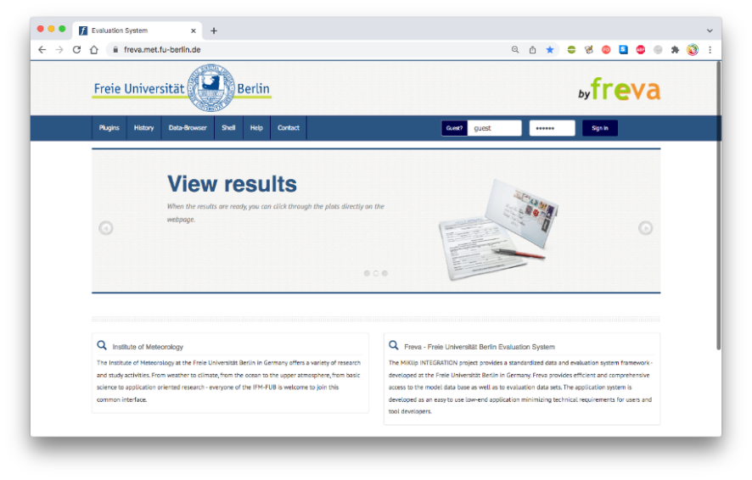
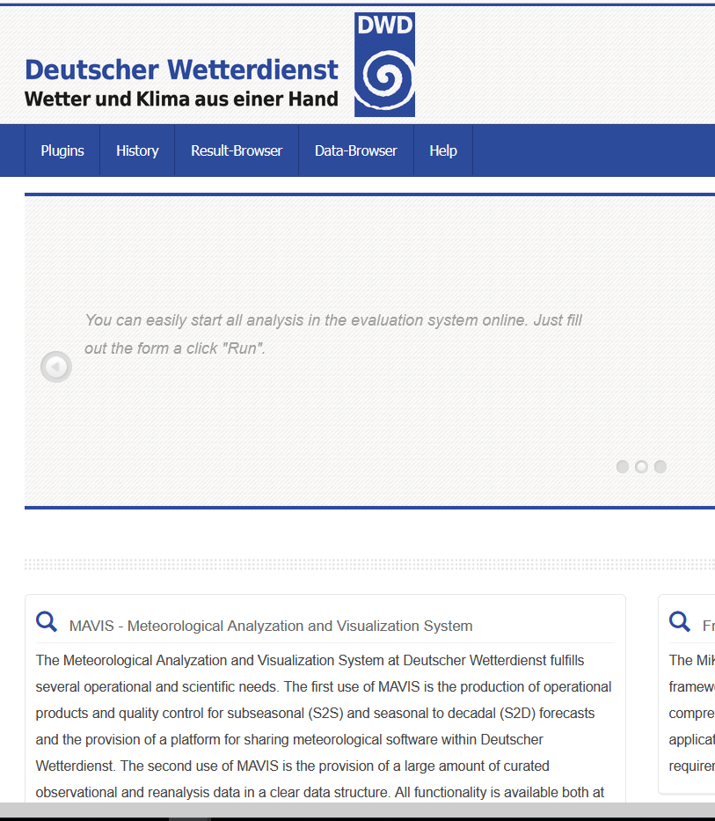
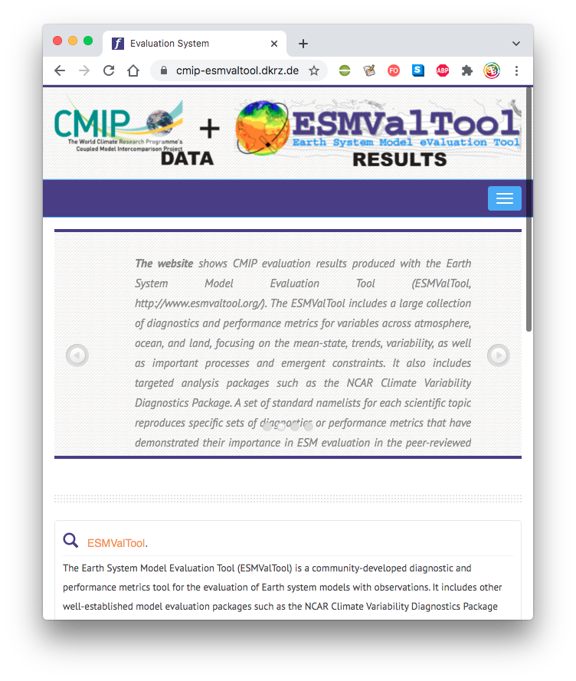

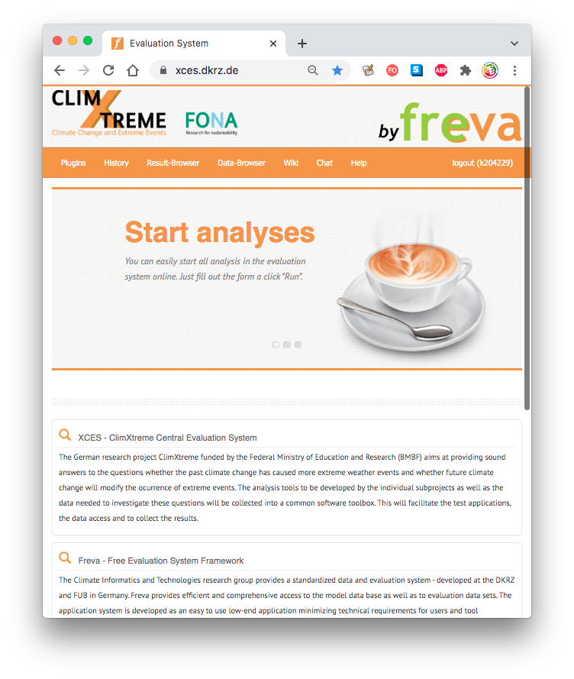


What is freva?
Software infraestructure for Earh system community.
For Big Data Analysis
For HPC environment
Written in python 2.7
Accesible via shell and web
Offers:
  Standardized database
  API for data evaluation tools (plugins)
  History of evaluations
python 3 !
Etor E. Lucio-Eceiza – Freva, a software framework for the Earth System community: Overview and and new features EGU 2022:ESSI3.3 - 23.05.2022
1

Slide 3

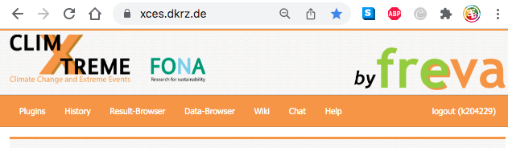
Usability & flexibility
Hybrid access
Similar features
shell
web
> ssh <user>@hpc
user@hpc $ module load freva
Freva
Available commands:
plugin : Applies some analysis to the given data.
history : provides access to the configuration history
databrowser : Find data in the system
crawl_my_data: Use this command to update your projectdata.
esgf : Browse ESGF data and create wget script
$ module load freva
freva plugin
freva history
freva databrowser
www.xces.dkrz.de
Plugins
History
Data-Browser
Etor E. Lucio-Eceiza – Freva, a software framework for the Earth System community: Overview and and new features EGU 2022:ESSI3.3 - 23.05.2022
2

Slide 4

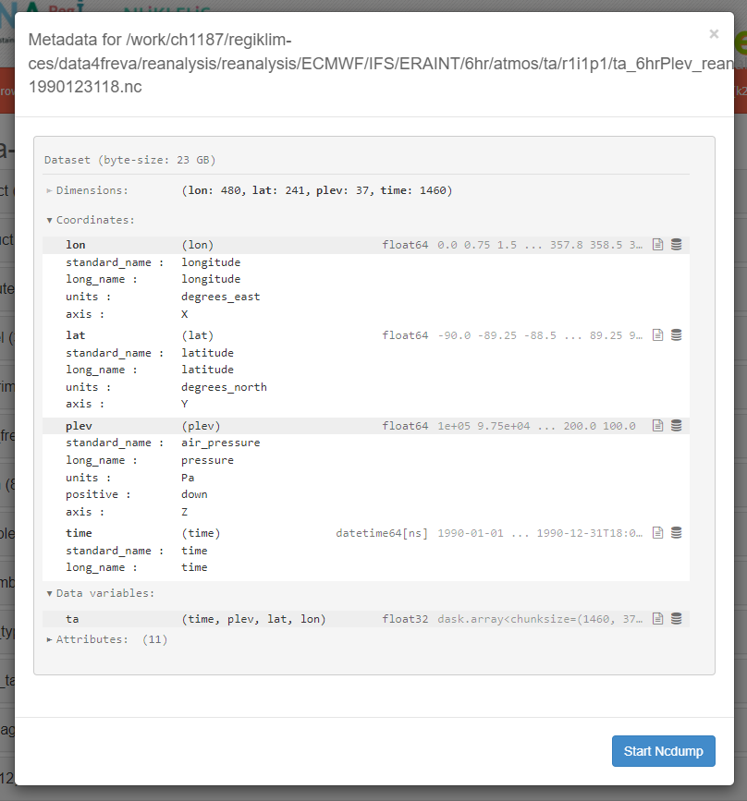
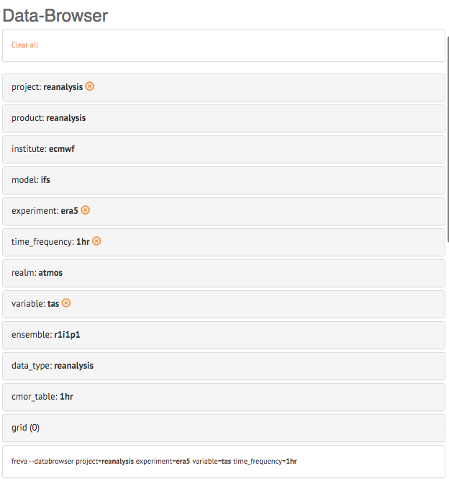
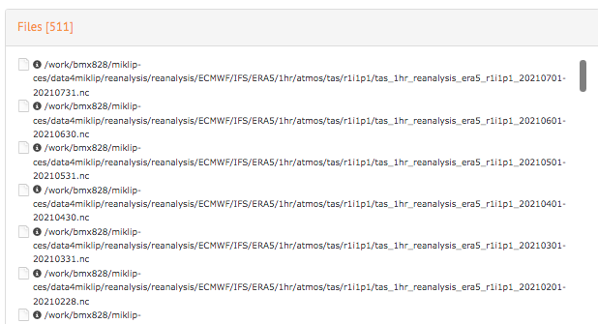
Data access
Follows CMOR & accesses several ESGF standards
Data ingested via SOLR Apache
More than 15 million of datafiles!
More than 6.6 PB!
Etor E. Lucio-Eceiza – Freva, a software framework for the Earth System community: Overview and and new features EGU 2022:ESSI3.3 - 23.05.2022
3

Slide 5
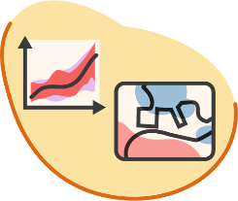
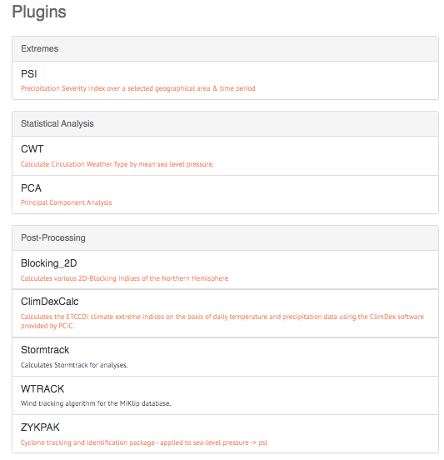
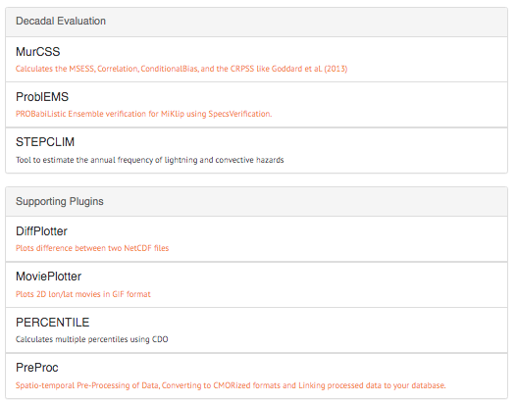
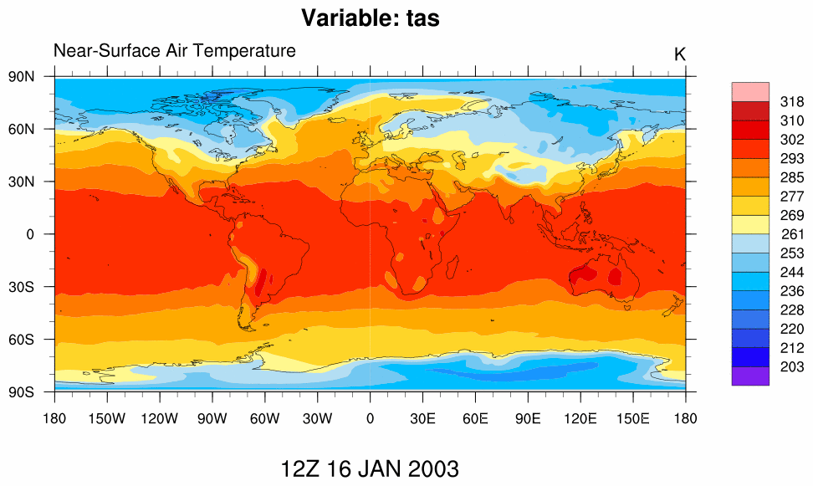
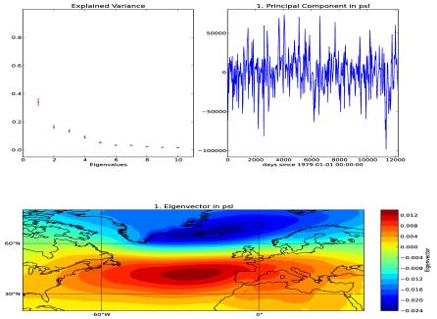
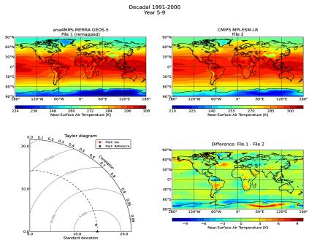
Data analysis
Flexible programming language (non commercial software)
Standardized API (Python 3.x)
MoviePlotter
Main program: any language
./movie_plotter.sh /path/2/INPUT /path/2/OUTPUT
PCA
from evaluation_system.api import plugin
class MoviePlotter(plugin.PluginAbstract):
__short_description__ = "Plots 2D lon/lat movies in GIF format"
__version__ = (0,0,1)
__parameters__ = ParamDict(
input = (None, dict(type=str, mandatory=True, help='File to be plotted')),
outputdir = (None, dict(type=str, mandatory=True, help='default output dir'))
)
def run_tool(self, config_dict=None):
input = config_dict['input']
outputdir = config_dict['outputdir']
result = self.call(f"{self.class_basedir}/movie_plotter.sh {input} {outputdir}")
DiffPlotter
Plugin API (Wrapper): in python
NCL
$ freva plugin MoviePlotter input=/path/2/tas_Amon_MPI-ESM-LR_decadal2000_r1i1p1_2003.nc outputdir=./
C++
Python
Etor E. Lucio-Eceiza – Freva, a software framework for the Earth System community: Overview and and new features EGU 2022:ESSI3.3 - 23.05.2022
4

Slide 6

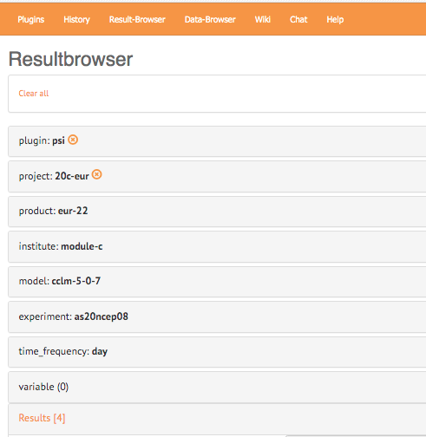
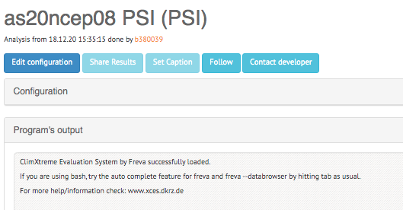
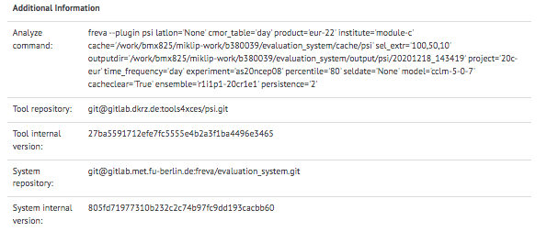
Transparency & reproducibility
Every configuration is stored in MySQL database
Every configuration is searchable
Every configuration can be modified & re-run
It even stores plugin & freva Git versioning!
Saves CPU hours, I/O, and storage!
Etor E. Lucio-Eceiza – Freva, a software framework for the Earth System community: Overview and and new features EGU 2022:ESSI3.3 - 23.05.2022
5

Slide 7




New features
Freva functions: direct call via python client
  Within Plugins
  for jupyter notebooks
Deployment:
  easier and more convenient (Ansible)
  containerized and configurable(Docker)
System configuration: more secure, via Vault integration.
Dataset incorporation (Rust):
  Different DRS types (CORDEX, CMIP6) into CMIP5
  Custom types
import freva
files = freva.databrowser(project='obs*‚,
institute='cpc', variable='pr')
print(files)
Etor E. Lucio-Eceiza – Freva, a software framework for the Earth System community: Overview and and new features EGU 2022:ESSI3.3 - 23.05.2022
6

Slide 8
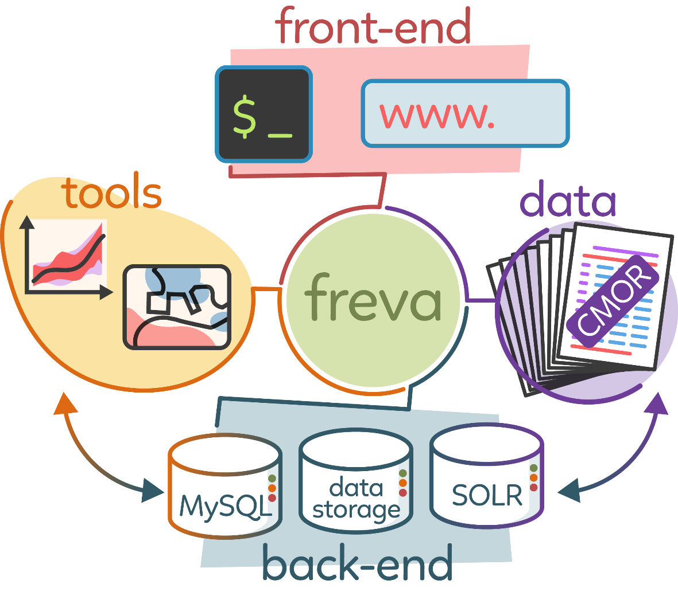
Summary
Flexibility
Transparency
Centralization
Standardization
Big Data Analysis
HPC resource management
Info (as guest):
  freva.met.fu-berlin.de
  www.xces.dkrz.de
  www-regiklim.dkrz.de
code: https://github.com/FREVA-CLINT/Freva
article: https://doi.org/10.5334/jors.253
Etor E. Lucio-Eceiza – Freva, a software framework for the Earth System community: Overview and and new features EGU 2022:ESSI3.3 - 23.05.2022
7

Slide 9
Thanks for your attention
Contact info: lucio-eceiza@dkrz.de

