Slide 1



Investigating root water uptake profile shifts of a grassland species under varying hydro-climatic conditions with non-destructive isotopic monitoring
Paulina Deseano Diaz, Dagmar van Dusschoten, Angelika Kübert, Nicolas Brüggemann, Mathieu Javaux, Steffen Merz, Jan Vanderborght, Harry Vereecken, Maren Dubbert, Youri Rothfuss
Vienna, Austria I May 26th 2022
Research Center Jülich, Institut of Bio- and Geosciences – Agrosphere (IBG-3)
Paulina Alejandra Deseano Diaz
p.deseano.diaz@fz-juelich.de

Slide 2
Role of water stable isotopic monitoring in ecohydrological research
Root water uptake (RWU) quantification
How do plants adapt their RWU patterns in dry conditions?
Destructive sampling and subsequent water extraction may result in isotopic fractionation.
Inability to monitor a single plant individual with destructive techniques.
(Rothfuss et al., 2021)

Slide 3
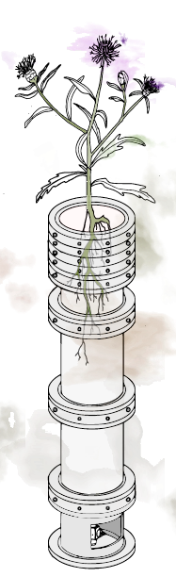
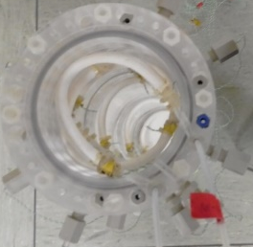
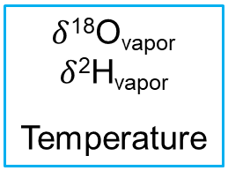
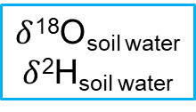
RWU quantification
Non-destructive monitoring
xylem sap water
↓
product
Online non-destructive isotopic monitoring for isotopic determinations of soil water (Rothfuss et al., 2013).
This method has been standardize in the lab and successfully used in the field.
Root water uptake quantification commonly done using multi-source mixing models with a Bayesian statistical approach and labeling.
soil water
↓
sources
Laser-based spectroscopy
(Kuehnhammer, 2018)
$δ$¹⁸O_{soil water}
$δ$²H_{soil water}
$δ$¹⁸O_{vapor}
$δ$²H_{vapor}
Temperature

Slide 4
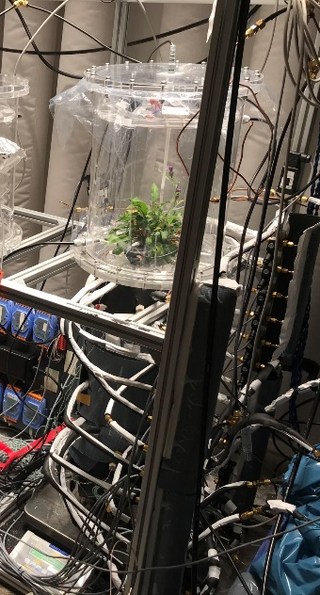
Experimental setup
δ_{transpiration} = δ_{xylem sap water} = δ_{product}
Ambient air
Modification of aboveground environmental conditions through humidity changes in ambient air entering the plant chamber and light intensity.
Addition of labeled water to the top and bottom of the column.
Monitoring of leaf water potential.
Ambient air +
Plant transpiration
δ_{soil water} = δ_{sources}
Dry air + Soil water vapor
Dry air
Notes:
Add explanation about plant chamber in bullet points

Slide 5
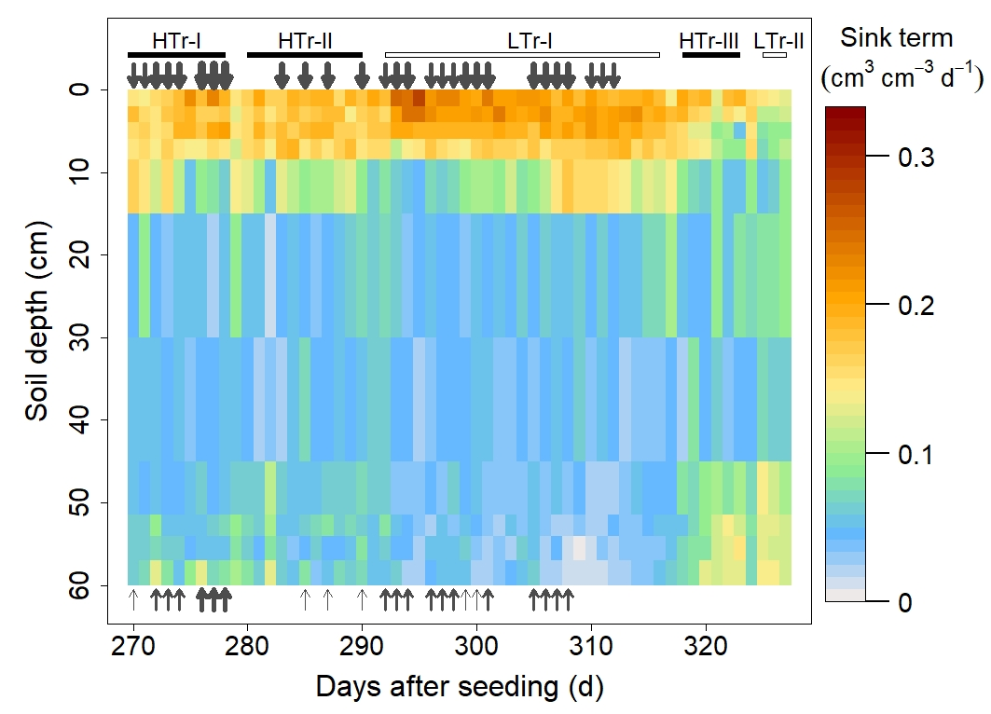
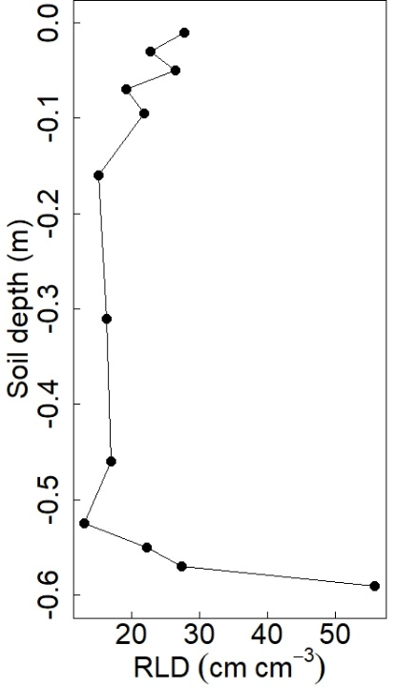
RWU DRIVERS
RWU at shallow soil depths was significant under varying hydro-climatic conditions
The stomatal control was mostly anysohydric (very low leaf water potential values ~-3 MPa)
Tr (mm d⁻¹)
Θ (cm³ cm⁻³)
5.9 ± 0.5
0.18 ± 0.02
4.3 ± 0.3
0.15 ± 0.01
4.3 ± 0.5
0.11 ± 0.02
1.2 ± 0.2
0.07 ± 0.00
2.6 ± 0.9
0.18 ± 0.03
Notes:
Add bullet points for the results, make a comment about plasticity of plant, maybe talk about iso-anysohydrcity

Slide 6
THANK YOU VERY MUCH FOR YOUR ATTENTION
I WELCOME YOUR QUESTIONS
Contact: Paulina Alejandra Deseano Diaz
p.deseano.diaz@fz-juelich.de

