Slide 1




Role of Moist Static Energy Advection in Evolution of Convective Aggregation in Idealized Simulation
Vijit Maithel and Larissa Back
University of Wisconsin-Madison
23rd May 2022
Session AS1.12 – Atmospheric Convection
EGU General Assembly 2022

Slide 2
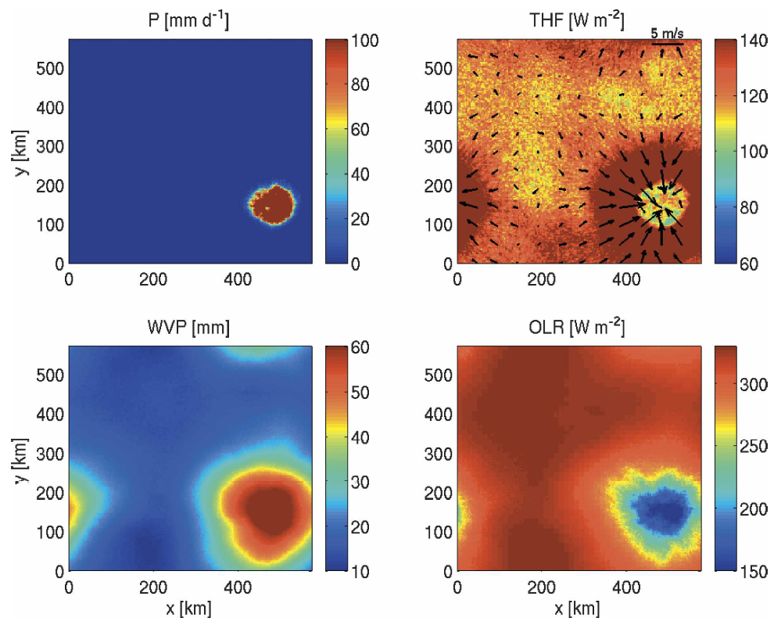
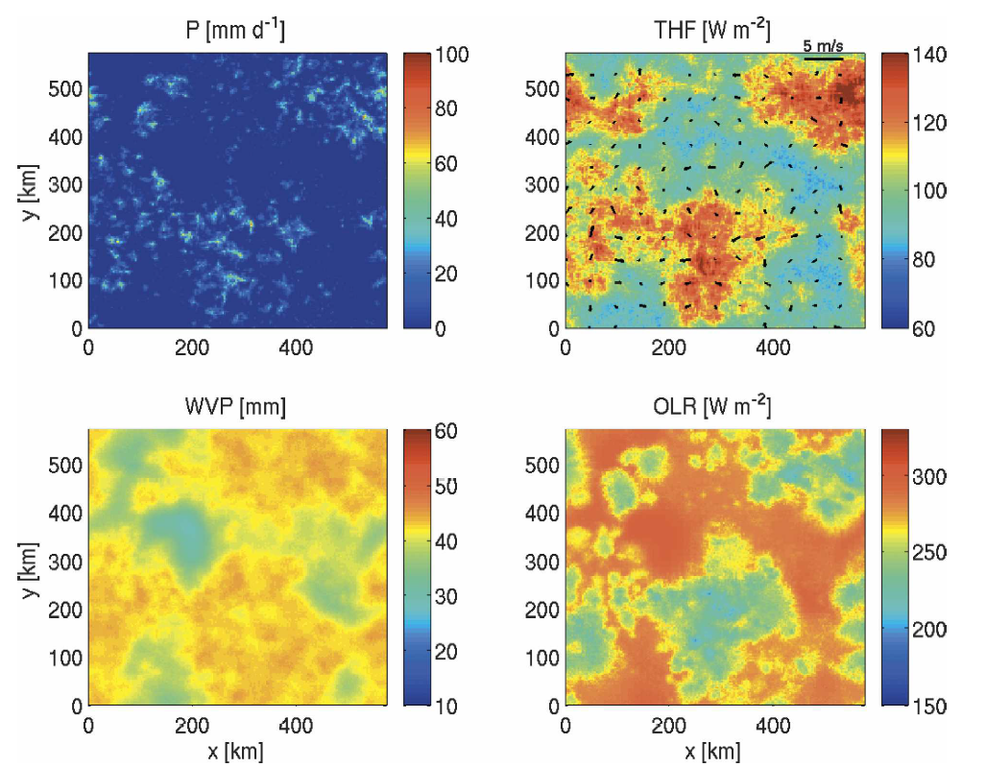
Self Aggregation in RCE models
Self-aggregation seen in a wide range of model setups with uniform boundary conditions (SST) – review by Wing et al. 2017
Figure from Bretherton et al. 2005
Day 10
Day 50

Slide 3
Impact of Self Aggregation
Self aggregation has been found to make the large-scale environment
Drier – Bretherton et al. 2005, Wing and Cronin 2016 and others
Reduce high cloud cover - Wing and Cronin 2016, Cronin and Wing 2017 and others
Increase heat loss – Wing and Emanuel 2014, Wing and Cronin 2016 and others
Figure from Bretherton et al. 2005

Slide 4
Self Aggregation → Aggregation
Self aggregation has been found to make the large-scale environment
Drier – Bretherton et al. 2005, Wing and Cronin 2016 and others
Reduce high cloud cover - Wing and Cronin 2016, Cronin and Wing 2017 and others
Increase heat loss – Wing and Emanuel 2014, Wing and Cronin 2016 and others
Self aggregation mechanisms have been linked with
MJO – Khairoutdinov and Emanuel 2018, Arnold and Randall 2015, others
Tropical cyclones – Wing et al. 2016, Muller and Romps 2018, others
Extreme precipitation events – Pendergrass 2020
Making it highly relevant for understanding tropical climate and climate sensitivity.

Slide 5
Convective Aggregation
Difficult to define aggregation exactly – for observations, many past metrics have focused on clustering methods and on cloud properties.
Can we use a more physically motivated metric for aggregation?
Utilize the variability of moisture or moist static energy seen with self aggregation to define degree of aggregation.

Slide 6

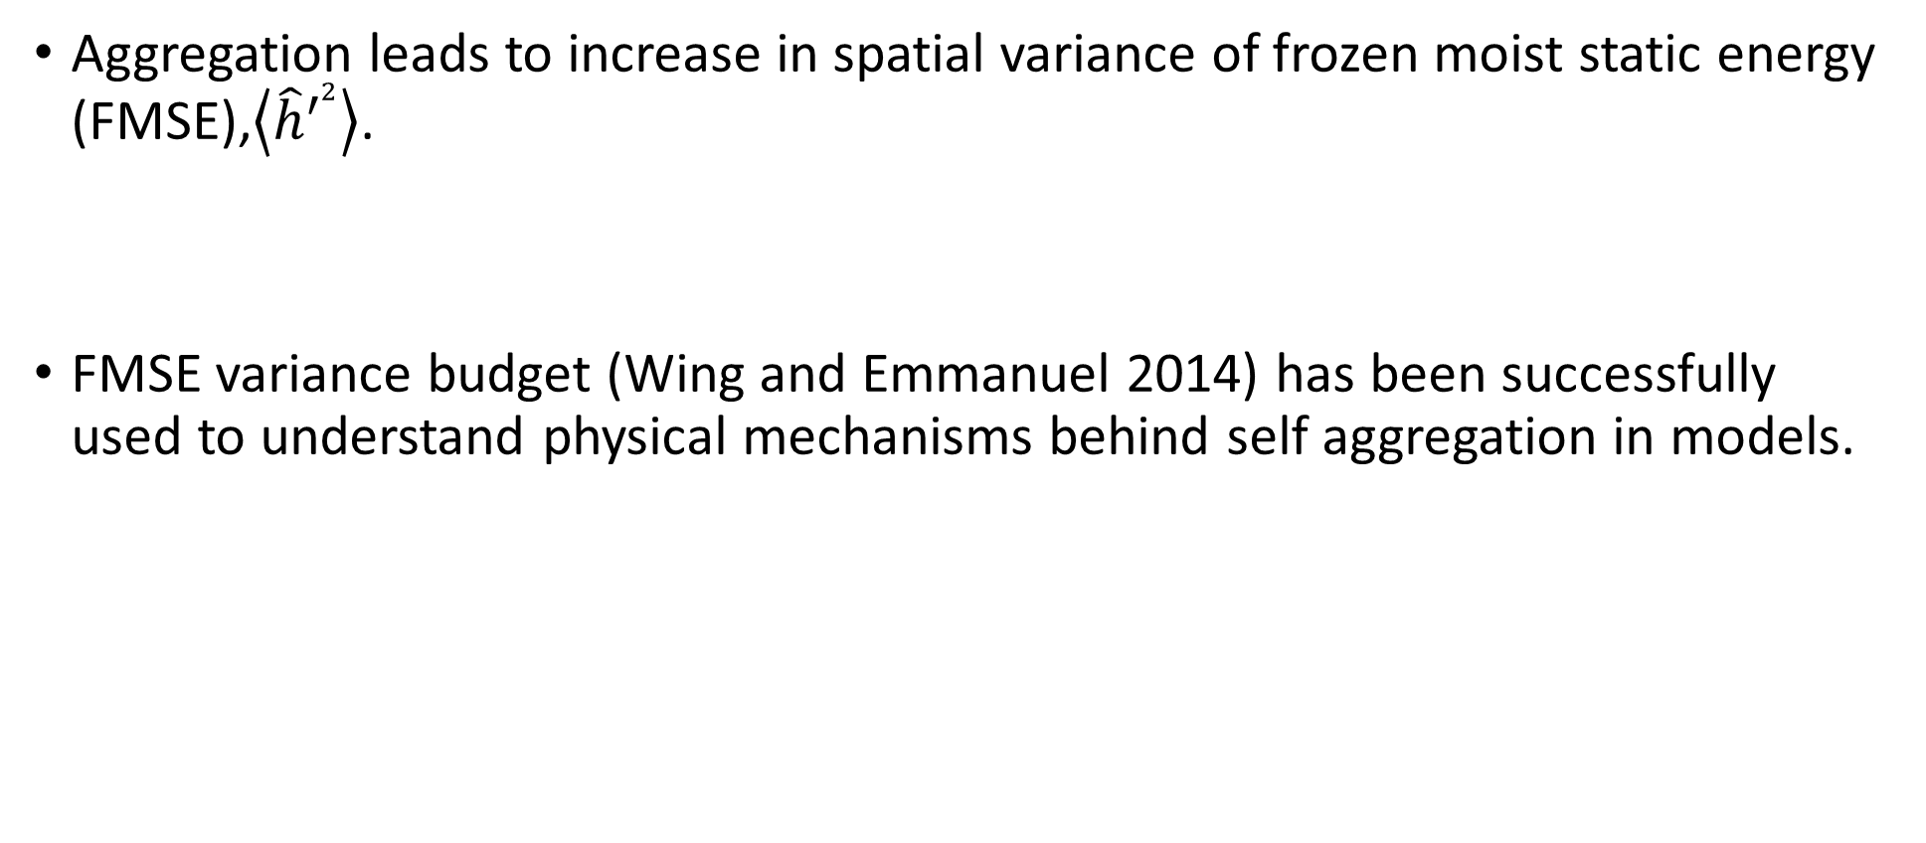
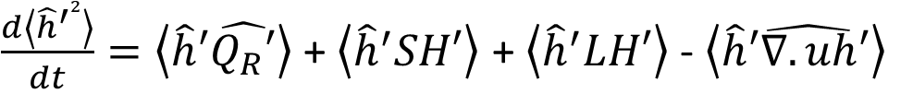
FMSE variance budget
Aggregation leads to increase in spatial variance of frozen moist static energy (FMSE),$\left\langle {\hat{h}}^{′2}\right\rangle$.
FMSE variance budget (Wing and Emmanuel 2014) has been successfully used to understand physical mechanisms behind self aggregation in models.
$\frac{d\left\langle {\hat{h}}^{′2}\right\rangle }{dt}=\left\langle \hat{h}′\hat{Q_{R}′}\right\rangle$ + $\left\langle {\hat{h}}^{′}SH′\right\rangle$ + $\left\langle {\hat{h}}^{′}LH′\right\rangle$ - $\left\langle \hat{h}′\hat{∇.uh}′\right\rangle$

Slide 7
Data
System for Atmospheric Modeling 6.11.2 (Khairoutdinov and Randall 2003)
Long channel geometry ~ 6000 x 380 km horizontal domain
3km grid resolution
74 vertical levels – model top 33km
Hourly data which additionally passed through a 24 hour running mean filter.
Data from simulations run for RCE Model Intercomparison Project (Wing et al. 2018,2020)

Slide 8
FMSE spatial variance time series

Slide 9
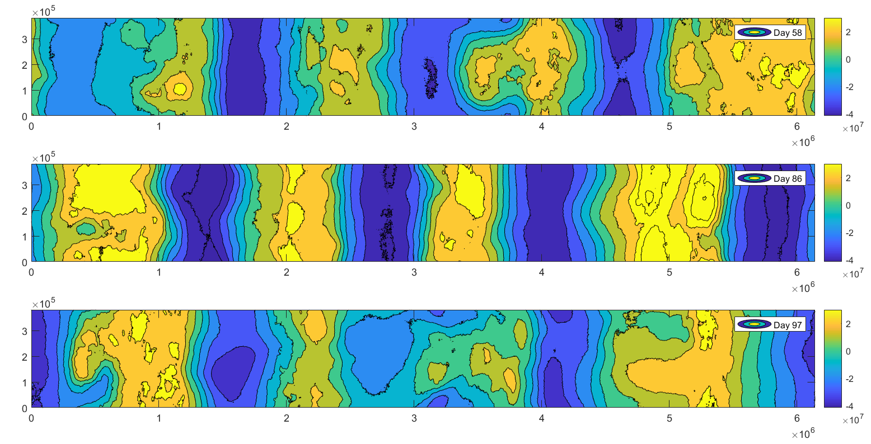
Spatial structure of FMSE anomalies

Slide 10
Thinking about models to real world
Unlike models, real world has boundary conditions which continuously organize convection.
Therefore, convection will always be in some state of aggregation
But it can be more aggregated or less aggregated with time.

Slide 11
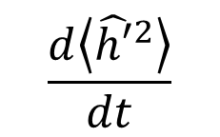

FMSE variance phase plane
$$\frac{d\left\langle {\hat{h′}}^{2}\right\rangle }{dt}$$
Aggregating
$$\left\langle {\hat{h′}}^{2}\right\rangle$$
More Aggregated
Disaggregating

Slide 12
MSE variance phase plane – aggregating process
$$\frac{d\left\langle {\hat{h′}}^{2}\right\rangle }{dt}$$
Aggregating
$$\left\langle {\hat{h′}}^{2}\right\rangle$$
More Aggregated
Disaggregating

Slide 13
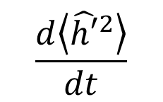
MSE variance phase plane – aggregation disaggregation cycles
$$\frac{d\left\langle {\hat{h′}}^{2}\right\rangle }{dt}$$
Aggregating
$$\left\langle {\hat{h′}}^{2}\right\rangle$$
More Aggregated
Disaggregating

Slide 14
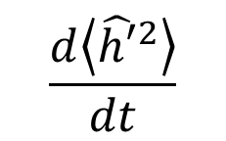

MSE variance phase plane
$$\frac{d\left\langle {\hat{h′}}^{2}\right\rangle }{dt}$$
$$\left\langle {\hat{h′}}^{2}\right\rangle$$

Slide 15
MSE variance phase plane – Cycle 1 (day 42-62)

Slide 16
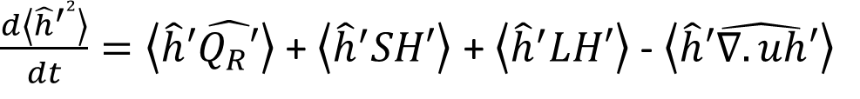
$\frac{d\left\langle {\hat{h}}^{′2}\right\rangle }{dt}=\left\langle \hat{h}′\hat{Q_{R}′}\right\rangle$ + $\left\langle {\hat{h}}^{′}SH′\right\rangle$ + $\left\langle {\hat{h}}^{′}LH′\right\rangle$ - $\left\langle \hat{h}′\hat{∇.uh}′\right\rangle$

Slide 17
$\frac{d\left\langle {\hat{h}}^{′2}\right\rangle }{dt}=\left\langle \hat{h}′\hat{Q_{R}′}\right\rangle$ + $\left\langle {\hat{h}}^{′}SH′\right\rangle$ + $\left\langle {\hat{h}}^{′}LH′\right\rangle$ - $\left\langle \hat{h}′\hat{∇.uh}′\right\rangle$

Slide 18
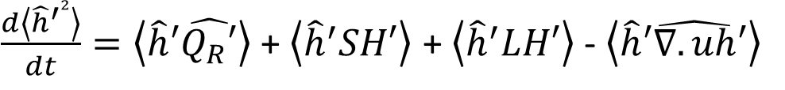
$\frac{d\left\langle {\hat{h}}^{′2}\right\rangle }{dt}=\left\langle \hat{h}′\hat{Q_{R}′}\right\rangle$ + $\left\langle {\hat{h}}^{′}SH′\right\rangle$ + $\left\langle {\hat{h}}^{′}LH′\right\rangle$ - $\left\langle \hat{h}′\hat{∇.uh}′\right\rangle$

Slide 19
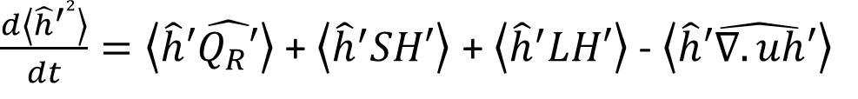
$\frac{d\left\langle {\hat{h}}^{′2}\right\rangle }{dt}=\left\langle \hat{h}′\hat{Q_{R}′}\right\rangle$ + $\left\langle {\hat{h}}^{′}SH′\right\rangle$ + $\left\langle {\hat{h}}^{′}LH′\right\rangle$ - $\left\langle \hat{h}′\hat{∇.uh}′\right\rangle$

Slide 20
MSE variance phase plane – Cycle 2 (day 75-92)

Slide 21
$\frac{d\left\langle {\hat{h}}^{′2}\right\rangle }{dt}=\left\langle \hat{h}′\hat{Q_{R}′}\right\rangle$ + $\left\langle {\hat{h}}^{′}SH′\right\rangle$ + $\left\langle {\hat{h}}^{′}LH′\right\rangle$ - $\left\langle \hat{h}′\hat{∇.uh}′\right\rangle$

Slide 22
$\frac{d\left\langle {\hat{h}}^{′2}\right\rangle }{dt}=\left\langle \hat{h}′\hat{Q_{R}′}\right\rangle$ + $\left\langle {\hat{h}}^{′}SH′\right\rangle$ + $\left\langle {\hat{h}}^{′}LH′\right\rangle$ - $\left\langle \hat{h}′\hat{∇.uh}′\right\rangle$

Slide 23

$\frac{d\left\langle {\hat{h}}^{′2}\right\rangle }{dt}=\left\langle \hat{h}′\hat{Q_{R}′}\right\rangle$ + $\left\langle {\hat{h}}^{′}SH′\right\rangle$ + $\left\langle {\hat{h}}^{′}LH′\right\rangle$ - $\left\langle \hat{h}′\hat{∇.uh}′\right\rangle$

Slide 24

$\frac{d\left\langle {\hat{h}}^{′2}\right\rangle }{dt}=\left\langle \hat{h}′\hat{Q_{R}′}\right\rangle$ + $\left\langle {\hat{h}}^{′}SH′\right\rangle$ + $\left\langle {\hat{h}}^{′}LH′\right\rangle$ - $\left\langle \hat{h}′\hat{∇.uh}′\right\rangle$

Slide 25
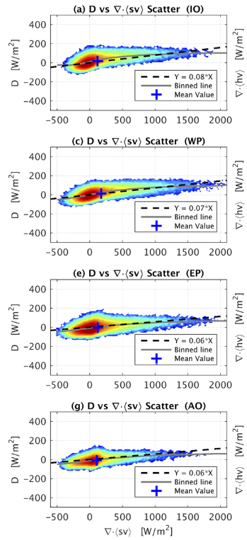
Future Work – applying to observation
Apply the same methodology to Reanalysis data to look at real world.
Domain size ~ entire tropical band or large ocean basins
Hypothesis – Advection is more important for driving variability of aggregation cycles in observations since diabatic terms seem to constantly favor aggregation.
Figure from Inoue and Back 2017

Slide 26
Conclusion
Using spatial variance of FMSE, a variance phase plane is developed suited particularly to look at aggregation-disaggregation cycles in simulations and observations.
Cycles with varying relative importance of advection, column radiation, and surface fluxes in contributing to the aggregation disaggregation variability can be seen in simulations.
Variance phase plane seems adept at investigating the different balances.
Correspondence – maithel@wisc.edu

