Slide 1

Water table depth dynamics derived from optical remote sensing data in northern peatlands
Iuliia Burdun,
Michel Bechtold,
Viacheslav Komisarenko,
Annalea Lohila,
Elyn Humphreys,
Ankur R. Desai,
Mats B. Nilsson,
Eeva-Stiina Tuittila,
Gabrielle De Lannoy,
Evelyn Uuemaa,
Hannu Marttila,
Maarit Liimatainen,
Paavo Ojanen,
Kari Minkkinen,
Mika Aurela,
and Miina Rautiainen

Slide 2
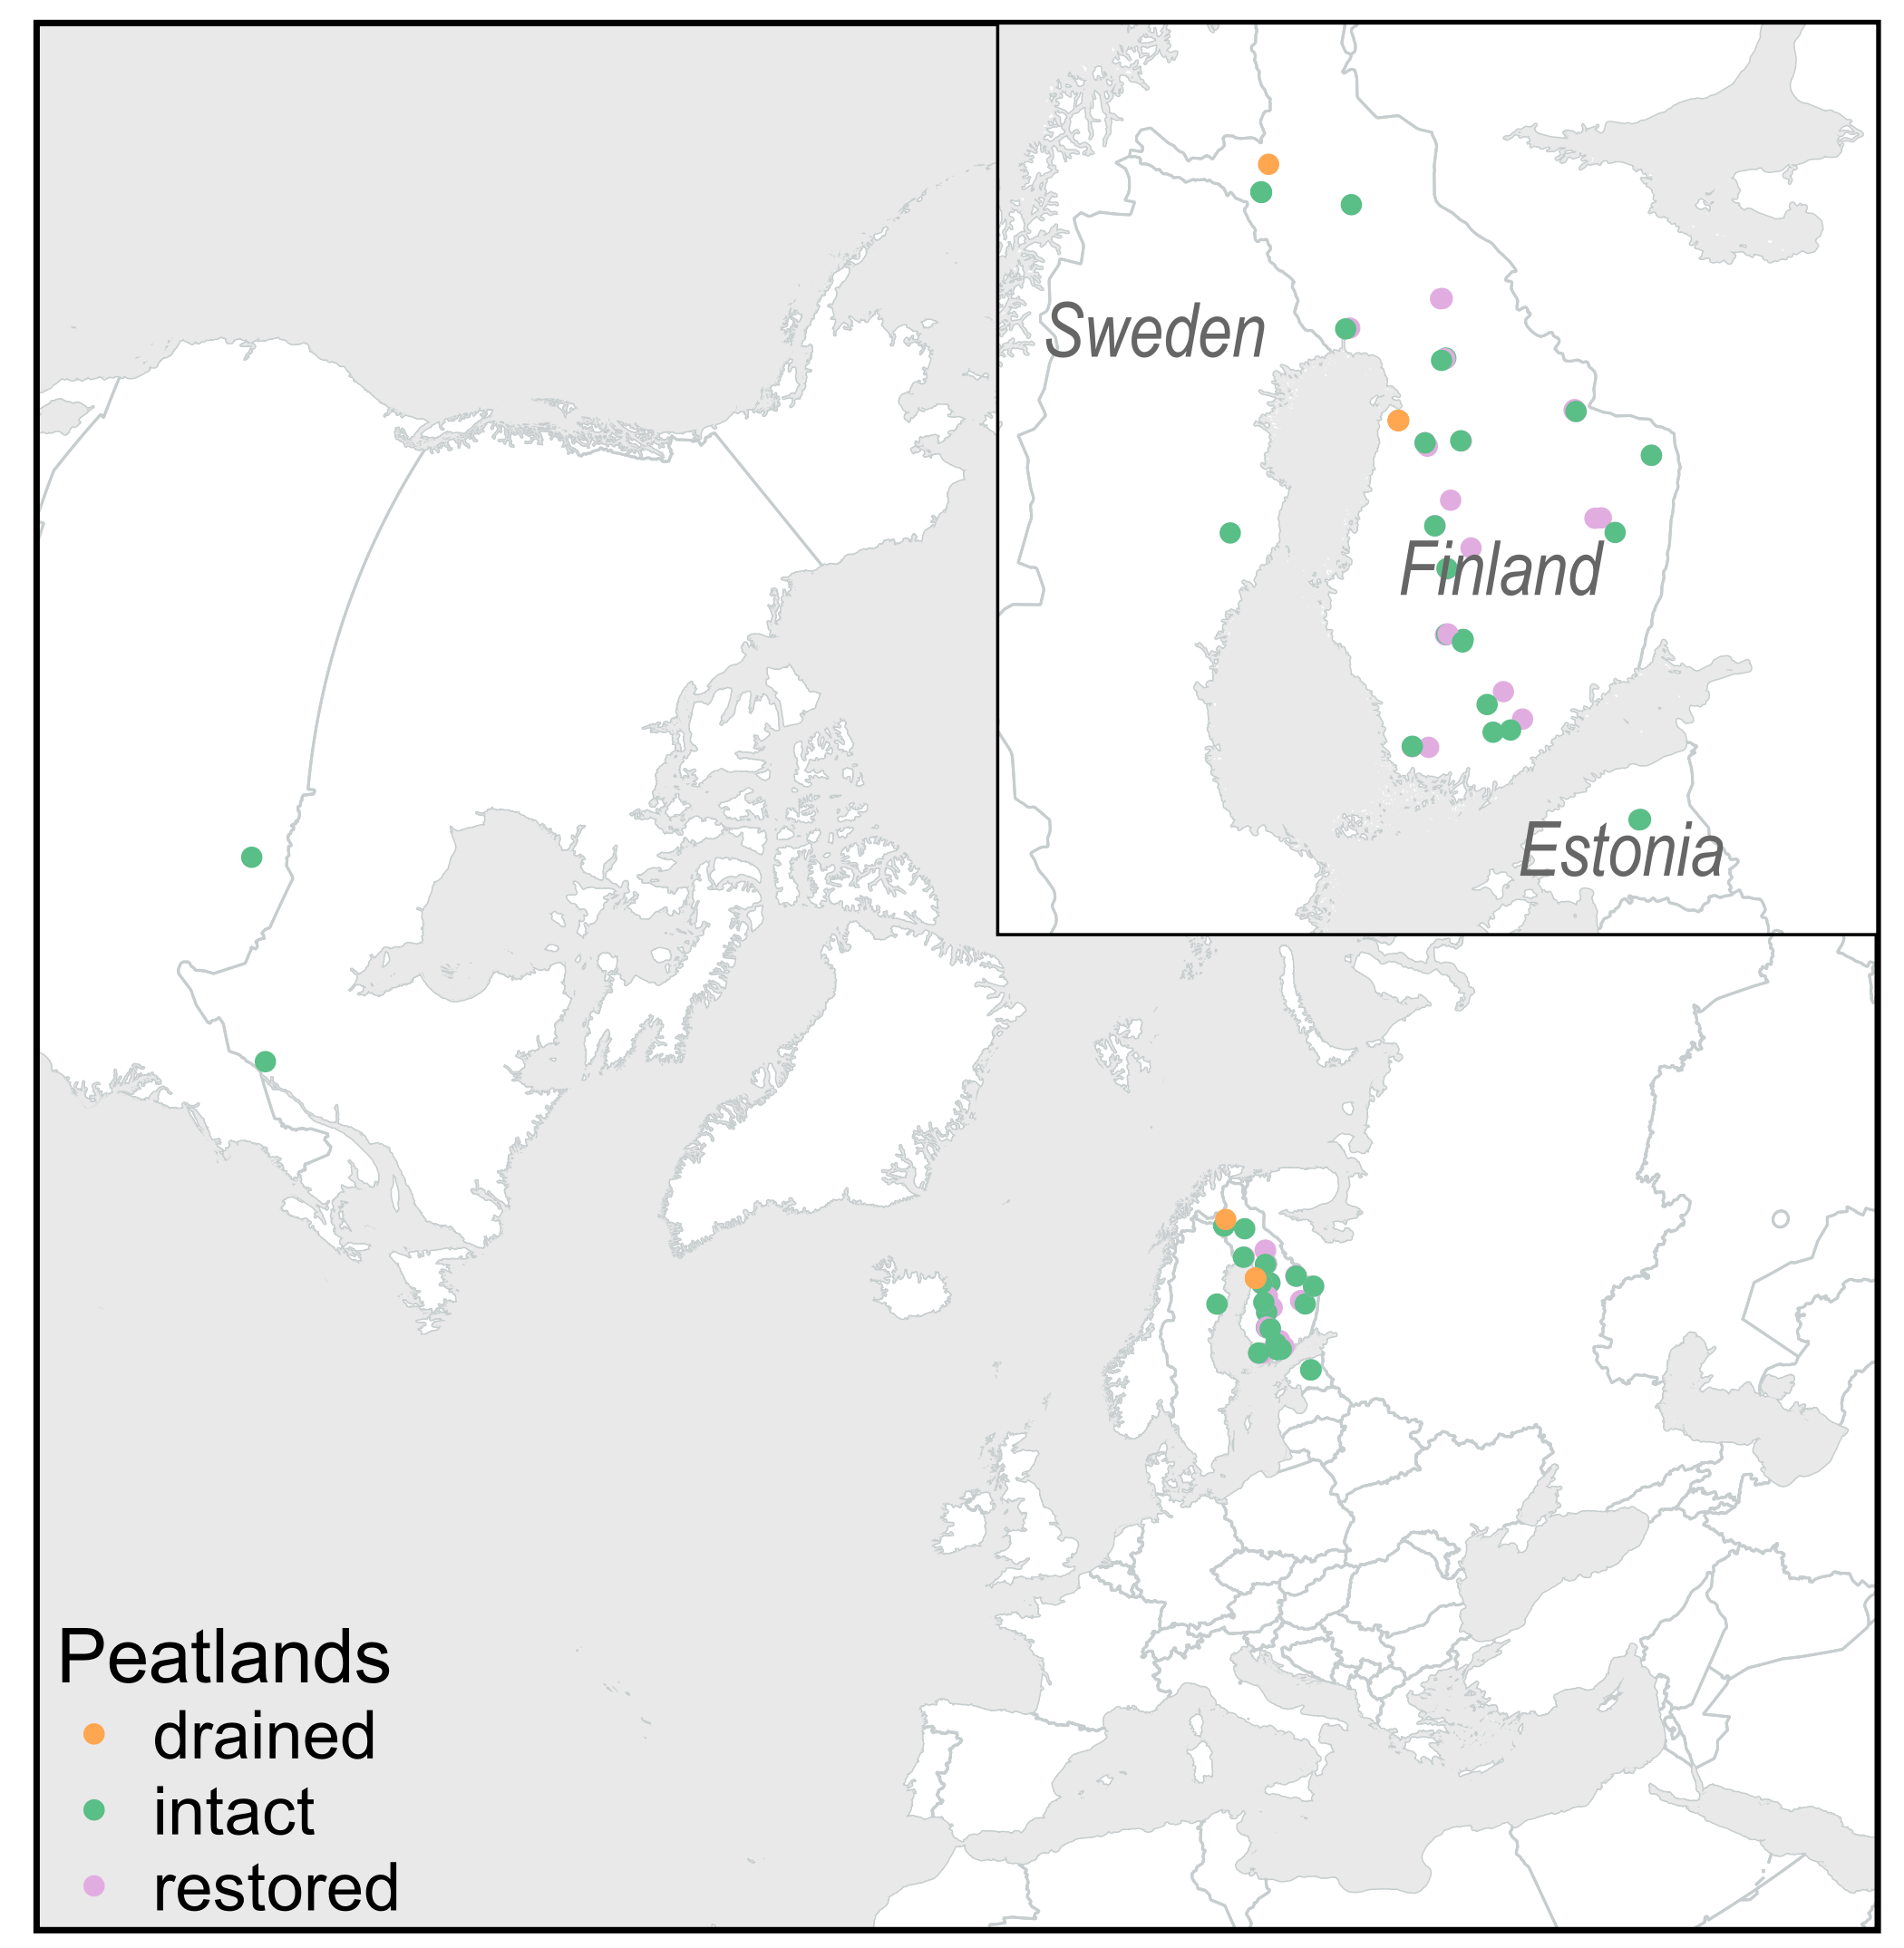
Research questions
Can SWIR-based moisture index (i.e. OPTRAM – OPtical TRApezoid Model) depict the temporal changes in water table depth position in intact, restored and drained peatlands?
Does vegetation index choice affect the OPTRAM performance?
58 peatlands:
 | Peatlands | Intact | Restored | Drained
Eutrophic | 11 | 6 | 5
Meso-eutrophic | 9 | 3 | 6
Mesotrophic | 7 | 3 | 4
Meso-oligotrophic | 7 | 3 | 4
Oligotrophic | 13 | 6 | 7
Ombrotrophic | 5 | 5
Drained for agriculture | 6 |  |  | 6

Slide 3
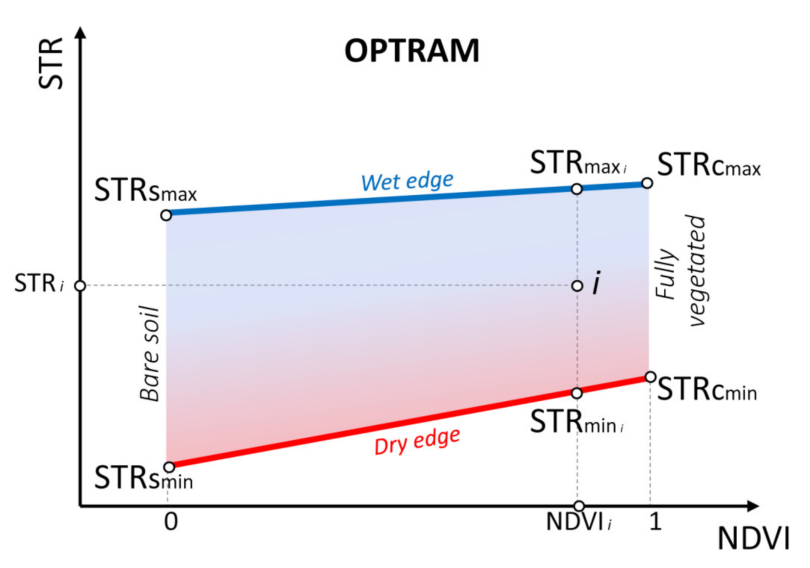
OPTRAM Calculation
Google Earth Engine
Sentinel-2 MSI Surface reflectance
Vegetation indices:
NDVI
kNDVI
EVI
RENDVI
Moisture index:
STR
Other:
MNDWI
Calculation of dry and wet edges
1
2
2018—2021 years
April—September

Slide 4
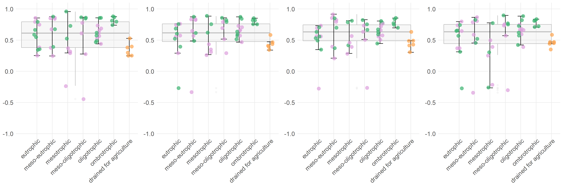
Pearson correlation between OPTRAMs and WTD
OPTRAM based on different vegetation indices resulted in very similar correlation values with in-situ water table depth.
OPTRAM performance in ombrotrophic sites is the highest.
Correlation values for drained sites are persistently low.
OPTRAM_NDVI
OPTRAM_kNDVI
OPTRAM_EVI
OPTRAM_RENDVI
Pearson correlation with WTD
intact
restored
drained

Slide 5
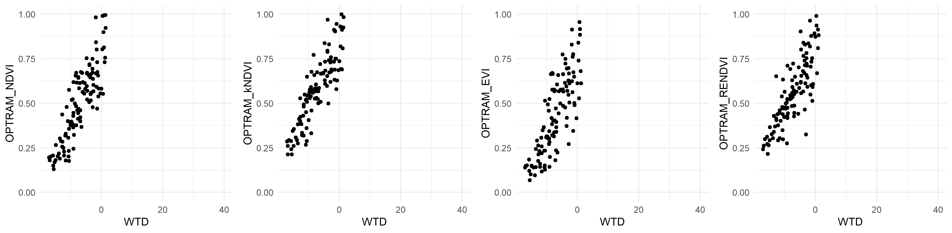
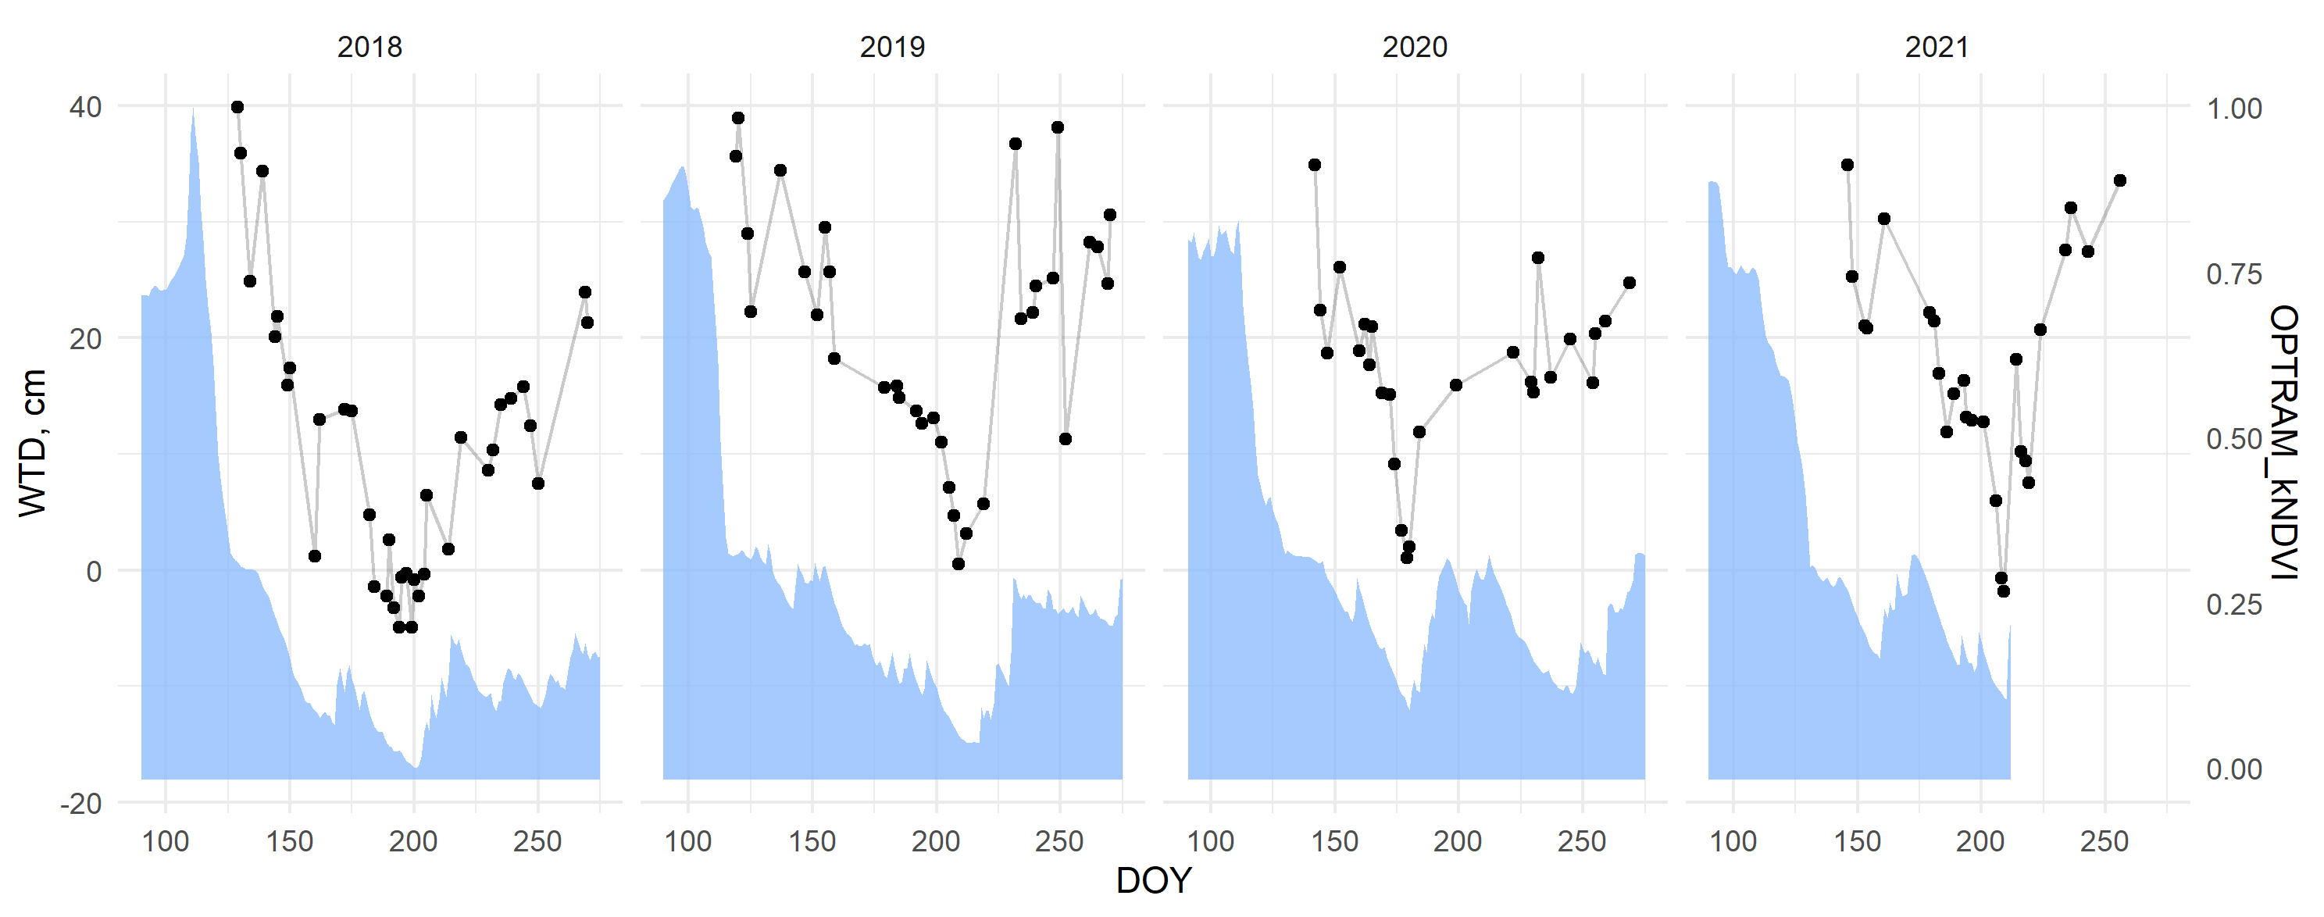
Pearson correlation between OPTRAMs and WTD
Oligotrophic peatland - Degerö Stormyr
R = 0.85
R = 0.87
R = 0.81
R = 0.82

Slide 6
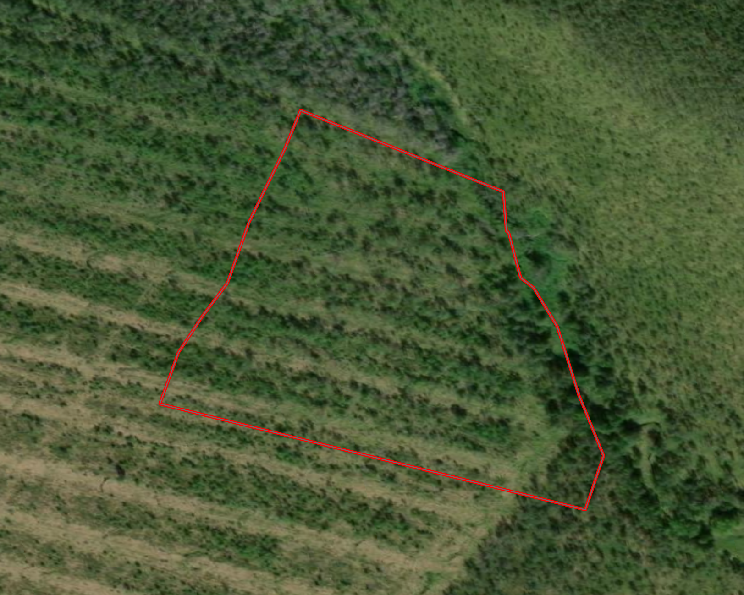
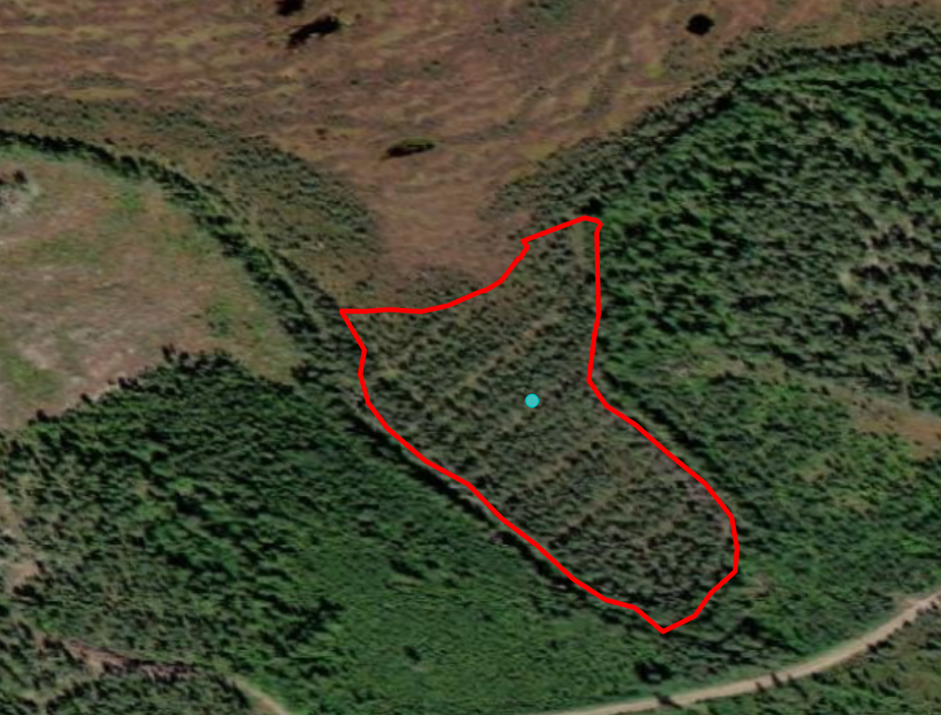
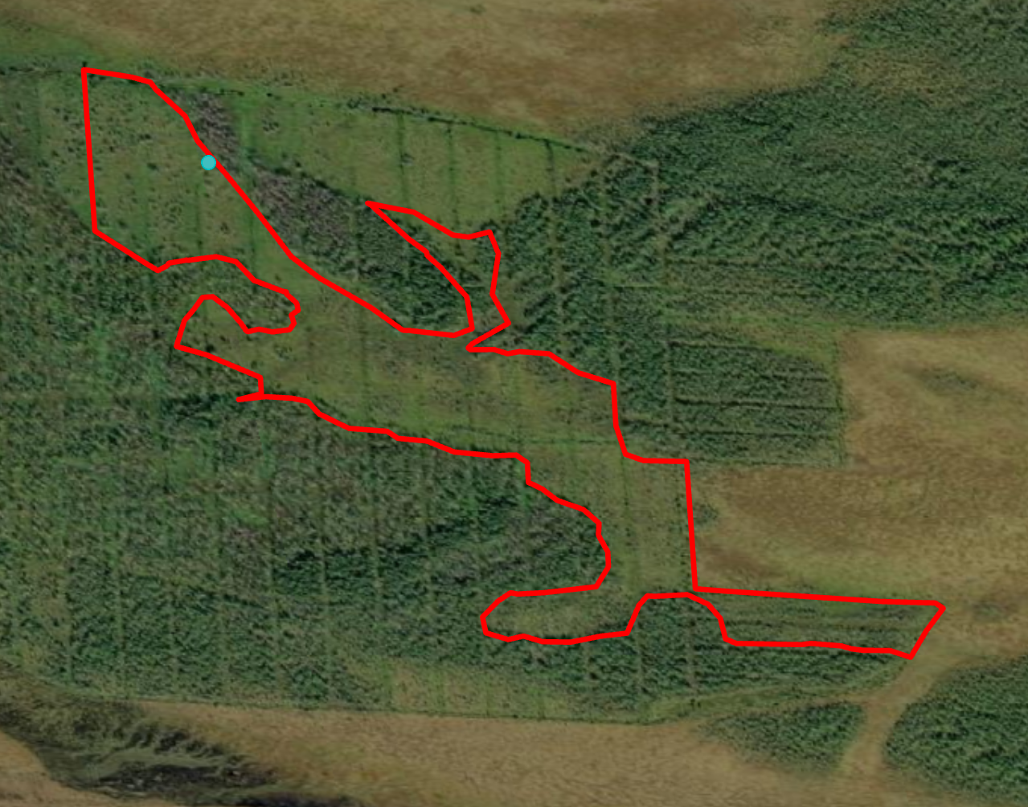
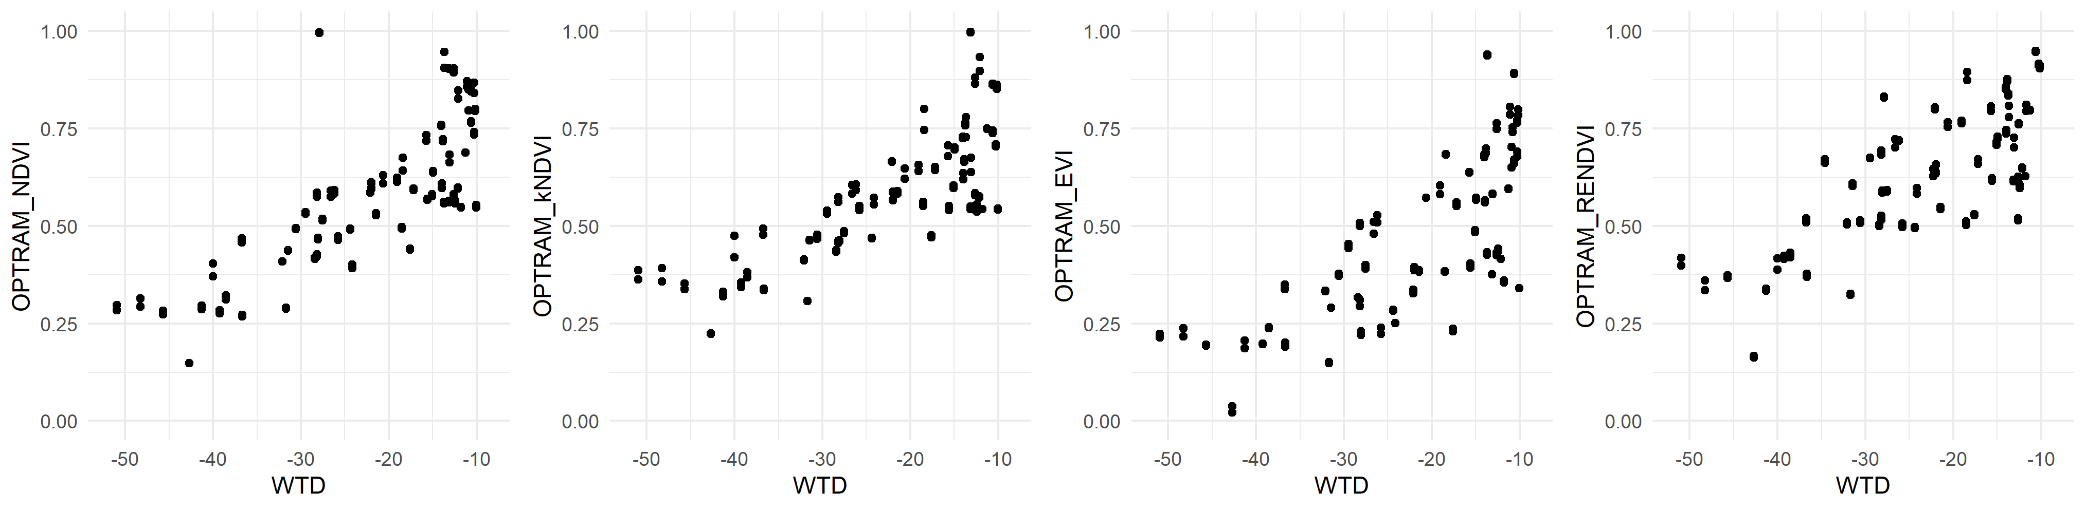
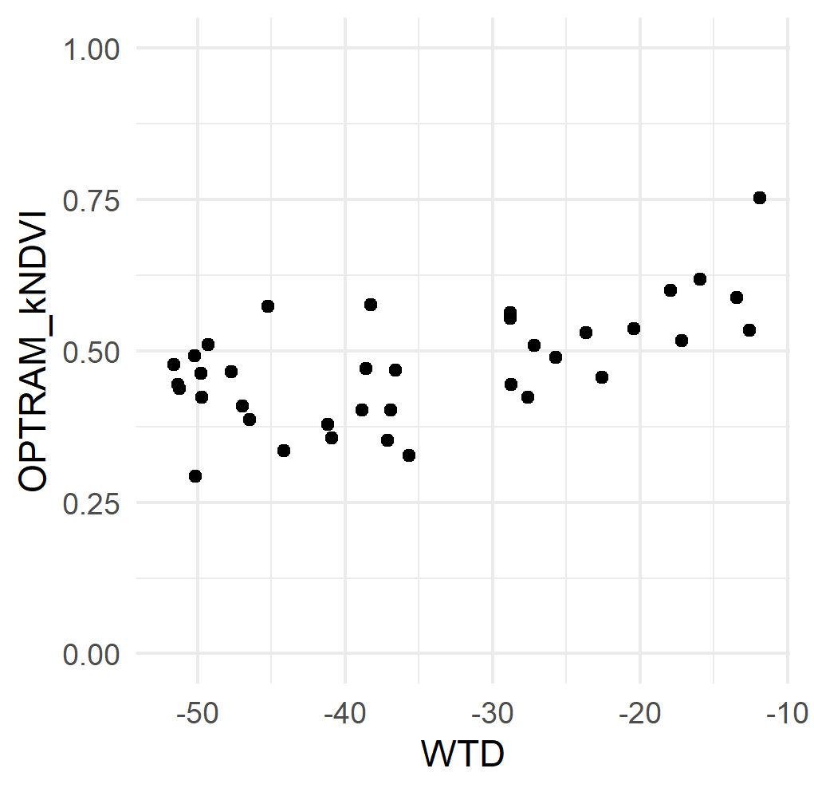
Pearson correlation between OPTRAMs and WTD for restored sites
OPTRAM can be used for monitoring moisture conditions in restored peatlands with sparse tree vegetation.
Restored in 2011 meso-oligotrophic site (tall-sedge pine fen)
Restored in 2011 oligotrophic site (spruce)
Restored in 2009 meso-oligotrophic site (tall-sedge pine fen)

Slide 7
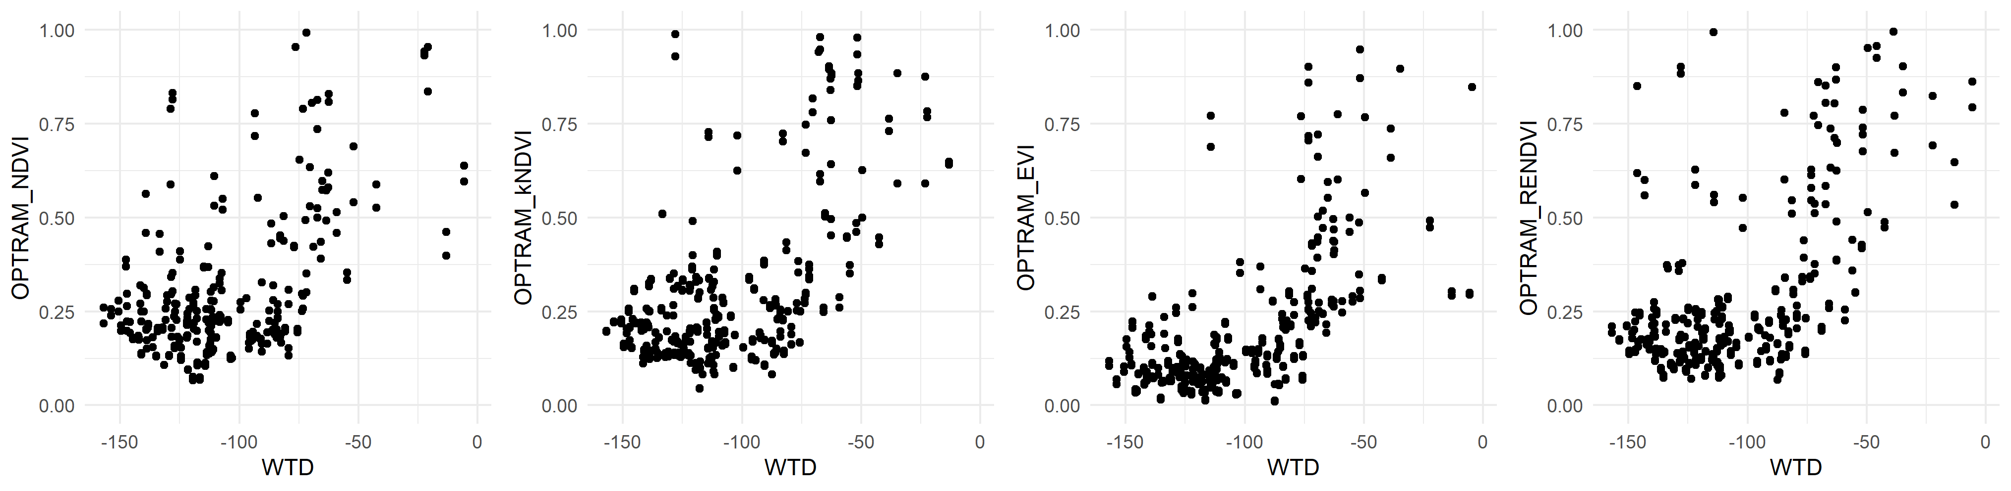
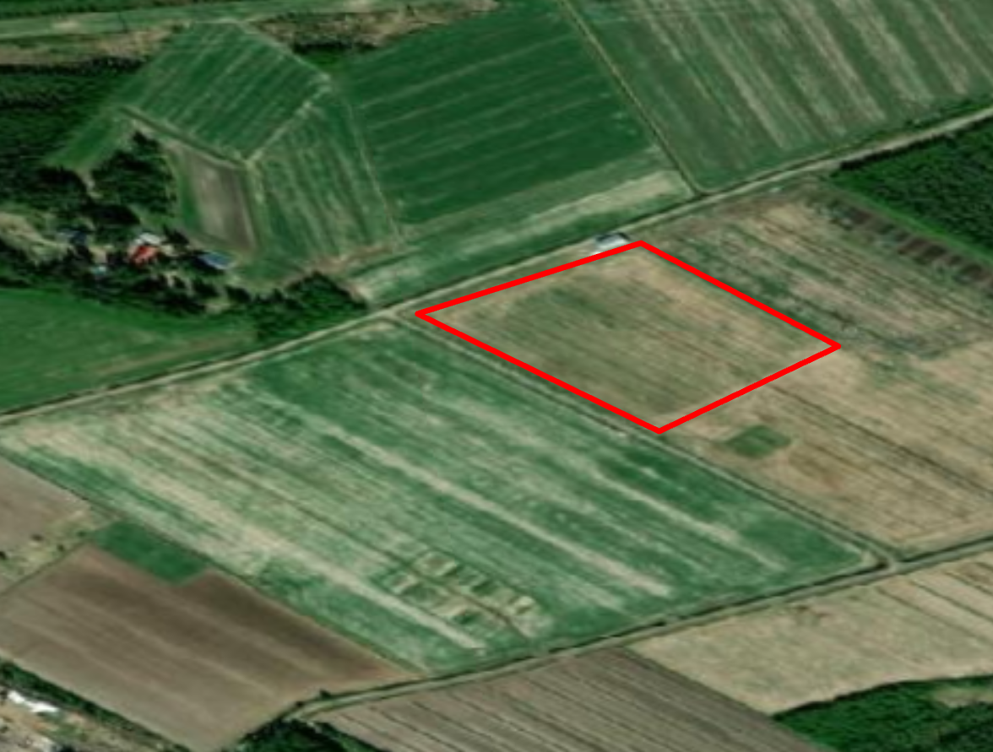
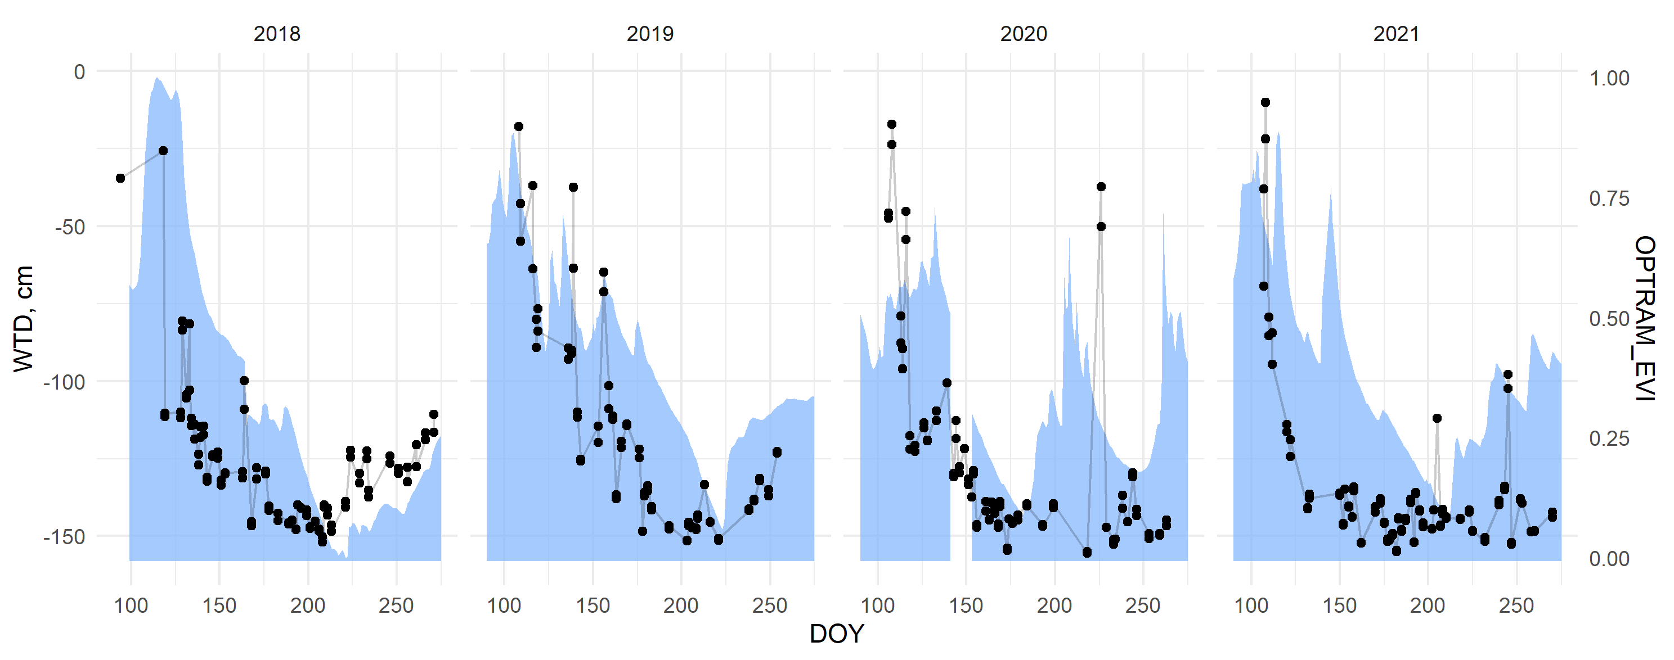
Pearson correlation between OPTRAMs and WTD for drained sites
In drained peatlands used for agriculture, OPTRAM becomes insensitive to water table depth drawdown after >100 cm

Slide 8
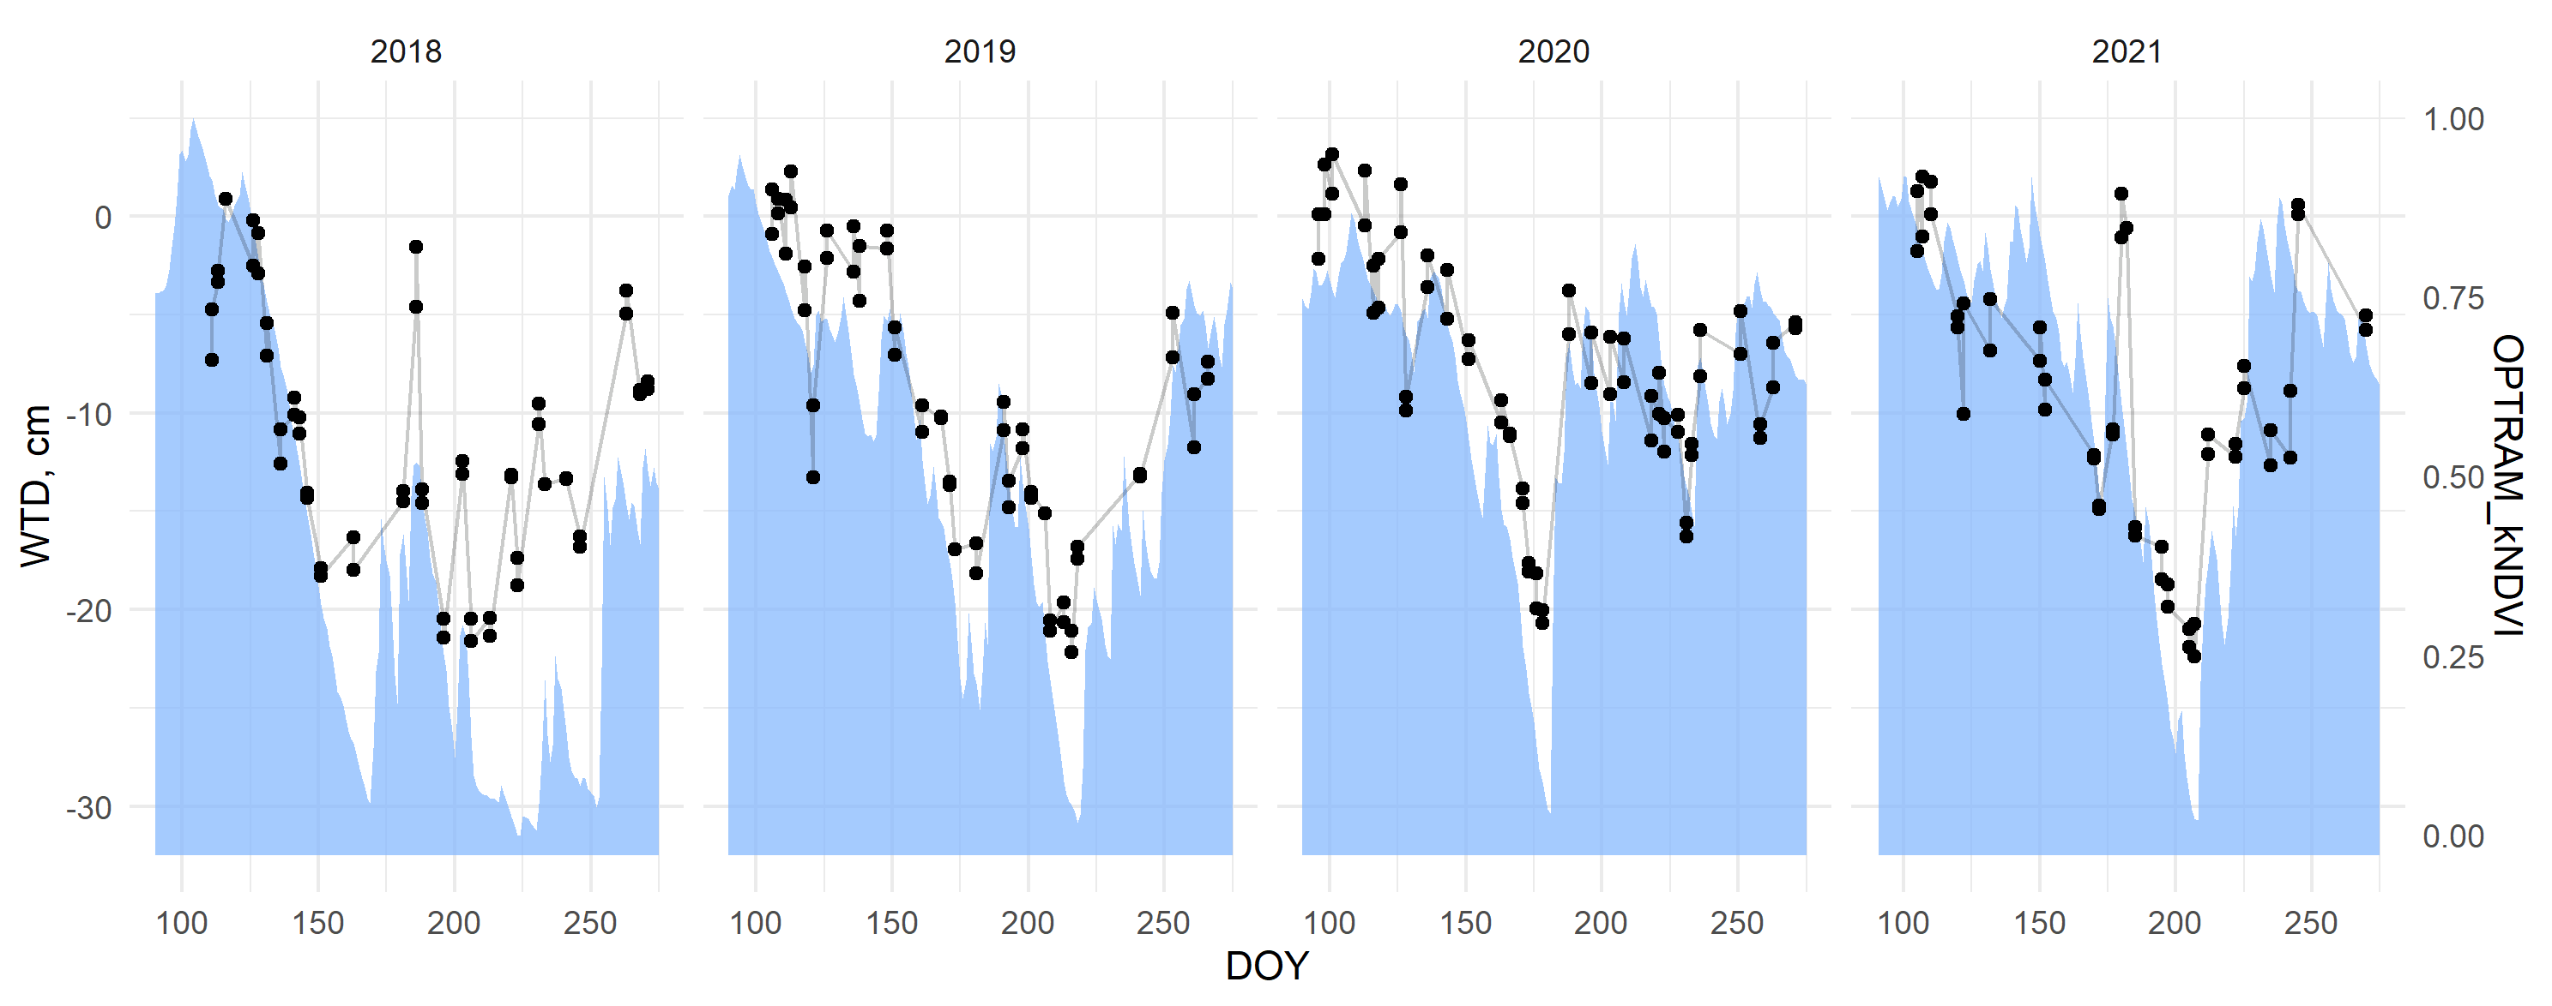
Conclusions
OPTRAM can be used for monitoring moisture conditions in
intact peatlands with treeless areas,
restored sites with sparse tree vegetation, and, to a smaller extent,
drained peatlands with water tables varying up to 1 m.
Tervalamminsuo bog (Finland)

