Slide 1





Shannon and Tsallis Entropy results
for
Particle Resting times and Jump lengths
in
River Bedload
Ashkan Pilbala¹, Luca Tosato¹, Luigi Fraccarollo¹, Farhad Bahmanpouri², and Tommaso Moramarco²
¹University of Trento, Department of Civil, Environmental and Mechanical Engineering, Trento, Italy.
²The National Research Council (CNR) - Research Institute for Geo Hydrological Protection (IRPI), Perugia, Italy
¹University of Trento, Department of Civil, Environmental and Mechanical Engineering, Trento, Italy.
²The National Research Council (CNR) - Research Institute for Geo Hydrological Protection (IRPI), Perugia, Italy

Slide 2
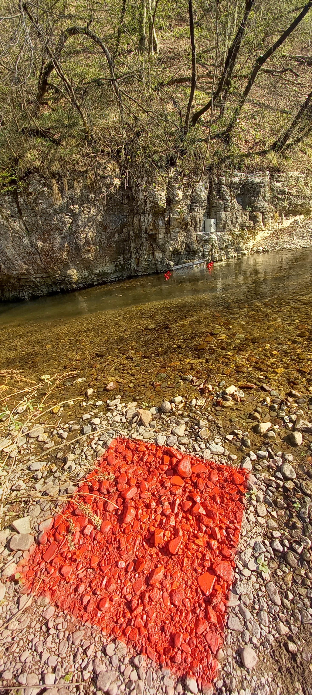
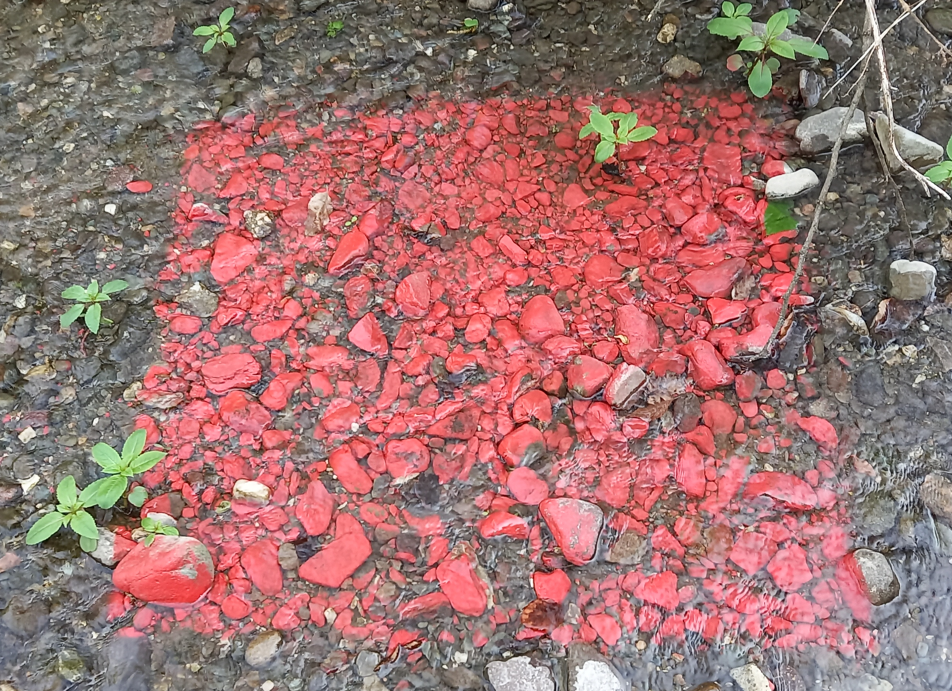

Aim of Study:
In this study, we exploited available data representing resting time and jump length of particles involved in bedload processes. We got formal probability functions describing the distribution of the above-mentioned kinematic quantities
After
14 days
After
21 days
14/April/2022
28/April/2022
18/May/2022
Fig 1. Sediment transport (Bedload) in Fersina River, Trento, Italy
2
ashkan.pilbala@unitn.it
Pilbala et al, 27 May 2022

Slide 3
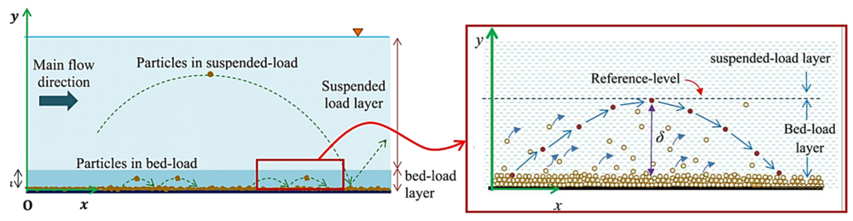
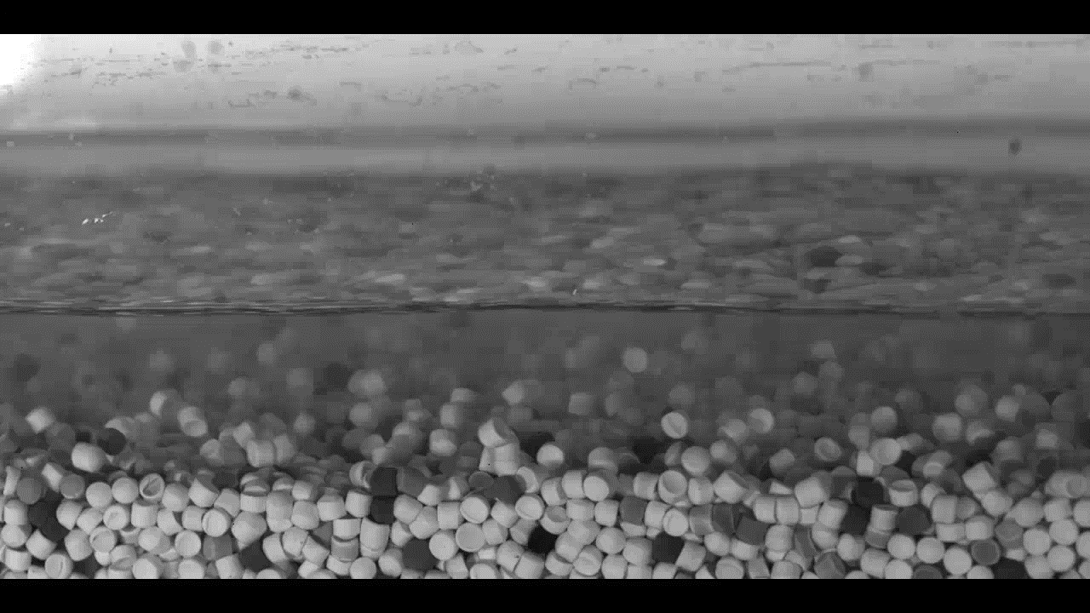
Literature Review:
Until now, some work have done about using Entropy theory to find:
- Bed layer thickness (Zhu et al, Kumbhakar et al -Tsallis entropy)
- Suspended load discharge (Martins et al 2017- Tsallis entropy)
-Velocity distribution (Cui et al, Bahmanpouri et al,…- Tsallis, Shannon Entropy)
Fig 2. Bed layer thickness (Kumbhakar et al, 2018)
3
ashkan.pilbala@unitn.it
Pilbala et al, 27 May 2022

Slide 4
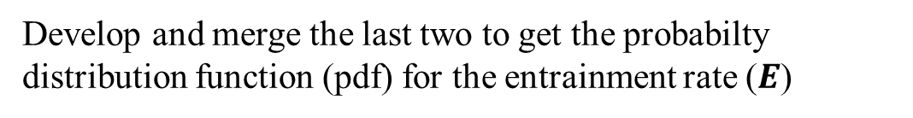
Research Approach:
Step 1
Bed-load Einstein
Step 2
Entropy approach based on Shannon and Tsallis theories
Step 3
Develop and merge the last two to get the probabilty distribution function (pdf) for the entrainment rate ($E$)
Step 4
Validation - Comparison between experimental and theoretical distributions
4
ashkan.pilbala@unitn.it
Pilbala et al, 27 May 2022

Slide 5


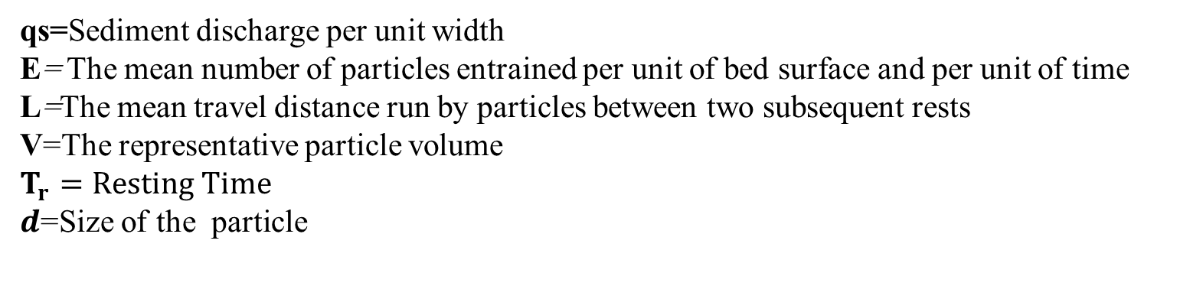

Step 1
Einstein conjecture and resting-time and Jump lengths statistics in the bed-load
$$q_{s}=ELV$$
$${<T}_{r}^{−1}>≅E$$
L $≅100d$
qs=Sediment discharge per unit width
E= The mean number of particles entrained per unit of bed surface and per unit of time
L=The mean travel distance run by particles between two subsequent rests
V=The representative particle volume
$$T_{r}=Resting Time$$
$d$=Size of the particle
5
ashkan.pilbala@unitn.it
Pilbala et al, 27 May 2022

Slide 6

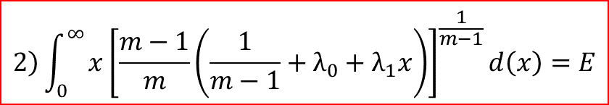
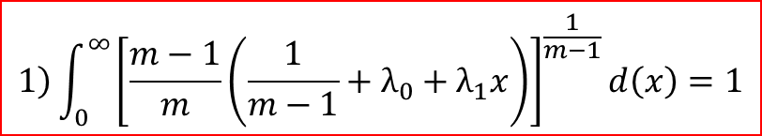
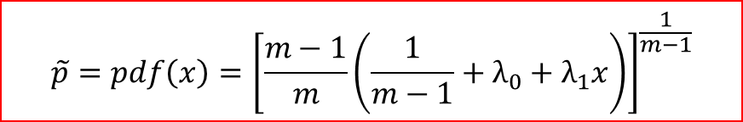
Step 2,3
Entropy Approach
$$\int_{0}^{∞}{\frac{1}{m−1}\left\{1−\int_{0}^{∞}{{\left[\tilde{p}\right]}^{m}d\left(x\right)}\right\}}d\left(x\right)−λ_{0}\left[\int_{0}^{∞}{\tilde{p}d\left(x\right)−1}\right]−λ_{1}\left[\int_{0}^{∞}{x\tilde{p}d\left(x\right)−E}\right]$$
Tsallis Entropy:
x= $T_{r}^{−1}$ or L
$$\tilde{p}=pdf\left(x\right)={\left[\frac{m−1}{m}\left(\frac{1}{m−1}+λ_{0}+λ_{1}x\right)\right]}^{\frac{1}{m−1}}$$
$$\left.1\right)\int_{0}^{∞}{{\left[\frac{m−1}{m}\left(\frac{1}{m−1}+λ_{0}+λ_{1}x\right)\right]}^{\frac{1}{m−1}}d\left(x\right)=1}$$
$$\left.2\right)\int_{0}^{∞}{{x\left[\frac{m−1}{m}\left(\frac{1}{m−1}+λ_{0}+λ_{1}x\right)\right]}^{\frac{1}{m−1}}d\left(x\right)=E}$$
6
ashkan.pilbala@unitn.it
Pilbala et al, 27 May 2022

Slide 7
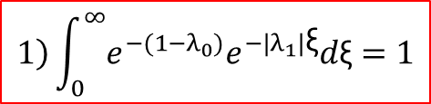
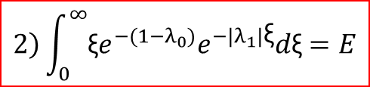

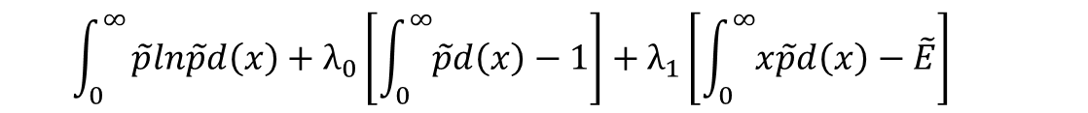
Step 2,3
Entropy Approach
$$\int_{0}^{∞}{\tilde{p}ln\tilde{p}d\left(x\right)+λ_{0}\left[\int_{0}^{∞}{\tilde{p}d\left(x\right)−1}\right]+λ_{1}\left[\int_{0}^{∞}{x\tilde{p}d\left(x\right)−\tilde{E}}\right] }$$
Shannon Entropy:
x= $T_{r}^{−1}$ or L
$$\tilde{p}=pdf=f\left(x\right)=e^{−(1−λ_{0})}e^{λ_{1}x}$$
$$\left.1\right)\int_{0}^{∞}{e^{−(1−λ_{0})}e^{{−|λ}_{1}|\text{ξ}}d\text{ξ}=1}$$
$$\left.2\right)\int_{0}^{∞}{{\text{ξ}e}^{−(1−λ_{0})}e^{{−|λ}_{1}|\text{ξ}}d\text{ξ}=E}$$
7
ashkan.pilbala@unitn.it
Pilbala et al, 27 May 2022

Slide 8
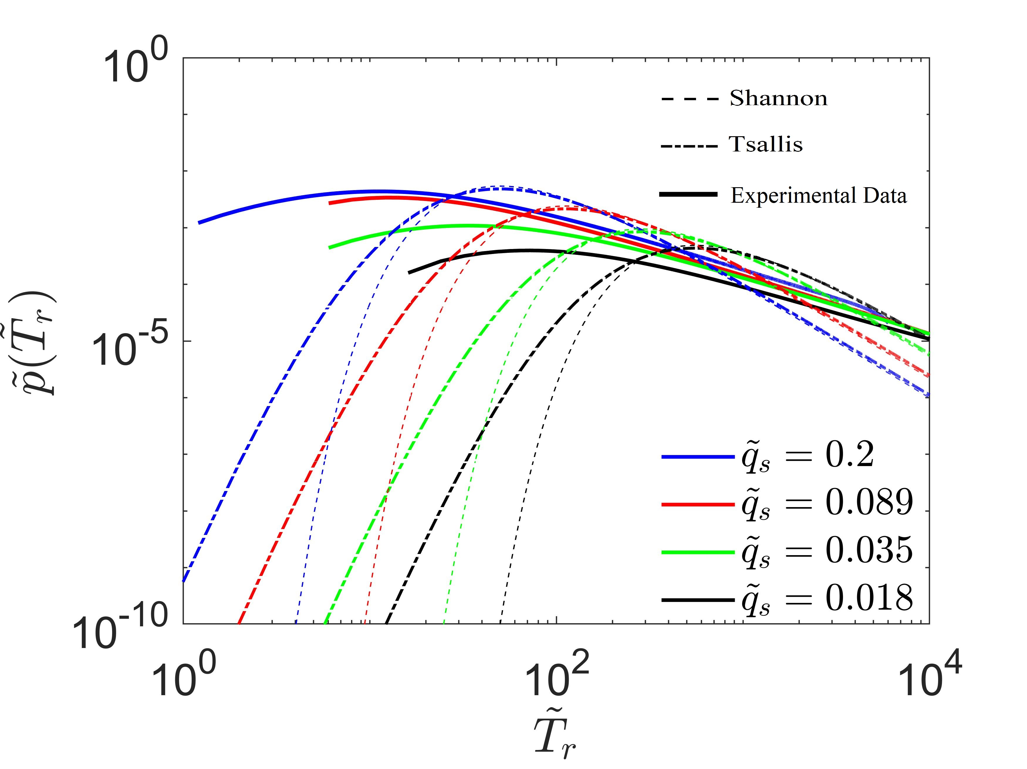
Step 4
Comparison between experimental and theoretical distributions
An indirect, but quite relevant, way to prove the validity of the obtained probability distribution, is worked out by looking at the dispersion of traced grains, originally located in well-bordered pillows at different depths within the bed.
The application of a stochastic model able to move the grains of the bed with prescribed frequencies in space and time allowed us to further appraise a good behavior of the entropy-based distributions versus the experimental ones.
Fig 3. pdf versus resting time (d=0,0031 m)
8
ashkan.pilbala@unitn.it
Pilbala et al, 27 May 2022

Slide 9
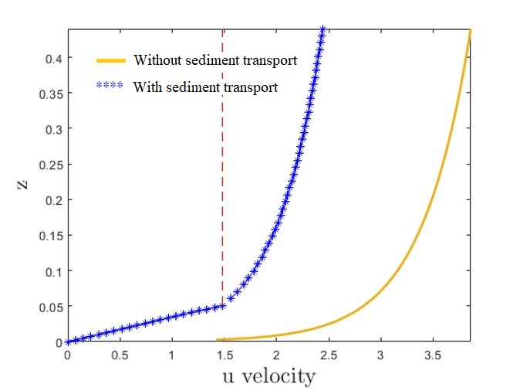
Future plan:
We aim to exploit this information on velocity profile to reach some Entropy Description of sediment transport
Bedload thickness
Fig 4. Depth versus Velocity
9
ashkan.pilbala@unitn.it
Pilbala et al, 27 May 2022

Slide 10
Thank you for your attention
&
Special thanks to Enterprising project members
Ashkan Pilbala
University of Trento, Italy
10
‘Enterprising’ project website: https://enterprisingprin.eu/

