Slide 1
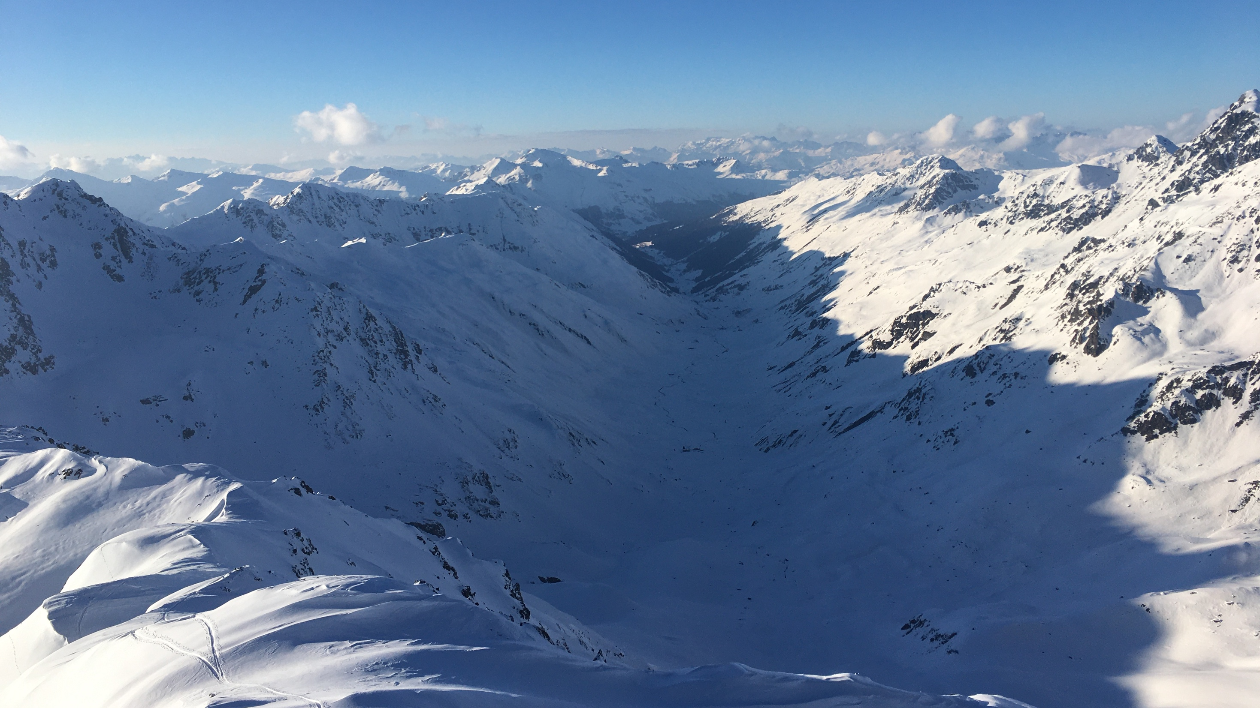


HICAR: Towards a coupled atmosphere-snow modeling system capturing ridge-scale snow deposition patterns over large domains
Dylan Reynolds^{1,3}, Bert Kruyt¹,Ethan Gutmann²
Michael Haugender^{1,3}, Tobias Jonas¹,Michael Lehning^{1,3},Rebecca Mott¹
¹WSL Institute for Snow and Avalanche Research, SLF
²National Center for Atmospheric Research, UCAR, Boulder ³École polytechnique fédérale de Lausanne, EPFL
Notes:
2-3 min introduction of problem
2 min explanation of HICAR
4-5 min results
1 min conclusion

Slide 2
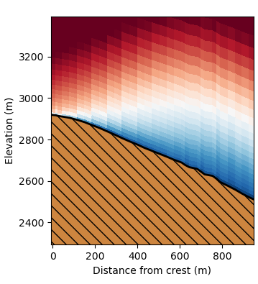
High-resolution Intermediate Complexity Atmospheric Research (HICAR) model
Extension of ICAR model (Gutmann et al., 2016)
Developed to simulate snow deposition patterns in complex terrain
Applies correction to input winds using terrain descriptors
3D Sx (Winstral et al., 2002) and TPI
Mass-conserving constraint is applied while minimizing adjustment to input winds
25-50x faster than comparable WRF runs
3D Sx
+
-
Notes:
4 Min to here

Slide 3
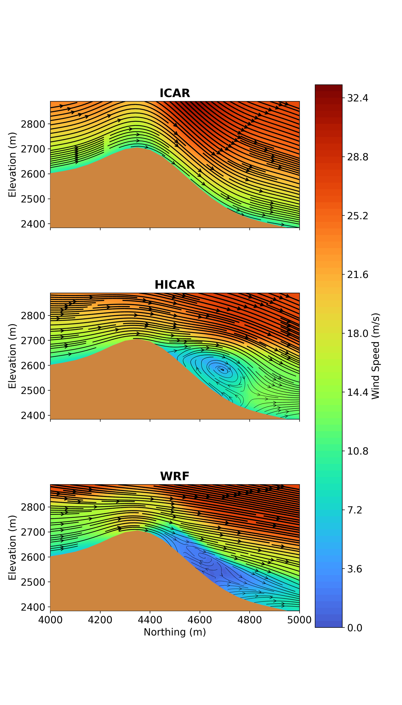
Wind field
Computationally efficient representation of non-local, dynamic effects
Represents < 1% of model run time
3D Sx
+
-

Slide 4
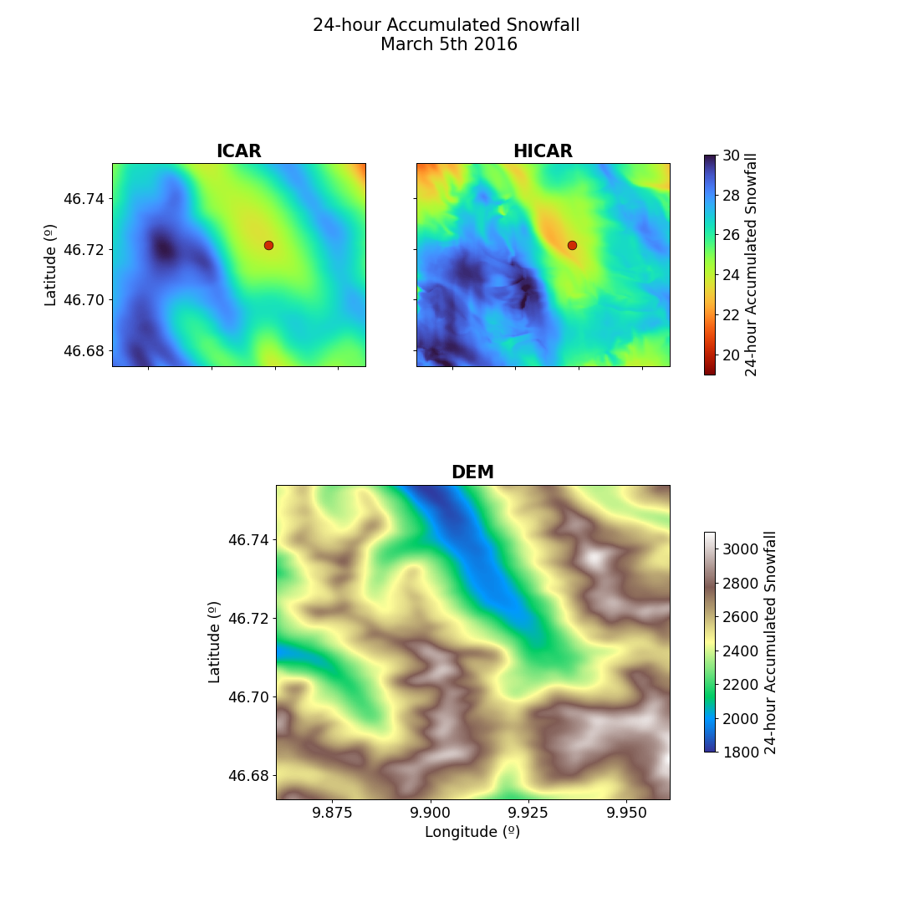
Snowfall Patterns
Snow depth sensor
50m resolution
10 x 10km domain

Slide 5
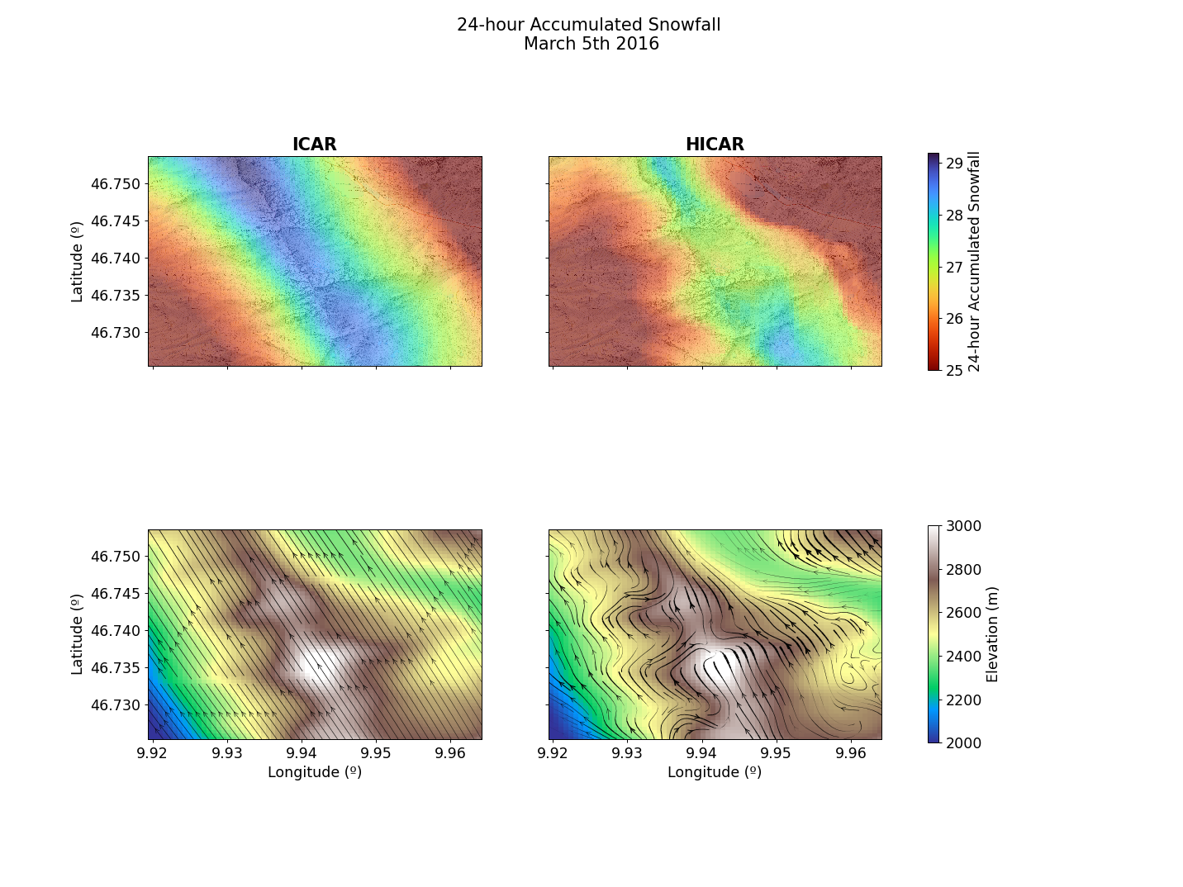
24-hour Accumulated Snowfall
Increased/Decreased deposition in areas of convergence/divergence
Surface Flow Field During Event

Slide 6
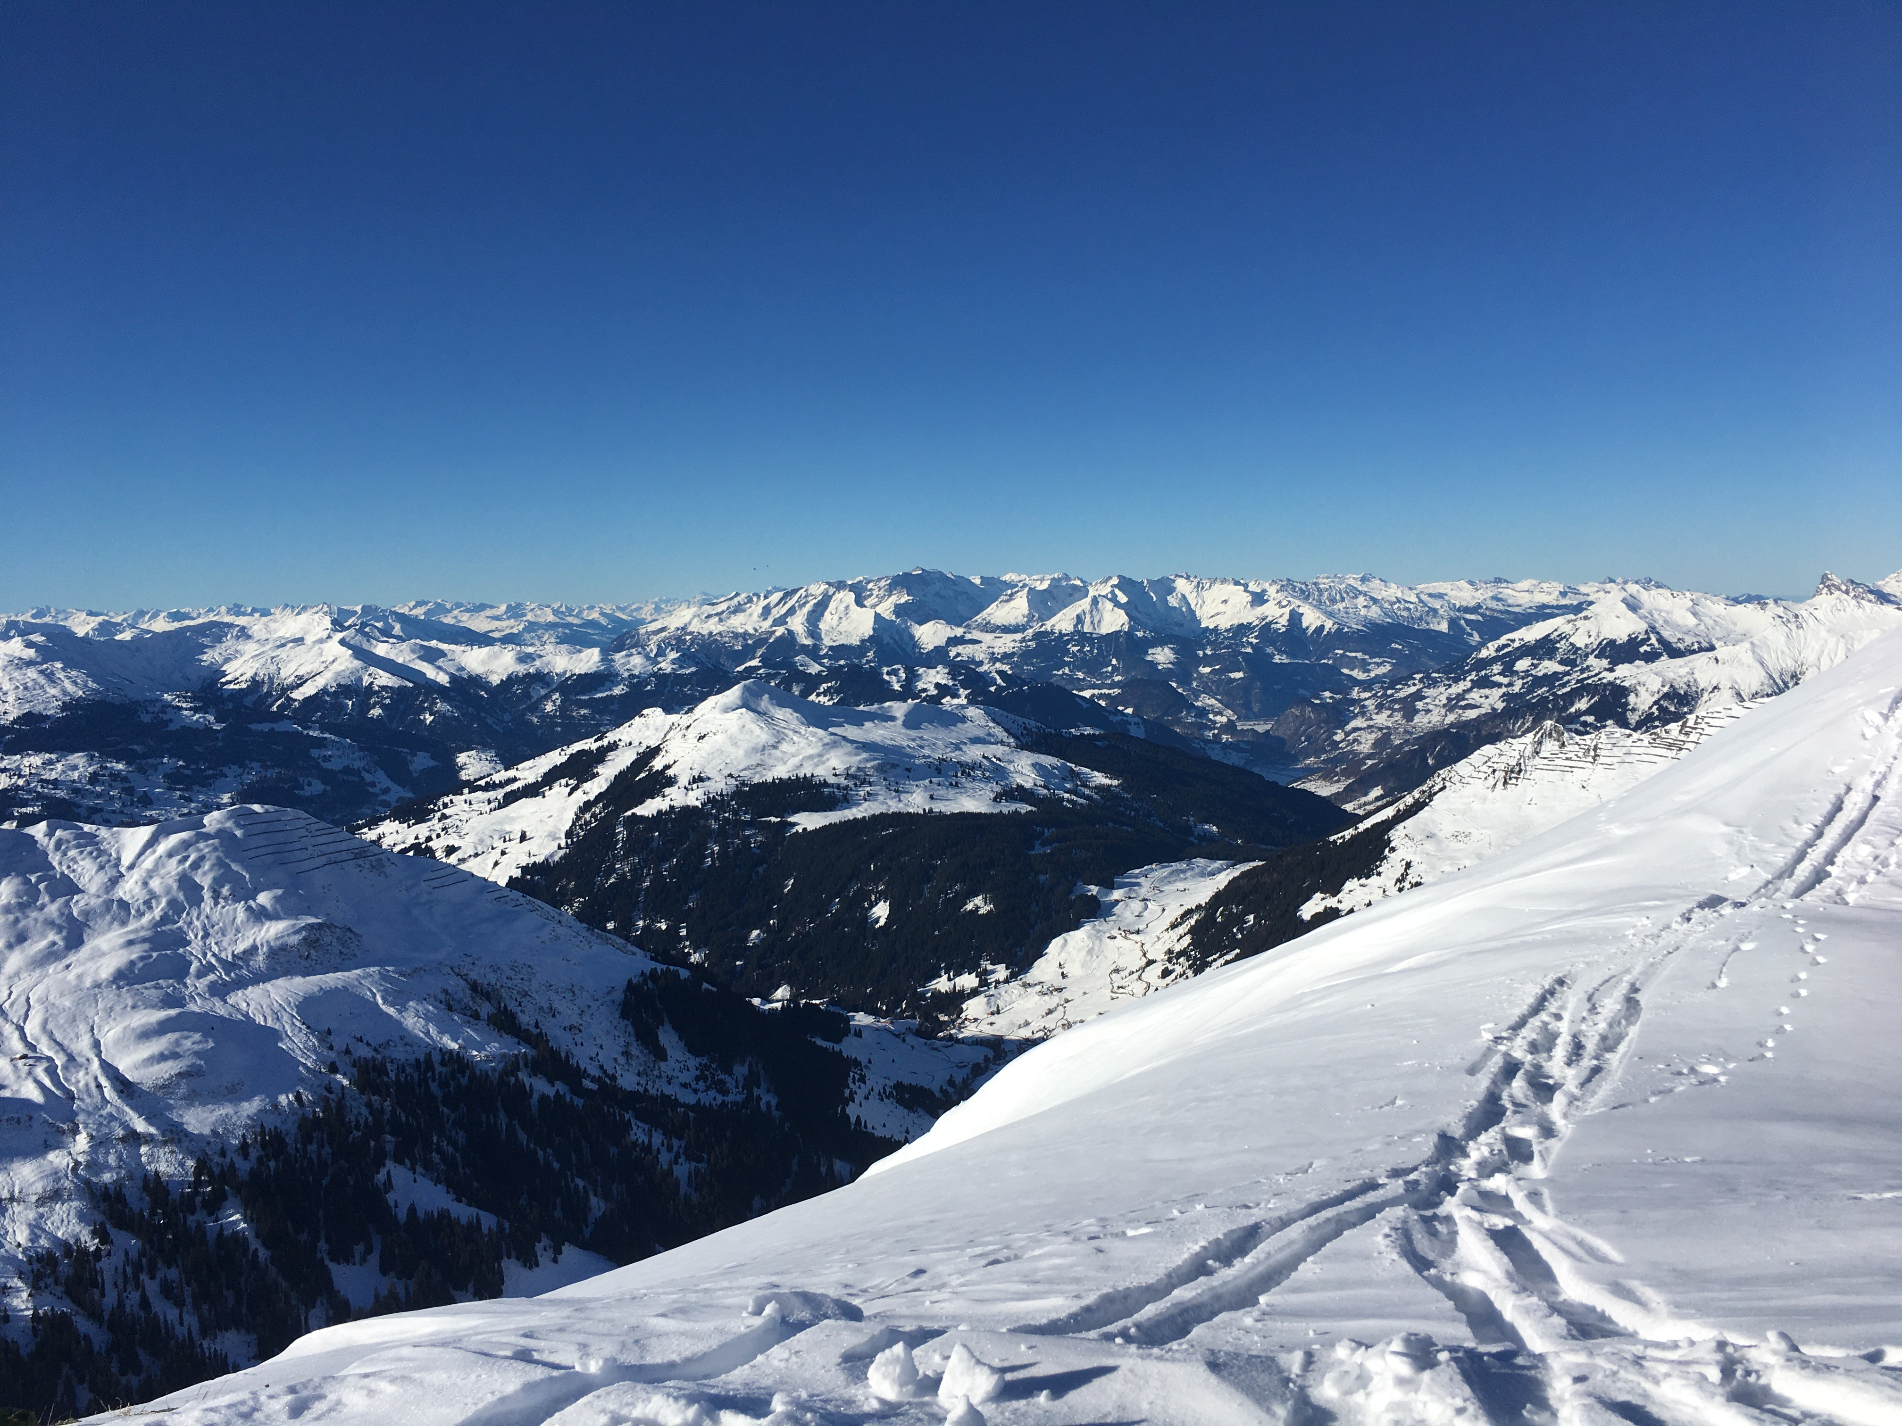
Thank You
e-mail: Dylan.Reynolds@slf.ch
Github: https://github.com/d-reynolds/HICAR

