Slide 1

Dynamics of helium abundance inside and around ICME
Alexander Khokhlachev, Yuri Yermolaev, Maria Riazantseva, Liudmila Rakhmanova, Irina Lodkina
Space Research Institute (IKI) Russian Academy of Sciences, Moscow, Russia
EGU22-11326
Session ST1.8
aleks.xaa@yandex.ru
23-27 May 2022

Slide 2
Introduction
Doubly ionized helium ions are the second most abundant ion component of the solar wind. The helium abundance is an important part of plasma dynamics.
The relative helium abundance N_{α}/N_{p} averages ~ 3% in slow streams and ~ 4% in fast streams of the solar wind. The maximum value (> 10%) is reached in ICME.
N_{α}/N_{p} can significantly vary (from percent to tens of percent) for times of the order of seconds-minutes.
Sun
Schematic representation of large-scale types of the solar wind (Yermolaev et al., Cosmic Res., 2009; http://iki.rssi.ru/pub/omni/catalog/)
Main goal
1. Heliospheric current sheet HCS.
2. Slow streams SLOW.
3. High speed stream FAST. 4. Interplanetary coronal mass ejections ICME: Magnetic Clouds MC and EJECTA. 5. Compressed regions: Corotating Interaction Regions CIR and SHEATH before fast ICME.
Study the relationship of the helium abundance with other solar wind plasma and interplanetary magnetic field parameters inside ICME.

Slide 3
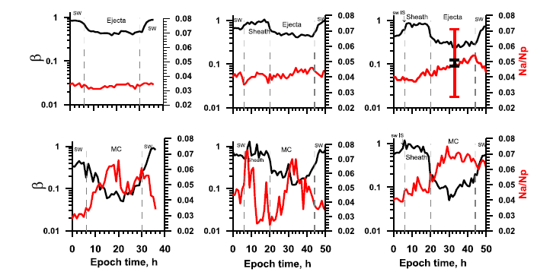
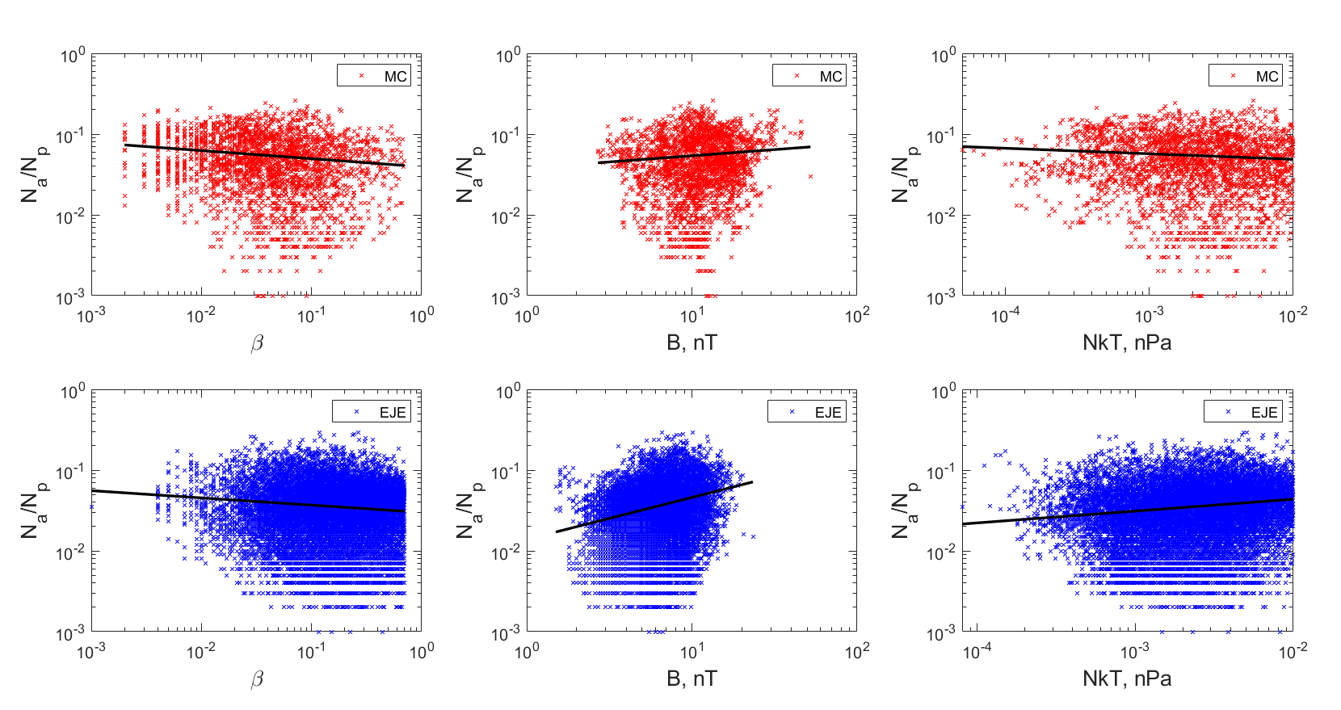
Large-scale dynamics of the helium abundance in ICME
Temporal variations of the helium abundance N_{α}/N_{p} and the plasma β‐parameter in ICME and SHEATH before it by double superposed epoch analysis (Yermolaev et al., JGR, 2020)
Anticorrelation of N_{α}/N_{p} and β-parameter inside ICME. It is related to the growing in the N_{α}/N_{p} with an increase in B.
Possible existence of a current enriched with helium ions inside ICME in a region with a scale of ~10⁶ km.
Dependence of N_{α}/N_{p} vs β, B and N_{p}kT in MC and EJECTA (Khokhlachev et al., Cosmic Res., 2022)

Slide 4
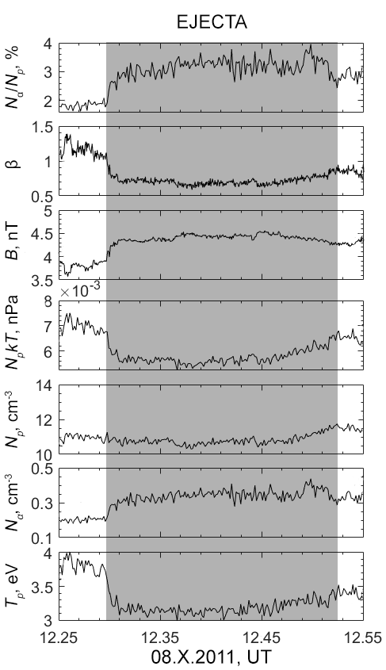
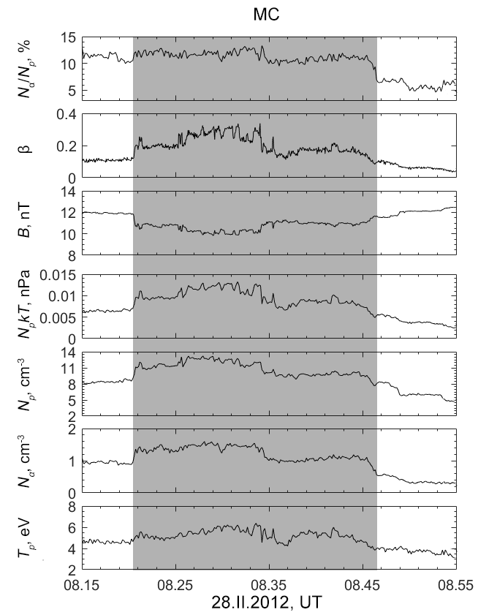
Medium-scale dynamics of the helium abundance in ICME
An analysis of the correlation between the helium abundance and other SW parameters was carried out using 3 sec WIND spacecraft data (cdaweb.gsfc.nasa.gov).
At medium scales 10⁵-10⁶ km, both the correlation of the helium abundance N_{α}/N_{p} with the magnetic field magnitude B (as at large scales) and the anticorrelation between them are observed.
Examples of SW parameters (N_{α}/N_{p}, β, B, N_{p}, N_{α}, T) time series inside EJECTA 08.X.2011 (on left) and MC 28.II.2012 (on right) by WIND spacecraft data

Slide 5
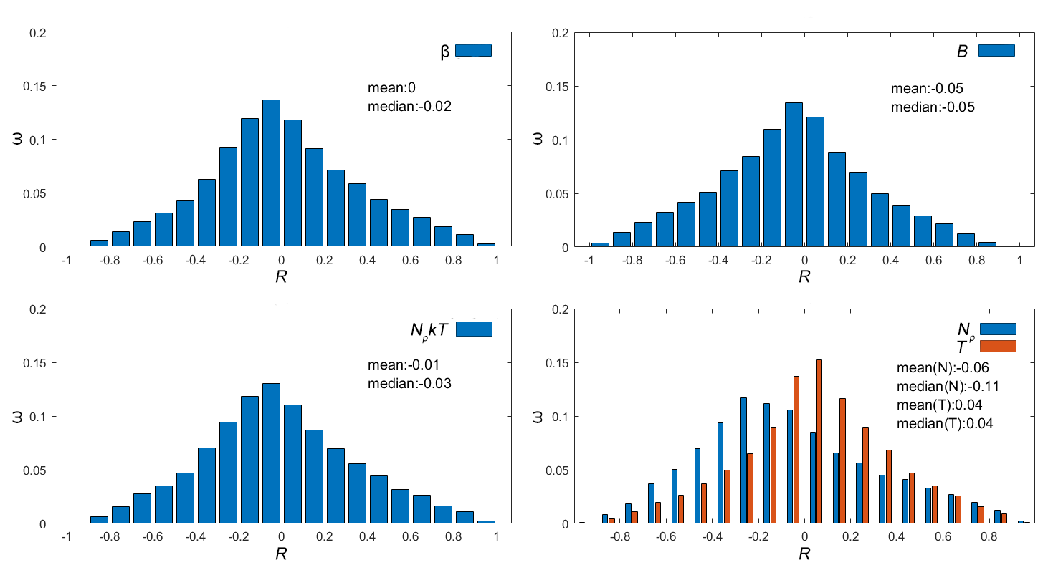
Medium-scale dynamics of the helium abundance in ICME
The time series of parameters inside ICME were divided into hourly interval for statistical analyze.
All statistical distributions for MC are close to be symmetrical with the exception of R(N_{α}/N_{p}, N_{p}). The maximum of distributions is close to zero.
A high positive or negative correlation between parameters is relatively common - ~ 3% and ~ 6% respectively for R(N_{α}/N_{p}, B).
Statistical distribution of correlation coefficients R between N_{α}/N_{p} and β, B, N_{p}kT, N_{p}, T on hourly intervals inside MC

Slide 6
Conclusion
On large spatial scale (> 10⁶ km) in ICME the relative helium abundance anticorretates with the plasma β-parameter. It is related to the correlation with the magnetic field magnitude, which can indicate the existence of a helium-enriched current inside ICME (Yermolaev et al., JGR, 2020; Khokhlachev et al., Cosmic Res., 2022).
On medium scale (10⁵-10⁶ km) an increase in the helium abundance inside ICME can be observed both with an increase and a decrease in the magnetic field. On average, no obvious correlations of the helium abundance with any parameters were found.
The existence of medium-scale structures with a high correlation between the helium abundance and the magnetic field magnitude, as well as structures with a clear anticorrelation of these two parameters (~ 3% and ~ 6% of cases), inside ICME was revealed. Such structures generally occur against the background of anticorrelation of the magnetic field and thermal pressure.

Slide 7
Thank you for attention

