Slide 1


Testing potential mitigation measures
to reduce nutrient loads to
a temporary river
A.M. De Girolamo^{a*}, A. Lo Portoª
annamaria.degirolamo@ba.irsa.cnr.it
Water Research Institute – National Research Council of Italy
EGU22 session HS2.3.1
Water quality at the catchment scale: measuring and modelling of nutrients,
sediment and eutrophication impacts

Slide 2
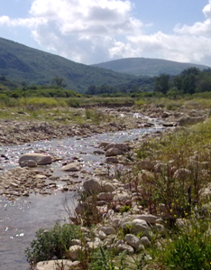
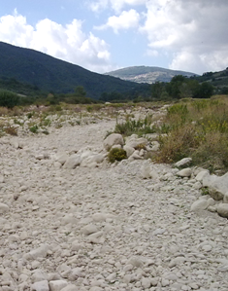
The problem
Temporary rivers are characterised by a period of extremely low flow and by periodic flow cessation
Agriculture and point sources have several implications in terms of quantity and quality
A Program Of Measures is needed to achieve and maintain the «Good Status» of water bodies

Slide 3

Objectives
General objective
To define a methodology for investigating the effects of mitigation measures for reducing diffuse and point sources pollution
The specific objectives
quantify the nutrient loads from point and diffuse sources to the Rio Mannu stream
Investigate the relations between flow regime and water quality
Investigate the effects of mitigation measures in reducing the nutrient loads being delivered to the wetland differentiated on flow regime basis

Slide 4
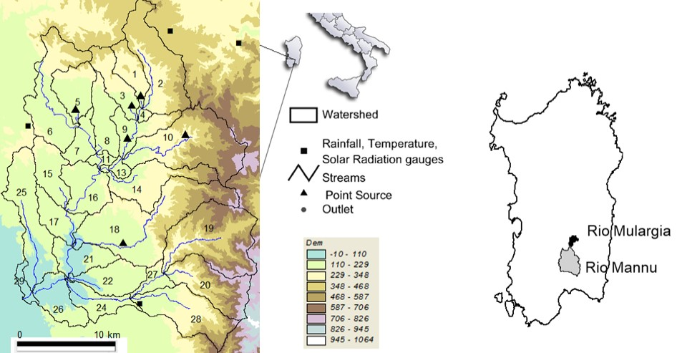
Study area
Rio Mannu (Sardinia, Italy)
Drainage area 488 km²
Precipitation 500mm
Anthropogenic pressures
Agriculture
Point sources
Durum wheat 37%
Natural forest and range grasses 32%
Olive trees 8%
Minor land uses (alfalfa, corn sillage, orchards, vineyards)
6 Waste water treatment plants

Slide 5
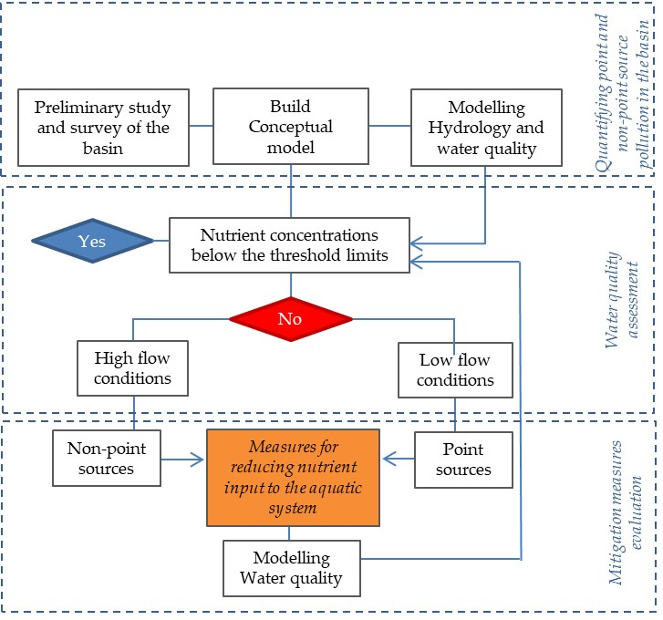
Methodology
SWAT Model
(from 1994 to 2007)
Flow regime/water quality relation determination
Mitigation options definition
Reduction in nutrient concentration and loads
Estimation by using SWAT

Slide 6
Results
MODEL CALIBRATION
Streamflow (no measurements were available)
Regionalization scheme based on hydrological parameters transposition from the adjacent gauged river basin Rio Mulargia
Simulated monthly streamflow falls within the interval of its natural variability (mean±SD) from 1922 to 1967
Water quality
PBIAS 12.68% for TP; −3.32% for TN
NSE 0.52 for TP; 0.76 for TN

Slide 7
Results
Basin scale

Slide 8
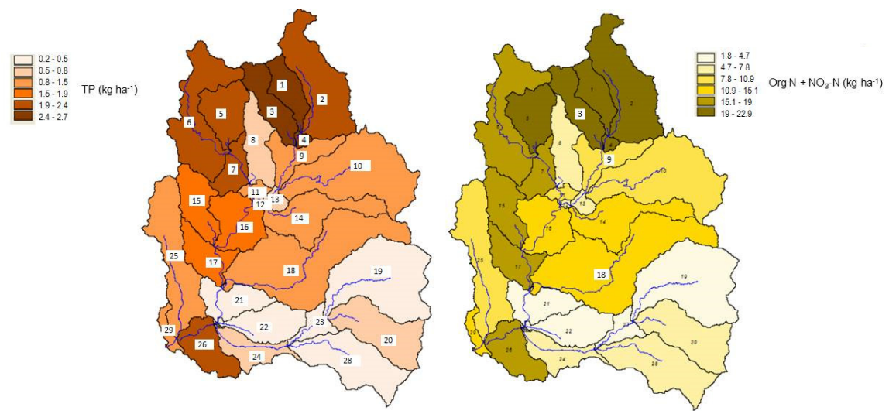
Results
Sub-basin scale
De Girolamo A.M., Lo Porto A. 2020. Water 12 (2), 577 https://doi.org/10.3390/w12020577

Slide 9
Results
Nutrient concentrations at the outlet
Point sources are the major sources of TP in normal and low flow conditions
Agriculture is the major source
of nutrients in high, normal flow conditions
Current conditions (point and diffuse sources)
Concentrations higher than threshold limits
The river became perennial due to point sources discharge
Diffuse sources
N-NO3 higher than threshold limits in high, normal and low flow,
TP lower that threshold limits in normal and low flow

Slide 10
Results
Scenario for Reducing Nutrient Input to the Aquatic System
To reduce nutrients in low flow conditions
Reuse of Treated Wastewater from 3 WWTPs for irrigation purpose on olive cultivations
20 % Reduction in Fertiliser Usage
To reduce nutrients in high and normal flow

Slide 11
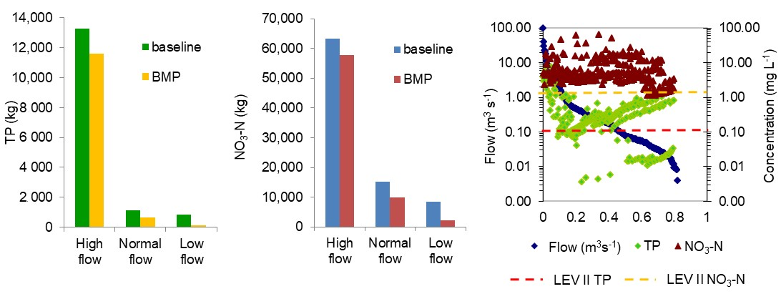
Results
Mitigation options: reduction in nutrient loads and concentrations
Reduction in nutrient loads under all hydrological conditions (high, normal, low flows).
Under high flow conditions, the reduction was 9% and 12% for NO₃-N and TP, respectively.
The reduction under normal and low flow conditions was 75% and 83% for NO₃-N and TP, respectively.
TP and NO₃-N concentrations remained higher than threshold limits

Slide 12
Conclusions
SWAT model proved to be a valuable tool for estimating nutrient riverine export and for testing scenarios for reducing nutrient loads
Agriculture is the main source of the nutrients in the surface waters. Most of the nutrient loads are delivered to the wetland under high flow conditions.
Point source discharge constitutes a relevant issue for intermittent streams
20% reduction in fertiliser usage and the reuse of wastewater from some WWTPs result in a nutrient load reduction, although this reduction is not large enough, and supplementary measures would be required.
A programme of measures for improving the current status of surface waters must be oriented towards reducing nutrient loads, both under high and low flow conditions.

Slide 13
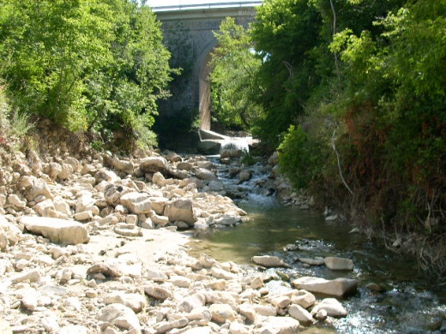
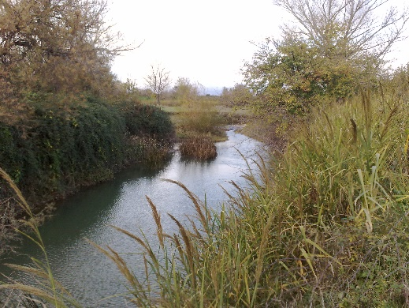
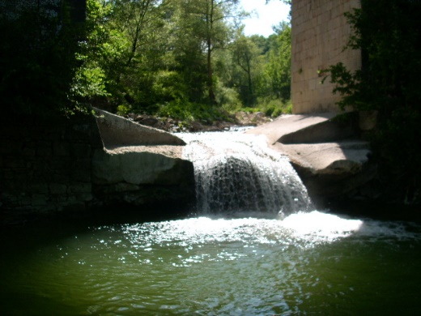
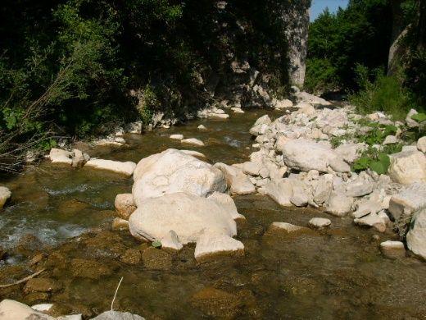
Thank you
for your attention!

