Slide 1
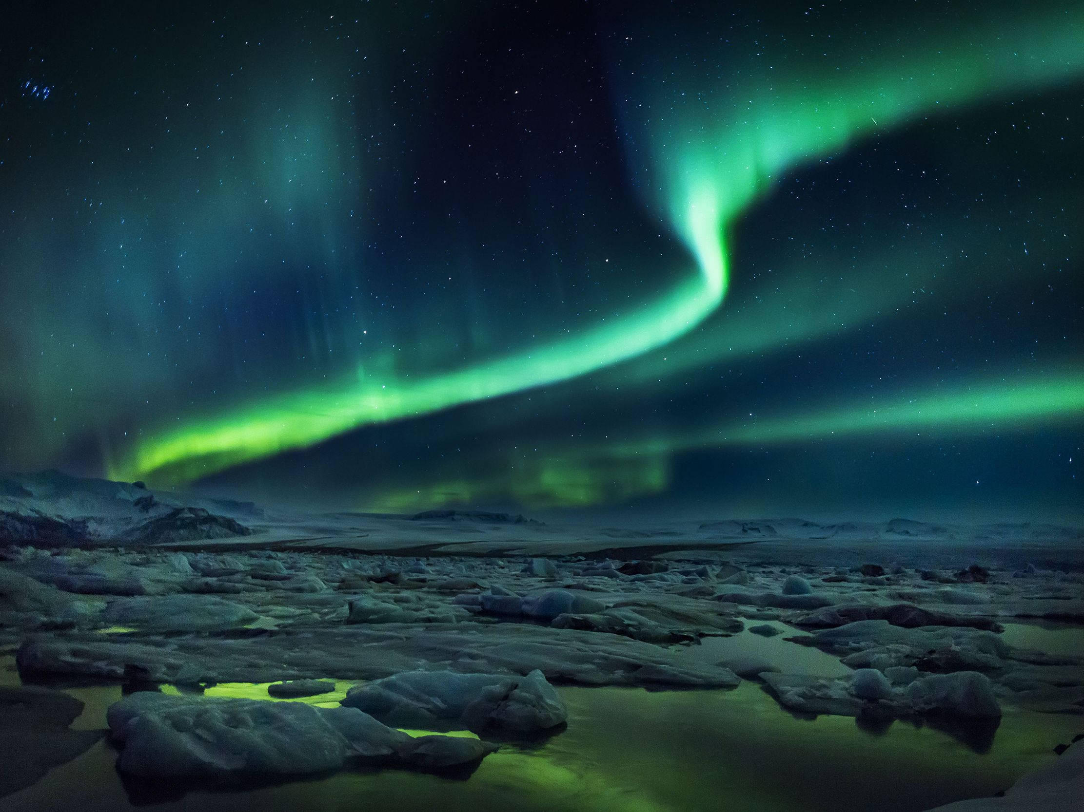







Planetary wave-driven enhanced descent of NO into the top of the Arctic polar vortex during major and minor SSWs
V Lynn Harvey, Nick Pedatella, Seebany Datta-Barua, Cora Randall, Dave Siskind, Katelynn Greer, Larisa Goncharenko
European Geophysical Union Meeting 27 May 2022

Slide 2
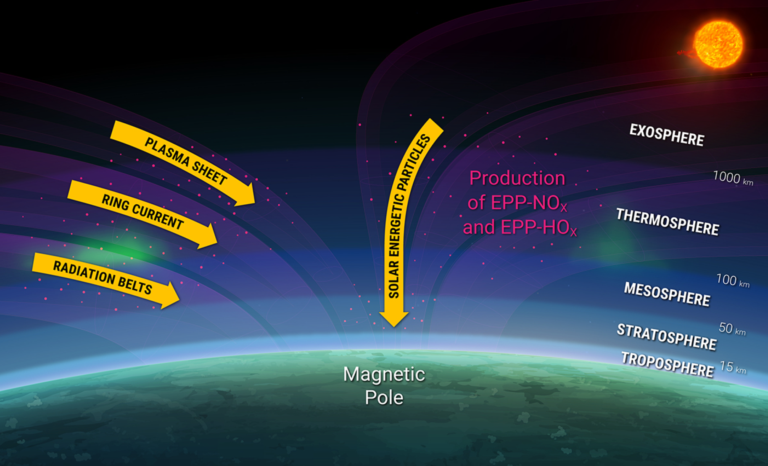
NOx produced by EPP descends in the winter polar vortex and destroys ozone
Courtesy of Dan Baker & Allison Jaynes, CU Boulder/LASP
European Geophysical Union Meeting 27 May 2022
Notes:
The sun bombards Earth’s magnetosphere with solar flares, coronal mass ejections, and high speed streams
Precipitating energetic electrons and solar protons produce HO_{x} and NO_{x}, which destroy ozone catalytically
click
The vortex is perfectly situated over the poles where the field lines converge – to confine the EPP-NOx and HOx. Since HOx is very short-lived we hereafter focus on the NOx.
Descent in the vortex transports the nitric oxide produced by the ionization down to the stratosphere where the ozone is

Slide 3
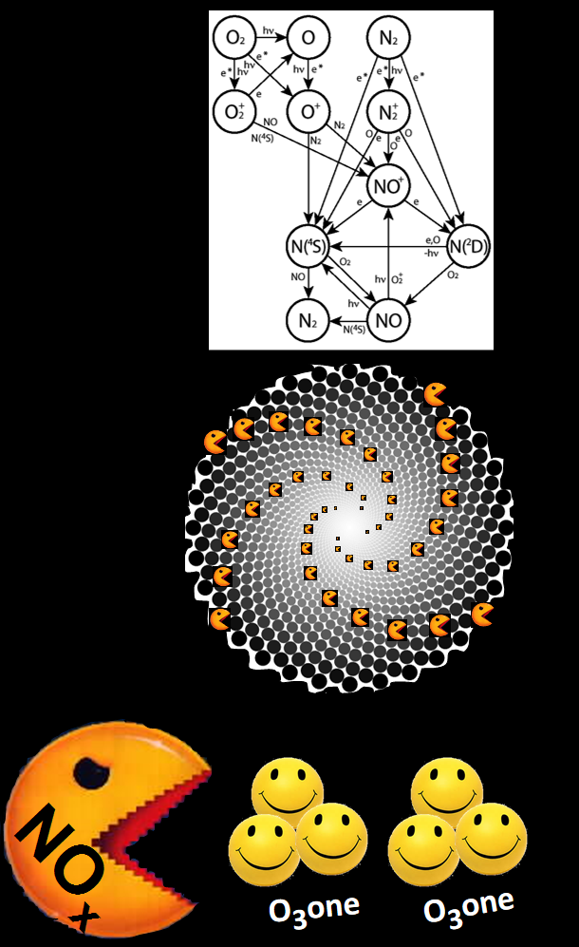
EPP INDIRECT EFFECT (EPP-IE)
• NO_{x} formed in MLT via EPP
↓↓↓
• Descends in polar vortex during winter
↓↓↓
• Ozone destroyed (~22-40 km)
Courtesy of Charles Barth
Randall et al. (2006)
Courtesy of Cora Randall
European Geophysical Union Meeting 27 May 2022
Notes:
Ozone loss due to the descent of EPP-produced NOx is known as the “indirect effect”, coined by Cora Randall
The “Indirect Effect” is where NOx is transported from the thermosphere to the stratosphere inside the winter polar vortex.
The nitrogen oxides once transported to the stratosphere destroy ozone

Slide 4
O₃
Changes in polar ozone can trigger a redistribution of solar and magnetospheric energy at Earth, coupling the upper and lower atmosphere
Waves
Temp
Winds
European Geophysical Union Meeting 27 May 2022
Notes:
since ozone is a radiatively active gas, changes to ozone impact the temperature.
Changes in temperature gradients change the background winds which affect the upward propagation of waves.
The polar vortex acts to facilitate this coupling

Slide 5
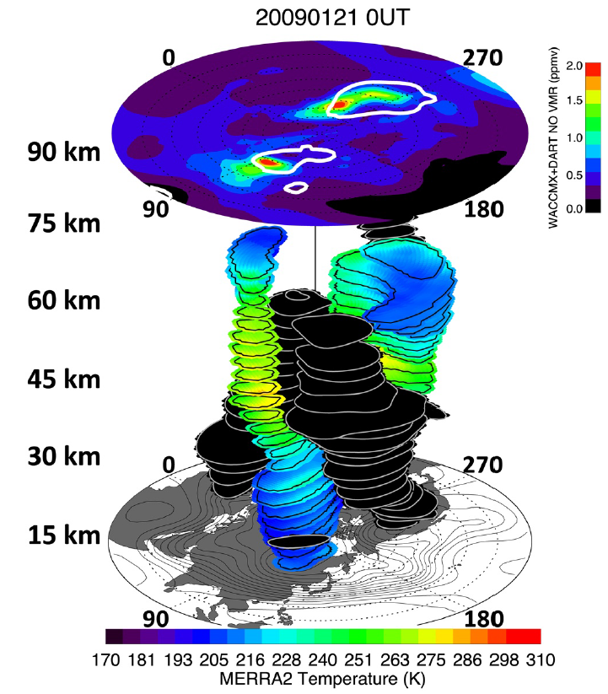
The EPP-IE needs to be studied in 3D
Harvey et al., JGR 2021: EPP-NOx exhibits zonally asymmetric descent into the top of the polar vortex following the 2009 SSW
WACCMX + DART
Lagrangian coherent structures (transport barriers) near 90 km confined EPP-NOx to the polar region
5x stronger descent at planetary wave trough longitudes, mostly driven by large-scale vertical advection
EPP effects must be studied in 3D
Is this common?
WACCM
MERRA2
European Geophysical Union Meeting 27 May 2022
Notes:
Exactly how air descends across the mesopause is a topic of ongoing work motivated by the fact that all state-of-the-art high top GCMs currently underestimate the descent.
Last year we used the Whole Atmosphere Community Climate Model with thermospheric eXtension, and a variety of satellite observations and reanalysis data, to study the extent to which Lagrangian Coherent Structures exist near the polar winter mesopause acted to confine air to high latitudes as it descends into the top of the vortex.
Results from our JGR paper last year show 5x stronger descent in PW troughs.
Is this common?

Slide 6
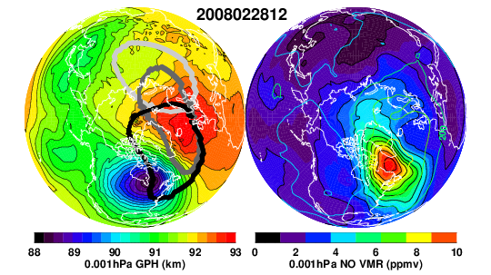
Enhanced NO in PW troughs during all 14 SSWs
5
6
We use WACCMX+DART, SABER, ACE-FTS, SOFIE from 2006-2019
Require dU > -10 m/s for 5 days
Identified 15 case studies
14 of 15 case studies are SSWs
8 Minor and 6 Major SSWs
4
9
10
11
13
15
2
7
8
1
3
12
14
3.5x stronger descent in PW troughs compared to PW ridges
In 30% of cases there is ascent in the PW ridge
European Geophysical Union Meeting 27 May 2022
Notes:
For this work we use 14 years of Whole Atmosphere Community Climate Model output with data assimilation, SABER and MERRA-2 winds and temperature and NO observations by the ACE-FTS and SOFIE instruments
First we consider model fidelity at 90 km.
If you look at daily 90 km zonal mean zonal wind differences between WACCM and SABER you’ll see that they vary in time
Shown here are 14 years of January and February days in which SABER is looking toward the NH from 2006-2019
That the black line is predominantly in the negative is a reflection of the well-known easterly wind bias in the model
Major and minor SSWs are denoted by the red and yellow dots.
In general, the model is in better agreement with the observations during SSWs
Click
To identify case studies to explore NO descent into the vortex, we first require model-measurement differences to be > -10 m/s for at least 5 days
Click
We identified 15 case studies, 14 of which are SSWs
Click
We show NH polar maps of this case study
Click
The lower left gives a representative example during Feb 2008 – NH polar plots of GPH (left) and NO (right) that shows high NO coincident with a region of low pressure (PW trough) at 90 km
Click
Finally, we estimate descent rates in the troughs vs. the ridges in all 15 cases by quantifying the vertical displacement of NO profiles over the duration of each case
Here we show mean vertical velocity (in the 70-90km layer) – for all 15 cases (listed along the x-axis from 2006-2019)
Descent in the trough is shown by the thick black contour
Descent/ascent in the ridge is shown by the black dots.
Click
On average, descent is 3.5x stronger in PW troughs compared to PW ridges
Click
And in 30% of cases, there appears to be ascent in the PW ridge
So while the NOx in the model is far too low at 90 km
The NOx that is there descends preferentially in the PW troughs and at the right rate
This suggests model underestimates in NOx are either due to a missing NOx source or to transport issues in the lower thermosphere (but not the upper mesosphere)

Slide 7
THANK YOU
During SSWs near the winter mesopause, there is enhanced descent of NO in traveling PW troughs into the top of the polar vortex
Lynn.Harvey@lasp.Colorado.edu
European Geophysical Union Meeting 27 May 2022

