Slide 1
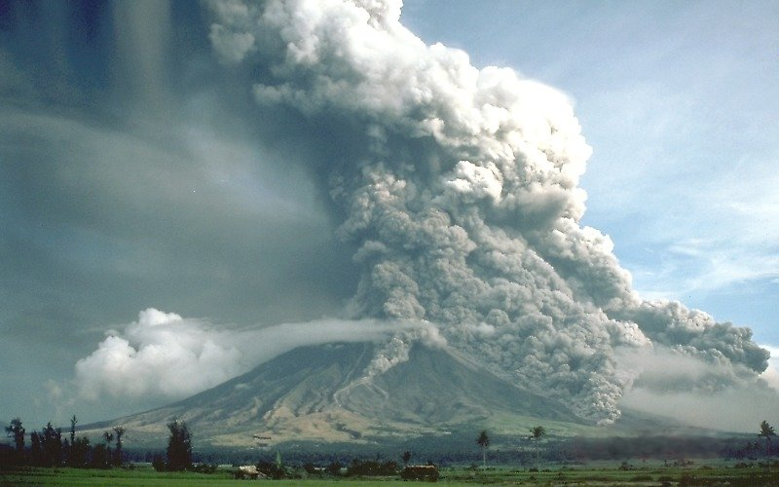




Reconstructing Pyroclastic Currents’ Source and Flow Parameters from Deposit Characteristics and Numerical Modelling: The Pozzolane Rosse Ignimbrite case study (Colli Albani, Italy)
Laura Calabró⁽¹⁾, Tomaso Esposti Ongaro⁽²⁾, Guido Giordano^{(1,3)}, de’ Mattia Micheli Vitturi^{(2,4)}
Dipartimento di Scienze – Sezione Geologia, Università di Roma Tre, Roma, Italy;
Istituto Nazionale di Geofisica e Vulcanologia, Sezione di Pisa, Pisa, Italy.
Istituto di Geologia Ambientale e Geoingegneria, CNR, 00010 Montelibretti, Italy.
4. Department of Geology, University at Buffalo, 126 Cooke Hall, Buffalo, New York 14260, USA.
Notes:
Calabrò, L., Esposti Ongaro, T., Giordano, G., & de’ Michieli Vitturi, M. (2022). Reconstructing pyroclastic currents' source and flow parameters from deposit characteristics and numerical modeling: The Pozzolane Rosse ignimbrite case study (Colli Albani, Italy). Journal of Geophysical Research: Solid Earth, 127, e2021JB023637. https://doi.org/10.1029/2021JB023637

Slide 2
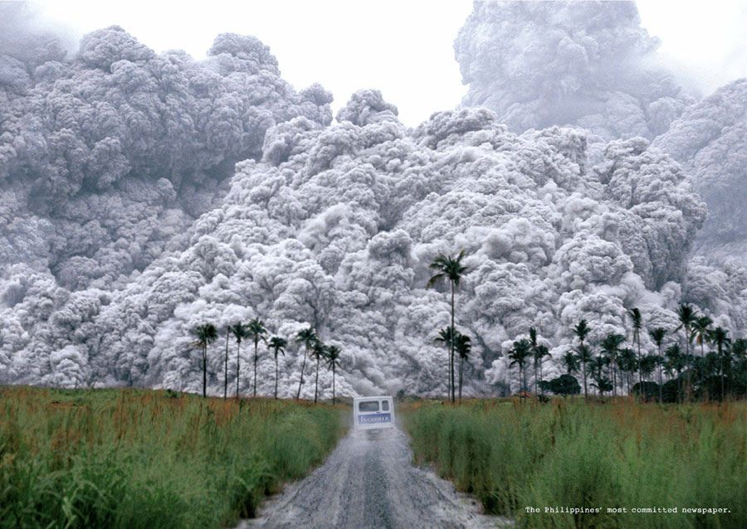
What are pyroclastic currents (PCs)?
Turbulent ground-hugging flows
Hot mixture gas + particles of different sizes
Velocity up to several hundred meters per second
Temperature up to thousand degrees centigrade
Account for half of all deaths due to historic volcanic eruptions
(~90.000 deaths; Aucker et al., 2013)
Direct observation of such events is not possible

Slide 3
Case Study: RED - Pozzolane Rosse (Colli Albani)
The ignimbrite of Pozzolane Rosse (457±4 ka):
Low aspect-ratio ignimbrite
Radially spreading flow
Ability to overcome topography
Max runout = ~33 km
Max thickness = 80 m
Volume = 69 km³
Total Grain size distribution
Modified from Giordano and Doronzo, 2017

Slide 4
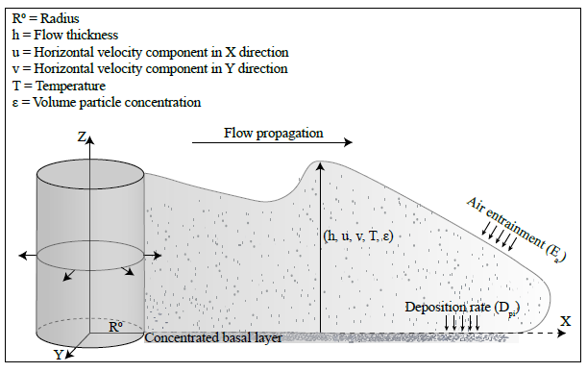



Depth-averaged model: Implementation of Entrainment and Sedimentation
Mass Conservation:
$$\frac{∂\left(ρ_{m}h\right)}{∂t}+\frac{∂\left(ρ_{m}v_{x}h\right)}{∂x}+ \frac{∂\left(ρ_{m}v_{y}h\right)}{∂y}=\sum_{i= 1}^{n_{p}}{\left[−ρ_{i}D_{p_{i}}\right]}+ ρ_{a}E_{a}$$
Momentum Conservation:
$$\frac{∂\left(ρ_{m}v_{x}h\right)}{∂t}+\frac{∂}{∂x}\left(ρ_{m}v_{x}^{2}h+ \frac{1}{2}ρ_{m}g′h^{2}\right)+\frac{∂}{∂y}\left(ρ_{m}v_{x}v_{y}h\right)=ρ_{m}g^{′}h\frac{∂B}{∂x}+ F_{x}−v_{x} \sum_{i= 1}^{n_{p}}{\left[−ρ_{i}D_{p_{i}}\right]}$$
$$\frac{∂\left(ρ_{m}v_{y}h\right)}{∂t}+\frac{∂}{∂x}\left(ρ_{m}v_{x}v_{y}h\right)+ \frac{∂}{∂y}\left(ρ_{m}v_{y}^{2}h+ \frac{1}{2}ρ_{m}g′h^{2}\right)=ρ_{m}g^{′}h\frac{∂B}{∂y}+ F_{y}−v_{y} \sum_{i= 1}^{n_{p}}{\left[−ρ_{i}D_{p_{i}}\right]}$$
Energy Conservation:
$$\frac{∂}{∂t}\left(ρ_{m}he\right)+ \frac{∂}{∂x} \left[\left(e+\frac{1}{2}g^{′}h\right)ρ_{m}hv_{x}\right]+ \frac{∂}{∂y} \left[\left(e+\frac{1}{2}g^{′}h\right)ρ_{m}hv_{y}\right]=ρ_{m}g^{′}h \left(v_{x}\frac{∂B}{∂x}+v_{y}\frac{∂B}{∂y}\right)+ \sum_{i=1}^{n_{p}}{\left(ρ_{i}C_{p}T\right)− \frac{1}{2} \left(v_{x}^{2}\text{+}v_{y}^{2}\right)}\sum_{i=1}^{n_{p}}{\left(ρ_{i}{D_{p}}_{i}\right)− \sum_{i=1}^{n_{p}}{\left(ρ_{i}C_{p}T{D_{p}}_{i}\right)+C_{a}ρ_{a}T_{a}E_{a}}}$$
In large scale natural flow, entrainment of ambient fluid into a gravity current can be significant, diluting the flow up to a point where it can be positively buoyant.
(5)
(6)
$$ε= \frac{0,075}{(1+718{Ri}^{2,4})^{0,5}}$$
$$E_{a}= ε\sqrt{(u^{2}+v^{2}}$$

Slide 5
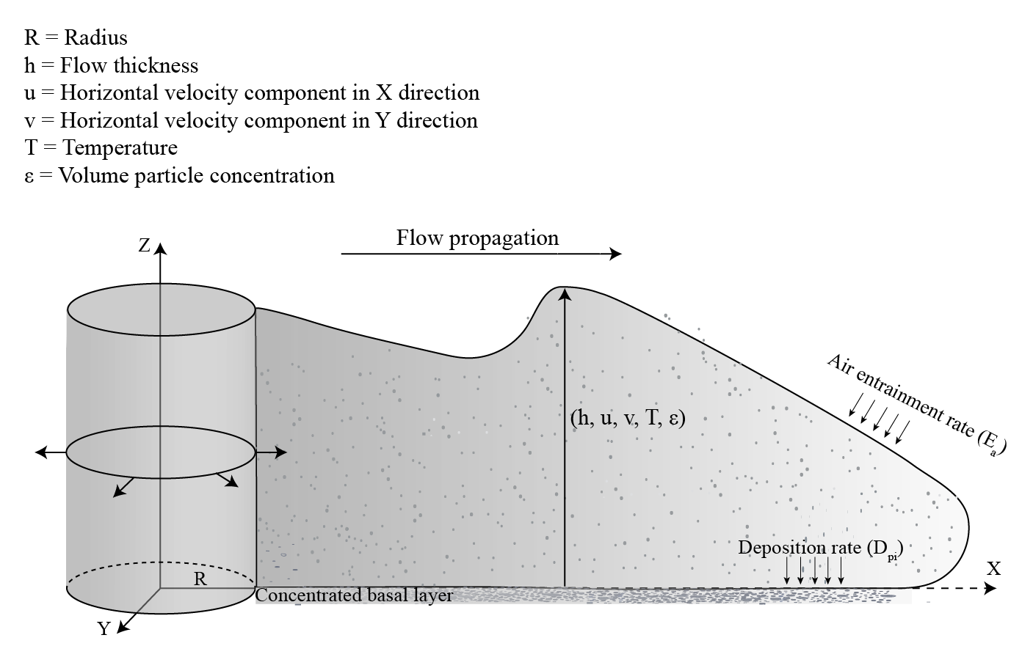
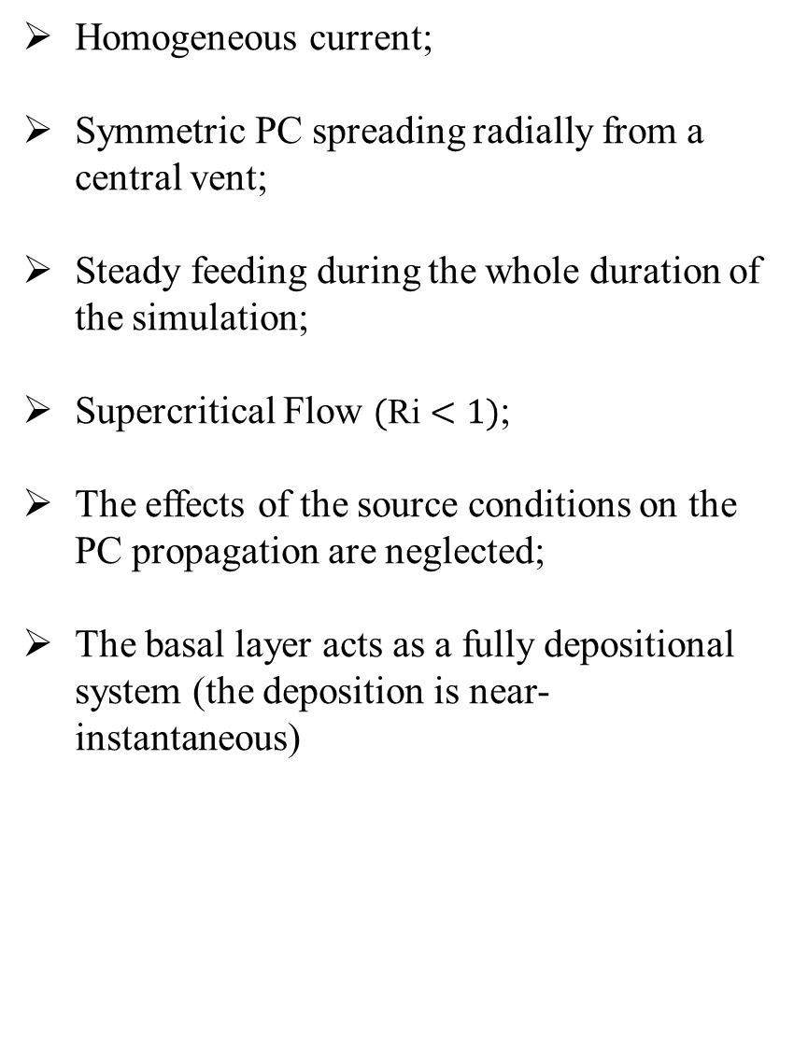
Assumptions
Homogeneous current;
Symmetric PC spreading radially from a central vent;
Steady feeding during the whole duration of the simulation;
Supercritical Flow $(\text{Ri}<1)$;
The effects of the source conditions on the PC propagation are neglected;
The basal layer acts as a fully depositional system (the deposition is near-instantaneous)
From Calabrò et al., 2022

Slide 6
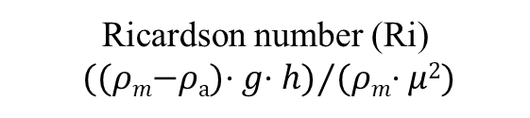
What parameters do I need?
Output
Observable parameters
Input
Ri = 0.5
Ri = 0.05
Ricardson number (Ri)
((𝜌_{𝑚}−𝜌_{a})⋅ 𝑔⋅ ℎ)⁄(𝜌_{𝑚}⋅ 𝜇²)
Initial Velocity
Initial Thickness
Mixture density
(9.70 kg/m³, 23.65 kg/m³,70.14 kg/m³)
Grain-size
(200 µm, 1mm, 1.6 cm)
Temperature
(873 K, 923 K, 973 K)
Runout
Thickness of deposits
Grain-size distribution
Temperature
Co-ignimbrite
Mass flow rate
2 ⋅ π ∙ 𝑟 ∙ ℎ ∙ μ⋅ 𝜌_{𝑚}
𝜌_{𝑚} = mixture density
𝜌_{a} = air density
𝑔 = acceleration of gravity
ℎ = thickness
𝜇 = velocity
𝑟 = radius

Slide 7
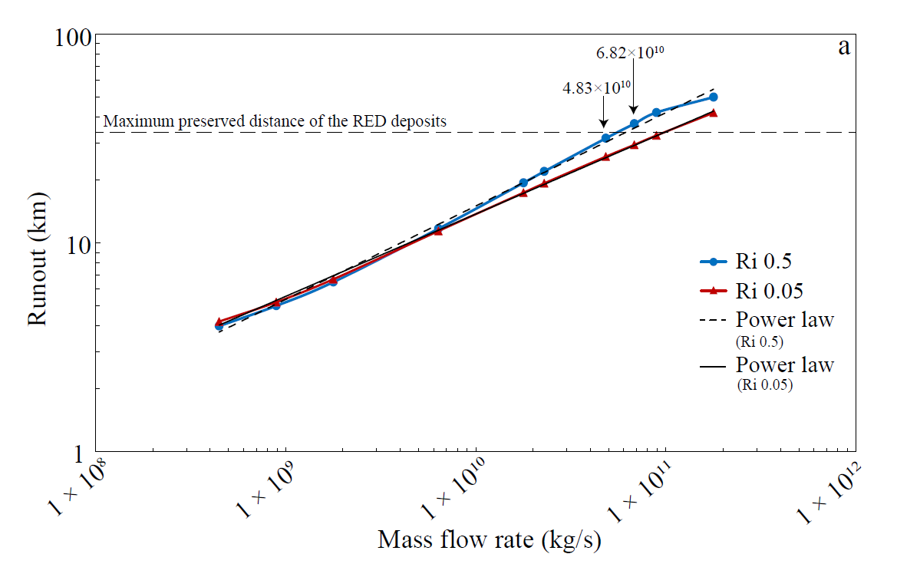
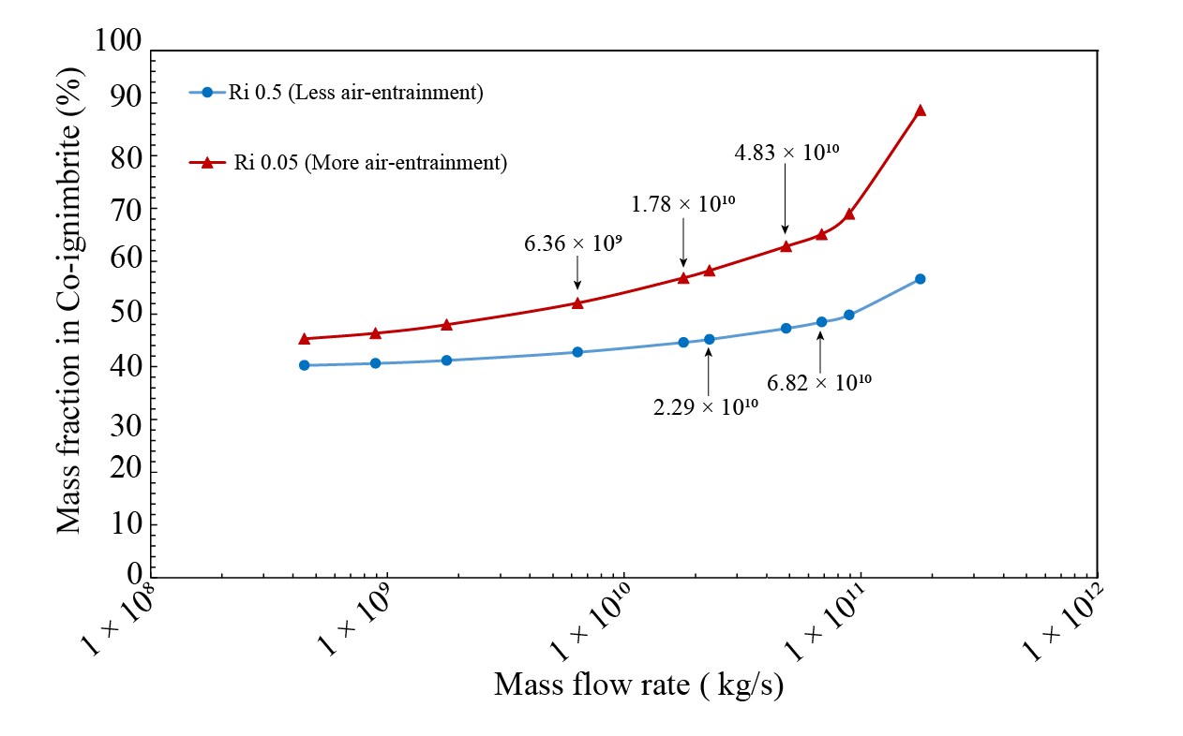
Model Results: Mass flow rate (Mfr) control on Runout
Runout increases with increasing Mfr
Air-entrainment increases with increasing Mfr
From Calabrò et al., 2022

Slide 8
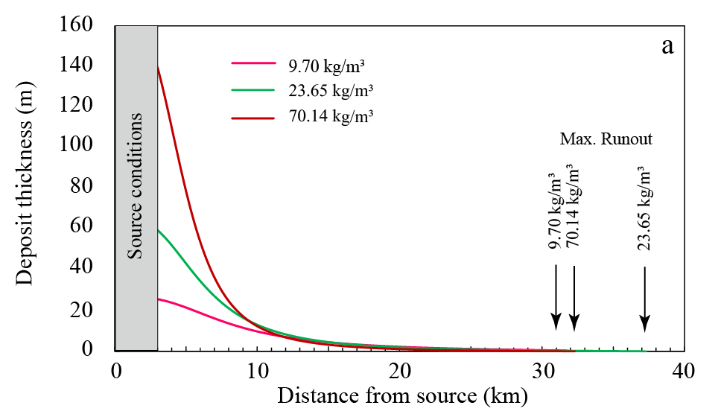
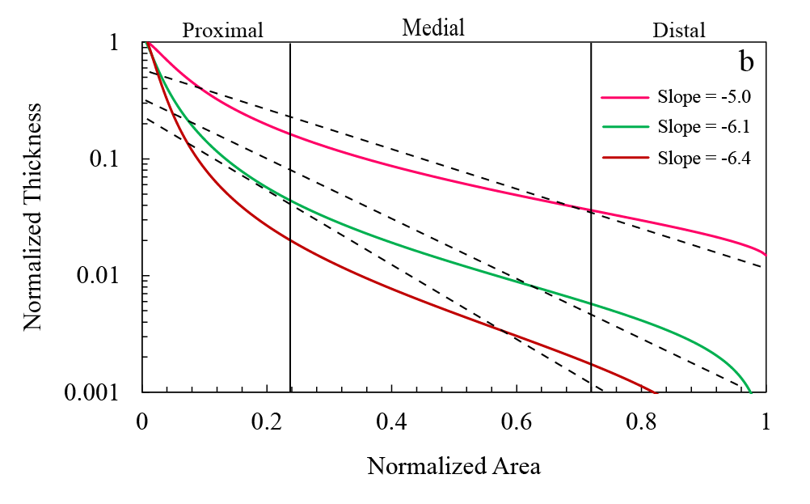
Model Results: Mixture Density control on the deposit
Density has a 20% influence on runout
The deposits show a first order exponential relationship between thickness decay and related covered area.
Rapid sedimentation
The exponential fitting slope increases with the flow density

Slide 9
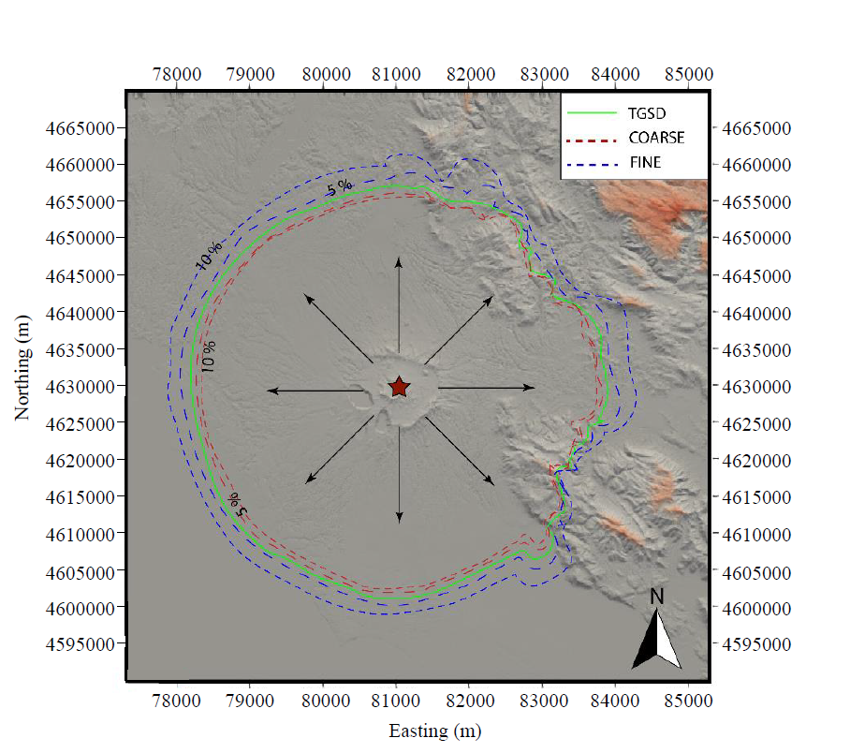
RED ignimbrite: reconstruction of source and flow properties
Assuming
Runout increases with increasing finer fraction
Mfr =6.82×10¹⁰ kg/s
T = 873K
Ri = 0.5
 | Mass Fraction
 | 200µm | 1mm | 1.6cm
TGSD | 0.12 | 0.77 | 0.11
+5% Finer | 0.17 | 0.73 | 0.10
+10% Finer | 0.22 | 0.68 | 0.09
+5% Coarse | 0.11 | 0.73 | 0.16
+10% Coarse | 0.10 | 0.69 | 0.20
Modified from Calabrò et al., 2022

Slide 10
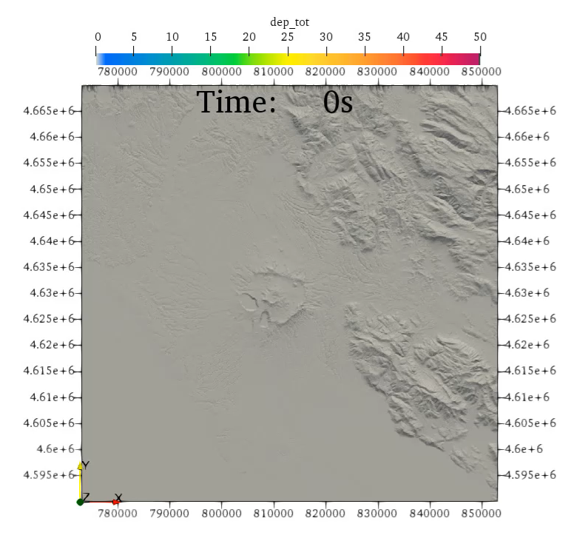
Real Vs Simulated flow
Flows with 10% more fine particles
To note, simulated flows have equal duration and mass flow rate, but they can have different deposit volumes, because of their different sedimentation rate.

Slide 11
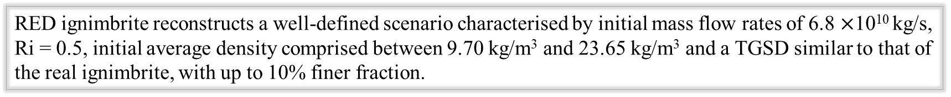
Summary
RED ignimbrite reconstructs a well-defined scenario characterised by initial mass flow rates of 6.8 $×$10¹⁰ kg/s, Ri = 0.5, initial average density comprised between 9.70 kg/m³ and 23.65 kg/m³ and a TGSD similar to that of the real ignimbrite, with up to 10% finer fraction.
The excellent fit between simulated flow and field-descriptors of the RED ignimbrite confirmed the hypothesis that the largest part of the mass was transported in an inertial flow.
The implementation of a series of equations, such as Entrainment and Sedimentation, in the depth-averaged model, allow us to reproduce not only the runout but also the variation of the thickness deposits and the interaction with the topography.

